Slide 1
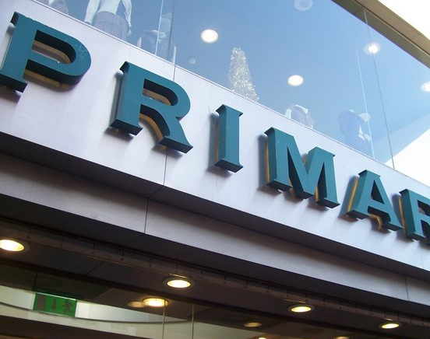
Three Ways of Designing Organisational Structure Using Primark (UK)
MODULE NAME AND CODE:UNDERSTANDING ORGANISATIONAL STRUCTURE AND CULTURE LCBB4009
NAME: RALUCA FLORINA NICOLICI
STUDENT ID: 2311955
LECTURER NAME: SAID USMAN
ThePhoto by PhotoAuthor is licensed under CCYYSA.

Slide 2
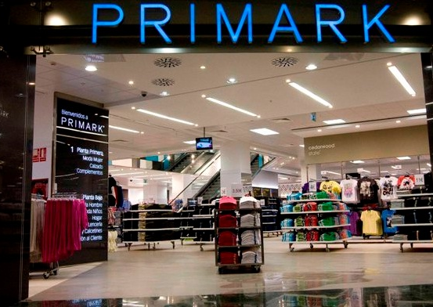
TABLE OF CONTENT
Definition of organisational structure
Importance of organisational structure
Three main types of structure (Functional, Divisional, Matrix)
Comparison of Organisation Structure
Conclusion
References

Slide 3

Definition of Organisational Structure?
Defines how tasks, coordination, and supervision are directed.(Robbins & Coulter, 2021)
Organisational chart shows hierarchy and communication flow.

Slide 4
Importance of organisational structure
Clarifies roles and responsibilities
Improves communication
Increases efficiency and accountability(Mullins, 2020)

Slide 5
Primark Functional Structure
Employees are grouped by specialised functions (HR, Marketing, Finance).
Advantages: efficiency, expertise, clear roles.
Disadvantages: poor inter-department communication. (Daft 2021)
CEO
HR DEPARTMENT
MARKETING DEPARTMENT
FINANCE DEPARTMENT
OPERATION DEPARTMENT
CUSTOMER SERVICE

Slide 6
Primark Divisional Structure
Organised by regions or product lines.(Jones & George, 2020)
Each division manages its own HR, Finance, and Marketing.
Advantages: flexibility, customer focus.
Disadvantages: duplication of resources
CEO
UK DIVISION
NORTH AMERICA DIVISION
ONLINE RETAIL DIVISION
EUROPE DIVISION

Slide 7
Primark Matrix Structure
Combines functional and divisional structures.(Armstrong & Taylor, 2023)
Employees report to two managers (functional and project-based).
Advantages: collaboration, flexibility.
Disadvantages: potential role confusion.
REGIONAL MANAGER
FUNCTIONAL MANAGER
EMPLOYEES

Slide 8
COMPARISON OF ORGANISATION STRUCTURE
PROS
CONS
Complex management
•Collaboration, adaptability
FUNCTIONAL STRUCTURE
DIVISIONAL STRUCTURE
MATRIX STRUCTURE
PROS
CONS
•Customer focus, flexibility
•Duplication of resources
PROS
CONS
•Efficient, expertise
•Siloed communication

Slide 9
CONCLUSION
Structure determines efficiency and communication in a business.
Primark benefits from a functional base with regional divisions.
Choosing the right structure depends on strategy, environment, and goals.
Effective structures align with objectives and support collaboration.

Slide 10
REFERENCES
Armstrong, M. & Taylor, S. (2023) Armstrong’s Handbook of Management and Leadership for HR. Kogan Page.
Daft, R.L. (2021) Management. 14th ed. Cengage Learning.
Jones, G.R. & George, J.M. (2020) Contemporary Management. 12th ed. McGraw-Hill Education.
Mullins, L.J. (2020) Management and Organisational Behaviour. 12th ed. Pearson Education.
Robbins, S.P. & Coulter, M. (2021) Management. 15th ed. Pearson Education.
Primark (2024) About Us. Available at: https://www.primark.com/en

