Slide 1

Sinological English III
Module code: SICH6011
Module tutor: Jie Deng
Date: 22 April 2021
Location: Academy of Sinology UWTSD,
Lampeter campus
Notes:
http://mi.eng.cam.ac.uk/~cipolla/archive/Presentations/MakingPresentations.pdf
https://www.ed.ac.uk/files/atoms/files//presentation_skills_checklists_independent_study_version.pdf
https://oro.open.ac.uk/41291/8/AssessingOralPresentations.pdf

Slide 2
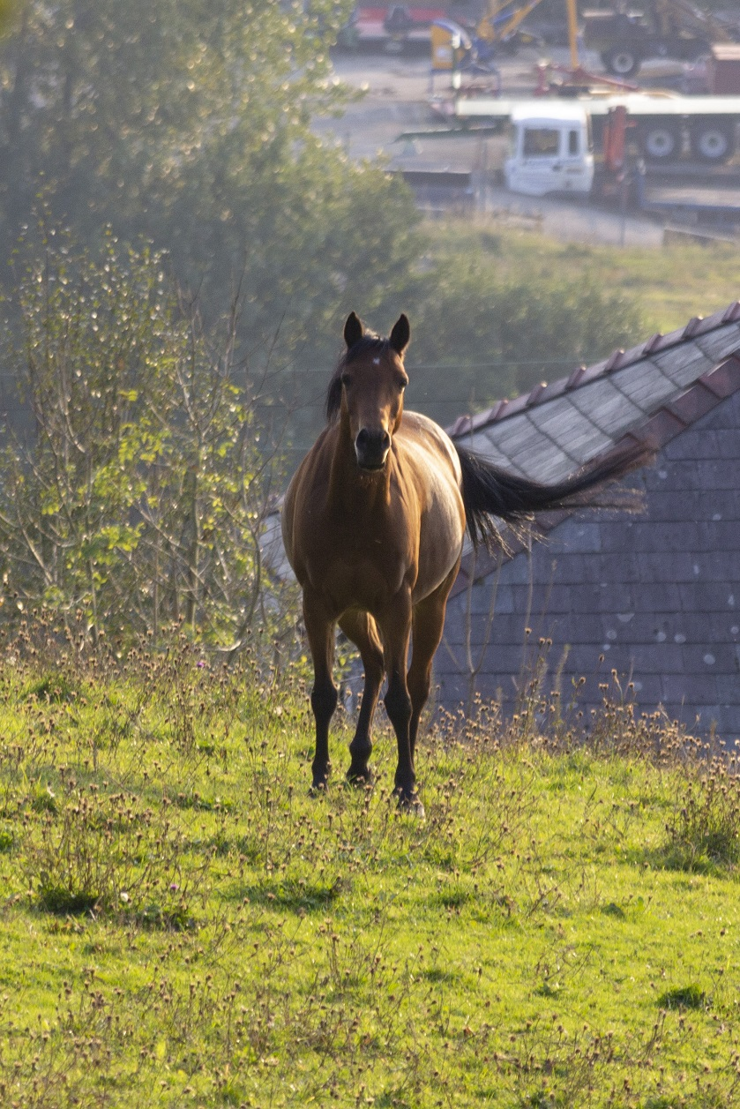

Slide 3
Untranslatability of Chinese shi-poetry

Slide 4
Untranslatability
The internal structure of Chinese characters has a beauty of its own.
The calligraphy in which classical poems were written.
The written result, hung on a wall, presents a rectangle
How to imitate the 1-2, 1-2-3 rhythm in which five-syllable lines in classical Chinese poems normally are read?
The patterns of tone arrangement in classical Chinese poetry.

Slide 5
Difficulties in Chinese shi-poetry translation

Slide 6
Difficulties experienced
Classical Chinese is often ambiguous; (Really?)
The basic prosodic foot in the two languages is different (the trochee, 長短格; the iamb, 短長格);
Chinese has more rhymes than does English;
Most Chinese poetry was rhymed with a break in the middle of each line. It is therefore exceedingly difficult in translation to avoid misrepresenting the sonic and metrical nature of Chinese poetry.

Slide 7
Difficulties
What does the translator think the poetic line says?
How can he render it into the target language? (the letter-versus-spirit dilemma)
Chinese characters, in avoiding grammatical specificity, offer advantages to poets.
It is the norm in classical Chinese poetry to omit subjects; the reader or listener infers a subject.
The grammars of some Western languages require that a subject be stated (although this is often avoided by using a passive or impersonal construction).
Nouns have no number in Chinese.
Chinese verbs are tense-less.

Slide 8
There is probably no single set of criteria for a good translation of a poem, but the best translations are almost without exception the work of poets translating into their own language.
-- Endymion Wilkinson

Slide 9
The Direction of Chinese Shi-Poetry Translation
Native target-language speakers or native Chinese?

Slide 10
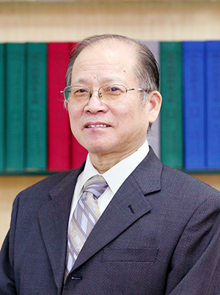
The direction of translation
The translation of Chinese classics is not ‘the privilege of native target-language translators’ and ‘Chinese scholars and translators should undertake the task with full justification and confidence’.
Professor Wenguo Pan
潘文國教授 (1944-present)

Slide 11
The direction of translation
1) Individual cases of poor translations by Chinese translators do not mean that the Chinese are not well-suited for the job.
2) Native English-speaking translators might have a ‘linguistic advantage’ over non-natives, but they are often baffled when it comes to the comprehension of the original.
3) Chinese classics and Chinese characters constitute special difficulties for the non-native learner. Therefore, native English-speaking translators, however well-versed they are in Chinese, frequently make errors, often serious errors, when translating Chinese classics into English.
Professor Wenguo Pan
潘文國教授 (1944-present)

Slide 12
The direction of translation
Spare no effort
Strengthen the command
Deepen and broaden
Professor Wenguo Pan
潘文國教授 (1944-present)

Slide 13
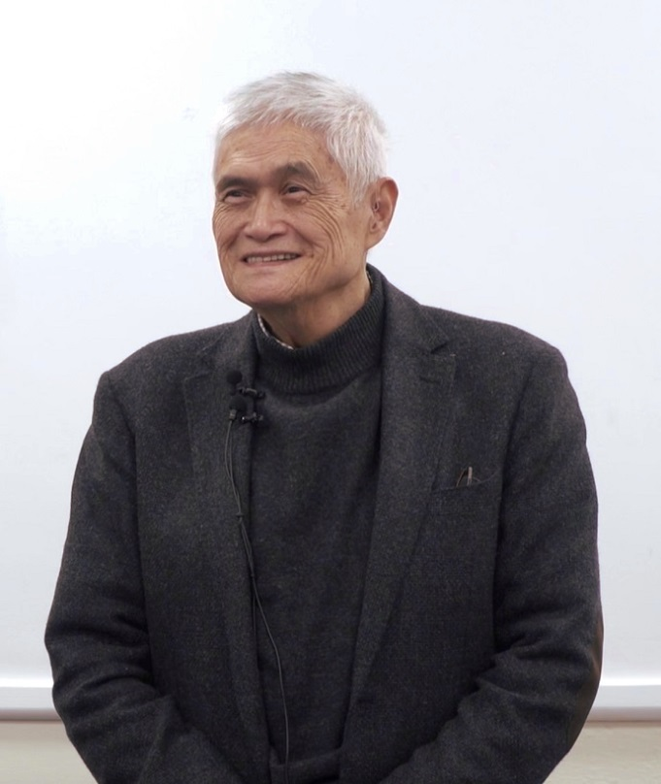
The direction of translation
…What makes Lin Yutang so great? His Chinese was first-class, his English was outstanding. He was also very open-minded. His great aspirations. His deep love for China…
The reason why I choose Lin Yutang for our last lecture is because I want to correct your views. You mustn’t think that translation has to rely on native target-language speakers. Not true. Not necessary. We can do it ourselves, and we can do it very well.
We must never belittle ourselves…
Professor Clayton Chuntang Chou
周春塘教授

Slide 14
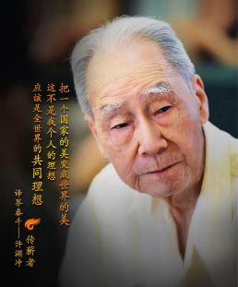
The direction of translation
Only the Chinese can translate Chinese
shi-poetry properly.
Using a target language with two dimensions of beauty to convey the meaning of a source language with three dimensions of beauty is not easy.
Professor Yuanchong Xu
許淵衝教授 (1921-present)

Slide 15
The direction of translation
觀獵
Stephen Owen: The wind is strong, the horn-how sings, The general is hunting east of Wei City. The plants are sere, the hawk’s eye keen, Snow is gone, horses’ hooves move easily. Suddenly they are past Xinfeng Market, Then back to Thin-Willow Camp. Turn and look where the eagle was shot, A thousand leagues of evening clouds fat.
<觀獵> 王維
「風勁角弓鳴 將軍獵渭城
草枯鷹眼疾 雪盡馬蹄輕
忽過新豐市 還歸細柳營
回看射雕處 千里暮雲平。」

Slide 16
The direction of translation
Translating Chinese shi-poetry needs to convey the emotion and express the meaning.
Expressing the meaning is a low standard, and conveying the emotion is a high standard.
Professor Yuanchong Xu
許淵衝教授 (1921-present)

Slide 17
The direction of translation
觀獵
大中華文庫·唐詩三百首: Louder than gusty winds twang horn-backed bows, Hunting outside the town the general goes. Keener o’er withered grass his falcon’s eye, Lighter on melted snow his steed trots by. No sooner is New Harvest Market passed, Than he comes back to Willow Camp at last. He looks back where the vultures were shot down, Only to find cloud on cloud spread on and on.
<觀獵> 王維
「風勁角弓鳴 將軍獵渭城
草枯鷹眼疾 雪盡馬蹄輕
忽過新豐市 還歸細柳營
回看射雕處 千里暮雲平。」

Slide 18
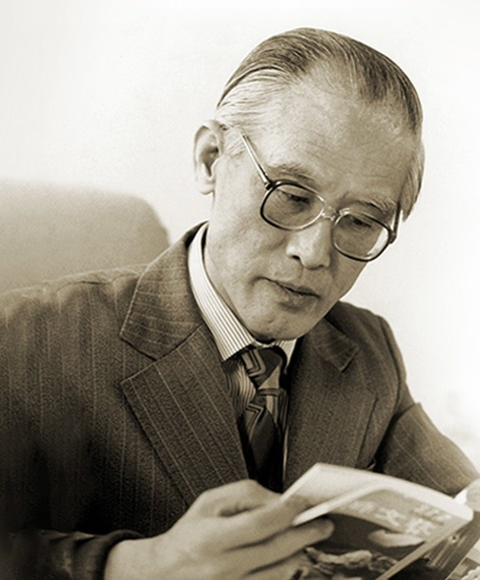
The direction of translation
A great translator should be the combination of a scholar, a write and a translator.
Professor Guangzhong Yu
余光中教授 (1928-2017)

Slide 19
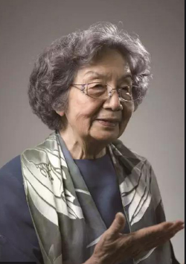
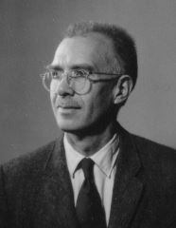
The direction of translation
吝情忽共傷去留
論學曾同辨古今。
Reluctant or impatient, stay or leave, someone’s hurt;
We have studied together, debated past and present.
Professor Jiaying Ye
葉嘉瑩教授 (1924-present)
Professor James Hightower
海陶瑋教授 (1915-2006)
https://www.thepaper.cn/newsDetail_forward_4198655

Slide 20
The direction of translation
吝情忽共傷去留
論學曾同辨古今。
We’ve grieved at heart to part at last,
For we have studied present and past.
Professor Yuanchong Xu
許淵衝教授 (1921-present)

Slide 21
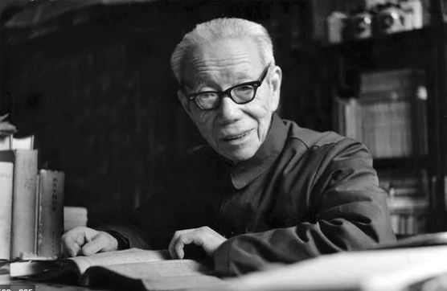
The direction of translation
以原則言 從事翻譯者於原文不容有一詞一語之誤解。以中國文字之艱深 詩詞鑄語之凝練 譯人之誤會在所難免。
Professor Shuxiang Lv
呂叔湘教授 (1904-1998)

Slide 22
The direction of translation
<山石> 韓愈
「僧言古壁佛畫好
以火來照所見稀。」
僧言古壁佛畫好 以火來照所見稀
Witter Bynner: And he brought a light and showed me, and I called them wonderful.
Misunderstanding word meaning

Slide 23
The direction of translation
<玉臺新詠•古詩為焦仲卿妻作>
「妾不堪驅使 徒留無所施。」
妾不堪驅使 徒留無所施
Arthur Waley: I said to myself, ‘I will not be driven away.’ Yet if I stay, what use will it be?
Misconnection of meaning,
Punctuation error句讀之誤

Slide 24
The direction of translation
<聞官軍收河南河北> 杜甫
「卻看妻子愁何在？
漫卷詩書喜欲狂。」
卻看妻子愁何在 漫卷詩書喜欲狂
Witter Bynner: Where is my wife? Where are my sons? Yet crazily sure of finding them, I pack my books and poems.
Misunderstanding parts of speech

Slide 25
The direction of translation
<春望> 杜甫
「感時花濺淚 恨別鳥驚心。」
感時花濺淚 恨別鳥驚心
Witter Bynner: …Where petals have been shed like tears And lonely birds have sung their grief.
Special meanings of Chinese verbs

Slide 26
The direction of translation
<玉臺新詠•古詩為焦仲卿妻作>
「四角龍子幡」
四角龍子幡
Arthur Waley: As its four corners a dragon-child flag.
Misunderstanding empty words and idioms

Slide 27
The direction of translation
<玉臺新詠•古詩為焦仲卿妻作>
「著我繡夾裙 事事四五通。」
著我繡夾裙 事事四五通
Arthur Waley: ‘…Takes what she needs, four or five things
Misunderstanding empty words and idioms

Slide 28
The direction of translation
<月下獨酌> 李白
「月既不解飲 影徒隨我身。」
月既不解飲 影徒隨我身
W. J. B. Fletcher: The moon then drinks without a pause…
Misunderstanding word meaning

Slide 29
The direction of translation
<月下獨酌> 李白
「暫伴月將影 行樂須及春。」
暫伴月將影 行樂須及春
W. J. B. Fletcher: Rejoice until the Spring comes in.
Misunderstanding word meaning

Slide 30
The direction of translation
初期譯人好以詩體翻譯 即令達意 風格已殊 稍一不慎 流弊叢生。故後期譯人Waley Bynner 諸氏率用散體為之 原詩情趣 轉易保存。此種得失 可發深省。
Professor Shuxiang Lv
呂叔湘教授 (1904-1998)

Slide 31
大風歌
許淵衝: A great wind rises, oh! the clouds are driven away. I come to my native land, oh! now the world’s under my sway. Where can I find brave men, oh! to guard my four frontiers today!
<大風歌> 劉邦
「大風起兮雲飛揚 威加海內兮歸故鄉。安得猛士兮守四方。」

Slide 32
<出塞> 王昌齡
「秦時明月漢時關
萬里長征人未還。
但使龍城飛將在
不教胡馬度陰山。」
出塞
許淵衝: The moon still shines on mountain passes as of yore. How many guardsmen of Great Wall come back no more! If the Flying General were still there in command, No hostile steeds would have dared to invade our land.

Slide 33
<飲酒•其五> 陶淵明
「結廬在人境 而無車馬喧。
問君何能爾？心遠地自偏。
採菊東籬下 悠然見南山。
山氣日夕佳 飛鳥相與還。
此中有真意 欲辨已忘言。」
飲酒•其五
許淵衝: In people’s haunt I build my cot; Of wheel’s and hoof’s noise I heart not. How can it leave on me no trace? Secluded heart makes secluded place. I pick fenceside asters at will; Carefree I see the Southern Hill. The mountain air’s fresh day and night; Together birds go home in flight. What revelation at this view? Words fail me if I try to tell you.

