Slide 1

Evidence Based Approaches to Community Policing
BMPL4016
Charlie Hughes
2400697
Notes:
Hello, good afternoon. Thank you for having us and for this opportunity, My name is Charlie and with me is Skye and Hywel. Today we will be giving you a presentation on evidence-based approaches to community policing. Each of us will go through a particular case study of when such an approach has been used. Evaluating its overall effectiveness and the challenges they have faced.

Slide 2
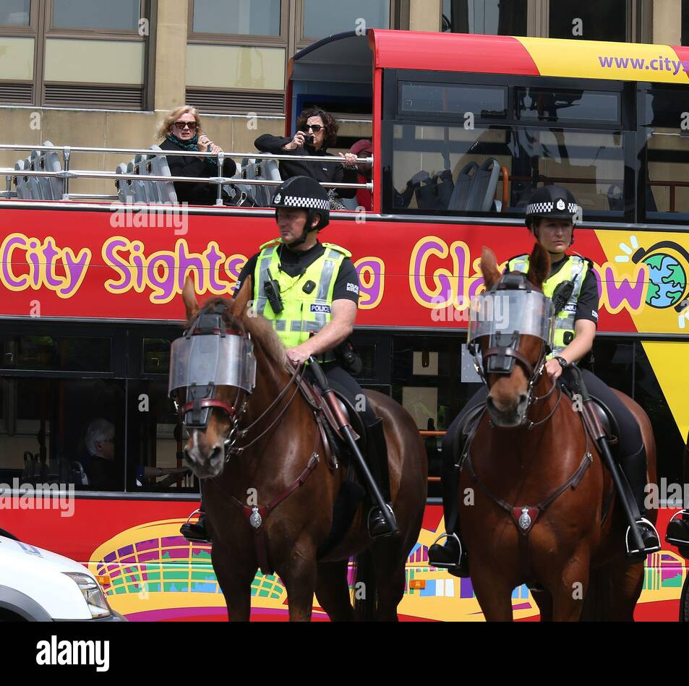
The Scottish Violence Reduction Unit (SVRU)
What is the SVRU?
Glasgow – Murder Capital of the Europe.
(Fraser & Gillon, 2024)
UK’s Longest Running Public Health Policing Model ~ est. 2005.
(SVRU, 2022)
“Treat Violence Like a Disease.”
(Paul, 2024)
Bases its Model on Procedural Justice to Grow Trust & Legitimacy.
(Tyler, 2006)
(Sutton-Hibbert 2018)
Notes:
The example I will be looking at is known as the Scottish Violence Reduction Unit (SVRU). Now what is the SVRU? It was created in response to Scotland's incredibly high rate of violent crime, in particular knife crime and homicides.
At the time of it’s creation Glasgow was considered the murder capital of Europe (Fraser & Gillon, 2024). This had a profound impact on the local communities in Glasgow and Scotland as a whole.
To combat this the SVRU was formed in 2005. It is part of the Scottish Police and funded directly by the Scottish government with an annual budget of roughly £1million. The SVRU strives to use evidence based, innovative solutions to violence. It brings in a wide variety of experts across all fields and police themselves to produce these solutions. (SVRU, 2022).
As highlighted by the current head of the SVRU, Jimmy Paul (2024), violence is treated as a disease by the public health model. Therefore, the police need to reflect this opinion as it is something that is constantly evolving, necessitating the demand for no complacency in the objective of reducing violence.
The model itself is based upon the work of Tyler (2004) who states that for people to obey the law, there must be a mutual respect between law enforcement and the public. As he found that people obey the law because they believe that it is legitimate institution, not because they fear the punishment.

Slide 3
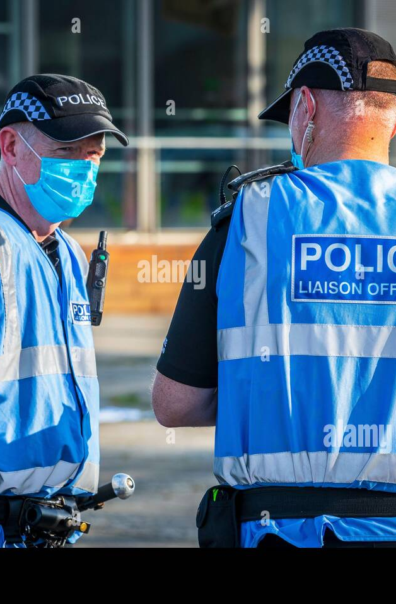
Has it Worked? – The Evidence
Violence Decreased: Glasgow Homicide Rate Down 60% between 2005 – 2012.
(Scottish Government, 2014,)
Public Confidence Up: 7% Increase from 2023-24
(Scottish Police Authority, 2024,)
Stop & Search Engage.
(Clayton, 2024,)
2013 - 70% of all Stop & Searches found Non-Statutory
(Lennon & Murray, 2018)
(Findlay, 2020)
Notes:
Now the real question is.. Has it worked? Overall, it can be said that the SVRU has had a significant impact in reducing the level of violent crime. From its inception till 2014, the homicide rate in Glasgow fell by over 60%. Going from 39 homicides in 2005 to just 16 by 2012 (Scottish Government, 2014).
Furthermore, annual surveys by the Scottish Police Authority (SPA) found that through their initiatives, public trust in police increased from 40% in 2023 to 47% in 2024. This is a significant increase and while the majority may still lack in trust, its indicative that further successes will only see this percentage increase more and more over time (SPA, 2024)
This improved trust is likely developed through effective policing practises being implemented. Such as Stop & Engage instead of stop & search (Clayton, 2024). Lennon & Murray (2018) found that 70% of all Stop & Searches were found to be non-statutory, meaning they had no legal basis and where predominantly implemented on young people, leading to many having their trust in police broken. By pivoting to a Stop & Engage approach it has shown a significant increase in public trust as the police were now acting more lawfully.

Slide 4
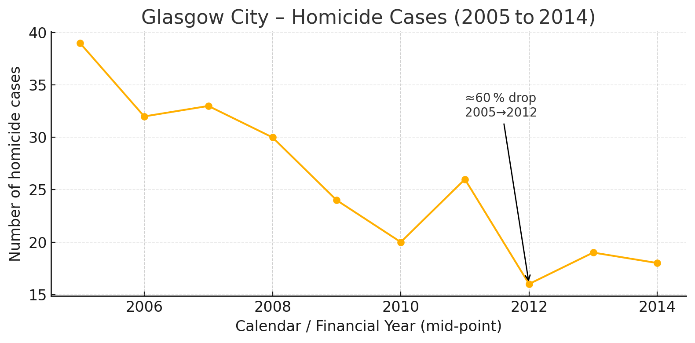
(Scottish Government, 2014)
Notes:
This is a chart I created using data from the Scottish Government (2014) in the previous slide that highlights just how significant of an impact the SVRU has had on the reduction in homicides

Slide 5



SVRU Challenges
Funding – SVRU relies on government funding and grants every 3 years.
(Scottish Government, 2024)
Data Granularity ~ LOW
(SPA, 2024)
Culture Shift – “Warrior” -> “Guardian”
(Clayton, 2024)
Notes:
Now I’ll explain some of the significant challenges the SVRU faces. The first being the issue of funding itself. As I previously stated the government funds the SVRU by roughly £1million each year. In addition to this they receive grants every 3 years from the Scottish government. Because of the nature of this cycle, staff face significant job security risks and many talented, needed individuals get poached by other sectors or organisations (Scottish Government, 2024).
The second issue is the granularity of the data itself is rather low. Most of the data used is from national polls. The results obtained aren’t broken down below policing division levels. Therefore, it becomes difficult for police to gauge where the specific hot and cold spots of the violent crimes are (SPA, 2024).
Finally, we have the culture shift required. Most police officers before the SVRU were “enforcement-heavy” in mindset. This wasn’t an effective response to the issue so many officers needed to be retrained in a “procedural-justice” style mindset. When the SVRU was first formed it took a long time and money to get all officers up to speed with the new improved way of doing things (Clayton, 2024).

Slide 6

Conclusion
Notes:
In conclusion, Glasgow's SVRU proves that violence falls, and trust rises when policing is data driven, co-designed and funded for the long haul. Guardian culture sustains the gains

Slide 7
Reference List
Clayton, E 2024, ‘Mechanisms of the social control of children and young people: From “stop and search” to “stop and engage” in Police Scotland’, Criminology & Criminal Justice, advance online publication 25 April, doi: 10.1177/17488958241249828.
Findlay (2020), Police liaison officers on duty and wearing the identifying blue tabard, Police Scotland, Glasgow, Scotland, UK [photograph], Alamy Stock Photo, 17 September, viewed 12 April 2025, https://www.alamy.com/police-liaison-officers-on-duty-and-wearing-the-identifying-blue-tabard-police-scotland-glasgow-scotland-uk-image375355348.html.
Fraser, A. & Gillon, F. (2024), ‘The Glasgow miracle? Storytelling, violence reduction and public policy’, Theoretical Criminology, vol. 28, no. 3, pp. 328–345, doi:10.1177/13624806231208432.
Lennon, G & Murray, K 2018, ‘Under-regulated and unaccountable? Explaining variation in stop and search rates in Scotland, England and Wales’, Policing and Society, vol. 28, no. 2, pp. 157–174, doi:10.1080/10439463.2016.1163359.
Paul, J. (2024), ‘We all need to pull together as never before to make progress in reducing violence’, Scottish Violence Reduction Unit, 5 January, viewed 11 April 2025, https://www.svru.co.uk/2024/01/we-all-need-to-pull-together-as-never-before-to-make-progress-in-reducing-violence/.

Slide 8
Sutton-Hibbert, J. (2018), Mounted police during a demonstration by the Scottish Defence League, George Square, Glasgow, Scotland, 21 July [photograph], Alamy Stock Photo, viewed 11 April 2025, https://www.alamy.com/stock-photo-mounted-police-during-a-demonstration-by-the-scottish-defence-league-105071627.html.
Scottish Government (2014), Homicide in Scotland, 2013-14: statistical bulletin – Crime and Justice series, 9 December, Scottish Government, Edinburgh, viewed 12 April 2025, https://www.gov.scot/publications/homicide-scotland-2013-14/.
Scottish Government (2024), Violence prevention framework for Scotland: annual progress report 2023 to 2024, 11 September, Scottish Government, Edinburgh, viewed 13 April 2025, https://www.gov.scot/publications/violence-prevention-framework-scotland-annual-progress-report-2023-2024/.
Scottish Police Authority [SPA] (2024), Public polling insights – August 2024: Policing Performance Committee paper, 18 September, Scottish Police Authority, Edinburgh, viewed 12 April 2025, https://www.spa.police.uk/spa-media/eb1j0yfm/item-2-4-public-polling-insights-august-v2-0.pdf.
Scottish Violence Reduction Unit [SVRU] (2022), About us, Scottish Violence Reduction Unit, viewed 11 April 2025, https://www.svru.co.uk/about-us/.
Tyler, T. R. (2006), Why people obey the law, 2nd edn, Princeton University Press, Princeton.

Slide 9
Research Timeline
06/04/25 – Background Reading: I first looked online for a large range of different evidence-based policing approaches across the UK.
07/04/25 – Planning: After collating many different EBP approaches I finally settled on the SVRU due to the long history it has had
10/04/25 – Structure: Using the assignment brief and all of the sources I had gathered on the SVRU I created a storyboard to help lay out my ideas coherently.
11/04/25 – Wider Reading: I collected a large range of sources, from journals to websites all on the SVRU to gather a good range of varied sources.
27/04/25 – Reflection: Going forward I will make more of an effort to learn my presentation off by heart in order to be ess reliant on que cards.

