Slide 1
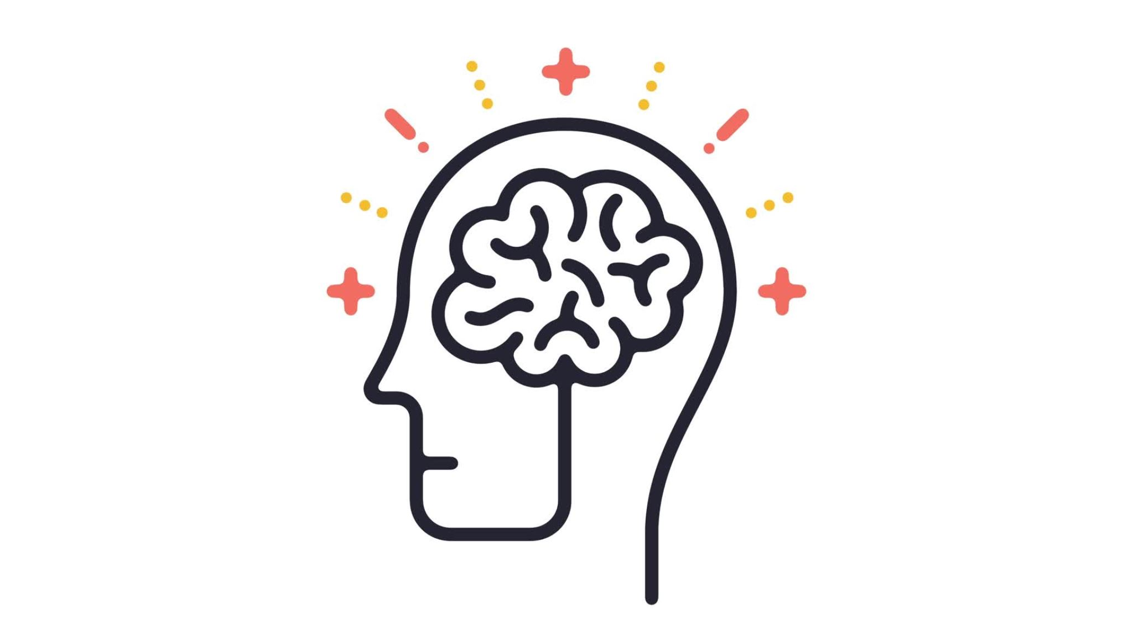
PSYCHOLOGY FOR HEALTH AND SOCIAL CARE
Why is psychology important when working as a Community Youth Worker?
ELENA TODOROVA 2124115
BMHP4003 NEALE HADDON

Slide 2

INTRODUCTION
The following presentation will introduce what is psychology and why is important when working as Community Youth Worker.
Which theories can apply and why they are most suitable and compatible in this work field.
Also will look in to the role of Nature and Nurture in behaviour.
On the other hand, as mentioned by Gillibrand, R. (2016) Family and society have a role in child development.
However, Rousseau believed society is harmful to new born children as it corrupt them. Gillibrand, R. (2016)
This Photo by Unknown Author is licensed under CC BY-ND

Slide 3

What is psychology?
Psychology is:
A scientific study of the way the human mind works and how it influences behaviour.
Psychology is ''study of the mind''

Slide 4
The frame work used will be Vygotsky Sociocultural development theory.
ZPD
Social interaction
Modelling
Guided learning
Scaffolding
Social learning and individual learning
Culture
language
Vygotsky believed that development and learning is a socially mediated process. And that children learn by social interaction with family and close people around them such as friends, relatives and teachers(MKO).

Slide 5

Community Youth Worker using the theory in their practice.
Behavioural difficulties
Emotionally unstable
Problem fitting in
This Photo by Unknown Author is licensed under CC BY

Slide 6
Conclusion
As Community Youth worker role is to support young people and teenagers with difficulties as emotional and social behaviour development. In this role is paramount to know the development and how to use the theories in order to be able to help and support the young generation. There are other theories on the development such as Piaget's, Ericson and Freuds theories. However Vygotsky theory is more suitable in this work field. As well, it is evident that nature and nurture are both merging together to form humans behaviour. How to think, behave and feel is all mixture of nature and nurture. However, peoples behaviour and mind are been subjected to many examinations and experiment to find why we do what we do, but there is not 100% straight forward explanation.

Slide 7
REFERENCE LIST
https://dictionary.cambridge.org/dictionary/english/psychology
Gross, R 2015, Psychology : The Science of Mind and Behaviour, Hodder Education Group, London. Available from: ProQuest Ebook Central. [26 September 2022].
Gillibrand, R. (2016) Developmental psychology . Second edition. Harlow, England :, Pearson.
Nottingham, J. (2013) Encouraging learning [electronic resource] : how you can help children learn . New York :; London ;, Routledge.
MacLeod-Brudenell, I. (ed.)(2004) Advanced Early years care and education for levels 4 and 5. Oxford: Heinemann
: https://www.youtube.com/watch?v=kDlkb4UESpE
Boyd, D.R. (2019) Lifespan development . Eight, Global edition. Harlow, England :, Pearson

