Slide 1
Developing Relationships and Workplace Achievement (BMSW5102)
Dr. Mushfiqur Rahman
Adebare Akinwale Moronkeji
Student No: 1818408

Slide 2

Training and Development needs for an HR Officer
Presented by: Adebare A Moronkeji

Slide 3
Introduction
Appropriate knowledge, skills and behaviours which HR professionals need across departments.
Personal skills audit and identification of training and development needs.
Critical assessment of the potential benefits the organisation of developing the skills of HR through the use of development and training.

Slide 4


Overview of Harrods
Over 160 years old
Has a global brand and reputation
Has five brand values:
Innovation
Sensation
Service
British
Luxury
4,000 employees and 3,500 agency and concession employees
Notes:
Harrods is a retailing organisation in the UK having more than 330 department stores in one location occupying more than 1 million square feet of store space (The Times, 2014). It has a global brand recognition and reputation having created its brand image on five brand values which is based on innovation, sensation, service, British and luxury. There are over 4,000 employees who are supplemented by agency and concession employees numbering over 3,500 employees. Harrods has been in operation for over 160 years and it is important that HR planning is in place to ensure that staffing levels are always at the required levels to achieve the five brand values and maintain high reputation (The Times, 2014).

Slide 5
Appropriate Knowledge, skills and behaviours that HR professionals across the department needs.
Knowledge of training and development of employees, knowledge regarding equality, diversity and equal opportunities.
The HR professionals will also require to prepare handbooks for staff on organisational policies and equality and diversity.
Liaise with different individuals in key policy areas such as health and safety and performance of staff.
Notes:
Appropriate Knowledge and skills that the HR officer for Harrods will require across the departments include knowledge of training and development of employees, knowledge regarding equality, diversity and equal opportunities. The HR professionals will also require to prepare handbooks for staff on organisational policies and equality and diversity. Different departments such as sales, finance, marketing and other departments will have to be worked with so that strategies for short and long-term developments of the departments and the Harrods overall can be determined.

Slide 6
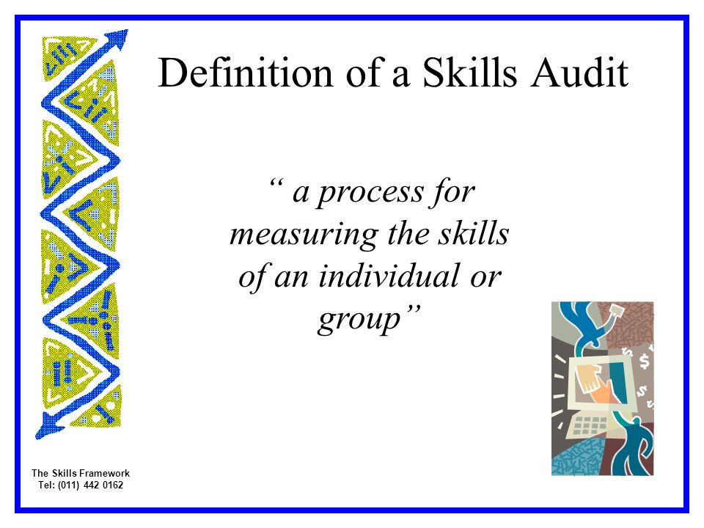
The criteria used for determining appropriate and professional knowledge, skills and behaviours that HR professionals need
Skills audit
Identify current skills and knowledge the individuals need in their current role.
Identify skills, knowledge and behaviour they will need for the future.
Identifies gaps within skills, behaviour and knowledge.
Notes:
A criteria that can be used to determine the appropriate professional knowledge, skills and behaviours that the HR professionals need is to assess the skills and abilities of the individual or group using a Skills audit based on the skills and knowledge that the organisation or position requires (Greer, 1995).
The skills audit is used to make an identification of skills and potential gaps in knowledge and abilities in an individual to determine the knowledge, skills ad behaviour that the HR professional will need. A skills audit can be defined as the process by which skills of an individual or a group are measured and recorded (Anthony et al., 2002). The main aim for the skills audit to be conducted within an organisation so that the knowledge and skills that the organisation needs can be identified as well as the skills and knowledge which are currently available within the organisation (Goldstein and Ford, 2002).

Slide 7
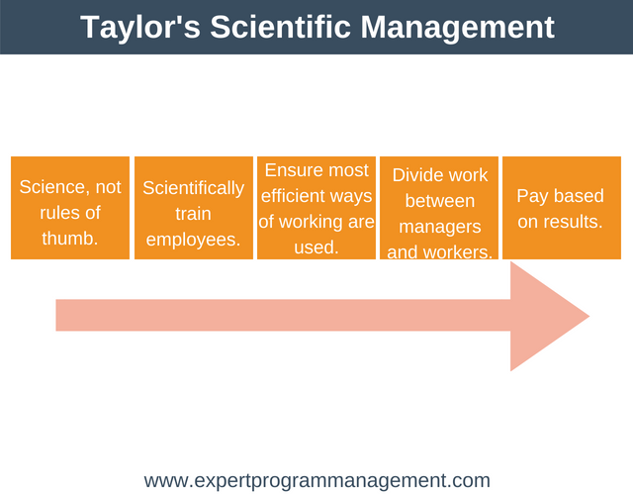

Critical assess the potential benefits of the organisation of developing the HR officer through development and training
Notes:
When employees receive training and development they become motivated. For instance the HR officer will use the skills audit to identify gaps in the knowledge and skills such as management and leadership skills need to be improved (Riley, 1996). Based on the identification of this gaps, training and development is designed so that the gaps can be minimised and the skills and abilities of the HR officer is improved (Greer, 1995). According to Maslow Hierarchy of Needs, employees will have needs such as job security and esteem needs and this is a part of the psychological needs that Harrods will have to address. Being provided with training and development shows to employees that the organisation is interested in them and want to develop them and this can motivate the employee. Also, by improving skills and abilities this results in the employee being able to better do their jobs and will result in improved performance within the organisation (Anthony et al., 2002). The benefits of improved motivation and improved performance to the organisation is that the organisation will have reduced staff turnover which lowers costs and also have a productive workforce which improves the overall reputation and success of the organisation (Greer, 1995).
According to Fredrick Taylor, Scientific management is the theory that promotes management taking an active role in training and developing employees so that they can have the right skills and abilities to carry out their tasks and this will result in organisational productivity being improved.

Slide 8
Critical assess the potential benefits of the organisation of developing the HR officer through development and training
Knowledge of training and development of employees
Benefits – Motivated and well trained staff
Disadvantages – cost of training
Knowledge regarding equality, diversity and equal opportunities
Benefits – Improved innovation, improved working relationships.
Disadvantages – Increased conflicts, bad reputation for Harrods
Notes:
Knowledge of training and development of employees – The HR officer by having this knowledge will ensure that Harrods will have well-trained employees which will allow for their values to be promoted such as being innovative, engage in problem solving, being British and also coming up with strategic plans to ensure that Harrods remains competitive (Mullins, 2006). The disadvantages are that return on investment has to be explored for carrying out this training as training is expensive and if the return on investment is low then this is a negative for the organisation.
Knowledge regarding equality, diversity and equal opportunities – By the HR officer having this knowledge, the benefits to Harrods is that it will have better working relationships within the workplace. According to Herzberg two factor theory, hygiene factors include having good workplace relationships and this will result in improved employee motivation and jobs satisfaction (Hutchinson and CIPD, 2013). By having this in place it will also result in better ideas and innovations coming forth from improved diversity. The disadvantages are that if this is not managed it can result in conflicts and people reporting Harrods as not being an equal opportunity workplace and being discriminated against and this can negatively impact on Harrod’s reputation resulting in declining sales (Armstrong, 2012).

Slide 9
Critical assess the potential benefits of the organisation of developing the HR officer through development and training
Prepare handbooks for staff on organisational policies and equality and diversity.
Benefits – Improves performance by staff learning organisational culture
Liaise with different individuals in key policy areas such as health and safety and performance of staff
Benefits – improves job satisfaction, staff retention
Notes:
Prepare handbooks for staff on organisational policies and equality and diversity – This will allow staff within Harrods to be better able to learn the culture of the organisation and this will result in the employee being able to quickly adapt and start performing within the organisation. Also, studies show that many staff will decide to leave an organisation within the first few months of their employment so having staff being engaged in organisational policies and equality and diversity will improve staff retention. The disadvantages are that failure to prepare is that there is lack of information and knowledge about the organisation.
Liaise with different individuals in key policy areas such as health and safety and performance of staff – Improve working relationships within the organisation, ensure that the organisation is safe and improve hygiene and motivation factors in the organisation to improve job satisfaction and performance.

Slide 10
Conclusion
The HR officer have a critical role in improving the skills and knowledge of employees within the organisation
A good starting point to improve skills and knowledge of employees is to use personal skills audit
This allows for skills and knowledge gap to be identified and use training and development to reduce the gap.

Slide 11
References
Anthony W.P., Kacmar, K.M., Perrewé, P.L. (2002) Human resource management: a strategic approach, 4th ed. Fort Worth : Harcourt College Publishers
Armstrong, M. (2012) Armstrong’s handbook of ☒ performance management: an evidence based guide to delivering high performance 4th edition. (Online) London, U.K. ; Philadelphia, Pa. : Kogan Page.
Goldstein, I. L., Ford J.K. (2002) Training in organizations : needs assessment, development, and evaluation, 4th ed. Belmont, CA .
Greer, C.R. (1995) Strategy and human resources – a general managerial perspective, Prentice Hall.
Harrison, R. (2009). Learning and Development. 5th ed.London: Chartered Institute of Personnel and Development.
Mullins, L. (2006). Essentials of organisational behaviour. Harlow: Financial Times Prentice Hall.
Riley, M. (1996) Human resource management in the hospitality and tourism industry, 2nd ed. Oxford ; Boston : Butterworth-Heinemann.
The Times (2014). Harrods: Increasing employee engagement through HRM. The Times.

Slide 12
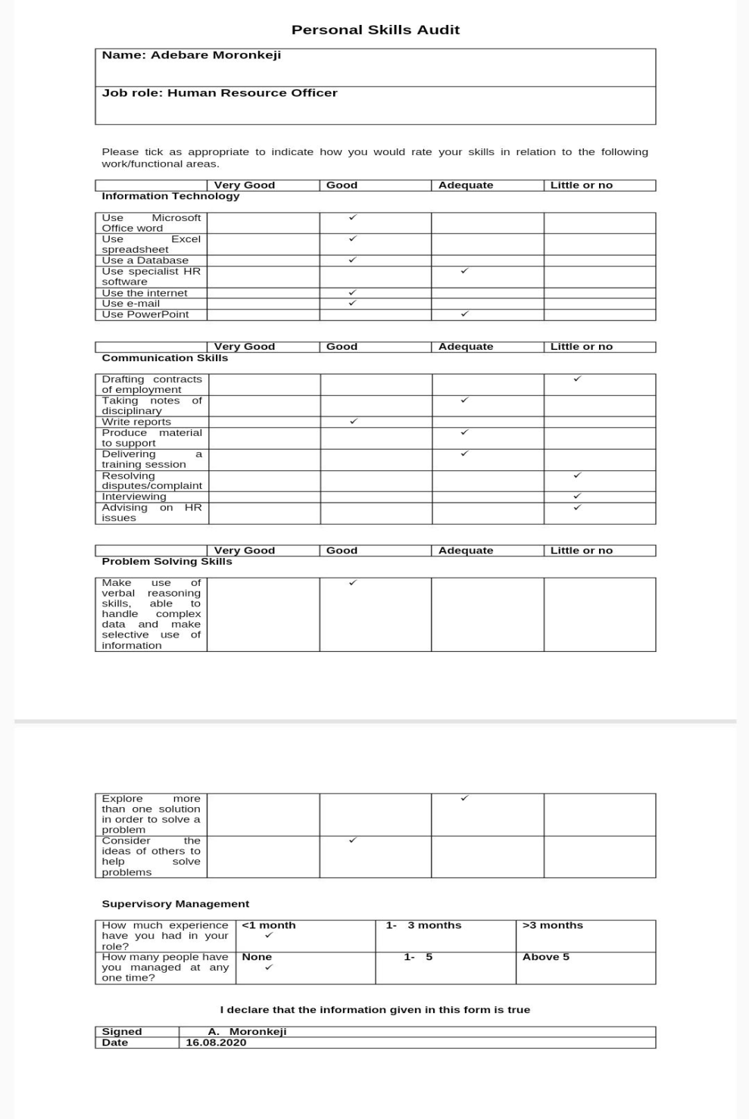
Appendices

