Slide 1
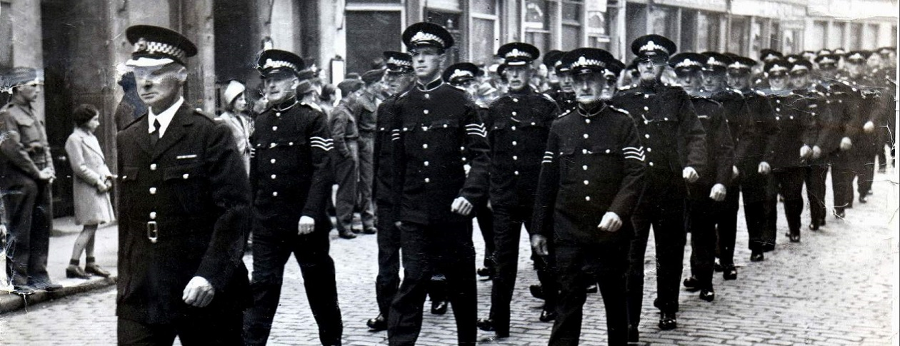
Tone from the Top
Leadership, ethics and accountability in policing
Committee on Standards in Public Life

Slide 2
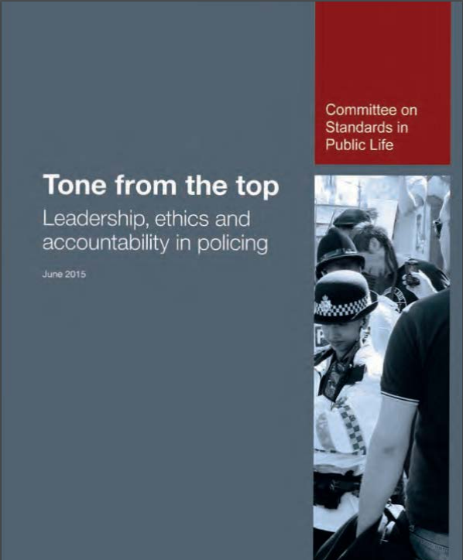
Structure
Chapter 1 Context
Chapter 2 Leadership
Chapter 3 Accountability
Chapter 4 Integrity
Chapter 5 Openness

Slide 3
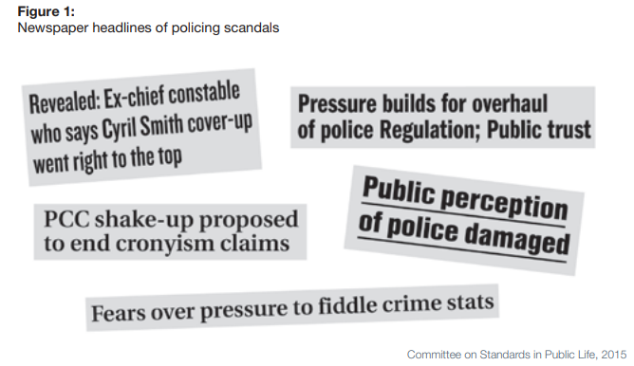
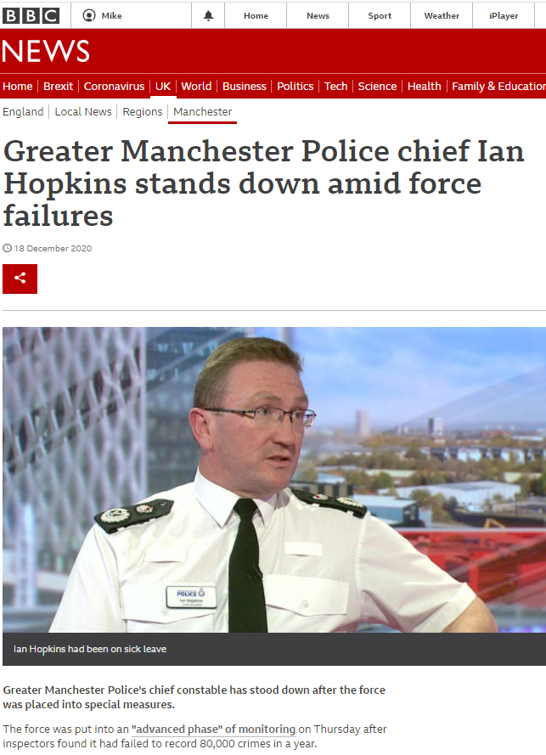
Headlines and scandal

Slide 4
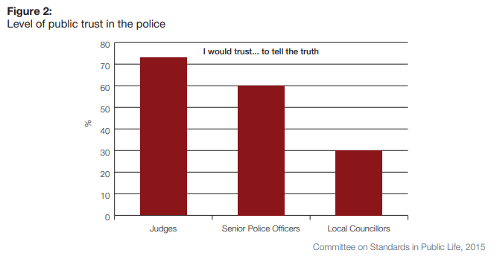
Trust in the police
Are there difference in the level of trust and confidence in the police across communities and demographic groups
Social class
‘Deprivation’ level

Slide 5
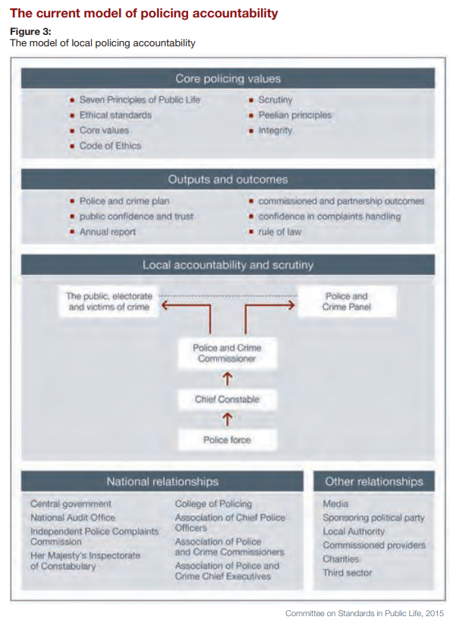
Accountability Model
Core policing values
Outputs and outcomes
Local accountability and scrutiny
National and other relationships

Slide 6
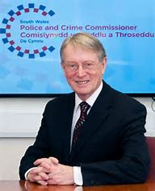
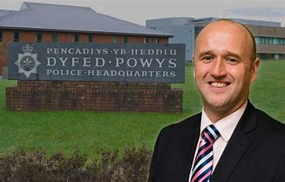
PCC?
What does PCC stand for?
What does the role entail?
Who might become a PCC?
What qualifications do they need?

Slide 7
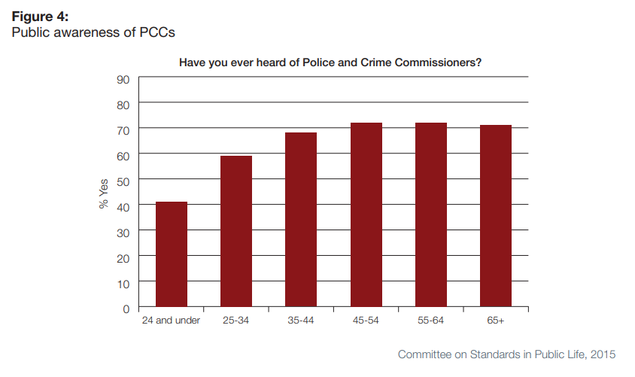
What is a PCC?

Slide 8
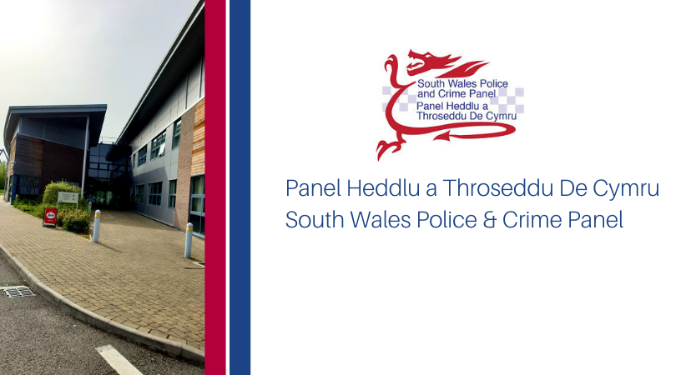
PCP?
What does PCP stand for?
What does the role entail?
Who might join a PCP?
What qualifications do they need?

Slide 9
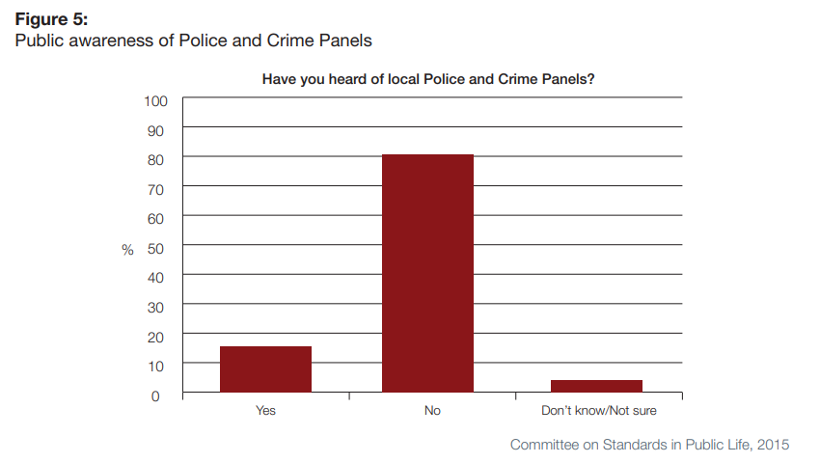
What is a Police and Crime Panel?

Slide 10
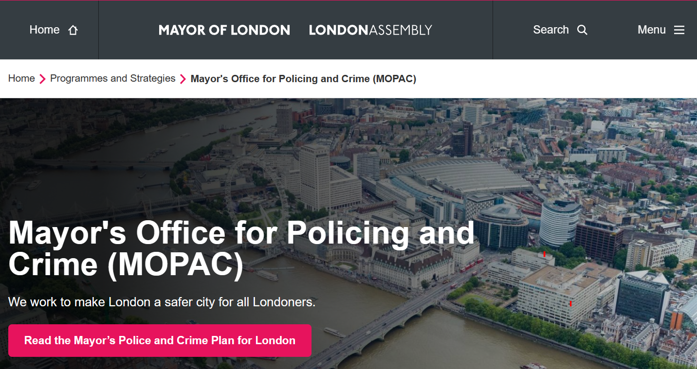
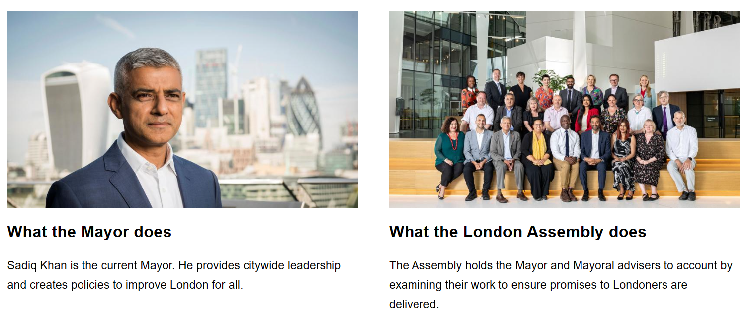

Slide 11
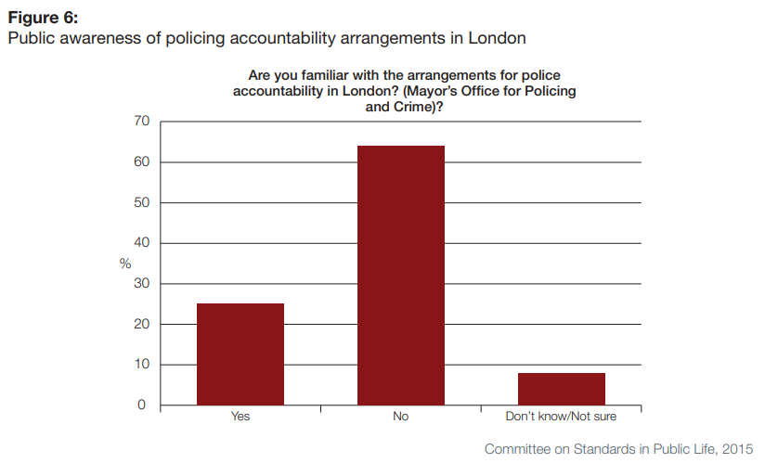
Accountability in London?

Slide 12
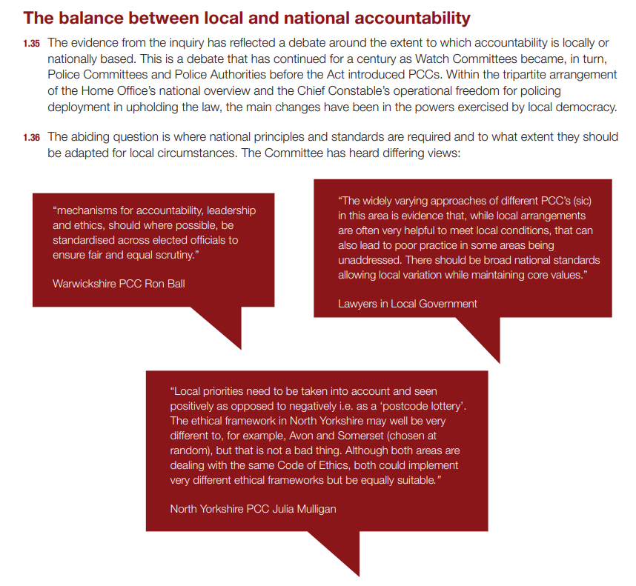
National to local
Watch Committees
Police Committees
Police Authorities
PCCs

Slide 13
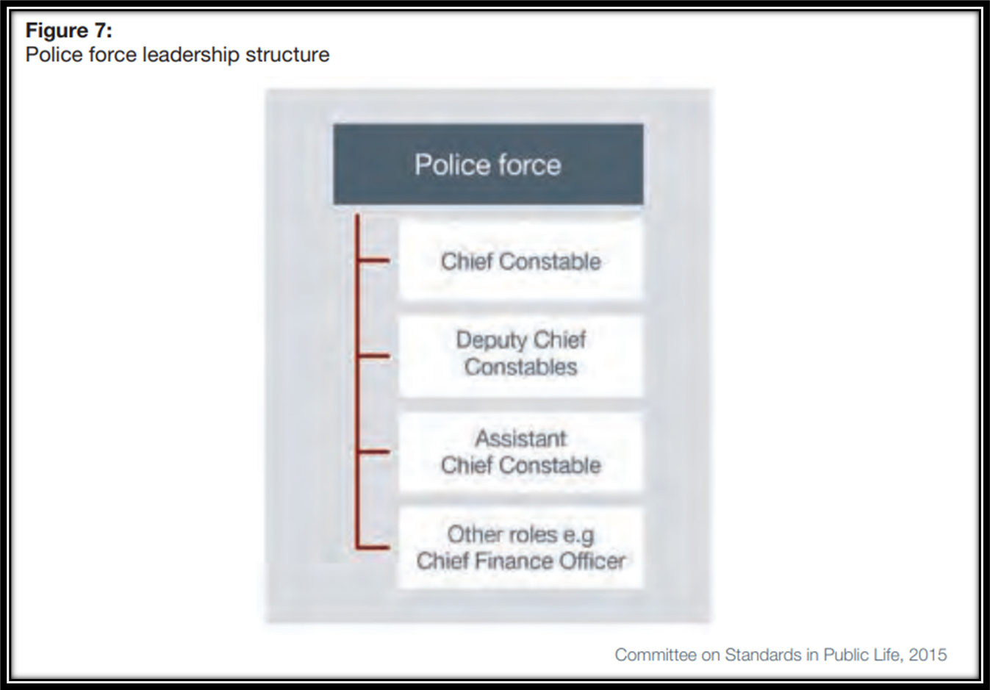
What is the leadership structure in operational policing?

Slide 14
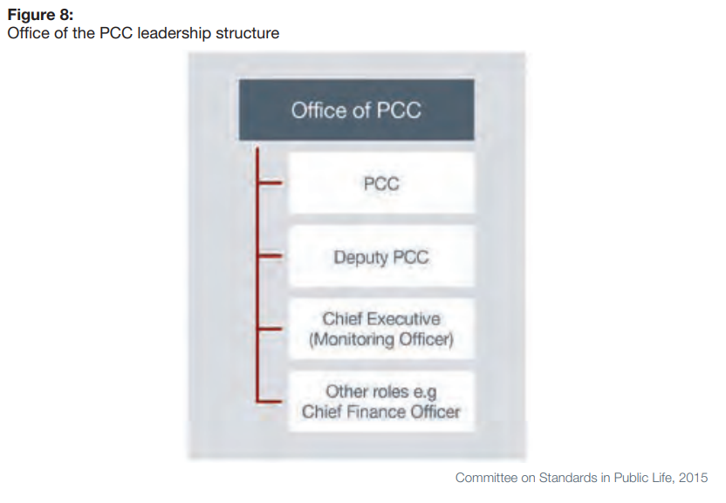
What is the PCC leadership structure?

Slide 15
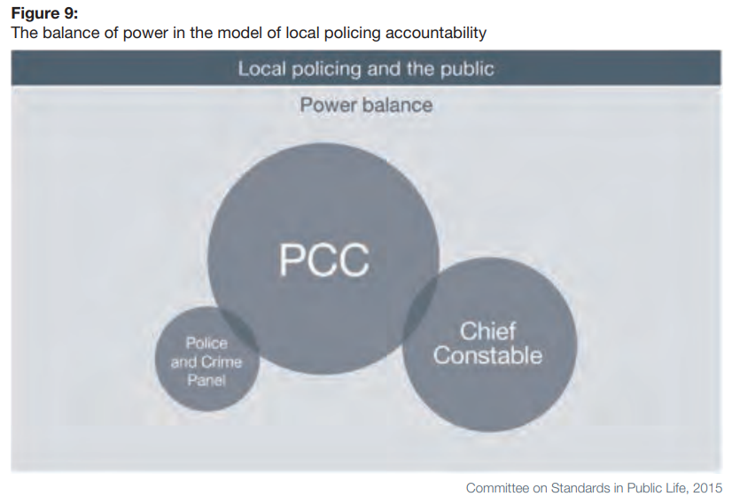
How is the power over policing distributed?

Slide 16
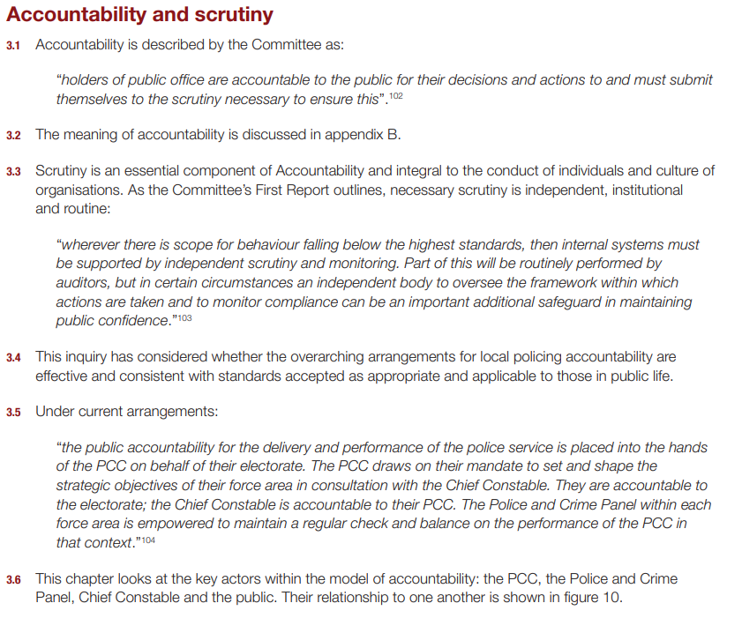
Accountability
Scrutiny
PCC role

Slide 17
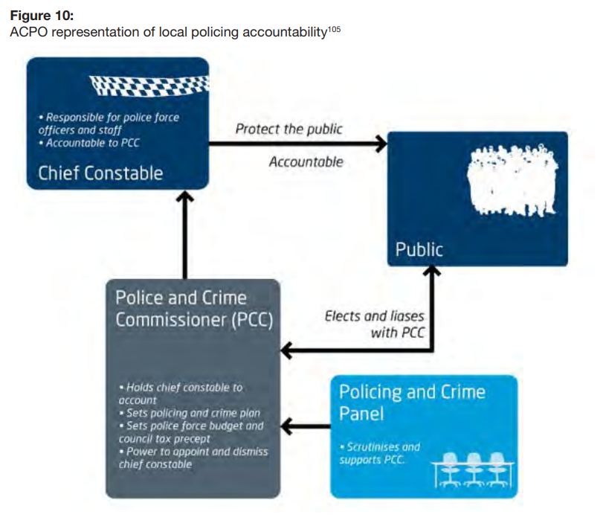

Slide 18
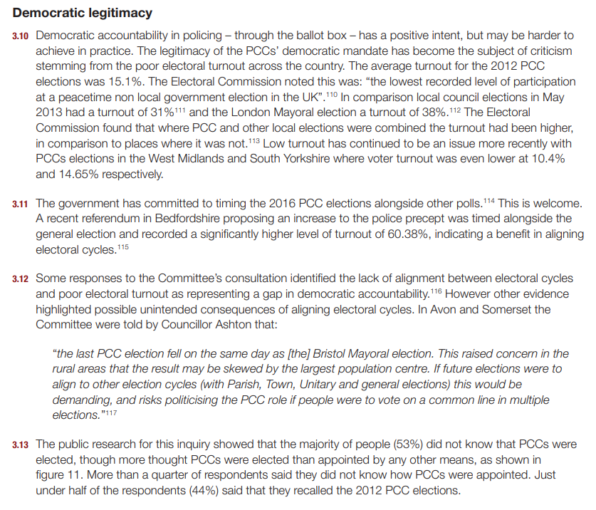
PCC elections
2012 - 15%
Electoral Commission – lowest ever participation
Local government turnout

Slide 19
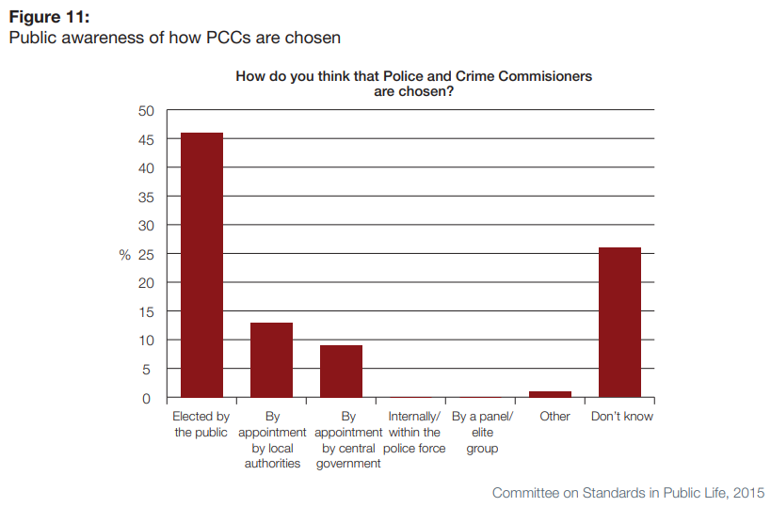

Slide 20
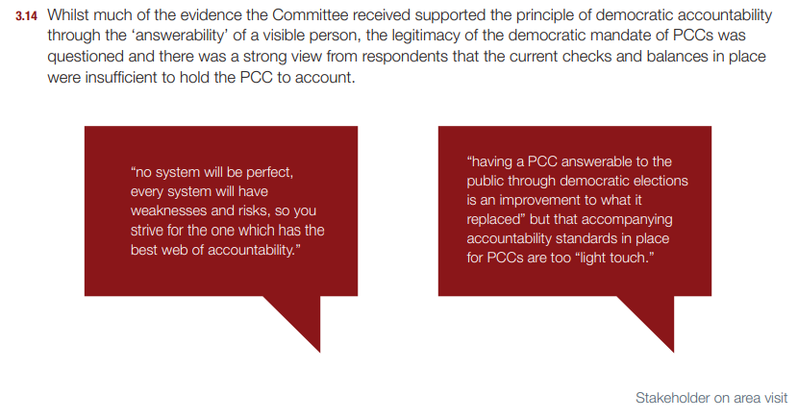
Visibility, answerability and legitimacy
What about people who already have a democratic mandate, and a stronger one at that?

Slide 21
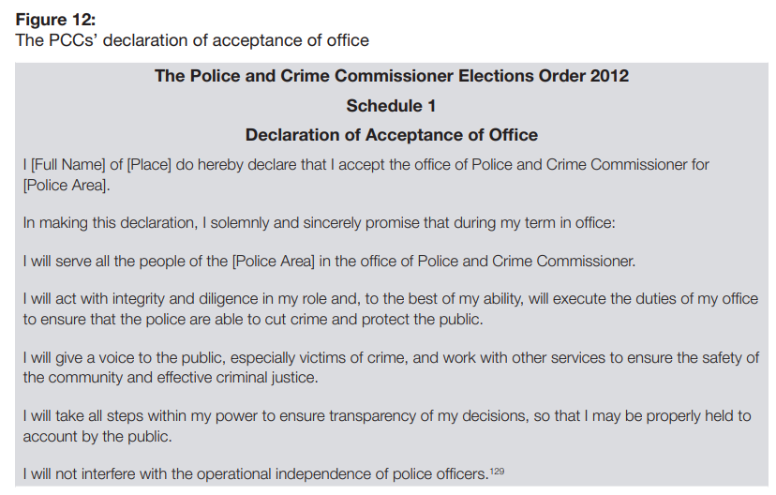

Slide 22
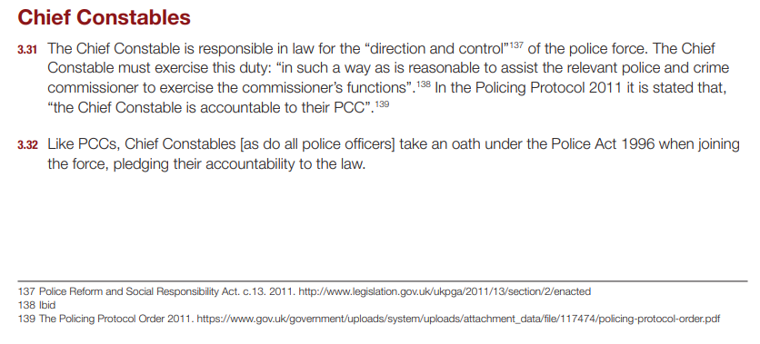
Chief Constables
Direction and control of the police force

Slide 23
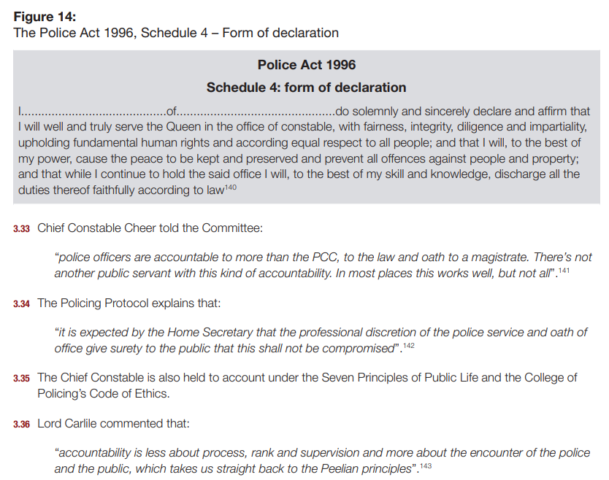

Slide 24
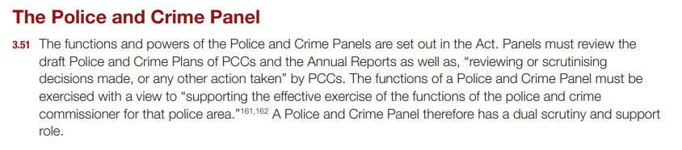
Police and Crime Panels

Slide 25
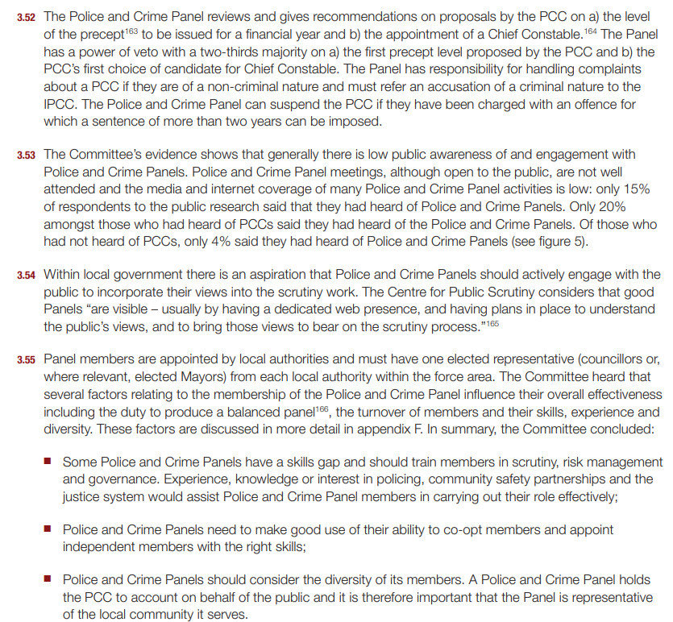

Slide 26
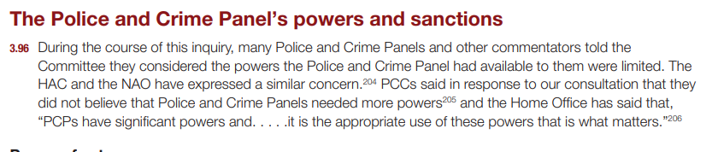
PCP Power?

Slide 27
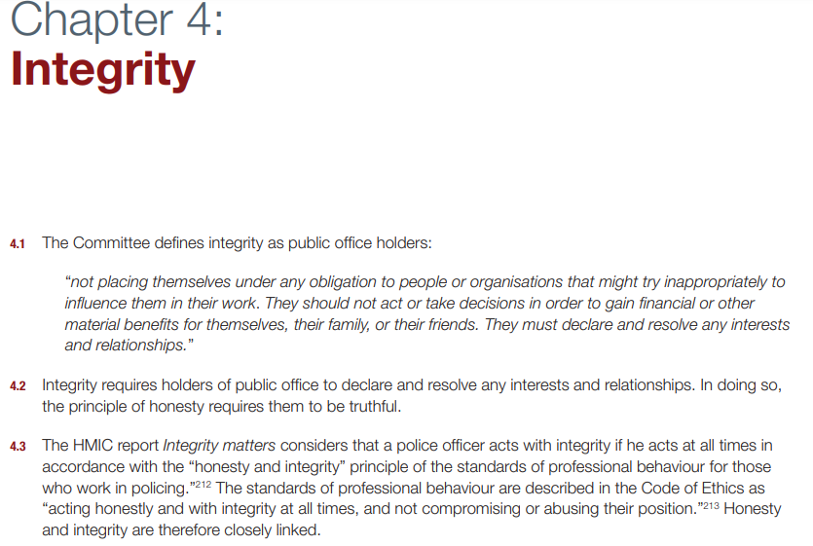
Declarations and honesty

Slide 28
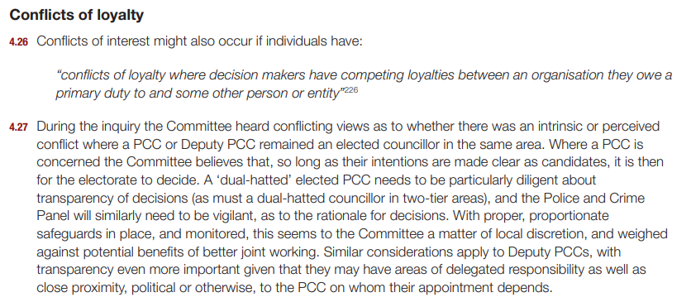
Loyalty
Being a PCC and Councillor?

Slide 29
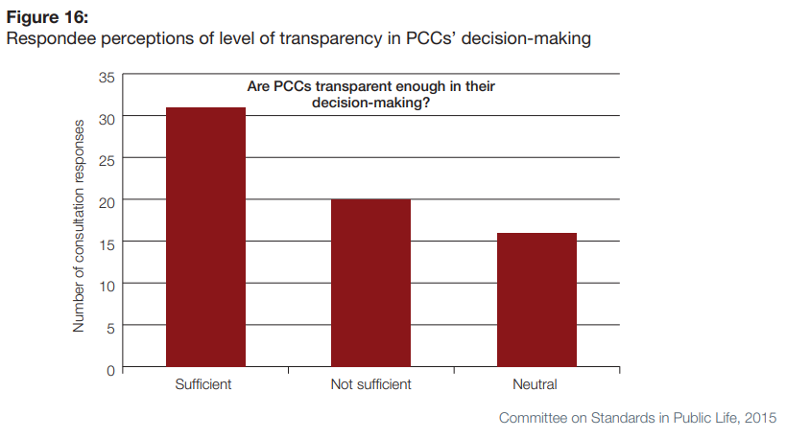
Transparency

Slide 30
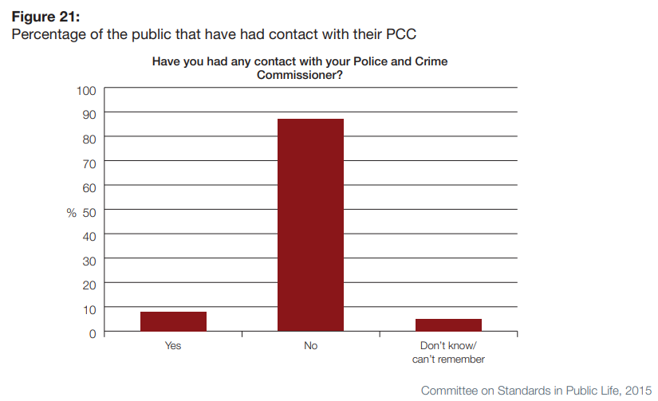
PCC Contact %

Slide 31
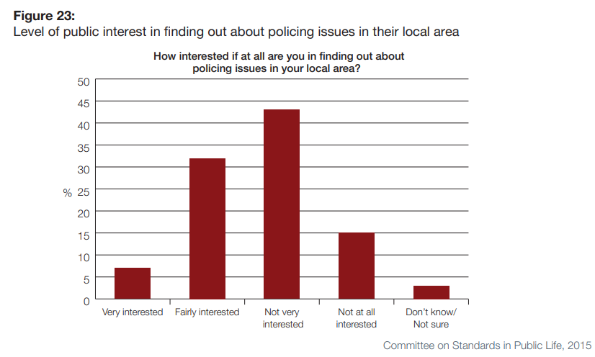
Public Interest in policing %

Slide 32
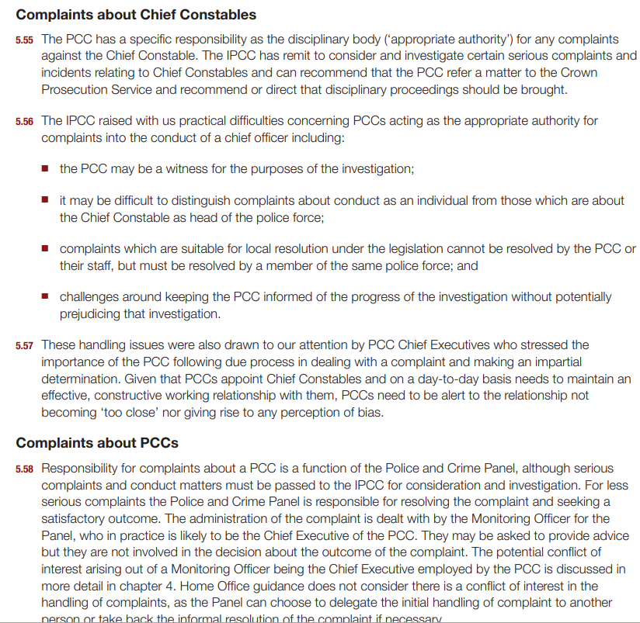

Slide 33
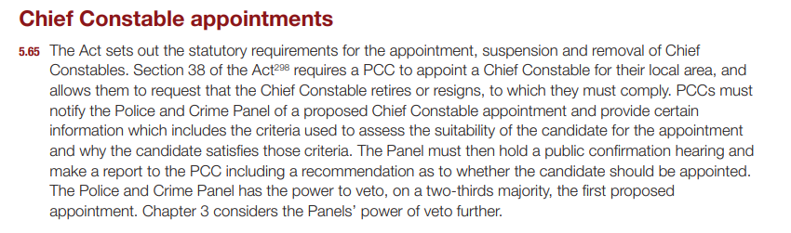

Slide 34
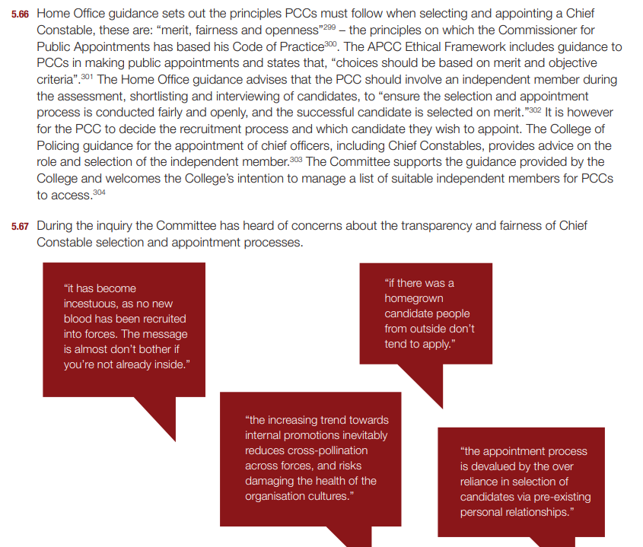
Chief Constables
Is appointment a fair process
Incestuous?
Internal opportunities?
Personal relationships?

Slide 35
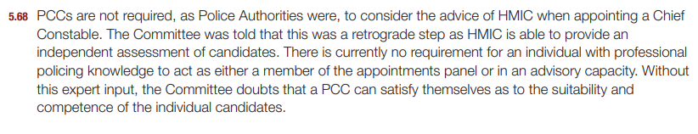

Slide 36


