Slide 1
Name: Tantou Sisay
Student Number: 2121741
Moduak Code:BMSW 4004/

Slide 2


Introduction
Im going to be talking about staff shortages in proper care uk
Nurse shortage across the NHS are having a "serious and detrimental impact" on services and will hinder efforts to tackle major care backlogs and improve access to services, according to a new survey of health leaders who say the government must accept a proposed amendment to the health and care bill to strengthen workforce planning.
It means that fewer nurses must care for more patients, possibly leading to an increase in errors and higher rates of mortality and failure-to-rescue situations. This nursing shortfall can lead to more errors and higher patient fatality rates

Slide 3

Scop of the problem
How wide is the nures shortage
Nuresing shortage has affected every hospital and care homes globaly the uk is not the only plcae it has affected, the World Health Organization (WHO) estimates a global shortage of 18 million health workers by 2030, mostly in low- and lower-middle-income countries, with nurses making up about half of this gap
Who is affected by it
Patients
Nurses
Hospitals
Care Homes

Slide 4
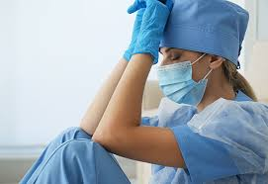
Impact
How does nurse shortage affect them
patient health and wellness is the primary goal of a nures however that goal is not met when a hospital is short in staffed nurse research shows that patient are 10% more likely to die if there is shortage of nurses
Patent
nurses shortage will affect patient by not giving them a good quality care and the care that they descrve, they will have higher chance of getting a serious infection, more complications from surgery or hospitalisation, fewer nurses could mean life or death for acute care patients.nurse shortage can also include medication errors,emergency room overcrowding,or a rise in the the mortality rates of patents
Nurses
Staff shortag has put a lots of stress on nurses becouse they are being forced to care for more patient then they need to care fore and it also affect them mental becouse they will not be ables to cope with the stree it aslo put them at risk becouse something may go wrong
A shorttga eof nurse could affect the quality of care

Slide 5
PESTEL
P) Political
E) Economic
S) Social
T) Technological
E) Environmental
L) Legal
Brexit
Language barrier
pandamic
Language barriers were identified as the biggest obstacles in providing adequate, appropriate, effective and timely care to patients with limited English proficiency.
It affected thousands of workers from EU
Nurses and care worker being forced to take the covide vaccine
p
S
E
E
T
L
tecnology
Risk assesments
Popualtion growth rat
Clinical spend more time struggling with technology rather then patient care
Older people uses more health servises than their younger counterparts becouse they have more health problems and they are also living longer
. It allows employers to fulfil their legal duty of care to protect their staff from harm, injury, or illness.

Slide 6
fishbone
Environment
Finance
Transport
Education
Cost of courses
Preventing students to enrole into nursing programs
Hospital too far away from staff
S
Unersessary difficult language test preventing them from up nursing roles
Bus fairs too expensive
Staff does not have car to to trave to work
Shortage of medical equpment such as goves,mask,aprons
Staff absent, staff calling sick or other personal problems
Staff ratio
Workover load, too many patients for one staff
Equpments
People

Slide 7

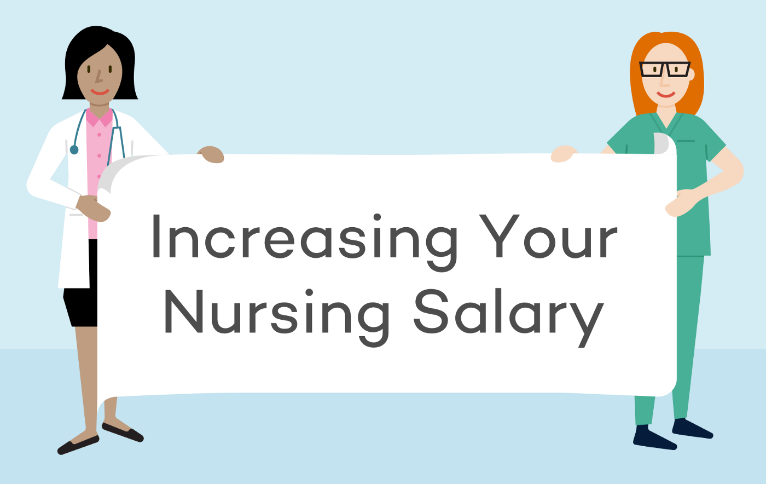
my Solutions
Thes are the solution I would put in place to reduse staff shortage
I would Hire Nurses from other countries and creat a work visa fore them to come to work in the uk
Educational opportunities, giving young people opperstunity to enrol into nursing programs and and fund them
I would increase Salary
I would Creating a healthy work invironment, make sure that nures and care workers to are the center of care.

Slide 8
Referances

