Slide 1
Sugar Tax
Week 4 Thursday – BMPE6006

Slide 2
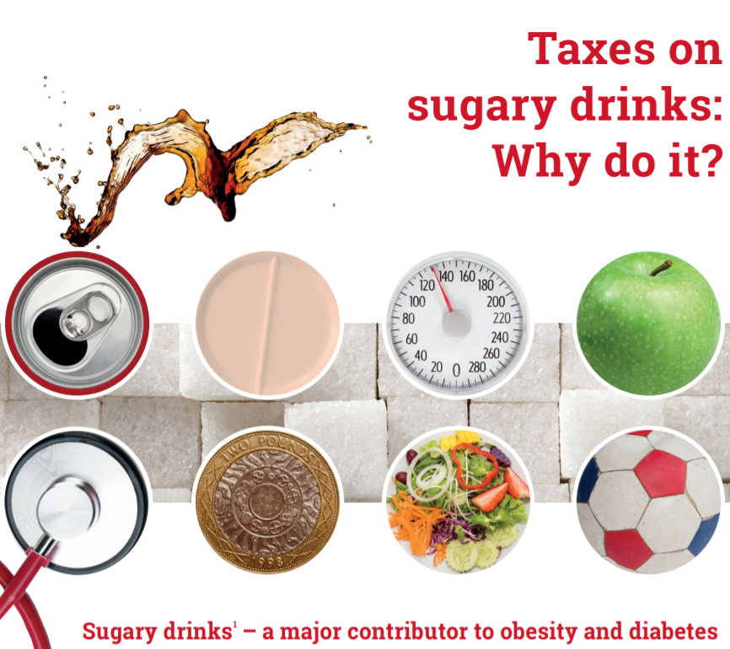
WHO - 2016

Slide 3
Consumption of sugar sweetened drinks…
How much of an issue is this?
How much are we consuming?
Different countries – global issue
  Highest consuming countries?
  Lowest consuming countries?

Slide 4
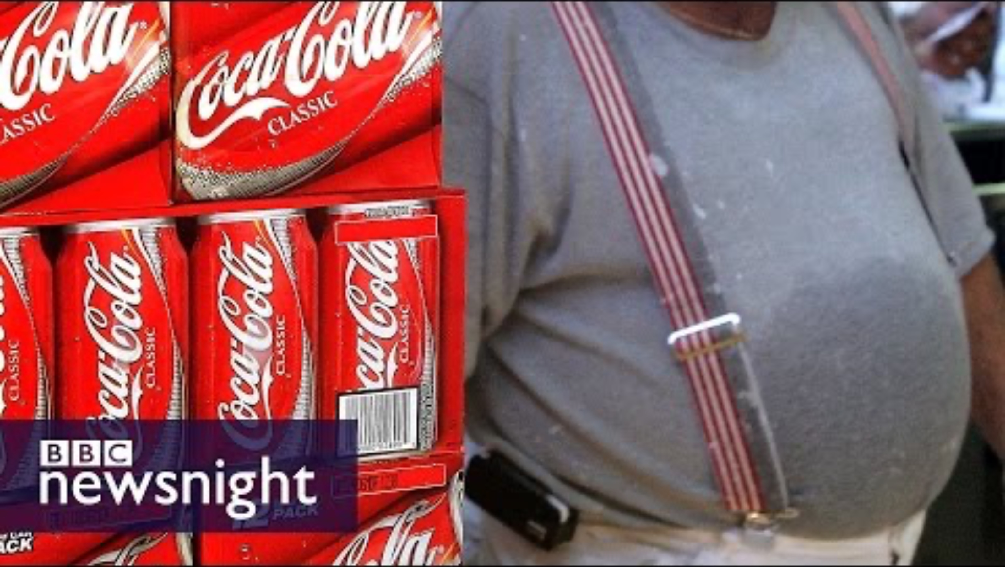
How much sugar is in a Coca-Cola supersize cup? - BBC Newsnight

Slide 5
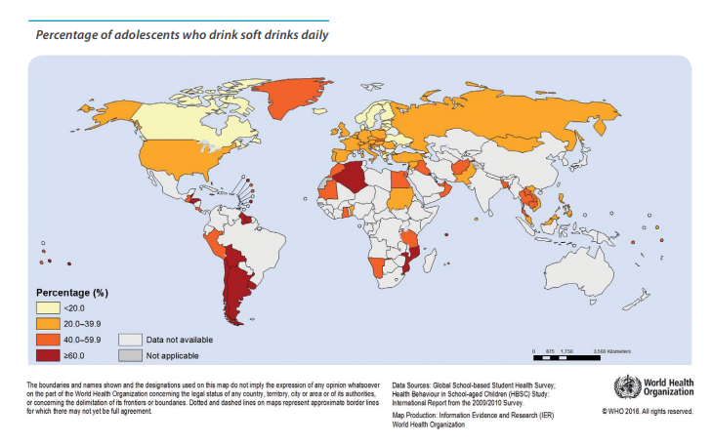

Slide 6
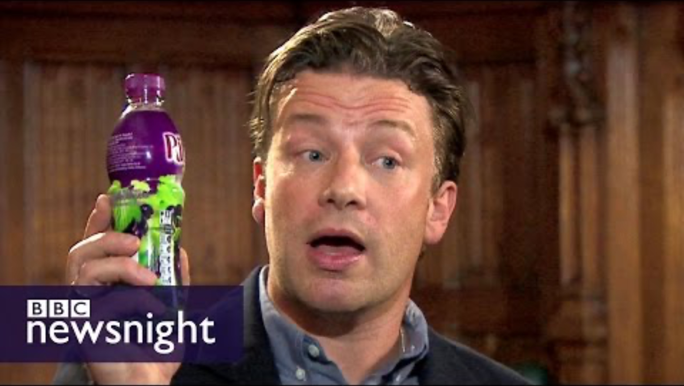
Jamie Oliver: Time to get 'medieval' on sugar - Newsnight

Slide 7
Problems with excess sugar
Dietary sugar, especially in liquid form, increases risk of dental issues, adiposity, and type 2 diabetes.
The United Kingdom Soft Drinks Industry Levy (SDIL) was announced in March 2016 and implemented in April 2018, Charges manufacturers and importers at:
  £0.24 per litre for drinks with over 8 g sugar per 100 mL (high levy category),
  £0.18 per litre for drinks with 5 to 8 g sugar per 100 mL (low levy category),
  and no charge for drinks with less than 5 g sugar per 100 mL (no levy category).
  Fruit juices and milk-based drinks are exempt.

Slide 8
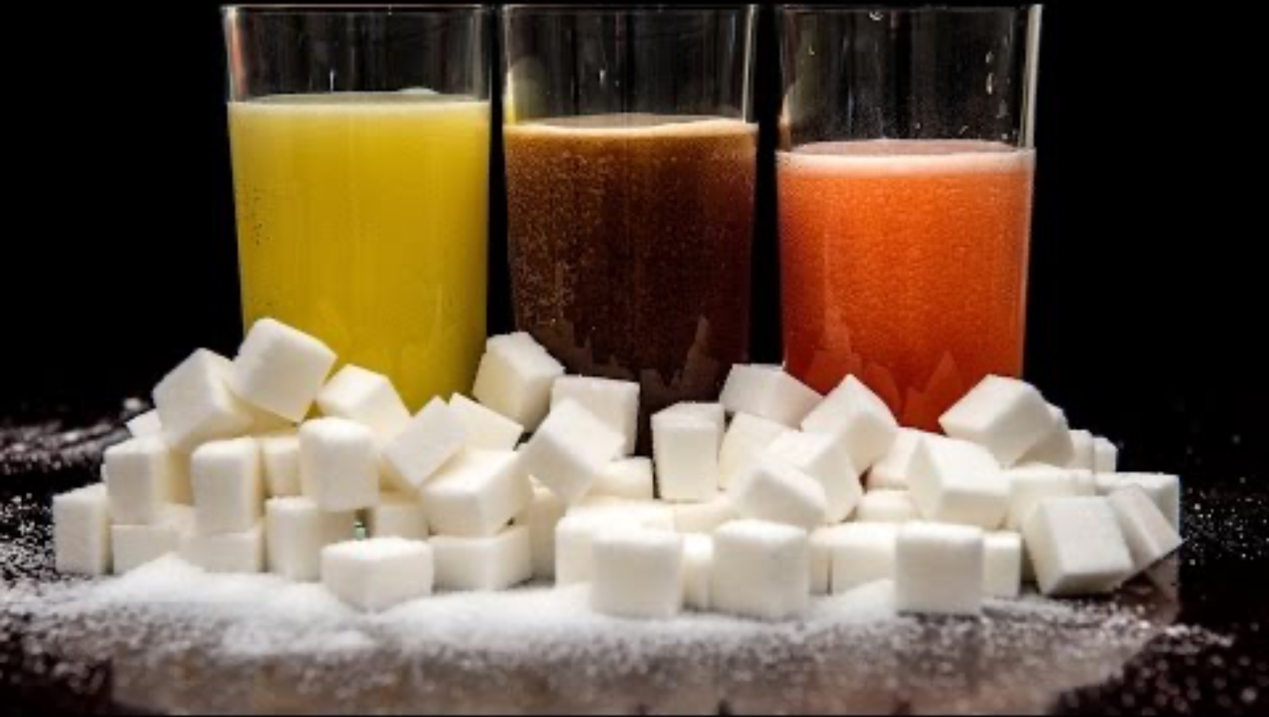
'Sugar tax' on soft drinks: What does it mean?

Slide 9
Globally what is happening?
With the global prevalence of obesity and associated health risks continuing to increase (WHO, 2016) health-related taxes have become an established policy option intended to reduce energy intake.
Most of these have focused on sugar-sweetened beverages (SSBs) due to their consistent association with energy intake, weight gain, risk of type 2 diabetes, as well as dental caries (Scientific Advisory Committee on Nutrition, 2015).
  In the USA, six local jurisdictions have a tax on sugary beverages implemented due to health concerns
  Chile taxes drinks with high levels of sugar at a rate 8% higher in comparison to drinks containing less sugar
  More recently, Portugal and Catalonia (Spain) implemented a two-tiered tax on sugary drinks
  the United Arab Emirates and Saudi Arabia introduced a 50% tax on carbonated drinks and Brunei and Thailand introduced an excise duty on sugary drinks.
  (World Cancer Research Fund, 2017).
There are similar plans across a number of other countries such as Estonia, the Philippines, Indonesia, Israel and South Africa (Public Health England, 2015).
The UK government started an industry levy in April 2018 to incentivise producers to reformulate their products or, if not, to increase the price of SSBs (UK Department for Health, 2016).

Slide 10
Research to date suggests that increasing the price of SSBs generates a small, but significant, reduction in their purchase (broadly, a 10% price rise reduces purchases by 6%–8%)
A more pronounced effect is found in poorer households and that substitution towards other soft drink categories only minimally offsets the energy reductions achieved through decreases in SSBs (Cornelsen et al., 2015; Briggs et al., 2013;2017)
However, there has been little research on the impact such a price increase could have on other contributors to sugar and energy intake, including alcohol (Quirmbach et al., 2018) and sweet snack foods (such as confectionery, cakes and biscuits).

Slide 11
SDIL rates – UK 2023 (Introduced April 2018)
There are 2 rates of SDIL:
standard rate (18p per litre) applied to drinks with sugar content between 5 grams (g) and up to (but not including) 8g per 100ml
higher rate (24p per litre) applied to drinks with sugar content equal to or greater than 8g per 100ml
In April 2023, SDIL was extended to include packaged concentrates which are mixed with sugar and diluted by a fountain machine to dispense a drink containing a total sugar content of 5 grams or more per 100 millilitres. These are charged at the higher rate (24p per litre).

Slide 12
Pro’s and Con’s of a sugar tax?

Slide 13
Pro’s and Con’s of a sugar tax?
Negatives…
Which foods should be taxed? Debate
Regressive tax – higher % comes from lower income groups
Obesity is caused by many factors – is sugar the main one?
Positives…
Raises revenue for the government
Encourages firms to produce healthier snacks?!
Provides incentives to reduce the consumption of sugar / unhealthy food.

Slide 14
Arguments for a sugar tax
External costs – NHS / businesses.
Sugary drinks impose high external costs on society. The overconsumption of sugar is a major cause of health problems such as:
  Tooth decay (especially amongst children)
  T2 Diabetes
  Obesity and obesity-related illnesses, such as back pain, heart disease,
These external costs are reflected in higher costs imposed on the national health service.
  Poor health also adversely affects work and productivity.
  Therefore, the social cost of sugar consumption is greater than the private cost of sugar.

Slide 15
‘Sugary drinks impose high external costs on society. The overconsumption of sugar is a major cause of health problems’
Discuss…

Slide 16

Lack of awareness of the harm caused
People may be unaware of the personal costs involved in sugar consumption?
Addictive qualities?
Popular to ‘quit sugar’?

Slide 17
Lack of awareness of the harm caused
People may be unaware of the personal costs involved in sugar consumption. Alternatively, people may be aware sugar is bad for you, but struggle to reduce consumption because of its addictive qualities.
How much sugar does an average person consume per week?
  Within foods?
This lack of awareness about sugar is an example of information failure – consumers not having full information to make informed choices.
  The amount of sugar in certain foods/drinks
  The harmful effects of sugar

Slide 18
Generates some much needed revenue
A great way of raising some tax revenue?
Revenue generated by these taxes could be spent on efforts to improve health care systems, encourage healthier diets, increase physical activity, or build capacity for effective tax administration, further increasing the value of this measure.

Slide 19
Continued…
Fund spending on growing health problems of sugar consumption (e.g. obesity management)
Tax to fund spending in a particular area? Would this make it more acceptable to the general public?
Tax raised used to fund health care or education about healthy eating?
Norway – very high tax on alcohol – goes directly to health care and treating problems caused by this.

Slide 20
Generates changes to supply and demand
Healthier alternatives?
Water…Awareness of hydration
Schools?

Slide 21
Generates changes to supply and demand
A sugar tax creates an incentive for firms to supply alternatives which are healthier.
Coca Cola – change in recipe – gradual sugar reduction
If you go into certain fast food restaurants, sugary drinks have often been heavily promoted – e.g. free refills in 5 Guys.
  It could be argued that supply creates its own demand. But, if firms have incentives to promote healthier drinks with substantially lower sugar content, then consumers will to an extent follow the supply.
  Meal deals in supermarkets – healthy drinks alternatives.
Evidence from the UK sugar tax suggests this is true. In the two years after the UK introduced a tax on sugary drinks, manufacturers responded by reducing the sugar content in their drinks to avoid the tax (Scarborough et al., 2020).

Slide 22
Policy paper – UK Government- Change from 1st April, 2023
Soft Drinks Industry Levy - concentrates mixed with added sugar when dispensed
Paper Published 15 March 2023
Consultation with industry members identified an opportunity to close a minor technical loophole within the Soft Drinks Industrial Levy (SDIL), improving the consistency of its application. This measure extends the definition of a soft drink liable to the SDIL to include packaged concentrates which are mixed with sugar when dispensed from a soft drink fountain machine.
The measure will bring consistency by incorporating concentrates which are mixed with sugar and diluted by a fountain machine to dispense a drink containing a total sugar content of 5 grams or more per 100 millilitres within the SDIL.

Slide 23
Sugar tax in the UK – freedom of choice / who is paying for this?
£0.24 per litre for drinks with over 8 g sugar per 100 mL (high levy category), (£0.28 from 1st April 2026)
£0.18 per litre for drinks with 5 to 8 g sugar per 100 mL (low levy category) (£0.21 from 1st April 2026)
no charge for drinks with less than 5 g sugar per 100 mL (no levy category)
A study (Scarborough et al., 2020) on the effect of the UK sugar tax, found prices only rose by 31% of the tax levy, suggesting manufacturers absorbed 2/3 of the tax increase themselves, suggesting demand is price sensitive for sugary drinks – with many alternatives.

Slide 24
Scarborough et al., 2020
Impact of the announcement and implementation of the UK Soft Drinks Industry Levy on sugar content, price, product size and number of available soft drinks in the UK, 2015-19:
The stated aim of the SDIL was to encourage the soft drinks industry to improve the healthiness of the drinks they produce, by reducing sugar content or reducing portion sizes. The SDIL was implemented in April 2018.
This study measured the impact of the SDIL on the soft drinks that are available to buy in the UK to evaluate whether the SDIL achieved its aim of influencing industry practice.
What did the researchers do and find?
They used data on 209,637 observations of soft drinks available from UK supermarket websites at 85 time points between September 2015 and February 2019.

Slide 25
At each time point, they measured the percentage of drinks with sugar levels greater than 5 g per 100 mL, the price of drinks, the volume at which they were sold, and the number of different drinks available to purchase and compared these with estimates of what would have happened if the SDIL was not introduced.
Changes were found to sugar levels in drinks.
  The percentage of drinks with sugar over 5 g per 100 mL fell from an expected level of 49% to 15% over the time period.
  There was little change in the product size or the number of products available to consumers.
  The price of high sugar drinks increased after the implementation of the SDIL but only by one third of the amount of the tax.
  The results show that the SDIL was associated with a considerable impact on the soft drinks industry, particularly with regard to the amount of sugar in soft drinks.
  The SDIL was not associated with a reduction in the size of the soft drinks marketplace.

Slide 26
Arguments against sugar tax

Slide 27
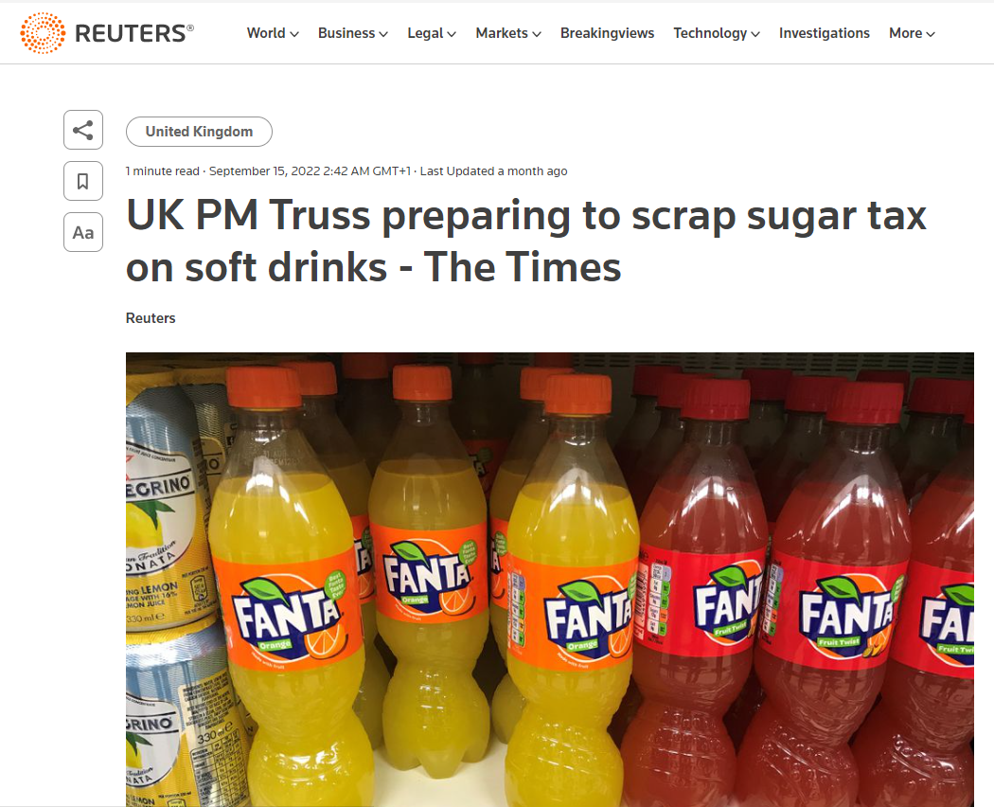
"Those taxes are over," Truss said in an interview with the Daily Mail. "Talking about whether or not somebody should buy a two-for-one offer? No. There is definitely enough of that."
Truss said Britons wanted the government to focus on things like delivering good transport links, communications infrastructure and cutting National Health Service waiting lists.
"They don’t want the government telling them what to eat," she said.

Slide 28
It is unfair on low-income groups
It is argued that the sugar tax is regressive because it will take a higher percentage of income from those on low-incomes.

Slide 29
Regressive tax – disproportionate impact on low-income groups
However:
  People can switch to non-sugary drinks and avoid tax.
  Everyone could benefit from the increased health care spending and improved quality of life.
If there were concerns about income distribution as a result of the tax, the tax revenues could be used to reduce other regressive taxes such as VAT,
Would spending on health care be a better way to improve quality of life for those on low-incomes?
Would the income raised go towards this however?
Less likely to be able to afford private health care treatment.

Slide 30
People should be allowed to do what they like – make their own lifestyle choices…
One argument about sugar tax is that it is wrong for the government to make judgements about people’s lifestyle and influence consumer patterns.
Nanny state?
If the state is paying for the NHS – should the government have a say in what we do?
Health promotion focus rather than dealing with the consequences?

Slide 31
Other methods to reduce sugar consumption may be better?
What else could be put in place to reduce sugar consumption in the British public?

Slide 32
Case Study - Mexico
Evidence shows that implementing taxes on sugary drinks leads to reduced consumption of these products.
Several countries are well on their way to implementing taxes on sugary drinks.
In January 2014, the government of Mexico added a 1 peso per litre excise tax on any non-alcoholic beverage with added sugar (powder, concentrates or ready-to drink) to the country’s Special Tax on Production and Services, which is paid by the producer and represents about a 10% increase in price for the consumer.
A study conducted by the Mexican National Institute of Public Health and the University of North Carolina evaluating the first two years of implementation showed an average reduction of 7.6% in the purchase of taxed sugary drinks during 2014 and 2015.
Households with the fewest resources had an average reduction in purchases of 11.7%.
The study showed a 2.1% increase in purchases of untaxed beverages, particularly purchased bottled water (Colchero et al., 2017).
Over US$ 2.6 billion was raised during the first two years of implementation; some of this revenue is beginning to be invested towards installing water fountains in schools across Mexico (Nutritional Health Alliance Mexico, 2016).

Slide 33
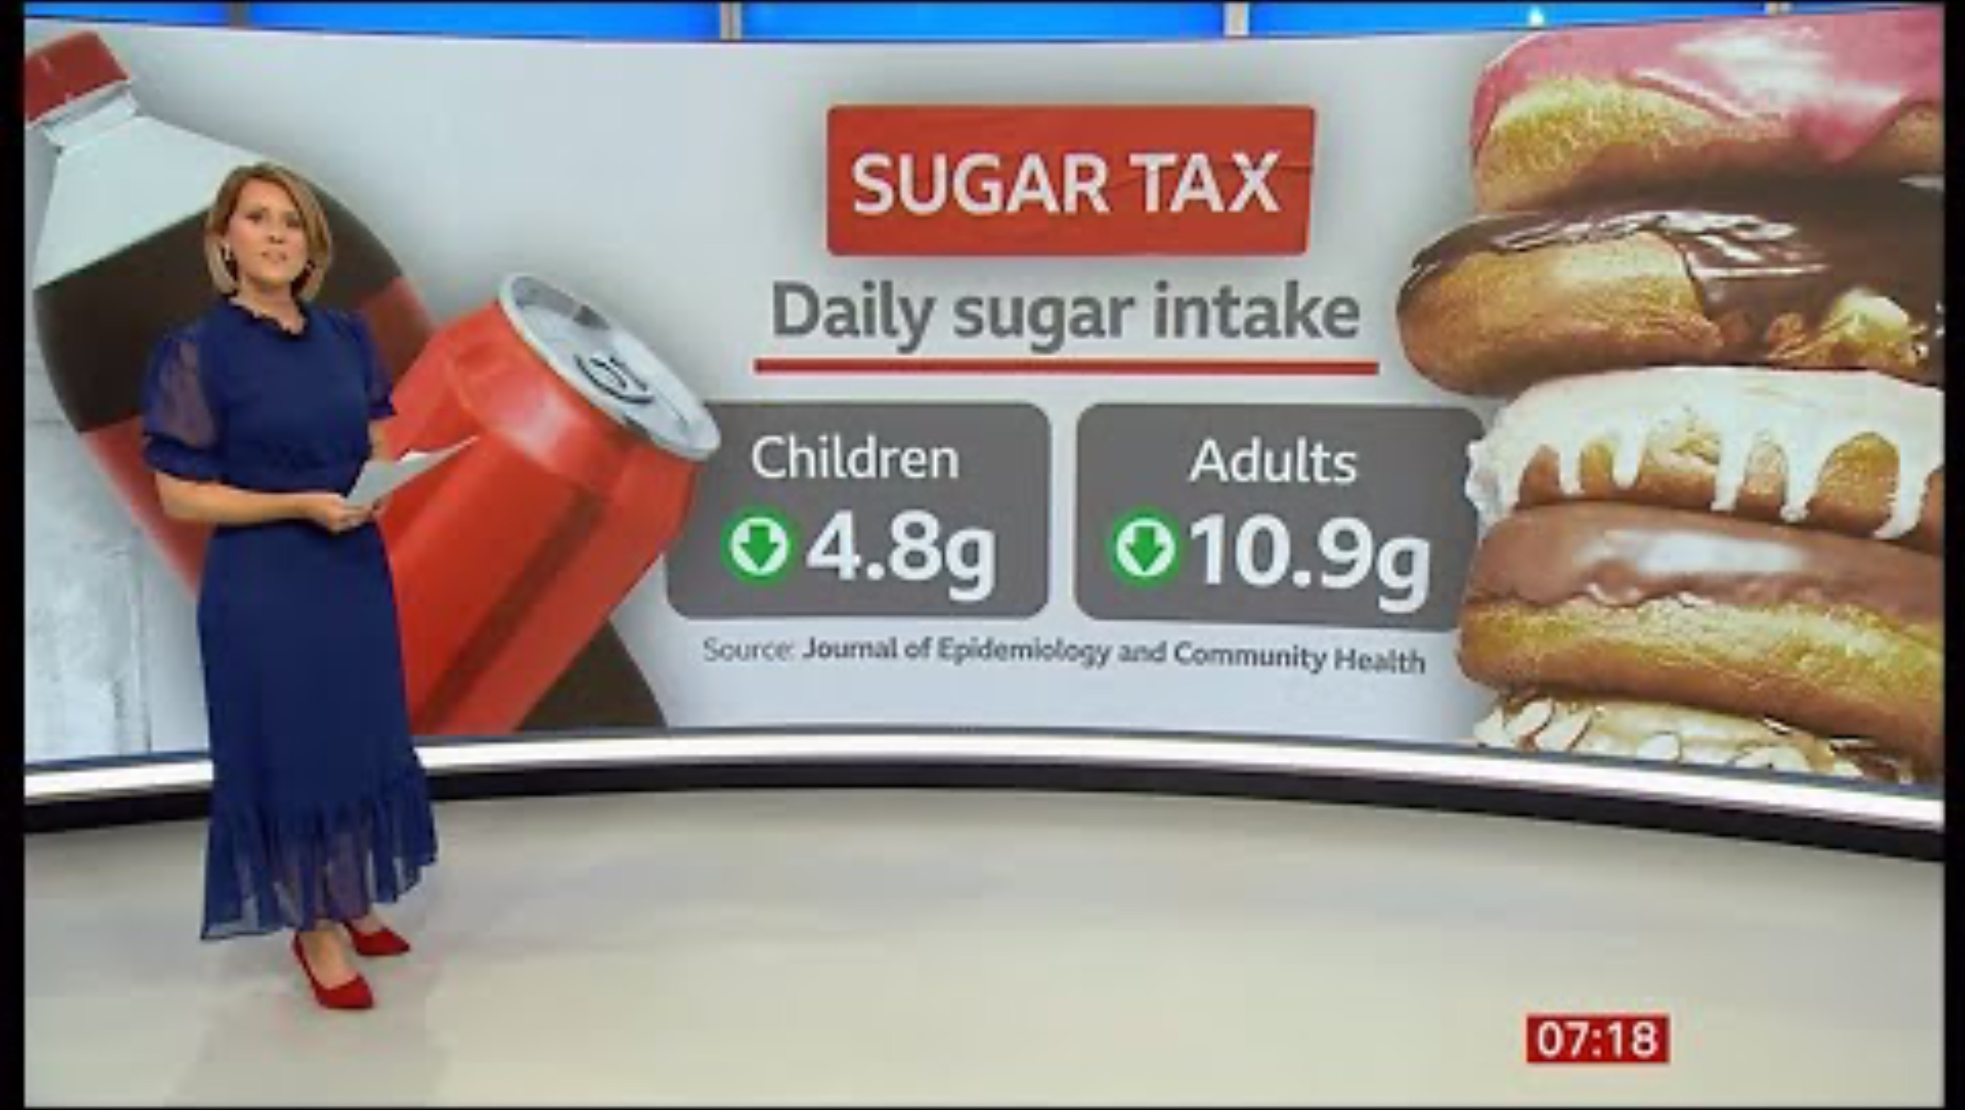
Update on progress - 2024

Slide 34
Action on Sugar: In 2025
3 July 2025
The latest statistics reveal:
An increase of 13.5% in the volume of drinks sold covered by the SDIL.
A decrease of 39.8% of total sugar sold from these drinks. This was due to the increase in sales of lower-sugar drinks and decrease in sales of higher-sugar drinks.
A reduction of 47.4% in the sales weighted average (SWA) of sugar content (g per 100ml) of drinks, and a reduction of 42.2% in SWA of calories per portion.
A reduction in the SWA sugar content of drinks purchased across all the social grades ranging from 51.8% in higher and intermediate, administrative and professional occupations, to 45% in state benefits casual and lowest grade workers.
The results also noted that within the same period there was an increase in the volume of sales of yogurt drinks (24.3%), milk-based drinks (53.2%), and flavoured milk substitute drinks (18.7%).
The sugar sold from yogurt drinks and milk-based drinks increased by 12.5% and 30.3% respectively, although decreased by 4.7% in flavoured milk substitute drinks.
https://www.actiononsugar.org/news-centre/sugar-in-the-news/2025/2025-news-stories/new-statistics-reveal-significant-sugar-reduction-as-a-result-of-the-soft-drinks-industry-levy-.html

Slide 35
2025
As of late 2025, the UK government continues to strengthen its Soft Drinks Industry Levy (SDIL) as part of its broader strategy to combat obesity and diet-related diseases.
The key updates:
A public consultation launched in spring 2025 is explored broadening the levy:
Lowering the threshold from 5 g to 4 g sugar per 100 ml.
Including milk-based and plant-based drinks (e.g., milkshakes, oat lattes, rice milk) which were previously exempt
https://www.gov.uk/government/consultations/strengthening-the-soft-drinks-industry-levy/strengthening-the-soft-drinks-industry-levy-consultation

Slide 36
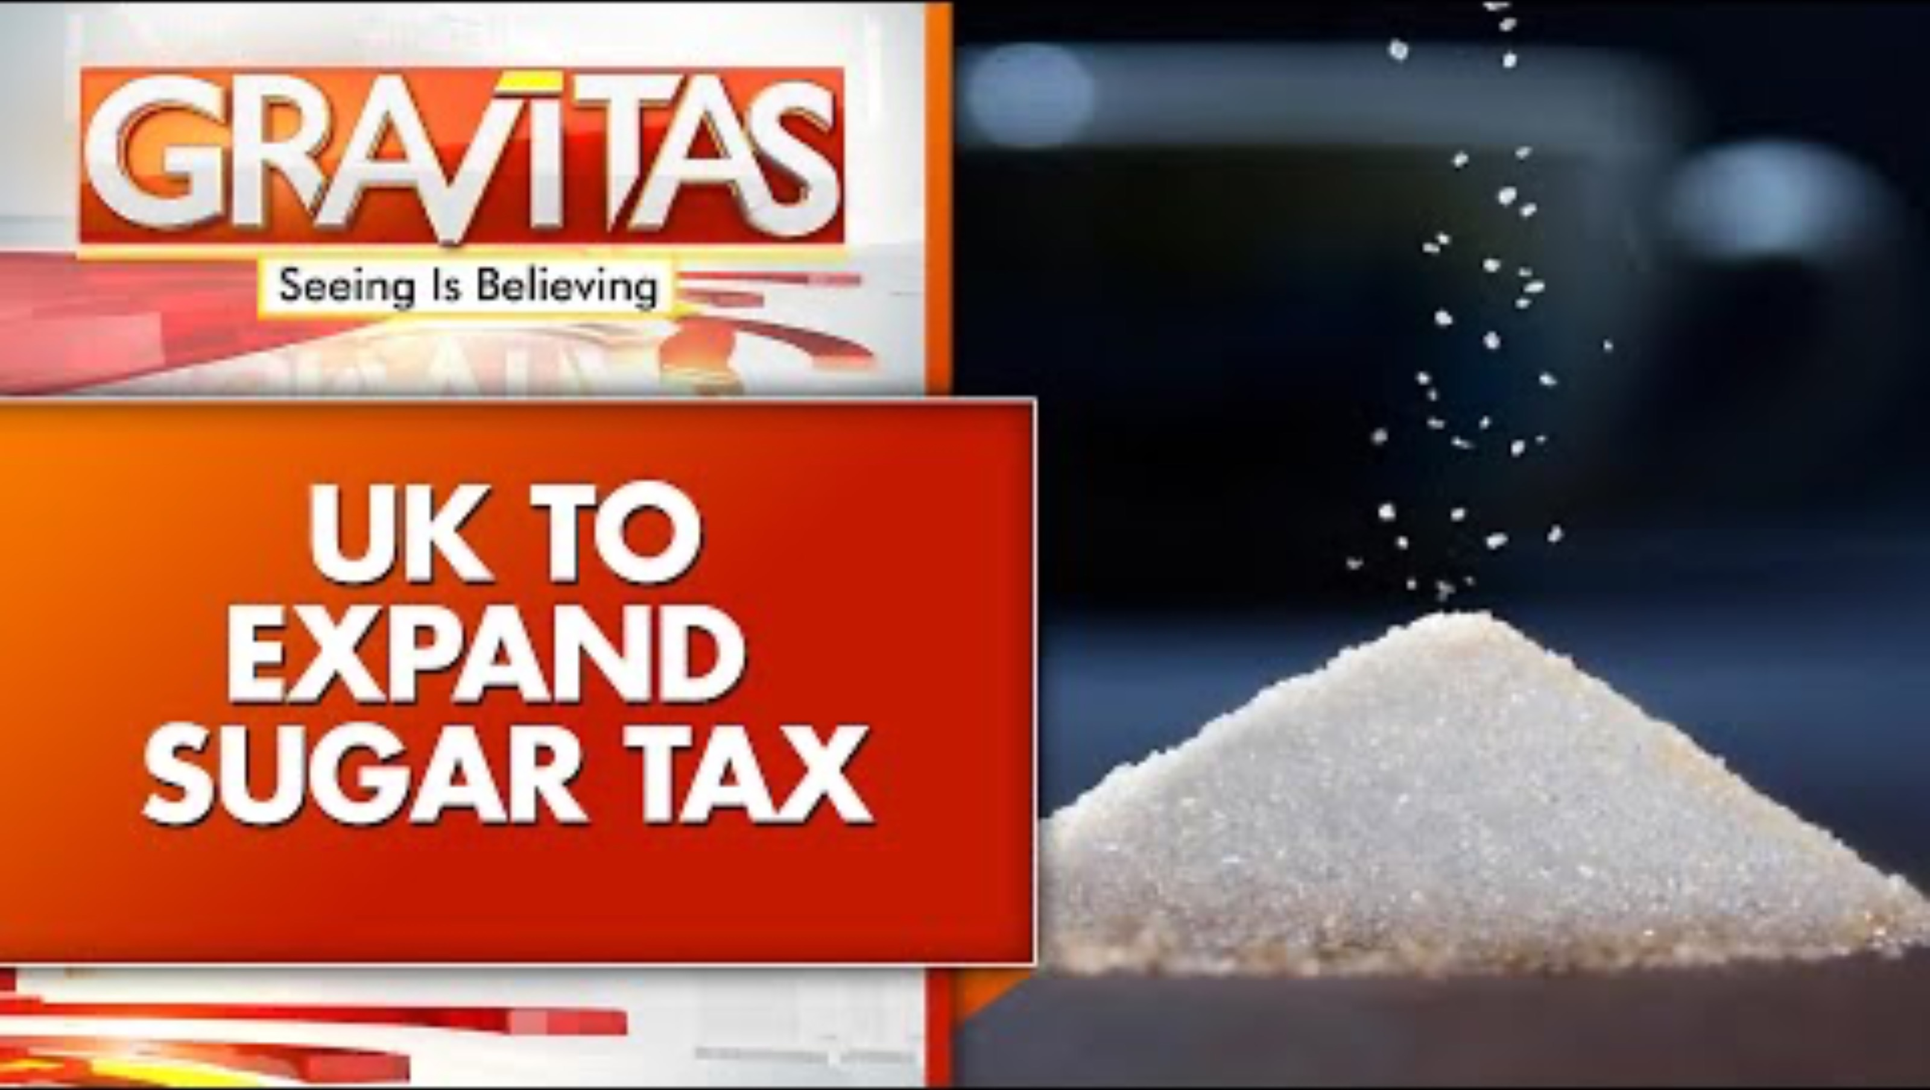
UK Targets 203 High-Sugar Milk Drinks In Health Crackdown

Slide 37
2026 onwards…
1 January 2028 – Major SDIL changes:
Lower sugar threshold: levy applies from 4.5g sugar/100ml instead of 5g.
Milk and milk‑substitute drinks included: pre‑packaged flavoured milks, milkshakes, sweetened yoghurt drinks, chocolate milk drinks, and ready‑to‑drink coffees with added sugar will be liable.
Open‑top drinks in cafés and restaurants remain exempt.
  Easier to administer if packaged – recipes used may vary in cafes

Slide 38
Group Task:
The UK’s Soft Drinks Industry Levy (2018) reduced sugar in beverages by over 44% and raised £240 million annually, funding school health projects.​
Debate on extending the tax to foods such as cereals and yogurts continues.​
Critics argue it disproportionately affects lower-income families.​
Task:
Argue that the sugar tax is effective and should be expanded.
Argue that the tax is regressive, stigmatises certain populations, and has unintended social consequences.

Slide 39
Discussion Points:
How effective is the UK sugar tax in reducing obesity and improving diet quality?
Is it ethical to use fiscal policy to shape individual diet behaviour?

Slide 40
Rogers et al. (2024) found significant reductions in household purchases of sugary drinks following the levy, particularly among families with children
https://nutrition.bmj.com/content/bmjnph/early/2025/01/21/bmjnph-2024-000981.full.pdf
Rogers et al. (2023) showed reductions of approximately 3 g of free sugar per child per day from soft drinks post-levy
https://jech.bmj.com/content/jech/78/9/578.full.pdf
A Public Health Modelling study in Lancet Public Health reported medium- and long-term benefits for reducing inequalities in child obesity rates
https://pmc.ncbi.nlm.nih.gov/articles/PMC11008889/

Slide 41
Summary
Health implications – especially children
Cost implications – business and consumers
NHS – protect and fund?
Personal responsibility
Awareness

