Slide 3
Social and emotional consequences of dyslexia

Slide 4
Aims
To provide some framework for understanding the emotional and social consequences of dyslexia (and other SPLDs)
  What is self concept?
  Effects of dyslexia on self concept
  Behavioural and emotional repercussions of dyslexia

Slide 5
Theories of Self
Self concept: an individuals belief about who they are that includes those personal attributes that they use to categorise themselves or perceive to distinguish them from others (Baumeister, 1999; Bee, 1992; Lewis, 1990)
Carl Rogers (1959) - self concept is a construct of:
  Self image - The view you have of yourself
  Self esteem/Self worth - The value you place on yourself
  Ideal self - What you aspire to be
Taken from McLeod (2008)

Slide 6
Self image is created from
Self beliefs not necessarily based in reality e.g. clever/stupid, fat/thin
Social roles – the expectations of others influencing our behaviour e.g. pupil, student, friend, class clown
Personal traits – personality characteristics that we use to describe ourselves

Slide 7
Self esteem influenced by:
Reactions of others contribute to:
  Positive self esteem (agreement, praise, inclusion etc)
  Negative self esteem (criticism, avoidance, neglect etc)
Comparison with others: are we better or worse at something than others? (particularly those we admire)
The prestige/stigma of our social roles
  Top-set pupil vs special needs class
Identification
  The extent to which roles we play, the groups we join, the jobs we do become internalised
Argyle, 2008

Slide 8
Ideal self
The fit between which your self-image and what/who you would like to be influences:
Your chances of achieving your ideal (self actualisation) depend on the level of congruence (Rogers, 1959)
The ways in which others (particularly significant others) react to us.
How we think we compare to others
Our social roles
The extent to which we identify* with other people
Argyle,2008
Many dyslexics report feelings of not fitting in at school (Alexander-Passe, 2015)

Slide 9
Consider
What happens if the ideal-self and the self-image are separate?
What effects do low self-esteem have on motivation?
Why do dyslexic students/pupils often feel they are stupid?

Slide 10
Social interactive theory
Society’s reaction to dyslexia -> disability
  Dyslexia viewed as a deficit in the learner
  Literate individuals considered superior to, and valued more highly than those without this skill
  Literacy skills commonly equated with intelligence
  Speed of processing often wrongly, associated with intelligence
Department for Education and Skills, 2004

Slide 11
Dyslexia and IQ ( underlying ability)
IQ is a composite measure of different cognitive abilities
Cognitive profile assesses individual cognitive abilities: verbal, and non verbal abilities working memory and processing speed

Slide 12

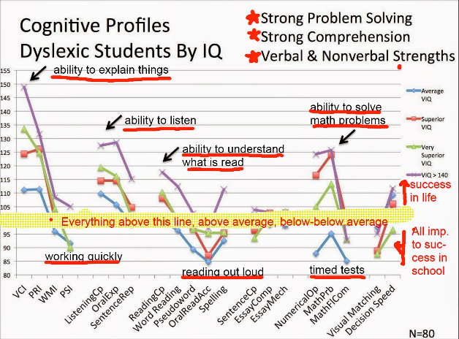

Slide 13
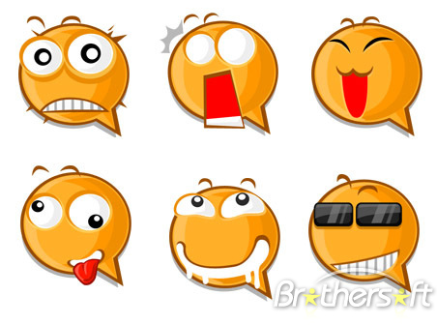
Socio-emotional consequences of dyslexia
Frustration
Anger
Low self esteem
Inadequacy, anxiety, stress, depression
Procrastination
Perfectionism
Developing strategies to hide difficulties
Many dyslexic adults have low self esteem and poor self concept due to the emotional scars of
negative experiences, particularly in education (Gilroy & Miles, 2002)

Slide 14
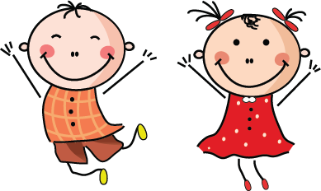
Frustration Anger
Frustration
Anger
Acting up
Exclusion
(My best school day ever!)
Anti-social or deviant behaviour
60% of young people with no GCSE’s have an SEN
(Dept. for Children, Schools and Families, 2009)
(Peer & Reid, 2001; Molnar &Lindquist, 1989)

Slide 15
Inadequacy, Anxiety, Stress, Depression
Inadequacy, anxiety, stress, depression
Avoidance- Persistent absenteeism
47% primary
42% secondary
absentees have SEN
Disaffection
(Delinquency/Can lead to drug /alcohol use, to mask feelings of inadequacy)
Difficulty making friends
Victimisation/bullying
(Alexander-Passe &Zimmer, 2009; Fontana, 1995))

Slide 16
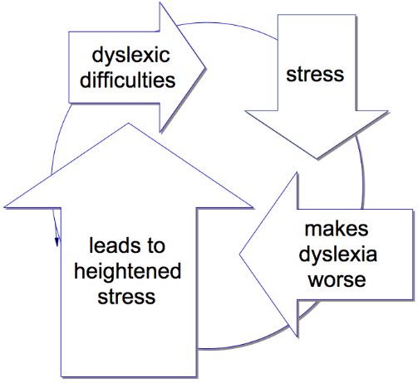
The vicious circle of stress
Stress is a drain on attentional resources
Lack of automaticity puts a higher demand on attentional resources
Most people with dyslexia report good days and bad days
– stress increases dyslexic traits (Miles, 2004)

Slide 17
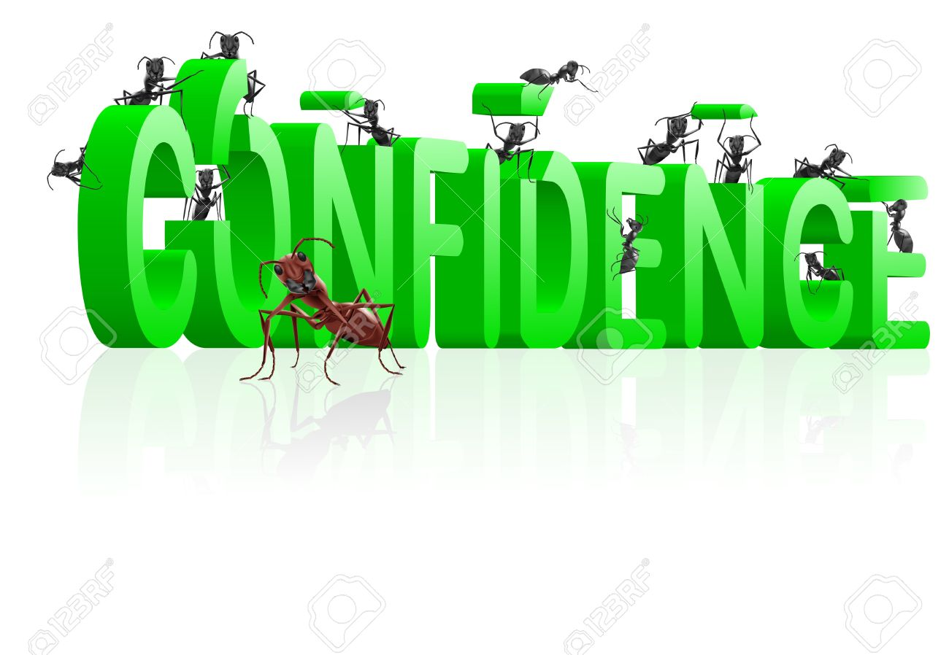
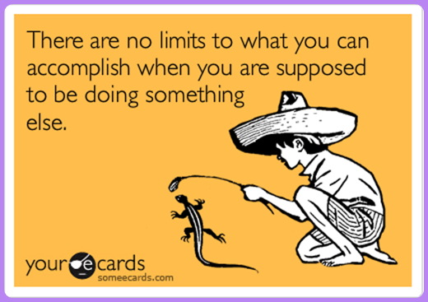
Clowning – gains attention May earn social approval from peers
Distractibility
Concentration = effort
so any breaks/distractions are welcome

Slide 18

Despite similarities in underlying difficulties dyslexic individuals’ have different:
  Experiences
  Strengths
  Expectations
  Personalities
  Needs
  likes/dislikes
  Sensitivities
  Emotional responses
Taking the personal, social, and emotional aspects of a student’s functioning and development into account can lead to real and sustained positive change (Long, MacBlain & Macblain, 2007, p126)

Slide 19
Reducing Classroom stress
Increase the feel good factor
Decrease the fear
Mark for success
  e.g % words spelled correctly
Use language of success
Focus on the ‘do’ rather than the ‘don’t’
Confidence building
Set achievable targets
Use scaffolds for writing tasks
Give the right to pass on reading aloud
Minimise copying from the board
“I’m glad you asked”

Slide 20
To conclude Dyslexic pupils/students need
A validating environment that positively addresses self esteem and self efficacy (Long, Macblain & MacBlain, 2007)
Positive attention and confidence boosting (Humphrey, 2002)
Safe learning environments where they are not afraid to ask for help to build self concept and self esteem (Green, 2014)
Help developing metacognitive skills -positive effects on sense of self and motivation (McLoughlin & Leather, 2013)

Slide 21
References
Alexander-Passe, N. & Zimmer, B. (2009) Dyslexia and the loss of learning dialogue. In ed. Educational Psychology: Cognition and learning, Individual differences and Motivation. New York, Happuage
Argyle, M. (2008). Social encounters: Contributions to social interaction. Aldine Transaction
Baumeister, R. F. (Ed.) (1999). The self in social psychology. Philadelphia, PA: Psychology Press (Taylor & Francis).
Bee, H. L. (1992). The developing child. London: HarperCollins.
Department for Education and Skills (2004) Framework for understanding dyslexia, Leicester NIACE.
Fontana, D. (1995) Psychology for Teachers. Basingstoke, MacMillan Press.
Green, R. (2014) Reflecting on dyslexi and its effects in on learning in regards to self-esteem, in a technology based mainstream school maintained by the local authority ion the South East of England. The Step Journal 1(1) pp3-10
Gilroy, D & Miles, T (2002) Dyslexia at College, Routledge
Humphrey, B Teacher and Pupil Ratings of self-esteem in developmental dyslexia. British Journal of Special Education, 29, 4 pp196-203

Slide 22
References
Lewis, M. (1990). Self-knowledge and social development in early life. In L. A. Pervin (Ed.), Handbook of personality (pp. 277-300). New York: Guilford.
Long, L., MacBlain, S. & MacBlain , M. (2007) Supporting students with dyslexia at the secondary level: An emotional model of literacy
Miles, T.R. (2004 Dyslexia and Stress, London, Whurr
Molnar, A & Lindquist, B (1989) Changing problem behaviour in schools. San Fransisco: Jossey Bass Publications
McLeod, S. A. (2008). Self concept. Retrieved from www.simplypsychology.org/self-concept.html
McLoughlin, D. & Leather, C. (2013) The Dyslexic Adult. Chichester, John Wiley & Sons
Peer, L. & Reid,G (2001) successful inclusion in the secondary school. London David Fulton Publications.
Rogers, C. (1959). A theory of therapy, personality and interpersonal relationships as developed in the client-centered framework. In (ed.) S. Koch, Psychology: A study of a science. Vol. 3: Formulations of the person and the social context. New York: McGraw Hill.

