Slide 1
Psychopathological Classifications & Provision
COMPONENT 1: INDIVIDUAL PRESENTATION (ACADEMIC POSTER)
Anorexia Nervosa: Historical Context, Contemporary Treatment and Ongoing Challenges
Student Name: Rozilene Araujo
Student Number: 2319163
Module Code: BMHP6029
Lecturer Name: Dr Neale Haddon

Slide 2
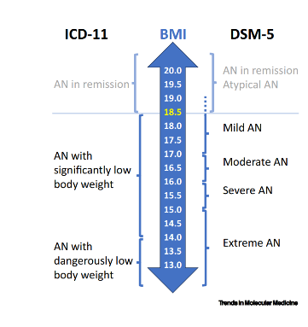
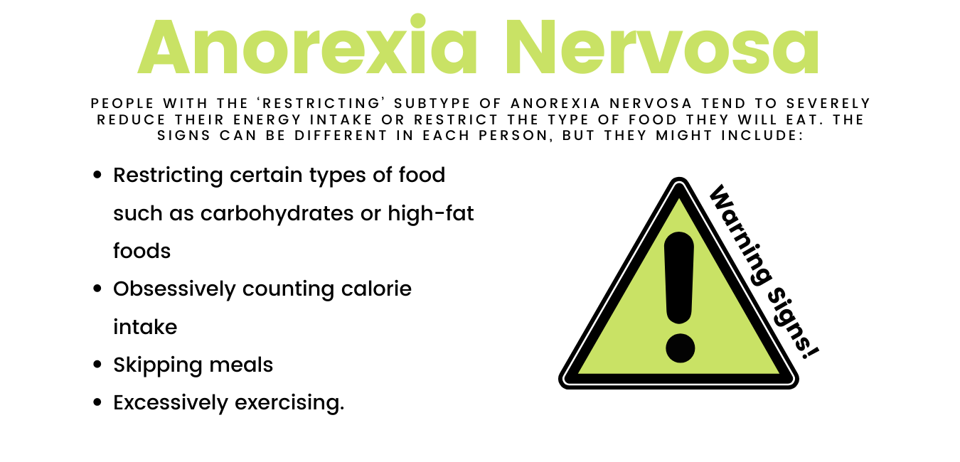
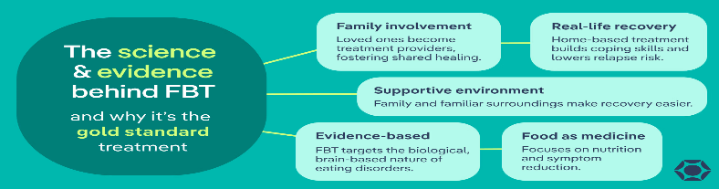
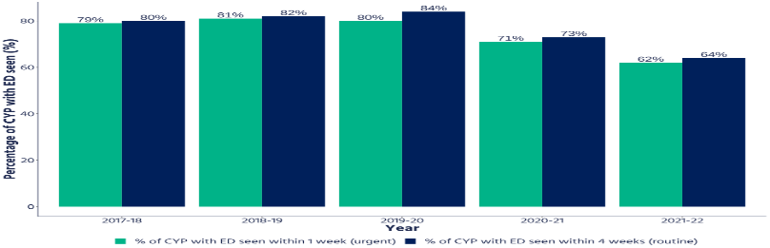
Anorexia Nervosa: Historical Context, Contemporary Treatment and Ongoing Challenges
Historical Treatment & Understanding of Anorexia Nervosa
1
Pre Modern Era: Religious & Moral Views
Before the late 19th century, anorexia was largely seen as a spiritual or moral behavior. Medieval Christian ascetics (e.g., St Simeon Stylites, St Catherine of Siena) practiced extreme fasting as religious devotion (Bryant et al., 2026).
Victorian Era: Medicalisation & Gender Politics
In the Victorian period, anorexia became formally medicalised and linked to gender norms.
Early–Mid 20th Century: Competing Explanations
Early 20th century theories split between biological and psychological models. Simmonds (1914) proposed a neuroendocrine cause while psychoanalytic Freud, Hartmann focused on ego and psychosexual conflicts.
Introduction & ICD-11 Classification
2
Defining Anorexia Nervosa in ICD-11
The ICD-11 (2022) defines Anorexia Nervosa as a severe eating disorder, which is defined as deliberate, sustained weight loss with the intense fear of fatness and distorted body image (NICE, 2024)
Epidemiology and Public Health Impact
According to Himmerich and Treasure (2024) Anorexia Nervosa (AN) carries significant public health implications, as the uppermost death proportion compared to all mental health illnesses. The condition is further complicated by high rates of comorbidities, such as major depressive disorder, obsessive-compulsive disorder (OCD), and different types of personality disorders.
Source: Self create
3
Contemporary Treatment and Care Provision
4
Western Oregon Uni (n.d.)
Evidence-Based Psychological Interventions
Family-Based Treatment (FBT), or the Maudsley approach, is the leading evidence-based approach for adolescent anorexia nervosa. It views the illness as biopsychosocial and positions parents as central to recovery through three phases: weight restoration, returning control to the adolescent, and supporting normal development (Vanderlinden, 2026).
Medical and Multidisciplinary Care
Medical management focuses on stabilising malnutrition and monitoring complications such as bradycardia and orthostatic hypotension. Assessment includes growth history and laboratory tests (CBC, CMP, TFTs) to detect issues like leukopenia or electrolyte imbalance. Nutritional rehabilitation is essential to prevent refeeding syndrome, and hospitalisation is recommended when weight falls below 75% of ideal or when medical instability is present (Fornari et al., 2025).
Stigma, Discrimination and Inequality
.
Contemporary Stigma: Attitudes and Beliefs
Aird et al. (2025) found anorexia nervosa (AN) is more stigmatised than depression, with participants rating individuals with AN as selfish or vain on the Eating Disorder Stigma Scale. These judgments place blame on sufferers and increase social discomfort, especially due to visible emaciation. At the same time, some people minimise AN by praising perceived discipline, masking its high mortality and reducing help‑seeking.
Clinician Stigma and Healthcare Discrimination
Lubieniecki et al. (2024) show that clinician stigma often appears as weight bias and diagnostic stereotypes, such as assuming eating disorders only affect “young, thin, White females,” which contributes to missed or dismissed cases in larger bodies. A reductionist focus on weight gain can damage the therapeutic alliance, leaving patients feeling judged. Stigma also discourages disclosure, with perinatal samples showing up to 70% non‑disclosure, contributing to delayed diagnosis and disengagement from care.
FBT (2026)
5
Social, Cultural and Political Contexts Shaping Treatment
Increase early screening in schools and primary care using validated tools.
Improve training for healthcare staff to reduce stigma and gender bias.
Enhance digital literacy programmes addressing social media pressures.
Culturally sensitive services to address ethnic, cultural, and gender disparities.
Contemporary Sociocultural Influences
Ramjan et al. (2024) report that social content strongly influences motivation and treatment in anorexia nervosa. Empathetic, person‑centred communication builds a better therapeutic alliance, while weight‑focused approaches weaken trust, including online.
Political, Legislative and Policy Evolution
Eisler et al. (2022) explain that NHS reforms have shaped child and adolescent eating‑disorder services. The 2012 shift to CCG commissioning and post‑2008 austerity limited CAMHS access. Later policy prioritised cost‑effective specialist outpatient care, and the 2015 Access and Waiting
6
Recommendations For Future Policy and Practice
.
Conclusion
Anorexia Nervosa remains a complex psychiatric condition with significant treatment challenges. Although evidence-based interventions such as Family-Based Therapy show some effectiveness, remission rates remain limited. Stigma and diagnostic disparities continue to delay intervention, particularly among males and minority ethnic groups. Continued efforts to reduce stigma and improve recognition are essential to addressing the seriousness of this disorder.

Slide 3
REFERNCES
Aird, C.S., Reisinger, B.A., Webb, S.N. and Gleaves, D.H. (2025) Comparing social stigma of anorexia nervosa, bulimia nervosa, and binge-eating disorder: A quantitative experimental study, Journal of Eating Disorders, 13(1), p.15.
Bryant, E., Touyz, S., Oldershaw, A., Treasure, J. and Maguire, S. (2026) Anorexia nervosa: 150 years of critical theory, Journal of Eating Disorders.
Eisler, I., Simic, M., Fonagy, P. and Bryant‑Waugh, R. (2022) Implementing service transformation for children and adolescents with eating disorders across England: the theory, politics, and pragmatics of large-scale service reform, Journal of Eating Disorders, 10(1), p.146.
Fornari, V., Dancyger, I.F., Fisher, M. and Zimmerman, J. (2025) Anorexia and bulimia nervosa in adolescents: medical, nutritional, psychological and psychiatric evaluation and management, Pediatric Medicine, 8, p.5.
Grilo, C.M. (2024) Treatment of eating disorders: status, challenges, and future directions, Annual Review of Clinical Psychology, 20.
Halbeisen, G., Braks, K., Huber, T.J. and Paslakis, G. (2022) Gender differences in treatment outcomes for eating disorders: a case‑matched, retrospective pre–post comparison, Nutrients, 14(11), p.2240.
Himmerich, H. and Treasure, J. (2024) Anorexia nervosa: diagnostic, therapeutic, and risk biomarkers in clinical practice, Trends in Molecular Medicine, 30(4), pp.350–360.
Lubieniecki, G., Fernando, A.N., Randhawa, A., Cowlishaw, S. and Sharp, G. (2024) Perceived clinician stigma and its impact on eating disorder treatment experiences: a systematic review of the lived experience literature, Journal of
Eating Disorders, 12(1), p.161.
Nitional Institute for Health and Care Excellence (2024) Eating disorders: recognition and treatment. Available at: https://www.nice.org.uk/guidance/ng69 (Accessed: 27 February 2026).
Radden, J., Pastore, L. and Dellantonio, S. (2024) Introduction: The Anorexia Enigmas, Review of Philosophy and Psychology, 15(3), pp.663–684.
Ramjan, L.M., Smith, B.W., Miskovic‑Wheatley, J., Pathrose, S.P. and Hay, P.J. (2024) Social support for young people with eating disorders—An integrative review, International Journal of Mental Health Nursing, 33(6), pp.1615–1636.
Vanderlinden, J. (2026) Family‑based Therapy for Eating Disorders: From the Milan Model to Contemporary Evidence, Frontiers in Child and Adolescent Psychiatry, 5, p.1765146.
World Health Organization (2022) International Classification of Diseases 11th Revision (ICD 11). Available at: https://icd.who.int (Accessed: 27 February 2026).

