Slide 1
BMTP4016
Events & Festivals Experience
Placement
Introduction

Slide 2
Additional Learning Opportunities – Do!
Observational - Passive learning, students come to a realization through watching
Research – Facilitate or support learning
Independent – Independently led to support & develop
Blended – Mix of teaching, instruction and student-led learning
Project-Based – Project to meet learning outcomes & development
Experiential – Learning through experience

Slide 3

Types of Learning & Development
Structured – Clear procedure to ensure learning occurs
Unstructured – Experiences have learning as a goal, but allow flexibility
Experiential – ‘Experiencing’ situations
Collaborative – Learning that occurs alongside and with other learners.

Slide 4

Experiential Learning
Active Engagement in learning through doing & reflecting on activities
Experience & reflection together
Professional & personal development
Skills Development
Placements & Events Projects
Employability
Action Centred
Management & Leadership

Slide 5
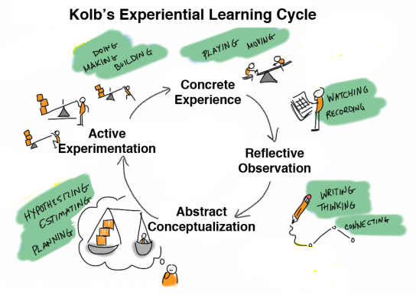
Learning By Experience based on Kolb (2014)

Slide 6

Experiential Learning Typologies
Placements
Project Based
Enquiry / Research Based
Observation
Experimentation
Self Reflection
Teamwork Tasks & Professional Development
Cooperative Learning
Service Learning
Performance Based
Study Abroad
Volunteering / Civic Engagement / Community Projects
Events

Slide 7
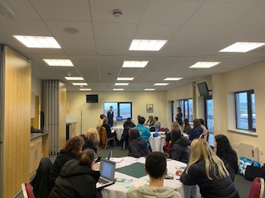
Association of Experiential Education
Knowledge—the concepts, facts, and information acquired through formal learning and past experience.
Activity—the application of knowledge to a “real world” setting.
Reflection—the analysis and synthesis of knowledge and activity to create new knowledge”.
(Indiana University, 2006, n.p.).

Slide 8
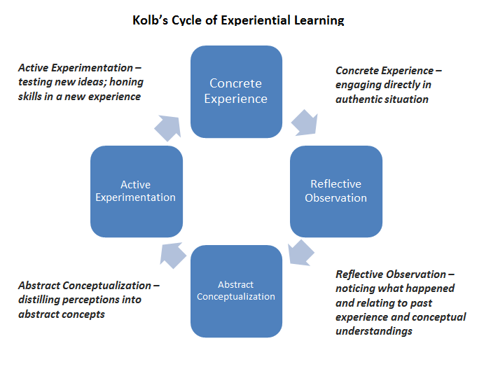
Kolb’s Cycle of Experiential Learning

Slide 9

Experiential Learning Education
In its simplest form, experiential learning means learning from experience or learning by doing.
Experiential education first immerses learners in an experience and then encourages reflection about the experience to develop new skills, new attitudes, or new ways of thinking.
-Lewis & Williams (1994)

Slide 10
Experiential Education v Experiential Learning
Experiential education (EE) is defined as the philosophical process that guides the development of structural and functional learning experiences
Education is a broader concept
Experiential learning (EL) is defined as the specific techniques or mechanisms that an individual can implement to acquire or meet learning goals (Roberts, 2012)
Specific learning categories and learning processes

Slide 11
Benefits of Experiential Learning
Increase in students’ content knowledge and skills.
Statistically higher outcomes in application of coursework to everyday life than comparable students not engaged in experiential learning.
Improved higher-order thinking skills—an ability to demonstrate greater complexities of understanding.
Statistically significant increases in ability to analyze increasingly complex problems.
Significant increases in students’ critical thinking abilities.

Slide 12
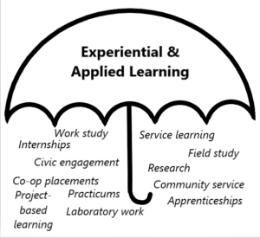
Experiential & Applied Learning Concepts

Slide 13


AIMS & OBJECTIVES OF EXPERIENTIAL LEARNING
Increases student motivation to learn.
Appreciate relevance
Stimulates academic inquiry
Enriches and applies the content
Provided authentic opportunities for applying learning
Motivates
Produces autonomous learners
Problem Solving
Task Management
Real-world context
Understanding
What you know, what you do not know, and how to learn it.

Slide 14

Learning Targets
Select suitable experiences – Action Centred
Link to criteria
Problems Solving
Empowerment
Enterprise
Set Learning Outcomes
Facilitator / Tutor / Employer
Resources
Physical & Emotional Safety
Challenges
Experimentation
Teamwork
Leadership Development

Slide 15
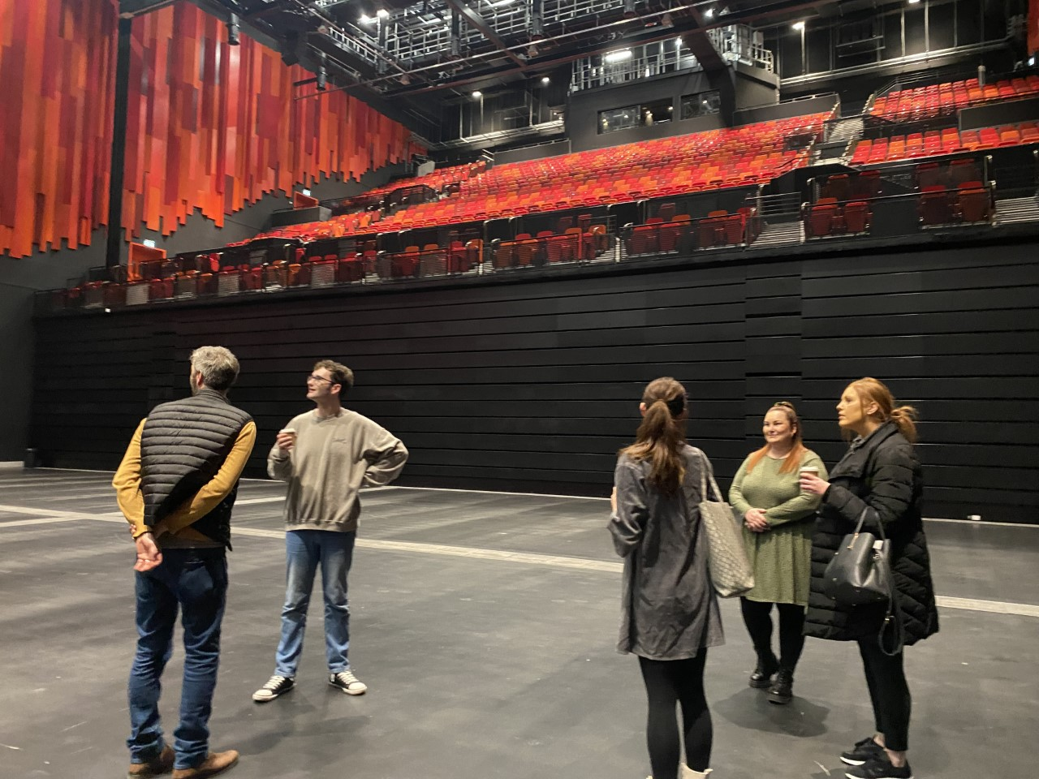
Personal Development
Employability
Enterprise
Empowerment
Increases students’ self-esteem
Enhances students’ sense of self-efficacy and empowerment
Increases students’ likelihood to engage and decreases students’ likelihood to engage in at-risk behaviours
Positive effect on students’ motivation for learning

Slide 16
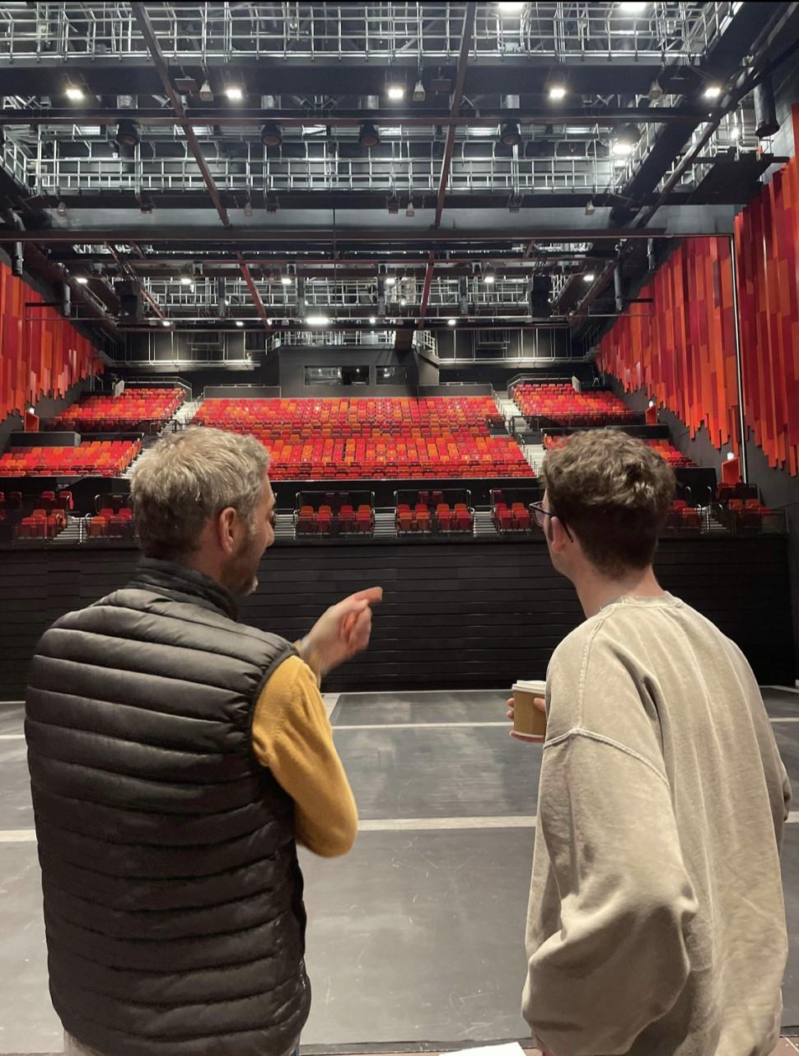
Reflection
Reflection deepens learning
Transfer previous learning to new contexts
Master new concepts, principles, and skills
Articulates how you developed

Slide 17

Transferable Skills
Most transferable and marketable skills are forged in “real world” settings
Civic engagement
Teamwork
Leadership
Key Skills
Instilled through practice not remembering / memory
Best practiced in the “real-world” not sitting in a classroom

Slide 18

Ownership
Self Management
Employability
Empowerment
Enterprise
Events
Self Development
Self Management
Coaching Styles

Slide 19
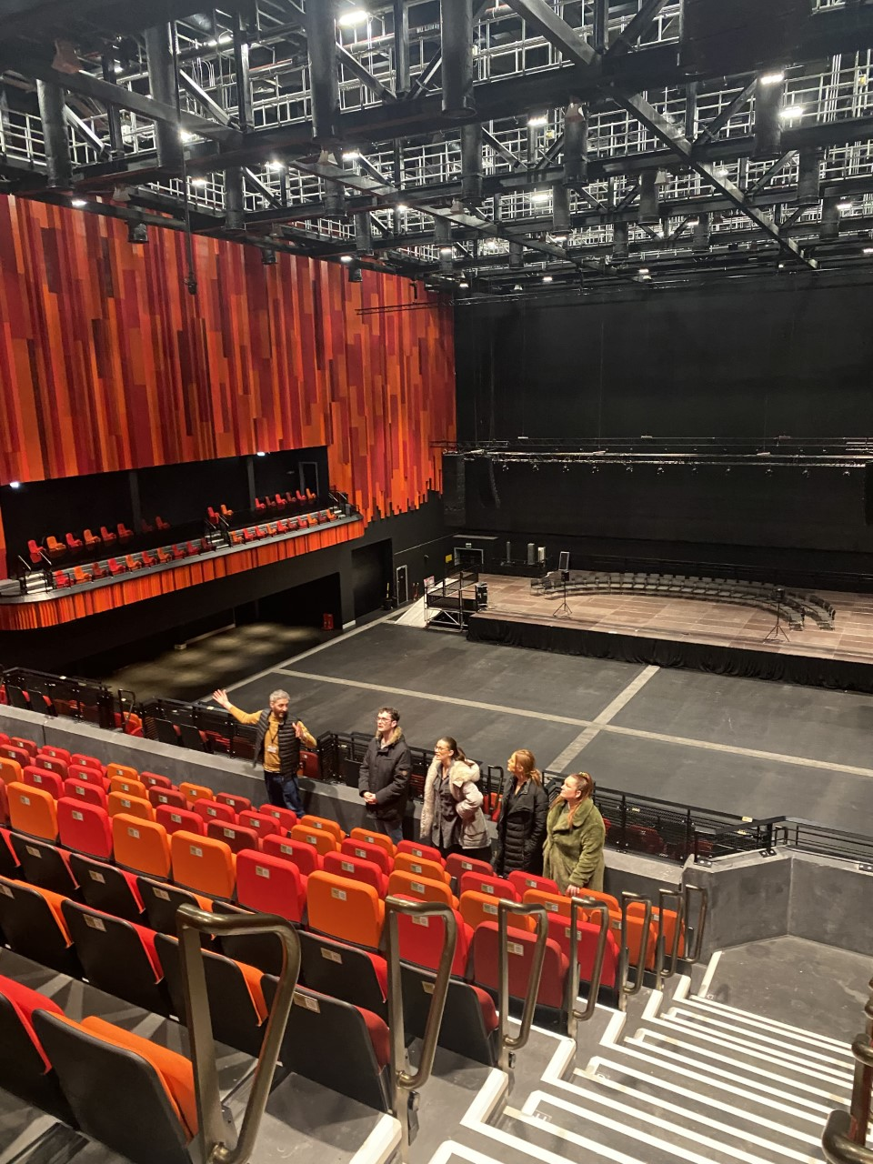
Benefits of Community Engagement
Learning Outcomes
Experience a positive impact on academic learning
Improved ability to apply learning in “the real world”
Problem analysis &solving
Critical thinking & cognitive development
Improved ability to understand complexity and ambiguity.
Personal Outcomes
Greater sense of personal efficacy, personal identity, spiritual growth, and moral development
Greater interpersonal development – Teamwork, Leadership and Communication Skills
Social Outcomes.
Reduce stereotypes
Increase inter-cultural understanding, improve social responsibility, citizenship skills & community service
Career Development.
Make connections with professionals and community for learning and career opportunities
Industry Partnerships
Improved Student Experience & Engagement

Slide 20
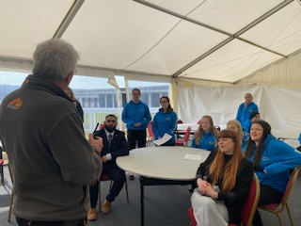
Problem Solving Learning
Challenging
Skills Based
Industry Based
Applied
Employability
Empowerment

Slide 21
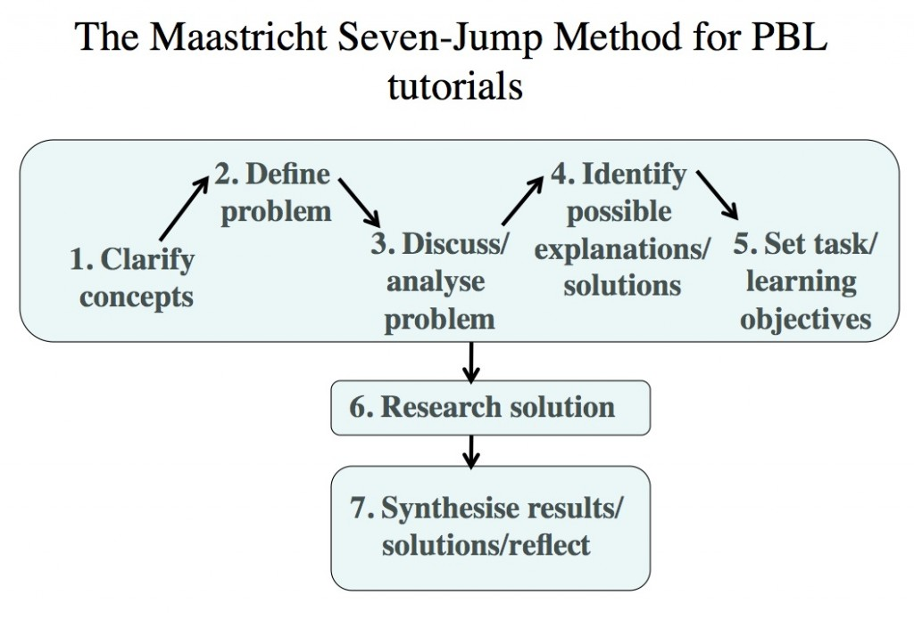
Problem Based Learning

Slide 22

Educational Experiences
Tied to educational objectives
Meaningful and engaging
Industry relevant
Match the learning styles & student needs (Honey & Mumford)
Connected to real-life / industry scenarios
Varied and dynamic – Events led
Culturally aware
Designed to allow students opportunities for development

Slide 23
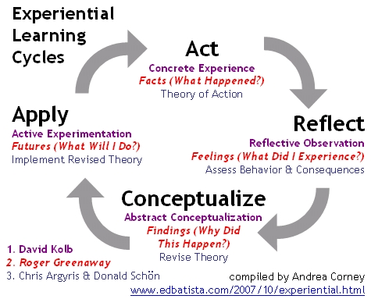
THE LEARNING CYCLE

Slide 24

EXPERIENTIAL = PRACTICAL EXPERTISE
Activity. Do something—anything! Turn every experience into a learning opportunity!
Reflect. Look back on your experience and assess the results. Review!
Conceptualize. Make sense of the experience. Understand why the results happened!
Apply. Test the results! Don't simply re-act, make a conscious plan to do things differently to be more effective.
Learn from it & re start the cycle!

Slide 25
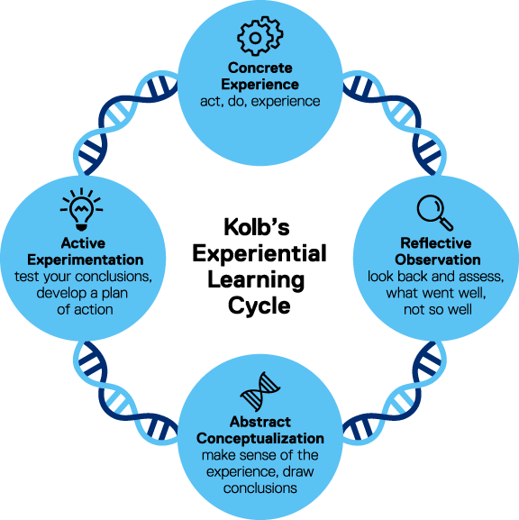
Recap – Kolb’s Learning Cycle 2014

