Slide 1
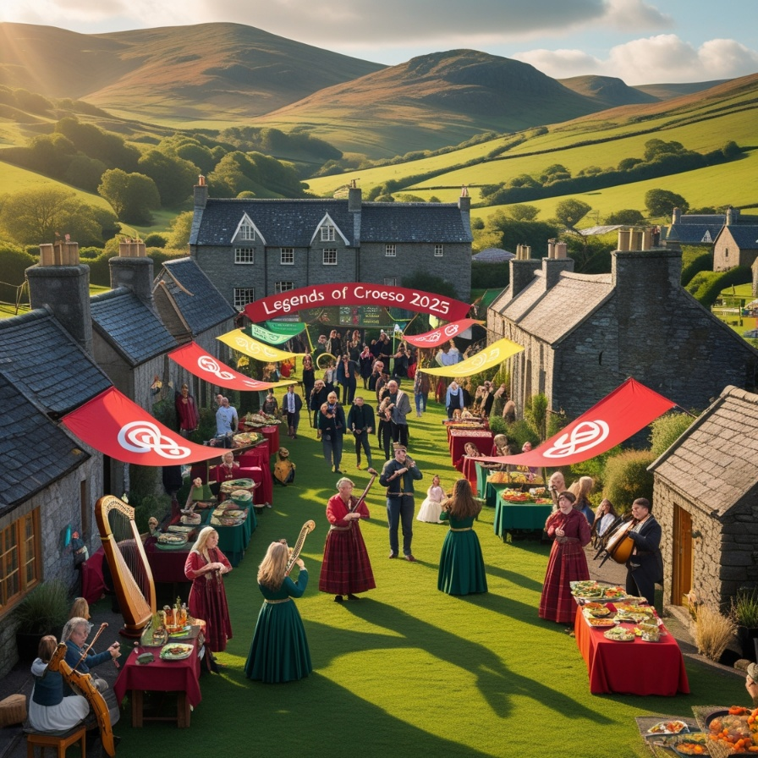
Legends of Croeso:
A Heritage Hospitality
Festival
Presented by: Mircea Nicolae Tilica
I can confirm that this presentation is made personally by me and I did not use any AI.

Slide 2
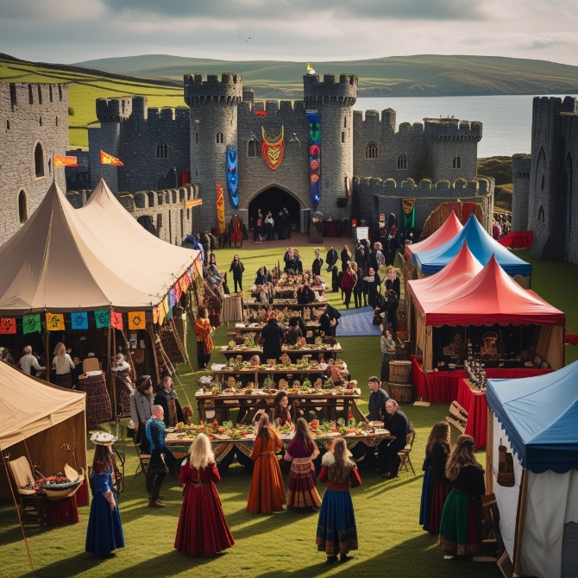
Introduction
Theme: Celebrating the Year of Croeso 2025
Date & Location: 3–5 July 2025 | Conwy Castle, North Wales
Purpose: Present a feasibility study for an original MICE event in hospitality
Focus: Promoting Wales’ cultural welcome (Croeso) to an international audience
Overview: Event content, market factors, operational setup, and financial viability
Goal: Showcase hidden Welsh hospitality history through immersive storytelling
Cultural Capital Theory:
By showcasing untold heritage and traditions, the event increases cultural value and knowledge sharing (Bihari, 2023;Tan, 2017;Guillory, 2023)

Slide 3

01
Event Overview
Event Name: Legends of Croeso
Theme: Local heroes & hidden stories in Welsh hospitality history
Type: Heritage storytelling festival (MICE: Meetings, Incentives, Conferences, Exhibitions)
Activities: Theatre, workshops, historical reenactments, cultural walks, food stalls
Target Audience: Travel trade, hospitality pros, media, researchers
Sense of Place Theory (Relph, 1997):
The festival reinforces emotional and cultural ties to a location, fostering deeper visitor identity with Conwy (Koenig-Lewis et al., 2022;Kamruzzaman et al., 2025)

Slide 4
Strategic Purpose
Heritage storytelling is a key driver of place branding and sustainable tourism (Richards, 2018)
The Legends of Croeso festival aims to merge heritage-based storytelling with cultural tourism, specifically highlighting Welsh hospitality.
Cultural narratives rooted in local heritage can significantly enhance the authenticity and depth of tourist experiences, fostering emotional and intellectual engagement with the destination (Richards, 2020)
This initiative aims to reinvent tourism in the region by unveiling local legends and untold stories, thereby cultivating community pride while fostering a deeper visitor experience (Semwal et al., 2024).
This event promote inclusive narratives and Welsh “Sense of Place” (Wales, 2016)

Slide 5

02
Market Analysis
Target Markets:
International hospitality delegates (UK, Europe, US, and East Asia)
Cultural & heritage tourists
Tour operators and media professionals
Academic and tourism researchers
Demand Drivers:
Experiential tourism trend (UNWTO, 2023)
Focus on female and hidden heritage (England, 2021)
2025 “Year of Croeso” support

Slide 6
Market Analysis
Competition:
Eisteddfod and regional arts festivals attract over 150,000+ attendees annually, showing strong cultural tourism demand (Wales, 2022)
These events primarily serve domestic markets, leaving a gap for internationally targeted MICE offerings (GOVERNMENT, 2021)
Differentiation:
MICE tourism in the UK is projected to grow by 5.3% annually post-COVID, driven by heritage-rich destinations
Combining theatre, training, and tourism creates a unique format, enhancing delegate engagement and learning outcomes
Events at UNESCO heritage sites like Conwy Castle can boost attendance by 25–30% due to global brand appeal (Hassan & Rahman, 2015)
Marketing Strategy:
VisitBritain campaigns influence over 33% of inbound tourist decisions, making it a key promotional partner (VisitBritain, 2022)
Influencer marketing increases event awareness by up to 60%, especially among millennial and Gen Z travellers (Kimilli, 2023)
MICE platforms like IMEX and Cvent are top channels for global event promotion and early-bird packaging

Slide 7
03
Operational Factor
Location
Chosen Location: Conwy Castle & Town Centre
Justification:
▪ UNESCO World Heritage Site
▪ Scenic & historic backdrop for storytelling
▪ Accessible by train from major cities
▪ Infrastructure for midsize events
Supports: Authenticity, culture, decentralised tourism ((WTTC), 2021)

Slide 8

Operational Factor
Resources & Staffing
Based on Getz’s Event Planning Model (Getz & Page, 2019) & Bowdin’s event logistics and HR principles (Bowdin et al., 2023)
Venue Usage:
Castle courtyard, inns, museums, town hall
Resources:
Tents, seating, portable lighting/sound
Catering vans, signage, decor
Staffing:
Guided by soft HRM theory, using local actors, historians, and volunteers (Ehrnrooth, 2002).
Stakeholder theory supports university partnerships for authenticity and educational value (Freudenreich et al., 2020).

Slide 9
04
Financial Factor
Category | Estimated Cost (£)
Venue Hire (Castle courtyard + Town Hall) | £5,500
Scaled AV/Lighting & Stage Setup | £4,000
Local Performers & Storytellers | £6,000
Food Pop-ups & Hospitality Tastings | £3,500
Digital Marketing & Local Promotion | £4,000
Staff Honoraria, Admin & Volunteers | £3,000
VIP Accommodations (select guests only) | £2,500
Insurance, Security & Event Permits | £2,500
Signage, Print Materials & Décor | £2,000
🔸Total Estimated Cost | £33,000

Slide 10
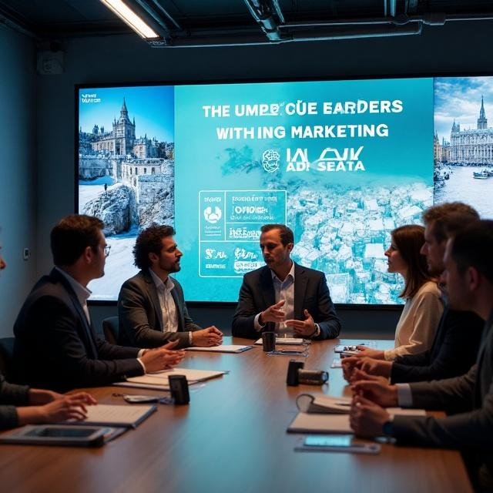
Financial Factor
Funding Source | Estimated Revenue (£)
Delegate Tickets (325 x £40) | £13,000
Visit Wales / Welsh Gov. Grant | £10,000
Cultural Sponsorship (Hospitality Brands) | £5,000
Local Vendor Stall Fees (10 x £300) | £3,000
Local Heritage Fund / Arts Wales Support | £5,000
🔸Total Projected Revenue | £36,000

Slide 11
Conclusion
Legends of Croeso is:
Feasible, cost-effective, and strategically aligned
A celebration of Welsh hospitality, culture, and identity
Original in format and powerful in impact
Positioned to elevate Wales on the international MICE stage

Slide 12
REFERENCES
Bihari, S. (2023). Cultural heritage and indigenous knowledge: Reviving traditions for future generations. In Sustainable Development Goals in SAARC Countries: Key Issues, Opportunities and Challenges, 1, 24–32.
Bowdin, G. A., Allen, J., Harris, R., Jago, L., O'Toole, W., & McDonnell, I. (2023). Events management. Routledge.
Ehrnrooth, M. (2002). Strategic Soft Human Resource Management—The Very Idea.
England, H. (2021). Championing heritage improving lives. https://historicengland.org.uk/images-books/publications/he-future-strategy-2021/he-future-strategy-2021/
Freudenreich, B., Lüdeke-Freund, F., & Schaltegger, S. (2020). A stakeholder theory perspective on business models: Value creation for sustainability. Journal of Business Ethics, 166(1), 3–18.
GOVERNMENT, W. (2021). Programme for Government – Update.
Graham, B., Ashworth, G. J., & Tunbridge, J. E. (2016). A Geography of Heritage: Power, Culture and Economy. Routledge.
Guillory, J. (2023). Cultural capital: The problem of literary canon formation. University of Chicago Press.
Hassan, A., & Rahman, M. (2015). World Heritage site as a label in branding a place. Journal of Cultural Heritage Management and Sustainable Development, 5(3), 210–223.
Kamruzzaman, L., Diemer, M. J., Currie, G., Pimenta, A., De Gruyter, C., & Hopkins, I. (2025). Making sense of place: A new framework for place-based research in the transport realm. Transport Reviews, 1–32.
Kimilli, G. (2023). The impact of Instagram travel influencers on Gen Z's tourism consumption.
Lazić, M., & Bradić-Martinović, A. (2022). Analysis of tourism demand in selected WB countries during the COVID-19 pandemic.

Slide 13
REFERENCES
Miao, L., Yang, F. X., Hu, J., Wang, K. Y., & Zhang, Q. (2024). Sense of place of tourism destinations in a metaverse paradigm. Tourism Management, 105, 104958.
Relph, E. (1997). Sense of place. In Ten geographic ideas that changed the world (pp. 205–226).
Richards, G. (2018). Cultural tourism: A review of recent research and trends. Journal of Hospitality and Tourism Management, 36, 12–21.
Richards, G. (2020). Designing creative places: The role of creative tourism. Annals of Tourism Research, 85, 102922.
Semwal, R., Tyagi, P., Tripathi, N., & Singh, A. (2024). Cultural crossroads: Communities guiding transformation in tourism. In Examining Tourist Behaviors and Community Involvement in Destination Rejuvenation (pp. 164–179). IGI Global.
Tan, C. Y. (2017). Conceptual diversity, moderators, and theoretical issues in quantitative studies of cultural capital theory. Educational Review, 69(5), 600–619.
UNWTO. (2023). World Tourism Barometer. https://www.unwto.org/
VisitBritain. (2022). Motivations, influences, decisions and sustainability research. https://www.visitbritain.org/
Wales, B. (2016). The Wales Identity—A Sense of Place. https://businesswales.gov.wales/tourism/sites/tourism/files/documents/Sense_of_Place_Guidance_v2_EN.pd
Wales, V. (2022). UK holidays, short breaks, and wonderful weekends in Wales. https://www.visitwales.com/inspire-me/feel-hwyl-only-wales
World Travel & Tourism Council (WTTC). (2021). Travel & Tourism Economic Impact Research (EIR). https://wttc.org/Portals/0/Documents/EIR/EIR2022-global-infographic-2pager-080622.pdf

