Slide 1
Contemporary Themes in the Hotel and Hospitality Sector (BMIH6001)
By Sandra Poupino
2018518
Lecture Giulia Chifari
“Importance and impact of renewable energy for the hotel industry”

Slide 2

(Vecteezy, 2023)
Conference of 13 November 2023

Slide 3
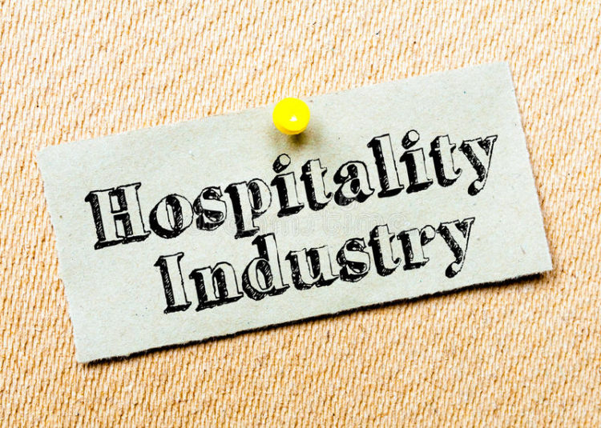
(Report, 2022)

Slide 4

(McPhee, 2023)

Slide 5
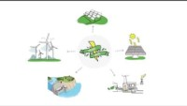
(www.youtube.com, 2023, Acciona)

Slide 6
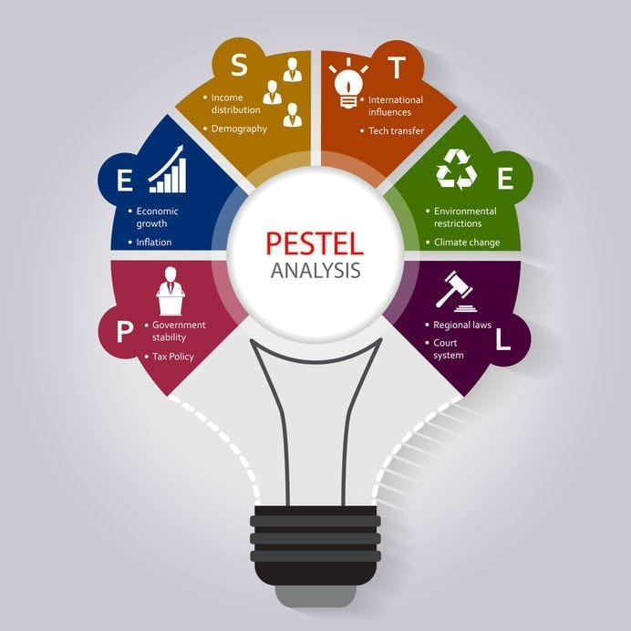
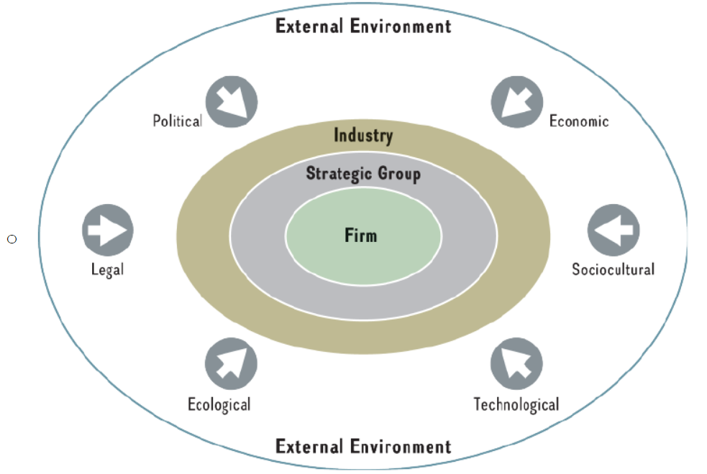
(Lewin, 2019)
(Studocu, 2022)

Slide 7


(MGX, 2021)
Advantages:
Clean energy
Return on investment.
Avoid power disruptions.
Reduction in costs
Add value to Brand.
Disadvantage:
High cost
Maintenance
(Morch, 2023)

Slide 8
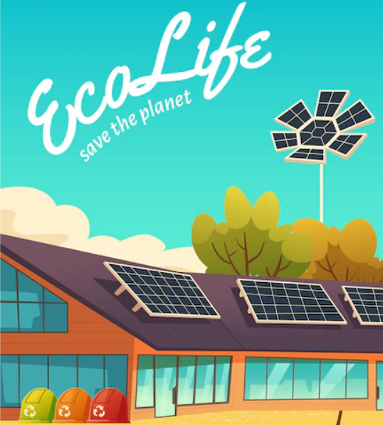
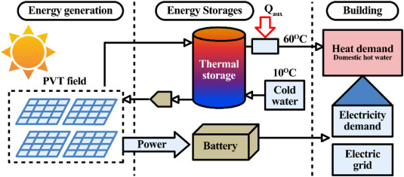
(Zhang et al., 2022)
(Freepik, 2023)

Slide 9

Solar panels investment and benefits
Price Large Hotel | 400 squares meters | 40KW | £30.000 | Installations £15.000
Savings Yearly bill | £25.000 | With solar panels £14.000 | Saves £11.000
(Fictional data for demonstration)
(Householdquotes.co.uk, 2023)

Slide 10


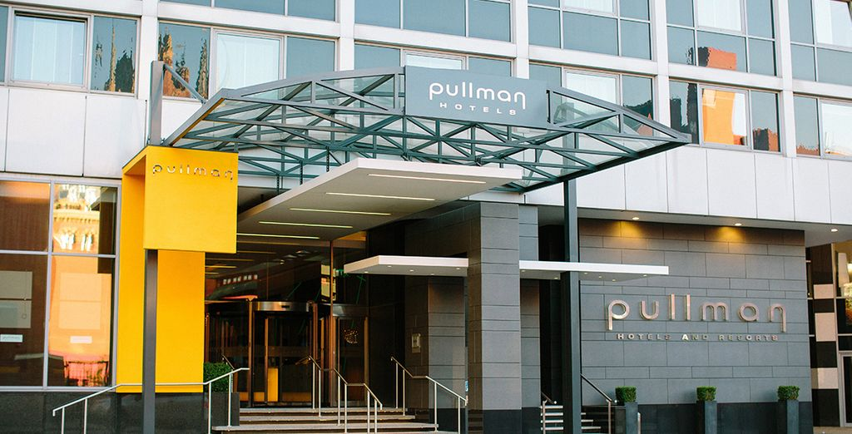
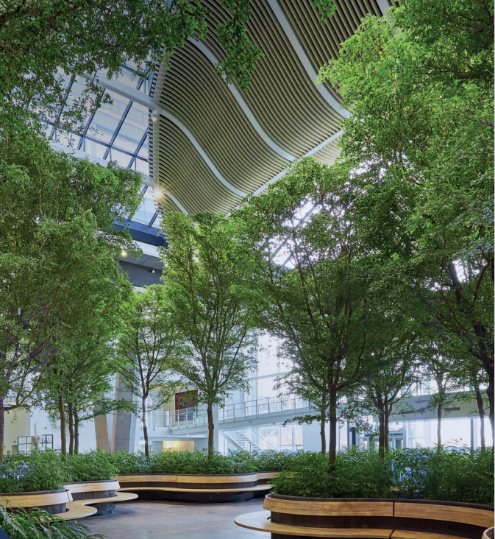
Hyatt Centric Cambridge, hotel leading in sustainable practices, with 80% of the roof space having solar panels, which generates a good portion of the power in the hotel. (Zentive Agency, 2022).
(cleanpng.com, 2023)
Crown Plaza Copenhagen Tower have solar panels in the façade of the hotel that help power the building, also using a state of art ground water-based heating system, help to be cool in the summer and warm in the winter. Intelligent automatic lighting, water and waste saving measures, and the restaurant serves organic local sourced food, and the atrium is full of air purifying plants. (InterContinental Hotels Group PLC, 2023).
The Pullman London St Pancras in the UK, where the hotel is taking step to avoid food and energy waste, by implementing a smart build management control systems to utilize air conditions, energy and heating according occupancy rate, and same areas use movement detectors for lighting, and beehives in the roof top, with their honey being incorporated into the dishes done in the kitchen. (Accor, 2023)
(Business Case for Sustainable Hotels March 2020, 2023)

Slide 11
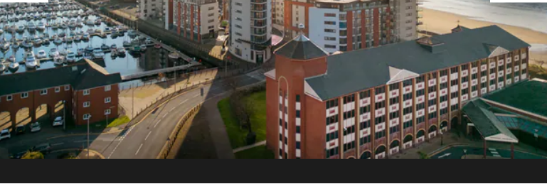
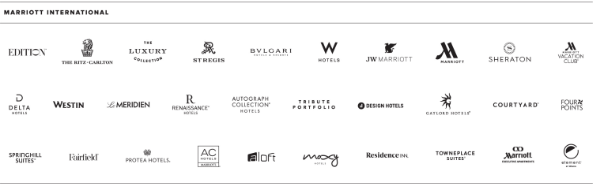
Hotel of Placement “ Delta by Marriott , Swansea “
Delta by Marriott , does not present good sustainability , although they exhibit a green key .
Marriott recent reports for sustainability , in relation to solar panels states , ANALYSING .
The problem with Marriott is that utilize a cost leadership management and is all about cutting costs , which may result in this problems , also the fact most hotels are franchises and owners may not have the money available for sustainable improvements.
(Marriott Bonvoy, 2023)
(Marriott International, 2018)

Slide 12

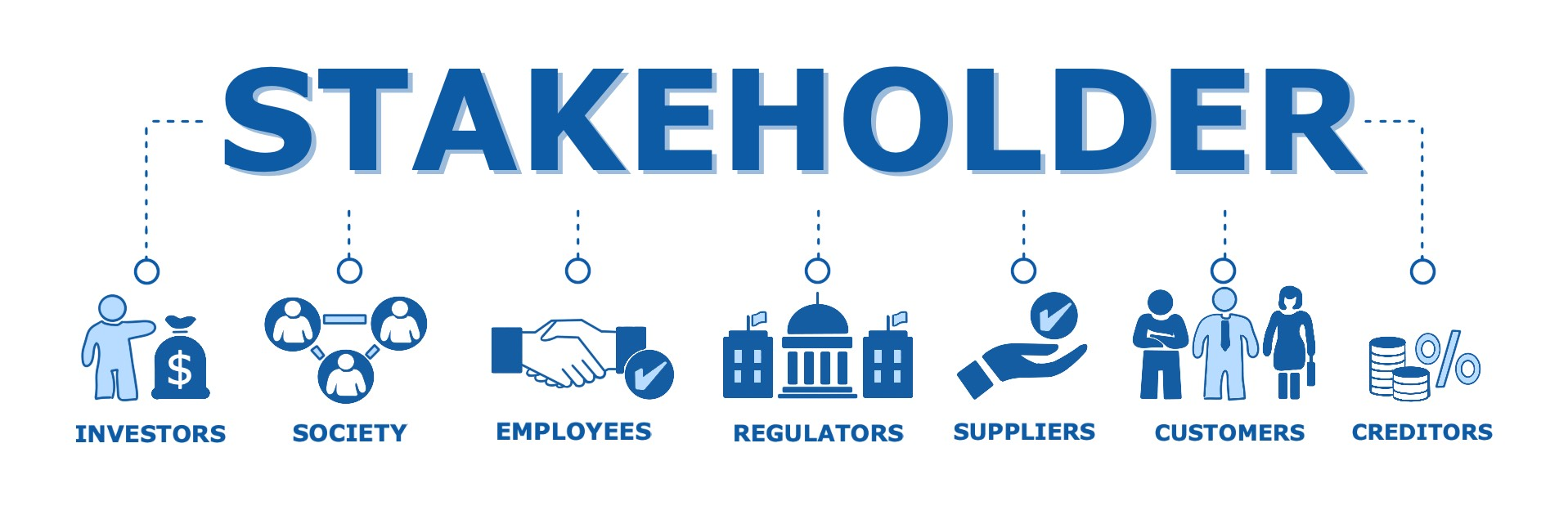

(WebRezPro, 2018)
Policies and management options
(Chiva, 2020)
(iStudy, 2023)
Policies are the way organisations do things , and how they want to achieve them .
Furthermore, organisations should utilize Stakeholder theory created in 1983 by Freeman , adding value for all stakeholders, not only shareholders.

Slide 13

1-It is crucial that hotels start using renewable energies to reduce costs on electricity bills and help the environment, such as solar panels .
2- Adopting a smart room system, the hotel can reduce their bill.
3- Be transparent.
4- Introduce incentives to achieve energy efficiency.
5- Tackle social acceptance from all stakeholders.
(says, 2019)

Slide 14


Slide 15
Anon, (2023). Thank You! – Energy Link International. [online] Available at: https://energylinkinternational.com/2021/01/01/thank-you/ [Accessed 4 Nov. 2023]
Business Case for Sustainable Hotels March 2020 In collaboration with. (2023). Available at: https://sustainablehospitalityalliance.org/wp-content/uploads/2020/05/Business-Case-for-Sustainable-Hotels.pdf. [ Accessed 1 Nov.2023].
Chiva, G. (2020). Stakeholder Management Is Not What You Think. [online] Aktia Solutions. Available at: https://aktiasolutions.com/stakeholder-management-is-not-what-you-think/. [ Accessed 1 Nov.2023]
cleanpng.com. (2023). Study Cartoon - Unlimited Download. cleanpng.com. [online] Available at: https://www.cleanpng.com/png-case-study-strategy-content-marketing-stock-photog-2277940/ [Accessed 4 Nov. 2023].
Freepik. (2023). Solar Panel Cartoon Images - Free Download on Freepik. [online] Available at: https://www.freepik.com/free-photos-vectors/solar-panel-cartoon [Accessed 4 Nov. 2023].
Householdquotes.co.uk. (2023). How Much Do Solar Panels In The UK Cost? (2023 Prices). [Online] Available at: https://householdquotes.co.uk/solar-panel-cost [Accessed 5 Nov. 2023].
iStudy (2023). Organisational Skills Training Course. [online] iStudy. Available at: https://www.istudy.org.uk/course/organisational-skills-training-course/. [ Accessed 2 Nov. 2023].
Lewin, J. (2019). Put Your PESTEL to the Mettle. [online] Cayenne Consulting. Available at: https://www.caycon.com/blog/put-your-pestel-to-the-mettle. [ Accessed 2 Nov. 2023].
McPhee, E. (2023). Is Now the Time for Your Home to Switch to Renewable Energy | Nanny McPhee. [online] Available at: https://www.nannymcphee.co.uk/is-now-the-time-for-your-home-to-switch-to-renewable-energy/. [ Accessed 1 Nov.2023]
MGX. (2021). The Advantages and Disadvantages of Printing on Plastics. [online] Available at: https://mgxdigital.com/advantages-and-disadvantages-of-printing-plastics/. [ Accessed 2 Nov.2023].
Morch, A. (2023). Greening the Hospitality Industry: Implementing Renewable Energy in Hotels. [online] Are Morch, Digital Transformation Coach. Available at: https://aremorch.com/greening-the-hospitality-industry-implementing-renewable-energy-in-hotels/. [ Accessed 1 Nov. 2023].
Marriott International. (2018). Annual | Marriott International. [online] Available at: https://marriott.gcs-web.com/annual. [ Accessed 5 Nov.2023]

Slide 16
Marriott Bonvoy. (2023). Hotels & Resorts | Book your hotel directly with Marriott Bonvoy. [online] Available at: https://www.marriott.com/en-gb/search/findHotels.mi?scid=d4f78882-f08b-46c8-9501-1867a73ae416&gclid=2f84cf7a41091586a81daa32b41cb0db&gclsrc=3p.ds&cid=PAI_GLB00050J9_GLE000BM2F_GLF000OOX3 [Accessed 6 Nov. 2023].
Report, A. (2022). Expert Advocates Cost Efficiency for Hospitality Entrepreneurs. [online] Available at: https://leadership.ng/expert-advocates-cost-efficiency-for-hospitality-entrepreneurs/ [Accessed 3 Nov. 2023].
says, P.R. (2019). Recommendations of the High-Level Committee on CSR. [online] Centre for Advancement of Philanthropy. Available at: https://capindia.in/recommendations-of-the-high-level-committee-on-csr [Accessed 4 Nov. 2023].
Studocu. (2022). CH 3 - Chapter Three "External Analysis: Industry Structure, Competitive Forces, and. [online] Available at: https://www.studocu.com/en-us/document/sacred-heart-university/strategic-management/ch-3-chapter-three-external-analysis-industry-structure-competitive-forces-and/34940491 [Accessed 3 Nov. 2023].
Vecteezy. (2023). Download Free Vectors, Clipart Graphics, Vector Art & Design Templates. [online] Available at: https://www.vecteezy.com/free-vector/welcome [Accessed 3 Nov. 2023].
VPG (2023). Pullman London St Pancras Hotel & West End Shows 4* Take a look at this great holiday offer on Voyage Privé! [online] www.voyage-prive.co.uk. Available at: https://www.voyage-prive.co.uk/ppl/holidays-united-kingdom-london-pullman-london-st-pancras-hotel-west-end-shows/51194/avis [Accessed 4 Nov. 2023].
WebRezPro. (2018). Social Responsibility in the Hospitality Industry: What You Can Do and Why You Should. [online] Available at: https://webrezpro.com/social-responsibility-in-the-hospitality-industry-what-you-can-do-and-why-you-should/. [ Accessed 2 Nov.2023].
www.youtube.com. (2023). What are renewable energies? | Sustainability. [online] Available at: https://www.youtube.com/watch?v=Bkow2fDy5KY&t=78s [Accessed 3 Nov. 2023].
Zhang, S., Ocłoń, P., Klemeš, J.J., Michorczyk, P., Pielichowska, K. and Pielichowski, K. (2022). Renewable energy systems for building heating, cooling, and electricity production with thermal energy storage. Renewable and Sustainable Energy Reviews, [online] 165, p.112560. doi: https://doi.org/10.1016/j.rser.2022.112560. [ Accessed 2 Nov.2023].

Slide 17
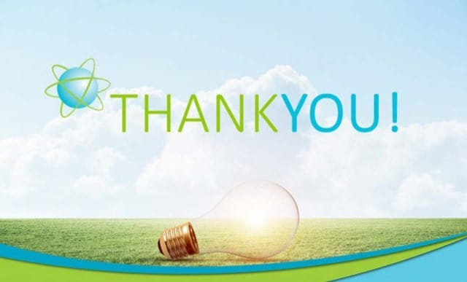
(Anon, 2023)

