Slide 1
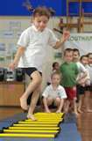
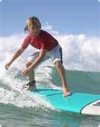
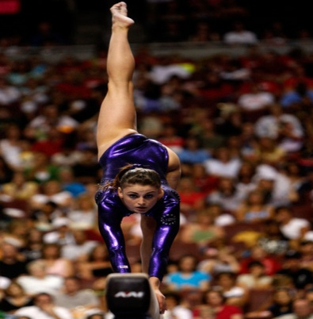
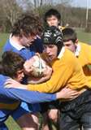

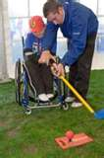
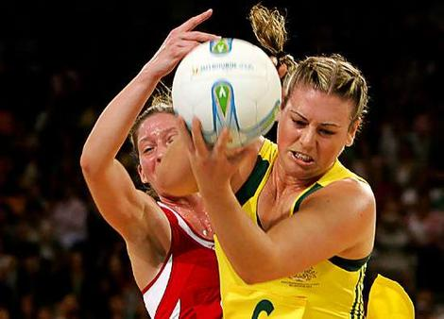
Acquisition of Skill
Steven Osborne

Slide 2
Aims:
Recap skill classification
To introduce learning theories

Slide 3
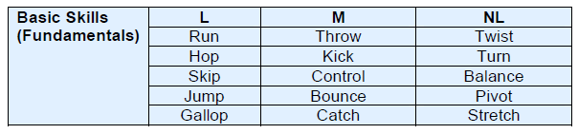
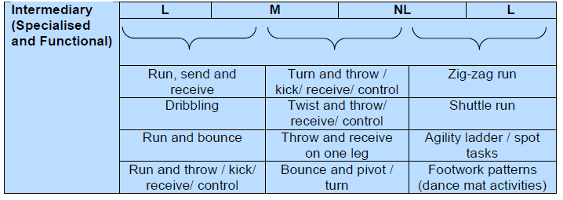
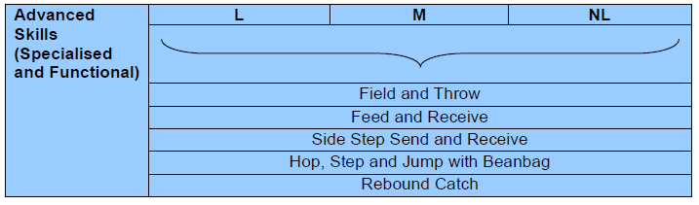

Slide 4
Locomotor
Non Locomotor
Maniplative

Slide 6
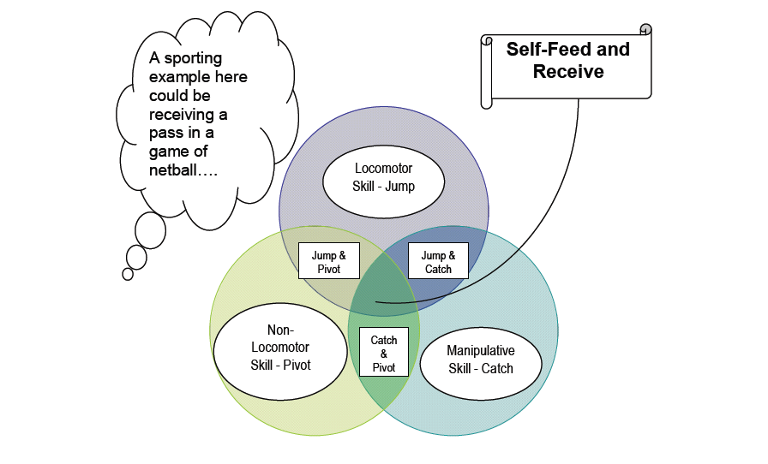

Slide 7
Classification of motor skills.
Muscular involvement GROSS – FINE
Environmental influence OPEN – CLOSED
Continuity DESCRETE – SERIAL – CONTINUOUS
Pacing EXTERNALLY PACED – SELF PACED
Difficulty SIMPLE – COMPLEX
Organisation LOW - HIGH

Slide 8
One-Dimensional Classifications
DISTINCTIVENESS OF MOVEMENT
Discrete Serial Continuous

Slide 9
Discrete, Continuous and Serial skills:
This classification shows how clearly defined are the start and completion of the movement.
Discrete
A discrete skill has a definite beginning and a end. They are usually performed in one single exertion and would include such skills as a tennis serve, a shot in netball or a tackle in rugby.
Discrete skills are important to sports performances; hitting, kicking, throwing and catching skills make up many of the countries most popular sporting activities.
Continuous
A continuous skill which has no real clear beginning or end and is a constant ongoing action. An example of this is running or swimming.
The end of one action is the start of another, Therefore continuous skills tend to be regular and rhythmical in nature. One important continuous skill is tracking, in which the performer’s limb movements control a lever, a wheel, a handle or some other device to the movements of a target or track.
Serial
serial skills, which are often thought as a group of discrete skills strung together to make up a new, more complicated skilled action.
Serial skills differ from discrete skills in that the movement duration are somewhat longer, yet each movement retains a discrete beginning and end. Serial skills would include a gymnastics floor routine, an ice dance display and the triple jump.

Slide 10
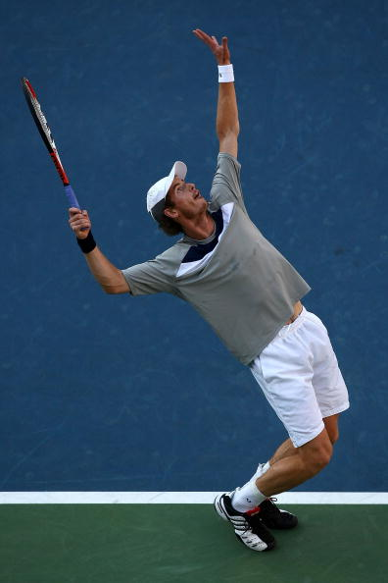

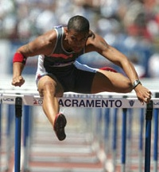
DISTINCTIVENESS OF MOVEMENT
Discrete Serial Continuous

Slide 11
One-Dimensional Classifications
Pace of Movement
Externally Paced Self Paced

Slide 12
The Pacing Continuum
The pacing continuum is concerned with the extent to which the performer has control over the timing of the action.
Actions are said to be 'self - paced' or 'externally'. According to the extent to which the performer can decide when to start the action.
Self paced skills
When the performer has control over the timing of the skill.
A badminton player determines the timing of the action of the serve.
High jumper has complete control over when they start to perform the skill.
Externally paced
Skills are when the performer is reliant on the actions of other players and situation to time the skill.
A tennis player facing the server is dependant upon external factors such as when the other player is going to serve the ball, the speed of the ball and the effect of the serve on the ball.

Slide 13
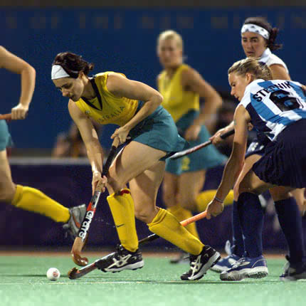
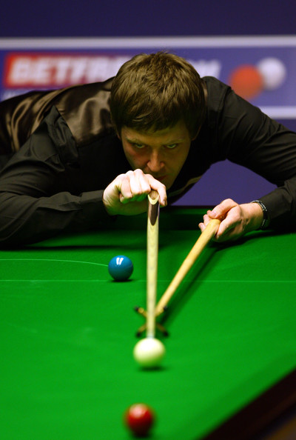
Pace of Movement
Externally Paced Self Paced

Slide 14
One-Dimensional Classifications
SIZE OF MUSCULATURE INVOLVED
Gross motor Fine motor

Slide 15
Gross and fine skills:
This continuum is based on how much movement or body involvement is involved.
Fine Skills
Involve small movement of specific body parts.
For example; rifle shooting.
Gross skill.
These skills involve large muscle groups and movements of the whole body.
An example of this would be; Long jump. Where you have to run up jump and land.
Mix
Require a bit of both fine and gross skills,
For example a basketball or netball free shot.

Slide 16
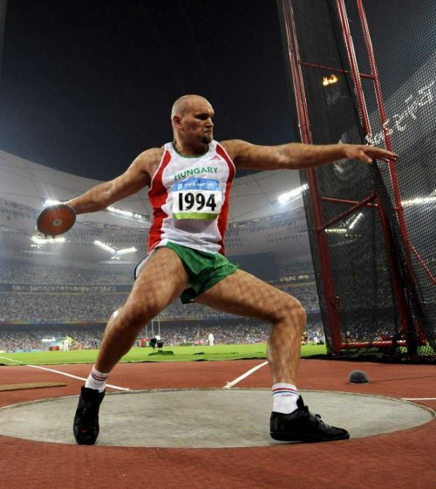
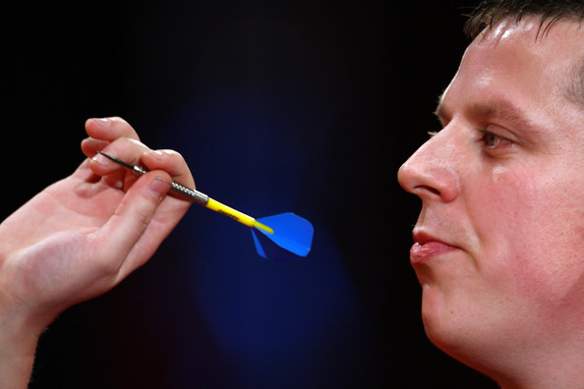
SIZE OF MUSCULATURE INVOLVED
Gross motor Fine motor

Slide 17
One-Dimensional Classifications
STABILITY OF ENVIRONMENT
Closed Open

Slide 18
Open and Closed skill
An open and closed continuum is based on the predictability of a skill action and can be affected by things such as the weather, surface type and playing against opposition teams where it is difficult to predict the move of that team.
A closed skill is one where the environment is stable, and an open skill is one where the environment is unpredictable.
This classification outlines a specifically important feature for skills, it defines the performers need to respond to moment to moment variations in the environment.
This introduces the process associated with perception, pattern, recognition and decision-making, these processes need to be performed quickly so that the skill action can be adapted for the environment.

Slide 19
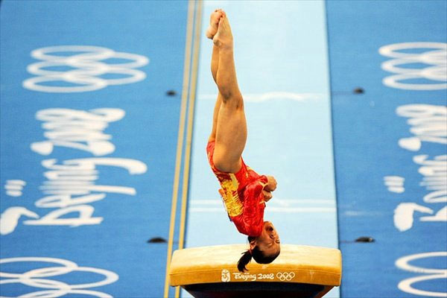
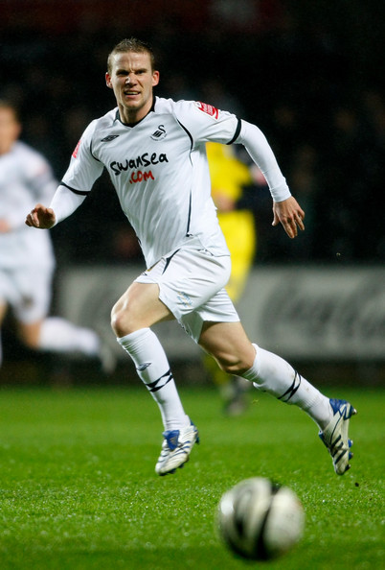
STABILITY OF ENVIRONMENT
Closed Open

Slide 20
Open skills:
Environment is constantly changing
Skill needs constant modification
Needs practice in a range of conditions
E.g dribbling in basketball, tackling in football, passing in netball.
Closed skills:
Environment is stable
Skill is predictable
A movement pattern can be established
E.g qymnastics, routine throwing darts, weightlifting.

Slide 21
MOTOR SKILL CONTINUUM
Locomotor
Non Locomotor
Manipulative
GROSS---------------------------------------------------------FINE
OPEN----------------------------------------------------------CLOSE
DISCRETE--------------------SERIAL-----------------------CONTINUOUS
SELF-PACED--------------------------------------------------EXTERNALLY PACED

Slide 22

Assess a skill

Slide 23
MOTOR SKILL CONTINUUM
Locomotor
Non Locomotor
Manipulative
GROSS---------------------------------------------------------FINE
OPEN----------------------------------------------------------CLOSE
DISCRETE--------------------SERIAL-----------------------CONTINUOUS
SELF-PACED--------------------------------------------------EXTERNALLY PACED

Slide 24
Perceptual Motor Abilities
Multilimb coordination
Control precision – ability to make movement adjustments
Response orientation
Reaction time
Speed of arm movement
Rate control – ability to time continuous anticipatory movement
Manual dexterity – ability to make skillful arm-hand movements
Finger dexterity
Arm-hand steadiness
Aiming
Physical Proficiency Abilities
Static strength
Dynamic strength
Explosive strength
Trunk strength
Dynamic flexibility
Gross body coordination
Gross body equilibrium
Stamina

Slide 25
MOTOR SKILL CONTINUUM
Locomotor
Non Locomotor
Manipulative
GROSS---------------------------------------------------------FINE
OPEN----------------------------------------------------------CLOSE
DISCRETE--------------------SERIAL-----------------------CONTINUOUS
SELF-PACED--------------------------------------------------EXTERNALLY PACED

Slide 26
Two-Dimensional Classification
Stationary Motion
No variability Variability
Regulatory conditions
CONTEXT

Slide 27
Batting Tee
Same height
Pitch Machine
Same speed/place
Batting Tee
Various heights
Live Pitch
Stationary
No variability
Stationary
Variability
In Motion
No Variability
In Motion
Variability

Slide 28
Two-Dimensional Classification
FUNCTION
Body Stability Object
Body Transport No Object

Slide 29
Two-Dimensional Classification
Stationary Motion
No variability Variability
Body Stability Object
Body Transport No Object
CONTEXT
FUNCTION

Slide 30
Theories
What is a theory?
  Orderly set of ideas which describe, explain, and predict behavior.
Why are theories important?
  To give meaning to what we observe.
  As a basis for action -- finding ways to improve the lives and education of children.

Slide 31
What is learning ?

Slide 32
Definition of Learning:
Learning is a change in the capability of a person to perform a skill that must be inferred from a relatively permanent improvement in performance as a result of practice or experience (Magill, 2001).
Definition of Motor Learning:
Motor learning is a set of internal processes that leads to a relatively permanent change in the learner’s capacity for skilled performance (Magill, 2001; Schmidt, 1991; Rose, 1997).
The theory of motor learning and the principles that govern motor learning, are increasingly being considered as important in teaching motor skills.

Slide 33
Theories of Learning
Associative approaches
Cognitive approaches

Slide 34
Behavioral and Social Learning Theories
Beliefs that describe the importance of the environment and nurturing in the growth of a child.
Behaviorism became the dominant view from the 1920's to 1960's

Slide 35
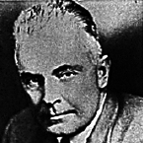
John Watson
Early 20th century, "Father of American Behaviorist theory.”
Based his work on Pavlov's experiments on the digestive system of dogs.
Researched classical conditioning
Children are passive beings who can be molded by controlling the stimulus-response associations.

Slide 36
B. F. Skinner
Proposed that children "operate" on their environment, operational conditioning.
Believed that learning could be broken down into smaller tasks, and that offering immediate rewards for accomplishments would stimulate further learning.

Slide 37
Social Learning Theory
Albert Bandura
Stressed how children learn by observation and imitation.
Believed that children gradually become more selective in what they imitate.

Slide 38
Biological Theories
Belief that heredity and innate biological processes govern growth.
Maturationists: G. Stanley Hall and Arnold Gesell
Believed there is a predetermined biological timetable.
Hall and Gesell were proponents of the normative approach to child study: using age-related averages of children's growth and behaviors to define what is normal.

Slide 39
Ethology
Examines how behavior is determined by a species' need for survival.
Has its roots in Charles Darwin's research.
Describes a "critical period" or "sensitive period,” for learning

Slide 40
Attachment Theory
John Bowlby applied ethological principles to his theory of attachment.
Attachment between an infant and her caregiver can insure the infant’s survival.

Slide 41
Cognitive Theories
Beliefs that describe how children learn

Slide 42
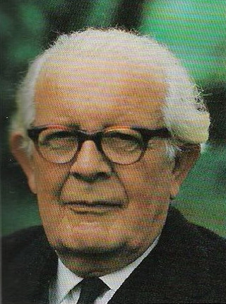
Jean Piaget
Cognitive development theory
Children "construct" their understanding of the world through their active involvement and interactions.
Studied his 3 children to focus not on what they knew but how they knew it.
Described children's understanding as their "schemas” and how they use:
  assimilation
  accommodation.

Slide 43
Piaget’s Cognitive
Development Stages
Sensori-motor
  Ages birth - 2: the infant uses his senses and motor abilities to understand the world
Preoperation
  Ages 2-7: the child uses metal representations of objects and is able to use symbolic thought and language
Concrete operations
  Ages 7-11; the child uses logical operations or principles when solving problems
Formal operations
  Ages 12 up; the use of logical operations in a systematic fashion and with the ability to use abstractions

Slide 44

Lev Vygotsky
Socio-Cultural Theory
Agreed that children are active learners, but their knowledge is socially constructed.
Cultural values and customs dictate what is important to learn.
Children learn from more expert members of the society.
Vygotsky described the "zone of proximal development", where learning occurs.

Slide 45
Information Processing Theory
Uses the model of the computer to describe how the brain works.
Focuses on how information is perceived, how information is stored in memory, how memories are retrieved and then used to solve problems.

Slide 46
Systems Theory
The belief that development can't be explained by a single concept, but rather by a complex system.

Slide 47
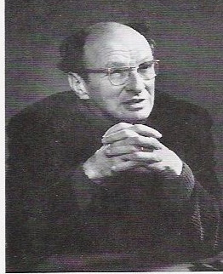
Urie Bronfenbrenner
Ecological Systems Theory
The varied systems of the environment and the interrelationships among the systems shape a child's development.
Both the environment and biology influence the child's development.
The environment affects the child and the child influences the environment.

Slide 48
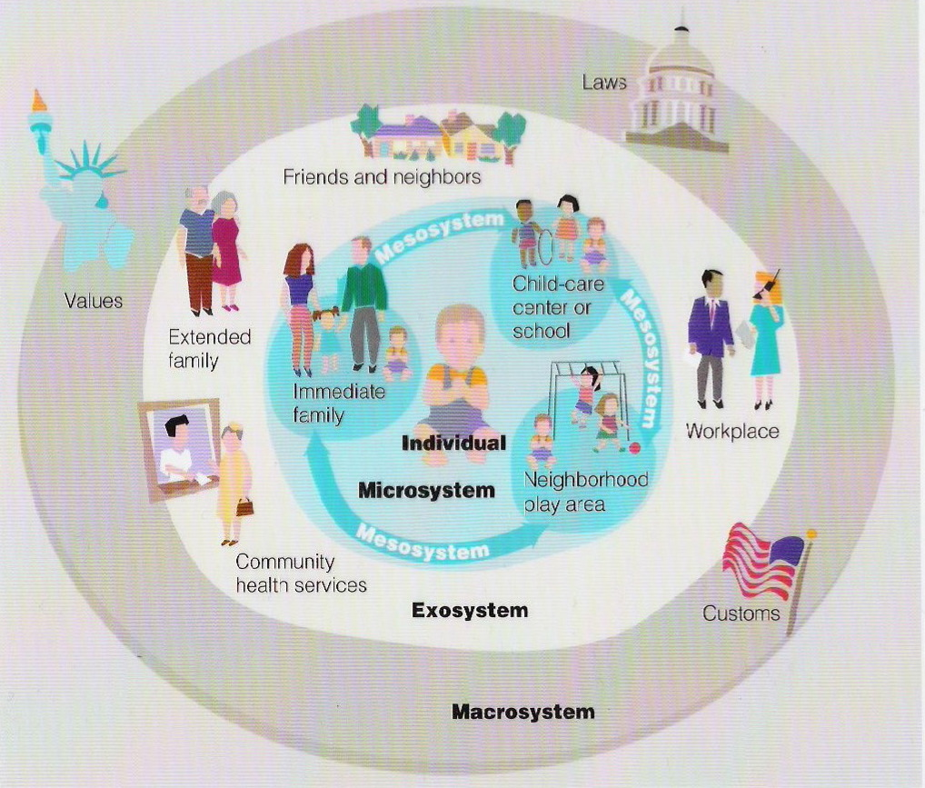
Bronfenbrenner’s Ecological Model
The microsystem - activities and interactions in the child's immediate surroundings: parents, school, friends, etc.
The mesosystem - relationships among the entities involved in the child's microsystem: parents' interactions with teachers, a school's interactions with the daycare provider
The exosystem - social institutions which affect children indirectly: the parents' work settings and policies, extended family networks, mass media, community resources
The macrosystem - broader cultural values, laws and governmental resources
The chronosystem - changes which occur during a child's life, both personally, like the birth of a sibling and culturally, like the Iraqi war.

Slide 49
Perceptual Motor Abilities
Multilimb coordination
Control precision – ability to make movement adjustments
Response orientation
Reaction time
Speed of arm movement
Rate control – ability to time continuous anticipatory movement
Manual dexterity – ability to make skillful arm-hand movements
Finger dexterity
Arm-hand steadiness
Aiming
Physical Proficiency Abilities
Static strength
Dynamic strength
Explosive strength
Trunk strength
Dynamic flexibility
Gross body coordination
Gross body equilibrium
Stamina

Slide 50
TYPES OF SKILL
Cognitive skills – Skill which involves thought process. E.g.?
Perceptual skills – Skill which involves interpreting information from the environment. E.g.?
MOTOR SKILLS – Skill which involves physical movement and muscular control

Slide 51
Event
Difficulty
Sport Specific
CPK’S
Catching Passing Kicking Striking
KGB’S
Kinaesthetic, Gliding, Buoyancy, Striking (Body)
RJT
Running Jumping Throwing
BCA’S
Balance, Co-ordintation, Agility, Speed

Slide 52
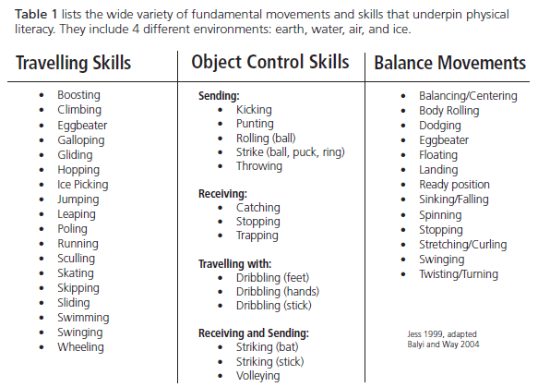
http://www.sasksport.sk.ca/CS4L/pdf/LTAD_ResourcePaper.pdf
Screen clipping taken: 18/02/2010, 16:14

Slide 57
Locomotor
Non Locomotor
Maniplative

Slide 60
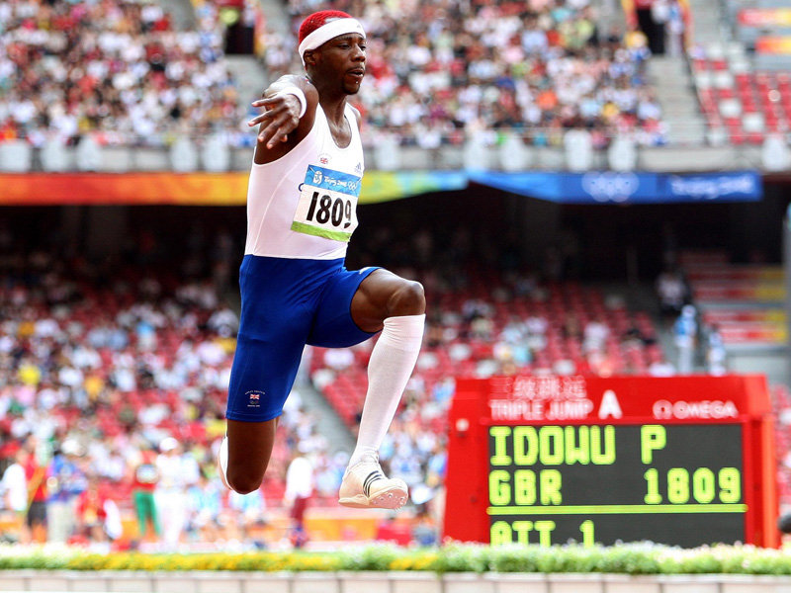

Slide 61
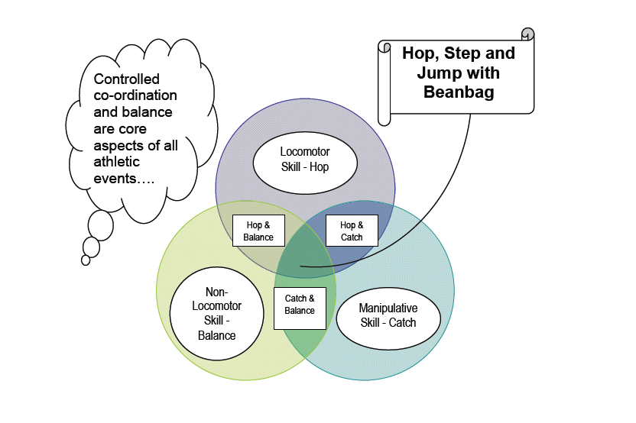

Slide 62
Assess a skill

Slide 63
Locomotor
Non Locomotor
Maniplative

Slide 64
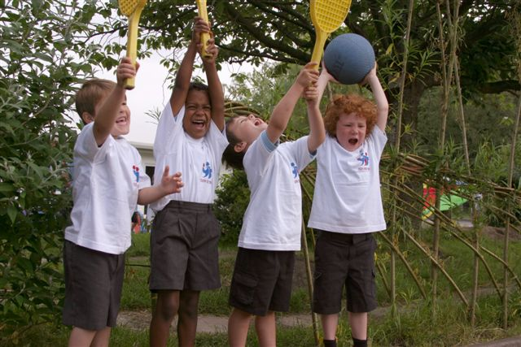

Slide 65
“Children who possess inadequate motor skills are often relegated to a life of exclusion from the organised and free play experiences of their peers, and subsequently, to a lifetime of inactivity because of their frustrations in early movement behaviour”
(Seefeldt, Haubenstricker & Reuchlien 1979, cited in Graham, Holt, Hale & Parker 2001)

Slide 66
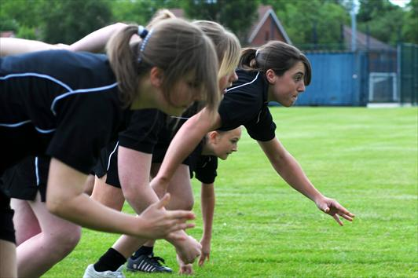

Slide 67
The establishment of a fundamental movement competence cannot be overemphasised as it allows children to pass through a ‘proficiency barrier’ when attempting to develop the simple activities of early childhood to the more complex activities of later years
Jess (2004)

Slide 68
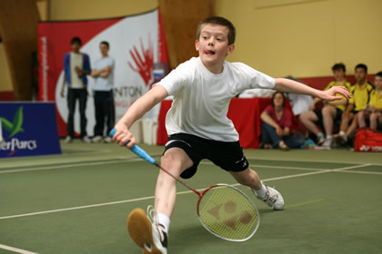

Slide 69
Child Development
Definition:
  Change in the child that occurs over time. Changes follow an orderly pattern that moves toward greater complexity and enhances survival.
Periods of development:
  Prenatal period: from conception to birth
  Infancy and toddlerhood: birth to 2 years
  Early childhood: 2-6 years old
  Middle childhood: 6-12 years old
  Adolescence: 12-19 years old

Slide 70
6th - 15th centuries Medieval period
Preformationism: children seen as little adults.
Childhood is not a unique phase.
Children were cared for until they could begin caring for themselves, around 7 years old.
Children treated as adults (e.g. their clothing, worked at adult jobs, could be married, were made into kings, were imprisoned or hanged as adults.)

Slide 71
16th Century Reformation period
Puritan religion influenced how children were viewed.
Children were born evil, and must be civilized.
A goal emerged to raise children effectively.
Special books were designed for children.

Slide 72

17th Century
Age of Enlightenment
John Locke believed in tabula rasa
Children develop in response to nurturing.
Forerunner of behaviorism
www.cooperativeindividualism.org/ locke-john.jpg

Slide 73
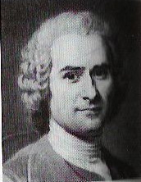
18th Century Age of Reason
Jean-Jacques Rousseau
  children were noble savages, born with an innate sense of morality; the timing of growth should not be interfered with.
Rousseau used the idea of stages of development.
Forerunner of maturationist beliefs

Slide 74
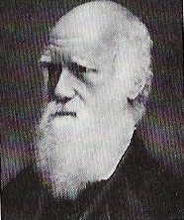
19th Century Industrial Revolution
Charles Darwin
  theories of natural selection and survival of the fittest
Darwin made parallels between human prenatal growth and other animals.
Forerunner of ethology

Slide 75
20th Century
Theories about children's development expanded around the world.
Childhood was seen as worthy of special attention.
Laws were passed to protect children,

Slide 76
How do children develop?

Slide 77
Domains of Development
Development is described in three domains, but growth
in one domain influences the other domains.
Physical Domain:
  body size, body proportions, appearance, brain development, motor development, perception capacities, physical health.
Cognitive Domain:
  thought processes and intellectual abilities including attention, memory, problem solving, imagination, creativity, academic and everyday knowledge, metacognition, and language.
Social/Emotional Domain:
  self-knowledge (self-esteem, metacognition, sexual identity, ethnic identity), moral reasoning, understanding and expression of emotions, self-regulation, temperament, understanding others, interpersonal skills, and friendships.

Slide 78
Physical
Cognitive
Social /Emotional

Slide 79
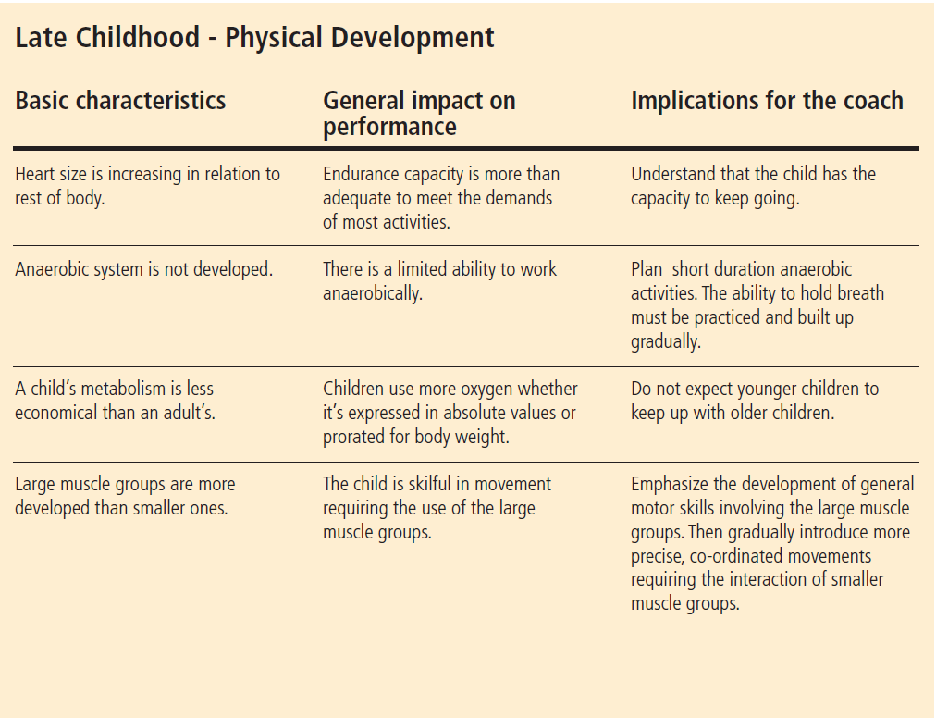

Slide 80
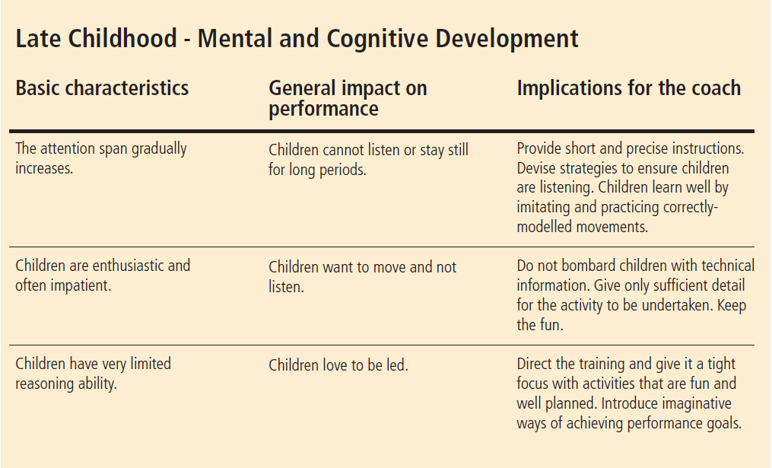

Slide 81
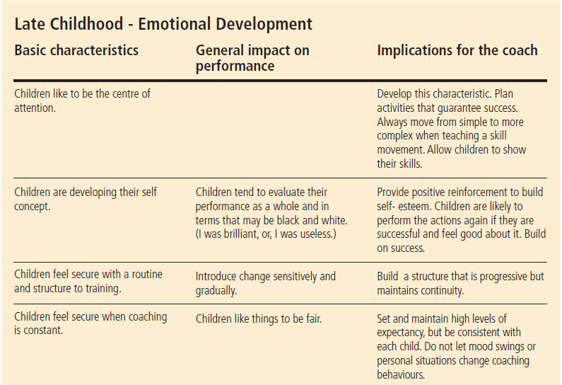

Slide 82
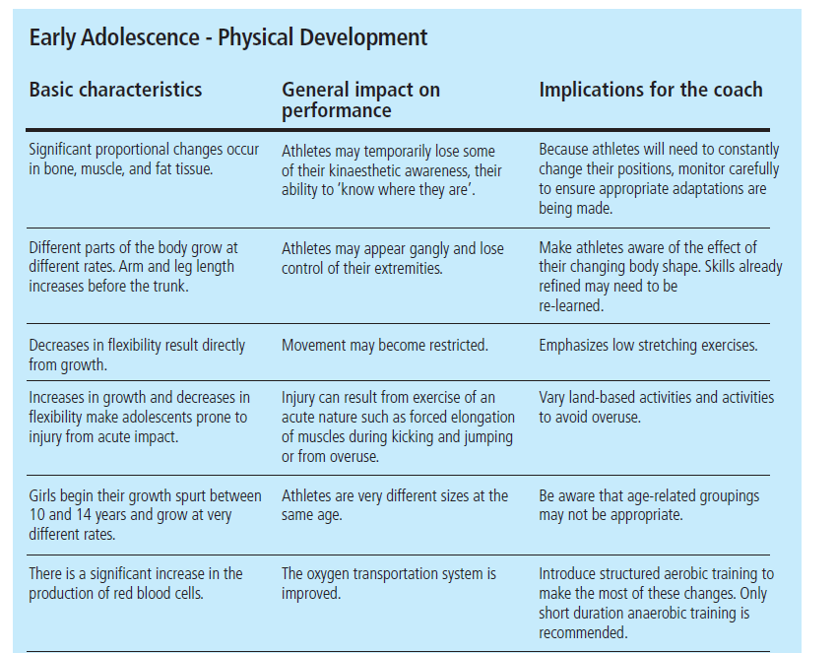

Slide 83
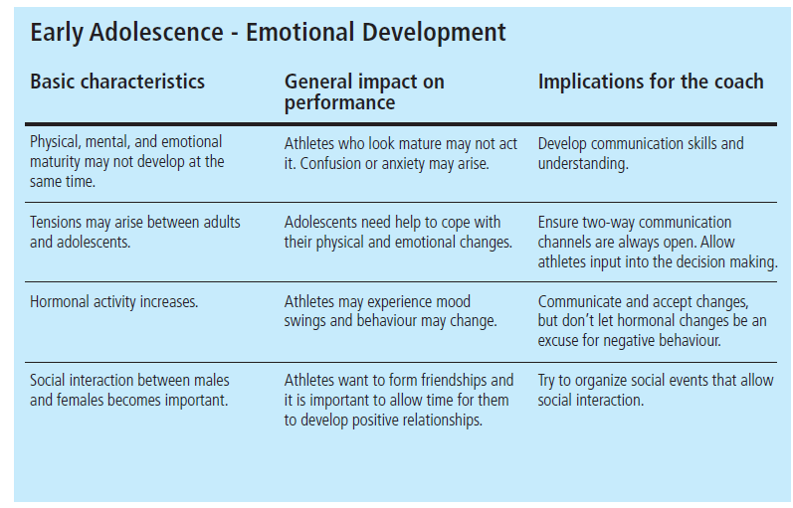

Slide 84
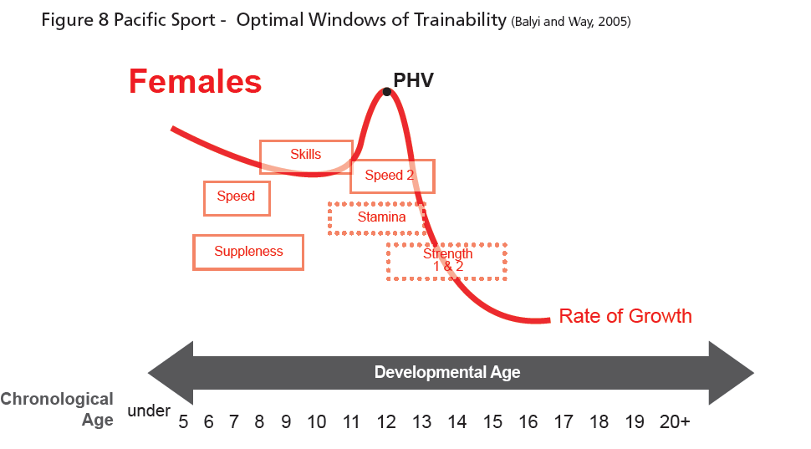

Slide 85
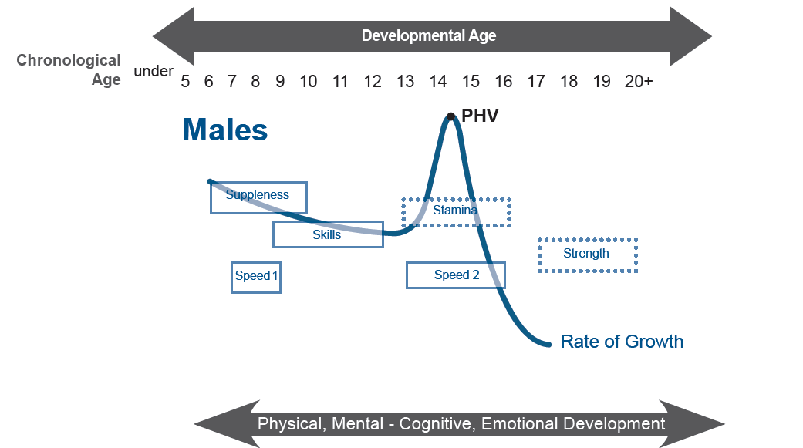

Slide 86
David Morley and Professor Richard Bailey.
Abilities
Physical
Social
Personal
Cognitive

Slide 87
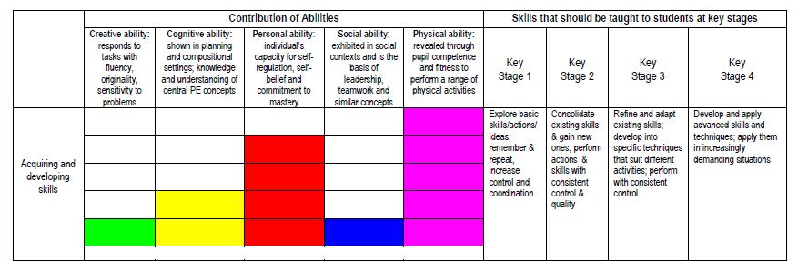

Slide 88
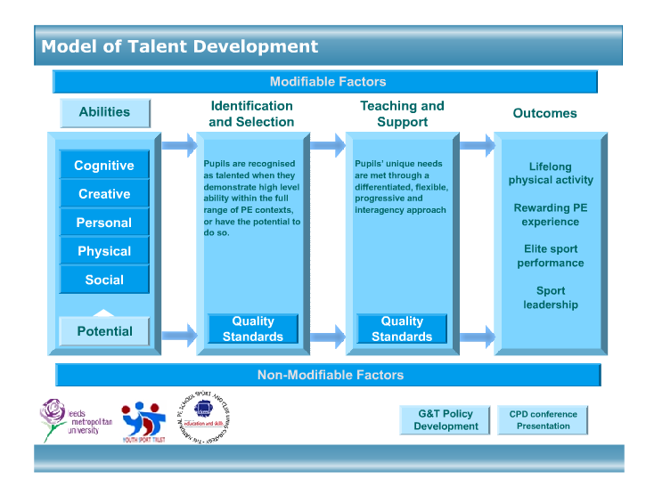
http://www.youthsporttrust.org/downloads/cms/talentmatters/index.htm

Slide 89
Identifying and Developing Talent - Who are the talented pupils in PE?
Pupils are recognised as talented when they demonstrate high-level ability within the range of PE contexts or have the potential to do so. Specifically it is suggested that talented pupils excel in one or more of the following abilities that reflect the full range of PE:
Physical ability
is revealed through pupil’s competence and fitness to perform a range of physical abilities.
Social ability
is exhibited in social contexts, and is the basis of leadership, teamwork and similar concepts.
Personal ability
underpins an individual’s capacity for self-regulation, self belief and commitment to mastery.
Cognitive ability
is shown in planning and compositional settings, as well as knowledge and understanding of central physical educational concepts.

