Slide 1
Catharism
A dualist heresy

Slide 2
Cathar
From Greek word ‘pure’
First recorded use at Cologne, 1163
Used at the Third Lateran Council, 1179

Slide 3
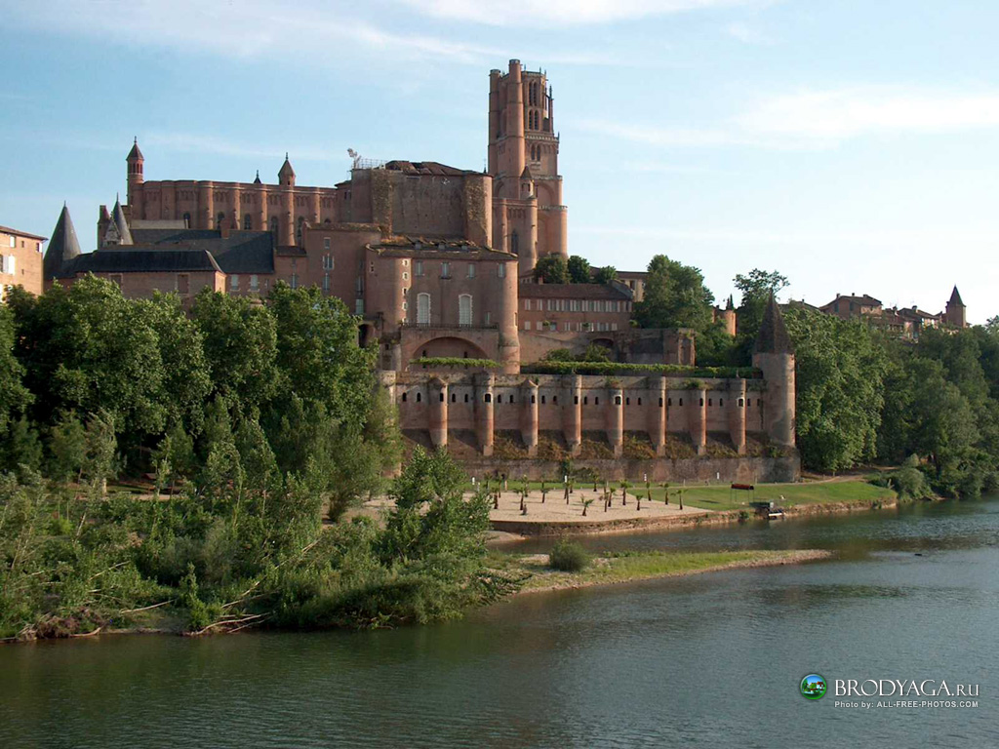
Albigenses
Common term in 13th century
From Albi

Slide 4
‘The little foxes on the vine’
Manes: Founder of Manichaeism
Bogomil: Dualist heresy occurring in Bulgaria in the 10th century
Dualism: based on the notion of a fundamental primeval conflict between the powers of dark and light, evil and good

Slide 5
Cathar beliefs
Denial of creation of world by one God
Two guiding principles, the Good God (spiritual); Devil (material, including the human body even before the Fall)
Human souls created by the Good God and imprisoned in flesh by the Evil God
Problem of the Incarnation
Christ came to liberate the souls

Slide 6
The Cathar church
Was founded by Christ
Christ’s teaching was the New Testament
The one sacrament is baptism, consolamentum
Given to fully instructed adults or the dying.
The perfecti
Cathar church divided between perfecti and simple believers

Slide 7
A suspected heretic
‘Sirs, hear me! I am not a heretic, because I have a wife. I lie with her, have children, eat meat, lie and swear, and am a Christian’.

Slide 8
A church
With its own organization
Own leaders
Own dioceses
Own bishops
‘We cannot do it. We have grown up with them, we are closely related to some of them, and we can see what respectable lives they lead’

Slide 9
Actions against heretics:
1178: a mission launched at the request of the count of Toulouse against the Cathars, using Christian missionaries (Cistercians) and military forces to expel heretics from their lands if they refused to recant
1179: decrees of the Third Lateran Council; encouragement of armed action against heretics

Slide 10
1184: papal bull Ad abolendam, the first attempt to demarcate and define the role of secular and ecclesiastical authorities with regard to heresy. Measures include: use of informers, excommunication, punishment by the secular arm
1198: Innocent III launches peaceful initiative against the Cathars; preaching missions
1208: Murder of papal legate, Pierre de Castelnau, and the beginning of the Albigensian crusade, led by Arnauld-Amaury, abbot of Cîteaux
1209: Capture of Béziers

Slide 11
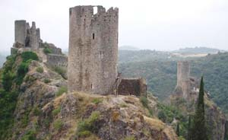
Lastours

Slide 12
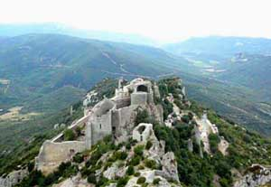
Peyrepetouse

Slide 13
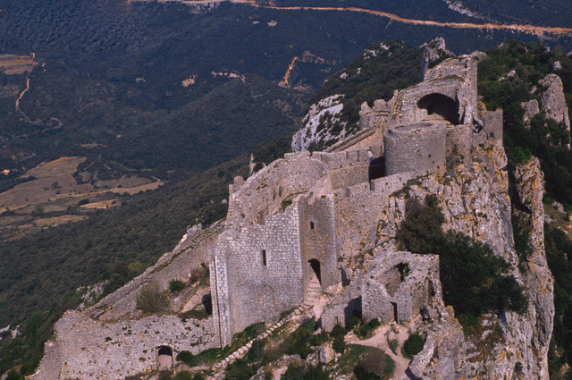
Peyrepetouse

Slide 14
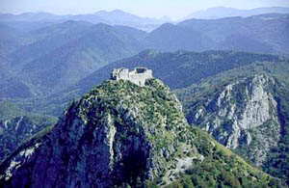
Montsegur

