Slide 1
Capacity Requirements Planning
By
Andrew Thorn

Slide 2
Capacity Planning
Capacity: - is the maximum capability to produce
Capacity planning: - establishes the overall level of productive resources for a firm

Slide 3
Capacity Decisions
Affect
Product lead times
Customer responsiveness
Operating costs
Business ability to compete
Growth and investment

Slide 4
Strategies for Capacity Expansion
Add Figure 7.1

Slide 5
Strategies for Capacity Expansion
Capacity Lead Strategy
Capacity Lag Strategy
Average Capacity Strategy
Incremental versus one-step expansion

Slide 6
Capacity Lead Strategy
Is an aggressive strategy used to lure customers from competitors who are capacity constrained
Gain a foothold in a rapidly expanding market
Allows business to respond to unforeseen surges in demand and to provide superior levels of service during peak demand periods

Slide 7
Capacity Lag Strategy
Capacity is increased after an increase in demand has been recorded
Provides a higher return on investment but may lose customers in the process
The strategy assumes the lost customers will return from competitors after capacity has expanded

Slide 8
Average Capacity Strategy
Capacity is expanded to coincide with average expected demand
Managers are sure that they will be able to sell at least some of the increased output, and endure some periods of unmet demand

Slide 9
How to Increase Capacity
Depends on
Volume
Certainty of anticipated demand
Growth
Customer service
Competition
Cost of expansion
Cost of operation

Slide 10
Best Operating Level/Capacity Cushion
Best operating level: - for a facility is the percent of capacity utilisation that minimises average unit cost
Capacity cushion: - is the percent of capacity held in reserve for unexpected occurrences

Slide 11
Capacity Requirements Planning
Projects the load from a give material plan onto the capacity of a system and identifies underloads and overloads
Then need to level the load- smooth out the resource requirements so that capacity constraints are not violated

Slide 12
Major Inputs into CRP
The planned order releases from the MRP process
A routing file which specifies: - (1) What machines are required; (2) Which workers are required; (3) In what order the operations are to be conducted and (4) Length of time each operation should take
An open orders file which contains information on the status of jobs that have already been released, but have not yet been completed

Slide 13
Calculating Capacity
Capacity is affected by the mix of products and services, choice of technology, the size of the facility and resources allocated
Rated capacity is the theoretical output that could be attained if a process were operating at full speed with interruption, exceptions or downtime

Slide 14
Effective Capacity
Takes into account the efficiency with which a particular product or customer can be processed and the utilisation of the scheduled hours or work
Effective capacity = No of machines/workers x hours per shift x no of shifts x utilisation x efficiency

Slide 15
Capacity Requirements Planning
MRP Planned order releases
Routing File
Capacity Requirements Planning
Open orders file
Load Profile for each process

Slide 16
Capacity Requirements Planning
Utilisation: - refers to the percentage of available working time that a worker actually works or a machine actually runs
Efficiency: - refers to how well a machine or worker performs compared to a standard output level. Efficiency is dependent on product mix
Load: - is the standard hours of work assigned to a facility

Slide 17
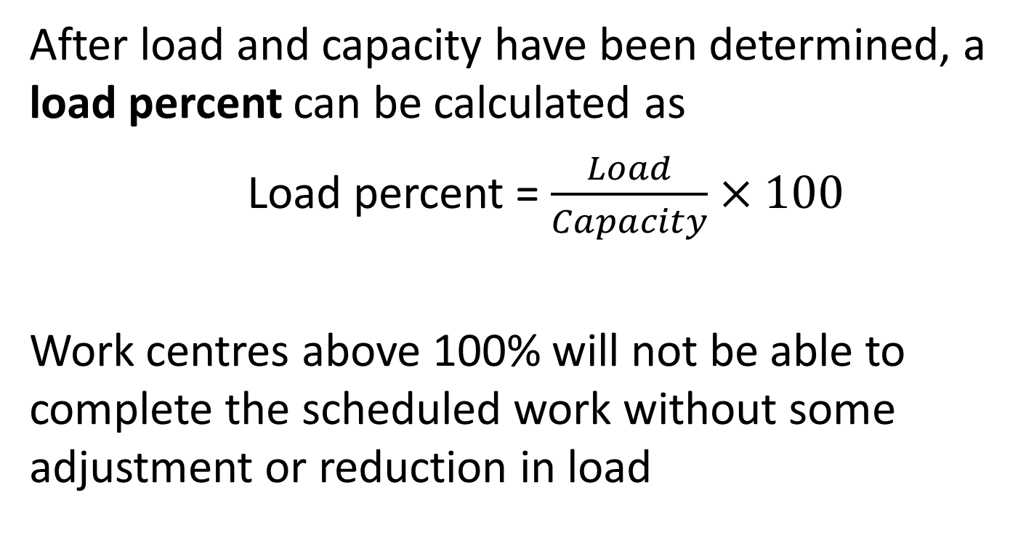
Capacity Requirements Planning
After load and capacity have been determined, a load percent can be calculated as
Load percent = $\frac{Load}{Capacity}$ $×100$
Work centres above 100% will not be able to complete the scheduled work without some adjustment or reduction in load

Slide 18
Example (1)
PPT currently has two printing machines that can be operated by one member of staff, and another member of staff as well. To maximise the available time both employees could work two shifts based on 8 hours a day, with 30 minutes for lunch and 30 minutes for setup/changeovers. The machines currently operate at 90% efficiency and estimates of set up time are kept with each order

Slide 19
Example (2)
Using the following information calculate the normal daily capacity and Monday’s load and load percent
Job Quantity Set up Time Run Time
(mins) (mins/unit)
A 500 5.2 0.08
B 1000 10.6 0.10
C 5000 3.4 0.12
D 4500 11.2 0.14
E 2000 15.3 0.10

Slide 20
Example (3)
Solution
The machines are out of operation for

Slide 22
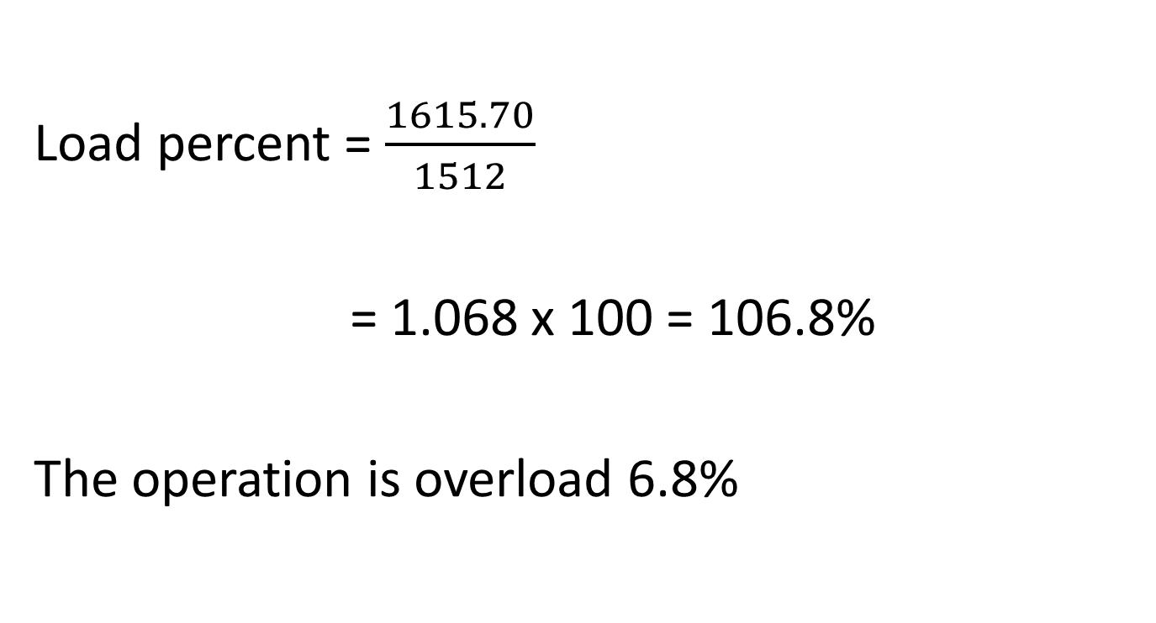
Example (5)
Load percent = $\frac{1615.70}{1512}$
= 1.068 x 100 = 106.8%
The operation is overload 6.8%

Slide 23
Possible Solutions
Each worker extends working day 36 minutes. Load percent reduces to 99%
Increase efficiency to 97%
Limiting the orders accepted to those that can be processed more efficiently
Grouping orders by similar processing requirements so that set up time is reduced

Slide 24
Add figure 15.9

Slide 25
Load Profiles
Underload conditions can be levelled by: -
Acquiring more work: - transferring work from other machines, making components in house normally bought in and seeking work from other sources
Pulling work ahead that is scheduled for later periods: - relies on the availability of required materials or components. Also, finished goods must be stored prior to dispatch and this incurs a holding cost

Slide 26
Load Profiles
Underload conditions can be levelled by:
Reducing normal capacity: - can be achieved by reducing the size of the workforce, reducing length of the working day/week, transferring work to other work stations

Slide 27
Load Profiles Overloads
Overloads can be reduced by: -
Eliminating unnecessary requirements
Re-routing jobs to alternative machines, workers or work centres
Splitting order between two or more machines
Increasing normal capacity
subcontracting

Slide 28
Load Profiles Overloads
Overloads can be reduced by: -
Increasing the efficiency of the operation
Pushing work back to later time periods
Revising the master schedule

Slide 29
Load Profiles Overloads
Some capacity problems are generated from an MRP plan that includes lot size, safety stock and unsubstantiated requirements for service parts or forecasted demand
With CRP, load profiles are determined with jobs assigned to the preferred machines first, but when capacity problems occur, jobs can be reassigned to alternate machines or splitting orders between jobs

