Slide 1
LCBB6004
Strategic Management and Sustainability
Week 3
Analysing Resources and Capabilities

Slide 2
Learning Objectives
Identify organisational resources and capabilities and how these relate to the strategies of organisations.
Analyse how resources and capabilities might provide sustainable competitive advantage on the basis of their Value, Rarity, Inimitability and Organisational support (VRIO).
Diagnose resources and capabilities by means of VRIO analysis, value chain analysis, activity systems mapping, benchmarking and SWOT analysis.

Slide 3
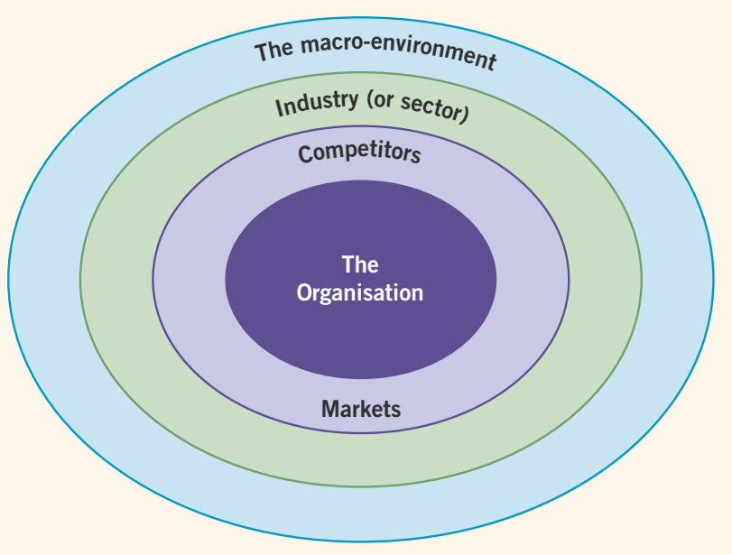
Layers of the Business Environment
So far, our emphasis has been on the external environment of the firm to evaluate opportunities and threats.
In this session, our emphasis shifts to the internal environment of the firm - specifically, with the resources and capabilities of the firm.
The external environment is not the only force that affects company’s performance. Within any given industry some companies are more profitable than others.

Slide 4

Why within a particular industry do some companies outperform others? What is the basis of their competitive advantage?
Question?
The answer is that companies which outperform their rivals do so because they are more efficient, have higher product quality, are more innovative or are more responsive to their customers than their rivals.

Slide 5
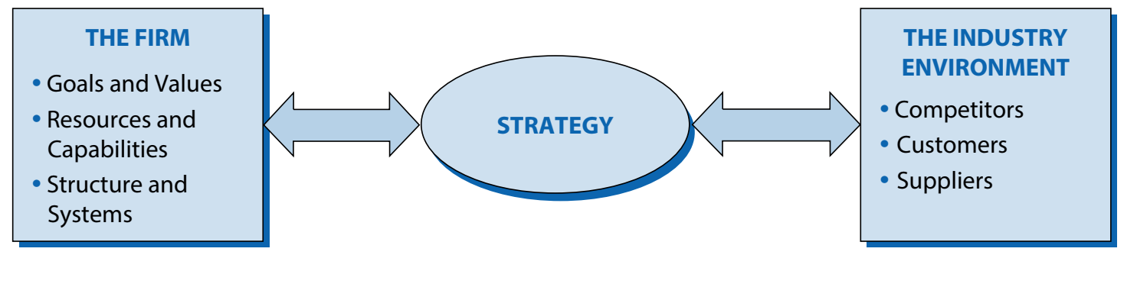
The Basic Framework for Strategy Analysis
Strategy as a link between the firm and its environment.
Strategy is concerned with matching a firm’s resources and capabilities to the opportunities that arise in the external environment.

Slide 6
Analysing Resources and Capabilities
The resources and capabilities of an organisation contribute to its long-term survival and potentially to competitive advantage.
The resources of an organisation are those assets that deliver value added in the organisation. The capabilities of an organisation are those management skills, routines and leadership that deploy, share and generate value from the resources of the organisation.
Analysing the resources and capabilities of an organisation has a dual purpose:
  to identify where value is added in the organisation
  to explore and enhance the competitive advantages of the organisation’s resources

Slide 7
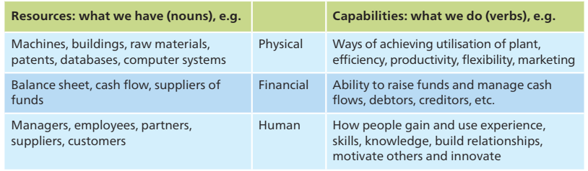
Resources and Capabilities
Resources and capabilities are typically related. Resources are certainly important, but how an organisation employs and deploys its resources matters at least as much.

Slide 8
Categories of Resources and Capabilities
Tangible Resources - are the physical resources of the organisation that contribute to its value added. Plant, Building, Equipment, …
Intangible Resources - are those resources that have no physical presence but represent real benefit to the organisation. Brand name, Patent, Technology, Service Level, …
Organisational Capabilities - are the skills, routines, management and leadership of the organisation. Having tangible and intangible resources is not enough: the organisation must also be able to deploy and share these resources, to link various parts of the organisation together and to co-ordinate the many activities effectively across the organisation.

Slide 9
Threshold and Distinctive Resources and Capabilities
Threshold resources and capabilities are those needed for an organisation to meet the necessary requirements to compete in a given market and achieve parity with competitors in that market. Without these, the organisation could not survive over time.
Distinctive resources and capabilities are required to achieve competitive advantage. These are dependent on an organisation having a distinctiveness or uniqueness that are of value to customers and which competitors find difficult to imitate or obtain.
    Distinctive resources: e.g. a long-established brand
    Distinctive capabilities: ways of doing things that are unique to that organisation and valuable to customers and difficult for rivals to obtain or imitate, e.g. R&D capabilities

Slide 10
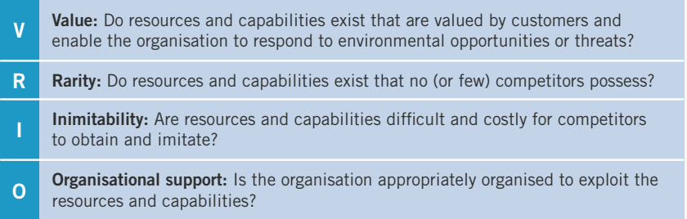
Distinctive Resources and Capabilities
Distinctive resources and capabilities are necessary for sustainable competitive advantage and superior economic performance.
Four key criteria by which resources and capabilities can be assessed in terms of them providing a basis for achieving such competitive advantage: value, rarity, inimitability and organisational support – or VRIO.

Slide 11
What is the Resource-Based View (RBV)?
The Resource-Based View (RBV) is a strategic management framework that focuses on the importance of a firm’s internal resources in achieving sustainable competitive advantage. According to RBV, external market conditions are less critical than the firm's internal capabilities and assets.
Firms differ from one another because they control unique sets of resources, which can lead to variations in performance and competitive positioning. Unlike industry structure-based approaches like Porter’s Five Forces, RBV emphasizes internal resources as the foundation of strategy.

Slide 12
Resource-Based View (RBV) Cont.
Types of Resources:
Tangible Resources: Physical assets such as equipment, buildings, inventory, and financial resources (e.g., cash, stocks).
  Example: A manufacturing company’s advanced robotics system.
Intangible Resources: Non-physical assets like brand reputation, intellectual property, company culture, technical know-how, and networks.
  Example: Google’s proprietary algorithms or Apple’s design expertise.
Why It Matters:
Understanding what makes a resource strategically valuable helps firms focus on building and protecting the most important assets for long-term success.

Slide 13
VRIO Framework – Analysing Resources
The VRIO framework is a tool to analyse and evaluate a firm’s resources and capabilities to determine if they can provide a sustainable competitive advantage. Whittington emphasizes this framework as part of RBV’s deeper analysis.

Slide 14
VRIO Framework – Components of VRIO
Valuable - Does the resource or capability allow the firm to exploit opportunities or neutralize threats?
  Example: A patent that protects a profitable technology.
Rare - Is the resource scarce in the industry, or do competitors also possess it?
  Example: A unique manufacturing process used by only one firm.
Inimitable - Is it difficult or costly for competitors to duplicate or substitute this resource?
  Example: Company culture or tacit knowledge that is hard to replicate.
Organised- Is the firm organized to capture value from the resource? This includes having the right management systems, structures, and processes in place.
  Example: A company having the right distribution systems to capitalize on a rare and valuable resource.

Slide 15
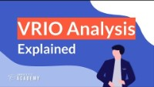
VRIO Analysis
https://youtu.be/0lCz29oaSG0?t=9

Slide 16
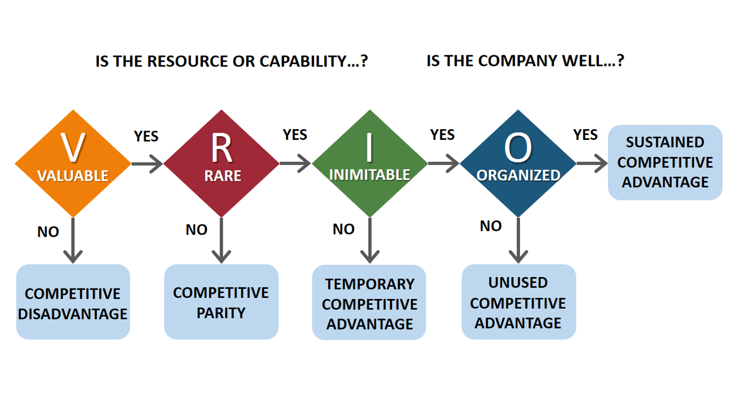

Slide 17
Strategic Implications of RBV
Sustained Competitive Advantage: Unique, valuable, rare, inimitable, and organised resources lead to long-term success.
Dynamic Capabilities: Firms must adapt and reconfigure resources in changing environments.
Limitations of RBV:
  External Factors: Can neglect market changes and disruptions.
  Resource Obsolescence: Resources lose value over time.
Strategy Formulation:
  Conduct regular VRIO analyses.
  Develop dynamic capabilities.
  Build core competencies for long-term goals.

Slide 18

Case Study
Read the case study and assess the bases of Groupon’s resources and capabilities using the VRIO criteria.
https://www.groupon.co.uk/

Slide 19
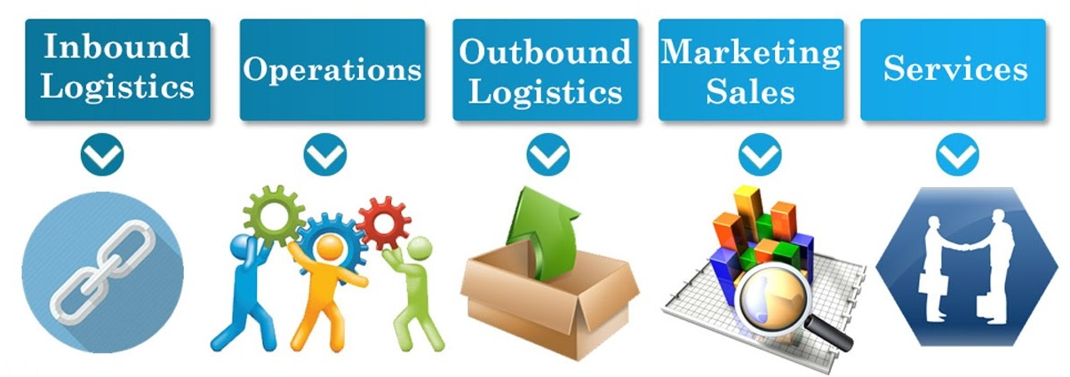
The Value Chain
The value chain describes the categories of activities within an organisation which, together, create a product or service.
If organisations are to achieve competitive advantage by delivering value to customers, managers need to understand which activities their organisation undertakes that are especially important in creating that value and which are not.

Slide 20
Porter's Value Chain Analysis
Porter’s Value Chain is a strategic tool used to analyse a firm’s internal activities and understand how they contribute to competitive advantage. It helps identify which activities are valuable, and how to optimize or reconfigure them to reduce costs or increase differentiation.

Slide 21
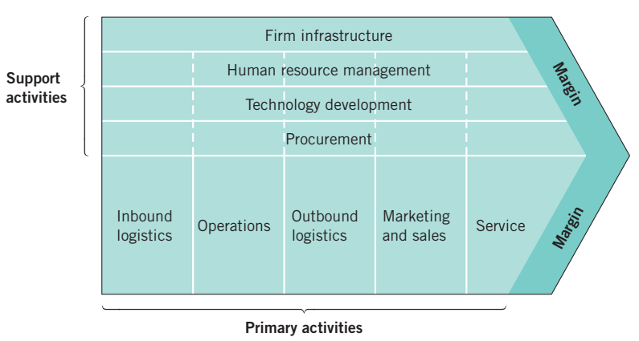
The Value Chain
Porter’s Value Chain Model
Primary activities are directly concerned with the creation or delivery of a product or service.
Support activities help to improve the effectiveness or efficiency of primary activities.

Slide 22
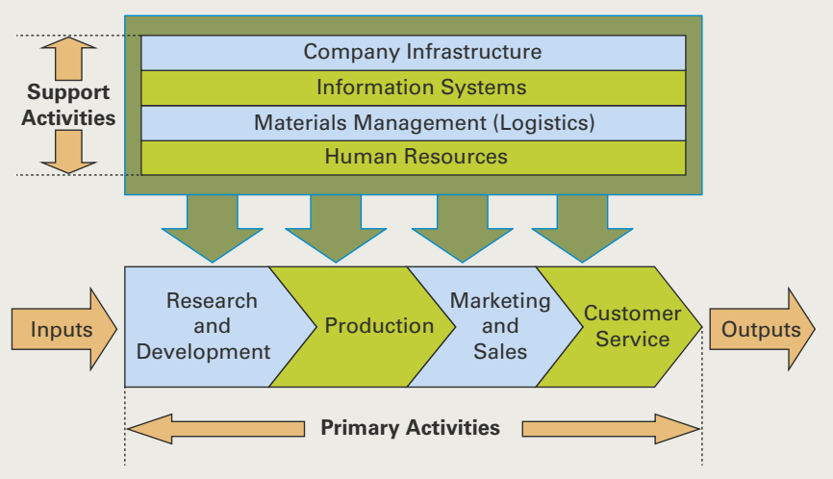

The Value Chain
All functions of a company - production, marketing, product development, service, information systems, materials management, and human resources - have a role in lowering the cost structure and increasing the perceived value of products through differentiation.
McDonald's Value Chain
Case study - Value Creation at Burberry

Slide 23
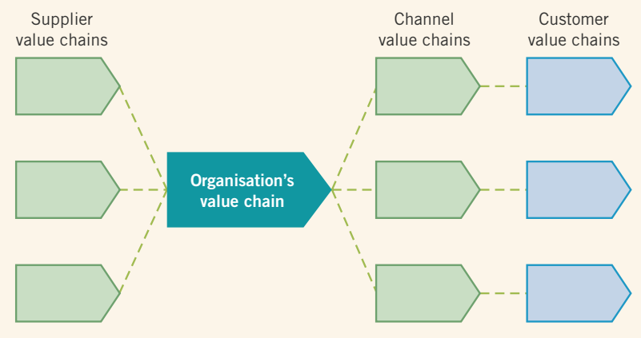
The Value System
A single organisation rarely undertakes in-house all of the value activities from design through to the delivery of the final product or service to the final consumer. Most organisations are part of a wider value system, the set of inter-organisational links and relationships that are necessary to create a product or service.

Slide 24
SWOT Analysis
Strategy as a link between the firm and its environment.
This view of strategy as a link between the firm and its industry environment has close similarities with the widely used SWOT framework.

Slide 25
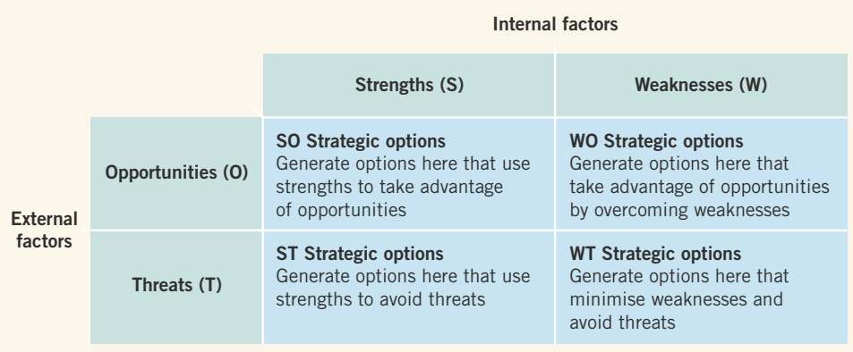
SWOT Analysis
A SWOT analysis explores the relationship between the environmental influences and the resources and capabilities of an organisation compared with its competitors.

Slide 26
Competitive Advantage through the Value Chain
Cost Advantage: Firms can gain cost advantage by optimizing each activity in the value chain to reduce costs, without compromising quality.
  Example: Walmart’s focus on efficient inbound logistics and procurement to offer low prices.
Differentiation Advantage: By creating more value in each activity (e.g., better marketing, superior service, innovative technology), firms can differentiate themselves and charge premium prices.
  Example: Apple’s attention to detail in operations, product design, and marketing results in strong brand loyalty.

Slide 27
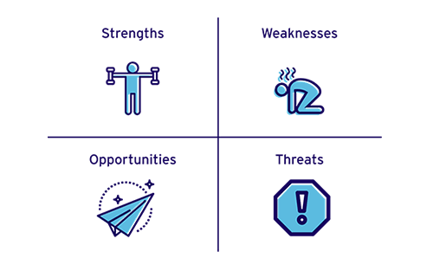
SWOT Analysis Allows Businesses to…
Define realistic goals
Improve capability
Overcome weaknesses with strengths
Identify threats than can be turned into opportunities

Slide 28

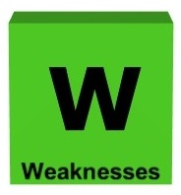

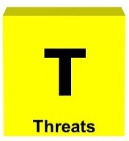
SWOT Analysis
Can be a competitive advantage such as…
Can be a disadvantage such as…
An opportunity can be…
A threat can be…
Superior product quality
Lowest price
Best expertise
Location
A tired brand
Inferior location
High overheads
A lack of R&D
A regulatory or tax change
A high-profile event (marketing opportunity)
An untapped market
A gap left by a failed competitor
Unfavourable regulation changes
A new entrant into the market
Problems with the economy
Market shrinkage

Slide 29
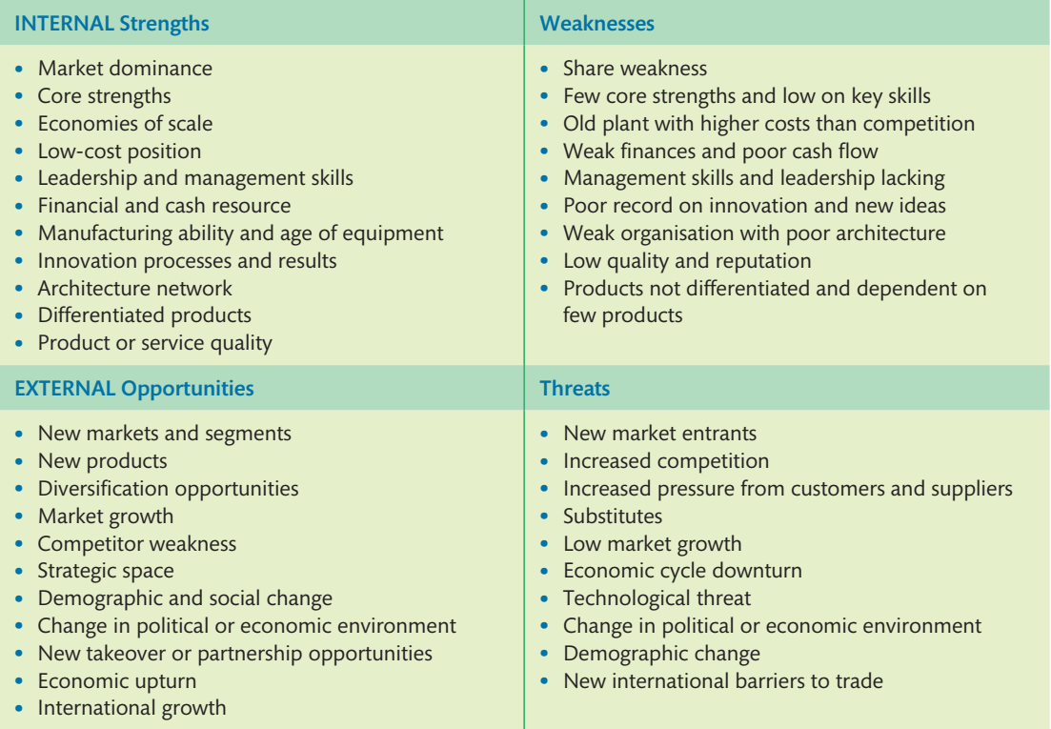
Some Other Possible Factors in a SWOT Analysis
In devising a SWOT analysis, there are several factors that will enhance the quality of the material:
Keep it brief – pages of analysis are usually not required.
Relate strengths and weaknesses, wherever possible, to industry key factors for success.
Strengths and weaknesses should also be stated in competitive terms, if possible.
Statements should be specific and avoid blandness.
Analysis should distinguish between where the company wishes to be and where it is now.
It is important to be realistic about the strengths and weaknesses of one’s own and competitive organisations.

Slide 30

Class Activity
In group, think about two possible strength, opportunity, weakness, and threat of Zara.

Slide 31

Any Questions?
Thank You ☺

Slide 32
Sources:
BBC, 2018. SWOT analysis. [Online] Available at: https://www.bbc.com/bitesize/guides/z3csycw/revision/3 [Accessed 12 11 2018].
Barney, J. B. & Hesterly, W. S., 2015. Strategic Management and Competitive Advantage: Concepts and Cases. 5 ed. Essex: Pearson Education Limited.
Grant, R. M., 2018. Contemporary Strategy Analysis. 10 ed. NJ : John Wiley & Sons, Inc.
Hill, C. W. L., Schilling, M. A. & Jones, G. R., 2017. Strategic Management, Theory. 12 ed. Boston: Cengage Learning.
Johnson, G. et al., 2017. Exploring Corporate: Text and Cases. 11 ed. Harlow: Pearson Education Limited.
Lynch, R., 2015. Strategic Management. 7 ed. Harlow: Pearson Education Limited.
Unicef, 2015. SWOT and PESTEL: Understanding your external and internal context for better planning. [Online] Available at: https://www.unicef.org/knowledge-exchange/files/SWOT_and_PESTEL_production.pdf [Accessed 18 11 2018].
Whittington, R. et al., 2020. Exploring Strategy. 12 ed. Harlow: Pearson Education Limited.

