Slide 1
BMSW 4006 Managing Enterprise in the 21st Century
Financial Plan

Slide 2
Learning Objectives
1. Understand the importance of cash flow management.
2. Read a cashflow statement.
3. Create a cashflow statement.
4. Understand an income statement.

Slide 3
Cash Flow: The Lifeblood of a Business
Cash is the energy that keeps your business flowing.
Without cash on hand, you will not be able to pay essential expenses, even while the income statement says you are earning a profit.
The success of your business will depend on cash from start-up through its entire existence.
Managing cash is more critical than managing sales, because sales without cash receipts are a recipe for disaster.

Slide 4
Rules to Keep Cash Flowing
cash flow statement - financial report that shows the money coming into and going out of an organization.
To avoid getting caught with insufficient cash, follow these rules:
1. Collect cash as soon as possible
2. Pay your bills by the due date, not earlier
4. Lease or finance instead of buying equipment where practical.
5. Avoid buying inventory you do not need.
3. Check your available cash daily.
6. Plan ahead for seasonal or contractual needs by seeking financing early.

Slide 5
Reading a Cash Flow Statement
Knowing how to read a cash flow statement will be a valuable skill for any businessperson. The cash flow statement gives a clear picture of its cash position.
The first function of a cash flow statement is to record all sources of income.
Cash flow statements break down inflows and outflows according to whether they are related to operations, investing, or financing.

Slide 6
Forecasting Cash Flow: The Cash Budget
There are two steps to forecasting cash flow receipts:
Step 1. Project cash receipts from all possible sources.
Remember, orders are not cash receipts,
because they may not become cash.
Step 2. Subtract expenditures that would need to be
deducted to meet this level of cash receipts.
Cash expenditures are only those expenses and
purchases you will actually have to pay during
the projected time period.

Slide 7
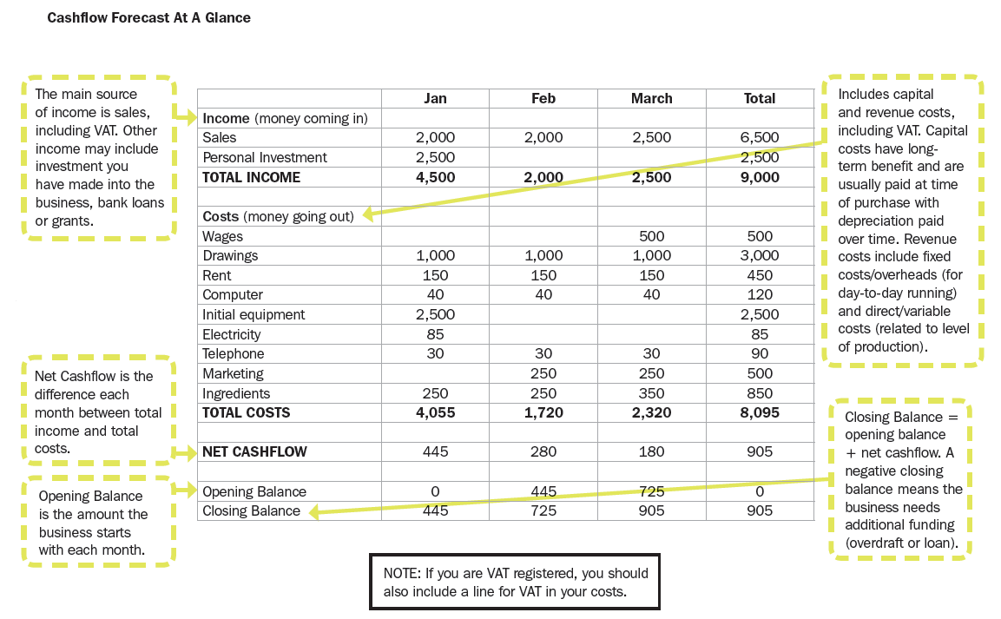

Slide 8
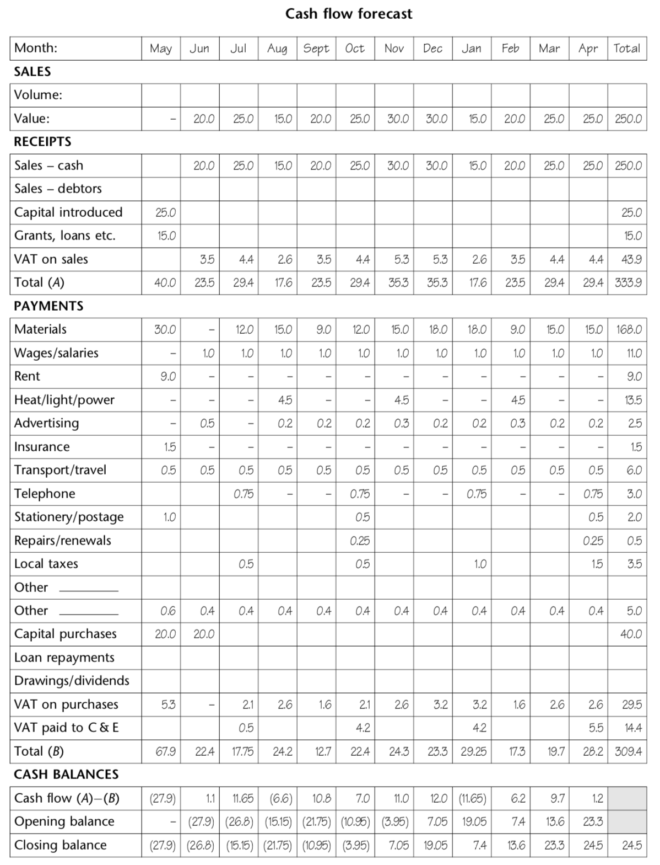

Slide 9
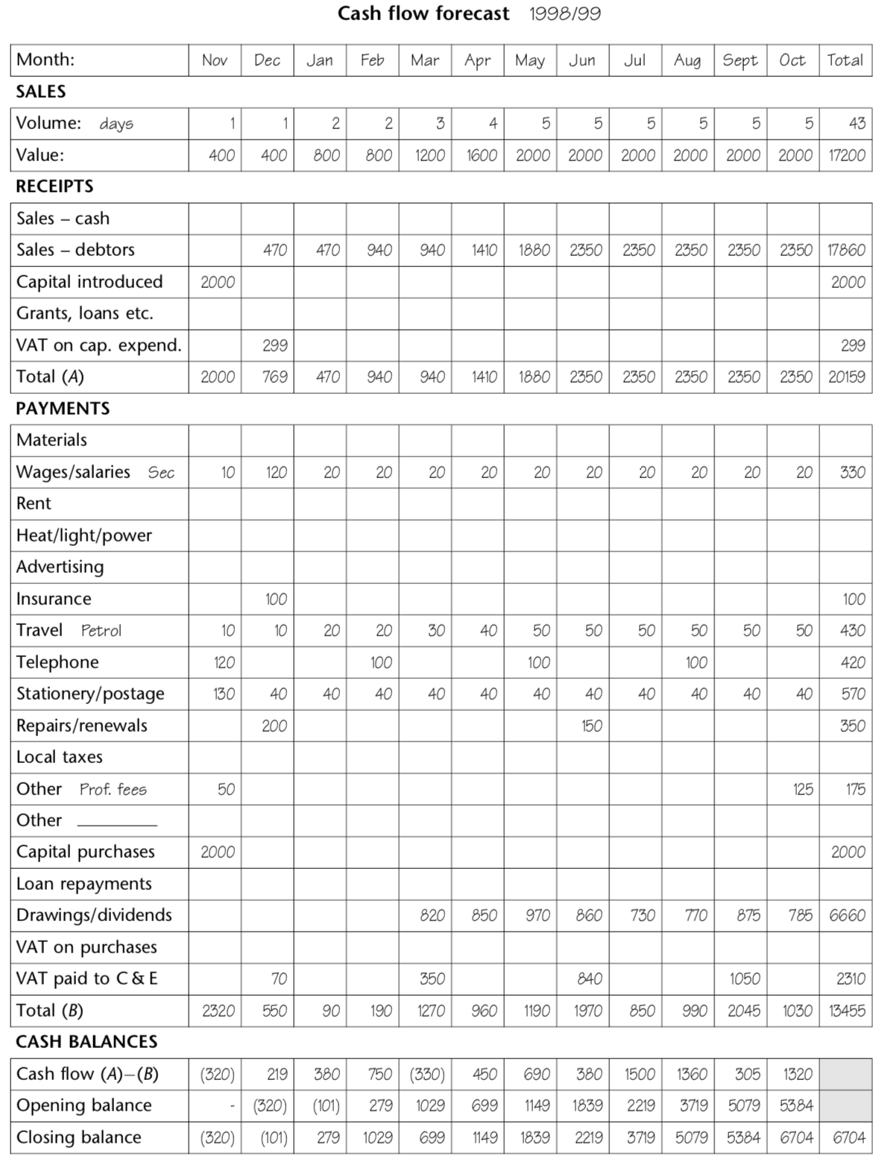

Slide 10
  Group Activity
  Complete the Cash flow Forecast and Profit & Loss sections of your business plan

