Slide 1





The Mental Health Crisis in the Hospitality Sector: An In-Depth Analysis of Stress Factors and Industry Solutions
BMIH6001 Contemporary Themes in the Hotel and Hospitality Sector
Student Name:Catalina Coman
Student ID Number:2238715

Slide 2
INTRODUCTION
There is growing mental health crisis in hospitality sector (Rosemberg et al., 2025)
Long hours and emotional labour increase strain
This presentation examines impacts, stress factors and evidence-based recommendations
Burnout and anxiety reduce performance, increase turnover (Shukla et al., 2023)
Notes:
The hospitality industry is witnessing an ever-increasing mental health crisis due to long working hours, emotional labour, job insecurity, and high demands of customers (Rosemberg et al., 2025). Studies prove that there is evident correlation among shift work, chronic fatigue and psychological strain among hotel workers. They are some of the stressors that lead to burnout, anxiety, poor performance, and high turnover (Shukla et al., 2023). This presentation will critically explore these stress factors; evaluate the impact they have on the organisation and provide evidence-based recommendations on how to improve employee wellbeing and sustainability in the sector.

Slide 3
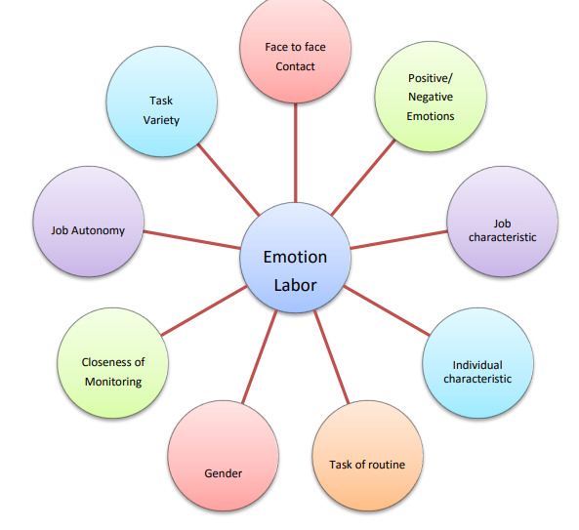
Literature Review- Key Stress Factors in Hospitality
Long and irregular working hours.
Job insecurity increases psychological distress (Abbas et al., 2021)
Emotional Labour Theory explains emotional resource depletion (Amissah et al.,2022)
Emotional labour causes exhaustion (Prentice et al., 2025).
Emotional Labour Theory
Source: (Rafique et al., 2017)
Notes:
The hospitality industry is more or less regarded as a stressful working environment that is typified by the long working hours, non-regular working hours and emotional strains. The shift work and chronic fatigue are one of the most severe issues that hotel workers experience in regards to the level of mental health stress (Prentice et al., 2025). Another disorder that causes burnout and disengagement is the work life imbalance. Emotional has a tremendous impact on emotional labour, which is the need to express positive emotions regardless of the feelings of the individual (Abbas et al., 2021). Moreover, employee job insecurity and financial security are other factors that enhance the development of psychological distress in hospitality workers Amissah et al. (2022) cover the Emotional Labour Theory that explains how the long-term management of emotions is associated with the draining of the psychological resources that subject hospitality workers to burnout and the consequences of stress.

Slide 4
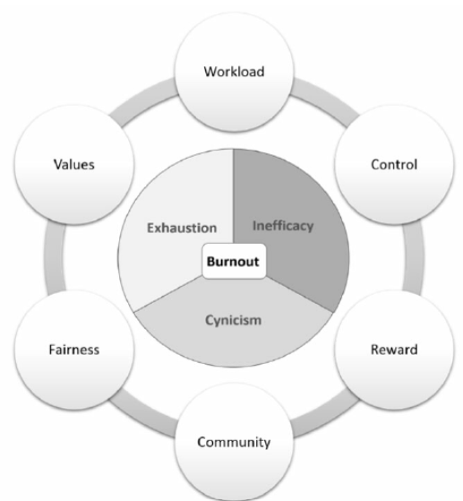
Literature Review- Impact of Mental Health on Employees and Organisations
Occupational stress increases turnover intentions (Cuc et al., 2022)
Rising recruitment and training costs
Burnout Theory explains organisational decline (Edú-Valsania et al, 2022)
Burnout reduces productivity and performance (Bhatti and Alnehabi, 2023)
Burnout theory
Source: (Prentice, et al., 2025)
Notes:
The effects of mental health issues are severe to both the workers and the organisations in the hospitality industry. Job stress leads to turnover intentions and decreased job satisfaction (Cuc et al., 2022). Burnout has been directly related to diminished work performance as well as diminished productivity (Bhatti and Alnehabi, 2023). Moreover, employee mobility can promote mental health challenges within organisations and exert more strain at a systemic level. Theoretically, the concept of burnout has been conceptualised by the theory of Burnout, which was reviewed by Edú-Valsania et al. (2022), and it is emotional exhaustion, depersonalisation, and a lack of personal accomplishment. Burnout is an organisational killer in a service-based business where employee engagement is the key to customer satisfaction, thus recruitment becomes expensive and the sustainability of the organisation is affected negatively.

Slide 5

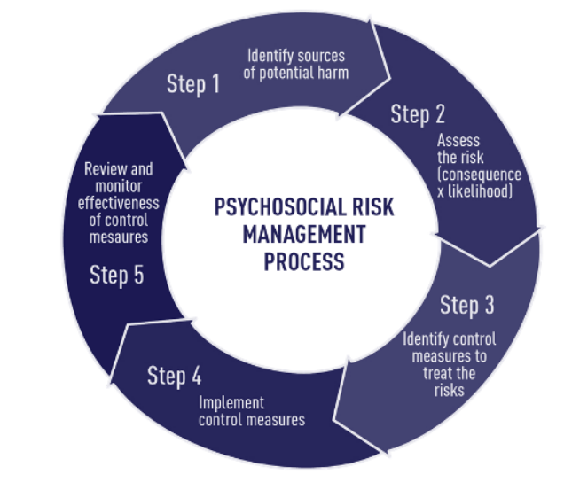
Literature Review- Organisational Responses to challenges
Structured wellness and counselling programmes (Popely and Uhlir, 2023)
Reduced hours improve work-life balance (Barck-Holst et al., 2022)
Proactive leadership enhances employee support (Shukla et al., 2023)
Psychosocial Risk Management
Source: (Jain et al., 2021)
Psychosocial Risk Management guides interventions (Jain et al., 2021)
Notes:
Hospitality organisations are currently beginning to implement wellbeing programmes and this time around in a structured way because of the rising mental health problems. Large hotel chains too have initiated employee wellness programmes, counselling and mental-health-awareness plans (Popely and Uhlir, 2023). The reduced working hours also have been connected with a positive work-life balance and minimal stress (Barck-Holst et al., 2022). It has been experiencing an increasing importance of proactive leadership strategies used to take care of the employees (Shukla et al., 2023). Theoretically, the Psychosocial Risk Management offered by Jain et al. (2021) is devoted to the systematic identification and reduction of stressors in the workplace. However, with the turn of events, this is still to be implemented particularly in smaller hospitality organisations whose financial and operational resources are restricted.

Slide 6
Research Method
Qualitative secondary research design adopted
PESTEL framework analyses external factors
Documentary analysis of hospitality studies
Case studies provide contextual depth (Çakar and Aykol, 2021)
Notes:
The research design used in this study is a qualitative secondary research design that will be used to study the mental health crisis in the hospitality industry. The study is based on the documentary review of the peer-reviewed journal articles, industry reports and available case studies so as to generalise current findings on stressors and organisational responses. As emphasised by Çakar and Aykol (2021), case study and qualitative methods are especially useful in the study of the hospitality industry to produce a deep contextual insight. The recurring themes pertaining to burnout, employee wellbeing and interventions in the industry were identified using content analysis. Besides, the external environmental factors were analysed with the help of a PESTEL framework. It is a systematic approach that guarantees the depth of analysis and adherence to theoretical intimacy of the objectives of the study.

Slide 7
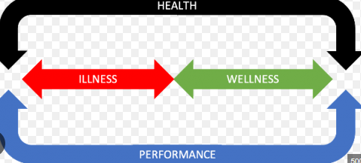
PESTEL Analysis (Political Factors)
Government focus on occupational wellbeing increasing
Psychosocial risk frameworks strengthened (Jain et al., 2021)
Regulatory enforcement varies across jurisdictions
Employer responsibility for mental health recognised
Notes:
The politics of mental health in the hotel industry are also major determinants of mental health care in the hospitality industry. Growing government focus on occupational wellbeing has empowered psychosocial risk management framework in certain areas (Jain et al., 2021). Mental health protection in the workplace is increasingly being identified by law as the responsibility of the employer. However, the implementation of the regulations differs across the world, which makes it inconsistent. The smaller hospitality organisations might find it more difficult to meet the changing standards, which will lead to the uneven provision of mental health services in the market and jurisdiction.

Slide 8
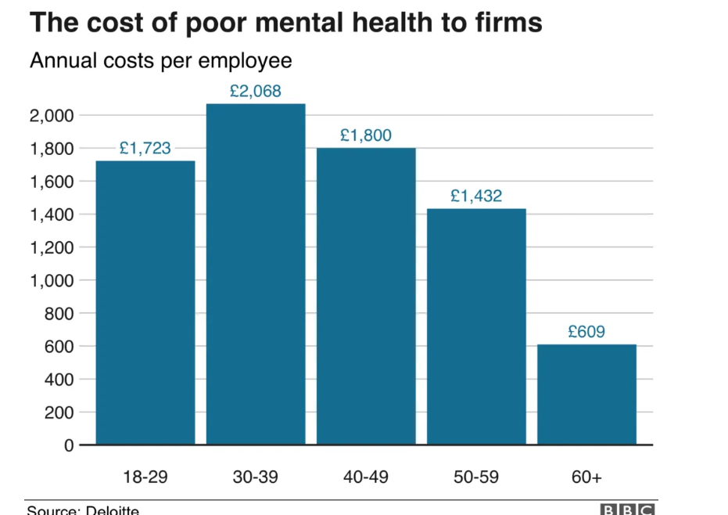
Economic Factors
Mental health costs £2,068 annually (30–39 age group) (BBC, 2020)
Employees aged 18–29 cost £1,723 yearly (BBC, 2020)
Absenteeism and productivity losses rise (Feltmann et al., 2023)
Stress increases turnover intentions (Kensbock et al., 2022)
The cost of poor mental health on employees
Source: (BBC News, 2020)
Notes:
This graph, which is made by using the data provided by Deloitte reported by BBC News (2020) shows the cost of poor mental health per employee in the UK which is greatest in the age-cohort 30-39 years as it resorts to £2,068 per year with the next highest cost being in the age-cohort 40-49 years of £1,800 annually. Even the younger workers who are between 18-29 are costing firms an amount of £1,723 a year. These costs are very applicable in hospitality where the young and mid-career workforce constitute a large percentage of the workers. Burnout and stress lower the productivity and, although work stress is a leading cause of turnover intent (Kensbock et al., 2022). Since the sector is labor-intensive in structure, the issue of mental health directly raises the cost of recruitment, absenteeism, and presenteeism, ultimately affecting the profitability and sustainability of the organisation (Feltmann et al., 2023).

Slide 9
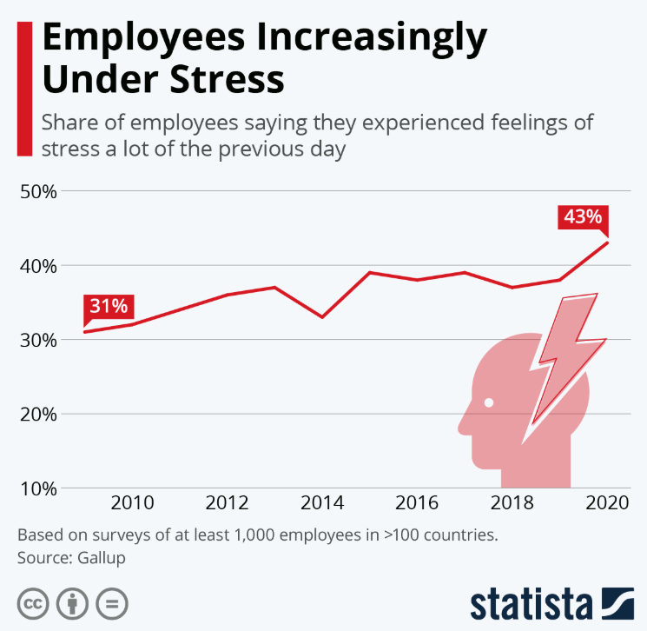
Social Factors and Technological Factors
Workplace stress rose from 31% to 43% (Statista, 2021)
Emotional labour drives exhaustion (Amissah et al., 2022)
Rapid technological change increases insecurity (Ghani et al., 2022)
Mental health stigma limits help-seeking (Ran et al., 2021)
Employees Increasingly Under Stress
Source: (Statisa, 2021)
Notes:
The available data of the Statista (2021) are based on the survey by Gallup and present a visible escalation of employees, who report high levels of stress, which rose to 43% in 2020, compared to 31% in 2009. This increase is indicative of the increasing pressure at the workplace around the world which is especially true of the hospitality industry as it is an emotionally coloured service culture. Emotional labour has been a major cause of exhaustion, since an employee must exhibit positive emotions despite the internal feelings (Amissah et al., 2022). Moreover, mental health stigma prevents open conversations and the help-seeking behaviour (Ran et al., 2021), which is continuing to perpetuate a culture of silence.
There are technological factors which are dual. Although the pressure of work can be diminished with the help of digital systems and automation, the rapid technological change can promote work insecurity and stress (Ghani et al., 2022). The effectiveness of technology versus human interaction poses an important strategic issue in the sphere of hospitality, where the quality of the services is dictated by human interaction (Vahdat, 2022).

Slide 10

Environmental & Legal Factors
Environmental Factor
Legal Factor
COVID-19 increased occupational stress levels (Wong et al., 2021)
Health risks and job insecurity intensified anxiety.
Sustainability roles increase workload pressures (Yuan et al., 2024)
Employer responsibility for mental health expanding (Edú-Valsania et al., 2022)
Burnout recognised within occupational health systems (Edú-Valsania et al., 2022)
Legal enforcement varies across jurisdictions (Ghani et al., 2022)
Notes:
The stress in the hospitality sector has been highly escalated by environmental factors especially the global crisis, like the COVID-19. It has been found that the pandemic raised work-related stress levels because of health-related risks, job insecurity, and fast-evolving working processes (Wong et al., 2021). Moreover, the sustainability initiatives also demand workers to engage in pro-environmental behaviours and the new role demands and pressure on workload further (Yuan et al., 2024).
Legally, the employer liability towards mental health is increasingly being realised. Burnout is also becoming an ingredient of official occupational health systems (Edú-Valsania et al., 2022). Nevertheless, the application of the laws and the enforcement is not uniform in every jurisdiction, which has inconsistencies in their enforcement (Ghani et al., 2022). In the case of multinational hospitality organisations, accustoming to divergent regulations is an issue of operational and compliance difficulties.

Slide 11
Conclusion
Structural stressors drive hospitality mental health crisis
Burnout reduces productivity and performance
Sustainable performance requires strategic wellbeing focus
Occupational stress increases turnover intentions
Notes:
In conclusion, structural stressors such as emotional labour, shift work, job insecurity, and the rising workplace pressure are the cause of the mental health crisis in the hospitality industry. It is proven that burnout lowers the productivity and raises turnover intentions, which have serious organisational and economic implications. These challenges are enhanced by external political, economic, social, technological, environmental and legal forces. Sustainable hospitality performance thus relies on the strategic organisational role of the importance of employee mental wellbeing.

Slide 12
Recommendations
Implement structured rest breaks
Ensure predictable scheduling for balance
Establish peer support initiatives
Reduce stigma through awareness campaigns
Notes:
Planned rest intervals could be the short-term mitigation strategies such as fatigue management and to minimise emotional and physical fatigue (Booker et al., 2024). Work-life balance and stress reduction may be achieved through clear and predictable scheduling (Dima et al., 2021). Peer support groups and mental health workshops should be provided at low costs in order to reinforce emotional support systems (Shukla et al., 2023). It is necessary to deal with job insecurity and financial instability in the long term and conduct mental health awareness campaigns to decrease stigma (Javed et al., 2021).

Slide 13
References
Abbas, M., Malik, M. and Sarwat, N. (2021) ‘Consequences of job insecurity for hospitality workers amid COVID-19 pandemic: does social support help?’, Journal of Hospitality Marketing & Management, 30(8), pp. 957–981. Available at: https://doi.org/10.1080/19368623.2021.1926036.
Amissah, E.F., Blankson-Stiles-Ocran, S. and Mensah, I. (2022) ‘Emotional labour, emotional exhaustion and job satisfaction in the hospitality industry’, Journal of Hospitality and Tourism Insights, 5(5), pp. 805–821. Available at: https://doi.org/10.1108/JHTI-10-2020-0196.
Barck-Holst, P., Nilsonne, Å., Åkerstedt, T. and Hellgren, C. (2022) ‘Reduced working hours and work-life balance’, Nordic Social Work Research, 12(4), pp. 450–463. Available at: https://doi.org/10.1080/2156857X.2020.1839784.
BBC News. (2020). Available at: https://www.bbc.com/news/business-51093712 Accessed Date: 12/Feb/2026
Bhatti, M.A. and Alnehabi, M. (2023) ‘Association between quality of sleep and self- reported health with burnout in employees: does increasing burnout lead to reduced work performance among employees’, American Journal of Health Behavior, 47(2), pp. 206–216. Available at: https://doi.org/10.5993/AJHB.47.2.1.
Booker, L.A., Fitzgerald, J., Mills, J., Bish, M., Spong, J., Deacon‐Crouch, M. and Skinner, T.C. (2024) ‘Sleep and fatigue management strategies: How nurses, midwives and paramedics cope with their shift work schedules—a qualitative study’, Nursing Open, 11(1), p. e2099. Available at: https://doi.org/10.1002/nop2.2099.
Çakar, K. and Aykol, Ş. (2021) ‘Case study as a research method in hospitality and tourism research: a systematic literature review(1974–2020)’, Cornell Hospitality Quarterly, 62(1), pp. 21–31. Available at: https://doi.org/10.1177/1938965520971281.
Cuc, L.D., Feher, A., Cuc, P.N., Szentesi, S.G., Rad, D., Rad, G., Pantea, M.F. and Joldes, C.S.R. (2022) ‘A parallel mediation analysis on the effects of pandemic accentuated occupational stress on hospitality industry staff turnover intentions in covid-19 context’, International Journal of Environmental Research and Public Health, 19(19), p. 12050. Available at: https://doi.org/10.3390/ijerph191912050.
Dima, G., Meseșan Schmitz, L. and Șimon, M.-C. (2021) ‘Job stress and burnout among social workers in the vuca world of covid-19 pandemic’, Sustainability, 13(13), p. 7109. Available at: https://doi.org/10.3390/su13137109.
Edú-Valsania, S., Laguía, A. and Moriano, J.A. (2022) ‘Burnout: a review of theory and measurement’, International Journal of Environmental Research and Public Health, 19(3), p. 1780. Available at: https://doi.org/10.3390/ijerph19031780.
Feltmann, K., Gustafsson, N.-K.J., Elgán, T.H., Gripenberg, J. and Kvillemo, P. (2023) ‘Effects of the COVID-19 pandemic on mental health, working, and life situation of employees in the Swedish hospitality industry’, Frontiers in Public Health, 11. Available at: https://doi.org/10.3389/fpubh.2023.1178847.
Ghani, B., Memon, K.R., Han, H., Ariza-Montes, A. and Arjona-Fuentes, J.M. (2022) ‘Work stress, technological changes, and job insecurity in the retail organization context’, Frontiers in Psychology, 13. Available at: https://doi.org/10.3389/fpsyg.2022.918065.
Jain, A., Hassard, J., Leka, S., Di Tecco, C. and Iavicoli, S. (2021) ‘The role of occupational health services in psychosocial risk management and the promotion of mental health and well-being at work’, International Journal of Environmental Research and Public Health, 18(7), p. 3632. Available at: https://doi.org/10.3390/ijerph18073632.
Javed, A., Lee, C., Zakaria, H., Buenaventura, R.D., Cetkovich-Bakmas, M., Duailibi, K., Ng, B., Ramy, H., Saha, G., Arifeen, S., Elorza, P.M., Ratnasingham, P. and Azeem, M.W. (2021) ‘Reducing the stigma of mental health disorders with a focus on low- and middle-income countries’, Asian Journal of Psychiatry, 58, p. 102601. Available at: https://doi.org/10.1016/j.ajp.2021.102601.
Kensbock, J.M., Alkærsig, L. and Lomberg, C. (2022) ‘The epidemic of mental disorders in business—how depression, anxiety, and stress spread across organizations through employee mobility*’, Administrative Science Quarterly, 67(1), pp. 1–48. Available at: https://doi.org/10.1177/00018392211014819.
Popely, D. and Uhlir, L. (2023) ‘Advancing health and well-being in hospitality: employers respond to new workforce expectations’, Kendall College Research [Preprint]. Available at: https://digitalcommons.nl.edu/kc/3.
Prentice, C., Dominique-Ferreira, S., Wang, X., Tuominen, J., Duarte, M. and Rocha, H. (2025) ‘Work-life imbalance, burning out, feeling down, I will quit, but quietly – the case of hospitality employees’, Journal of Hospitality Marketing & Management, 34(1), pp. 24–45. Available at: https://doi.org/10.1080/19368623.2024.2389074.
Rafique, T., Tasleem, S., Hassan, Q., Tariq, A. and Mumtaz, S. (2017). Antecedents and consequences of emotional labor: A review. Bulletin of Business and Economics (BBE), 6(4), pp.157-165.
Ran, M.-S., Hall, B.J., Su, T.T., Prawira, B., Breth-Petersen, M., Li, X.-H. and Zhang, T.-M. (2021) ‘Stigma of mental illness and cultural factors in Pacific Rim region: a systematic review’, BMC Psychiatry, 21(1), p. 8. Available at: https://doi.org/10.1186/s12888-020-02991-5.
Rosemberg, M.-A.S., Tu, J. and Armijo, J. (2025) ‘Shift work, sleep, chronic fatigue, and mental health among hotel workers’, Western Journal of Nursing Research, 47(10), pp. 952–964. Available at: https://doi.org/10.1177/01939459251341832.
Shukla, B., Sufi, T., Joshi, M. and Sujatha, R. (2023) ‘Leadership challenges for Indian hospitality industry during COVID-19 pandemic’, Journal of Hospitality and Tourism Insights, 6(4), pp. 1502–1520. Available at: https://doi.org/10.1108/JHTI-08-2021-0217.
Statisa. (2021). Available at: https://www.statista.com/chart/26363/share-employees-feeling-stress timeline/?srsltid=AfmBOooctxvOaUVELWf9rAwOZfZ0tg4ljDOZgciIlPxGgKVf3daBMMwt Accessed Date: 12/Feb/2026
Vahdat, S. (2022) ‘The role of IT-based technologies on the management of human resources in the COVID-19 era’, Kybernetes, 51(6), pp. 2065–2088. Available at: https://doi.org/10.1108/K-04-2021-0333.
Wong, A.K.F., Kim, S. (Sam), Kim, J. and Han, H. (2021) ‘How the COVID-19 pandemic affected hotel Employee stress: Employee perceptions of occupational stressors and their consequences’, International Journal of Hospitality Management, 93, p. 102798. Available at: https://doi.org/10.1016/j.ijhm.2020.102798.
Yuan, Y., Ren, S., Tang, G., Ji, H., Cooke, F.L. and Wang, Z. (2024) ‘How green human resource management affects employee voluntary workplace green behaviour: An integrated model’, Human Resource Management Journal, 34(1), pp. 91–121. Available at: https://doi.org/10.1111/1748-8583.12510.

