Slide 1

Title: What we have learnt about effective teams?
Certificate of Higher Education Employability Skills
Module: Effective Team Working and Communication
Module Code: BMSW4009
Lecturer Name: Melanie Squire
Student Name and Code: Irina Enachi 2409706
What is a conflict?

Slide 2

What is a conflict?
More interaction with people results to a wider range of different points of view (Altmae, Turk, and Toomet, 2013).
Accordindg to Putnam and Poole (1987) ''Conflict'' is a circumstance where people involved in debate have difference point of views, preferences, or attitudes which leads to tensions and possibly interruption to achieve main goal.
Importance of choosing appropiate way of handling
conflicts has become an essential element of
Leadership.

Slide 3

How to manage a conflict?
Managing a conflict inside a team involves careful management in order to keep efficiency and
Solidarity. Primary methods to keep the team happy includes:
Open communication: Create an environment in which team members discuss issues and are willing to listen to each other( Petre, 2020).
Define responsibilities and expectations: Define clearly the roles and responsibilities inside the team to prevent conflict in the future(Rahim, 2023).
Set clear goals: Make sure that the team is focused
On the same goal, avoiding mistakes and imbalances.
.

Slide 4
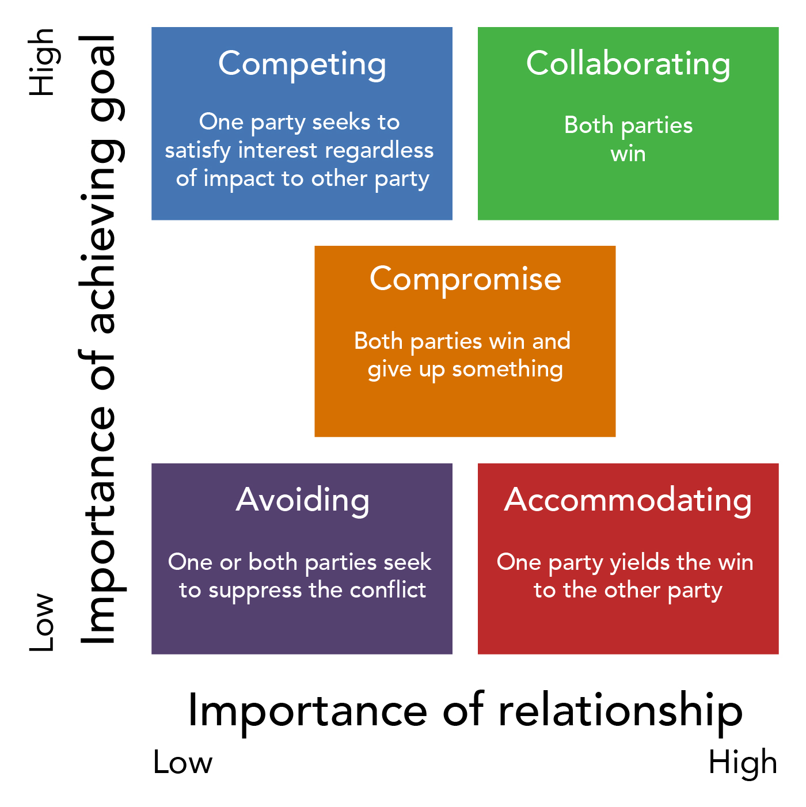
The Five Conflict-Handling Modes (Thomas & Kilmann)
According to Schaubhut(2007) the Thomas- Kilmann Conflict Mode Instrument(TKI) has been widedly use for more than 30 years, by helping people to understand different types of conflict and how it is affecting the future interaction between members of the team.
Assertiveness: It is how much someone try to make their own needs
Cooperativeness: it is when someone try to make someone needs happy (Thomas, and Kilmann, 1974, 2007).

Slide 5
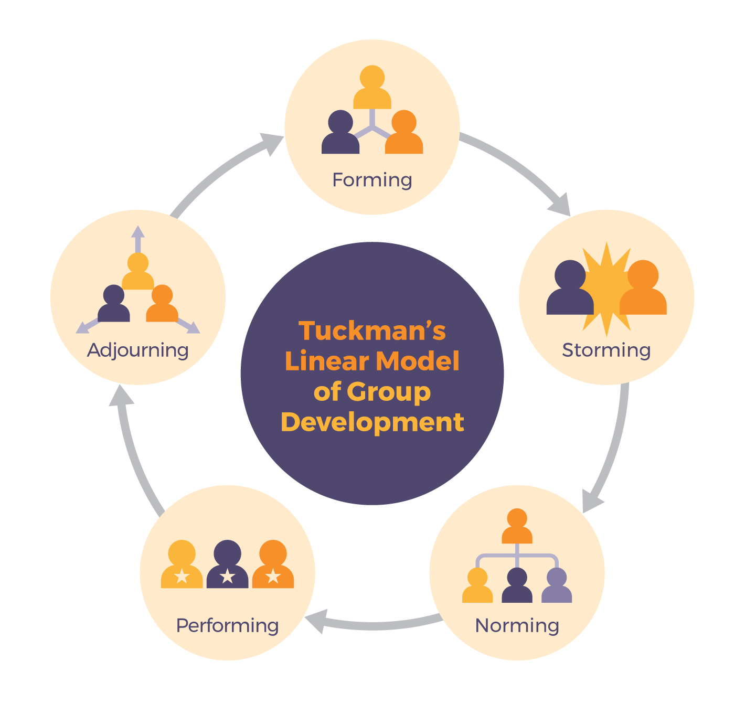
The five stages of team – Tuckman theory
According to Tuckman (1965, 1977) a team should go over five stages to achieves the best result in a common goal.

Slide 7
Altmäe, S., Türk, K. and Toomet, O.S., 2013. Thomas‐Kilmann's Conflict Management Modes and their relationship to Fiedler's Leadership Styles (basing on Estonian organizations). Baltic Journal of Management, 8(1), pp.45-65
Petre, G.E., 2020. Developing students’ leadership skills through cooperative learning: An action research case study. In International Forum Journal (Vol. 23, No. 2, pp. 143-162).
Putnam, L.L. and Poole, M.S. (1987), “Conflict and negotiation”, in Jablin, F.M., Putnam, L.L., Roberts, K.H. and Porter, L.W. (Eds), Handbook of Organizational Communication, Sage, Newbury Park, CA, pp. 549-99.
Rahim, M. A. (2023). Managing conflict in organizations. https://doi.org/10.4324/9781003285861
Schaubhut, N.A., 2007. Thomas-Kilmann conflict mode instrument. CPP Research Department.
Thomas, K. W., & Kilmann, R. H. (1974, 2007). Thomas- Kilmann Conflict Mode Instrument. Mountain View, CA: Xicom, a subsidiary of CPP, Inc.
Tuckman, B.W., 1965. Developmental sequence in small groups. Psychological bulletin, 63(6), p.384. https://doi.org/10.1037/h0022100

