Slide 1
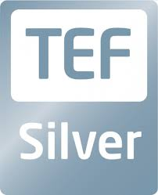



Network and Cybersecurity Essentials
(ACCA4024)
Cybersecurity Essentials: Ownership and Permissions

Slide 2
From our previous class… (recap)
Introduction to Networks
Understanding Networks
Identifying Networks
Building Networks
Security Overview
Nitheesh Murugan Kaliyamurthy | n.Kaliyamurthy@uwtsd.ac.uk

Slide 3
From our previous class… (recap)
Welcoming to the cyber world…
Good Guys Vs Bad Guys...
Threats...
Mitigating Threats...
Nitheesh Murugan Kaliyamurthy | n.Kaliyamurthy@uwtsd.ac.uk

Slide 4
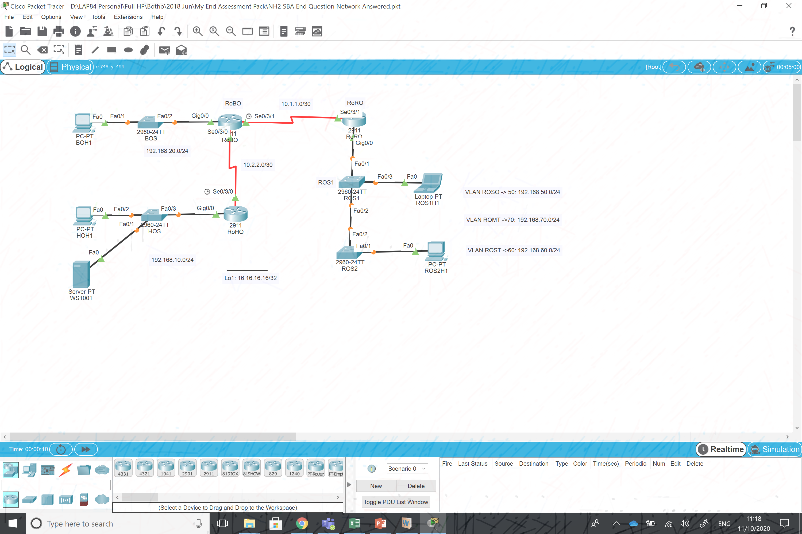
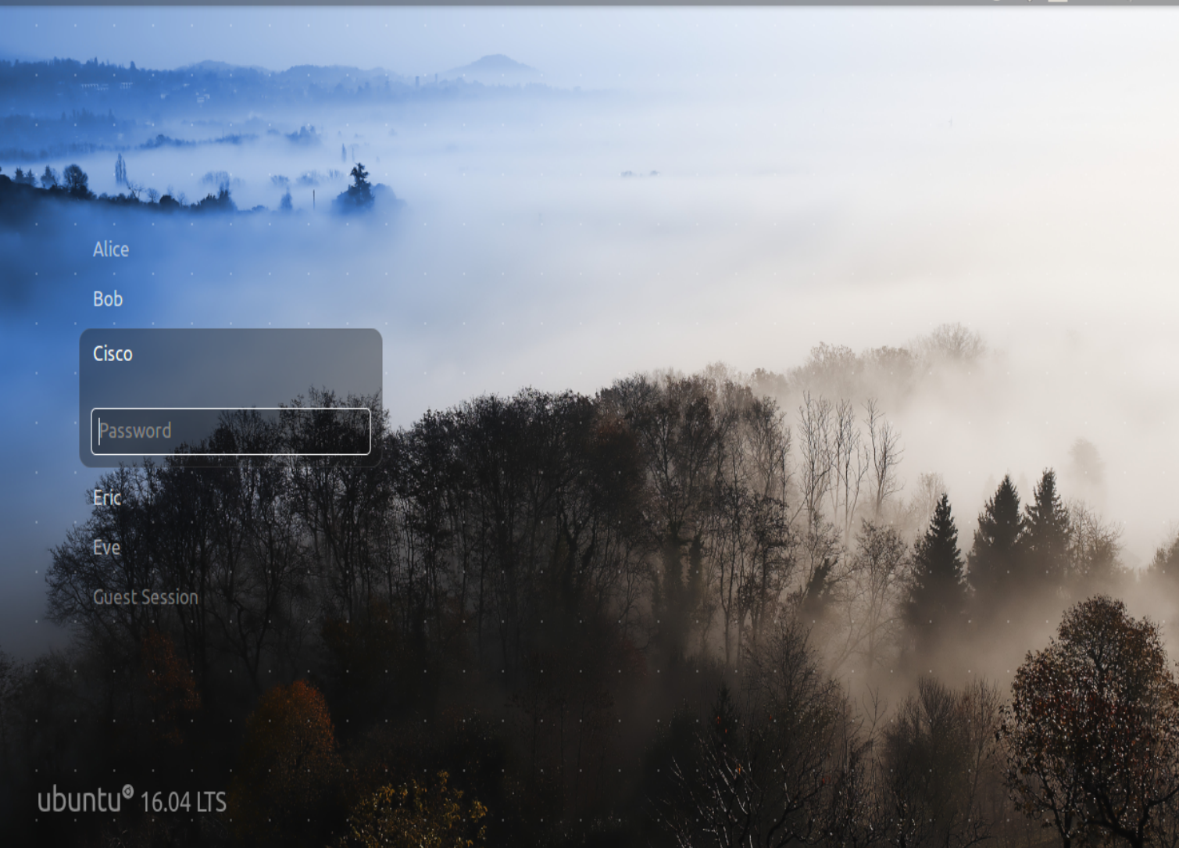
From our previous tutorials… and Independent Learning (recap)
Using Packet Tracer – Build simple, hybrid networks, Configure end devices and test the connection and troubleshoot.
Use Wireshark (Packet Sniffing Tool) to capture the packets (ARP, ICMP) and analyse them.
Working with Virtual Machines...
Ubuntu 16.04 LTS
Nitheesh Murugan Kaliyamurthy | n.Kaliyamurthy@uwtsd.ac.uk

Slide 5
Chat…
Write on the whiteboard…
What do you think
Anything which is confidential to you?
When are you available for a meeting?
----
Nitheesh Murugan Kaliyamurthy | n.Kaliyamurthy@uwtsd.ac.uk

Slide 6
Objectives and Discussions
The Cybersecurity Cube
the three dimensions of the McCumber Cube.
CIA TRIAD
confidentiality, integrity, and availability.
States of Data
the three states of data.
Cybersecurity Countermeasures
the types of cybersecurity countermeasures.
IT Security Management Framework
the ISO Cybersecurity Model
Nitheesh Murugan Kaliyamurthy | n.Kaliyamurthy@uwtsd.ac.uk

Slide 7
Objectives and Discussions
Working with Users, Groups and Permissions
Nitheesh Murugan Kaliyamurthy | n.Kaliyamurthy@uwtsd.ac.uk

Slide 8
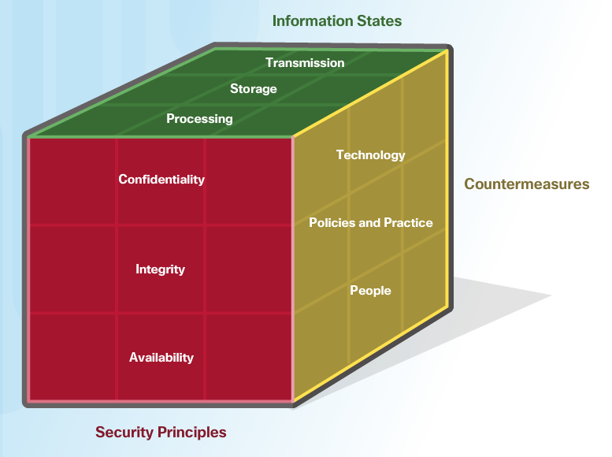
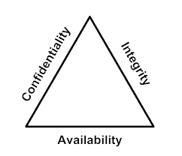
Our Focus…

Slide 9
the three dimensions of the McCumber Cube
The Principles of Security
The first dimension of the cybersecurity cube identifies the goals to protect the cyber world. The goals identified in the first dimension are the foundational principles of the cybersecurity world.
These three principles are confidentiality, integrity and availability.
The principles provide focus and enable cybersecurity specialists to prioritize actions in protecting the cyber world.
Nitheesh Murugan Kaliyamurthy | n.Kaliyamurthy@uwtsd.ac.uk

Slide 10
the three dimensions of the McCumber Cube
The States of Data
The cyber world is a world of data. So, the main focus is on protecting data.
The second dimension of the cybersecurity cube focuses on the problems of protecting all of the states of data in the cyber world.
Data has three possible states:
  Data at rest or in storage
  Data in transit
  Data in process
Nitheesh Murugan Kaliyamurthy | n.Kaliyamurthy@uwtsd.ac.uk

Slide 11
the three dimensions of the McCumber Cube
The Protection
The third dimension of the cybersecurity sorcery cube defines
the types of powers used to protect
the cyber world.
Nitheesh Murugan Kaliyamurthy | n.Kaliyamurthy@uwtsd.ac.uk

Slide 12
the three dimensions of the McCumber Cube
The sorcery cube identifies the three types of powers:
Technologies
devices, & products available to protect information systems and defend cyber criminals.
Policies and Practices
Procedures & guidelines that enable the citizens of the cyber world to stay safe & follow good practices.
People
Aware and knowledgeable about their world and the dangers that threaten their world.
Nitheesh Murugan Kaliyamurthy | n.Kaliyamurthy@uwtsd.ac.uk

Slide 13
The Triad
Confidentiality
Confidentiality prevents the disclosure of information to unauthorized people, resources and processes.
Maybe in other words, confidentiality is privacy.
Organizations need to train employees about best practices in safeguarding sensitive information to protect themselves and the organization from attacks.
Methods used to ensure confidentiality include data encryption, authentication, and access control.
Nitheesh Murugan Kaliyamurthy | n.Kaliyamurthy@uwtsd.ac.uk

Slide 14
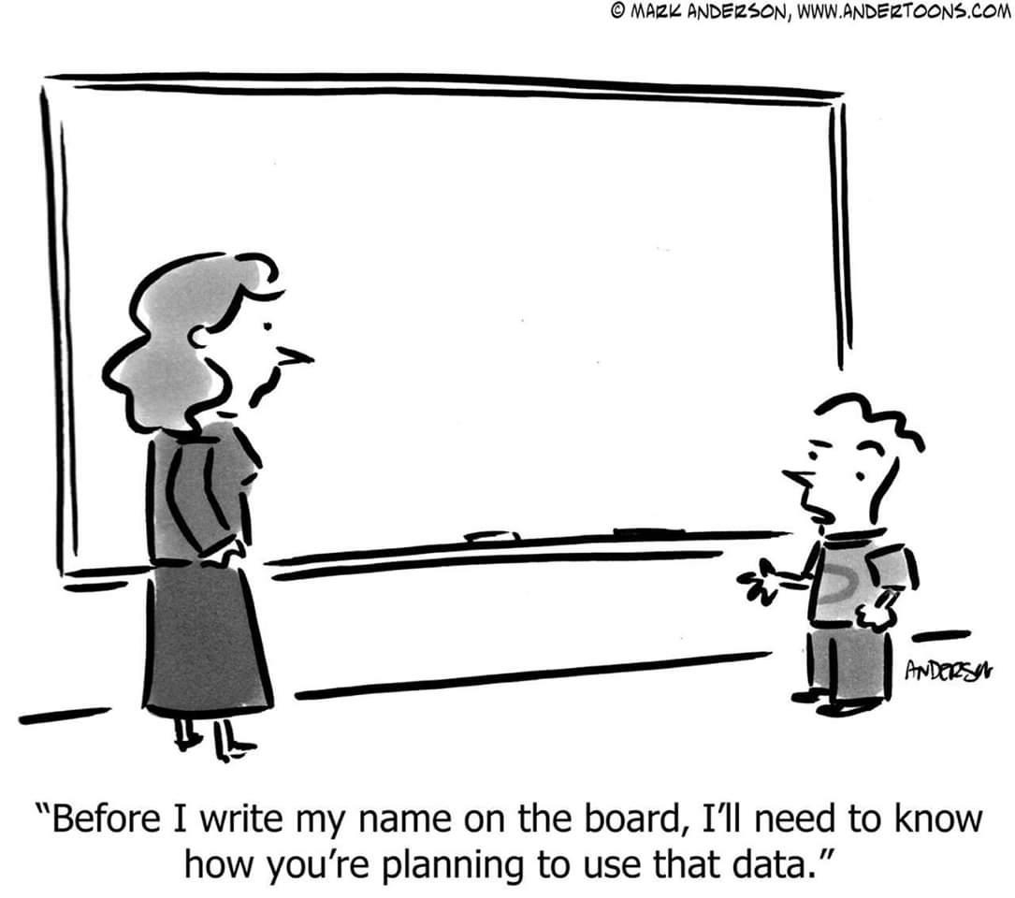
The Triad
Confidentiality
Protecting Data Privacy
Organizations collect a large amount of data and much of this data is not sensitive because it is publicly available, like names and telephone numbers.
Other data collected, though, is sensitive. Sensitive information is data protected from unauthorized access to safeguard an individual or an organization.
Nitheesh Murugan Kaliyamurthy | n.Kaliyamurthy@uwtsd.ac.uk

Slide 15
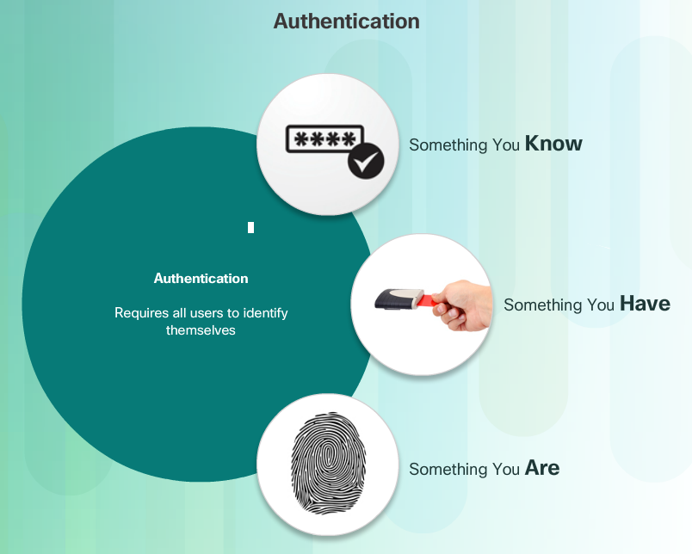
The Triad
Confidentiality
Controlling Access
Access control defines a number of protection schemes that prevent unauthorized access to a computer, network, database, or other data resources.
The concepts of AAA involve three security services.
Nitheesh Murugan Kaliyamurthy | n.Kaliyamurthy@uwtsd.ac.uk

Slide 16
The Triad
Confidentiality - Controlling Access
Authentication verifies the identity of a user to prevent unauthorized access. Users prove their identity with a username or I.D.
Authorization services determine which resources users can access, along with the operations that users can perform. Authorization can also control when a user has access to a specific resource.
Accounting keeps track of what users do, including what they access, the amount of time they access resources, and any changes made.
Nitheesh Murugan Kaliyamurthy | n.Kaliyamurthy@uwtsd.ac.uk

Slide 17
The Triad
Integrity
Integrity is the accuracy, consistency, and trustworthiness of data during its entire life cycle. In other words, quality.
Methods used to ensure data integrity include hashing, data validation checks, data consistency checks, and access controls.
Nitheesh Murugan Kaliyamurthy | n.Kaliyamurthy@uwtsd.ac.uk

Slide 18
The Triad
Integrity
The need for data integrity varies based on how an organization uses data.
  For example, Facebook does not verify the data that a user posts in a profile.
  A bank or financial organization assigns a higher importance to data integrity than Facebook does. Transactions and customer accounts must be accurate.
Protecting data integrity is a constant challenge for most organizations. Loss of data integrity can render entire data resources unreliable or unusable.
An integrity check is a way to measure the consistency of a collection of data (a file, a picture, or a record). The integrity check performs a process called a hash function to take a snapshot of data at an instant in time.
Nitheesh Murugan Kaliyamurthy | n.Kaliyamurthy@uwtsd.ac.uk

Slide 19
The Triad
Availability
Data availability is the principle used to describe the need to maintain availability of information systems and services at all times.
Cyberattacks and system failures can prevent access to information systems and services.
Nitheesh Murugan Kaliyamurthy | n.Kaliyamurthy@uwtsd.ac.uk

Slide 20
The Triad
Availability
Methods used to ensure availability include system redundancy, system backups, increased system resiliency, equipment maintenance, up-to-date operating systems and software, and plans in place to recover quickly from unforeseen disasters.
High availability systems typically include three design principles:
  eliminate single points of failure,
  provide for reliable crossover, and
  detect failures as they occur.
Nitheesh Murugan Kaliyamurthy | n.Kaliyamurthy@uwtsd.ac.uk

Slide 21
The Triad
Availability
Organizations can ensure availability by implementing the following:
  Equipment maintenance
  OS and system updates
  Test backups
  Plan for disasters
  Implement new technologies
  Monitor unusual activity
  Test to verify availability
Nitheesh Murugan Kaliyamurthy | n.Kaliyamurthy@uwtsd.ac.uk

Slide 22
States of Data!!!
Storage
Stored data refers to data at rest. Data at rest means that a type of storage device retains the data when no user or process is using it.
A storage device can be local (on a computing device) or centralized (on the network). A number of options exist for storing data.
Nitheesh Murugan Kaliyamurthy | n.Kaliyamurthy@uwtsd.ac.uk

Slide 23
States of Data!!!
Storage
Direct-attached storage (DAS) is storage connected to a computer.
  A hard drive or USB flash drive is an example of direct-attached storage.
Redundant array of independent disks (RAID) uses multiple hard drives in an array, which is a method of combining multiple disks so that the operating system sees them as a single disk. RAID provides improved performance and fault tolerance.
A network attached storage (NAS) device is a storage device connected to a network that allows storage and retrieval of data from a centralized location by authorized network users.
  NAS devices are flexible and scalable, meaning administrators can increase the capacity as needed.
A storage area network (SAN) architecture is a network-based storage system.
  SAN systems connect to the network using high-speed interfaces allowing improved performance and the ability to connect multiple servers to a centralized disk storage repository.
Nitheesh Murugan Kaliyamurthy | n.Kaliyamurthy@uwtsd.ac.uk

Slide 24

States of Data!!!
Transit
Data transmission involves sending information from one device to another. There are numerous methods to transmit information between devices including:
Sneaker net – uses removable media to physically move data from one computer to another
Wired networks – uses cables to transmit data
Wireless networks – uses the airwaves to transmit data
The protection of transmitted data is one of the most challenging jobs of a cybersecurity professional. The greatest challenges are:
Protecting data confidentiality – cyber criminals can capture, save and steal data in-transit.
Protecting data integrity – cyber criminals can intercept and alter data in-transit.
Protecting data availability - cyber criminals can use rogue or unauthorized devices to interrupt data availability.
Nitheesh Murugan Kaliyamurthy | n.Kaliyamurthy@uwtsd.ac.uk

Slide 25
States of Data!!!
Process
The third state of data is data in process. This refers to data during initial input, modification, computation, or output.
Protection of data integrity starts with the initial input of data.
Organizations use several methods to collect data, such as manual data entry, scanning forms, file uploads, and data collected from sensors.
Each of these methods pose potential threats to data integrity.
Data modification refers to any changes to the original data such as users manually modifying data, programs processing and changing data, and equipment failing resulting in data modification.
Processes like encoding/decoding, compression/decompression and encryption/decryption are all examples of data modification. Malicious code also results in data corruption.
Nitheesh Murugan Kaliyamurthy | n.Kaliyamurthy@uwtsd.ac.uk

Slide 26
Countermeasures and Frameworks
Software-based Technology Safeguards
Hardware-based Technology Safeguards
Firewall appliances, Intrusion Detection Systems (IDS),Intrusion Prevention Systems (IPS) and Content filtering systems
Network-based Technology Safeguards
  Virtual Private Network (VPN)
  Network access control (NAC)
  Wireless access point security
Cloud-based Technology Safeguards
  Software as a Service (SaaS)
  Infrastructure as a Service (IaaS)
  Virtual security appliances
Nitheesh Murugan Kaliyamurthy | n.Kaliyamurthy@uwtsd.ac.uk

Slide 27

Countermeasures and Frameworks
Security policy
Standards
Guidelines
Procedure
The International Organization for Standardization (ISO)/International Electrotechnical Commission (IEC) developed a comprehensive framework to guide information security management.
The ISO cybersecurity model is to cybersecurity professionals what the OSI networking model is to network engineers. Both provide a framework for understanding and approaching complex tasks.
Nitheesh Murugan Kaliyamurthy | n.Kaliyamurthy@uwtsd.ac.uk

Slide 28
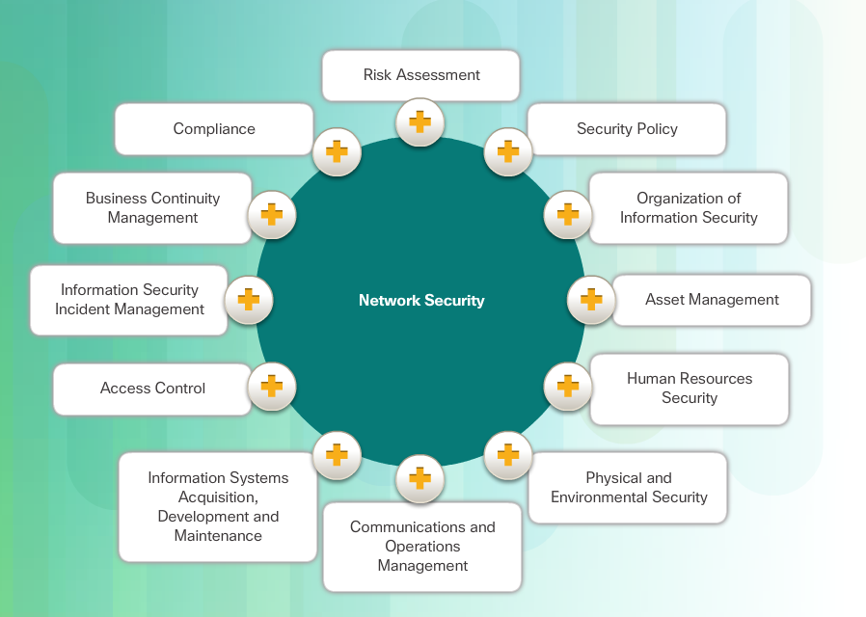
Countermeasures and Frameworks
ISO/IEC 27000 is an information security standard published in 2005 and revised in 2013.
ISO publishes the ISO 27000 standards.
Nitheesh Murugan Kaliyamurthy | n.Kaliyamurthy@uwtsd.ac.uk

Slide 29


Contents/ References/ Images used in this Presentation:
Contents & Selective Images : Cisco Networking Academy Course – Network Essentials | Selective images from Bing Internet Search | Cybersecurity Anatomy _{https://youtu.be/7egBsN_4B2A}

Slide 30
Reminders/ Action Plans:
All your homeworks – Independent Learning – Will be useful to complete your Assessments (Component 1 & 2).

