Slide 1
BMSW5001 Developing workplace critical thinking
Week 9
Theories of management
(Systems approach)

Slide 2

Recap
Classical management theory
  Scientific
  Bureaucracy
  Administrative
Behavioural school
Quantitative school
Modern theory
  Systems
  Contingency
Notes:
We would only look at the classical and modern theories in this module, Behavioural and Quantitative schools would be covered in the other modules.

Slide 3
Systems Approach

Slide 4
Systems approach to Management
Most modern approaches to management have integrated and expanded the key concepts developed within the classical approaches
Modern theory of management is studied in 2 phases:
  Systems approach
  Contingency approach

Slide 5
What is a system?
A system is a collection of interrelated parts which form some whole – like the human body – Cole and Kelly (2015)
Or, the term ‘System’ may be defined as a set of interrelated and interacting components assembled in a particular sequence so as to produce some results.

Slide 6
Systems approach and examples
The system approach is a management approach whereby attention is focused on the total work of the organisation and the interrelationships of structure and behaviour and the range of the variables within the organisation.
  For e.g. A tree is a system of leaves, branches, trunk, that together interact through photosynthesis and other processes to create outcomes far larger than what any single part could create.
  The tree itself could be a part of a larger system like a forest or the ecosystem.
  Neighbourhood Cities Regions Nation

Slide 7
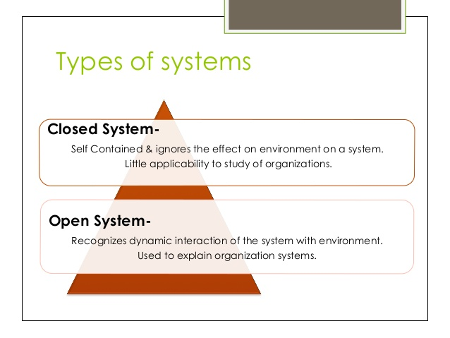
7

Slide 8
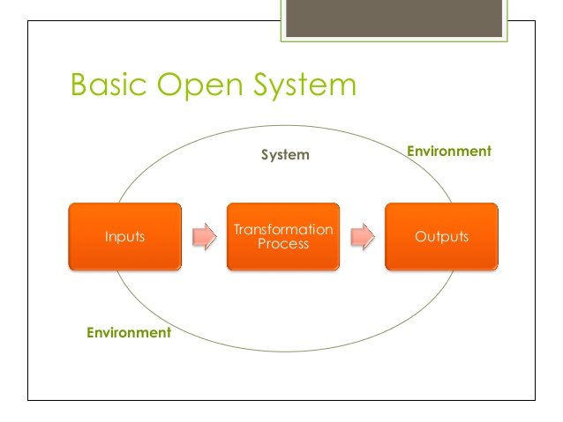

Slide 9
Elements of an open system
Input
Transformation
Output
Feedback
The environment
Notes:
Feedback as an element is discussed later in this session

Slide 10
An Industrial Organization as an Open System
Notes:
Take a look at the diagram and attempt to rationalise it. Using an example, make an attempt to explain how this system works

Slide 11
Importance of the Systems perspective
For managers, it permits seeing the organization as a whole with interdependent parts.
Prevents lower-level managers from viewing their jobs as static or isolated.
Encourages managers to identify and understand the environment.
More effective problem solving
Satisfaction of all stakeholders

Slide 12
Other properties of systems

Slide 13
Goals & Equifinality
Goals in a system are contingent and negotiated.
Equifinality:
  There is no best way to organise
  All ways of organising are not equally effective

Slide 14
Feedback
Negative feedback: Seeks to correct or reduce deviations in the system’s processes to re-establish a steady course back in the direction of the system’s goal
Positive feedback: Changes the system in ways that amplify and enhance current processes.

Slide 15
Entropy
The amount of order or lack of order in a system – (Cambridge Dictionaries, 2020)
Systems tend to run down and move towards disorganisation.
Balance: Energy, resources, and information coming into the system help it reach equilibrium.
Notes:
Entropy is a feature of systems as they tend to move toward disorganisation if unsupervised. This also supplements the Chaos theory.

Slide 16
Systems theory – related areas
Chaos theory
Learning organisations by Peter Senge
Karl Weick’s research on loosely coupled systems.
Notes:
Some of these related are not wholly within the field of management and are outside the scope of learning in this module.

Slide 17
TEST YOUR UNDERSTANDING

Slide 18
Group activity: Open systems
In groups, think about any organisation of your choice as a system and explain how they operate as an organisation within that system.

Slide 19
ANY QUESTIONS?

Slide 20
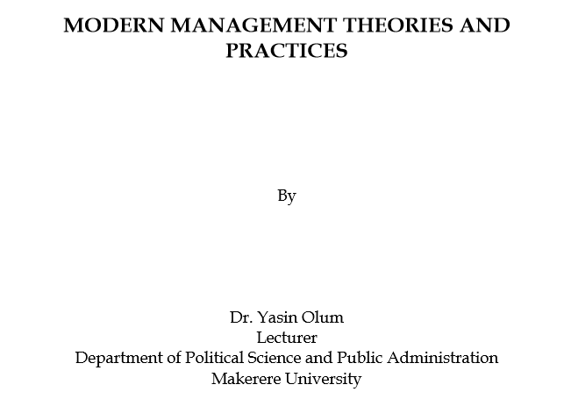
Home work read
Notes:
Available on Moodle

