Slide 1
My name: Petko Tonev Petkov
My student number: 2125440
Lecturer name: Chijioke Uba
Module name: Problem Solving and Decision Making
Module code: BMSW4004
Assignment name: Component 1 Solving the problem of profit decline in TM Lewin
Why has the company TM Lewin got a decreased amount of sales, what caused the decrease in profit and how can this issue be resolved?

Slide 2




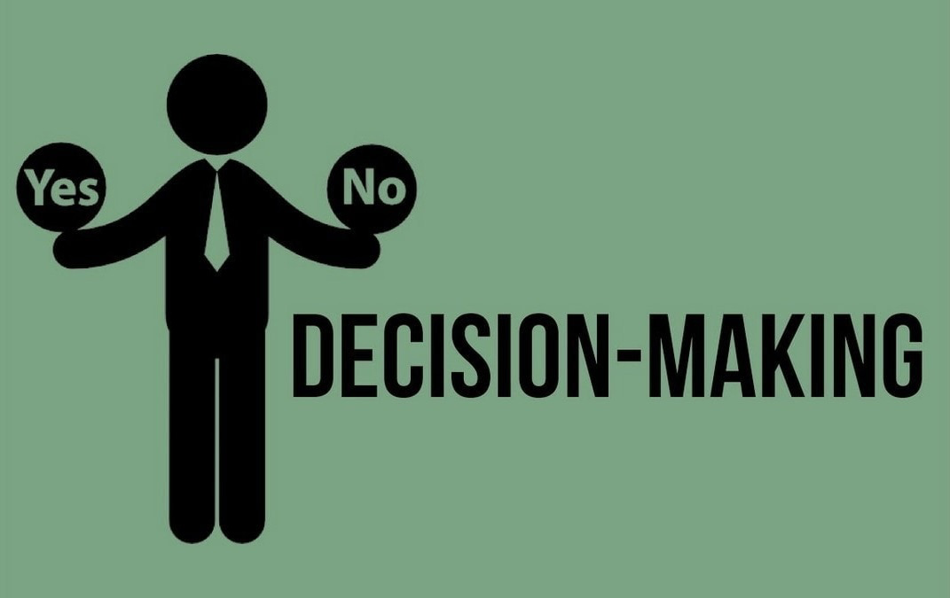
What is the nature and meaning of problem solving and decision making.
Problem solving: Problem solving. Problem solving is the act of defining a problem; determining the cause of the problem; identifying, prioritising, and selecting alternatives for a solution; and implementing a solution.
Decision making: Determining a decision, acquiring data, and weighing potential solutions are all steps in the decision-making process.
You can make more careful, intelligent decisions by organising pertinent information and outlining alternatives by following a step-by-step decision-making process.
Understanding the actual nature and impact of Profit Decline on the employees of TM Lewin and its company in general.
Nature of profit decline, profit decline could happen for numerous reasons, it could be external factors, which cant be determined by the company itself (as it mainly is in this case) or it could also be something within the company’s organisation and progression which has led to its profit decline?
How and why were employees of the company affected by the profit decline?
What has been the effect of each cause and the importance of each cause within the declining of profit?

Slide 3
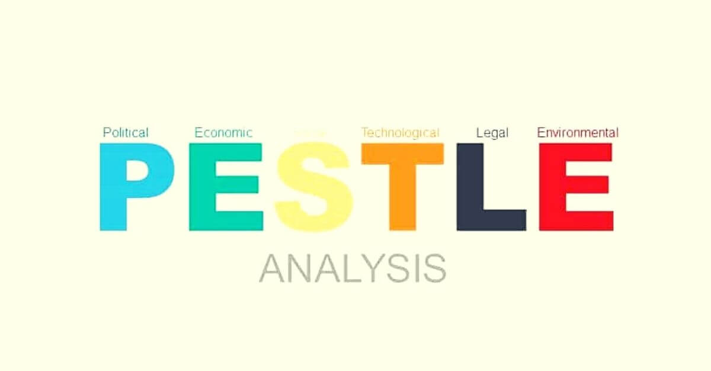
In this presentation, I will be using 2 of the main evaluation and analysis tools.
First tool is PESTEL, PESTEL is a tool, which allows us to break down and thoroughly analyse the EXTERNAL factors and features we might have to consider when we think of causes for the lowered profit and when we think of a solution for TM Lewin company and brand.
This technique is known for ‘scanning the business environment’ this will help us understand the limitations of TM Lewin and why the company has decreased in sales and help us find out what is the main cause of the decrease in profit.

Slide 4
A thorough analysis on TM Lewin‘s case using the PESTEL analysis technique.
Factors to consider: | How has each external factor affected TM Lewin’s decrease of profit.
Political | This is one of the most considerable factors in the TM Lewin‘s decrease of profit because as we know from the case study when the global pandemic started, the company accordingly started losing profit. This is simply because the impact of limiting people globally to working from home means that the people would stop purchasing the official clothing items that TM Lewin sells.
Social | During the pandemic, people did drastically have to change the ways they live and when they go out, be mindful, not spend as much time out and around shops. This is because most were closed, only essential stocks were sold. This impacted the company because there was no physical shop where people could go and try on and purchase their clothing line.
Legal | Not necessarily applicable
Economic | In terms of economical influence, there were many products with increased prices on the market that are essential for humans. For instance, the shortage of oil, petrol, even sanitary products were increased in price. Therefore, people have shifted their focus on purchasing these essential products instead of luxury official office clothing that TM Lewin offers.
Technological | Not necessarily applicable
Environmental | Not necessarily applicable

Slide 5
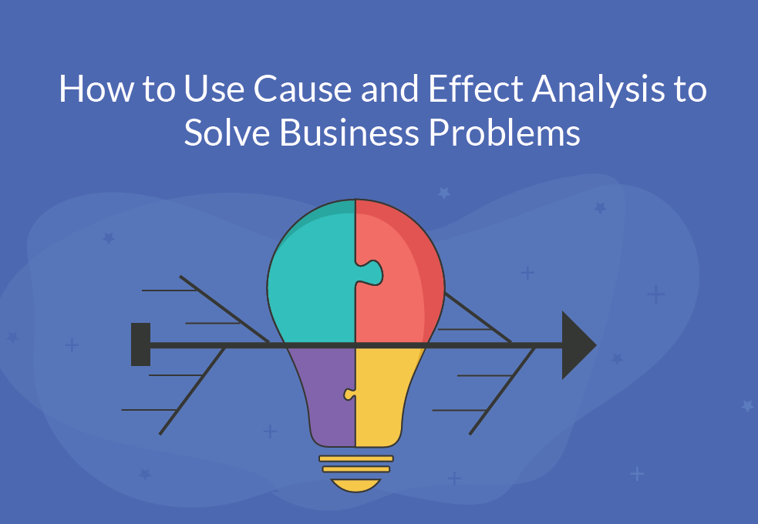

The next analysis technique is so called the Fishbone analysis.
It is called FISHBONE because it breaks down and evaluates the causes of a problem and also the importance of each cause linked to the effect it has on the specific company and which one of these causes is the main one by the importance of the effect it has on creating and causing the problem itself.
It is also known as the (cause and effect diagram) which suggests that this technique not only helps us brainstorm the causes of a problem, but also to identify which one is the main one and then selectively classify the importance of each cause.
Also important factor of the FISHBONE analysis is that it allows for us to just brainstorm what we find as important in the causes and link it back to the effect it has on the company in this case TM Lewin not being able to increase profit, but instead declining in profit because of: Pandemic, Society changing and adapting to new environments and laws, the lack of physical visitation of shops and more…

Slide 6
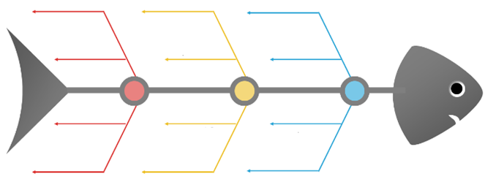
A demonstration of causes and effects on profit decline in TM Lewin using a fishbone diagram
The decline of profit in TM Lewin?
z

Slide 7
Next step is to create a grid analysis and demonstrate an even further breakdown of the importance of each factor and its effect on the company’s low profit

Slide 9
References list:
Hickson, L. and Khemka, I., 2013. Problem solving and decision making. The Oxford handbook of positive psychology and disability, pp.198-225.

