Slide 1
Hospitality and guest services
Module code: BMIH4003
Module tutor: Deborah Ann Lloyd
BY:Marian Cristian Avram
ID: 2235127

Slide 2
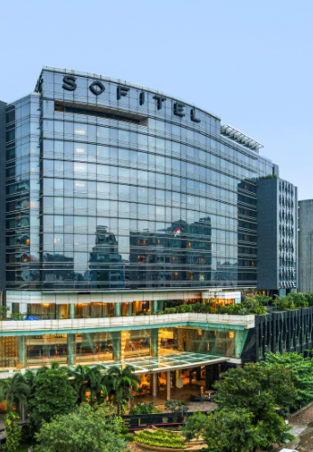
Sofitel
(michelin, 2021)

Slide 3
Introduction:
Synonymous with five-star accommodations blending French style and regional flavor.
Renowned for luxurious accommodations, succulent cuisine, and art and design.
Fuses French art de vivre with the spirit of a destination.
Premier lodging choice for discerning guests seeking cultural enrichment, high-end amenities, and customized service (Acharya, Sengupta, & Mishra, 2011).
(michelin, 2021)
Notes:
The name Sofitel is synonymous with five-star accommodations that blend traditional French style with regional flavor.
It is renowned worldwide for its luxurious accommodations, succulent cuisine, and attention to art and design.
By fusing French art de vivre with the spirit of a destination, Sofitel has established itself as a premier lodging option for discerning guests seeking cultural enrichment, high-end amenities, and customized service (Acharya, Sengupta, & Mishra, 2011).

Slide 4
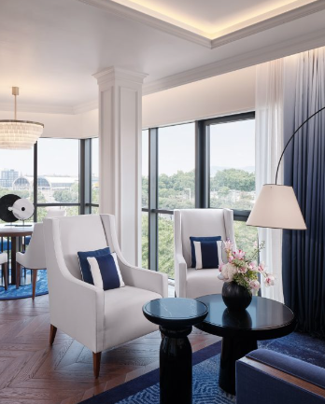
The guest list of Sofitel Hotel:
(Sofitel, 2022)
Guests of the Sofitel consist of:
Spa and wellness Seekers.
Meeting and Event Attendees
Luxury Travelers
Royal families
Historic or architecture-significant tourists.

Slide 5
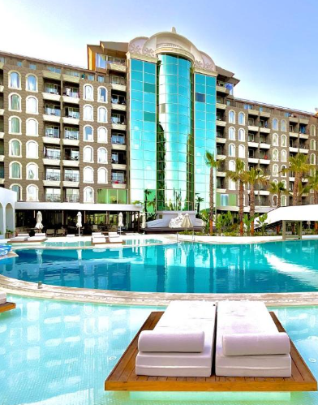
Nature, Scope, and Existing Tourism Infrastructure of Other Hotels:
Nature of Other Hotels:
Hotels are known for boutique design, eco-friendliness, family-friendliness, or cultural themes.
Located in city centers, on beaches, in mountain resorts, or in historic districts.
Common amenities include pools, fitness centers, restaurants, bars, conference facilities, and event spaces (Barsky & Nash, 2002).
(Gites, 2018)
Notes:
Nature of Other Hotels:
Some hotels are known for their boutique design, eco-friendliness, family-friendliness, or cultural theme (Barsky & Nash, 2002).
Other hotels are in the city center, on the beach, in a mountain resort, or a historic district.
Hotels usually offer pools, fitness centers, restaurants, bars, conference facilities, and event spaces.

Slide 6
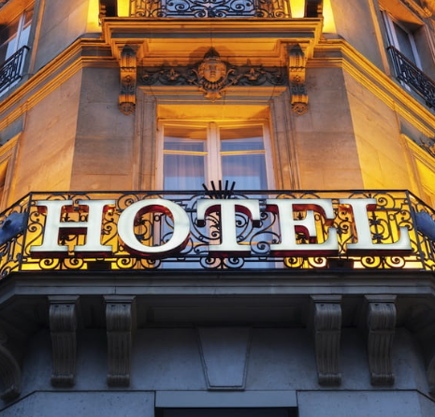
Scope of Other Hotels:
Hotels offer a range of dining options from cafes to fine dining.
Spa and wellness centers for guest health and relaxation.
Encouragement of guest participation in local culture through art exhibitions, performances, and cultural activities.
(Nancy, 2013)
Notes:
Numerous hotels provide a variety of dining options, spanning from cafes to fine dining establishments with a wide variety of cuisines and menu items.
Several hotels offer spa and wellness centers for the health and relaxation of their visitors.
Some hotels encourage customer participation in the local culture by hosting art exhibitions, performances, and other cultural activities (Gentry & Kalliny, 2008).

Slide 7
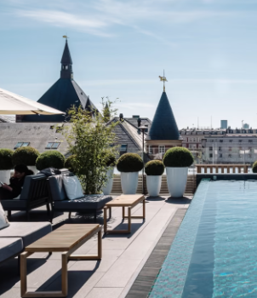
Hospitality and Guest Service of Other Hotels:
Personal assistance is a standard hotel service.
Accommodation of unique requests like dietary restrictions.
Concierge services for guest assistance.
Room service offering meals, snacks, and beverages for convenience (Guzzo, 2010).
(Isabel & Richard, 2023)
Notes:
Personal assistance is a standard component of hotel visitor services. It is possible to accommodate unique requests such as dietary restrictions and event capacities.
Numerous hotels offer concierge services, with knowledgeable personnel available to assist guests with anything they may need during their stay.
Many hotels now offer room service for their visitors' enjoyment and convenience, delivering a variety of meals, snacks, and beverages directly to their rooms (Guzzo, 2010).

Slide 8
Nature, Scope, and Existing Hospitality and Guest Service of Sofitel:
Nature of Sofitel:
Blend of French elegance and local culture.
Mix of local culture and modern French architecture.
Presence in key business and leisure destinations worldwide.
A global chain of five-star hotels offering unique cultural experiences.
Emphasis on art and design for visual appeal.
Notes:
Nature of Sofitel:
Sofitel hotels combine French elegance with local culture. These hotels are a refined combination of local culture and modern French architecture.
Sofitel operates hotels in the world's most important business and leisure destinations.
Sofitel is a global chain of five-star hotels that provides visitors with distinctive cultural experiences. Art and design have a significant impact on the visual appeal of their spaces.

Slide 9
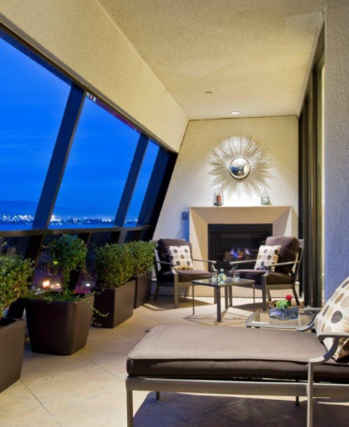
Scope of Sofitel :
Emphasis on cuisine and drink.
Upscale and casual dining options.
Offerings of international and regional cuisine.
Amenities include swimming pools, fitness centers, restaurants, bars, event spaces, and recreational activities (Hallowell, 1996).
(Sofitel, 2021)
Notes:
The Sofitel focuses on cuisine and drink, providing both upscale and casual dining options (Hallowell, 1996).
The restaurants at the Sofitel offer both international and regional cuisine.
Additionally, the hotel provides amenities and services to pamper visitors like swimming pools, fitness centers, restaurants, bars, event spaces, and recreational activities.

Slide 10
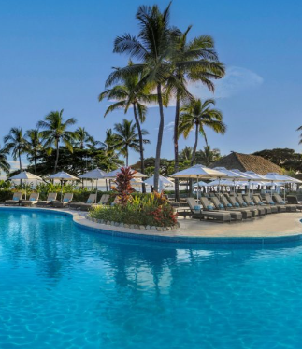
Hospitality and Guest Services of Sofitel:
Renowned for exceptional hospitality and individualized attention.
Free concierge services at all Sofitel hotels.
Professional concierge for reservations and activity arrangements.
Some Sofitel hotels offer world-class leisure and wellness facilities (Karatepe & Ekiz, 2004).
(Pacific, 2014)
Notes:
Sofitel is renowned for its exceptional hospitality and individualized attention to each visitor.
Free concierge services are available at all Sofitel accommodations. A professional concierge available to make reservations, and activity arrangements can significantly enhance a guest's stay.
Several Sofitel hotels feature among the world's finest leisure and wellness facilities (Karatepe & Ekiz, 2004).

Slide 11
Comparison between Sofitel Hotel and LXR Hotel:
Sofitel:
Luxury hotel chain with French and local fusion.
Blend of French elegance and contemporary style.
Design or art motifs as an attraction.
Wide range of dining options.
Global presence in major cities and tourist destinations.
Signature guest services include concierge, leisure, wellness, business assistance, and event planning (Salazar, Costa, & Rita, 2004).
Notes:
Sofitel:
Sofitel is a luxury hotel chain that incorporates French style with local flavor. French elegance is frequently paired with a more contemporary appearance.
Typically, Sofitel hotels feature a design or art motif to attract guests who value the finest things in life.
Focusing on regional and international cuisines, the name incorporates all types of restaurants, from fine dining to casual cafes.
Sofitel is a worldwide hotel chain with locations in the majority of main cities and vacation spots.
Signature Sofitel guest services include concierge, leisure, wellness, assistance for business travelers, and event planning (Salazar, Costa, & Rita, 2004).

Slide 12
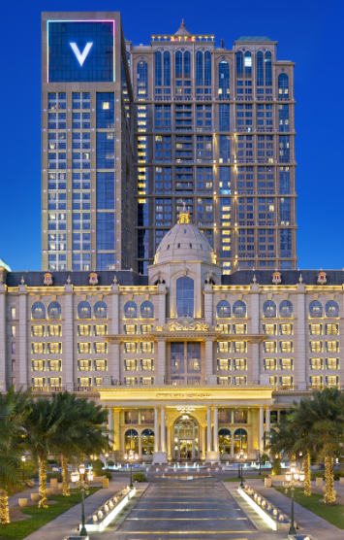
Continued:
Upscale lodgings with regional flavor.
Authentic, all-encompassing adventures.
Distinctive accommodations.
Part of the Hilton family.
5-star accommodations in unique locations.
Personalized experiences, local cuisine, and activities.
(LXR, 2018)
Notes:
LXR Hotels:
The LXR Hotels by Hilton brand features upscale lodgings with a regional flavor.
At LXR Hotels, you can expect authentic, all-encompassing adventures that highlight the best of the region's culture and ecology.
LXR accommodations are distinctive and authentic to their environments and cultures.
A member of the Hilton family, LXR Hotels offers 5-star accommodations in unusual locations.
Guests of LXR Hotels can immerse themselves in the local culture thanks to personalized experiences, delectable cuisine, and an incredible selection of local activities (Tideswell & Fredline, 2004).

Slide 13
Meeting client expectations.
Ensure Quality
Timely Responses
Solicit Feedback
Create Memorable Experiences
Resolve Issues Gracefully
(Sofitel, 2021)
Notes:
Ensure Quality: Maintain high standards of quality in all aspects of your service, from cleanliness and comfort to the quality of food and amenities.
Timely Responses: Respond to client inquiries and requests promptly. Whether it's answering a question or addressing a concern, timeliness is key.
Solicit Feedback: Encourage clients to provide feedback on their experience. Use this feedback to make improvements and address any issues promptly.
Create Memorable Experiences: Aim to create memorable experiences that go beyond meeting basic needs. Offer unique touches or surprises to make their stay or visit unforgettable.
Resolve Issues Gracefully: Mistakes and issues can happen. The key is in how you handle them. Resolve any problems gracefully and make amends when necessary.

Slide 14
My Job Role of Guest Services
Concierge Services
Problem Resolution
Billing and Payments
Guest Information
Local Knowledge
Loyalty Programs
Communication
Adaptability
Positive Attitude
(Pacific, 2014)
Notes:
Concierge Services: Offer concierge services, including assistance with restaurant reservations, transportation, and local recommendations.
Problem Resolution: Proactively address and resolve guest concerns and issues to their satisfaction.
Billing and Payments: Handle billing and payment processes accurately and efficiently.
Guest Information: Maintain guest information and records confidential and secure.
Local Knowledge: Possess knowledge of the local area, attractions, and services to assist guests effectively.
Loyalty Programs: Promote and explain loyalty programs or rewards for returning guests.
Communication: Communicate effectively with other hotel staff to ensure a seamless guest experience.
Adaptability: Be adaptable and responsive to changing guest needs and situations.
Positive Attitude: Maintain a positive and professional attitude in all interactions with guests.

Slide 15
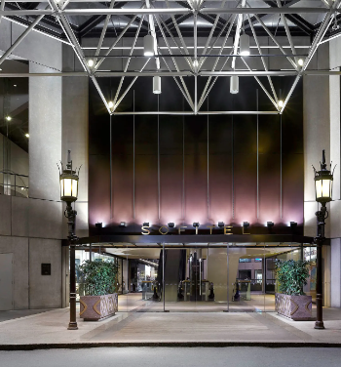
Conclusion:
Renowned for French cuisine, art, design.
Dedication to luxury, culture, art.
Attracts guests seeking French elegance.
Known for exceptional hospitality and guest service.
Builds a loyal client base.
(Traveller, 2018)
Notes:
Sofitel is renowned for its exceptional French cuisine, art, and interior design. Visitors interested in French elegance will enjoy it. Character, values, and guest services exemplify Sofitel's dedication to luxury, culture, and art, attracting wealthy guests in search of an authentic taste of France. They are known for their hospitality and guest service which enhances the preferences of the tourists resulting in permanent clientage.

Slide 16
References:
Acharya, S. B., Sengupta, P. P., & Mishra, R. (2011). Exploring customer loyalty :A study on fast food outlines in the city of chenna. International Journal of Multidisciplinary Research., 175 183.
Barsky, & Nash, L. (2002). Evoking emotion: affective keys to hotel loyalty. Cornell Hotel and Restaurant Administration Quarterly, 39-46.
Gentry, L., & Kalliny, M. (2008). Consumer Loyalty – A Synthesis, Conceptual Framework, and Research Propositions. The Journal of American Academy of Business, Cambridge, 1-9.
Gites. (2018). Laur Hotels Experience & Elegance. Retrieved from Gites.fr: https://www.gites.fr/gites_laur-hotels-experience--elegance_didim_h1786469_en.htm
Guzzo, R. (2010). Customer Satisfaction in the Hotel Industry: A Case Study from Sicily . International Journal of Marketing Studies, 1-12.
Hallowell, R. (1996). The relationships of customer satisfaction, customer loyalty, and profitability: an empirical study. International Journal of Service,, 27-42.
Isabel, B., & Richard, M. (2023). Financial Times . Retrieved from Keys to Copenhagen: five standout hotels: https://www.ft.com/content/c5d572a2-dfd6-41b3-9463-a5222cf88679
Karatepe, O., & Ekiz, E. (2004). The effects of organizational responses to complaints on satisfaction and loyalty: a study of hotel guests in Northern Cyprus. Journal of Managing Service Quality. Journal of Managing Service Quality, 476-486.
Kundampully, J. S. (2000). Customer loyalty in the hotel industry : the roll of customer satisfaction and image. International Journal of Contemporory Hospitality Management , 346 351.
LXR. (2018). Dream destinations and immersive experiences are at the heart of LXR. Retrieved from LXR hotels and Resorts: https://stories.hilton.com/brands/lxr-hotels
michelin. (2021). Sofitel Mumbai BKC. Retrieved from michelin: https://guide.michelin.com/ca/en/hotels-stays/mumbai/sofitel-mumbai-bkc-6572?arr=2023-11-17&dep=2023-11-18
Nancy, T. (2013). Best apps for booking last-minute hotel rooms. Retrieved from USA Today: https://www.usatoday.com/story/travel/hotels/2013/10/28/apps-booking-last-minute-hotels/3145765/
Pacific, S. (2014). Sofitel Fiji Resort and Spa. Retrieved from South Pacific: https://southpacificbydesign.com/product/334/sofitel-fiji-resort-and-spa
Salazar, A., Costa, J., & Rita, P. (2004). Relationship between Service Quality, Customer Satisfaction and Behavioural Intentions: A Study on the Hospitality Sector. . Murcia : EMACEuropean Marketing Academy Conference.
Sofitel. (2021). ROOMS & SUITES. Retrieved from Sofitel: https://www.sofitel-los-angeles.com/
Sofitel. (2022). BE OUR GUEST. Retrieved from Sofitel: https://www.sofitelbarcelona.com/
Tideswell, C., & Fredline, E. (2004). Developing and Rewarding Loyalty to Hotels: The Guest's Perspective. Journal of Hospitality & Tourism Research., 28-186.
Traveller, n. (2018). Sofitel Melbourne on Collins. Retrieved from CN Traveller: https://www.cntraveler.com/hotels/australia/melbourne/sofitel-melbourne-on-collins

