Slide 1
Eich Strategaeth Chwilio Swyddi Gwag
Your Vacancy Searching Strategy
20m Ex 10m

Slide 2
Eitem | Rh. / No. | Item
Gwybodaeth Gyrfaoedd o Ansawdd | A | Quality Careers Information
Strategaeth chwilio swyddi gwag | B | Vacancy searching strategy

Slide 3
Beth ydym ni'n ei olygu? | A | What do we mean?

Slide 4


Slide 5

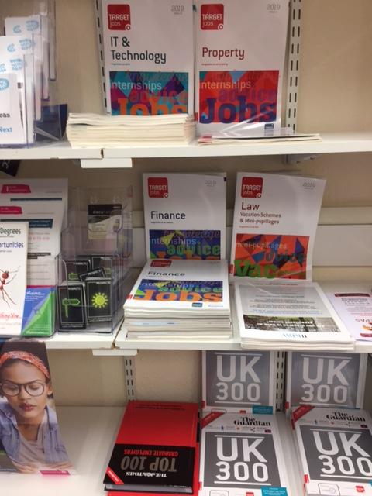

Slide 6

https://www.uwtsd.ac.uk/careers/
https://www.uwtsd.ac.uk/cy/gyrfaoedd/

Slide 7
Dewis swyddi gwag | B | Selecting vacancies

Slide 8
Swydd Wag
Swydd neu swydd heb ei feddiannu
Strategaeth
Cynllun gweithredu wedi'i gynllunio i gyflawni nod hirdymor neu gyffredinol
Vacancy
An unoccupied position or job
Strategy
A plan of action designed to achieve a long-term or overall aim

Slide 9
Swydd Wag
Swydd neu swydd heb ei feddiannu
Strategaeth
Cynllun gweithredu wedi'i gynllunio i gyflawni nod hirdymor neu gyffredinol
Vacancy
An unoccupied position or job
Strategy
A plan of action designed to achieve a long-term or overall aim

Slide 10
Y manylion
The detail

Slide 11



+ve
CV
4P
Vacancy Sources | Your ‘machine’ |  | Criteria x2 | Your Target(s)

Slide 12
+ve
CV
4P
Vacancy Sources | Your ‘machine’ |  | Criteria x2 | Your Target(s)
ON-LINE Search engines Vacancy sites Industry sites Agency sites Employers SN OFF-LINE All the above Media Network Word of Mouth Speculative

Slide 13

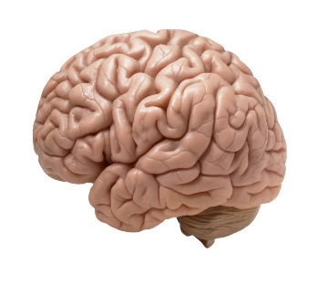


+ve
CV
4P
Vacancy Sources | Your ‘machine’ |  | Criteria x2 | Your Target(s)
ON-LINE Search engines Vacancy sites Industry sites Agency sites Employers SN OFF-LINE All the above Media Network Word of Mouth Speculative | SELF Gender Family Ethnicity Values Beliefs | MINDSET Attribution 2.0 Generic (CC BY 2.0)Michael de groot
 | CV | POSITIONING

Slide 14
+ve
CV
4P
Vacancy Sources | Your ‘machine’ |  | Criteria x2 | Your Target(s)
ON-LINE Search engines Vacancy sites Industry sites Agency sites Employers SN OFF-LINE All the above Media Network Word of Mouth Speculative | SELF Gender Family Ethnicity Values Beliefs | MINDSET Attribution 2.0 Generic (CC BY 2.0)Michael de groot | CURRENCIES HARD Qualifications Experience Skills Knowledge Place £ / Hours Contract SOFT Personality Values Brand Image Fit Culture
 | CV | POSITIONING

Slide 15
+ve
CV
4P
Vacancy Sources | Your ‘machine’ |  | Criteria x2 | Your Target(s)
ON-LINE Search engines Vacancy sites Industry sites Agency sites Employers SN OFF-LINE All the above Media Network Word of Mouth Speculative | SELF Gender Family Ethnicity Values Beliefs | MINDSET Attribution 2.0 Generic (CC BY 2.0)Michael de groot | HARD Qualifications Experience Skills Knowledge Place £ / Hours Contract SOFT Personality Values Brand Image Fit Culture | ? Number Deadlines Application Technical
 | CV | POSITIONING

Slide 16
+ve
CV
4P
Vacancy Sources | Your ‘machine’ |  | Criteria x2 | Your Target(s)
ON-LINE Search engines Vacancy sites Industry sites Agency sites Employers SN OFF-LINE All the above Media Network Word of Mouth Speculative | SELF / VB Gender Family Ethnicity Values Beliefs | MINDSET Attribution 2.0 Generic (CC BY 2.0)Michael de groot | HARD Qualifications Experience Skills Knowledge Place £ / Hours Contract SOFT Personality Values Brand Image Fit Culture | ? Number Deadlines Application Technical Support available Feedback & improvement
 | CV | POSITIONING

Slide 17
Cwestiynau?
Questions?
20m Ex 10m

Slide 18
End gap start

