Slide 1
The Complex Problem Of Job Dissatisfaction among UK Workers
Student Name: Sonia Dworkin
Student Number: 2028974
Module Code: BMSW 4004
Lecturer: Chijioke Uba

Slide 2
What is Issues that lead to stress among UK workers?
Nature of the problem
Impact of the problem on workers
UK employee’s Job dissatisfaction highlight’s a complex problem.
It has various dimensions (individual, intentional and social)
Females on average experience stress more than Men.
Impact of the problem on organisation
Managing sustainability, reduced productivity, impacting negatively on profits.
Causes stress and reduces worker productivity
Impact Negatively on family life
Work-related stress and Mental illness accounts for over half of work absences.
British businesses estimated £26 billion per annum.
Events in life which are more stressful

Slide 3
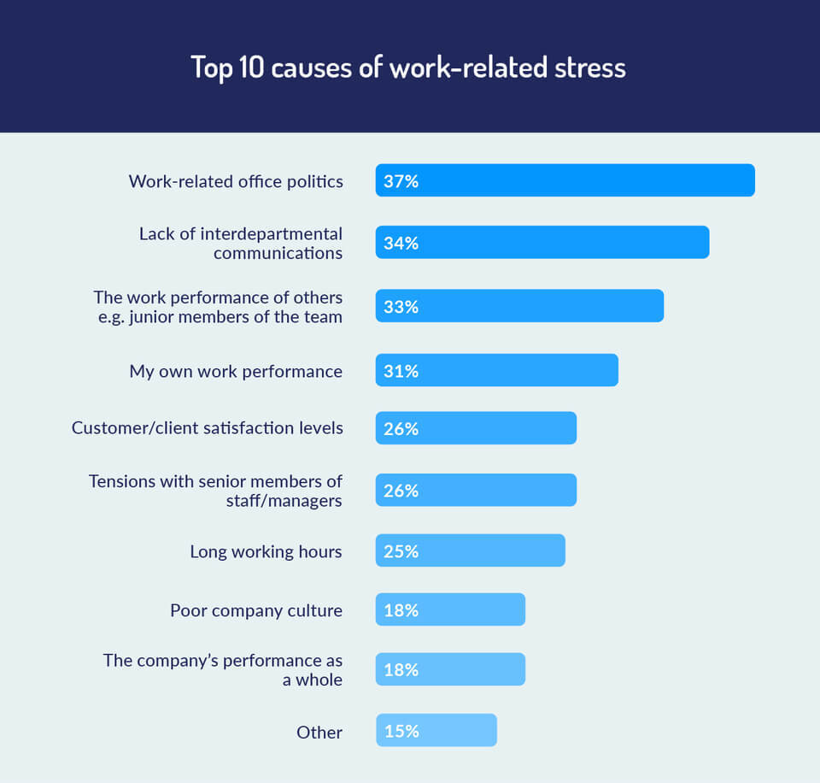
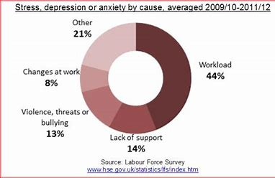
Work related stressful life events graphs
Top 10 Causes of work-related stress
Stress, depression, anxiety work-related

Slide 4
What is a Fishbone Diagram?
Good tool for brainstorming to identify causes, effects and sorting into categories.
Fishbone diagram helps you to visualise the way we look at the causes and effect.
The underlying problem is placed at fish head and this is extended outwards to the bones of the skeleton, the ribs, and denote root causes.
Professor Kaoru Ishikawa created in 1960’s and was used for Management.
It is a useful tool to analyse what went wrong and prevent these from re-occurring in the future.

Slide 5
Cause and Effect (Fishbone) Diagram
Student Name: Sonia Dworkin Student No: 2028974

Slide 6
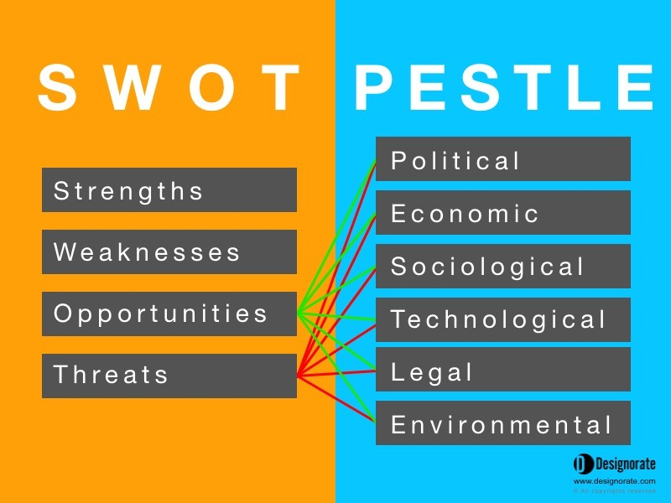
What is the difference between SWOT & PESTLE Analysis?
SWOT analysis focuses on actions you can take the Internal to your business environment.
SWOT uses these findings for the business to determine the strengths, weaknesses, opportunities and threats.
PESTLE analysis identifies External factors that are mainly outsides of your control.
PESTLE uses findings to consider the environmental context that affects business and the changes that occur in this context.

Slide 7
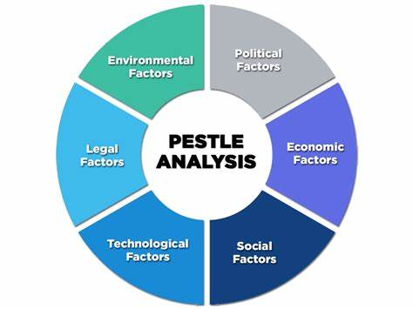
Why use PESTLE Analysis?
Francis Aguilar (1967)
Broad fact-finding activity
Organisation’s can establish what external factors that could impact their decision making process.
Understanding external factors help strategic thinking in maximising opportunities and minimising threats to an organisation.

Slide 8
Grid Analysis
Factors Changes at work Lack of support Performance
Government taxes 4 | 3 | 3 | 3 Total
Impact on businesses | 3 = 9 | 3 = 9 | 3 = 9 27
Impact on workers | 3 = 9 | 3 = 9 | 3 = 9 27
Impact on customers | 2=6 | 3=9 | 3=9 24
Wages | 3=9 | 3=9 | 2=6 24
Home life | 3=9 | 3=9 | 3=9 27

Slide 9
Possible Solutions from Fishbone and PESTLE Analysis
Fishbone highlights 3 Main causes
Possible solutions for Organisation in the UK
Impact on Businesses
Impact on Workers
Work life balance

Slide 10
REFERENCES
Nandonde, felix Adamu ( 9 April 2019). “ A pestle analysis of international retailing in the East African Community”. Global Business and Organizational Excellence. 38 (4): 54-61. Do: 10.1002/JOE.21935. ISSN 1932-2054
2.Lawrence P. Carr,; Alfred J.Nanni Jr.. 28 July 2009). Delivering Results; Managing what Matters. Springer science & Business Media. P.44. ISBN 978-1.
3.Bradley, Edgar (2016-11-03). Reliability engineering: a life cycle approach. ISBN 778-1498765374. OCLC 963184495.
4.How to use the Fishbone diagram to determine data quality
Root causes light on Data. 2018-12-05
5. R|Richardson, J. A brief intellectual History of the STEPE model or framework (i.e., the social, Technical, Economic, political, and Ecological), accessed 6 May 2019.
6. Walden, J, (2011), Comparison of the Steeple strategy, methodology and the department of Defense’s PMESII-PT Methodology, Supply chain Leadership Institute, accessed 10 February 2019.
7. Ishikawa, Kaoru (1968). Guide to Quality Control. Tokyo: JUSE
8. Ishikawa, Kaoru (1976). Guide to Quality control Asian productivity Organization ISBN: 92-833-1063-5
9. Mason, L (2018), Contract Administration, Chartered Institute of procurement & Supply, p. 116

