Slide 1
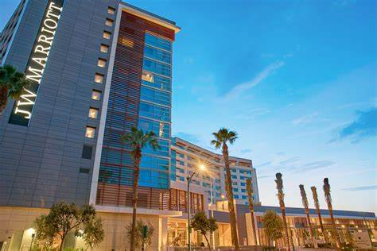
BMIH4003 Hospitality and Guest Services
The role and importance of quality service, hospitality, and guest services within the hotel Industry
Name OANA NICOLETA STANCILA
Course title HOSPITALITY AND GUEST SERVICES
Course instructor
Date 20.11.2023
University BA INTERNATIONAL HOTEL MANAGEMENT

Slide 2

Introduction
The Marriott Corporation was founded in 1927 by J. Willard and Alice Marriott.
The establishment's inception may be traced back to its origins as a root beer stand in Washington, D.C.
Has transformed into a renowned symbol of hospitality on a worldwide scale.
Founded on a dedication to going above and beyond for customers.
Values honesty, loyalty, and solidarity above anything else.
remains true to the spirit and tradition of the Marriott name.
With a global footprint of more than 90 sites.
From renowned metropolitan cores to exotic resort resorts.
A demonstration of the brand's lasting popularity across the world.
presentation takes a look back at JW Marriott's incredible history, highlighting how the company has evolved into a symbol of premium hospitality excellence because to its dedication to classic style, discriminating clients, and widespread availability.

Slide 3
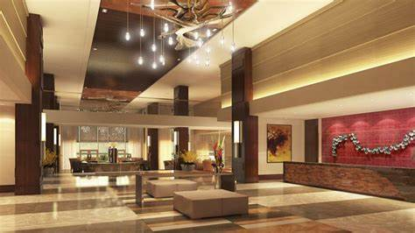
Main Consumers and Their Attraction
Those who have a lot of money and want to live lavishly.
Businessmen and women who want to relax in style when traveling for business or pleasure.
Individuals who value luxurious accommodations and special services.
Superb lodgings, spas, and leisure offerings.
Elegant bars and restaurants are available.
Staff members who are trained to provide proactive, one-on-one care.
Excellent focus on detail and a will to go above and beyond.
Specially designed vacation packages, activities, and collaborative ventures.
The ability to take use of our exclusive premium services.
Notes:
Our customer base comprises people with significant financial means who are in search of opulent lifestyles. Our establishment is favored by business people, regardless of gender, seeking opulent respite whether on work or recreational journeys. Individuals who possess a fondness for luxurious lodgings and personalized services will discover a suitable fit with our establishment. Our establishment provides exceptional accommodations, spa amenities, and recreational activities, complemented by sophisticated bars and dining establishments. The staff members at our institution are highly trained and committed to provide proactive and individualized care. They prioritize attention to detail and strive to surpass expectations. Our establishment offers a range of tailored holiday packages, activities, and partnerships, enabling visitors to make the most of our unique and high-quality services.

Slide 4
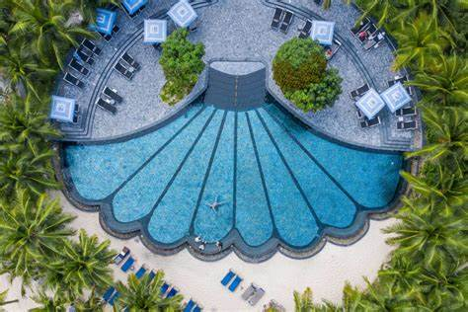
Nature, Scope, and Role of Guest Services and Facilities in General
Nature of Guest Services
Providing comprehensive assistance through concierge services, room service, and 24/7 support.
These services cater to diverse needs, ensuring a seamless and memorable guest experience (Gregersen and Black, 2002).
Scope of Guest Services
Offering reservation assistance and personalized itinerary planning to enhance anticipation.
Providing opportunities for room upgrades, spa services, and personalized event planning.
Engaging in feedback collection, implementing loyalty programs, and conducting personalized follow-ups.
Role of Facilities
Presenting suites, premium rooms, and state-of-the-art design for a lavish stay experience.
Offering fitness centers, pools, and wellness spas to promote relaxation and rejuvenation.
Featuring fine dining restaurants, lounges, and exclusive event spaces to cater to diverse culinary and entertainment preferences.
Notes:
The nature of guest services refers to the characteristics and qualities that define the role and responsibilities of individuals who provide assistance and support to guests.
We offer a wide range of services to help you with anything you need, including concierge services, room service, and round-the-clock support.
According to Gregersen and Black (2002), these services are designed to meet a variety of needs and provide a smooth and enjoyable experience for guests.
The scope of guest services refers to the range or extent of services provided to guests. It encompasses all the different services and assistance offered to guests during their stay or visit, such as check-in and check-out procedures
We provide help with making reservations and creating customized itineraries to make your travel experience even more exciting.
We offer various benefits such as the chance to upgrade your room, enjoy spa services, and have personalized event planning.
The user is talking about three different actions: collecting feedback, implementing loyalty programs, and conducting personalized follow-ups.
The role of facilities refers to the functions and responsibilities associated with managing and maintaining physical spaces, such as buildings, offices, and infrastructure. This includes tasks such as ensuring the
We offer a variety of luxurious accommodations, including suites and premium rooms, all designed with the latest and most sophisticated features to provide an extravagant and enjoyable stay.
We provide fitness centers, pools, and wellness spas to help people relax and feel refreshed.
Our establishment offers a variety of options for dining and entertainment. We have upscale restaurants, comfortable lounges, and private event spaces to accommodate different tastes and preferences.

Slide 5
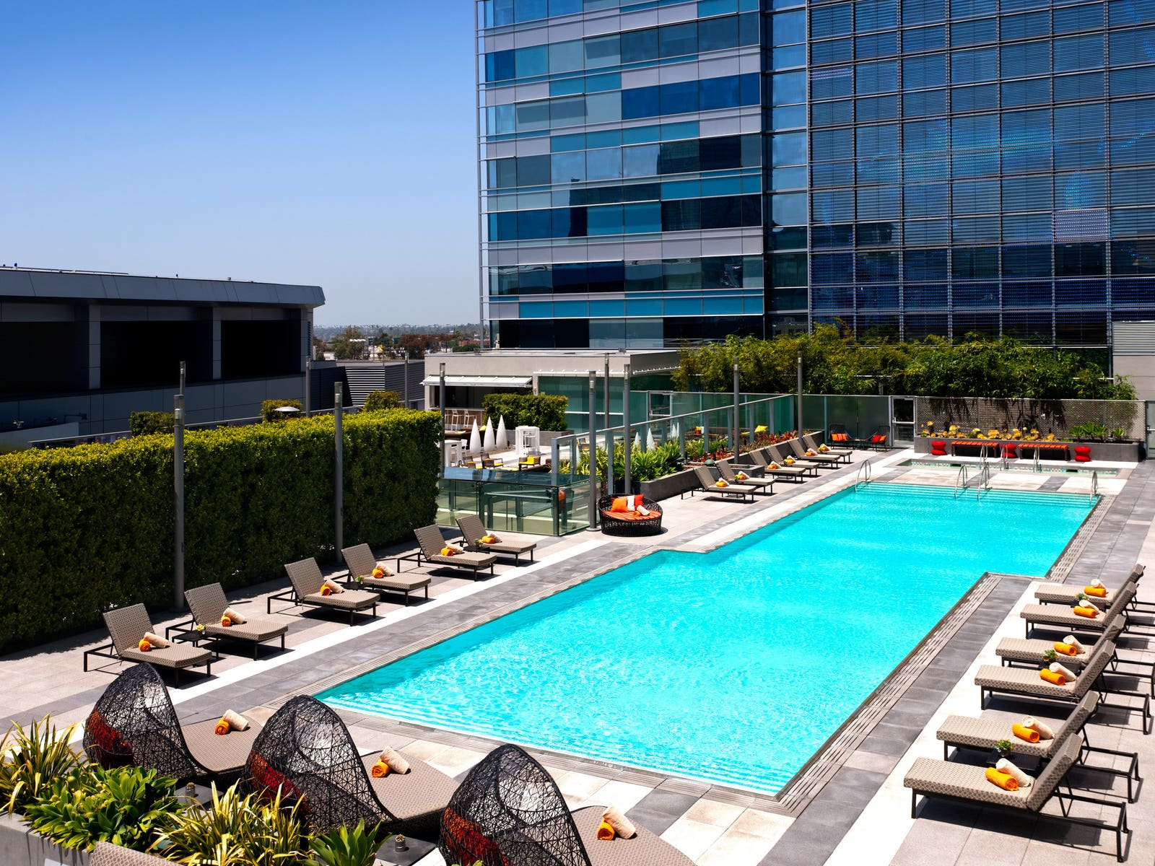
JW Marriott's Exceptional Guest Services
Guest Services at JW Marriott:
Delivering personalized assistance, local recommendations, and efficient travel arrangements.
Offering exquisite in-room dining experiences tailored to individual guest preferences.
Facilities at JW Marriott:
Providing spacious rooms, premium bedding, and cutting-edge design for an opulent stay.
Boasting state-of-the-art fitness centers, rejuvenating spas, and exclusive pool areas (Andreani et al., 2012).
Featuring fine dining restaurants, sophisticated lounges, and unique culinary experiences for a diverse range of preferences.
Bespoke Experiences:
Offering customized stays, exclusive event packages, and personalized services for a unique and memorable visit.
Collaborating with local entities to provide authentic experiences, enriching the overall stay.
Notes:
Guest Services at JW Marriott provides a range of services to enhance your stay. Our team is dedicated to offering personalized assistance, including helping you with any specific needs or requests you may have. We are also knowledgeable about the local area and can provide recommendations for restaurants, attractions, and activities. Additionally, we can assist you with making travel arrangements, ensuring that your journey is smooth and efficient.
We provide personalized in-room dining experiences that are carefully designed to meet the unique preferences of each guest.
The JW Marriott offers a range of amenities and services for guests to enjoy during their stay.
Our accommodations offer large rooms, high-quality bedding, and modern design to create a luxurious experience for our guests.
According to Andreani et al. (2012), the facilities at these locations include modern fitness centers, relaxing spas, and private pool areas.
The place offers a variety of options for dining, including high-quality restaurants, elegant lounges, and one-of-a-kind culinary experiences, catering to different tastes and preferences.
Bespoke Experiences provides tailored stays, special event packages, and personalized services to create a one-of-a-kind and unforgettable visit.
Working together with local organizations to offer genuine experiences that enhance the overall quality of your stay.

Slide 6
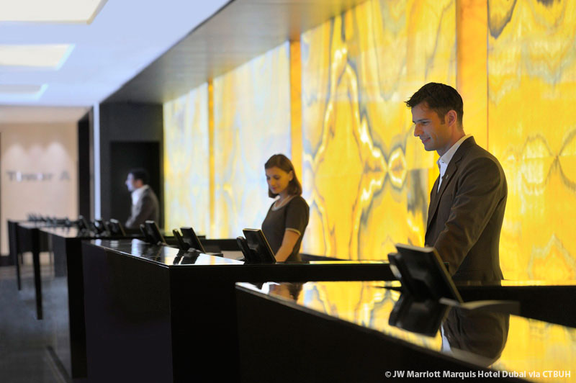
Importance of Hospitality
Hospitality is a diverse practice that involves the skillful provision of a sincere and kind reception to those visiting a particular establishment or event (Zhang et al., 2015).
The task at hand entails the ability to anticipate and fulfill the requirements of visitors with sincere attention and thoughtfulness (Andreani et al., 2012).
Notes:
Hospitality is a practice that encompasses various activities aimed at providing a warm and friendly welcome to individuals who are visiting a specific place or attending an event. It involves the ability to skillfully offer genuine and kind reception to these individuals.

Slide 7
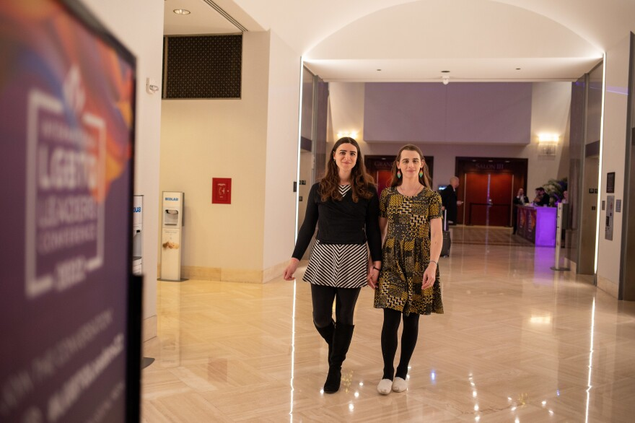
Importance of Hospitality
  The establishment of a hospitable environment establishes the foundation for a favorable and enduring customer encounter (Wernick. and Von Glinow, , 2012).
  The cultivation of a feeling of connection has been shown to promote visitor loyalty and generate favorable word-of-mouth.
  The provision of a hospitable atmosphere plays a crucial role in enhancing the overall comfort and happiness of guests.
Notes:
The establishment of a friendly atmosphere is fundamental in ensuring a favorable and enduring client experience (Wernick & Von Glinow, 2012). The establishment of a strong feeling of connection has been shown to cultivate visitor loyalty and produce favorable word-of-mouth. The creation of a welcoming environment plays a pivotal function in augmenting the overall satisfaction and well-being of guests.

Slide 8

JW Marriott's Commitment to Exceeding Expectations
The JW Marriott hotel chain implements a range of strategies aimed at providing a distinctive and customized guest experience by tailoring services to individual tastes (Yudianto, 2023).
The objective is to meticulously execute every facet of a guest's experience with utmost accuracy.
Exceeding expectations by proactive anticipation of visitor requirements prior to their emergence.
Notes:
The JW Marriott hotel chain uses different strategies to give each guest a unique and personalized experience by offering services that are tailored to their preferences. The goal is to carefully and precisely manage every aspect of a guest's experience to ensure it is done correctly.
Anticipating and meeting visitor needs before they arise, going above and beyond what is expected.

Slide 9
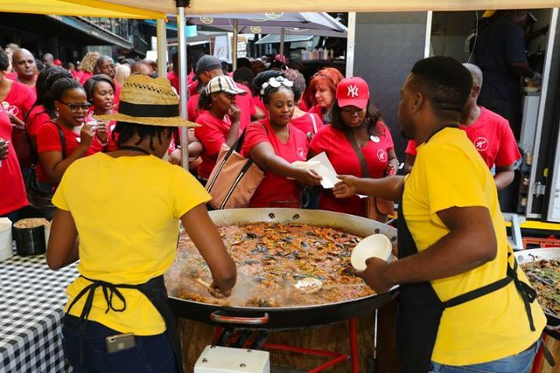
Cultural and Local Engagement
The incorporation of indigenous art and design elements into the hotel's atmosphere.
The establishment highlights dishes that draw inspiration from local sources and fosters partnerships with chefs from the surrounding community.
Establishing relationships with local companies and craftspeople (Chen and Tabari, 2017).
Engaging in the organization or involvement in community-based cultural events and festivals.
The objective is to provide training to staff members with the aim of cultivating and disseminating local cultural knowledge (Huan et al., 2021).
Notes:
The use of local art and design aspects enhances the overall atmosphere of the hotel. The institution exhibits culinary creations that draw inspiration from regional origins, hence cultivating collaborative relationships with chefs within the local community. The establishment of connections with local companies and artisans has been emphasized in the study conducted by Chen and Tabari (2017). The prioritization of active engagement in community-based cultural activities and festivals is emphasized. The primary goal is to provide training to employees with the aim of fostering and sharing local cultural knowledge in order to enhance the visitor experience, making it more immersive and genuine (Huan et al., 2021). The dedication to fostering local involvement produces a distinctive and culturally immersive atmosphere for both visitors and the surrounding community.

Slide 10

Innovative Marketing Strategies
Increasing online presence and participation by use of state-of-the-art digital tools.
Including such features as interactive material and virtual tours.
Creating niche social media strategies to reach certain demographics.
Featuring sneak peeks, discounts, and exclusive deals not available anywhere else.
Using influential people to increase the brand's visibility and popularity.
Cooperating with public figures who share a similar vision of luxury and leisure( Barreto and Mayya, 2022).
Using individualized loyalty programs to provide distinct perks.
Creating memorable occasions and exclusive offers for repeat customers.
Creating entertaining and interactive material using virtual reality, augmented reality, or gamification.
Improving how visitors engage with the brand as a whole.
Notes:
Improving one's online profile by using state-of-the-art digital instruments, such interactive materials and virtual tours. Using social media campaigns tailored to certain audiences. Showcasing unique sneak peeks, discounts, and bargains. Using influential people to raise awareness and interest in a product or service. Working together with well-known personalities who share the premium brand's ethos (Barreto & Mayya, 2022). Creating unique loyalty programs for each individual customer. Making unique events and discounts for loyal clients. Making material that users can engage with via mediums like VR, AR, or gamification. Assuring a lively and engaged online presence by increasing total visitor interaction with the business.

Slide 11

Navigating Challenges at JW Marriott
Navigating industry uncertainties and travel changes.
Ensuring guest safety in dynamic global conditions.
Evolving to meet changing guest expectations.
Swiftly addressing feedback for continuous improvement (Wibawa and Mathilda, 2023).
Standing out in a competitive market.
Focusing on what makes JW Marriott unique.
Proactively addressing unforeseen events.
Embracing tech changes for enhanced experiences.
Strategic investments for operational efficiency.
Notes:
adjusting to a volatile market and ever-evolving travel needs. Keeping visitors secure as we adapt to a changing world. (Wibawa & Mathilda, 2023) The ability to adapt to changing guest needs and act quickly in response to input is essential to achieving and maintaining excellence. Standing out in a competitive market by stressing what makes JW Marriott special. Taking preventative measures with effective crisis management in the face of calamity. Adapting to new technologies in order to provide better service to guests. Spending wisely to improve productivity and quality control. Collectively, these initiatives strengthen JW Marriott's fortitude, individuality, and dedication to delivering an exceptional hospitality experience.

Slide 12
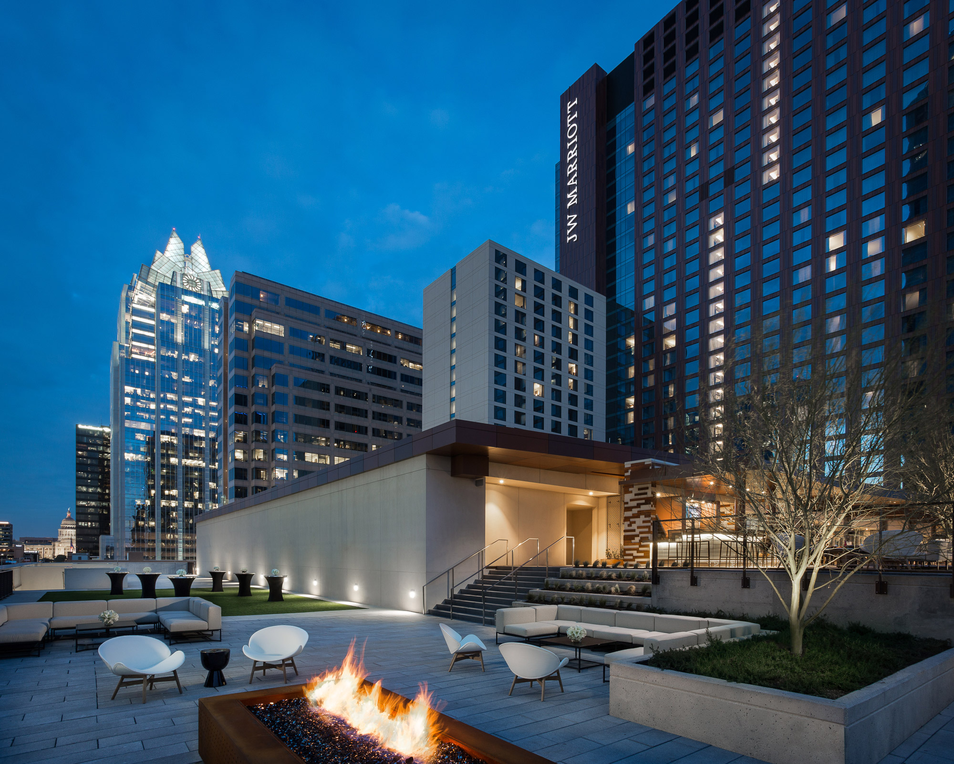
Conclusion
In conclusion, we have explored the unique characteristics that delineate JW Marriott's unwavering dedication to exceptional hospitality.
By catering to guests with refined tastes and delivering exceptional services, we have identified the fundamental components that distinguish JW Marriott from its competitors .
JW Marriott maintains a resolute commitment to curating individualized and opulent experiences for each and every visitor.

Slide 13
References
Andreani, F., Sumargo, Y. and Lie, C., 2012. The influence of customer relationship management (CRM) on customer loyalty in JW Marriott hotel surabaya. Jurnal manajemen dan kewirausahaan, 14(2), pp.156-163.
Andreani, F., Sumargo, Y. and Lie, C., 2012. The influence of customer relationship management (CRM) on customer loyalty in JW Marriott hotel surabaya. Jurnal manajemen dan kewirausahaan, 14(2), pp.156-163.
Barreto, N. and Mayya, S., 2022. SWOC Analysis of Marriott International-A Case Study. International Journal of Case Studies in Business, IT and Education (IJCSBE), 6(2), pp.877-889.
Chen, W. and Tabari, S., 2017. A study of negative customer online reviews and managerial responses on social media—case study of the marriott hotel group in Beijing. Journal of Marketing and Consumer Research, 41, pp.53-64.
Gregersen, H.B. and Black, J.S., 2002. JW Marriott, jr., on growing the legacy. Academy of Management Perspectives, 16(2), pp.33-39.
Huan, C., Park, S. and Kang, J., 2021. Panic buying: Modeling what drives it and how it deteriorates emotional well‐being. Family and Consumer Sciences Research Journal, 50(2), pp.150-164.
Wernick, D.A. and Von Glinow, M.A., 2012. Reflections on the evolving terrorist threat to luxury hotels: A case study on Marriott International. Thunderbird International Business Review, 54(5), pp.729-746.
Wibawa, I.K. and Mathilda, K., 2023, June. Squences Of Service Implementation In Improving The Service Quality At Lobby Lounge Bar And Restaurant JW Marriot Hotel Surabaya. In Journey: Journal of Tourismpreneurship, Culinary, Hospitality, Convention and Event Management (Vol. 6, No. 1, pp. 107-126).
Yudianto, V., 2023. Industrial Training Report" Pastry Kitchen IN JW Marriott Hotel Surabaya" (Doctoral dissertation, OTTIMMO INTERNATIONAL).
Zhang, Y., Shu, S., Ji, Z. and Wang, Y., 2015, March. A study of the commercial application of big data of the international hotel group in China: based on the case study of marriott international. In 2015 IEEE First International Conference on Big Data Computing Service and Applications (pp. 412-417). IEEE.

Slide 14
Our sincere thanks for your time and engagement throughout this exploration of JW Marriott's hospitality journey.

