Slide 1


TSD Secondary school unit of work for KS 3
Trigger warning- this power point talks about deaths due to drowning and harm caused to children as the result of open water
Warning- this is a interactive presentation, so be ready for questions
Lewis Thornton

Slide 2
What's the unit about?
All of them were deemed as survivable with better water safety/ swimming knowledge by the welsh parliament (Senedd Cymru, 2022)
Over 54 people last year alone lost their lives to water thought to be due to a lack of water safety/ swimming knowable
Wales has a coastline of 1,680 miles (including the island of Anglesey)
(Gwaith, 2019)
30 of them were kids aged between 11-16 (Senedd Cymru, 2022)
There are over 200 books written about rivers and lakes in south Wales alone
(The UK Rivers Guidebook ,2023)

Slide 3
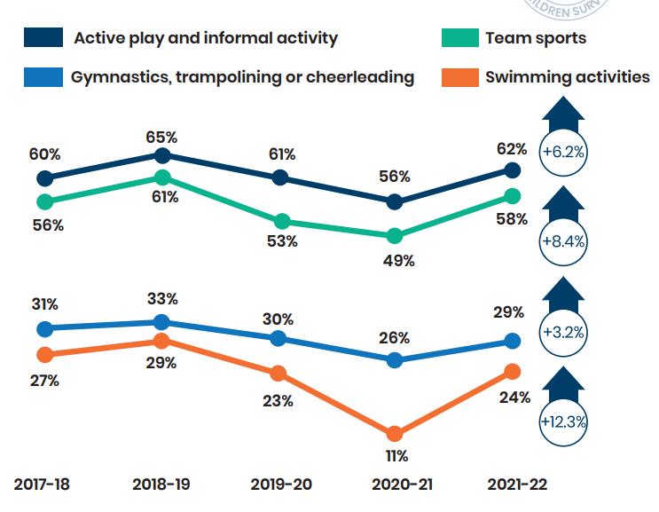
What's the unit about?
In 2019 21% of year 7s cant swim 25 meters unaided and 18% still can not by the start of KS4
These numbers have gotten worst since the pandemic and have gotten better since being at an all-time low the stats are still not great
NOT GREAT
Sports England (2019)
Sports England (2022)

Slide 4
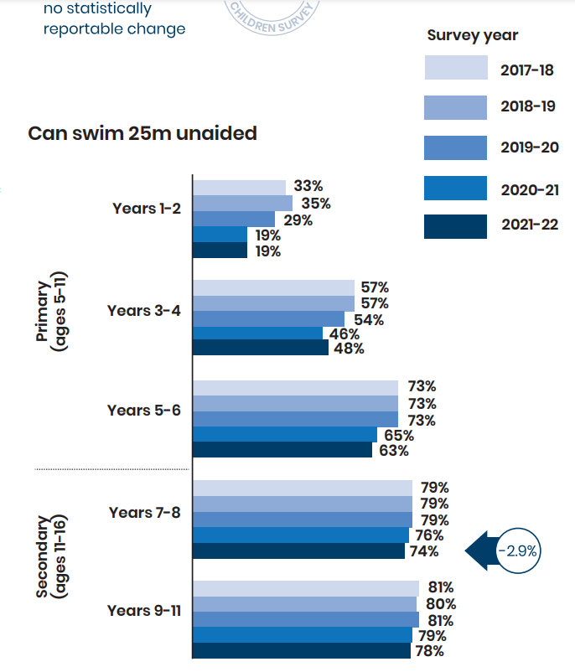
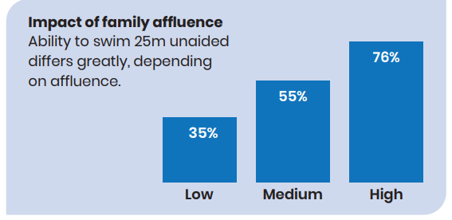
What's the unit about?
The number of ks3 people who can swim 25m unaided has decreased in recent years
There is direct correlation between family affluence and swimming ability
South Wales is mostly made up of mostly Low and some Med affluence families
(Gov Wales,
2022)
Sports England (2022)

Slide 5
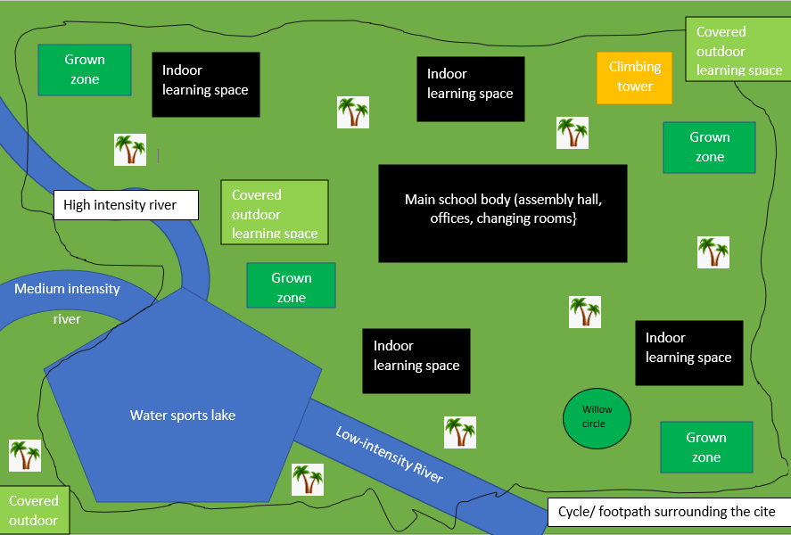
So what is the unit about??
I present TSD Secondary school, I wish to show a newly developed water safety-based unit of work
Made up of two one-hour-long lessons a week over 6 weeks utilizing TSDs Moist zone
By the end of the unit I wish to create water-confident pupils who understand the dangers water provides as well as ways to mitigate those dangers

Slide 6

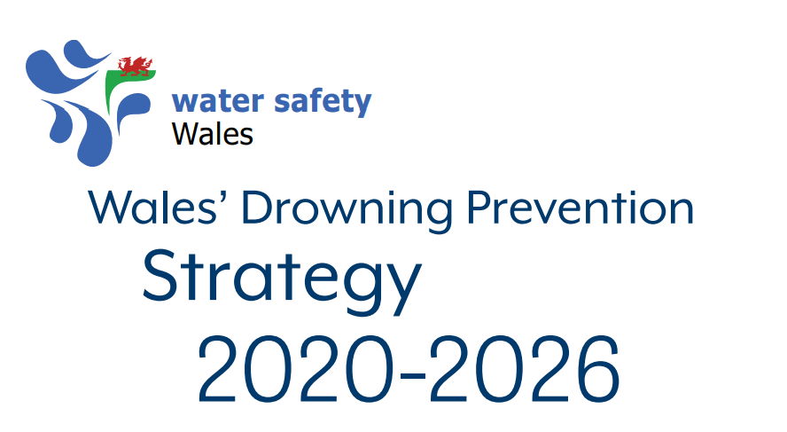
Why TSD Secondary school?
Wales over the last two years has had a huge push for water safety schemes with the two biggest ones being-
River and Sea Sense (2021)- started by a mother who lost her daughter at Capel Curig (Cyfyng Falls on the Afon Llugwy) on 14th August 2006.
Water Safety Wales (2020)- created after Welsh MP Lesley Griffiths MS saw the high death rates caused by open water in Wales using a collaboration of individuals, communities, and charities to develop a scheme to help reduce the numbers of drownings by 2026

Slide 7
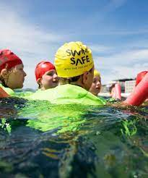
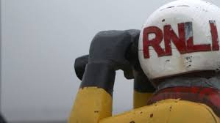
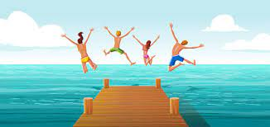

Why TSD Secondary school?
So why not try and progress and educate students as a part of weekly PE sessions with in outdoor adventures activities
These already existing schemes are based on education and prevention over rescuing and reacting
The mentioned schemes go into schools and run workshops around the dangers of open water

Slide 8
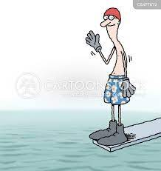
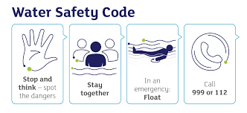
Learning Outcomes
Session- goals
1/2 -find students swimming levels through games/races
2-4 -discuss with students where open water is, and the dangers associated with them as well as go over basic swimming styles
4-6- develop weaker areas with games and discussions such as the effects of cold water (RNLI, 2022), treading water/ F.L.O.A.T (RNLI, 2022) , etc depending on the group’s needs
Identify dangers associated with open water
Discuss the effects of cold water shock on the body
Understand self-rescue techniques for getting out of open water
“assessments”
The group would be marked based on where the student’s based discussion compared to the start of the unit, with week-by-week class and personal discussions then compared to the knowledge of students by the end of the unit would provide a mark based on the Learning outcomes
The discussions will be backed by weekly videos made by the students will show the development of each pupil week by week and allow the teachers to create marks off the videos and discussions

Slide 9
Links to Health and well-being AOLE (Gov Wales, 2020)
I have the confidence and motivation to move in different ways
“resulting in a growing responsibility for their own health and well-being”
“Progression will require learners to revisit aspects, topics, and issues, developing knowledge at a deeper level”
Cross-curricular skills- This includes relationships with others, online safety, legal implications and social influences online (including social media).
”learners can develop positive, informed behaviors that encourage them both to care for and respect themselves and others”
What Matters Statements
Descriptions of learning
Designing your curriculum
“Learning and experience in this Area can enable learners to develop the critical-thinking skills necessary to consider their decision-making in terms of possible implications”
“Viewing different aspects and topics related to health and well-being through the lens of different statements of what matters”
I can use and improve basic movement skills in familiar and unfamiliar situations
”Progression in health and well-being occurs across a wide range of skills, including physical, emotional, psychological and social skills”
Integral skills-
provides learners with the opportunity to develop the confidence and openness to explore ideas, to consider the opinions of others, and the courage to express their own.
Attitude to assessment and progress
I can develop and apply a range of skills in familiar, unfamiliar and changing situations,
“help learners explore the connections between their experiences, mental health and emotional well-being”

Slide 10
Barriers to the unit
Inclusion?
Qualifications teachers need to run good safe sessions
Water fears
Students not knowing how to swim
Weather conditions
Swimming has become one of the most beneficial and inclusive sports for people of all abilities, with modern tequke the sport is more accessible than ever before (Hammond et al, 2019)
challenge by choice
A variety of weather conditions may raise anxiety in students however do help develop skills in a range of weather
BU’s FSRT would be required to run sessions with anyone under 18 in open waters, this is a common qual for instructors who work with paddle craft
(British Canoeing, 2022)
Many float devise will be available to help ease young people into the waters, as well as start slow and progressing confidence in the young people (Graham and Gaffan, 1997)
The unit has a focus on self-life saving, so these students would be a focus for teachers (River and Sea Sense, 2021)
Potential fixes

Slide 11



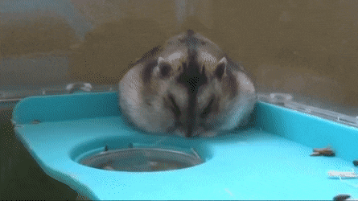

Any questions?

Slide 12
Refs
British Canoeing (2022) Canoeing qualifications: Free Elearning, British Canoeing Awarding Body. Available at: https://www.britishcanoeingawarding.org.uk/ (Accessed: January 9, 2023).
Gov Wales (2022) Child poverty strategy: 2022 progress report | gov, Child poverty strategy: 2022 progress report. Available at: https://www.gov.wales/sites/default/files/pdf-versions/2022/12/3/1671008541/child-poverty-strategy-2022-progress-report.pdf (Accessed: January 5, 2023).
Gov Wales (2020) Health and well-being: Introduction, Hwb. Available at: https://hwb.gov.wales/curriculum-for-wales/health-and-well-being/ (Accessed: January 10, 2023).
Graham, J. and Gaffan, E.A. (1997) “Fear of water in children and adults: Etiology and familial effects,” Behaviour Research and Therapy, 35(2), pp. 91–108. Available at: https://doi.org/10.1016/s0005-7967(96)00086-1.
Gwaith, E. (2019) Wales factfile - geography, Institute of Welsh Affairs. Available at: https://www.iwa.wales/wales-factfile-geography/?lang=cy (Accessed: January 11, 2023).
Hammond, A. et al. (2019) “‘I feel we are inclusive enough’: Examining swimming coaches’ understandings of inclusion and disability,” Sociology of Sport Journal, 36(4), pp. 311–321. Available at: https://doi.org/10.1123/ssj.2018-0164.
River and Sea Sense (2021) Water safety, river & sea sense, River & Sea Sense. Available at: https://www.riverandseasense.com/ (Accessed: January 7, 2023).
RNLI (2022) Cold water shock - water safety tips - know the risks, Cold water shock. Available at: https://rnli.org/safety/know-the-risks/cold-water-shock (Accessed: January 9, 2023).
RNLI (2022) Float to live – what to do in an emergency – RNLI, Float to Live. Available at: https://rnli.org/safety/float (Accessed: January 9, 2023).
Senedd Cymru (2022) We must do better to prevent drowning deaths - senedd report, Senedd Cymru. Available at: https://senedd.wales/senedd-now/news/we-must-do-better-to-prevent-drowning-deaths-senedd-report/#:~:text=%E2%80%9CAround%2050%20people%20a%20year,the%20UK%20as%20a%20whole. (Accessed: January 5, 2023).
Sports England (2019) Active lives, Sport England. Available at: https://www.sportengland.org/research-and-data/data/active-lives (Accessed: January 5, 2023).
Sports England (2022) Active lives, Sport England. Available at: https://www.sportengland.org/research-and-data/data/active-lives (Accessed: January 5, 2023).
The UK Rivers Guidebook (2023) UKRGB, Rivers. Available at: https://www.ukriversguidebook.co.uk/rivers/wales/south/ (Accessed: January 12, 2023).
Water Safety Wales (2020) 2020-2026 - National Water Safety, Wales’ Drowning Prevention Strategy 2020-2026. Available at: https://www.nationalwatersafety.org.uk/media/1236/water-safety-strategy-2020-2026.pdf (Accessed: January 7, 2023).

