Slide 1

Digital Tools
Virtual Collaboration

Slide 2
Lesson Aim
Aim:
To explore and practice digital tools and skills
Objectives:
To explain how these digital tools and be used during your studies
To show understanding by demonstrating the application of digital tools.

Slide 3

What is digital literacy?

Slide 4
Interchangeable terminology
Digital Literacy
Digital Skills
Digital Competencies
Notes:
All three terms are applied across literacy, but on the surface they may appear to mean the same thing, but if you dig a little bit deeper, you’ll find that all terms are slightly different, which has contributed towards the lack of consensus.
Digital Literacy
Digital Skills
Digital competencies

Slide 5
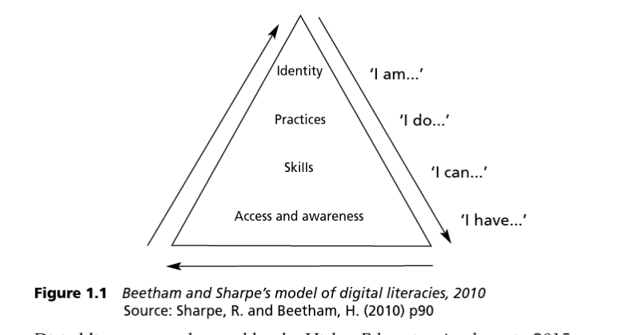
Digital Literacy
The term ‘digital literacy’ is in widespread use but lacks definition consensus.
Original thought to be “… the ability to understand and use information in multiple formats” Digital literacy goes beyond “simply reading”
Key terms have been used interchangeably: E-learning, e-literacy, ICT
(Cited in Reedy and Parker, 2018, p.5)

Slide 6
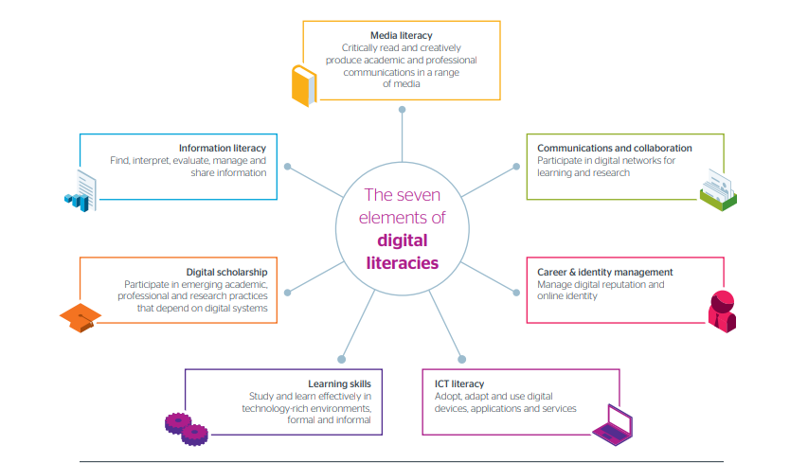

Slide 7
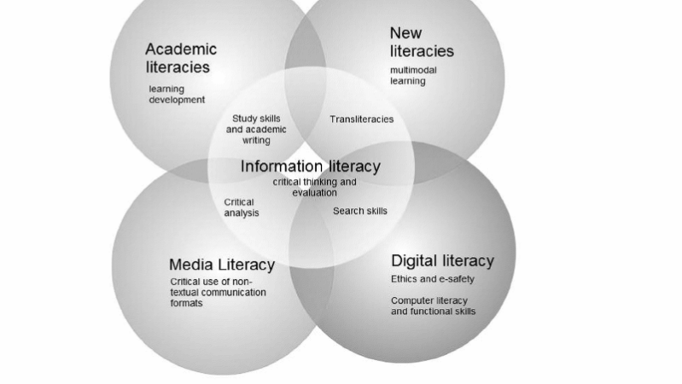

Slide 8
Digital Skills
Digital skills refers to the practical application of technical abilities. Such abilities include:
Sending emails
Saving and storing and organizing data
Navigating the internet
Using software (Microsoft Office)

Slide 9
Digital Competencies
Digital Capabilities build upon digital skills but add an element of problem solving and adaptability.
Doesn’t refer to just knowing how to use digital tools
The ability to apply skills and knowledge effectively.

Slide 10
Example
Let’s imagine activity in healthcare setting where a nurse or a healthcare professional uses a patient management system to update and share patients medical records with other healthcare professionals

Slide 11
Digital Literacy
The nurse needs to understand the importance of protecting the patient's privacy and comply with data protection regulations like GDPR while using the system. They need to evaluate the sources of information and verify the accuracy of the data before sharing it with other healthcare professionals. The nurse is aware of the ethical and legal responsibilities tied to sharing patient data digitally.
Notes:
Digital Literacy Focus: Understanding how to use the patient management system safely and ethically, with attention to data security and privacy laws.

Slide 12
Digital Skills
The nurse uses the patient management system to input the patient’s updated medical data (e.g., symptoms, treatment plans) and shares it with the relevant healthcare team. They can easily navigate the system, retrieve and upload data, send secure messages to colleagues, and schedule follow-up appointments.
Notes:
Digital Skills Focus: Operating the patient management system, performing tasks like data entry, retrieving records, and using communication tools.

Slide 13
Digital Competency
The nurse not only updates the patient's records but also notices that a recent lab result may need a follow-up with a specialist. The nurse uses their digital competency to identify the need for further action, contacts the appropriate doctor through the system, and schedules an intervention. They also suggest a way to streamline record-sharing among departments to improve patient care workflows in the future.
Notes:
Digital Competency Focus: Problem-solving and applying the system to enhance workflow efficiency and improve patient outcomes. This includes proactive use of the system and suggesting improvements.

Slide 14
Towards a Welsh Minimum Digital
Living Standard: Interim Report
Commissioned in 2022, The MDLS examined key digital inequalities highlighted from the pandemic. The inequalities highlighted were:
lacks and limitations in access
skills and capabilities with regard to digital systems and media that have significant tangible consequences for citizens, households and communities.

Slide 15
Findings
92% Households had internet access
12% of over 65s didn’t have access to household internet access
29% of over 75s had no household internet access
7% of adults had no access to internet
These findings were higher than any other nation within the UK.

Slide 16

What is the problem with not having access to the internet?

Slide 17
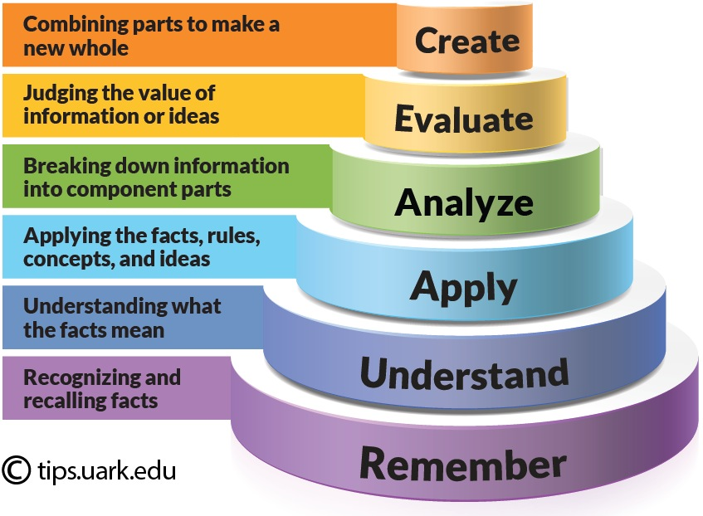
Digital Learning
Notes:
Within the context of digital literacy, creating artefacts (PowerPoint, Word documents etc) is the highest order or learning within blooms taxonomy as it is a combination of all the underlying skills.

Slide 18
Digital Literacy and Constructivism
Constructivist approach to learning suggests that knowledge is acquired through experiences
Active learning
Build upon existing knowledge
Social interaction
Application in real-world context
Critical and problem-solving development
Notes:
Have you ever been shown how to use a digital device or a particular software and afterwards unable to remember all the necessary steps to fully use said device/software?
Perhaps this may be the result of you not having the opportunity to have a go and practice, or you did not see the full relevance of using it.
Constructivism facilitates learning by placing the learner in the driving seat and provides them the opportunity to ‘give it a go’ and apply problem-solving skills to develop a new skill.

Slide 19
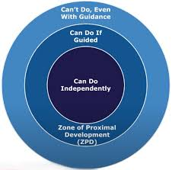
Digital Literacy and Zone of Proximal Development (ZPD)
Vygotsky ZPD argues that social interaction is fundamental to learning.
Peer-to-peer
Teacher-student
Notes:
Key points of ZPD
Current Ability: The ability to complete tasks without guidance.
Potential development: Represents what a learner can achieve and may include tasks that beyond their ability but can accomplish with guidance.
Scaffolding: The application of support that may include hints, encouragement comments (You can do this!!), breaking tasks down to smaller steps.
Social Interaction: Through collaboration and discussions, learners develop a deeper understanding and acquire new skills.
Dynamic Nature: The ZPD is not static meaning that learners will always encounter new skills that they may not necessarily have acquired.

Slide 20

Digital Tools
OneDrive
Office 365
Word
PowerPoint
Teams
Stream
Outlook

Slide 21
Email Etiquette
Dear Student, my name is not
Hey xx

Slide 22
What is email etiquette?
Email etiquette is a common struggle for students. It is important to do this correctly though, because the lecturers and other university staff receiving your emails are etiquette professionals.
Developing good practice with regard to email etiquette also prepares you for future employability!

Slide 23

Communicating with the University
It is university policy for students to use their student e-mail address to communicate with their lecturers and other members of university staff.
Emails will be answered within 48hours (excluding weekends)
Emailing staff outside of working hours may not be answered.

Slide 24

What does an email need to include
A subheading: What is the email about?
Include a respect opening: “ Hello Jonathan, I hope you are well”.
A short explanation of the nature of the email (why are you emailing your lecturer)
A respectful end: “ Thank you, best wishes, Abby”

Slide 25
The don’ts of email:
Please do not use your personal email address.
Please do not use text-talk, slang or foul language.
Please do not address staff in an over familiar or unnecessarily formal manner.
Please use the correct name and spelling
Please do not use any “x” (Kisses) within your emails.
Please do not send multiple emails if your first email has not been answered, unless your email has not been answered within 48 hours.
We are human… we have personal lives outside of the university.

Slide 26
Now give it a go…
Using your student email address…. Please send me an email explaining that you now know how to send a professional email to your lecturers.
j.wyatt@uwtsd.ac.uk

Slide 27
Saving and creating Files and Folders: Why is it important?
Organisation is crucial for academic success
Students often misplace their work which leads to submitting incorrect assignments.
On your personal laptop or computers, it is a good idea to create folders.
If you do not have your own computer or laptop, you can use the universities; however, please do not save work on them, instead please buy a USB stick to save your own on.

Slide 28

Creating Folders

Slide 29
Now it’s your turn
Creating folders are super helpful in organising your work. You can organise your work in different ways, but for the purpose of the activity I would like you:
Create a folder named: BMHP4028
Create a folders within the folders named: Assignment Brief, My Assignment.

Slide 30
Downloading
Often, there will be documents available on your module page which will need to be downloaded.
Downloading and saving these documents can be very helpful in your studies.
Let’s go through together how we can download documents.

Slide 31
Now it's your turn:
I would like you to go onto the module page and:
Download the Assignment Brief
Save the Assignment Brief in your folder you created

Slide 32
Turn-It-In
Turn-It-In is a web-based text-matching service used by educational institutions to detect plagiarism and promote academic integrity.
All assignment will need to be submitted through a Turn-It-In Link, unless specified otherwise.
Let’s go through submitting something together.

Slide 33
Submitting work
All your assignments will be submitted in Turn-It-In links in your module page.
Sending work to your lecturer by email is not an accepted form of submission.
I would like you now to submit the assignment brief you downloaded to the turn it in link within week 2 teaching materials.

Slide 34

Break Time

Slide 35

Microsoft office
Notes:
During your studies, you will be submitting work with either Microsoft Word and Microsoft PowerPoint, and it is important that you become confident at using these digital tools.

Slide 36
Written Assignments:
Microsoft Word
Who has used Microsoft Word before?
How easy is it to use?
Let’s explore the basics

Slide 37

How to use Microsoft Word
Notes:
This video provides detailed, step-by-step guidance on how to use Microsoft Word

Slide 38
Presentations: PowerPoint
Who has made a PowerPoint presentation before?
How easy is it?
Let's take a look at the basic features of Microsoft PowerPoint.

Slide 39

How to use Microsoft PowerPoint
Notes:
This video provides detailed, step-by-step guidance on how to use Microsoft PowerPoint

Slide 40
Microsoft Teams
Microsoft Teams is a multi-collaborative platform which you will need to be familiar with!
It comes as a handy app on your phone too!
Let's check it out!!

Slide 41

How to use Microsoft Teams
Notes:
This video provides detailed, step-by-step guidance on how to use Microsoft Teams

Slide 42
Screenshots
The easiest way to take a screenshot on your computer is the Print Screen or PrtScn button.
Press this button and then you have a snapshot of the whole screen.
Then press Ctrl + V to paste it into your portfolio, or right click and click on 'Paste'

Slide 43
Screenshots
Another method is to use the Snipping Tool.
This can be accessed by searching in the lower left of the Windows bar, or by the shortcut: Windows + Shift + S
This will allow a more precise selection to be collected.
This can then be pasted into your portfolio as before, or saved as individual images to add later.

Slide 44
Digital Literacy in Healthcare
Digital literacies are the capabilities which fit someone for living, learning, working, participating and thriving in a digital society” (NHS England, 2024)
“…The ability to obtain, comprehend and apply health information to make informed decisions related to health” (cited in Fitzpatrick, 2023)

Slide 45
The Shift Toward Digital Healthcare
According to the Kings Fund (2023) “Digital technologies can change how care is delivered, making health and care services more accessible, flexible, person centred, and a better experience for patients and staff while also improving efficiency”.
In July 2023, Welsh Government published the Digital and data strategy for
health and social care that includes 3 aims:
Transform digital skills and partnerships
Build digital platforms fit for Wales
Make services digital first

Slide 46
Digital Literacy and Healthcare: Problems
Aging Workforce
Aging Population
Low Pay
Lack of Training and support
Technophobia ( fear of change)
Digital exclusion
Workload and efficiency
Language a literacy barriers
Notes:
Social Care report (2024): Aging work force: 60,600 people were part of the professional regulated.
Workforce Gender Imbalance: Thee workforce continues to be mainly female (82 per cent), with male workers remaining a minority (18 per cent).
NHS England (2024) that digital exclusion remains prevalent particularly for those aged 75 and above
Burnout and compassion fatigue continue to be a pressing issue for staff within social care positions.
Increased number of specific demographics are digitally excluded such as ethnic minorities, homeless inviduals, sex workers, Gypsy, Roma and Traveller communities, people living in rural areas and those who are from low-socioeconomic backgrounds.

Slide 47
Why Digital Literacy
Limited health literacy has been linked to:
Poor health outcomes
Increased healthcare costs
Health disparities
Fitzpatrick, 2023)

Slide 48
Digital Health Literacy: A global Problem
The lack of digital health literacy is a far-reaching challenge that has implications for numerous demographics and populations.
A cross-sectional study by Sulinskaite et al found 40.6% of respondents within Lithuania had problematic health literacy.
Studies in the USA revealed 88% of adult's have inadequate health literacy
60% OF Australian adults have low health literacy
(Cited in Fitzpatrick, 2023)

Slide 49
Key Digital Literacy Skills for Healthcare Workers
According to Skills for Care (2016) individuals working within the sector need the following four key digital skills:
Managing Information
Sharing data
Using digital skills in direct care
Learning and development.

Slide 50
The change in how we work
The pandemic can be considered as a catalyst for the accelerated utilisation of digital technology.
The way companies, business and organizations operate has been changed dramatically
Remote working/ working from home and flexible has become more prevalent.

Slide 51
The benefits of digital technology and teamwork
Collaboration does not know boundaries
Virtual teams facilitates multidisciplinary collaboration
Improved communication
Centralised information and data sharing
Supports decision making
Increases flexibility and adaptability
Help with workflow management
Monitoring performance

Slide 52
Downside of digital technology and teamwork
Connectivity issues (Digital exclusion)
Time differences
Over reliance can potentially impact critical thinking and interpersonal communication
Information overload (Always staying connected)
Decreased personal interactions and team bonding (Impersonal)
Resistant to change and adopt technology
Notes:
Over-reliance on technology weakens critical thinking and interpersonal skills.
Communication overload and fragmented platforms reduce productivity and focus.
Digital inequality can create divisions and leave some members behind.
Security risks and privacy concerns are heightened with sensitive digital data.
Reduced personal interaction weakens team bonding and trust.
Technical issues and downtime can disrupt teamwork and delay progress.
Blurred work-life boundaries contribute to stress and burnout.
Reduced accountability may emerge due to less visibility of contributions.
Resistance to technology and fatigue affect engagement and efficiency.

Slide 53
Reference List:
Fitzpatrick PJ. (2023) ‘Improving health literacy using the power of digital communications to achieve better health outcomes for patients and practitioners’. Front Digit Health. 17;5: doi: 10.3389/fdgth.2023.1264780. PMID: 38046643; PMCID: PMC10693297.
Lopes, I., Oliveira, A. and Costa, J. C. (2015) Tools for Online Collaboration: Do they contribute to Improve Teamwork? Mediterranean Journal of Social Science. 6 (6): DOI:10.5901/mjss.2015.v6n6s4p511
Mistry, P. and Jabbal, J. (2023) Moving from exclusion to inclusion in digital health and care. [Online] Available at: https://www.kingsfund.org.uk/insight-and-analysis/long-reads/exclusion-inclusion-digital-health-care#:~:text=Digital%20technologies%20can%20change%20how,staff%20while%20also%20improving%20efficiency. Accessed 18th October 2024)
Reedy, K. and Parker, J. (eds) (2018) Digital literacy unpacked. London: Facet Publishing.
Social Care Wales (2024) Social care workforce delivery plan 2024 to2027. [Online] https://socialcare.wales/pdfs/scw-social-care-delivery-plan-2024-to-2027-414085.pdf. Accessed 11th October 2024.
Welsh Government (2019) Digital 2030: A strategic framework for post-16 digital learning in Wales. [Online] Available at: https://www.gov.wales/sites/default/files/publications/2019-06/digital-2030-a-strategic-framework-for-post-16-digital-learning-in-wales.pdf. Accessed 11th October 2024.
Welsh Government (2022) Towards a Welsh Minimum Digital Living Standard: Interim Report. [Online] Available at: https://www.gov.wales/sites/default/files/publications/2022-09/towards-a-welsh-minimum-digital-living-standard-interim-report.pdf. Accessed 11th October 2024
Welsh Government (2023) Digital and data strategy for health and social care in Wales. [Online] Available at: https://www.gov.wales/digital-and-data-strategy-health-and-social-care-wales-html#127608. Accessed 18th October 2024.

