Slide 1
ECAD5007C
Cefnogi dysgwyr MATh
Meryl Bowen
m.bowen@uwtsd.ac.uk

Slide 2
Amcanion:
I ystyried dysgwr Mwy Abl a Thalentog MATh
Sut i gefnogi dysgwr MATh

Slide 3
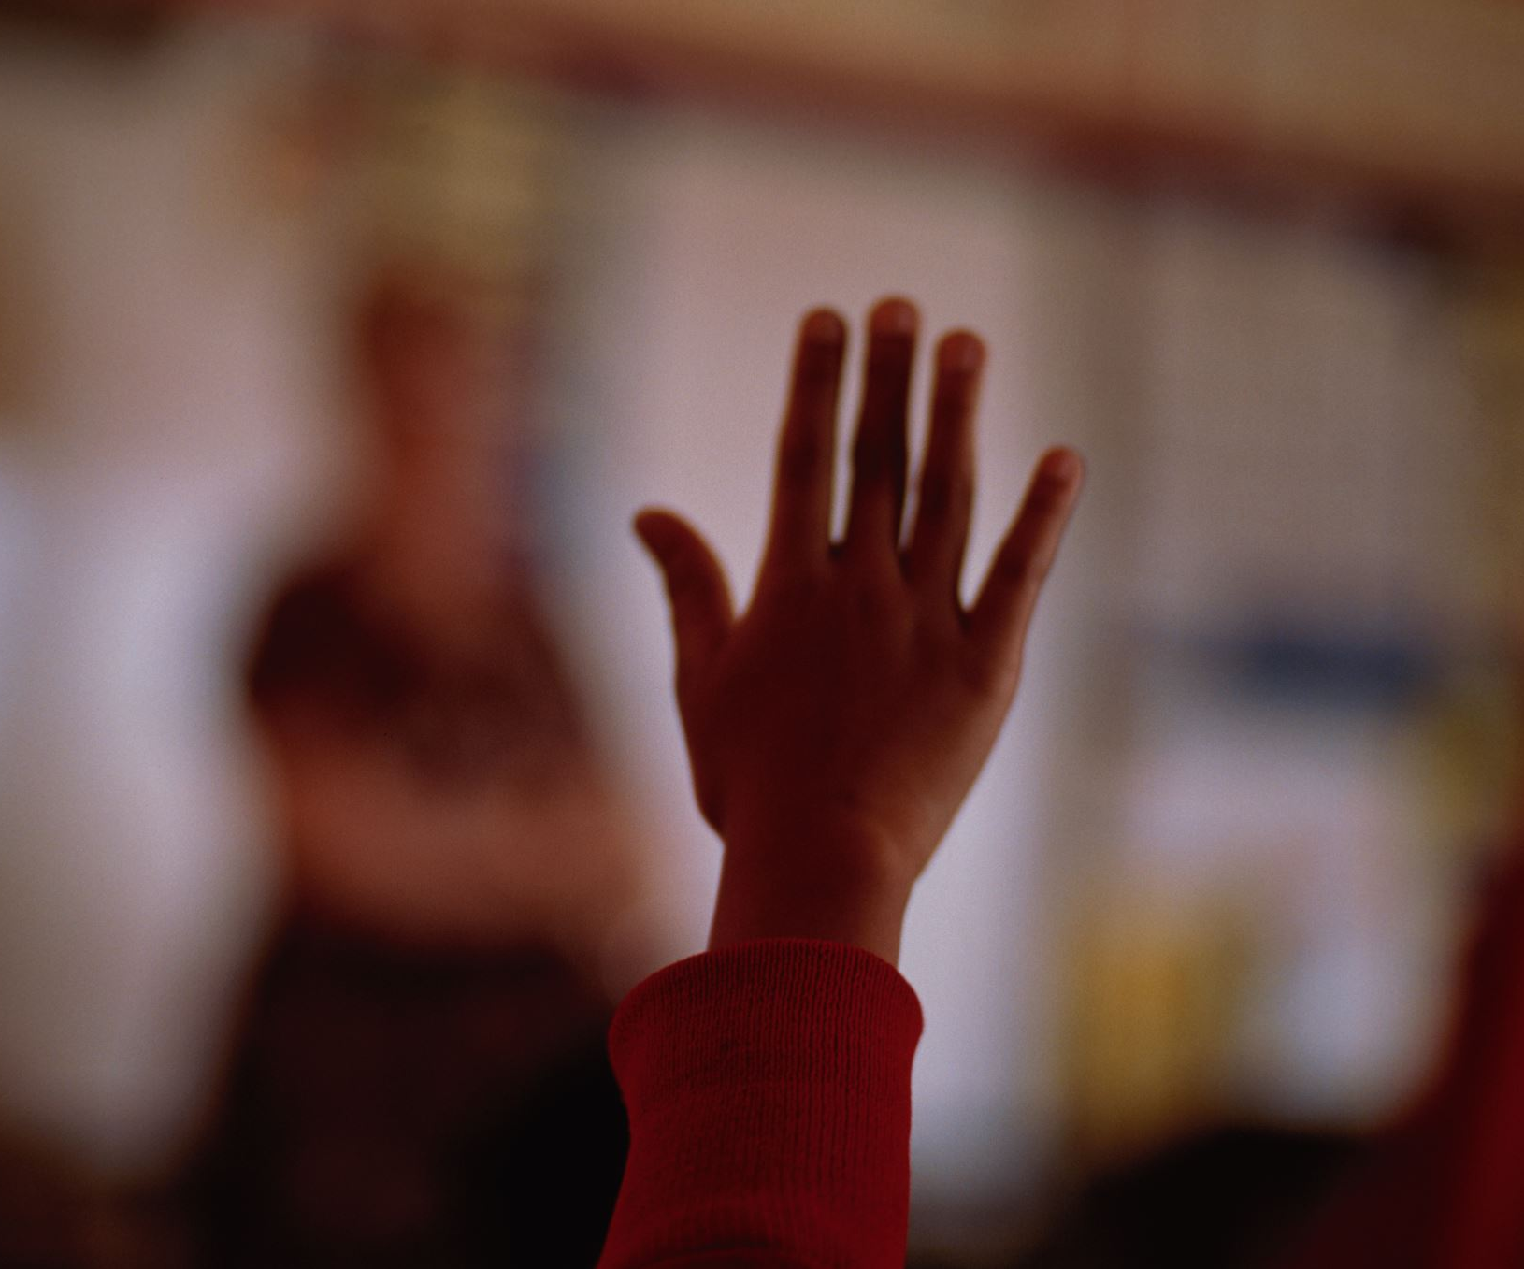
Felly sut fyddech chi’n diffinio dysgwr math?
Pam?
Notes:
Gweithgaredd

Slide 4
TASG
Gall y dasg yma gael ei gynnig yn unigol, ond mae e’n well mewn pâr. Nodwch a chytunwch ar ddiffiniadau cryno am bob un o’r geiriau/ymadroddion canlynol:
Dawnus | Talentog | Perfformiad eithriadol | Creadigrwydd | Deallusol
Gallu deallusol | Gallu uchel | Cyrhaeddiad uchel | Cyflawniad uchel | Anelu’n uchel
Eithriadol o ddawnus | Potensial mawr | Gallu eithriadol | Deallusrwydd | Gallu uwch gyfartaledd
Sgil | Tueddfryd | Tueddfryd amlwg | Amlwg/pwysig | Ardderchog
Rhyfeddod | Academic | Athrylith
• Giftedness • Talent • Exceptional performance • Creativity • Intellectual • Intellectual capacity • High ability • High attainment • High achievement • High flyer • Exceptionally gifted • Great potential • Exceptional ability • Intelligence • Above-average ability • Skill • Aptitude • Marked-aptitude • Outstanding • Excellent • Prodigy • Academic • Genius
Notes:
Make the words available and ask pairs/small groups to sort the list into synonyms and words with a singular meaning. Then arrive at a common definition for any perceived synonym groups and distinctive definitions for words with distinctive implications (NB: ‘Post-it’ notes stuck to flip chart paper are an effective and visually striking way of organising this). Take feedback regarding the list of different terms and concepts so identified. Try to arrive at some agreed overview and go on to discuss the range of different categorisations within the topic. Work towards answering the question ‘what do the differences imply about learners so described’? (Timing ranges from 20 minutes for an individual activity to 45 minutes as a PDP activity.)
The point of this activity is threefold: It suggests the very large number of potentially vague terms that educationalists use to describe high ability and so reveals some of the problems of terminology and definition faced by policymakers in this area. It indicates how the language used to describe and define an able child within the school relates to the school's ethos with regard to ability and what particular aspects of the AG&T agenda it seeks to support. It provides an opportunity via feedback and discussion to arrive at some initial school-based consensus within the somewhat shifting sands of definitions and educational perspectives surrounding AG&T performance.

Slide 5
Diffiniad MARLAND
Gifted and talented children are those identified by professionally qualified persons who, by virtue of outstanding abilities, are capable of high performance. These are children who require differential educational programs and/or services beyond those provided by the regular school program in order to realize their contribution to self and the society. Children capable of high performance include those with demonstrated achievement and/or potential ability in any of the following areas, singly or in combination –
• Gallu deallusol cyffredinol:
• Tueddfryd academaidd benodol:
• Meddwl creadigol a chynhyrchiol;
• Gallu arweinyddol;
• Celfyddydau perfformio a gweladol;
• Gallu seicoechddygol (psychomotor).
(Marland, 1972)

Slide 6
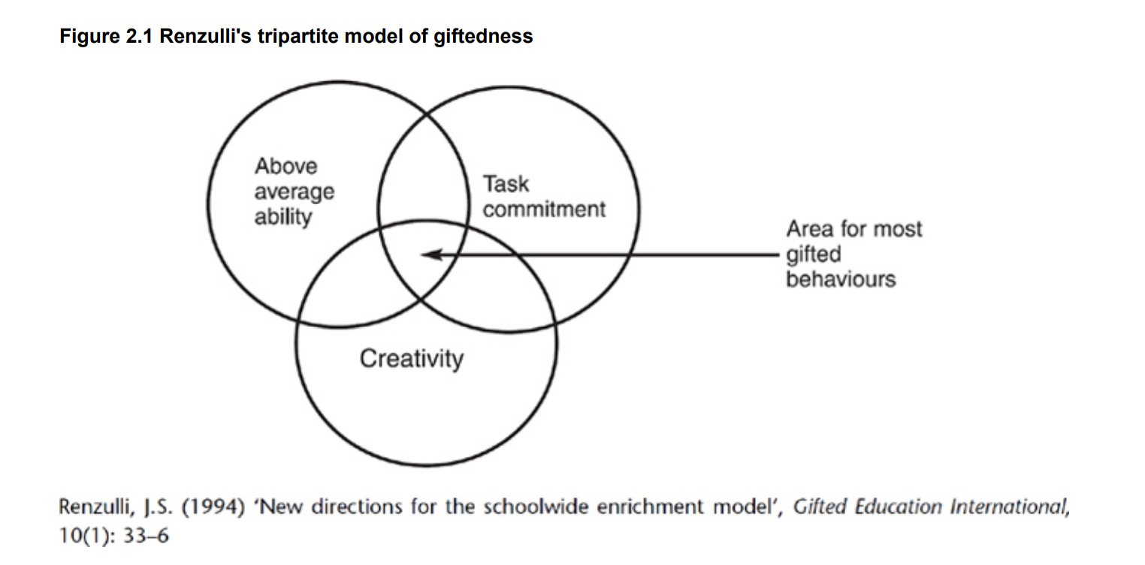
Notes:
The psychologist Joseph Renzulli divided giftedness into two main categories.
The first (or schoolhouse giftedness) is associated with success in tests and quantifiable assessments. Such pupils are easy to identify though sometimes the potential revealed in IQ tests fails to translate into academic performance.
The second category (creative-productive giftedness) relates to activity that puts high value on the development of original material or products designed to suit defined audiences. This is a key factor in ensuring productive outcomes emerge from the challenges of education and of life.

Slide 7
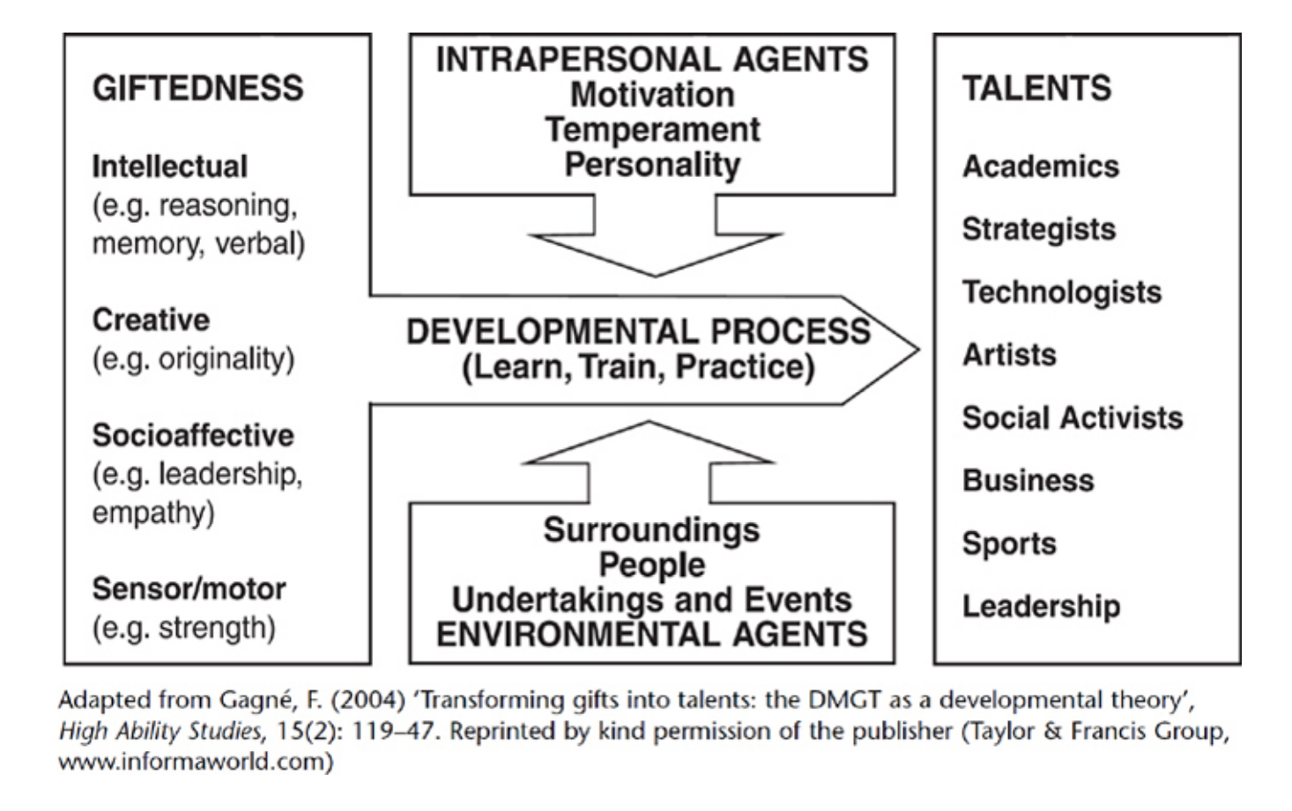
Notes:
Key points for this model are:
• Gifts that are not developed remain as raw materials and represent under-achievement.
• The highest levels of talent require the most intensive development.
• The quality of the developmental process from gift to talent is shaped by school programmes and other formal agents and environmental influences which establish the ‘nature of the nurture’, but also by a more fluid and unpredictable variety of motivational characteristics, inherited predispositions or traits and acquired attitudes towards learning.
• Personal qualities such as determination, courage, cooperativeness and enthusiasm are as important as latent ability in securing the transition from potential to talented performance. For potential to be deemed gifted and performance to be deemed talented it must by definition be above average. Significant deviation above the average in any normal distribution is considered by statisticians to begin beyond the 85th percentile and it is the top 15% of youngsters who are routinely targeted within this developmental context. The size of target groups will, of course, vary from setting to setting for a diversity of reasons.
One constant, however, is the understanding that high achievement requires positive attitudes. For schools to foster the individual curiosity, motivation, strength of purpose and simple joy in learning necessary to facilitate the journey towards talented performance may well be the most powerful way in which any intervention programme can support gifted young people. In this context, developing such personal qualities becomes a major objective of personalisation. Any definition drawing on recent research and socio-political expectations would do well to reflect this insight.

Slide 8
Diffiniad
MATh
?
?
?
?
?
?
Mewn parau cytunwch ar, a labelwch lun ar gyfansawdd dysgwr MATh o’r ysgol PAP.
Notes:
In pairs agree on and label a picture of a composite MA&T pupil from your PTE school drawing on ideas taken from PTE. Join each pair into a four to work collaboratively on an agreed picture and illustrative labels, captions, headings, etc. Finally snowball the fours into eight. Here each four presents its diagram to the other and the ultimate task is to construct a concept map incorporating all of the key terms and features to be included in the definition

Slide 9
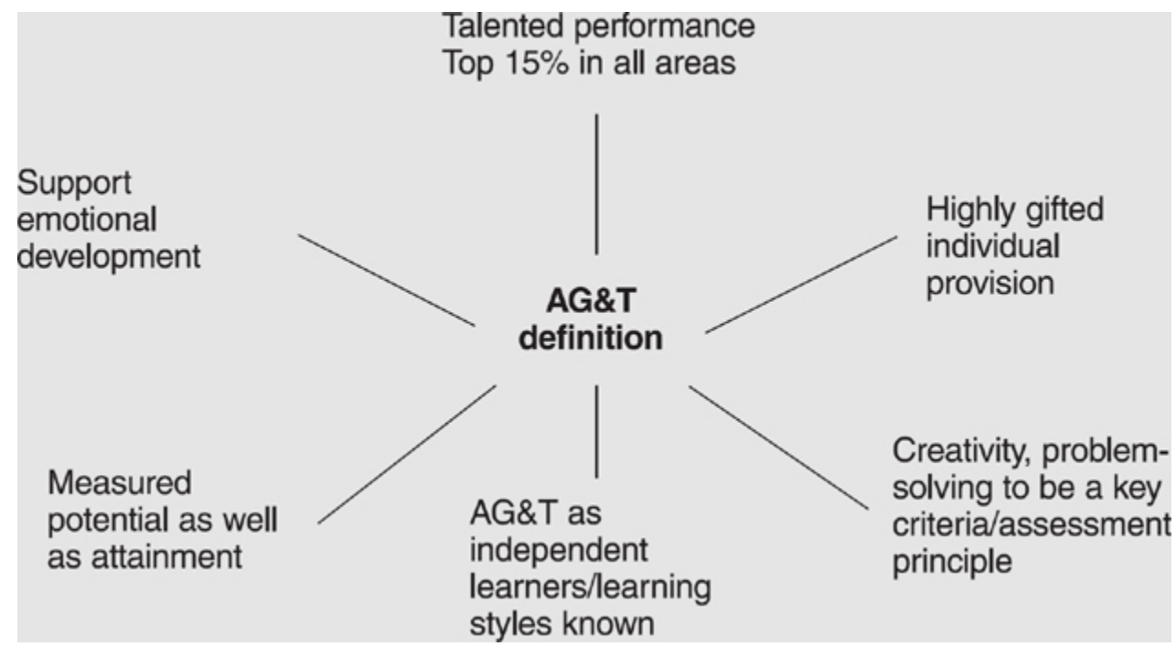
SAGE © Clive Tunnicliffe 2010 SAGE Books Page 11 of 12 SAGE Books - Defining Able, Gifted and Talented • multiple intelligences
Notes:
Summary Some key points have been made in this chapter in relation to defining able, gifted and talented children. MAT More Able and Talented in Wales!!
• There are a variety of terms, definitions and theories linked to MA&T that are not always interchangeable.
• A school or setting should be clear about what it wants to achieve through its policy and not be tempted to ‘bolt-on’ definitions that do not support its ethos and improvement objectives.
• Involving all staff in professional development on the topic of MA&T will promote wider ownership of the policy.
• giftedness • talent • learners • IQ • high achievement • pupils

Slide 10
Principles of good practice
A Framework of Support for Teachers and Children
If inclusionary classrooms are committed to serving all students they must choose to include, both physically and philosophically, even the more extremely gifted children as well as children with the most severe disabilities. This means more for both groups than simply being in attendance in the regular classroom, it means respecting and teaching one's students to respect the unique developmental paths of each individual, no matter how unusual; providing access to a developmentally appropriate curriculum; and providing related support services.
The greatest concerns about educational provision for gifted and talented pupils has related to the coherence and progression of learning. A large amount of provision is inappropriate.
We provide a pullout programme, an accelerated course, an honours class, a special class or some other program with a clever acronym and consider that we have provided adequately for the gifted.i
A lot of provision is ad hoc:
… fragmentary learning experiences, lacking in complex form, long-range purpose, or clear directionality.
Providing an appropriate, coherent and planned programme for upwards of 30 pupils in a class can be a daunting task and we cannot be expected to do it on our own.
Smith, C. (2005). Teaching gifted and talented pupils in the primary school: A practical guide. SAGE Publications Ltd,

Slide 11
ASTUDIAETHAU ACHOS – SUT ALLWN NI GYnORTHWYO EIN DYSGWYR MATH?
Mae ein dull o gyfathrebu gyda’r plant nid yn unig yr hyn rydyn ni’n dweud, er bod rhain yn elfennol bwysig, ond mae e hefyd am y negeseuon tawedog/distaw sydd yn cael eu trosglwyddo.
Astudiaeth Achos
Roedd un dosbarth arsylwais yn astudio Rhyfeloedd Annibyniaeth yr Alban. Roedd Robert yn wybodus tu hwnt am y testun ac roedd e’n awyddus iawn i’r athro wybod hyn. Ond, yn fuan fe ddeallodd nad oedd hyn o gymorth i’r athro iddo fe wybod gormod oherwydd ni ofynnwyd iddo i gyfrannu i’r dosbarth nac ateb cwestiwn. Cadarnhawyd hyn yn gynnar yn y wers pan ddwedodd yr athro, ‘Rwyt ti i weld yn gwybod y cyfan am hyn Robert, felly rho dy law lawr a rho gyfle i’r gweddill’. Fe dreuliodd Robert y chwe wythnos ganlynol yn astudio testun roedd e’n ei wybod ac yn ei ddeall yn dda. Does dim amheuaeth iddo ddysgu’r wers werthfawr o’r anfanteision o fod yn geffyl blaen y dosbarth.
Notes:
Have a read through the case studies, how would you support a MAT learner? Read through the case studies and think of the best way to support the learners. Discuss the one on the slide together, then download the document ( print document)t to discuss the other three case studies.
I am sure the intention of the class teacher in this story would have been to place children in groups according to their ability so that work at an appropriate level could be provided. There is no merit in asking children to undertake tasks that are too far beyond their current level of ability. However, it was clear to Julie that her group was not expected to use capital letters and full stops.
Expectations are funny things and often really difficult to get right. It is often said that we should have high expectations of all children. I agree but what does this mean? We surely cannot expect more of some children than they are able to provide at that point in time. Having our expectations too high would be as bad as having them too low. I have come to the conclusion that it is really about opportunity and being open to being surprised. Julie clearly felt that she should not do capital letters and full stops; the way the class was set up was preventing her from trying. This is where it is important to make a range of opportunities available to all children. Providing choice from this range will allow them to surprise us.

Slide 12
MAE’R MODD RYDYN NI’N YMATEB I DDEWISIADAU’R PLANT A’U HYMDRECHION YN BWYSIG. Mae ambell adborth yn fwy cadarnhaol nac eraill. Er mwyn bod yn gadarnhaol mae angen iddo fod yn:
Ddidwyll/gonest. Mae hyn yn gallu bod yn ddyrys. Rwy’n cofion myfyriwr yn dod ataf gan ddweud ‘Rydw i am fod yn gadarnhaol Meryl, ond mae’r gwaith yma’n wan ac mae angen llawer o waith arno’. Cawsom ni sgwrs hir ar sut rydyn ni’n darparu adborth sydd yn ddidwyll ac yn gadarnhaol. Roedd mwyafrif y drafodaeth yn cwmpasu ar sut i gynorthwyo’r plentyn i ddod i ddyfarniad ei hunan am ei waith.
Benodol ac yn eglur, er mwyn i’r disgyblion wybod yn union sut i wella’r gwaith. Daeth plentyn ataf mewn clwb ar ôl ysgol ataf unwaith gyda stori roedd hi wedi ysgrifennu yn y dosbarth. ‘Mae’r athrawes wedi dweud wrthai am fynd i ffwrdd i feddal sut allai wneud hen yn well, ond dydw i ddim yn gwybod’. Mae adborth amwys yn waeth na dim adorth o gwbl.
Yn breifat yn hytrach nac yn gyhoeddus ac osgoi cymharu gydag eraill. Mae gallu bod yn chwithig (embarrasing) i gael eich llwyddiant neu’ch methiannau wedi eu cyhoeddi yn gyhoeddus. Y gwaethaf, wrth gwrs, yw, pan mae adborth yn gyhoeddus ac yn gymhariaeth. Rwy’n cofio pan roeddwn i yn yr ysgol ble roedd un ferch druan yn cael ei chymharu yn gyson gyda’i chwaer a oedd dwy flynedd yn hŷn.
Yn berthnasol i waith neu i’r ymddygiad yn hytrach na’r person. Yn hytrach na rhoi sylwad bod Rhys yn ‘fachgen hyfryd’, mae’n fwy cadarnhaol chynorthwyol i gynnig esiampl o’r ymddygiad, fel, ’Roedd Rhys wedi gwneud rhywbeth hyfryd heddiw, fe gynorthwyodd e Bronwen wedi iddi ddisgyn ar y buarth’.

Slide 13
Pa fath o gwestiynau allwn ni ofyn ac annog plant i ofyn er mwyn cynyddu lefel anhawster ar gyfer y plant sydd angen gweithgareddau mwy heriol?
BETH YDYN NI’N EI WYBOD AM GWESTIYNAU?
Y cwestiynau gorau yw’r rhai sy’n:
Ysgogi plant i’w ateb;
Nad oes angen ateb cywir, heb gyfyngder
Annog dysgu dwfn ac ymrwymiad gyda’r broblem
Mae llawer rhy rhwydd, mewn dosbarth cynradd, i ganfod ein hunain yn disgyn i ystod cyfyng o fathau o gwestiynau. Yn gyffredinol rydyn ni’n ceisio defnyddio’r math cywir o gwestiwn ar yr amser addas. Mae’n bosibl i gategoreiddio’r mathau o gwestiynau i ystod o ffyrdd gwahanol, Ond heddiw rydyn ni’n mynd i edrych ar ddau categorïau eang: caeëdig ac agored.
Mae’n bwysig fod plant yn deall natur y cwestiynau a sut mae gwahanol gwestiynau yn gofyn am gwahanol fathau o atebion. Anogwch y dysgwyr i ofyn cwestiynau dyfnach, cwestiynau chwilfrydig drwy drafod yr hyn sy’n gwneud cwestiwn da.
Notes:
Closed questions tend to be good for checking and encouraging the recall of knowledge:
finding out what facts are already known;
finding out which facts have been remembered from teaching;
directing children to specific information in a text;
highlighting key points in a passage or presentation;
helping children to make notes and summarise lessons;
identifying gaps and difficulties in knowledge and understanding;
leading into new learning.
Open questions are necessary if we want to help children think about ideas and topics by:
stimulating ideas;
focusing attention;
stimulating curiosity and interest;
stimulating discussion;
eliciting views;
identifying previous experiences and knowledge;
recognising feelings;
encouraging hard thinking;
extending and deepening a topic.

Slide 14
Tacsonomeg bloom
Esiampl : Jac a’r Goeden Ffa
Gwybodaeth | (cofio a chadw) Am beth wnaeth Jac gyfnewid ei fuwch?
Amgyffred | (dehongli a dealltwriaeth) Pam wnaeth Jac gael ei hun mewn i drwbwl am gyfnewid y fuwch am y ffa?
Cymhwysiad | (gwneud defnydd o) Beth fyddai eich mam chi’n dweud petai chi’n mynd i siopa gyda £20 a dychwelyd gyda ffa hudolus?
Dadansoddiad | (cymryd rhan) Rhestrwch y cymeriadau yn y stori a’r hyn mae nhw’n gwneud yn y stori.
Synthesis | (gosod at ei gilydd) Petai draig yn byw ar frig y goeden ffa yn hytrach na chawr, sut allai pethau fod yn wahanol?
Gwerthusiad | (barnu ac asesu) Oedd Jac yn arwr neu’n leidr?
Mae tacsonomeg Bloom yn dosbarthu meddwl i raddau hierarchaidd yn ôl lefel anhawster. Cynigodd Bloom byddai’r dair lefel cyntaf, gwybodaeth, dealltwriaeth ag amgyffred, yn cynnwys sgiliau trefnu is ac roedd mwy o sialens yn cael ei gynnwys petai dysgwyr yn cael eu gofyn i ymrwymo i’r dair olaf: dadansoddi, synthesis a gwerthuso.
Y fantais sydd gan tacsonomeg Bloom dros fframweithiau eraill yw ei fod yn cynnig hierarchaeth o weithgareddau yn hytrach na ystod o weithgareddau ar yr un lefel.
Tasg Tacsonomeg Bloom.docx
Notes:
Allwch chi gwblhau’r tabl gan ddefnyddio stori o’ch dewis. Lawrlwythwch y ddogfen a gweithiwch mewn pâr i gwblhau’r tabl.

Slide 15
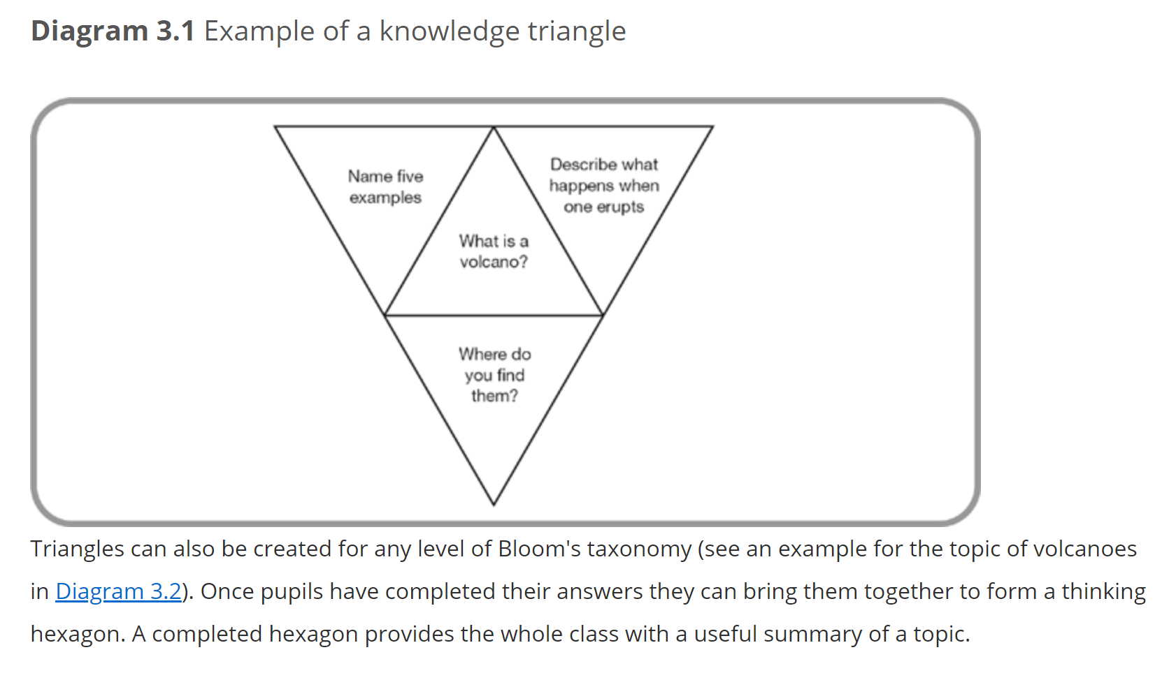
Trionglau Meddwl
Gan ddefnyddio tacsonomeg Bloom, allwn ni hefyd greu trionglau meddwl ar gyfer pob lefel yn y tacsonomeg.
Gall triongl fod ar unrhyw un o’r chwech lefel.
Mae trionglau meddwl yn gallu bod yn fframweithiau defnyddiol i gynorthwyo dysgwyr pan mae’n nhw’n dod ar draws cysyniadau newydd, syniadau neu destunau. Mae pob triongl yn cynnwys yr un mewnbwn gan yr athro hyd nes bod y dysgwyr yn cyfarwydd gyda’r dull.

Slide 16
Beth sy’n cynorthwyo fi i fod yn ddysgwr da?
Os yw’r thema yn ddiddorol
Os ydw i’n dysgu am bethau newydd, nid dim ond yn ailadrodd yr hyn rydw i’n gallu ei wneud yn barod a’r hyn rwy’n ei wybod yn barod
Os ydw i’n cael cyfle i roi mewnbwn i’r gweithgareddau rwy’n eu cyflawni a sut rydw i’n cyflawni nhw.
Os yw fy marn a’m gwybodaeth yn cael eu gwerthfawrogi.
Os ydw i’n cael y cyfle i arddangos yr hyn rydw i’n ei wybod yn barod, am y testun cyn i ni ddechrau
Os mae’r athro yn gofyn i mi gynorthwyo gyda’r paratoadau ar gyfer y testun.
Os ydw i’n cael y cyfle i fentro a chael pethau’n anghywir.
Os ydw i’n cael y cyfle i ddysgu oddi wrth pobl yn fy nosbarth ac adref a’i ddefnyddio yn fy ngwaith
Os ydw i’n cael y cyfle i weithio ar fy mhen fy hun ac weithiau mewn grwpiau. Rwy’n hoffi’r ddau ffordd o weithio.
Os ydw i’n cael gweithio ar gyflymder fy hun ac nad yw pethau’n rhy anodd ac nad ydynt yn rhy rhwydd.
MAE ATHRO DA YN UN SY’N...
Notes:
A good teacher is one who: Ask for students response!!
Doesn't humiliate you in front of the class; doesn't try to destroy you so that you'll leave school, or tell you that you're no good and that you should leave school.
Doesn't write slabs of work on the board to be copied.
Lets you talk and move about the classroom.
Doesn't favour girls, or the boys who do what they're told.
Doesn't keep picking on people who have a reputation, pushing them to retaliate.
Doesn't mark you down because of your behaviour.
Gives you a chance to muck up and learn from it.

Slide 17
References/RESOURCES
Enrichment Activities for More Able and Talented Learners
A set of resources and ideas for targeting / challenging more able and talented pupils.
Repository - Hwb (gov.wales)
More able and talented thematic survey report (gov.wales)
meeting-the-challenge-quality-standards-in-education-for-more-able-and-talented-pupils_0.pdf (gov.wales)
Smith, C. (2005). Teaching gifted and talented pupils in the primary school: A practical guide. SAGE Publications Ltd, https://sk-sagepub-com.ezproxy.uwtsd.ac.uk/books/teaching-gifted-and-talented-pupils-in-the-primary-school/n2.xml
Tunnicliffe, C. (2010). Defining able, gifted and talented. In Teaching able, gifted and talented children: Strategies, activities and resources (pp. 15-28). SAGE Publications Ltd, https://sk-sagepub-com.ezproxy.uwtsd.ac.uk/books/teaching-able-gifted-and-talented-children/n2.xml

