Slide 1
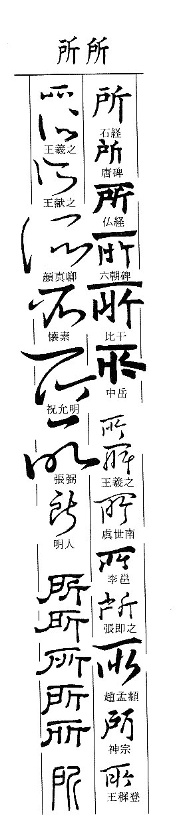
Lesson 4
The 所 construction and nominalised verbs

Slide 2
Suŏ 所 – a nominalising particle
者 zhĕ forms noun phrases: 讀書者 “a person who reads a book” or “he who reads a book”
者 substitutes for the subject of this sentence, i.e. the person who reads.
By contrast, suŏ 所 substitutes for the object of the verb or preposition it precedes
“that/the book which he reads” → 所讀

Slide 3
所 + verb
所食 “what someone eats”
所欲 “what someone desires”
所知 “what someone knows”
所愛 “what someone loves”
Note:
所 is always followed by a verb or a co-verb (i.e. preposition), e.g. yu 於, zi 自, cong 從. The character after所 has to be a verb!
所 + verb constructions usually have a passive sense:
  所食 “what is eaten”
  所知 “what is known”

Slide 4
X + 所 + verb
The subject ‘x’ of an action is placed before 所
王所食 “what the king eats”
吾所欲 “what I desire”
其所知 “what he knows”
民所愛 “what the people love”

Slide 5
X +之+所+verb
Optionally, the subordinating particle 之 can be inserted between the subject and 所:
王之所食 “what the king eats”
吾之所欲 “what I desire”
其之所知 “what he knows”
民之所愛 “what the people love”
The use of 之 does not change the meaning!

Slide 6
Applications of 所
The phrase with 所 is rarely used on its own, but rather forms part of a larger sentence.
1. As topic in a nominal sentence (A – B也)
Topic Comment
王之所好(者) 道也。What the king loves, that is the Dao.
2. As comment in a nominal sentence
Topic Comment
宋地 楚魏之所欲也。
The land of Song, that is what the Chu and Wei states desire.

Slide 7
3. As object in a verbal sentence
臣 欲 食 王之所食。
Subj./Aux./ Verb/ Object
Your servant desires to eat what the king eats.
4. Part of attribute
王所欲之金玉 難(difficult)得(to obtain)也。
The gold and jade which the king desires is difficult to obtain.

Slide 8
Suŏ 所 preceding prepositions
Suŏ 所 is often followed by a coverb (Lesson 7) to indicate the place, reason or other circumstances of an action. Examples:
所自 suǒ zì , 所由 suǒ yóu, 所從 suǒ cóng introduce the place whence/where from/where through/through which/from which etc.:
所自 suǒ zì
問其所自來 wèn qí suǒ zì lái
‘[someone] asked where he came from’
所由 suǒ yóu
不知鼠之所由出 bù zhī shǔ zhī suǒ yóu chū
‘[someone] does not know where the mouse comes out from’
所從 suǒ cóng
指其所從出邑之門 zhǐ qí suǒ cóng chū yì zhī mén
‘[someone] points out the gate through which he had left the town’

Slide 9
Suŏ 所 preceding prepositions
所為 suǒ wèi the one for whom / the reason why (為 pronounced wèi!)
先生所為文市義者 xiānshēng suǒ wèi Wén shì yì zhě
‘the justice which you Sir (先生) have bought (市) for me, [Tian] Wen’
所與 suǒ yǔ the one with whom
其妻問所與飲食者 qí qī wèn suǒ yǔ yǐn shí zhě
‘his wife asked about the people with whom he had been drinking and eating’
所以 suǒ yǐ that by means of which, the reason why
問其所以知之 wèn qí suǒ yǐ zhī zhī
‘[he] asked how he knew it’
人之所以不能知天之大 rén zhī suǒ yǐ bù néng zhī tiān zhī dà
‘the reason why people cannot know the greatness of Heaven’
Note: In modern Chinese 所以 suǒ yǐ means ‘therefore’. It NEVER has this meaning in classical Chinese.

Slide 10
The main coverbs
從 cóng ‘to follow’
自 zì ‘to start from’
由 yóu ‘to follow along’
與 yǔ ‘to give to’ → ‘to accompany’
因 yīn ‘to rely on’
以 yǐ ‘to grasp’ → ‘to use’
為 wèi ‘to act for the sake of/on behalf of’

Slide 11
Text Fuller Lesson 4
楚人有涉江者，
其劍自舟中墜於水。
遽契其舟曰：『是吾劍之所從墜。』
舟止，從其所契者入水求之。
舟已行矣，而劍不行。
求劍若此，不亦惑乎？
Chǔ rén yǒu shè jiāng zhě,
qí jiàn zì zhōu zhōng zhuì yú shuǐ.
jù qì qí zhōu, yuē shì wú jiàn zhī suǒ cóng zhuì.
zhōu zhǐ, cóng qí suǒ qì zhě rù shuǐ qiú zhī.
zhōu yǐ xíng yǐ, ér jiàn bù xíng.
qiú jiàn ruò cǐ, bù yì huò hū.

