Slide 1
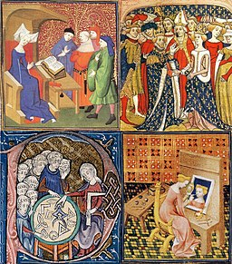
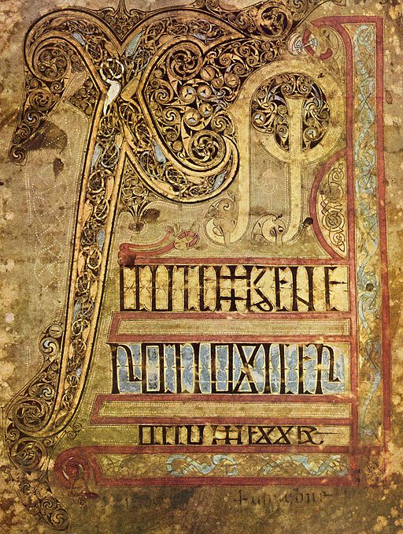
Women in the Middle Ages: Sources From the Celtic Regions
MA in Medieval Studies
MA in Celtic Studies

Slide 2
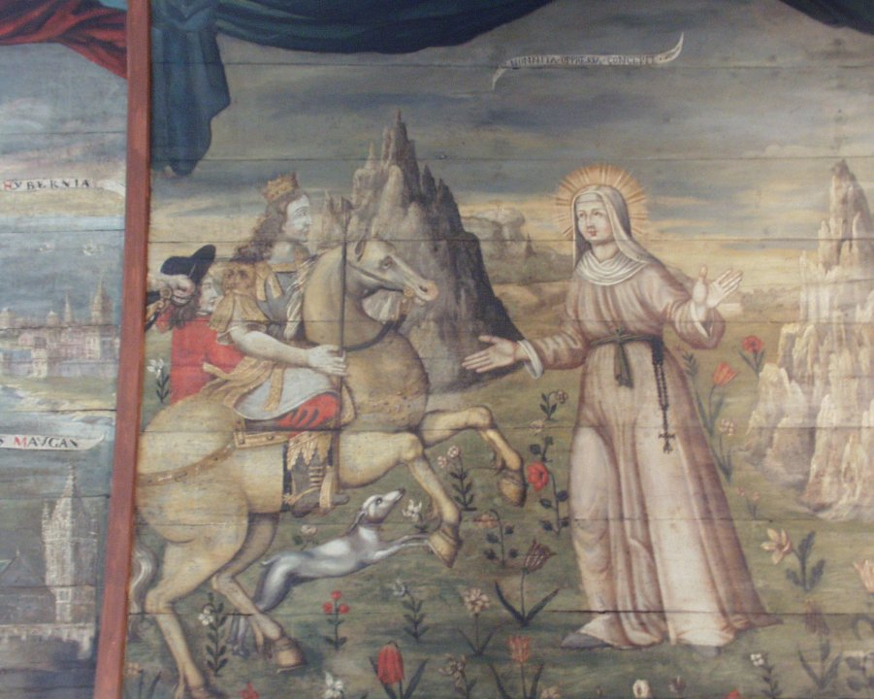
These are some of the topics covered in the module:
attitudes towards women in medieval texts (both religious and secular);
the development of women’s studies since the 1970s and how various theoretical and methodological perspectives have contributed to the field of gender and medieval studies;
Image: St Non meets Sant, seventeenth-century ceiling painting St Divy, Brittany photo Jane Cartwright

Slide 3
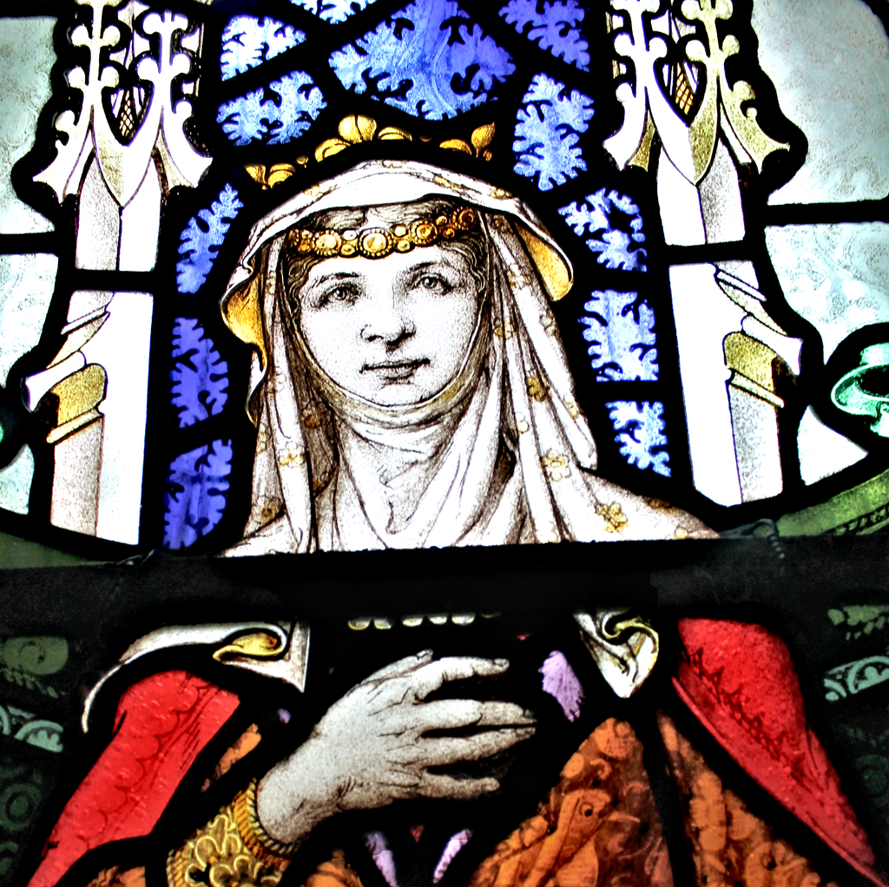
the lives of women in secular life (both aristocratic and ‘ordinary’ women): case studies looking at real women such as the daughters of Llywelyn ab Iorwerth;
Image: Siwan, stained glass at Trefriw
Llywelyn2000, CC BY-SA 4.0 <https://creativecommons.org/licenses/by-sa/4.0>, via Wikimedia Commons

Slide 4
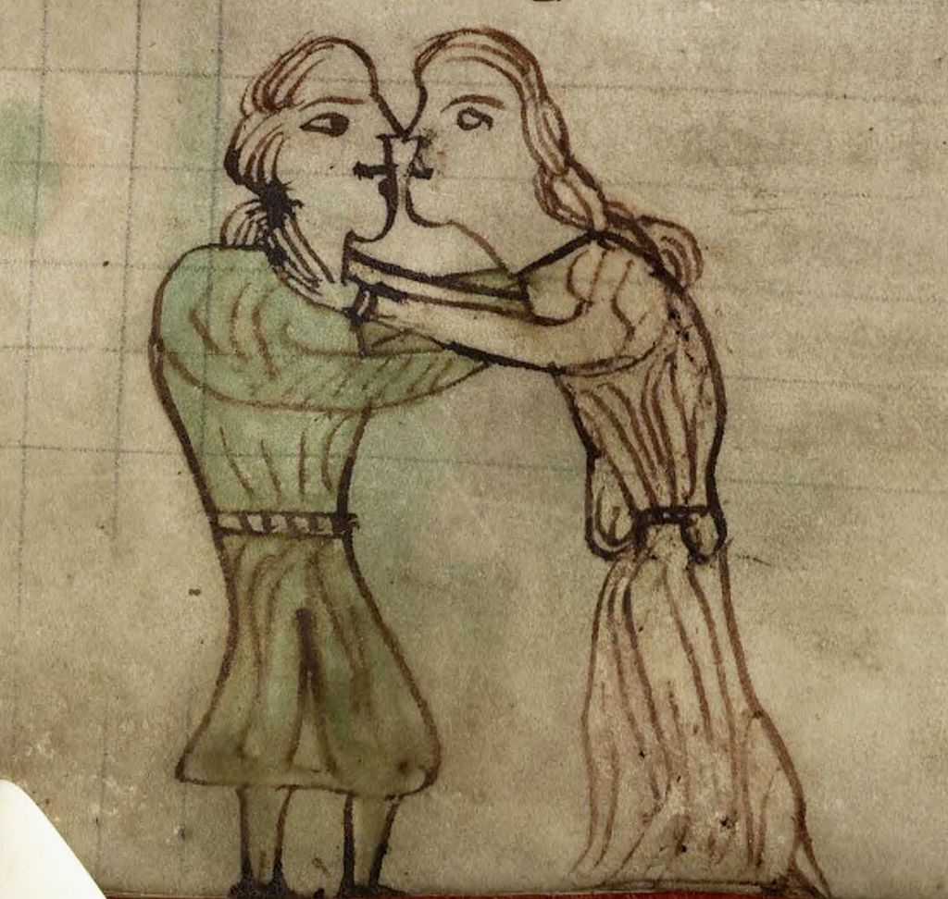
women’s legal status and the paradigms of a woman’s life: What do the lawcodes reveal about key issues such as marriage, rape, physical abuse, divorce and property ownership?
Image: Kissing Couple. From a Latin copy of the Laws of Hywel Dda Aberystwyth, National Library of Wales, MS Peniarth 28

Slide 5
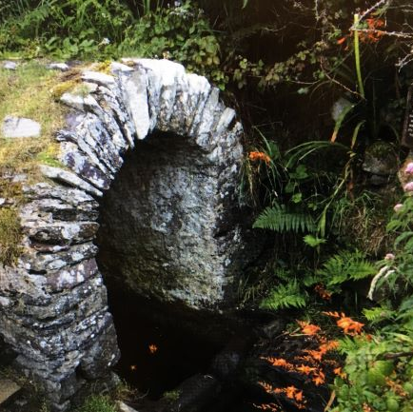
women and religion: medieval nunneries, female saints and lay piety, pilgrimage and religious sites;
Image: St Non’s holy well, Pembrokeshire, photo Jane Cartwright

Slide 6
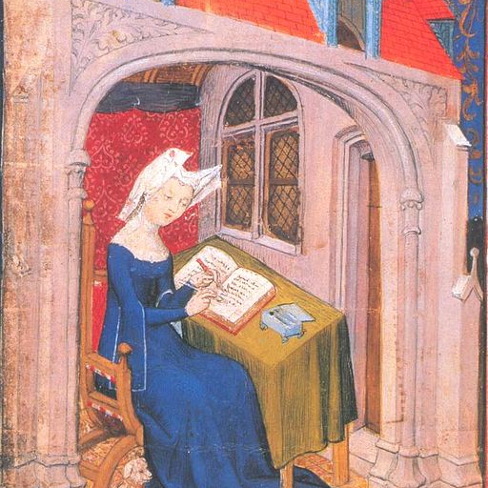
Literature, books and literacy: how women are depicted in literary texts as well as literature by women (for example Gwerful Mechain);
Image: Christine de pisan.jpg - Wikimedia Commons

Slide 7
How will the module be assessed?
Two 4,000-word essays
See the ‘Assignments’ tile for further details.
Check topics and submission dates for this year and make a note of them in your diaries.
Marking criteria on form GA36
Remember you cannot ask me or an extension (Extenuating Circumstances)
Submit your assignments via the correct submission link in Moodle.
The ‘draft’ link will allow you to see your Turnitin report beforehand if you would like to use this link as a ‘trial run’ but you MUST submit via the submission link in order for your work to be assessed.

