Slide 1

Digital Skills and Research Methods
How digital technology can improve efficiency, data safety and staff collaboration across the Organisation.
Module:LCHS4007
Helema Khanum(2527108@student.uwtsd.ac.uk,
Aysha Begum (2518869@student.uwtsd.ac.uk),
Irj Hussain (2419541@student.uwtsd.ac.uk)

Slide 2


Contents
Introduction
PowerPoint – Benefits and Limitations
Teams – Benefits and Limitations
Digital Safety
Conclusions

Slide 3

Chosen Tool:
PowerPoint
Module:
Digital Skills and Research Methods
LCHS4007
Aysha Begum
2518869

Slide 4

Digital Transformation Context at Greenfield Home Care
Greenfield Home Care Agency supports older adults living independently, requiring coordinated community care delivery across multiple staff roles. (Jeilani & Hussein, 2025)
• The agency adopted Microsoft 365 to streamline communication, documentation, and coordination. (Alotaibi et al., 2025)
• Despite the technology rollout, many staff lack confidence with digital platforms, leading to partial tool adoption. (Alotaibi et al., 2025)
• Digital maturity in healthcare organizations influences how effectively teams use collaborative tools. (Raunaq et al., 2025)
• Mobile, distributed workforces such as carers experience challenges with fragmented information and asynchronous communication. (Raunaq et al., 2025)
• Therefore, Greenfield needs productivity applications that support structured information sharing and reduce workflow fragmentation. (Ofori et al., 2025)
(Adobe, 2025)

Slide 5
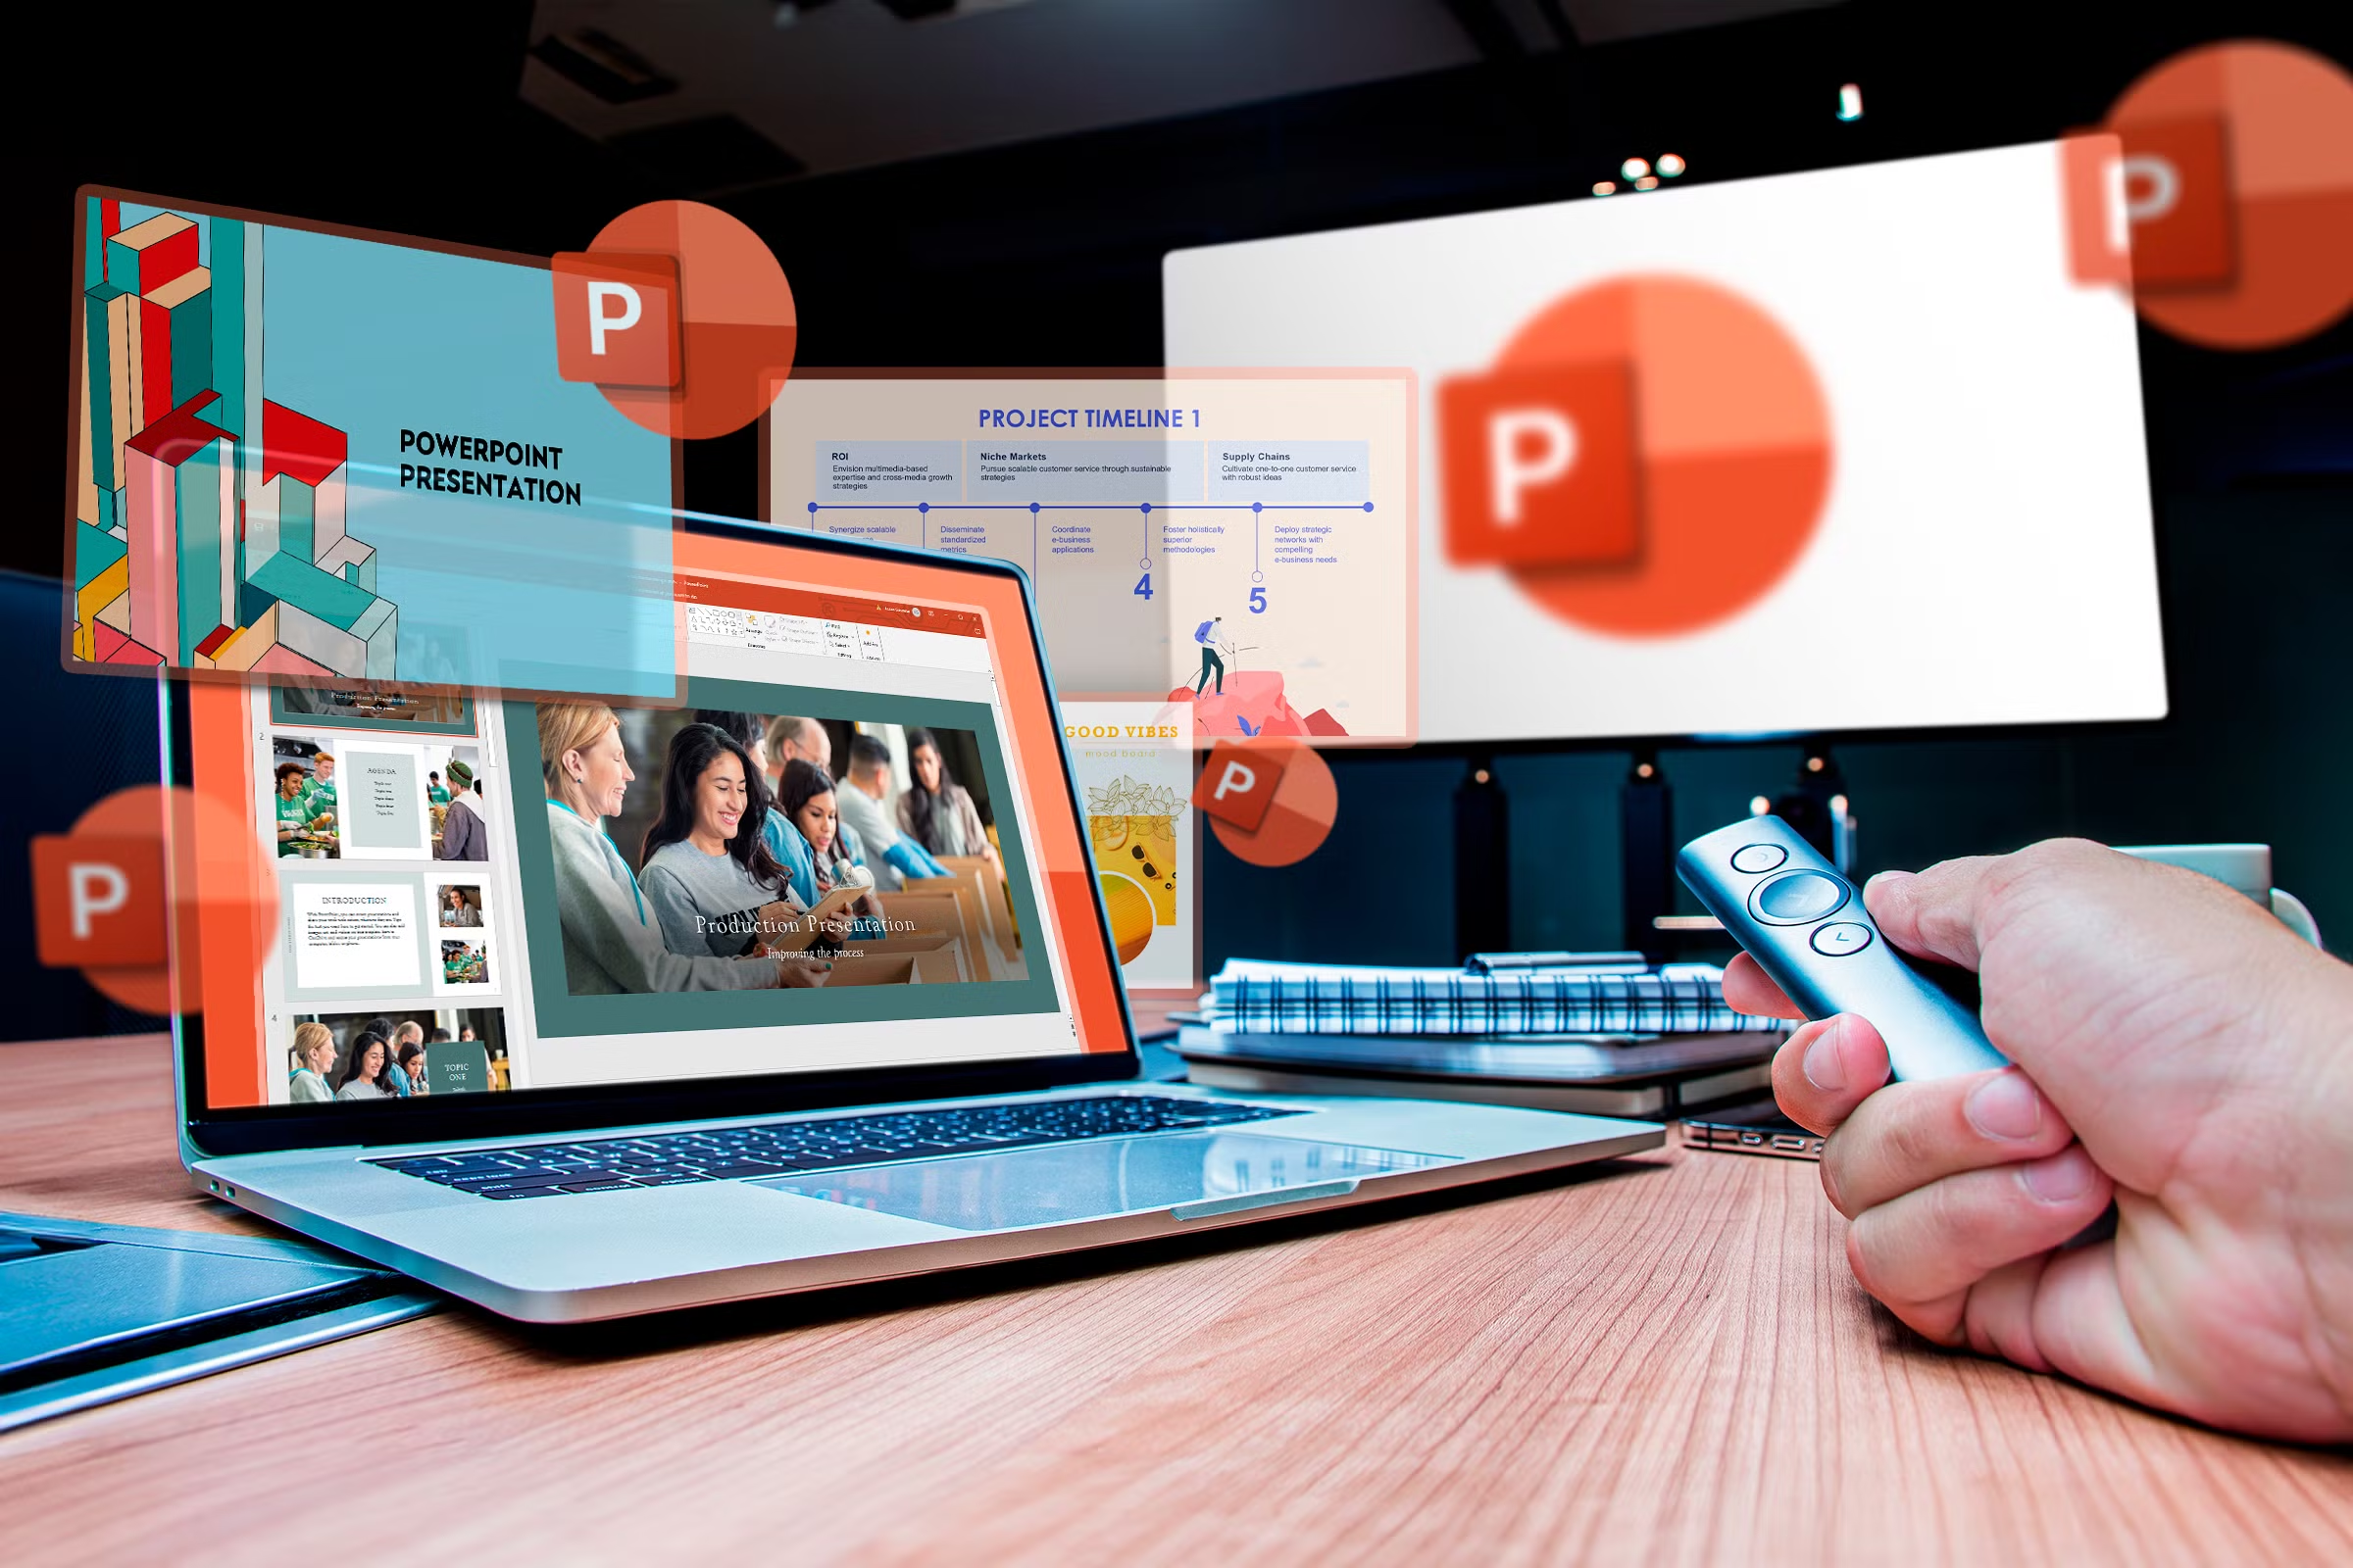
PowerPoint as a Digital Productivity Application
Microsoft PowerPoint within Microsoft 365 supports visual structuring of information, not just formal presentations. (Ofori et al., 2025)
• Visual organization can reduce cognitive effort and improve clarity of procedural knowledge at point of use. (Raunaq et al., 2025)
• In healthcare training, multimedia and slide-based formats enhance understanding compared with text-only formats. (Awungafac et al., 2024)
• Visual communication frameworks help translate complex protocols into digestible, actionable steps for staff. (Ofori et al., 2025)
• Structured slides facilitate contextualized training modules that staff can revisit, improving retention and consistency. (Awungafac et al., 2024)
(Phillips, 2025)

Slide 6
How Tasks Are Done Now vs PowerPoint-Enhanced Workflow
Task Aspect | Current Method | PowerPoint-Enhanced Method
Information Delivery | Dense text messages and emails | Clear visual sequences and summaries
Guidelines Accessibility | Stored in printed notes | Centrally stored slides available via Teams
Training Format | Ad-hoc verbal sessions | Slide-based structured training
Updates & Edits | Email threads and PDF versions | Shared and versioned slide decks
Staff Collaboration | Fragmented comments | Shared visuals and annotations
Current workflows rely on text and verbal communication that are hard to scan and interpret quickly. (Jeilani & Hussein, 2025)
•PowerPoint slides break down tasks into visual steps, reducing ambiguity.(Awungafac et al., 2024)
• Slide decks shared via Teams can be updated centrally and accessed by all team members. (Ofori et al., 2025)
• Training modules in slides support self-paced review and more consistent onboarding. (Awungafac et al., 2024)

Slide 7
PowerPoint in Workflow Redesign
PowerPoint templates can be created for routine care procedures, so staff access standardized formats. (Ofori et al., 2025)
• Visual checklists embedded in slides help carers perform tasks with fewer errors. (Raunaq et al., 2025)
• Handover slides summarize key client information, reducing information loss during shift changes. (Awungafac et al., 2024)
• Weekly briefing decks consolidate messages, reducing the need for repeated email chains. (Ofori et al., 2025)
• Integration with Teams enables real-time collaboration on slide updates. (Raunaq et al., 2025)

Slide 8
Benefits of PowerPoint: Efficiency & Team Coordination
• Visual formats such as slide sequences reduce cognitive strain and accelerate comprehension. (Raunaq et al., 2025)
• Slide-based modules improve training effectiveness and information retention. (Awungafac et al., 2024)
• PowerPoint supports role-specific briefings, enhancing tailored communication. (Ofori et al., 2025)
• Use of visuals fosters shared understanding across carers, coordinators, and nurses. (Ofori et al., 2025)
• Standardized slide templates reduce duplication of effort and avoid inconsistent documentation. (Jeilani & Hussein, 2025)
Limitations & Practical Consideration
• Visual tools can introduce information overload if slides are too complex or poorly structured. (Awungafac et al., 2024)
• Staff with low digital literacy may struggle to create or interpret complex slide decks. (Alotaibi et al., 2025)
• PowerPoint does not function as a data storage system, so clinical records need dedicated systems. (Raunaq et al., 2025)
• Over-reliance on slides may reduce direct discussion if not facilitated interactively. (Ofori et al., 2025)
• Designing high-quality slides requires time and skill, which may be limited in care settings. (Awungafac et al., 2024)

Slide 9

Using Teams to Improve Performance
Using teams in healthcare organizations can optimize the use of resources.
Teams are to solve specific problems, improve quality, or plan an event.
By using Teams you can create and develop teams.
Teams provide training with high performance and effectiveness.

Slide 10

Disadvantages of Teams
For full capabilities subscription is required
Microsoft tools can overlap
Risk of duplicate channels
Requires high internet stability
High storage consumption
File management issues
Minimal customization

Slide 11
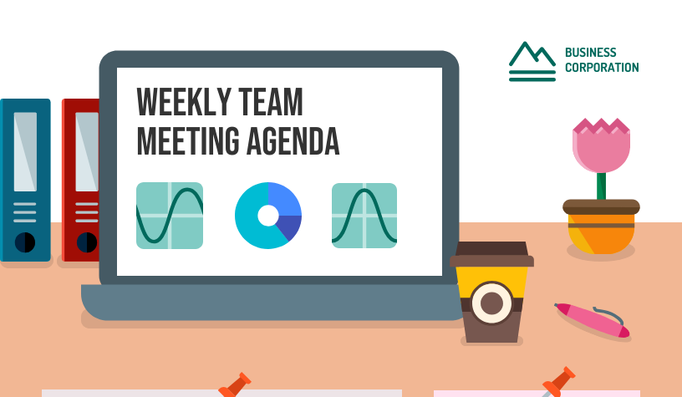
Challenges you Could face using Microsoft Teams in a care home
1. Limited Digital skills among staff.
Some staff may not be confident with technology.
Difficulty navigating channels, uploading documents, or joining meetings.
2 . Poor Wi-Fi or Device Access
Care home might have weak internet, especially older or rural buildings.
Limited shared computers on shifts.
Staff may rely on personal phones.
3. Meeting fatigue
Back-to-back video calls.
Screen sharing glitches.
Audio or connectivity issues.
4. Too many Notifications
From chats, Channels, meetings and mentions.
Important messages can get buried.
5. Performance Issues
Can be slow if using older devices.
High memory usage.
Lag during large meetings.
6. Permission & Access Problems
Users unable to access certain files or channels.
Confusion between guest and member permissions.

Slide 12

What are the benefits of using Microsoft Teams in Greenfield Care home?
Improves efficiency and resident care by facilitating secure.
Gives Instant communication among staff to stay connected in different locations.
Enabling virtual GP/Specialist consultations.
Allowing families to connect with residents via video.
Supports the organizations use
Of Microsoft 365.

Slide 13


How to overcome some Challenges
Improve Wi – Fi coverage with boosters.
Use device stands, headphones, and simple log – in guides.
Provide structured staff training.
Obtain written consent for Virtual meetings.
Use clear digital policies ( GDPP, Safeguarding, recording rules).
ThePhoto by PhotoAuthor is licensed under CCYYSA.

Slide 14

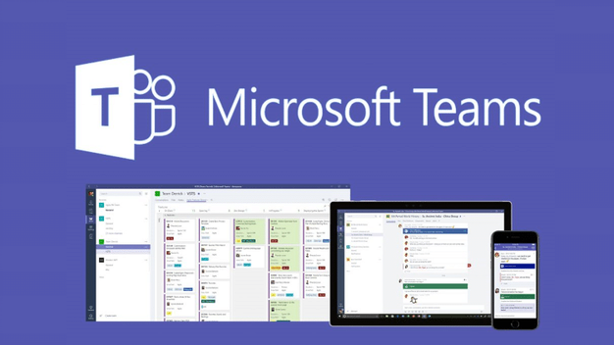
Top 9 Key Benefits of Microsoft Teams
Meetings and scheduling tools
Enhanced Communication
Quick questions
Digital Transformation
Video calling
Microsoft Integration
User Enablement through Bots
Security
Increased Productivity

Slide 15

Digital Safety Action Plan
Greenfield Home Care Agency
Group Member 3 | LCHS4007 | Level 4

Slide 16
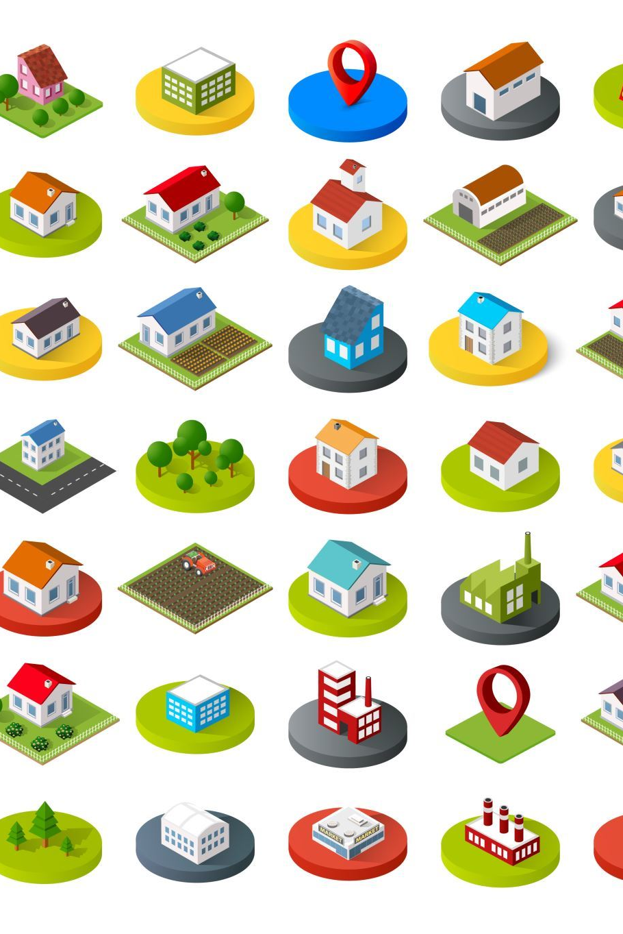
Context and Importance
Microsoft 365 across different locations to store and share information. Because this data is private, strong digital security is needed to protect clients and follow the law (ICO, 2023).
Data protection is guided by the Data Protection Act 2018 and the UK General Data Protection Regulation. These laws explain how organisations must collect, store and protect personal data (UK Government, 2018).
This report uses information from books, articles and official guidance. All sources are shown using Harvard in-text citations and a reference list.

Slide 17

Digital Safety Action Plan
ThePhoto by PhotoAuthor is licensed under CCYYSA.
Required Goal | Actions for Greenfield Home Care Agency
Secure Access | • Strong passwords for all staff accounts • Multi-factor authentication (MFA) • Role-based access controls
Email Awareness | • Staff training on phishing emails • Reporting suspicious emails • Avoid unknown links and attachments
Data Management | • Store client data on OneDrive/SharePoint • No storage on personal devices • Regular cloud backups
Confidentiality & Compliance | • Share information with authorised staff only • Lock devices when not in use • Follow data protection legislation

Slide 18

Expected Benefits
• Improved protection of confidential client data
• Reduced risk of data breaches
• Increased staff awareness of digital responsibilities
• Compliance with legal and ethical standards
This will happen by training staff to handle data properly limiting who can access confidential information and using secure systems to store data .These steps reduce the risk of data breaches and help staff understand their responsibilities.

Slide 19
References
Alotaibi, N. et al. (2025) Enhancing digital readiness and capability in healthcare: critical factors and interventions, BMC Health Services Research, 25(1), pp.1–20.
Awungafac, N.K., et al. (2024) Assessment of the use of visual aids in imparting knowledge and skills in nursing education: lessons and barriers, Scholastic Medical Sciences, 6(3), pp.45–58.
Jeilani, A. and Hussein, A. (2025) Impact of digital health technologies adoption on healthcare workers’ performance and workload: perspective with DOI and TOE models, BMC Health Services Research, 25(1), pp.271–289.
NHS (2025) Microsoft Teams and Remote Working. Available at: NHS (2023) Microsoft Teams and Remote Working - Search (Accessed: 10/02/26).
Ofori, M.A., Lartey, S., Durneva, P. et al. (2025) Visual communication of public health data: a scoping review, Frontiers in Digital Health, 7:1555231.
Raunaq, F.F., Islam, S. and Anam, M.Z. (2025) Assessing challenges to digital technology adoption in the healthcare sector: implications for sustainability, International Journal of Information Healthcare, 33(4), pp.200–217.
Information Commissioner’s Office (ICO) (2023) Guide to data protection. Available at: [website URL] (Accessed: 15 February 2026).
UK Government (2018) Data Protection Act 2018. Available at: [website URL] (Accessed: 15 February 2026).

Slide 20
References
Microsoft (2023) Microsoft 365 security overview. Available at: https://learn.microsoft.com (Accessed: 6 February 2026).
NHS Digital (2022) Data Security and Protection Toolkit. Available at: https://www.dsptoolkit.nhs.uk (Accessed: 6 February 2026).
Office for National Statistics (2021) Data protection and confidentiality. Available at: https://www.ons.gov.uk (Accessed: 6 February 2026).
Rieth, E. (2025) The Pros and Cons of Microsoft Teams. Available at: The pros and cons of Microsoft Teams | The Jotform Blog (Accessed: 09/02/26).
Parsons, K. et al. (2017) ‘Human factors and phishing attacks’, Computers & Security, 68, pp. 63–70.
Ulrich, B et. al. (2017) ‘Using Teams to Improve Outcomes and Performance’ Nephrology Nursing Journal, 44 (2), pp 141- 151.

