Slide 1
EdD: Module 1
Webinar 1: The Great Debate
Gareth Evans
Director of Education Policy

Slide 2
Goals for education – what are we trying to do?

Slide 3
The struggle
‘Formal schooling by and large is organized and controlled by the government. This means that by its very nature the entire schooling process – how it is paid for, what goals it seeks to attain and how these goals will be measured, who has power over it, what textbooks are approved, who does well in schools and who does not, who has the right to ask and answer these questions, and so on – is by definition political. Thus, as inherently part of a set of political institutions, the educational system will constantly be in the middle of crucial struggles over the meaning of democracy, over definitions of legitimate authority and culture, and over who should benefit the most from government policies and practices.’
(Apple, 2003, p.1)
What is education for? Who is education for? Who decides?

Slide 4
Public confidence
‘Belief in, faith in, understanding of, willingness to support, pride in, loyalty to, and willingness to defend a school or school system. Public confidence is the aggregate of individual citizens’ sentiments about institutions.’
(Carol & Cunningham, 1984)

Slide 5
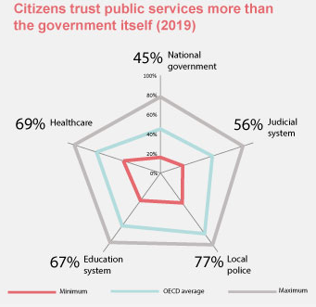
(OECD, 2019)

Slide 6
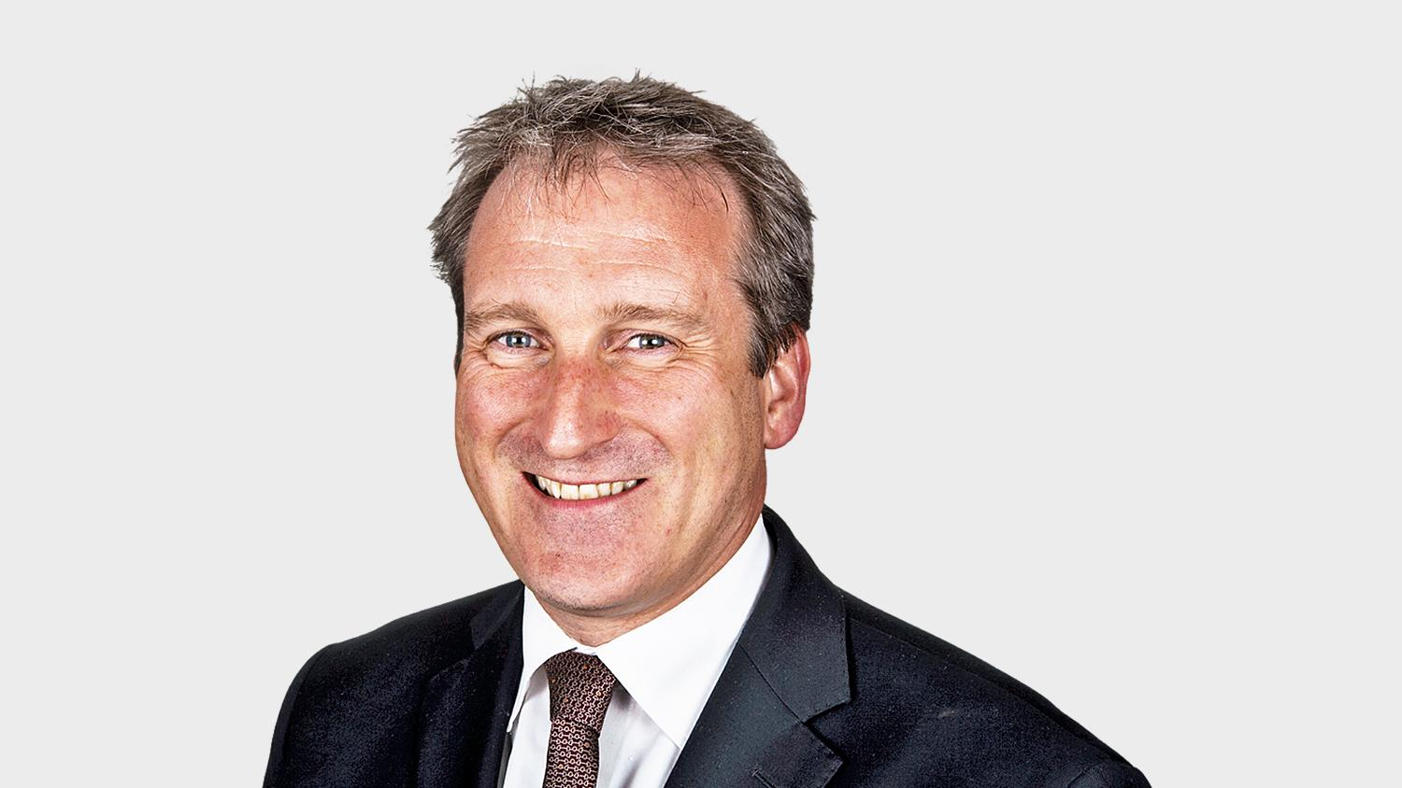
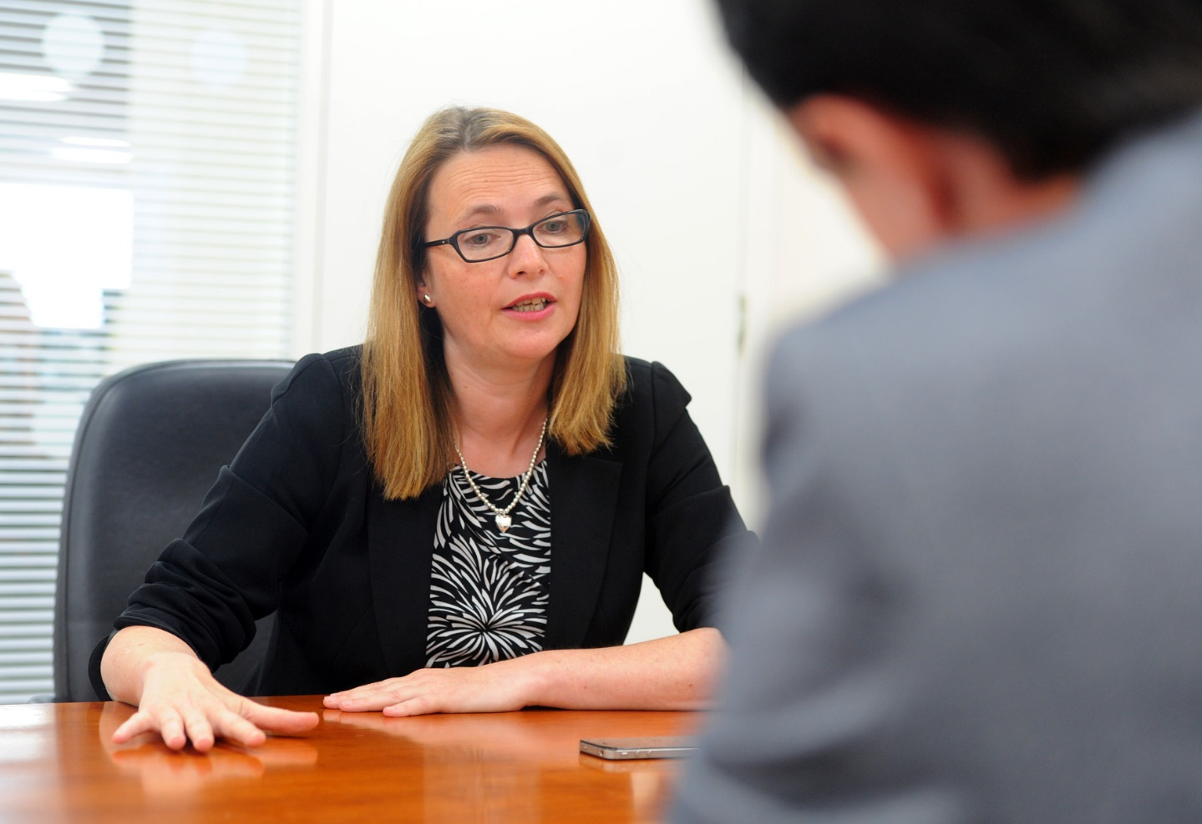
‘A nation’s economic prosperity, social cohesion and well-being are built on the foundations of a strong and successful education system. That is why I describe our focus on raising school standards, reducing the attainment gap between different groups of learners and delivering an education system that is a source of national pride and public confidence as our national mission.’
(Kirsty Williams, 2017)
‘It’s also important that we evolve our safeguards around propriety and good management and management of public funds. So things like the rules that we bring in on related-party transactions and challenging on high pay and making sure there’s transparency, these are all very important for public confidence in our system.’
(Damian Hinds, 2018)

Slide 7
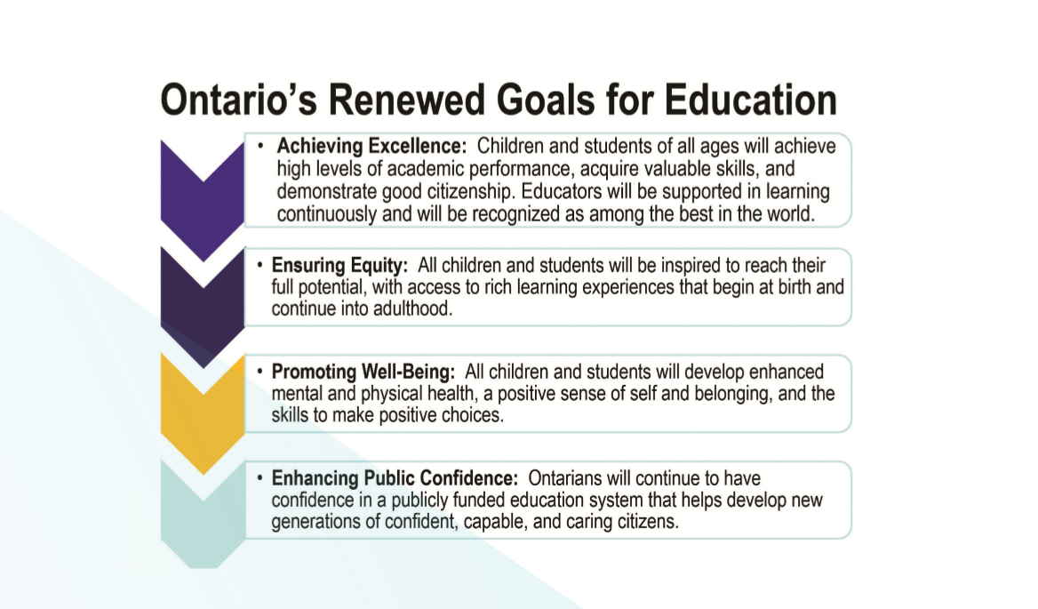

Slide 8
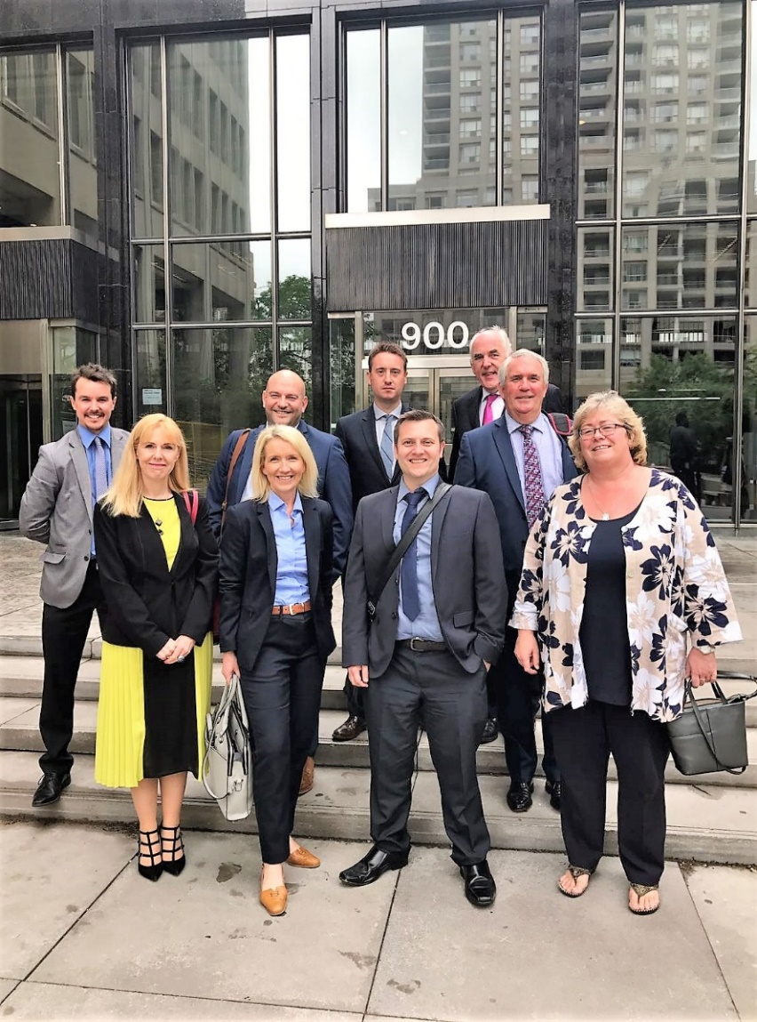
‘Ontario has a clear mission, it aims to achieve excellence, ensure equity, promote wellbeing and crucially looks to enhance public confidence in education. The clarity and simplicity of the mission provides direction for the system.’
Chris Parry, Headteacher, Lewis School Pengam, Caerphilly
‘Throughout the visit, it became very clear that there was a cohesiveness amongst the stakeholders, all working towards achieving three key goals: raising the bar, closing the gap and raising confidence. Three very clear goals that everyone in the system could tell you what they were aiming for.’
Michele Thomas, Headteacher, Pembroke Dock Community School, Pembrokeshire

Slide 9
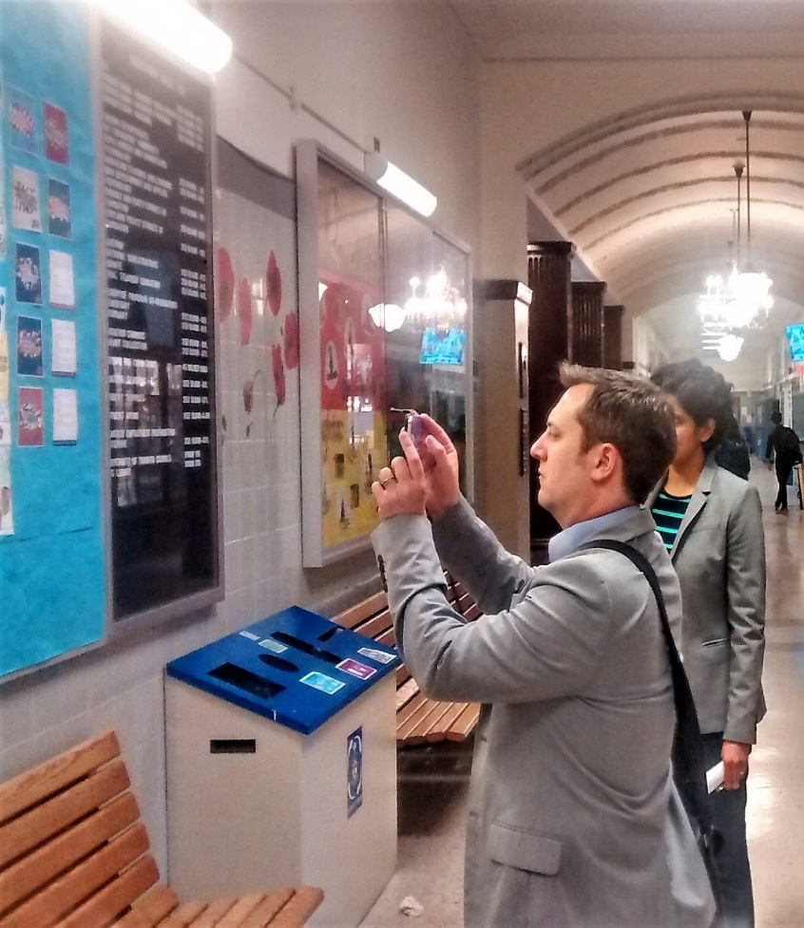
‘Wales needs to hold its own; it needs to keep on the path it is travelling – a path, such as that in Ontario, where every child is expected to achieve and it is everyone’s responsibility to get them there. We have to recognise the importance of developing our own public confidence, in order to grow that all-important sense of mutual trust and respect.’
Russell Dwyer, Headteacher, St Thomas Community Primary School, Swansea
‘Ontario’s success in establishing a shared vision on all levels was evident in the momentum you could feel in its schools. The respect and confidence gradually developed in the education system and teaching profession was evident.’
Rhian Morgan Ellis, Headteacher, Ysgol Gyfun Cymer Rhondda, Rhondda Cynon Taf

Slide 10
Three levels of communication
Education systems tend to work on three inter-connected levels:
a) the macro level – where national policies are developed and negotiated;
b) the meso level – which oversees the implementation of national policy into practice, this is often located in the equivalent of provincial/local departments of education;
c) the micro level – the schools and communities where policies are put into practice, and where educational stakeholders want to see change in practices in education.
‘Effective communications in formal education systems therefore have to take place at a range of levels and include diverse groups of actors, depending on the messages and ideas being communicated.’
(Hunt, 2007)

Slide 11
How is public confidence achieved?
Macro – government
Meso – local authorities/regional consortia
Micro – schools

Slide 12
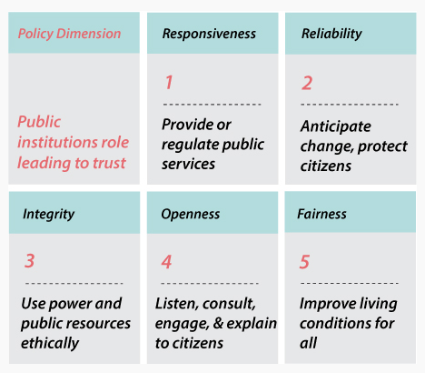
(OECD, 2019)

Slide 13
Engagement/Partnerships/Relationships
“...citizen engagement values the right of citizens to have an informed say in the decisions that affect their lives.”
Accountability/Transparency
“Improved accountability won’t happen without transparency. ...Transparency means the public has easily accessible, understandable and meaningful information that makes clear what is being achieved for society with public funds and where the gaps are.”
3. Communication Plan
“Effective communication fosters relationships and builds confidence. It informs the public on data, policies, decisions, and the current state of schools’ achievement, successes, strengths and weaknesses”
The Council of Ontario Directors of Education (CODE), 2012
http://www.ontariodirectors.ca/CODE_Advisories/Downloads/CODE%20Advisory%20No%2021%20Web.pdf

Slide 14

‘An education system that is sustainable, responsible, accountable and transparent inspires public confidence and contributes to positive student outcomes. Public trust is built when the education system makes decisions based on evidence and research, and when it is seen as a good steward of public resources.’
Enhancing public confidence
‘Our education system is consistently recognized as one of the best in the world, and for good reason. This international recognition also builds confidence among Ontario's parents and families, who have come to expect extraordinary results.’

Slide 15
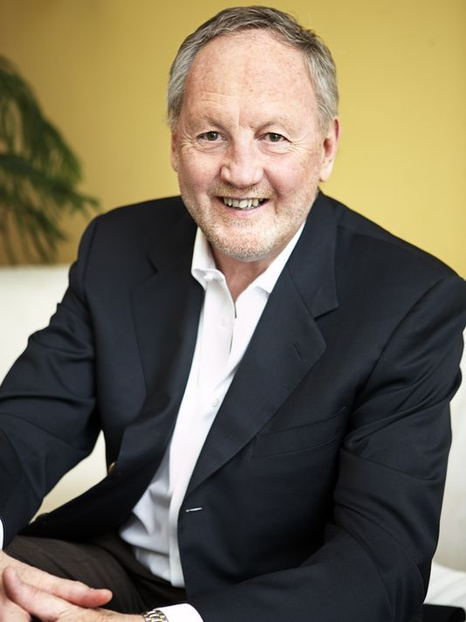

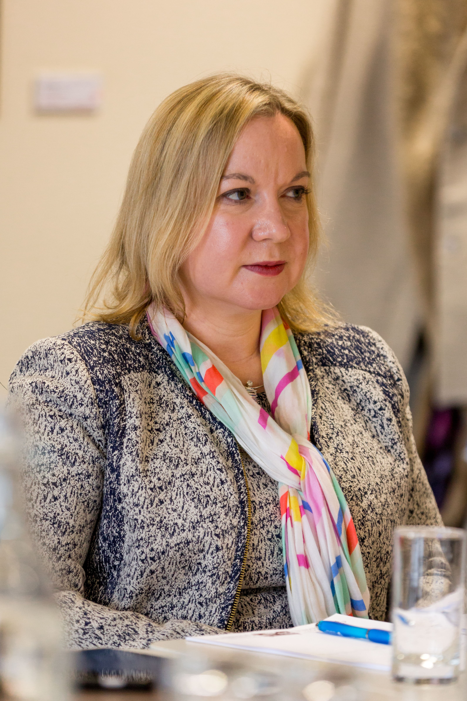
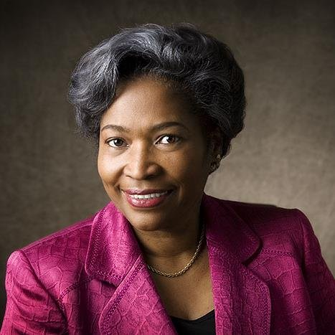

Slide 16

‘Our national mission is to achieve high standards and aspirations for all by tackling the impact of poverty on educational attainment and supporting every learner.’
(Miles, 2023)
‘My first message is that good mental health will be the platform on which our education system will be built… I have been really clear that raising attainment and standards is my top priority. I have announced additional support for schools improving the new curriculum... Attendance is a huge part of the effort to raise standards. We have seen some improvement but there is a lot more work to do.’
(Neagle, 2024)

Slide 17
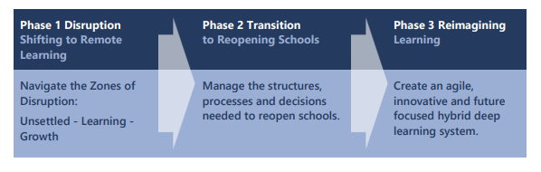
Re-imagining education…
‘The pivotal question is whether seizing the opportunity to create a whole new powerful learning system is more appealing than slipping back into a status quo that does not work.’ (Fullan et al, 2020)

Slide 18
Fundamental change reliant on two conditions…
The old model is palpably failing
There is an alternative, better model available
‘Failure of existing rules is the prelude to a search for new ones.
‘The assimilation of either a new sort of phenomenon or a new scientific theory must demand the rejection of an older paradigm.
‘Once it has achieved the status of paradigm, a scientific theory is declared invalid only if an alternate candidate is available to take its place.’
(Kuhn, 1962)
Notes:
Normally, defenders of the status quo can argue that their policies, while perhaps not perfect, have stood the test of time and that, while some marginal adjustments may always be in order, any fundamental shift in the general orientation carries too many risks.

Slide 19
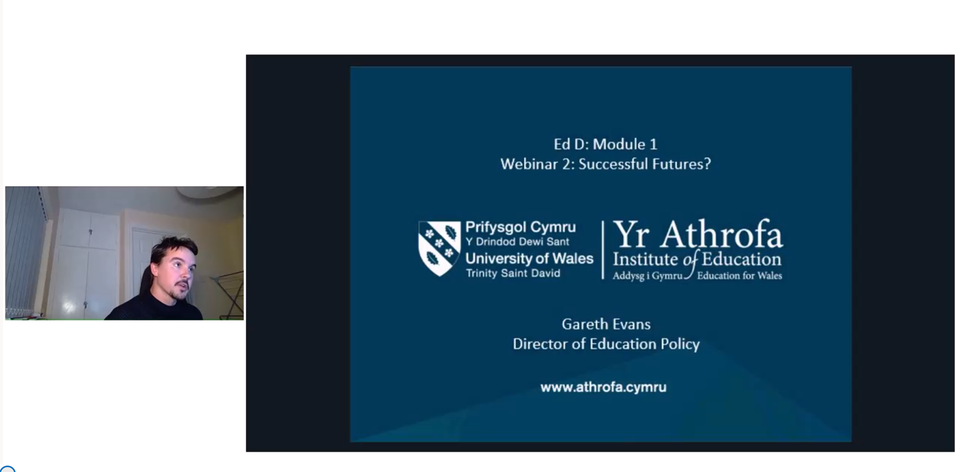
Tuesday, Nov 4 @ 7.30pm – Webinar 2: Successful Futures?
Microsoft Teams
Invite via email – accept meeting
Arrive few mins early

Slide 20
@garethdjevans
gareth.evans@uwtsd.ac.uk

