Slide 1
Component 2:Group Project Presentation
Module code:LCHS7007
A Digital Health Solution for Safer, Smarter Device Management and Fall Prevention in Adults 65+
Group members
Dhruv Ahir 2412381 ( slides 2 to 8)
Zarna tandel 2408231 (slides 9 to 12)
Kajal patel 2407645 ( slides 13 to 16)
Manishaben patel 2406807( slides 17 to 20)
Charmil modi 2412382 ( slides 21 to 24)
Lecturer Name :-Dr Ping Wu

Slide 2
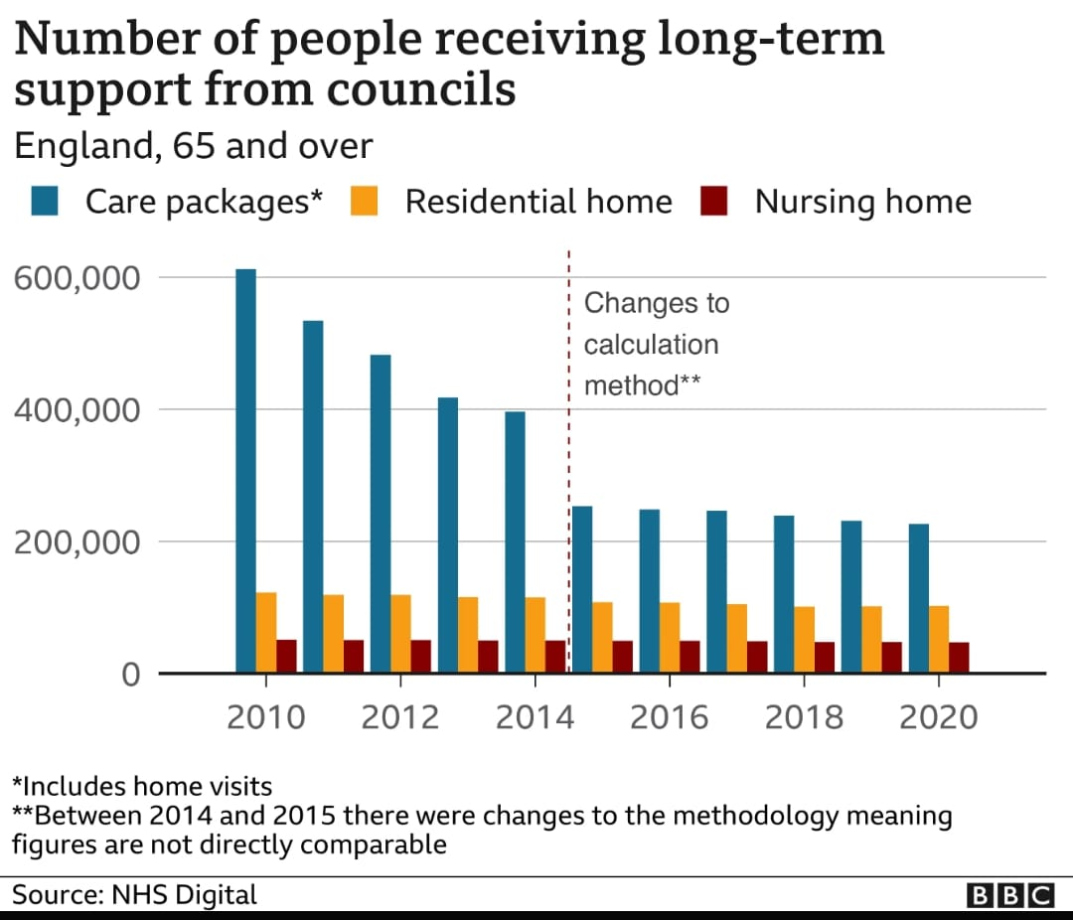
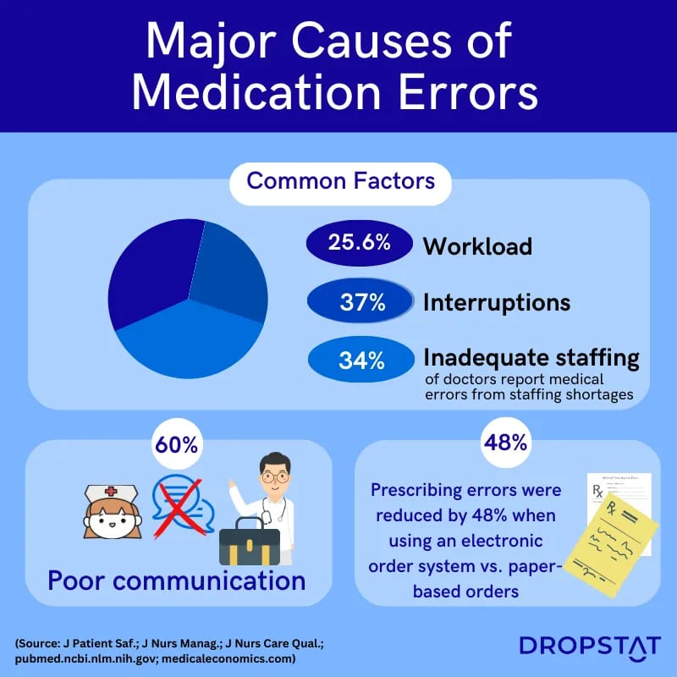
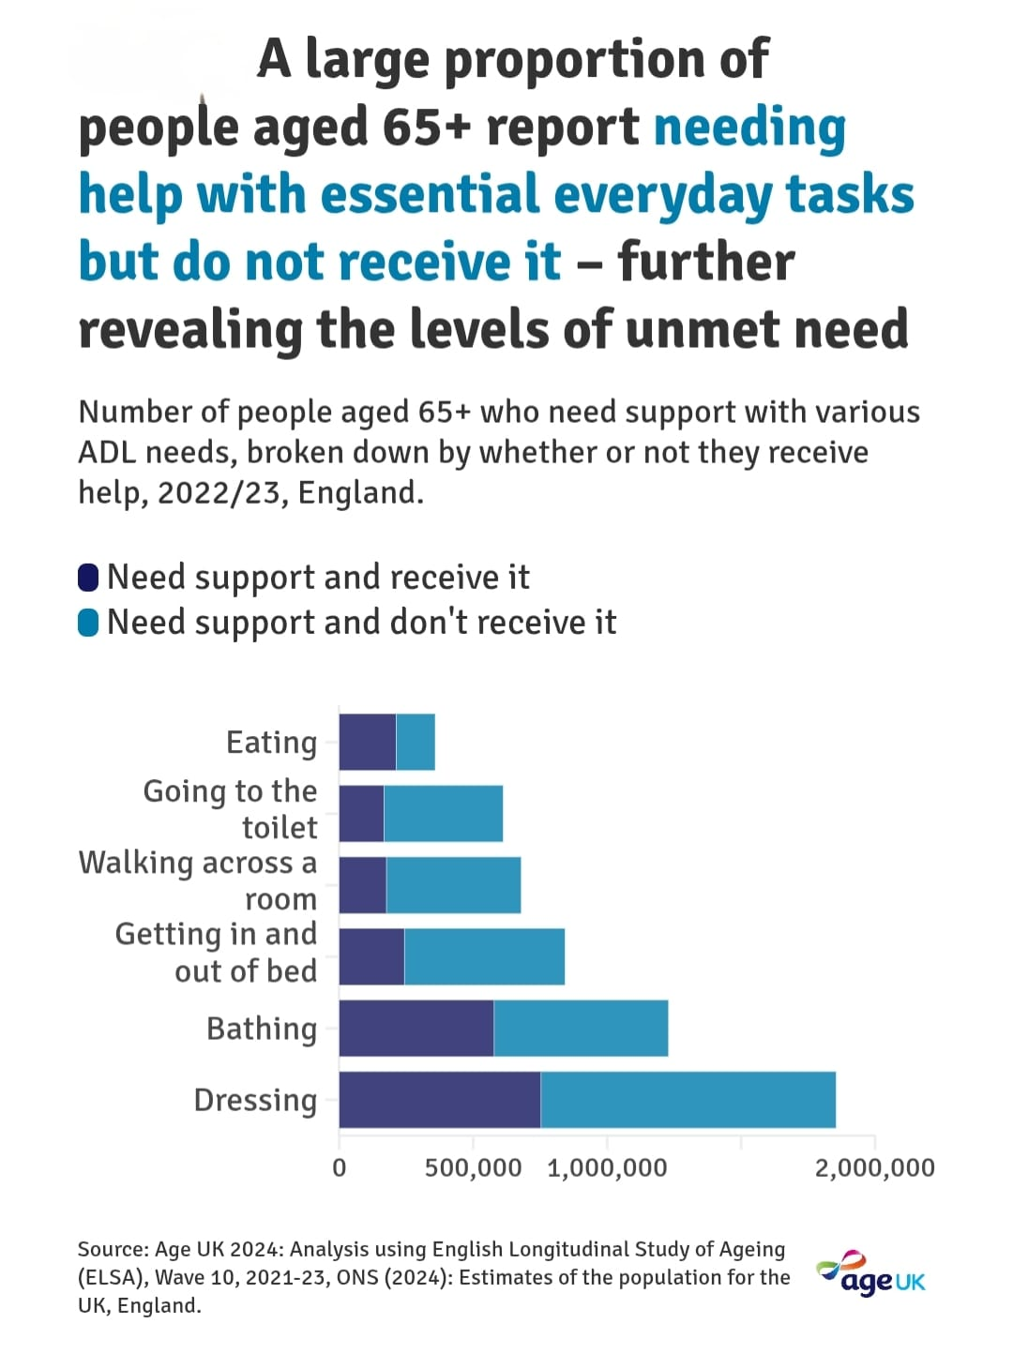
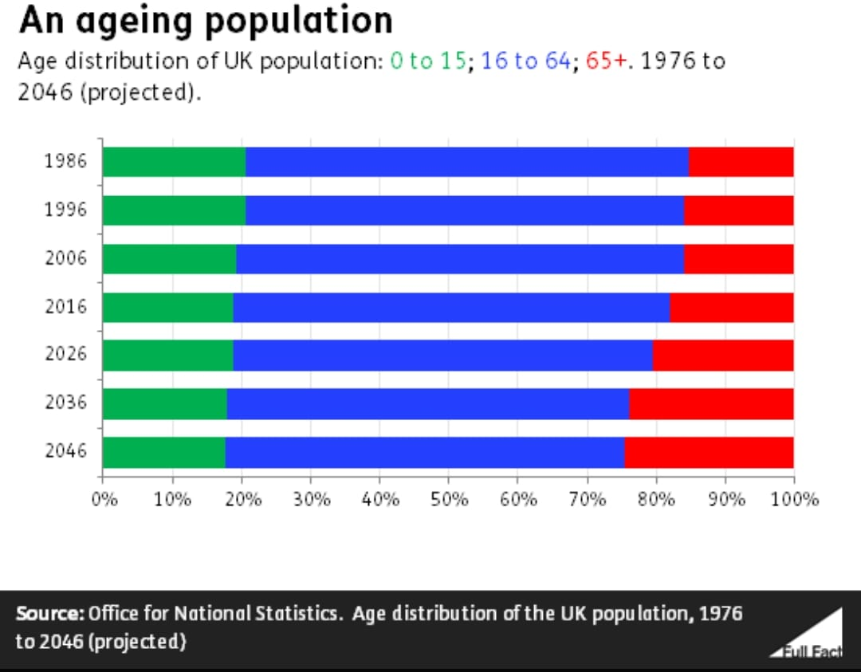
CareLink: Remote Monitoring for Elderly Care
Who Needs CareLink for Fall Prevention?
Adults aged 65+ at risk of falls.
People with heart conditions or implanted cardiac devices.
Those with mobility or balance issues.
The Problem
1 in 3 older adults fall yearly, risking injury and hospitalization.
Falls cause fractures, disability, and increased healthcare costs.
Cardiac issues can increase fall risk.
Traditional monitoring is often infrequent and inaccessible.
Falls strain healthcare systems and caregivers.
CareLink enables remote monitoring to prevent falls and improve safety.
(Quizlet, no date)
(Age UK, 2024)
(BBC News, 2019)
(Office for National Statistics, n.d.)

Slide 3

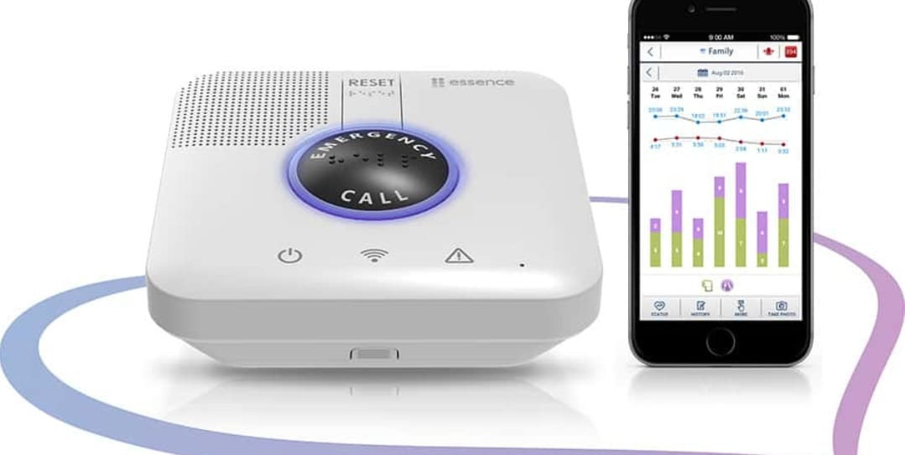

Intervention Overview
Aim: Reduce hospitalizations through real-time health monitoring for seniors in care homes/at home.
Content:
IoT wearables tracking blood pressure, heart rate, and falls.
Caregiver app with emergency alerts (e.g., prolonged inactivity.
Automated medication reminders + weekly virtual GP check-ins.
Family portal for activity reports
Google free images

Slide 4
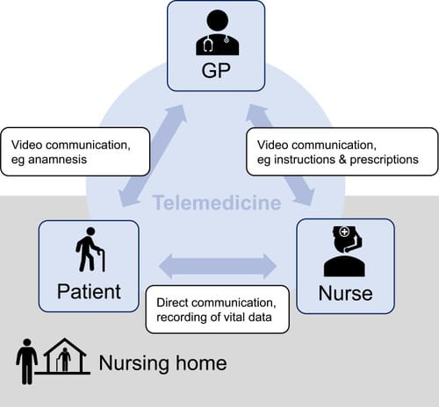

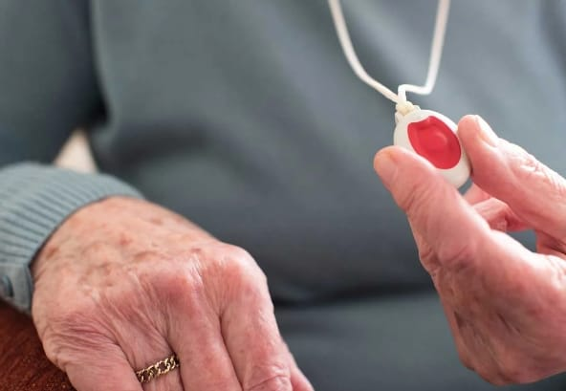
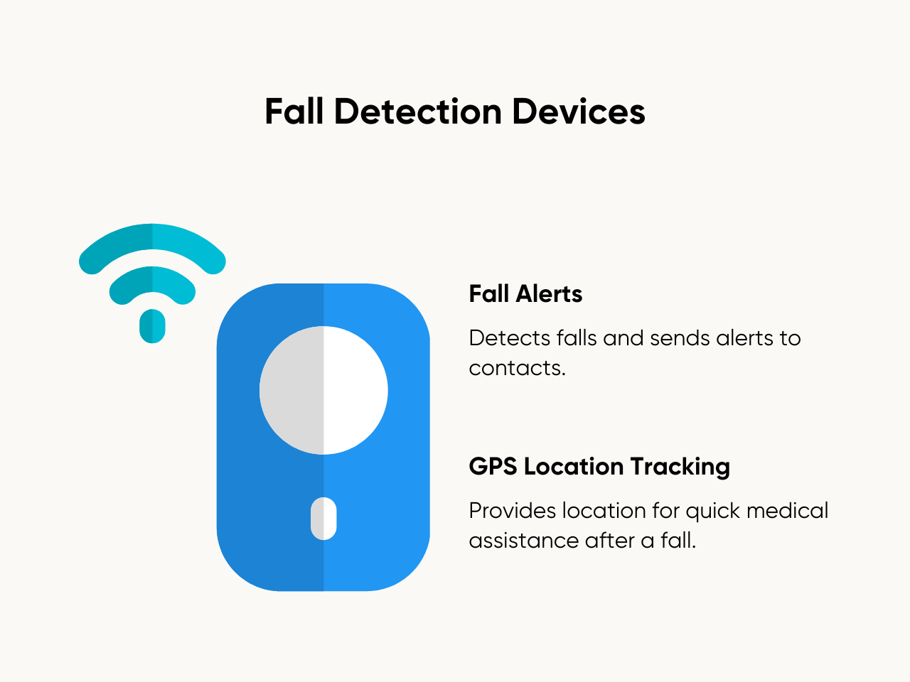
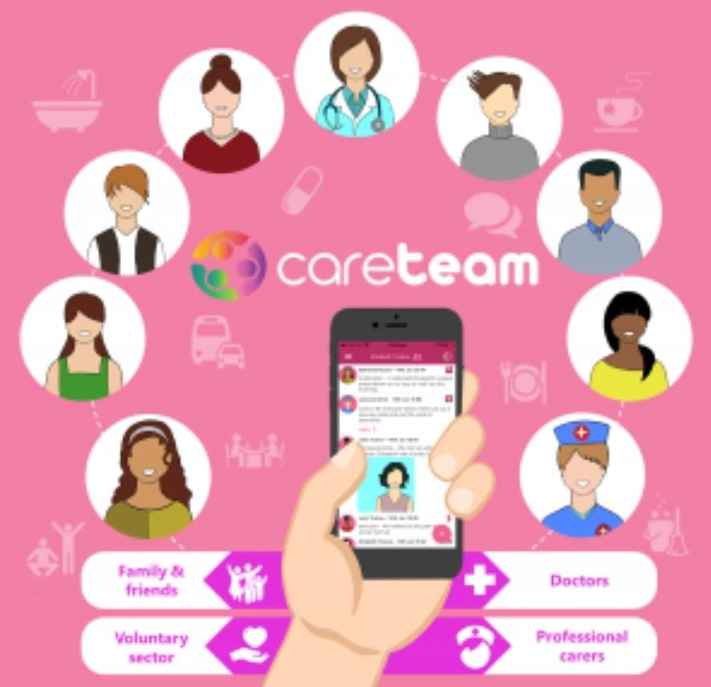
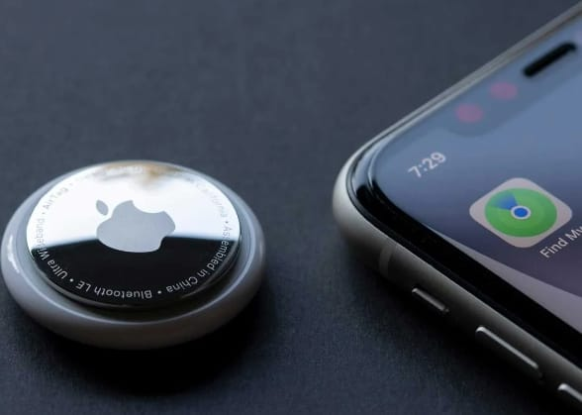
Digital Technology
Wearable biosensors (heart rate, SpO₂, temperature
Smart home sensors (non-intrusive appliance monitoring
CareLink Alert System: 24/7 emergency response pendant
Centralized dashboard for care teams with traffic-light adherence indicators
Fall alert system and alaram
Google free images

Slide 5
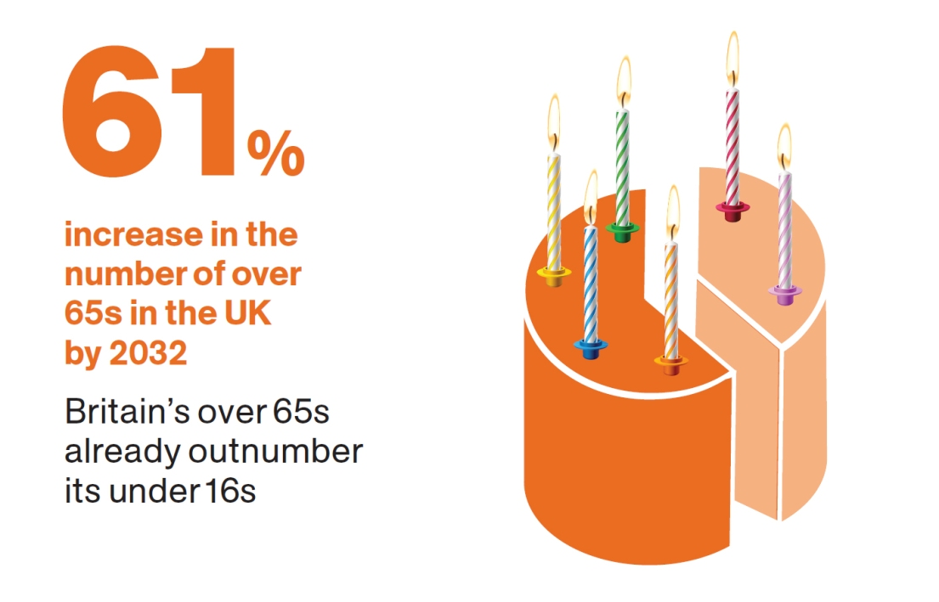
Why Focus on Elderly in the UK?
• The UK population is ageing rapidly: nearly 19% (more than 12 million) are aged over 65 years, projected to rise to 24% by 2043 (ONS, 2023).
• The 85+ age group is set to double over the period of the next 25 years to over 3 million, with the fastest-increasing age group (Centre for Ageing Better, 2023).
• Already 2 million older people in England already have unmet social care needs, the majority of whom live alone and are more vulnerable to health emergencies (Age UK, 2024).
• Already over 23% of individuals in coastal and rural areas are over 65, putting further pressure on local health and care services (Centre for Ageing Better, 2023).
(Office for National Statistics, 2022)

Slide 6
The Public Health Problem – Gaps in Real-Time Monitoring
Falls cause more injury-related hospital admissions than any other factor in individuals above the age of 65 years; 18% of the elderly have one or more falls annually (PHE, 2018).
40% of care home residents have no access to real-time monitoring of their health, with a risk of unrecognised deterioration and delayed action (CQC, 2023).
Chronic conditions such as heart disease, diabetes, and dementia are prevalent: 58% of adults aged 65+ have two or more long-term conditions (NHS Digital, 2023).
Incompleted or unclear health episodes (e.g., falls, misuse of medicine) cost the NHS around £3.8 billion annually for unwanted hospital admission (Age UK, 2024).

Slide 7
National Guidelines and Policy Context
• The NHS Long Term Plan seeks to reduce avoidable hospital attendance by 30% via remote monitoring and digital health solutions by 2030 (NHS England, 2019).
• The Digital Social Care Strategy requires 80% of care providers to digitalize care records by 2025, allowing for safer, more coordinated care (DHSC, 2022).
•National Service Framework for Older People places focus on early intervention, partnership care, and use of technology to gain maximum outcomes (DHSC, 2023).
•Evidence indicates IoT-enabled monitoring decreases emergency admissions due to falls by as much as 32% in care homes for the elderly (Newcastle university, 2025).

Slide 8
Why Digital Health Interventions Matter
Expanded Access:
Health interventions on the digital front facilitate the geographical and mobility barriers to be overcome, promoting expanded access to care for elderly people and chronic patients.
Individualized Support:
The technology provides the ability to personalize reminders, education, and monitoring that facilitates compliance and self-management
Resource Efficiency:
Telemedicine interventions can help decrease healthcare system pressures by reducing missed appointments and hospitalizations.
Patient Empowerment:
Technology enables patients' increased control of their health, promoting independence and engagement. Italic text.
Alignment with Global Health Goals:
Digital health is central to WHO's strategy for developing robust health systems and promoting universal health coverage.

Slide 9
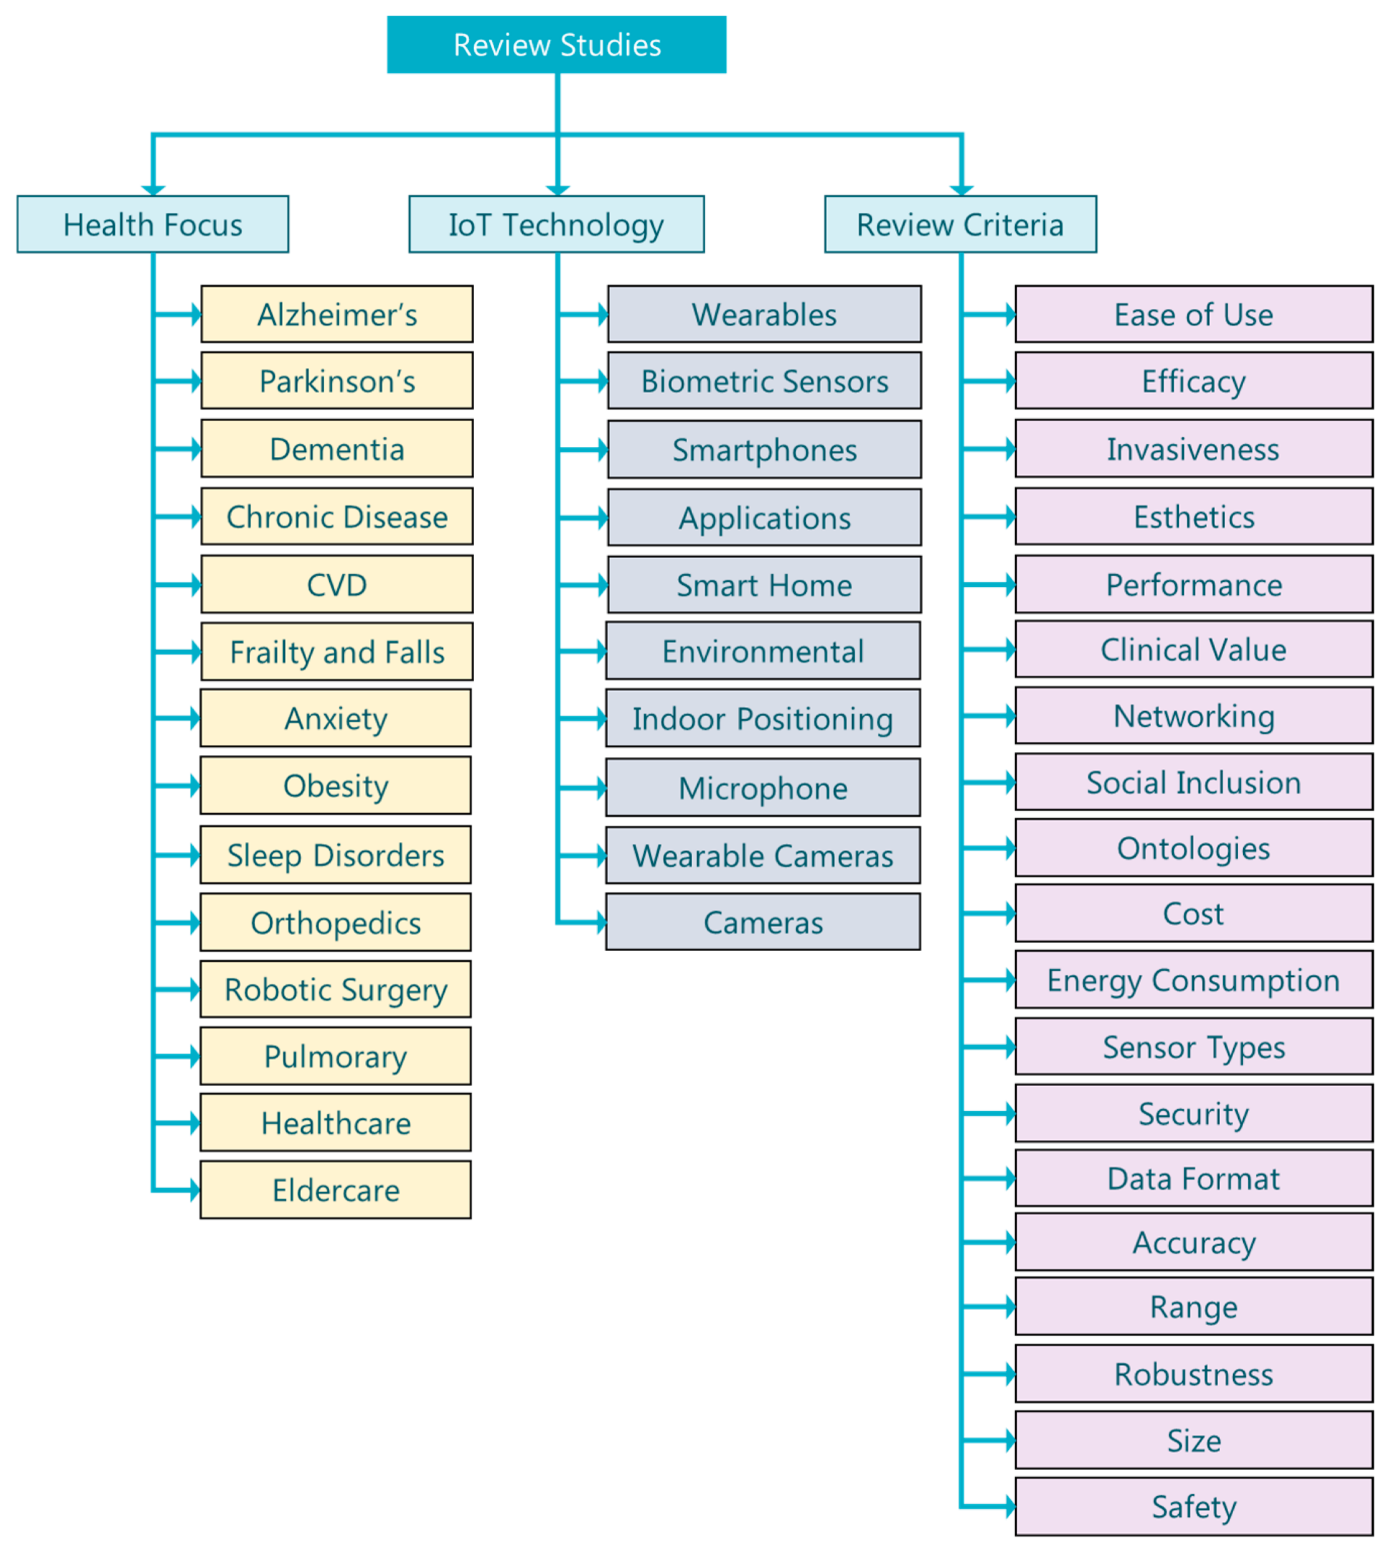
Why CareLink? – Rationale for the Intervention
CareLink utilizes IoT-capable wearable technology and smart sensors to monitor vital signs (heart rate, blood pressure, SpO₂) and real-time fall detection (Ignitec, 2024).
The system gives immediate notifications to caregivers and families, medication reminders automatically, and a secure daily health update platform (Ignitec, 2024).
It's evidence-based, UK policy compliant, and fills the vast gap in current care for the elderly (NHS England, 2019).
CareLink can improve quality of life, prevent hospitalization, and reduce pressure on health and social care services by providing early intervention and promoting independence (A Newcastle university, 2025
(Sandeepa et al., 2020)

Slide 10
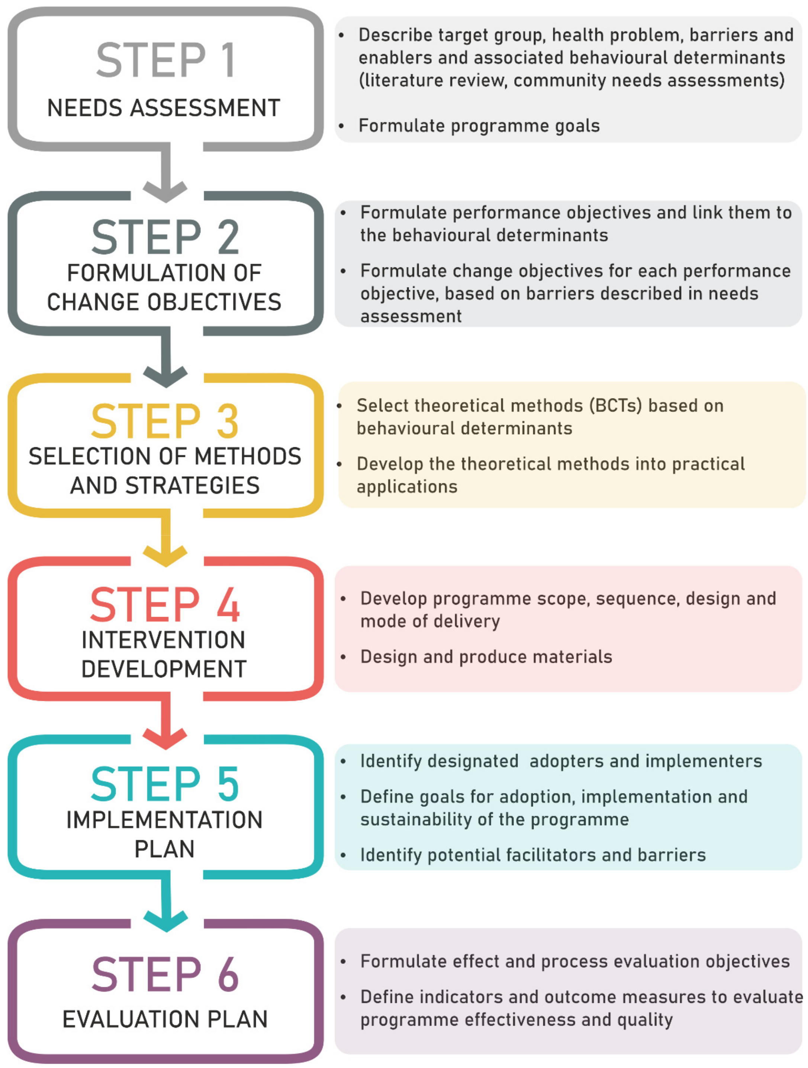
Chosen Planning Model – Intervention Mapping (IM)
• Intervention Mapping (IM) is a systematic, evidence-based process for the planning, implementation, and evaluation of health promotion programs (Bartholomew Eldredge et al., 2016).
specifically suited to complex digital health interventions (Fernández et al., 2022).
• IM involves six steps in an iterative manner: (1) needs assessment, (2) definition of program objectives, (3) choosing theory-based intervention methods and strategies, (4) developing program components, (5) planning for adoption and implementation, and (6) evaluation (Fernández et al., 2022).
• This model allows for the integration of behavioural science, stakeholder engagement, and user-centred design to develop interventions that are tailored to the target population's needs (Sniehotta et al., 2017).
• IM is widely used in eHealth because it maps intervention characteristics onto behaviour change theory and actual use in a direct way, making it more transparent and reproducible
(Bartholomew Eldredge et al., 2016)

Slide 11
Applying IM Step 1–3 to CareLink
• Needs Assessment: We begin by reviewing epidemiological data, care deficits, and user input from older patients, caregivers, and clinicians to establish priority health.
•Setting Objectives: Specific, measurable goals are established, e.g., decreasing fall incidence by 20% and medication adherence by 30% in one year (WHO, 2018).
•Strategy Choice: Theoretical strategies (e.g., social support, reminders, self-monitoring) are converted to digital features like real-time messaging, reminder for medication, and caregiver dashboards (Sniehotta et al., 2017).
• Each of the features is linked to behaviour change techniques, e.g., tailoring, goal-setting, and feedback, to address determinants such as self-efficacy and capability for behaviour (Marcos et al., 2024)

Slide 12
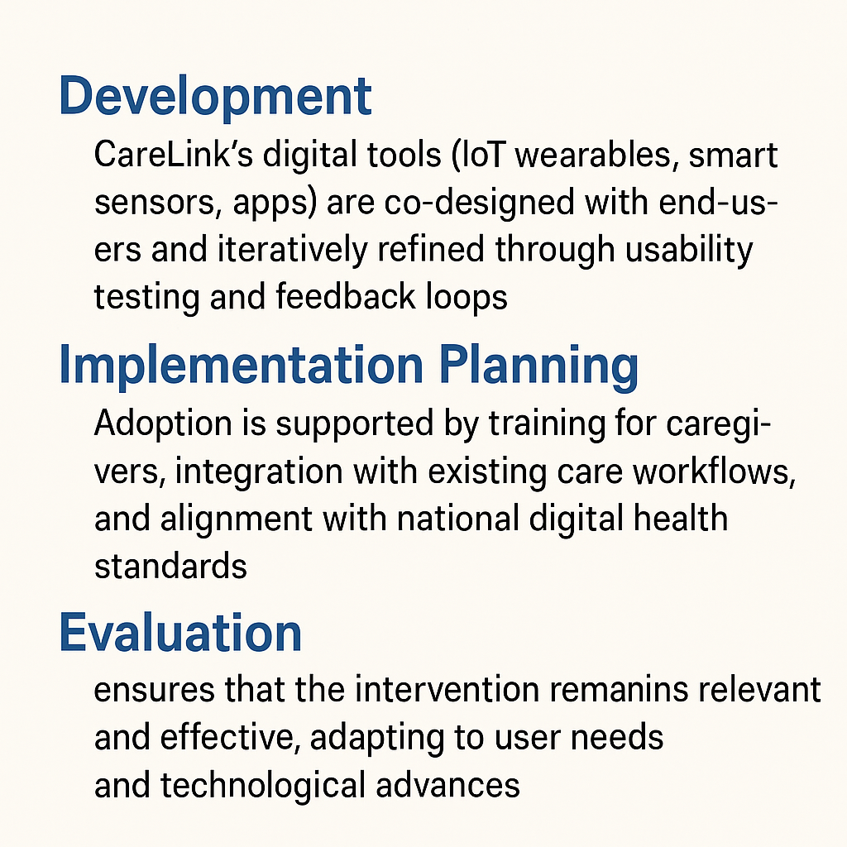
IM Step 4–6 – Development, Implementation, and Evaluation
Development:
CareLink's digital resources (mobile apps, intelligent sensors, IoT wearables) are co-designed and iteratively optimized with usability assessment and feedback processes (Sniehotta et al., 2017; Geidl et al., 2024).
Implementation Planning:
Adoption is enabled through caregiver training, incorporation into existing care workflows, and compliance with national digital health standards (ICT&Health, 2024).
Assessment:
Real-time monitoring utilizes process (technical functioning, user adoption) and outcome (hospital admissions, rates of falls) measures, with repeated improvement based on real-world evidence (ICT&Health, 2024; Fernández et al., 2022).
Reflexive monitoring ensures that the intervention is valid and effective, responding to the demands of the users and technological progress (Marcos et al., 2024).
self created

Slide 13
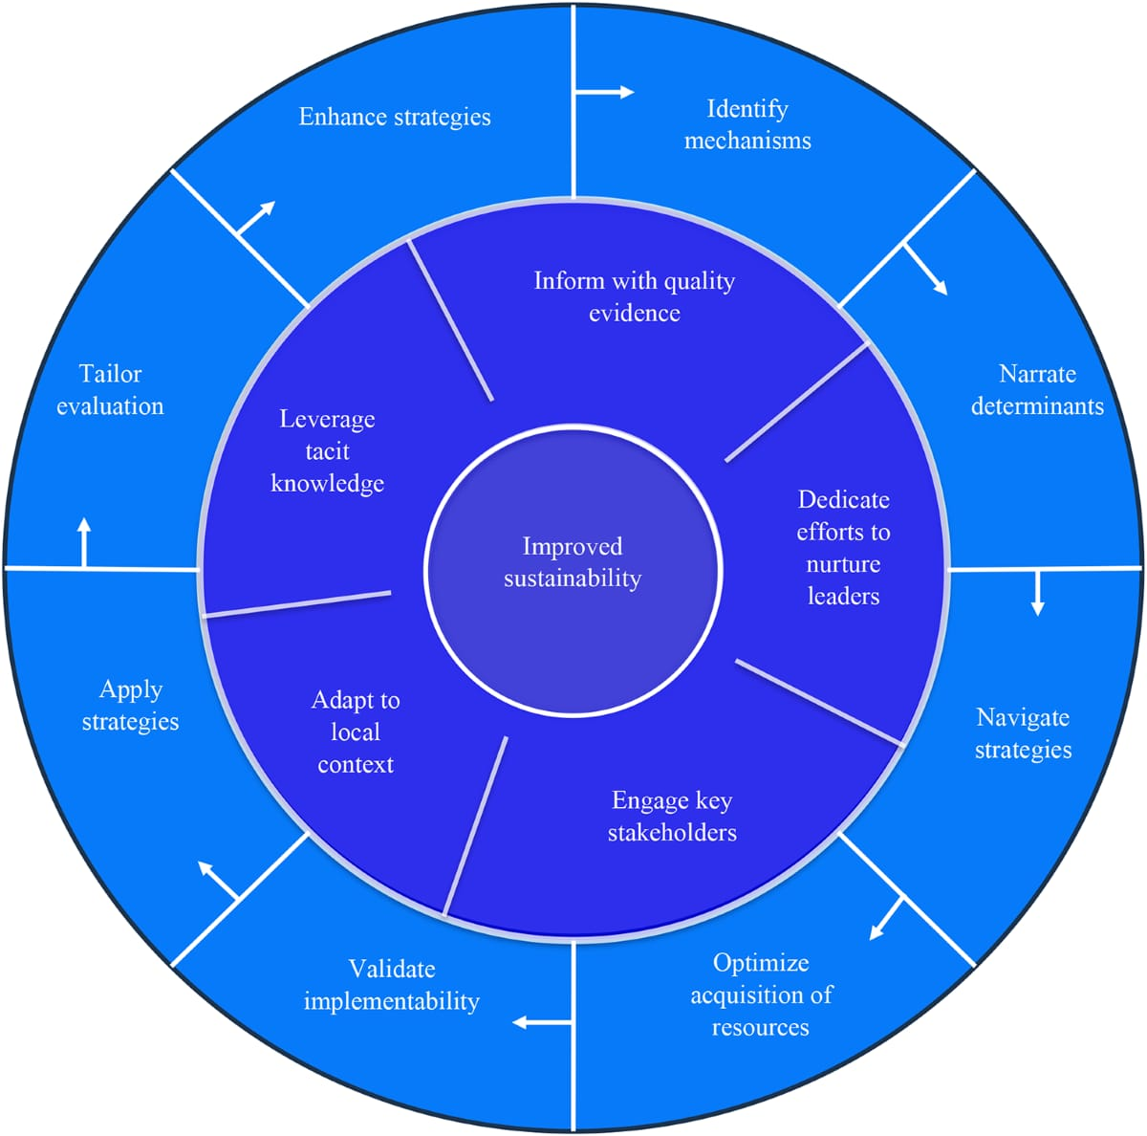
Value of IM for Digital Health Interventions
• IM assures interventions are grounded in theory, evidence, and contextually adjusted to optimize the potential for good health outcomes (Fernández et al., 2022).
• The model makes it possible to involve stakeholders at every stage, which increases acceptability and sustainability for a practice (Sniehotta et al., 2017).
• IM's organized approach allows easy mapping of intervention attributes to outcome in behaviour, allowing scalability and policy consistency (Marcos et al., 2024).
• Through systematic linking of needs, strategies, implementation, and evaluation, IM optimizes the potential of digital interventions like CareLink to reduce health inequalities and improve care for the elderly (WHO, 2018).
(SlideTeam, 2023)

Slide 14
Key Takeaways from the Intervention Mapping Approach
Systematic Planning: Intervention Mapping provides a clearly outlined, step-by-step process of planning for successful digital health interventions.
2. Stakeholder Engagement: Patient, caregiver, and professional engagement from the beginning guarantees the intervention addresses real-world needs.
3. Theory-Informed Design: Leveraging implementation and behavioral science optimizes the potential for success and sustainability.
4. Continuous Monitoring: Continuous monitoring and adjusting according to the user feedback and outcomes are required to achieve long-term impact.
5. Scalability: The method is adaptable to different environments and populations, enabling its widespread application.

Slide 15

Key Stakeholders in Digital Health Interventions
Carers and Patients:
Patients and older adults and their informal carers are the target of digital uptake of health. Their motivation, technological competence, and self-efficacy immediately determine the success of an intervention (Heijsters et al., 2022).
Health Care Professionals:
Physicians, nurses, and doctors are the focal point around which prescribing by writing, backing, and consolidating digital goods like Medisafe spin (Nascimento et al., 2023)
IT and Digital Staff:
These staff undertake technical deployment, maintenance, and protection of digital health solutions and technical support for end-user diagnosis.(Iqbal et al., 2024).
Management and Leadership:
NHS Trust leaders and managers allocate resources, set policies, and influence a culture that is a driver of digital transformation (NHS England, 2023).
Regulators and Policymakers:
National bodies (e.g., NHS England, NICE, and the Department of Health and Social Care) and international agencies (e.g., WHO) set standards, regulations, and priorities for funding digital health (WHO, 2019).
Google free image

Slide 16
User-Level Barriers to Digital Health Implementation
Confidence and Digital Literacy:
The majority of older people and some health professionals lack confidence or the required digital competence to utilize apps, leading to low take-up or abandonment (Nascimento et al., 2023)
Training and Support Gaps:
Inadequate training and insufficient ongoing support can overwhelm or frustrate the users, contributing to decreased usage (Heijsters et al., 2022)
Resistance to Change:
Psychological obstacles such as technophobia, fear of making mistakes, and concern about losing direct contact with healthcare professionals are common (van der Laan et al., 2024)
Language and Accessibility:
Apps that are not offered in several languages or are not accessible to individuals with visual or cognitive disabilities may marginalize vulnerable populations (NICE, 2023).
Privacy and Trust:
Fear of data privacy, security violation, and misuse of personal health information prevents patients and professionals from utilizing digital health tools (WHO, 2019).

Slide 17
System, Policy, and Resource Barriers
Hardware and Infrastructure:
Unstable internet connections, outdated hardware, and lack of proper integration with current electronic health records are major technological obstacles, especially in rural or low-resource environments (Yew et al., 2024)
Workflow and Workload:
Doctors can perceive digital tools as contributing to their workload or interfering with current procedures, and therefore resisting or applying them superficially (Iqbal et al., 2024)
Resource and Finance Constraints:
Lack of finances to purchase equipment, software, and maintenance may slow down or prevent implementation, especially in the public sector and the NHS (NHS England, 2023).
Policy and Regulation:
not clearly understand national policies, lack of clear data governance, and slow regulatory approval processes can potentially cause uncertainty and slow down the adoption of digital health innovations (ARTNeT, 2023).
Equity and Inclusion:
Digital health can exacerbate health inequalities unless it is planned and delivered

Slide 18
Recommendations and Solutions
Co-Design and User Involvement:
NICE recommend that digital health products should be piloted and co-designed with the participation of patients, carers, and frontline staff so that they would be acceptable in practice as well as accessible to all (NICE, 2023).
Comprehensive Training and Support:
Ongoing patient- and professionally designed training and readily accessible support pathways are imperative to establish digital confidence and enduring engagement (Nascimento et al., 2023)
Open Policy and Data Governance:
gov.uk emphasizes robust data protection, transparent privacy policies, and an explicit regulatory approach to facilitate trust and safe use of digital health (GOV.UK, 2023).
Financing infrastructure:
financing in system integration, equipment, and broadband infrastructure offers end-to-end functionality and equal access to digital health interventions (Yew et al., 2024)
Targeted Insertion Strategies:
Targeted inclusion and support for digitally excluded groups such as the elderly, disabled, and those in disadvantaged groups are enabled by NHS England with an aim to enhance digital equity and inclusion in health (NHS England, 2023).

Slide 19
Practical Solutions to Address Barriers
Digital Inclusion Initiatives:
Provide devices, internet, and digital literacy training for patients and staff.
2. Clear Data Governance:
Establish transparent privacy and security policies to build trust and meet legal compliance.
3. User Testing and Co-Design:
Involve end-users in piloting and design phases to ensure usability and relevance.
4. Policy and Leadership Support:
Seek the support of policymakers and organizational leaders for integration and funding.
5. Ongoing Support and Feedback:
Provide ongoing technical helpdesks and feedback loops to resolve difficulties as and when they happen.

Slide 20
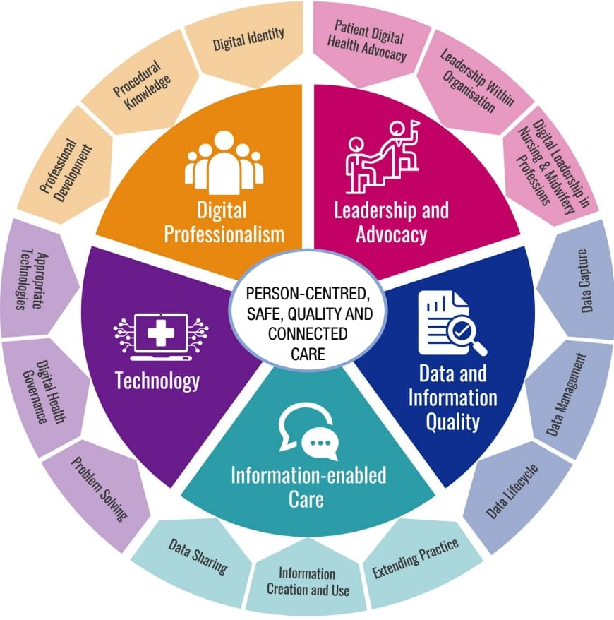
Patient and Public Success Factors
User-Centered Design:
Direct patient involvement in developing digital health tools ensures accessibility, usability, and cultural acceptability, which maximizes adoption and satisfaction (Schramm and Carbon, 2024)
Digital Literacy Assistance:
Providing tailored digital capability training and ongoing technical assistance helps to overcome barriers, particularly for older adults and those who are vulnerable (NHS England, 2023).
Trust and Transparency:
Openness in open communication about data privacy, security, and consent builds trust among patients and encourages the utilization of digital health applications.
Personalization:
Making interventions more relevant and effective by tailoring them to individual health states, preferences, and needs.
Empowering Patients:
Electronic patient engagement with self-management capability and timely feedback empowers patients and improves health outcomes (NHS England, 2023).

Slide 21
Professional and Clinical Success Factors
Comprehensive Training:
Clinicians require intensive training and continuous education to use digital technologies confidently in clinical practice (Prodan et al., 2022).
Clinical Integration:
Digital treatments should be aligned with existing clinical guidelines and care pathways to be useful and acceptable (NICE, 2023).
Interdisciplinary Collaboration:
Interprofessional collaboration among clinicians, IT specialists, and management enables problem-solving and smooth.
Workflow Compatibility:
Digital technologies need to complement instead of interfering with healthcare professionals' workflows to reduce resistance and increase utility (Prodan et al., 2022).
Evidence of Effectiveness:
Offering clinical benefits through good evidence encourages professional adoption and sustained use (NICE, 2023).

Slide 22
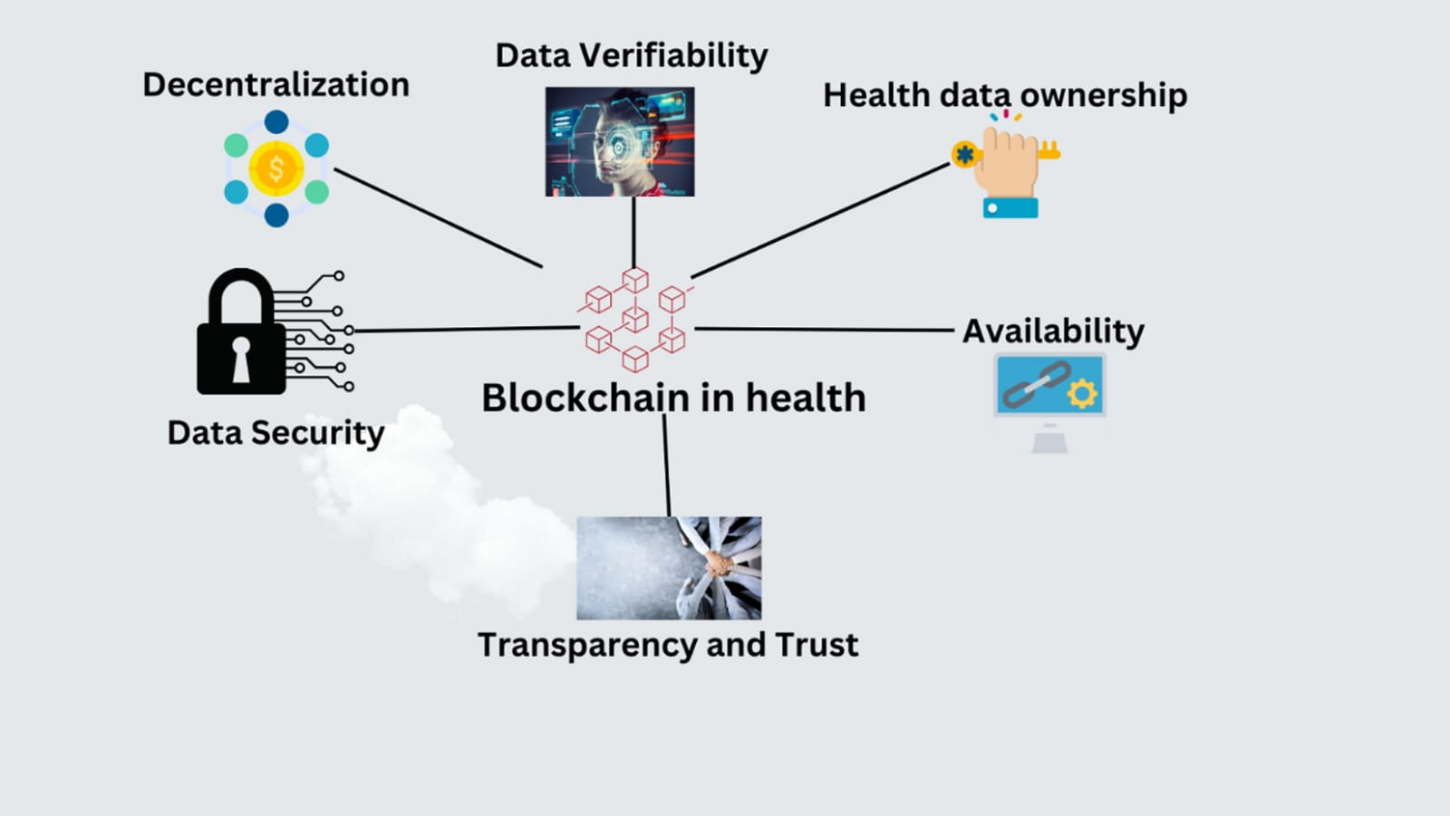
System and Policy Success Factors
Reliable Infrastructure:
Stable internet connectivity, modern hardware, and compatible software are needed for effective digital health deployment.
Data Privacy and Security:
Regulation of laws like GDPR and open data governance models increase patient and organizational trust (WHO, 2019).
Supportive Policies:
National and institutional policies that promote adoption, funding, and scale-up of digital health interventions are evident (WHO, 2019).
Equity and Inclusion:
Strategies to reach digitally excluded groups do not worsen health inequities and promote equitable access (NHS England, 2023).
Funding Sustainability:
Sustaining funds for maintenance, upgrading, and training are essential to support intervention sustainability (Aref-Adib et al., 2019).
(Dhodho, 2025)

Slide 23
Evaluation, Improvement, and Sustainability
Continuous Monitoring:
Continuous monitoring of the interaction of the user, clinical performance, and technical operation provides for immediate enhancement (Schramm and Carbon, 2024).
Stakeholder Feedback:
Obtaining feedback from clinicians, patients, and IT staff ensures the intervention remains current and easy to use (Prodan et al., 2022).
Flexibility:
Health technologies must be adaptable enough to accommodate changing user needs, technological advancements, and health care environments (NHS England, 2023).
Leadership Commitment:
Strong leadership drives organizational culture transformation and investment in favor of digital health sustainability (WHO, 2019).
Scalability Planning:
Scale-up pre-planning, including the readiness of infrastructure and staff, facilitates long-term success (Aref-Adib et al., 2019).

Slide 24

Ensuring Sustainability and Long-Term Impact
Embed Evaluation:
Integrate continuous monitoring of outcomes and user experience right from the start.
2. Adapt to Change:
Build flexibility into digital health technologies to evolve with technology and users' needs.
3. Encourage Collaboration:
Encourage ongoing collaboration between patients, clinicians, IT, and policymakers.
4. Prioritize Equity:
Interventions must be made inclusive for all, with special provision for those who are likely to be digitally excluded.
5. Secure Long-Term Resources:
Plan for sustainable financing, infrastructure, and workforce development.
Google free image

Slide 25
References
Office for National Statistics (ONS) (2024)Population estimates for the UK, England, Wales, Scotland and Northern Ireland: mid-2023.
Available at: https://www.ons.gov.uk/peoplepopulationandcommunity/populationandmigration/populationestimates/bulletins/annualmidyearpopulationestimates/mid2023 (Accessed: 22 April 2025).
Centre for Ageing Better (2023)The State of Ageing 2023–24.
Available at: https://ageing-better.org.uk/the-state-of-ageing-2023-4 (Accessed: 22 April 2025).
Age UK (2024)State of Health and Care of Older People in England 2024.
Available at: https://www.ageuk.org.uk/discover/2024/september/state-of-health-and-care-of-older-people-in-england-2024 (Accessed: 22 April 2025).
Public Health England (PHE) (2018)Falls: Applying All Our Health.
Available at: https://www.gov.uk/government/publications/falls-applying-all-our-health/falls-applying-all-our-health (Accessed: 22 April 2025).
Care Quality Commission (CQC) (2023)The State of Health Care and Adult Social Care in England 2022/23.
Available at: https://www.cqc.org.uk/publications/major-report/state-care/2022-2023 (Accessed: 22 April 2025).
NHS Digital (2023)Health Survey for England.
Available at: https://digital.nhs.uk/data-and-information/publications/statistical/health-survey-for-england (Accessed: 22 April 2025).
Department of Health and Social Care (DHSC) (2001)National Service Framework for Older People.
Available at: https://www.gov.uk/government/publications/quality-standards-for-care-services-for-older-people (Accessed: 22 April 2025).
Department of Health and Social Care (DHSC) (2022)A Plan for Digital Health and Social Care.
Available at: https://www.gov.uk/government/publications/a-plan-for-digital-health-and-social-care/a-plan-for-digital-health-and-social-care (Accessed: 22 April 2025).

Slide 26
Newcastle University (2025)Ageing and Health Research.Available at: https://www.ncl.ac.uk/ageing/ (Accessed: 22 April 2025).
Ignitec (2024)IoT in Elderly Care: Enhancing Quality of Life Through Technology.
Available at: https://www.ignitec.com/insights/iot-in-elderly-care-enhancing-quality-of-life-through-technology (Accessed: 22 April 2025).
NHS England (2019)The NHS Long Term Plan.
Available at: https://www.longtermplan.nhs.uk (Accessed: 22 April 2025).
Fernández, M.E., ten Hoor, G.A., van Lieshout, S., Rodríguez, S.A., Beidas, R.S., Parcel, G., Ruiter, R.A.C., Markham, C.M., & Kok, G. (2019). Implementation Mapping: Using Intervention Mapping to Develop Implementation Strategies. Frontiers in Public Health, 7, 158. Available at: https://www.frontiersin.org/articles/10.3389/fpubh.2019.00158/full [Accessed 21 Apr. 2025].
ICT&Health (2024). How To Plan, Budget And Implement Digital Health Interventions. Available at: https://ictandhealth.com/news/how-to-plan-budget-and-implement-digital-health-interventions/ [Accessed 21 Apr. 2025].
World Health Organization (WHO) (2018). Classification of Digital Health Interventions v1.0. Geneva: WHO. Available at: https://www.who.int/publications-detail-redirect/WHO-RHR-18.06 [Accessed 21 Apr. 2025].
Marcos, T.A., Crutzen, R., Leitner, V., Smeddinck, J.D., Strumegger, E.-M., Wurhofer, D., & Kulnik, S.T. (2024). Making it transparent: A worked example of articulating programme theory for a digital health application using Intervention Mapping. Digital Health, 10, 20552076241260974. Available at: https://pubmed.ncbi.nlm.nih.gov/38894945/ [Accessed 21 Apr. 2025]
Sniehotta, F.F., Presseau, J., & Araújo-Soares, V. (2014). Time to retire the theory of planned behaviour. Health Psychology Review, 8(1), pp. 1–7. Available at: https://pubmed.ncbi.nlm.nih.gov/25053004/ [Accessed 21 Apr. 2025]
Alruwaili, M.M., Shaban, M., & Elsayed Ramadan, O.M. (2023) ‘Digital health interventions for promoting healthy aging: A systematic review of adoption patterns, efficacy, and user experience’, Sustainability, 15(23), 16503. Available at: https://doi.org/10.3390/su152316503 [Accessed 21 Apr. 2025].
Bournemouth University (2017) ‘Factors that influence older people’s engagement with digital health technology’, RCNi Nursing Older People, 29(4), pp. 31–36. Available at: https://eprints.bournemouth.ac.uk/29961/3/DHT%20Article%20for%20RCNi%20NOP.pdf [Accessed 21 Apr. 2025].
Gov.uk (2022) ‘A plan for digital health and social care’, Department of Health and Social Care. Available at: https://www.gov.uk/government/publications/a-plan-for-digital-health-and-social-care/a-plan-for-digital-health-and-social-care [Accessed 21 Apr. 2025].
Hall, C., Gómez Bergin, A., & Rennick-Egglestone, S. (2024) ‘Research into digital health intervention for mental health: 25-year retrospective on the ethical and legal challenges’, Journal of Medical Internet Research, 26(1), e58939. Available at: https://doi.org/10.2196/58939 [Accessed 21 Apr. 2025].
NHS England (2023) ‘Inclusive digital healthcare: a framework for NHS action on digital inclusion’. Available at: https://www.england.nhs.uk/long-read/inclusive-digital-healthcare-a-framework-for-nhs-action-on-digital-inclusion/ [Accessed 21 Apr. 2025].
Talwar, S., Dhir, A. & Kaur, P., 2023. Resistance of Multiple Stakeholders to E-Health Innovations: Integration of Fundamental Insights and Guiding Research Paths. Journal of Business Research, 166, 114396. Available at: https://www.sciencedirect.com/science/article/pii/S0148296323004940.
Bromley Council (2024) ‘Carelink and assistive technology’. Available at: https://www.bromley.gov.uk/home-care/carelink-assistive-technology/2 (Accessed: 21 April 2025).

Slide 27
Jung, Y., Kim, E., Park, S., & Lee, M. (2023) ‘Personalization in digital health interventions for older adults with cancer’, PubMed. Available at: https://pubmed.ncbi.nlm.nih.gov/37866009/ (Accessed: 21 April 2025).
medRxiv (2025) ‘Impact of Digital Health Interventions on Health Literacy’. Available at: https://www.medrxiv.org/content/10.1101/2025.02.27.25323025v1.full-text (Accessed: 21 April 2025).
WHO (2021) ‘Global strategy on digital health 2020-2025’. Available at: https://www.who.int/docs/default-source/documents/gs4dhdaa2a9f352b0445bafbc79ca799dce4d.pdf (Accessed: 21 April 2025).
Yoonseo Park, Eun-Ji Kim, Sewon Park, Munjae Lee (2025) ‘Digital Health Intervention Effect on Older Adults With Chronic Diseases Living Alone’, Journal of Medical Internet Research. Available at: https://pubmed.ncbi.nlm.nih.gov/40163849/ (Accessed: 21 April 2025).
Office for National Statistics (2022) Living longer: how our population is changing and why it matters. [Online] Available at: https://www.ons.gov.uk/peoplepopulationandcommunity/birthsdeathsandmarriages/ageing/articles/livinglongerhowourpopulationischangingandwhyitmatters/2022-08-24 [Accessed 23 Apr. 2025].
Sandeepa, K., Ajay, D., Praveen, R. and Bharath, G. (2020) ‘A systematic review on IoT technologies for healthcare: applications, review criteria, and future directions’, Journal of Network and Computer Applications, 149, pp. 102–121. Available at: https://doi.org/10.1016/j.jnca.2019.102409 [Accessed 23 Apr. 2025].
Bartholomew Eldredge, L.K., Markham, C.M., Ruiter, R.A.C., Fernández, M.E., Kok, G. and Parcel, G.S. (2016) Planning health promotion programs: an Intervention Mapping approach. 4th edn. San Francisco, CA: Jossey-Bass.
SlideTeam. (2023). Sustainability and Environmental Management PowerPoint Presentation Slides [PowerPoint slides]. Retrieved from https://www.slideteam.net/blog/top-10-sustainability-presentation-templates-with-examples-and-samples
Dhodho, A. (2025) ‘AI with the Dimitra Protocol Powered by $DMTR’, LinkedIn, 23 January. Available at: https://www.linkedin.com/posts/admire-dhodho-64824772_dimitraprotocol-decentralizedai-dmtr-activity-7286227005199585280-Ay8e [Accessed 23 Apr. 2025].
Quizlet (no date) Fluid and Electrolytes Polling Questions. Available at: https://quizlet.com/615928853/fluid-and-electrolytes-polling-questions-flash-cards/ (Accessed: 23 April 2025).
Age UK (2024) Analysis using English Longitudinal Study of Ageing (ELSA), Wave 10, 2021–23. Based on ONS (2024) Estimates of the population for the UK, England. London: Age UK.
Office for National Statistics (n.d.) Age distribution of the UK population, 1976 to 2046 (projected). Available at: https://www.ons.gov.uk/ (Accessed: 23Apr.2025).
BBC News (2019) Dementia and Alzheimer's now leading cause of death. Available at: https://www.bbc.co.uk/news/health-50377846 (Accessed: 23 April 2025).

Slide 28
Thank You

