Slide 1
Phonology session 3
Dr Jessica Clapham

Slide 2
Reading the following article
Sound and fury : how pronunciation provokes reactions
https://www.theguardian.com/books/2018/jan/13/pronunciation-complaints-phonetics-sounds-appealing-david-crystal
What is your opinion about different accents?

Slide 3
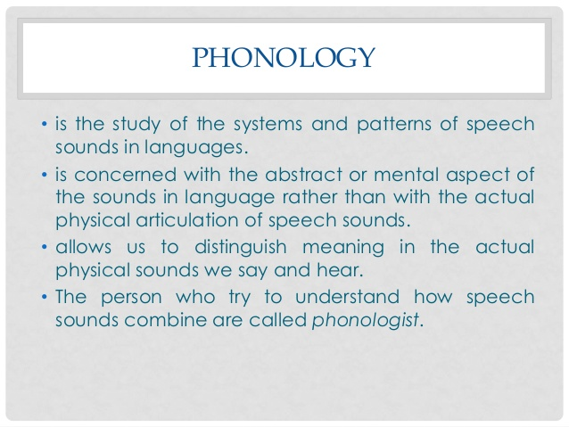
Phonolgy

Slide 4
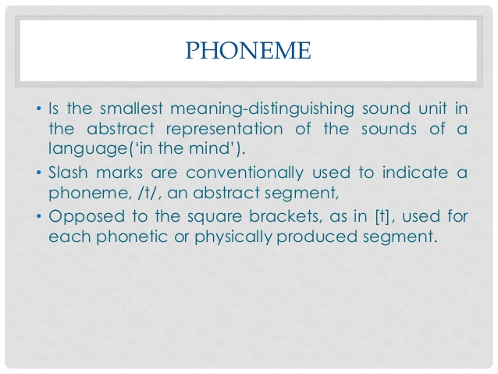
Phoneme

Slide 5
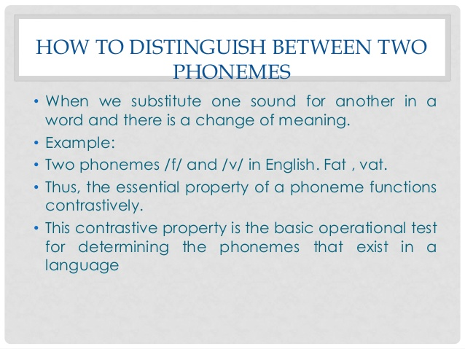
Distinguishing phonemes

Slide 6
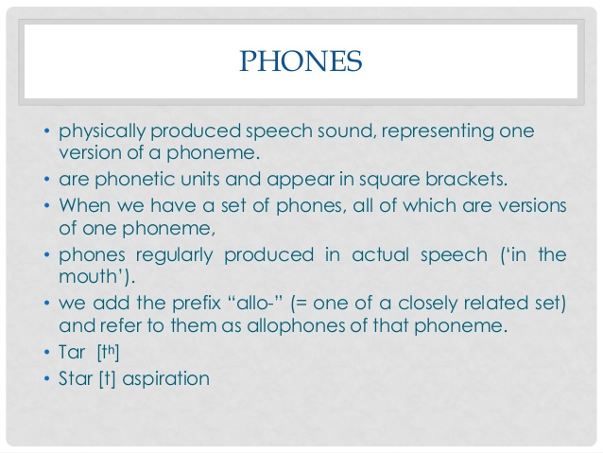
Phones

Slide 7
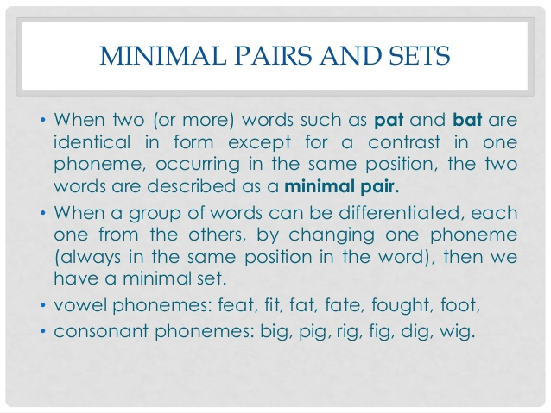
Minimal pairs

Slide 8
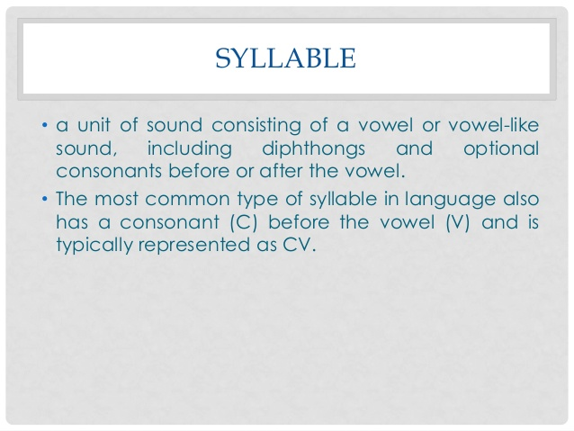
Syllables

Slide 9
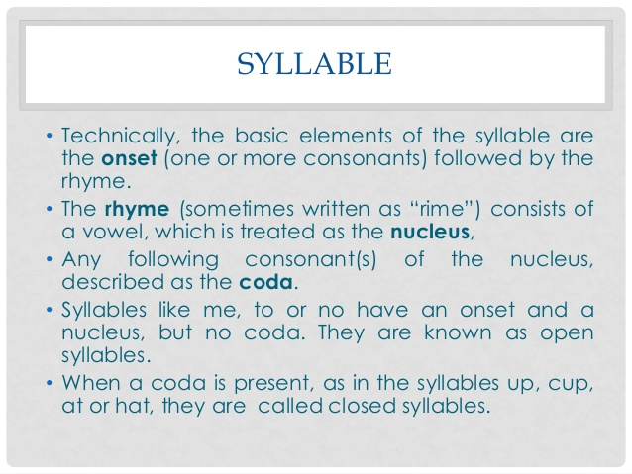
Syllables

Slide 10
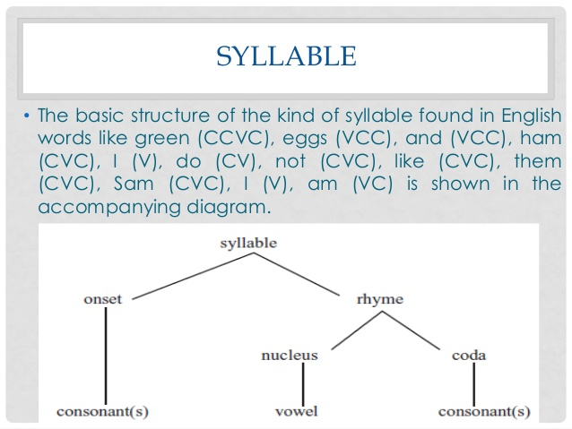
Syllables

Slide 11
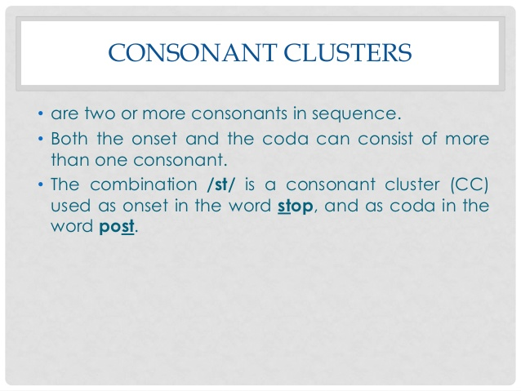
Consonant clusters

Slide 12
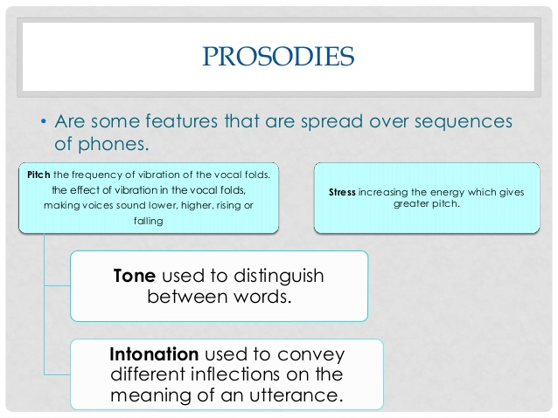
Prosodies

Slide 13
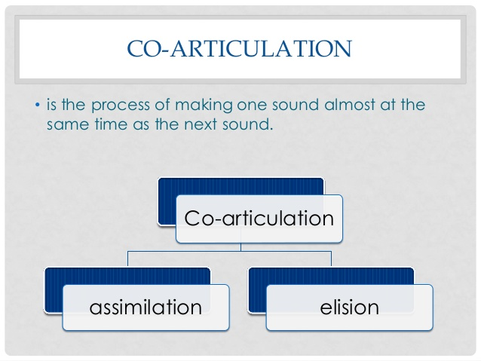
Co-articualtion

Slide 14
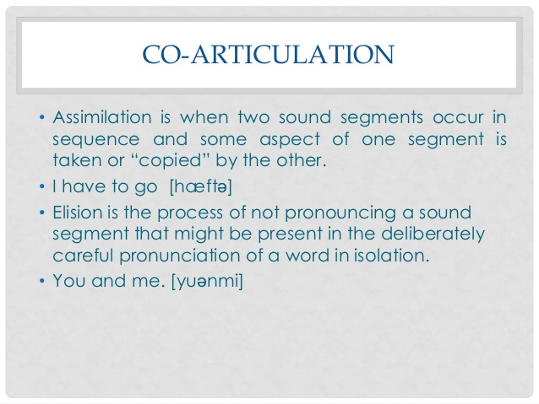
Co-articualtion

Slide 15
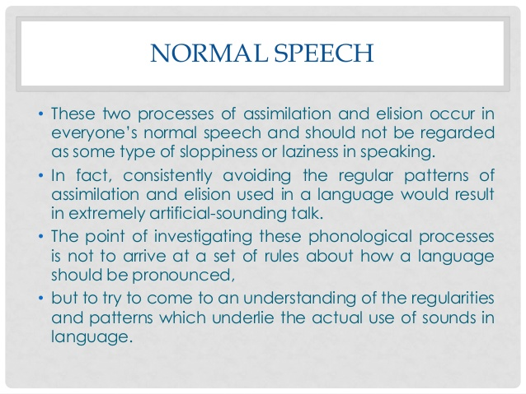
Normal speech

Slide 16
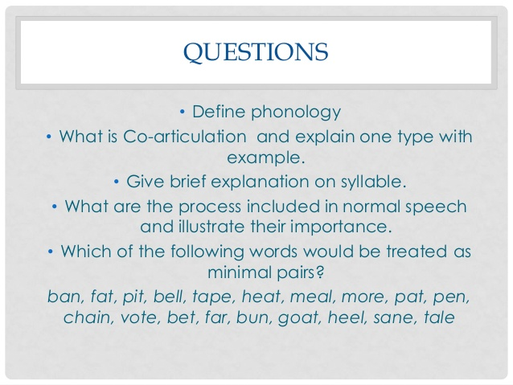
Further questions

Slide 17
Further reading
Core textbooks: - [e] Carr, Philip (2013) English Phonetics and Phonology: an Introduction. Oxford: Blackwell - Ladefoged, P. (5th edition, 2006) A Course in Phonetics, New York: Thomson-Wadsworth
Other recommended reading – starred items are particularly user-friendly
Ashby, Michael & John Maidment (2005) Introducing Phonetic Science, Cambridge: Cambridge University Press
Ashby, Patricia (2nd edition 2005) Speech Sounds. London and New York: Routledge.
*Collins, Beverley & Inger Mees (2008) Practical Phonetics and Phonology, London and New York: Routledge
Giegerich, H.J. (1992) English Phonology, Cambridge: Cambridge University Press
Gimson, A.C. (7th edition, revised by Alan Cruttenden, 2008) Gimson's pronunciation of English, London: Edward Arnold

Slide 18
Further Reading
Gussenhoven, Carlos and H. Jacobs (1998/2005). Understanding phonology. London: Arnold.
Hayward, K. (2000). Experimental Phonetics. London: Longman.
Ladefoged, P. (2001) Vowels and consonants, Oxford: Blackwell. (later editions also exist)
Lecumberri, M.L.G. and Maidment, J. (2000) English Transcription Course, London: Arnold - this is essentially a collection of transcription exercises
*Roach, P. (4th edition, 2009) English phonetics and phonology: a practical course, Cambridge: Cambridge University Press (The 3rd or earlier editions are still useful. Accompanying cassettes or CDs not essential)
*Roca, Iggy and Wyn Johnson (1999). A course in phonology. Oxford: Blackwell
Wells, J.C. (3rd edition, 2008) Longman Pronunciation Dictionary, Harlow: Pearson Longman (not a textbook, but includes highly informative entries on phonetic topics).
Don’t forget to look at the list of links on Moodle for further resources, exercises, and other useful information!

