Slide 1


Community Sports Development
Mark
Napieralla

Slide 2
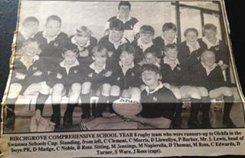
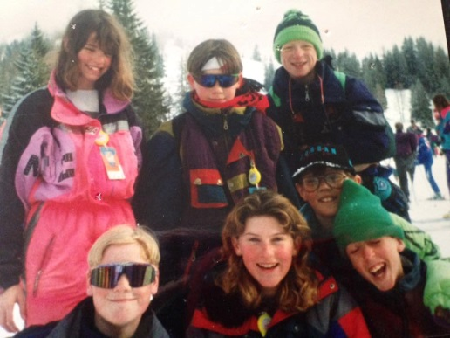
Community Sports Development
Who Am I? How did I get a job in the sports industry:
Brought up in Wales (Clydach) small village outside Swansea
Played Sport from a young age – Dad a huge influence sport / rugby mad
A Levels at Gorseinon College (football reasons)
Attended Plymouth College of St Mark and St John to study Sport and recreation, leisure and tourism
Year 1 ???? Year 2/3

Slide 3
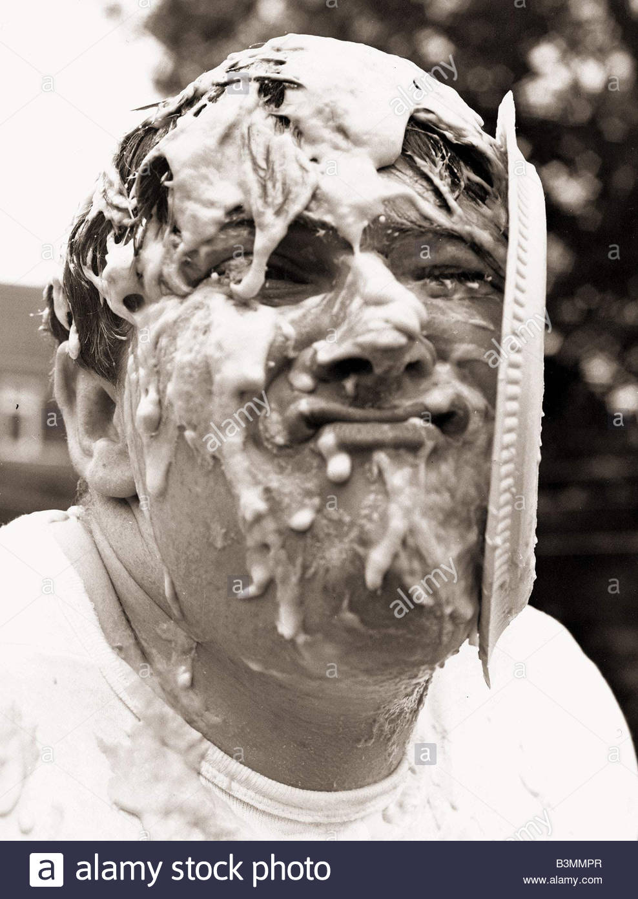
Community Sports Development
Who Am I / My Journey:
Wanted to work in Sports development
when leaving university.

Slide 4
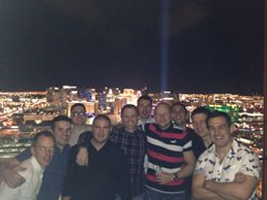

Community Sports Development

Slide 5
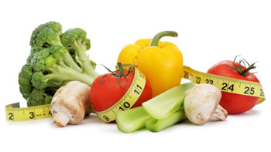
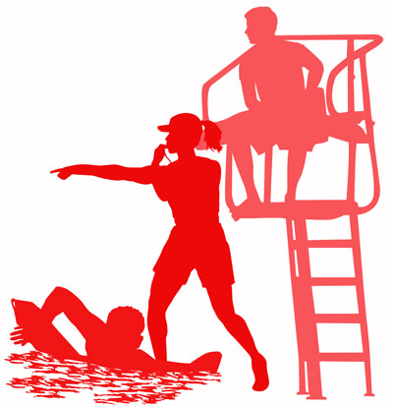
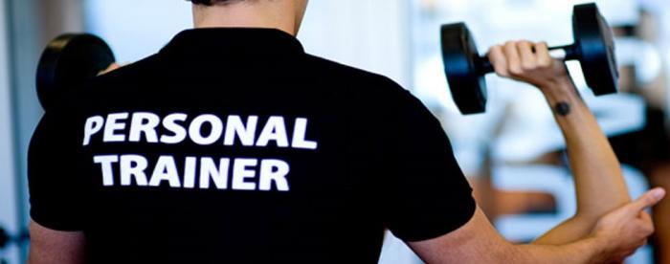
Community Sports Development

Slide 6
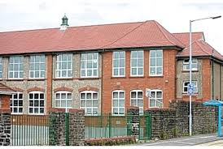
Community Sports Development

Slide 7



Community Sports Development

Slide 8
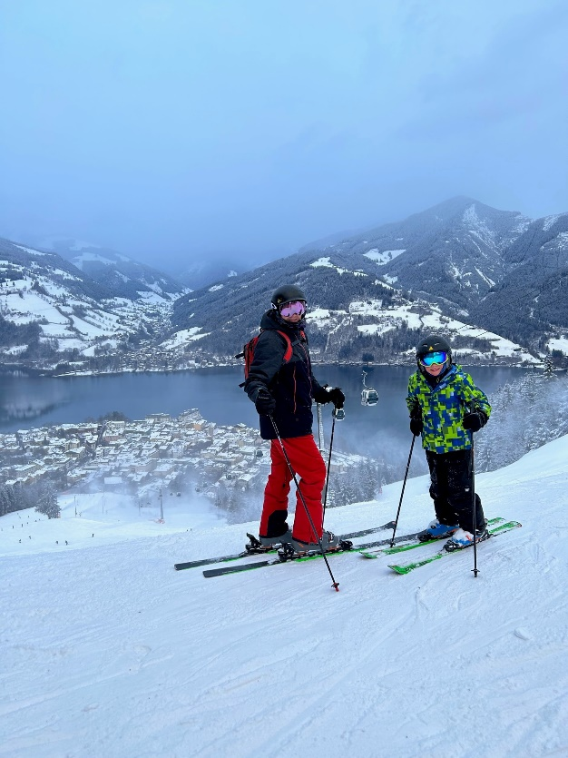
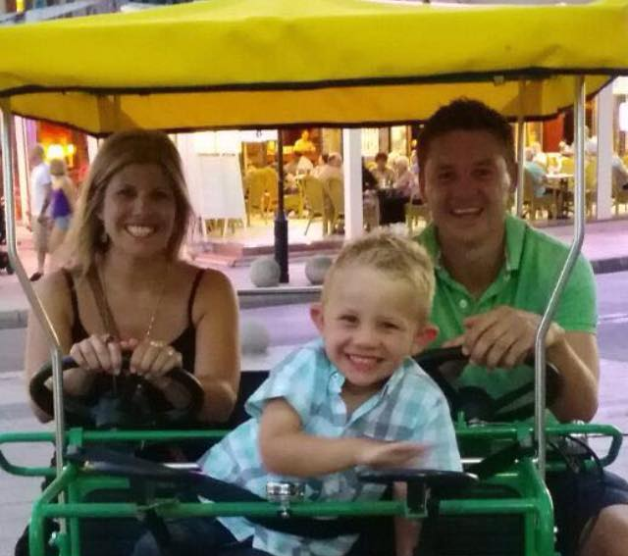

Outside Of Work

Slide 9
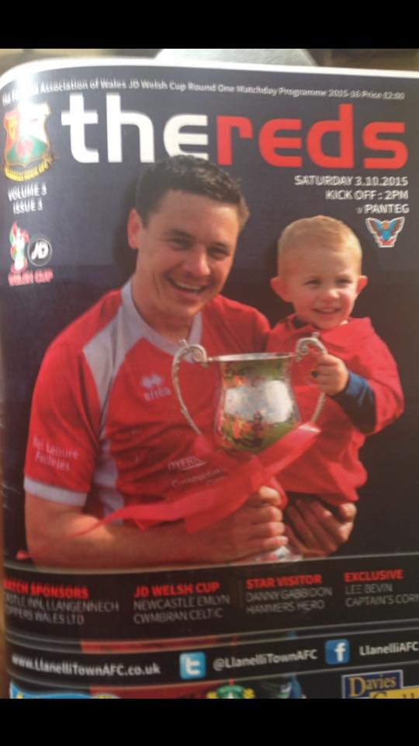
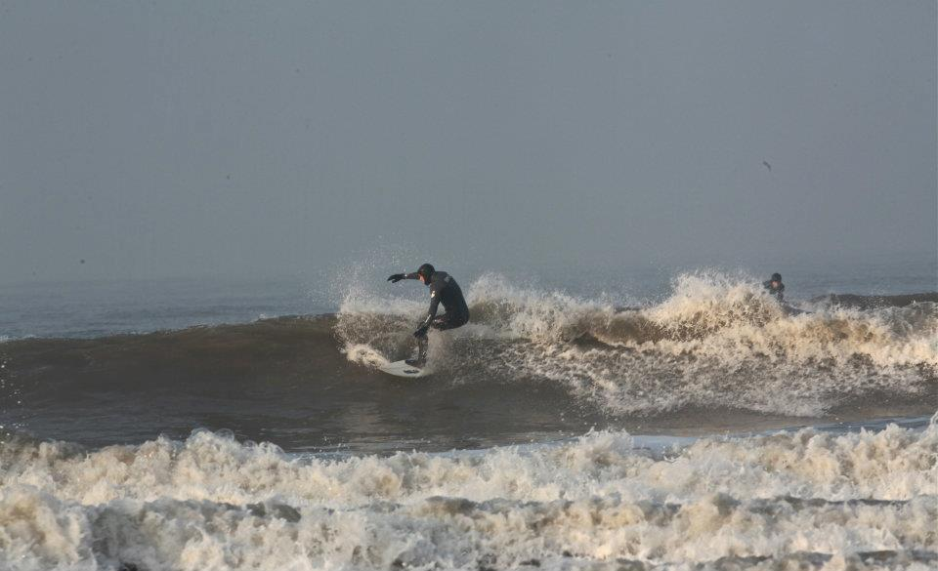
Outside Of Work

Slide 10
Community Sports Development
How well do you know each other?
Circle task- (speed discussions) Present your friend
Name
Where you Live
Your worst quality
Your best quality
Where you see yourself working in sport in the future
Where you work now
Your main interests
How you got to this point on your course (academically)
Feedback to group- present your friend

Slide 11
Community Sports Development
My expectations / standards:
Attendance- If you cant attend email me before the lecture starts
Professionalism / language
Mobile Phones- in bags not on the desk or in pockets
Hand in work on time
Value everyone's views, challenge, agree and disagree
My way of delivering:
Practical tasks
Use of technology
Real life experiences
Energisers / brain mash
Breaks-
Research / further reading

Slide 12
Community Sports Development
What you need to bring?
Pen / notepad / tablet / laptop
Smart Phone- QR Code Reader / device
Drink / non fizzy
Energy
Concentration
Ideas / creativity / an open mind!
Timings
9am for a 9:15am start- 11-11:30 finish

Slide 13

Community Sports Development
What do I expect from this module- Think, Pair, share
Feedback to the whiteboard

Slide 14
Monkey cucumber / grapes
Notes:
https://www.youtube.com/watch?v=gOtlN4pNArk

Slide 15
Community Sports Development
Aims of this module:
Develop an understanding of issues relevant to sports development, planning, managing sport infrastructures and key initiatives and programmes.
Evaluate arguments, assumptions and current strategies that are focused on creating pathways of opportunities for all individuals to achieve their potential through and in sport.

Slide 16
Community Sports Development
What will we be doing?
Presentations
Discussions / tasks / practical tasks in the classroom
Student research and presentation
A real life practical task- your project could be brought to life
Use of technology where possible- You will need a QR code reader

Slide 17


Community Sports Development
Two
Parts
1-
2-
How to get
Your grade?
Hand your work in on time!

Slide 18
Community Sports Development
Flip Chart Rotation Task- 3 groups
Think about Community Sports Development
1- Where does / should it happen
2- What does it look like
3- What are the day to day tasks of a sports development officer

Slide 19
Definitions
Sport- “All forms of physical activity that contribute to physical fitness, mental well-being and social interaction, such as play, recreation, organized or competitive sport, and indigenous sports and games,”
United Nations Task Force on Sport for Development and Peace (2003).
Physical Activity- “PA involves any bodily movement that is produced by the contraction of skeletal muscles and that substantially increases energy expenditure above the resting state”
Casperson, (1989) in Piggin, Mansfield and Weed, (2018:154).
Notes:
Sport > usually competitive, physically exertive, rule-governed with officials.
PA definition: Routledge handbook of PA Policy and Practice

Slide 20

Sport Development
Defined
“.. A process whereby effective opportunities, processes, systems and structures are set up to enable and encourage people in all or particular groups and areas to take part in sport for recreation or to improve their performance, to whatever level they desire”
Collins (1995: 21) in Houlihan and Green (2011)

Slide 21
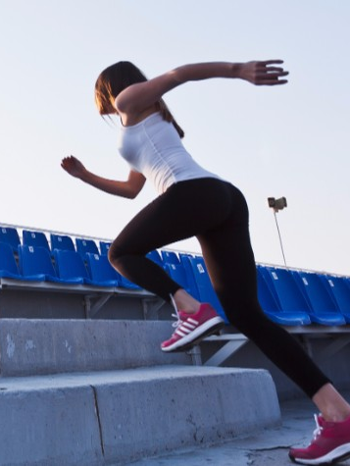
“An ambiguous and contested term,” Hylton (2013: 4)
It incorporates a broad and diverse range of sports workers.
Long standing & ongoing disputes exist about where the focus should be - grassroots or elite.
Overlaps/blurred edges regarding sport development, sport management and sport for development.
Hylton (2013: 4-5).

Slide 22
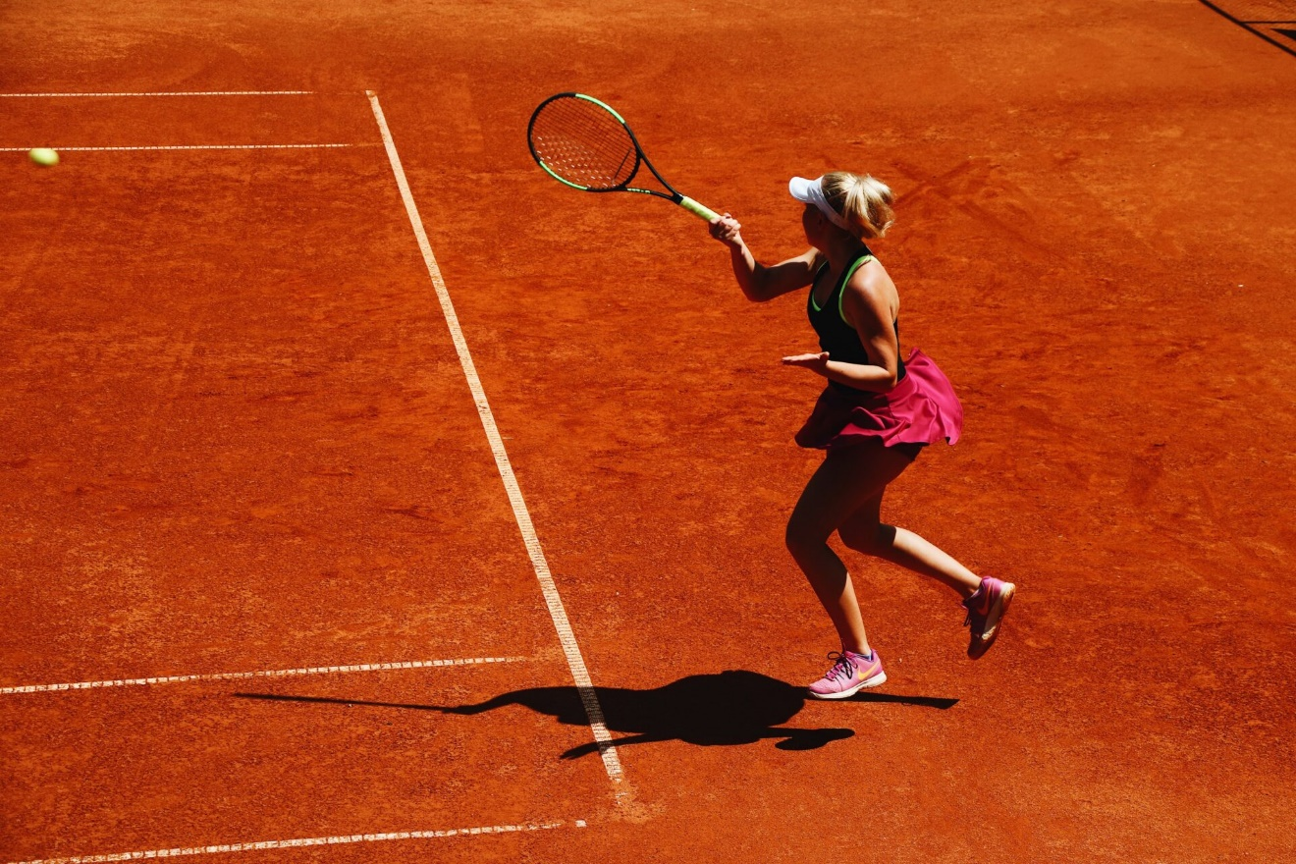
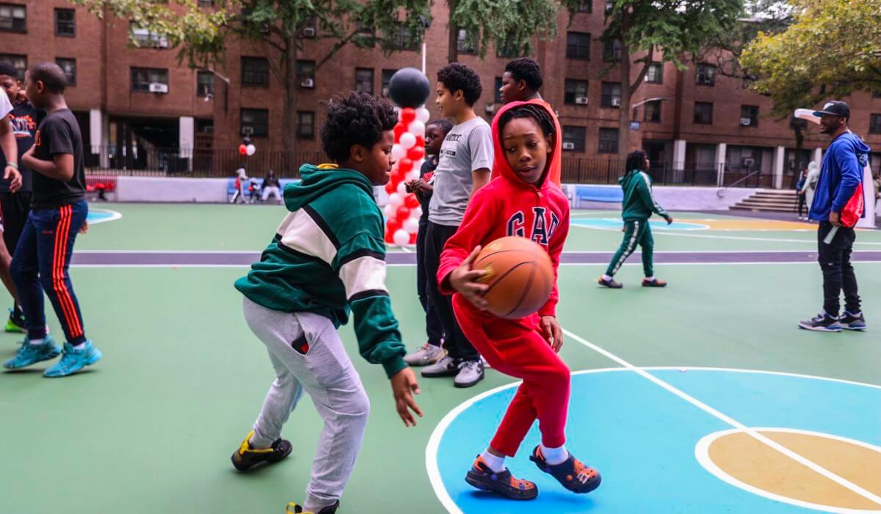
Sport Development has 2 strands
Development of Sport
  Development of sport itself i.e. codification of sports, constructions of facilities, creation of regular events and competitions (Houlihan & Green, 2011).
  Sport for Sport’s Sake (pure sport)
Development through Sport
  Aim is to develop people, communities
  Sport for Good (Key SD outcomes)
    e.g. Health, education, crime, regeneration, peace, social inclusion

Slide 23
Sport Development outcomes
Health
  Social
  Psychological
  Physical
Education
  Skill development
  Academic achievement
  Qualifications
Sporting Legacy
  Increased participation
  Improved infrastructure
    pathways
Physical Regeneration
  facilities/transport
Social Regeneration
  Crime prevention/reduction
  community cohesion
Economic Regeneration
  Tourism expenditure & income
  Job creation
  Coalter (2002)
Notes:
As a result of effective sport development i.e. promoting interest, increasing participation, improving performance, what would we expect to see?

Slide 24
Community Sports Development
BREAK

Slide 25
Community Sports Development
My previous department
My team
The projects / what we deliver
My budget-Was just under £500000 per year for all projects
2/3 from Sport Wales
1/3 working in partnership and taking leads on projects

Slide 26
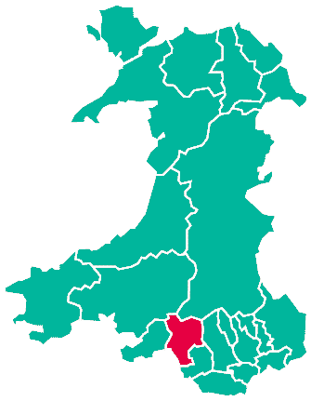

Neath Port Talbot

Slide 27
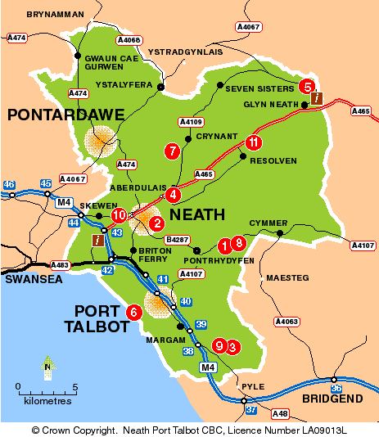
Neath Port Talbot

Slide 28
Staff Structure
Projects
Officers
Admin – Jess Davies / Alison Edwards
AYP CO-ORDINATORS
Mark Napieralla
Michelle Hall
MTB- Tom
Health- Rebecca P
Neath Valley AYP / Community 16 HOURS
Claire
Afan Valley
21 HOURS
Kyle Harkett
Bae Baglan Area- 21 HOURS
Claire
Neath Central- 15 hours Martin Kelly
Neath Cimla AYP- 21 HOURS
Stephanie
PT Central / West 37 HOURS
Sharon
Swansea Valley AYP- 37 HOURS
Carwyn
Inclusive Clubs
Development
Michelle Lewis
Volunteers
SG Offer
Students
Coaches
Coaches

Slide 29








Community
Sport
Pathway

Slide 30
LAPA-Community Clubs
Some of our focus for this year :
Netball – Swansea Bay Netball League
Badminton
Inclusive Sports Clubs
Early years / creche
Health intervention
Ambassadors, Improving delivery sport PA / training
MTB- 2 x community clubs, EMTB
Camps / holiday activities
Targeting areas that need it most
Sport Survey 2022
Afan Valley Active / Biking
Margam MTB Trail project / events / commonwealth games

Slide 31
Community Clubs
Student Research Task:
What new community sports sessions could be developed in the Swansea Bay region and why?
Research- growing trends, what is successful elsewhere (USA). What facilities could be used, is there evidence of a need? Why would you set up that session in that area?
Design a small PowerPoint presentation of 5 slides maximum

Slide 32
Task-
Research the physical activity recommendations for:
U18’s,
19–64-year old's,
Over 65’s.
Include your references.
Current participation data for these groups

Slide 33



Task- Research the 3 pages below to find out information about the services of physical activity and sport Neath Port Talbot
@nptpass
Search NPT PASS
Search NPT PASS

