Slide 1


Family Support
Early intervention -support given to a family when a problem first emerges.
Types of early help;
Home visiting programs
School-based programs
Mentoring schemes
(EIF, 2018).
Protect children from harm
Reduce the need for a referral to child protection services
Improve children's long-term outcomes
(Haynes et al, 2015).

Slide 2
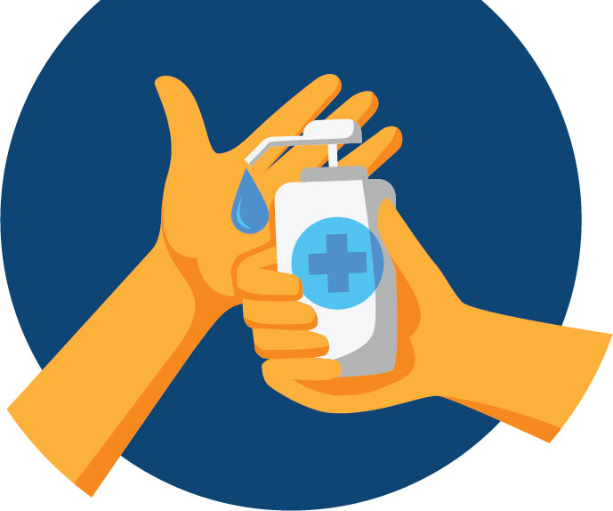
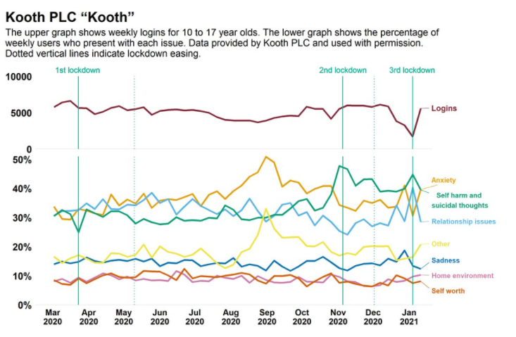
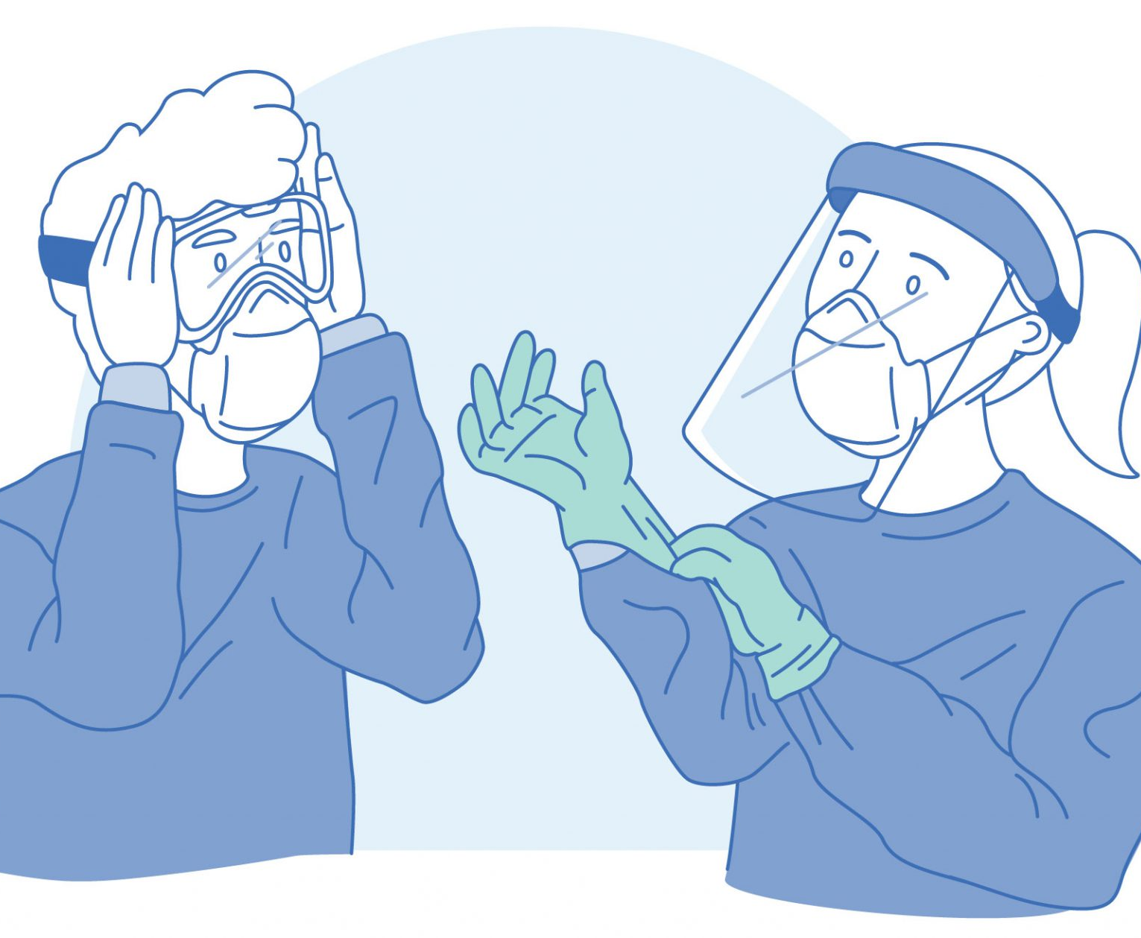
Covid-19
What procedures are in your school to keep our children safe?
Homeschooling & Emergency childcare
Return to school/ Post Covid

Slide 3

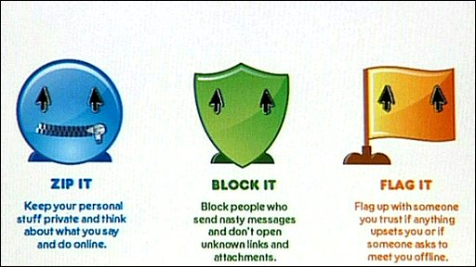
E-safety
How do schools keep our children safe online?
What age is this discussed in school?
How?
School & County Level Restrictions
Workshops for Parents
Schools have a dual responsibility when it comes to e-safety: to ensure the school’s online procedures keep children and young people safe, and to teach them about online safety, in and outside of school (NSPCC, 2020).

Slide 4
References
Department for Education (DfE) (2018) Working together to safeguard children: a guide to inter-agency working to safeguard and promote the welfare of children (PDF). London: Department for Education (DfE).
Early Intervention Foundation (EIF) (2018) About Early Intervention: why it matters. Available at: https://www.eif.org.uk/why-it-matters
Haynes, A.. Et al (2015) Thriving communities; a framework for preventing and intervening early in child neglect. London: NSPCC. Available at https://library.nspcc.org.uk/heritagescripts/hapi.dll/search2?searchterm0=5713
Lally, C. (2020) Child and adolescent mental health during COVID-19. UK Parliament. Available at Child and adolescent mental health during COVID-19 - POST (parliament.uk)
Welsh Government (2018) Social Services and Well-being (Wales) Act 2014: Part 2 code of practice (general functions) (PDF). Cardiff: Welsh Government.
YoungMinds. Coronavirus: Impact on young people with mental health needs. 2020. [Non-representative sample of 2,111 young people aged 13 to 25, more likely to have existing mental health issues, collected 20 to 25 March 2020]
ppe-scaled.jpg (2048×1259) https://highspeedtraining.co.uk/hub/wp-content/uploads/2020/04/ppe-scaled.jpg
social-hand-sanitizer.jpg (1080×1080) (miamidade.gov) https://www8.miamidade.gov/resources/images/initiatives/coronavirus/social-hand-sanitizer.jpg
https://kindpng.com/picc/m/123-1239177_need-advice-and-support-transparent-happy-cartoon-family.png
259_Image-1.jpg (376×357) (lrs.org) https://lrs.org/wp-content/uploads/208/05/259_image-1.jpg
https://www.gov.uk/government/publications/covid-19-mental-health-and-wellbeing-surveillance-report/7-children-and-young-people

