Slide 1
MANAGING PUBLIC HEALTH UK/ GLOBAL
WK 8

Slide 2
Contents
Public health - Childhood obesity
  Positive health promotion programs
    Global
    UK

Slide 3
Health promotion
The process of empowering people to increase control over their health and its determinants through health literacy efforts and multisectoral action to increase healthy behaviors.
This process includes activities for the community-at-large or for populations at increased risk of negative health outcomes.
Health promotion usually addresses behavioral risk factors such as tobacco use, obesity, diet and physical inactivity, as well as the areas of mental health, injury prevention, drug abuse control, alcohol control, health behavior related to HIV, and sexual health. (WHO)

Slide 4
Tobacco –global
Globalization of the tobacco epidemic
Due to complex factors:
  Cross-border effects, including trade liberalization, direct foreign investment, global marketing, transnational tobacco advertising, promotion and sponsorship, and the international movement of contraband and counterfeit cigarettes

Slide 5
The WHO Framework Convention on Tobacco Control (WHO FCTC) 2003
Global treaty
Reaffirms the right of all people to the highest standard of health
Redefines the role of international law in preventing disease and promoting health
Regulatory strategy to address addictive substances
Importance of demand reduction strategies as well as supply reduction issues.

Slide 6
The WHO Framework Convention on Tobacco Control (WHO FCTC) 2003
Visible different results at country level
Depend on the energy and political commitment of countries to implement in the coming years
Further depend on it spreading throughout the national and local levels
Successful result will be global public health gains for all.

Slide 7
FCTC successes
Ukraine
In October 2012, cigarettes sold in that country will have to carry picture-based warnings, as mandated by the FCTC. (Ukraine ratified the FCTC in June 2006).
They will replace the current text warnings and cover 50 per cent of the back of packages; a Smoking Kills text will cover 50 per cent of the front.

Slide 8
Chandigarh
Enacted strong, comprehensive smoke-free laws at the national or local level
On 15 July 2007, the administration of the Union Territory of Chandigarh declared it the first smoke-free city in India, although the Cigarettes and Other Tobacco Products Act passed four years earlier had included smoke-free provisions
Civil society led an active campaign in Chandigarh to get the provisions in the Act enforced
Twin strategy of raising public awareness and taking legal action to push local authorities to act

Slide 9
Uruguay
Has some of the strongest tobacco control laws in the world
Include graphic health warnings covering 80 percent of cigarette packages.
Impact of these policies the sharpest declines in prevalence of tobacco smoking ever reported, from 33% of adults in 2006 to 25% in 2009
2010 tobacco giant Philip Morris International (PMI) challenged Uruguay's proposed warning labels, and other tobacco control measures, claiming they violated the 1988 investment protection treaty between Uruguay and Switzerland
In 2010 the FCTC parties adopted the Punta del Este Declaration, noting “their concern regarding actions taken by the tobacco industry that seek to subvert and undermine government policies on tobacco control

Slide 10
China and South Africa
Examples of introducing taxation on tabacco
Good tobacco tax policies have enormous potential to encourage quitting amongst tobacco users, prevent young people from starting – and simultaneously generate considerable tax revenue
In China an increase that pushed tax incidence on cigarettes to 68 per cent could save as many as 13.7 million lives, and would be worth at least US$16 billion per year – more than the entire gross domestic product of at least 80 countries

Slide 11
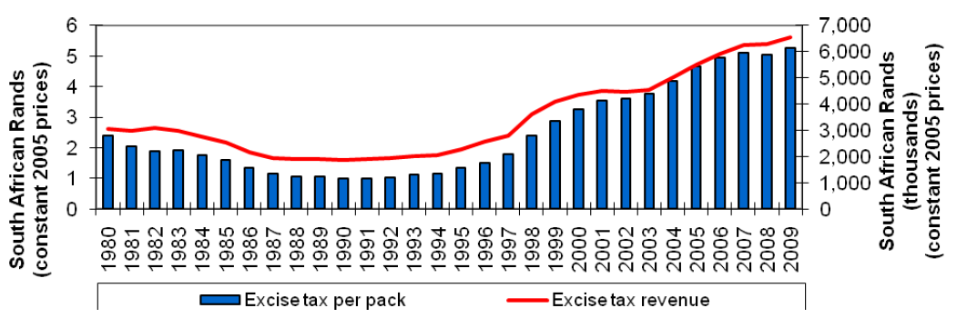

Slide 12
National health promotion
NHS England and Public Health England are responsible for the nationally managed public health campaigns
The topics for public health campaigns are chosen at a national level by Public Health England and NHS England in consultation with partners e.g. health services (trusts), pharmacy, GP, Health & well being boards,
National public health campaigns (funded by DoH)

Slide 13
Health promotion :
Health promotion & wellbeing:
Schools (lifestyle, nutrition, physical activity,..)
Universities (Portsmouth) mental wellbeing
Community (lifestyle, nutrition, physical activity,..)
Workplace (stress, health & safety, lifestyle,…)
Health promotion services
  e.g. farmacies are required to participate in up to six campaigns at the request of NHS England. This involves the display and distribution of leaflets provided by NHS England.,..) Required to undertake prescription-linked interventions on public health concern, such as encouraging smoking cessation

Slide 14
Regional - UK
Derbyshire health promotion services
A range of free health and well-being programs, advice and support to the local community and businesses of Derbyshire.
Programs are run and delivered by health specialists.
  Waist Wise - this is a weight management program with separate courses for men and women
  Derbyshire Stop Smoking Service - this is a specialist support program to help people quit smoking.
  Health Referral Program - this is an exercise and activity scheme for individuals who want to improve their health by becoming more active.

Slide 15
Children and Young People's Health Promotion Program - this is a local program to improve the health and wellbeing of children and young people in Derbyshire.
Working Well - this involves a range of programs to help local businesses to improve the health, well-being and safety of their workforce and work place.
Living with Long-term Conditions Program- this is a self-management program to help people with long-term conditions to improve their health and well-being.
Marketing and Resource Service - this is a range of health and well-being marketing resources for use in the community and education projects

Slide 16
Big questions – what impact on
Health
Finances
Equality
Equity
…..?

Slide 17
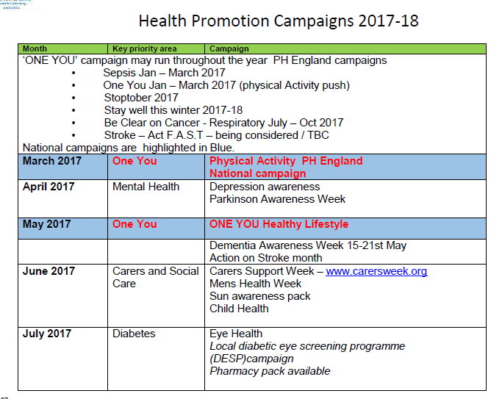

Slide 18
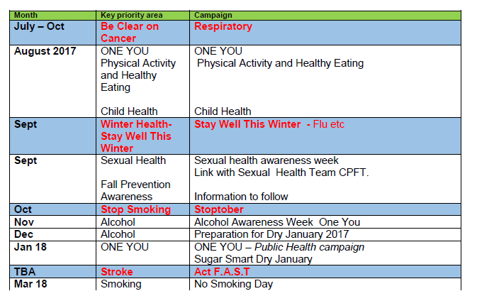

Slide 19
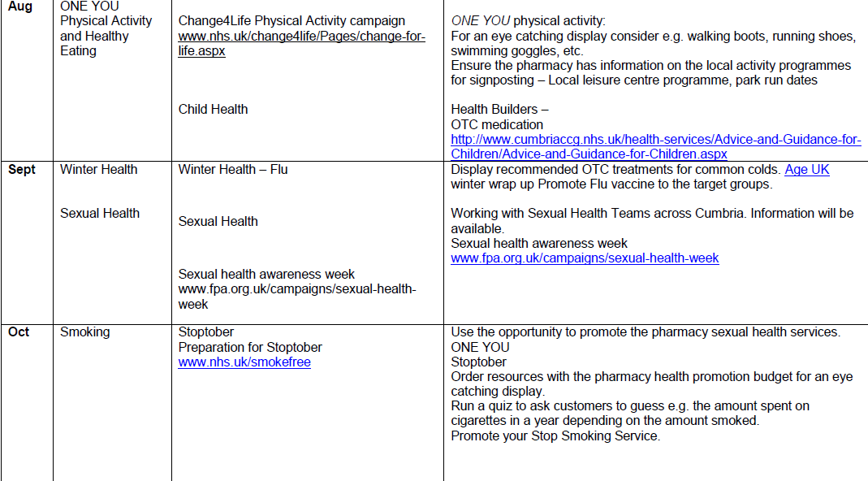

Slide 20
Q&A
Any Questions?

Slide 21
Sources
http://www.emro.who.int/about-who/public-health-functions/health-promotion-disease-prevention.html
(Derbyshire Community Health Service, 2012)
Health promoting universities, health promotion accessed on http://www.euro.who.int/__data/assets/pdf_file/0012/101640/E60163.pdf
http://psnc.org.uk/services-commissioning/essential-services/public-health/
http://psnc.org.uk/cumbria-lpc/wp-content/uploads/sites/48/2015/05/HLP-PH-campaigns-2017-18-vs3.pdf

