Slide 1
MBA IHM
Literature Review

Slide 2
Deilliannau Dysgu Learning Outcomes
Esbonio’r term ‘adolygiad llenyddiaeth’
Nodi’r problemau cyffredin y gellir eu wynebu wrth ddechrau ysgrifennu adolygiad o lenyddiaeth a sut i’w groesgyn
Amlinellu Nodweddion da a drwg ysgrifennu adolygiadau llenyddiaeth
Explain the term ‘literature review’
Identify the common problems that may be encountered when beginning to write a literature review and how to overcome them
Outline the good/bad features of literature review writing

Slide 3

What is meant by a 'Literature Review'?
a. A literature review is a comprehensive summary of previous research on a topic. The literature review surveys scholarly articles, books, and other sources relevant to a particular area of research' (Bloomsberg Uni, 2022)
b. A literature review is a piece of academic writing demonstrating knowledge and understanding of the academic literature on a specific topic placed in context. A literature review also includes a critical evaluation of the material; this is why it is called a literature review rather than a literature report. It is a process of reviewing the literature, as well as a form of writing ( Edinburgh Uni, 2022)

Slide 4

Literature Review
The WHY & the HOW
WHY do you need to undertake a literature review?
HOW do you write your literature review?
Notes:
Now that we know what a 'literature review' is - lets look at the WHY and the HOW of literature reviews.
WHY do you need to undertake a literature review
&
HOW do you write your literature review

Slide 5

Why do you need to do a literature review?
Notes:
So let me ask you – Why do you need to do a literature review as part of your dissertation?

Slide 6
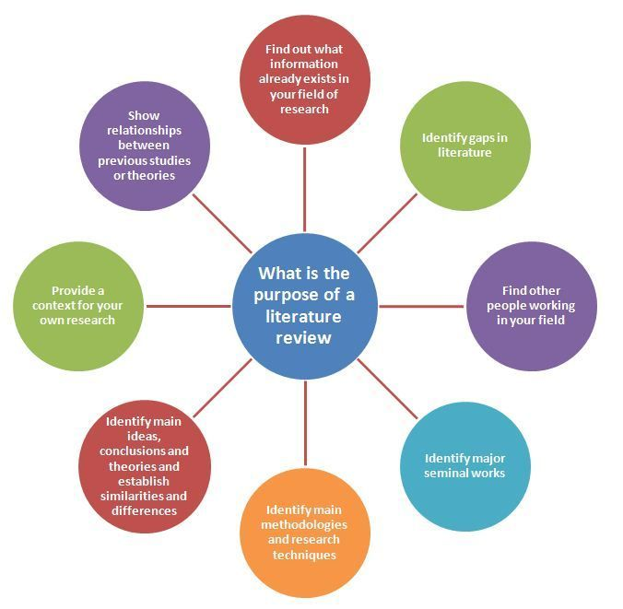
Literature Review - 'the WHY'
  To find out who is saying what about your topic area
  To identify gaps in the literature
  To provide context for your research
  To show that you have read widely and in depth
  To show you have the skills to interpret and evaluate the literature
  ‘ review of literature should demonstrate that ‘the writer has studied existing work in the field with insight’ (Haywood and Wragg, 1982.p2)
Notes:
There are a number of reasons, which inlcudes:
To find out what information already exists and who is saying what about your topic area
To identify gaps in the literature
To provide context for your research
To show that you have read widely and in depth
To show you have the skills to interpret and evaluate the literature
To identify major influential works
To identify main methodologies and research techniques already used in the subject area
To identify main ideas, conclusions and theories
Show relationships between previous research and theories in the area

Slide 7

Starting your literature review – common problems
Where will you find appropriate and relevant literature?
How to reference correctly
How to review the literature
How to structure the literature review chapter
Notes:
What do you think are the common problems that you will face in writing your literature review?
Think of the whole process
WHERE DO YOU START?
These are just some of the common problems encountered by students when they embark upon their literature reviews
Where will you find appropriate and relevant literature? What if you can't find anything? Do you concentrate online or do you go to the library?
How to reference correctly – how confident are you with your Harvard referencing at this moment in time?
How to review the literature – how do you actually do this?
How to structure the literature review chapter – how do you go about putting all the notes from your reading into a document?

Slide 8

The 'How' of writing a Literature review
Notes:
Lets now turn to the HOW of writing a literature review

Slide 9
Literature Review
When writing the Literature Review, it is very easy for students to drift from their main research objectives to find themselves immersed in writing about peripheral aspects of their topic that are extraneous to their research
Create sub-sections/headings in your Literature Review chapter that link directly to your specific research objectives
For example, for the research objectives above to be covered in the Literature Review (i.e. objectives 1 and 2)

Slide 10
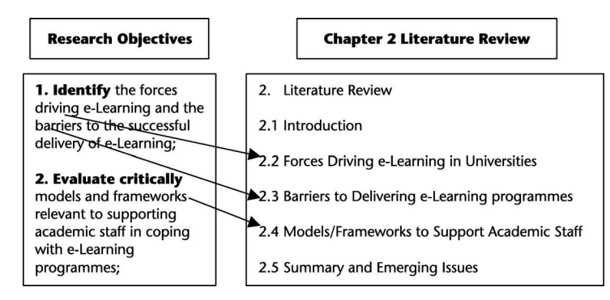
Notes:
Mapping research objectives to chapter sub-sections

Slide 11
A good Literature Review is characterised by the following features:
• It lays out what research has been done by others relevant to your research aim/objectives (why waste your time discussing irrelevant stuff?)
• It presents the work of others in a clear, interesting and progressive manner (to build up a coherent/logical picture).
• It provides evidence of in-depth critical evaluation (i.e. to show that YOU can give an opinion and support it with argument/evidence).
• It highlights pertinent/emerging issues (otherwise what is the point of your Literature Review?).
• It cites a variety of relevant sources properly (to show that you are well read and scholarly in your approach).
Biggam

Slide 12
At start of LR good practice - remind the reader of your research objectives and the areas that you intend covering in your Literature Review.
Notes:
(i.e. your tutor/marker) of your research objectives and the areas that you intend covering in your Literature Review

Slide 13
Where do you find resources?
Notes:
Lets start at the beginning - Where do you find the resources for you to undertake a literature review?
Its the same for everyone irrespective of the topic/subject area.

Slide 14

1. How to find your resources
Go and look for it!
4 methods of finding resources:
1. University Library
2. Google scholar
3. 'Snowballing'
4. Related dissertations
Detective skills –
Questions that need answers ( research objectives)
Clues are in literature sources
Discard any information that is irrelevant
Follow up any leads to other sources
Construct your ‘case’ on the evidence that you have found from your sources
Lay down the facts as you see them ( i.e. present the results of your review highlight your main findings and implications on your work)
Notes:
As some have already submitted your proposals you have already started on your literature review – so looking back on that research lets hear how you found your resources. For those that haven't where do you think you'll start?
ASK FOR EXAMPLES
The easy answer is : GO AND LOOK FOR IT!!
1. University Library – you will be having an input from Lisa Ellis , Academic Librarian on 7th November ( invitation has gone out - should be in your Teams calendar)
Don't forget - You can also visit the library on campus at anytime ( as a student you have access to the libraries in Swansea, Carmarthen, Lampeter and any other campus)
You may have specialist libraries within your organisations ( e.g. NHS, Gov depts etc)
Don't also forget about public libraries depending on your subject area
2. Google scholar – look at the abstract for articles – dismiss if not relevant to your topic/subject
3. Snowballing – this is when a few core articles will lead you to others via reference lists /bibliographies which you can then explore further. Note : you may find that as you explore they become dated and this is because they al build on each other
4. Related dissertations – to your topic area – look for sources of information from these ( use Proquest via University library)
Use your detective skills:
Questions that need answers ( research objectives)
Clues are in literature sources
Discard any information that is irrelevant
Follow up any leads to other sources
Construct your ‘case’ on the evidence that you have found from your sources
Lay down the facts as you see them ( i.e. present the results of your review highlight your main findings and implications on your work)

Slide 15
2. Log, Catalogue and Review
a. Log
Logging all the reference information
b. Catalogue
Catalogue all your literature – assist in remembering who said what/where etc
c. Review & digest
How it all fits together
How you will combine it all into narrative
Mind-map
Notes:
Log, Catalogue and review
a. Log
This is all about logging all the reference material as you go along
There are many different reference management programmes available online or you can just use an old fashioned spreadsheet/word document
DON'T FORGET – it must comply with UWTSD HArvard reference system
b. Catalogue
This is all about cataloguing all your literature - arguments, relevant quotations etc. This will assist you in locating information quickly and accurately. Again thik of how you will do this – notebook or excel spreadsheet ( excel spreadsheet will allow you to filter information quickly and easily).
c. Digest and review
Having logged and catalogued – step back and think about how it all fits together – look at who agrees/disagrees with each others points, how do different authors respond to the same points, what is the current research how does it differ from previous findings etc. How are you now going to combine it all together.
Use visuals like a mind-map to help you visualise how you will bring it together into a narrative
Zoom out/take a step back now and again and think about where everything fits in

Slide 16
Referencing & Reviewing Literature
How to reference correctly
  Harvard Referencing
  Keep a record of everything you read/reference from the start
  use the handout!
How to review the literature
Read widely
‘Critically evaluate’ what you read
Identify themes, gaps, trends, patterns
Make notes

Slide 17
When reviewing the literature , what kind of questions should you be considering as you are reading and making notes?

Slide 18
Reviewing the literature
What question or problem is the author addressing?
What are the key concepts and how are they defined?
What are the key theories, models and methods? Does the research use established frameworks or take an innovative approach?
What are the results and conclusions of the study?
How does the publication relate to other literature in the field? Does it confirm, add to, or challenge established knowledge?
How does the publication contribute to your understanding of the topic? What are its key insights and arguments?
What are the strengths and weaknesses of the research
Notes:
When reviewing the literature , what kind of questions should you be considering as you are reading through and making notes – the 'critical' side of things
Some suggestions:
What question or problem is the author addressing?
What are the key concepts and how are they defined?
What are the key theories, models and methods? Does the research use established frameworks or take an innovative approach?
What are the results and conclusions of the study?
How does the publication relate to other literature in the field? Does it confirm, add to, or challenge established knowledge?
How does the publication contribute to your understanding of the topic? What are its key insights and arguments?
What are the strengths and weaknesses of the research

Slide 19
How to structure your literature review?
Notes:
In which ways do you think you could structure your literature review?

Slide 20
3. How to structure your literature review
Notes:
4 ways that you can structure your literature review
1. Chronological
The simplest approach is to trace the development of the topic over time. However, if you choose this strategy, be careful to avoid simply listing and summarizing sources in order. It has to be critically written.
Try to analyse patterns, turning points and key debates that have shaped the direction of the field. Give your interpretation of how and why certain developments occurred.
2. Thematic
If you have found some recurring central themes, you can organize your literature review into subsections that address different aspects of the topic.
For example, if you are reviewing literature about inequalities in migrant health outcomes, key themes might include healthcare policy, language barriers, cultural attitudes, legal status, and economic access.
3. Methodological
If you draw your sources from different disciplines or fields that use a variety of research methods you might want to compare the results and conclusions that emerge from different approaches. For example:
Look at what results have emerged in qualitative versus quantitative methods
Discuss how the topic has been approached by empirical versus theoretical scholarship
Divide the literature into sociological, historical, and cultural sources
4. Theoretical
A literature review is often the foundation for a theoretical framework. You can use it to discuss various theories, models, and definitions of key concepts.
You might argue for the relevance of a specific theoretical approach, or combine various theoretical concepts to create a framework for your research.

Slide 21

Outlining and writing up
a. Outlining
Plan it!
Structural options
b. Writing up
Drafts
Supervisor feedback
Meet deadlines
Notes:
a. Outlining
Plan it first - this is not set in stone but is there to assist you
Structural options – on previous slide 4 structural options mentioned
Which will you chose?
b. writing up
Do drafts – perfection is not the objective at this time so don't aim for it, just get rough content down
Step away and go back to it and then tweak it so that you are happier with it
Get someone else to read it and give you feedback – then edit again if needed
Send draft in for formative feedback from supervisor
Listen to the feedback and act on it

Slide 22

Features of a good literature review
Lays out what research has been done by others which is relevant to your research aim/objectives
Presents work of others in a clear, interesting and progressive manner ( to build up a logical picture)
Provides evidence of in-depth critical evaluation
Highlights important/emerging issues
Cites a variety of relevant and appropriate sources properly
Notes:
What do you think are the features of a GOOD literature review?
Put yourself in your examiners position and think about what you would consider as good features?

Slide 23
Funnel Approach
The funnel structure moves from the broad to the detailed, the general to the specific, or from the abstract to the concrete.
Broader aspects of your topic (the contextual background, for instance) 2) gradually narrow your focus until you reach the specific aspect of the topic that you will be addressing.
You might equally be looking at the more abstract, theoretical work on your subject before moving to more concrete case studies in which those approaches have been applied, or more general treatments to more detailed and smaller scale studies.
That way, you are guiding your reader and helping them build their understanding of your topic: providing them with the background information and context they need in order to grasp your main ideas.
Newcastle University Accessed 2024

Slide 24
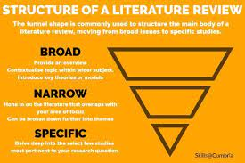

Slide 25
Features of a 'bad' literature review – what to avoid in your writing
Notes:
Put yourself in the shoes of your marker for a minute – what kind of things do you think a student should avoid doing or presenting in their written work?

Slide 26

Avoid…
Irrelevant rambling – stay focused
Ideas presented in no order – difficult to follow argument/discussions
Too descriptive – no opinion, no support
Ends abruptly, without highlighting any main findings
Limited sources used – mainly websites
Notes:
This list is not exhaustive , but can include things like:
Irrelevant rambling – stay focused
No structure - Ideas presented in no order – difficult to follow argument/discussions
Too descriptive – no opinion, no support
Lack of knowledge
Ends abruptly, without highlighting any main findings
Limited sources used – mainly websites
Copy/pasting and no referencing

Slide 27
A bad Literature Review exhibits
• Irrelevant rambling (i.e. what we call ‘student drift’);
• Ideas presented in no particular order (and so difficult to follow thread of student discussion);
• Too descriptive (with no/little attempt to give an opinion, much less support it with reasoned argument);
• Ends abruptly, devoid of any clarification of main findings; • Limited sources used (mainly websites), coupled with inconsistent referencing styles.
Notes:
Feedback includes

Slide 28
Learning Outcomes
Explain the term ‘literature review’
Identify the common problems that may be encountered when beginning to write a literature review and how to overcome them
Outline the good/bad features of literature review writing

Slide 29

Questions?

