Slide 1




Module Code: LCHS4007
Module Title: Digital Skills and Research Method
Lecturer’s Name: Reza Taghizadeh
Student Name: Shamim Naz

Slide 2
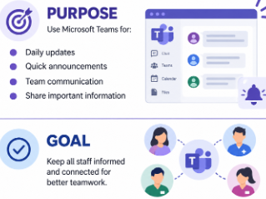
Workplace Task: Staff Communications and daily Updates
At Ashford Community Care Service, staff work in service user’s homes, in supported living environments and in the main office. Therefore, good communication between staff is important in providing information on daily activities, appointments changes, visit details, reminders and other work-related information.
Notes:
The chosen workplace task is staff communication and daily updates. At Ashford, staff work in several locations, so they need a reliable way to receive important information. So, we will use the Microsoft tool that can minimize the missed updates, duplicated work and inefficient communication.

Slide 3
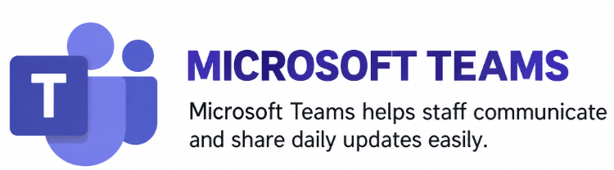
Microsoft 365 Tool: Microsoft Teams
Microsoft Teams is an application for communication and collaboration that enables employees to communicate via chats and messages, shared information, and meetings.
Notes:
I have chosen Microsoft Teams as it can facilitate instant messaging, group discussions, meetings and information sharing enables staff at Ashford to keep in touch and be alerted to vital information rapidly.

Slide 4
Why Microsoft Teams is Suitable
Quick communication – Staff can share daily updates and important messages instantly.
Group collaboration – Teams allows staff to communicate through group chats and team channels.
Online meetings – Staff can hold virtual meetings when working in different locations.
Centralized information – Important workplace information can be shared and accessed in one place.
Better coordination – Teams supports Ashford’s recommendation by improving teamwork, communication and coordination between staff.
Notes:
The use of Microsoft Teams makes sense since staff can communicate via group chat and team channels. It can also be used to discuss critical workplace information and conduct online meetings with staff. This can help minimize missed updates and working together.

Slide 5
How it Improves Efficiency and Communication
Faster updates – Staff can quickly share important daily information and workplace messages.
Better teamwork – Group chats and team channels help staff work together effectively.
Reduced confusion – Information is shared in one central place, making updates easier to follow.
Improved coordination – Staff across different locations can stay connected and organised
Notes:
Teams maintains staff communication in a single source. Staff can easily disseminate information about their day, talk about their work and communicate with their peers. This can help to eliminate repetition, miscommunications and delays in information sharing.

Slide 6
Recommendations
Ashford needs to enforce the use of Microsoft Teams to provide staff updates, team discussions, online meetings and to share information. The organisation should have clear guidelines and a basic training of staff to ensure effective and consistent use of Teams.
Advantages
Quick communication – get daily updates and important information from staff.
Improved team collaboration – enables group communication, meetings and discussions online.
Simple information sharing – Staff share information and documents from their worksites in one place.
Limitations
Information overload – When there are too many messages, important messages may not be noticed.
Internet dependency – Teams needs a good internet connection.
Training needed – Some staff may need to be trained to effectively use Teams.
Notes:
Employees stay informed with quick communication, improved teamwork and simple sharing of workplace data in Microsoft Teams. If there are too many messages, there will be information overload and staff will require access to the internet and basic training to make Teams work for them. I would recommend that Ashford should utilize Teams for daily updates and team communication and have clear guidelines and staff training.

Slide 7
References
Microsoft (2026) Explore the new chat and channels experience in Microsoft Teams. Microsoft Support. Available at: Microsoft Teams Chat and Channels.
Information Commissioner's Office (2026) Data sharing: a code of practice. Wilmslow: Information Commissioner's Office. Available at: ICO Data Sharing Code.
NHS England (2021) What good looks like: A guide to digital transformation in adult social care. London: NHS England.
Department of Health and Social Care (2021) Data saves lives: Building a world-leading digital health and social care system. London: Department of Health and Social Care.
World Health Organization (2021) Global strategy on digital health 2020–2025. Geneva: World Health Organization.

