Slide 1
Name : Likhitha Pyneni
Student Id : 2509981
Digital Forensic
Investigation
Case Study: Patent Theft at Quantum Tech

Slide 2
01
Case Background
Quantum Tech found out that unauthorized access to sensitive AI design of sensitive patent repository happened.
The internal monitoring found staff Emma to be the main suspect due to the rights to access the system.
Evidence (Karahan et al., 2025) of contact with Joe and Norman possibly to NexGen competitor.
Official forensic investigation to save evidence and find scope of compromise started.
Digital Forensic Investigation | Quantum Tech

Slide 3
02
Investigation Aim
Establish method used to gain access, copy or export confidential patent documents.
Determine suspicions' communication patterns during the incident time period of investigation (Durand and Briggs, 2025).
Locate admissible computer evidence on computers through legal forensic practices.
Provide transparent analysis to support action within the company and potential pursuit of action.
Digital Forensic Investigation | Quantum Tech

Slide 4
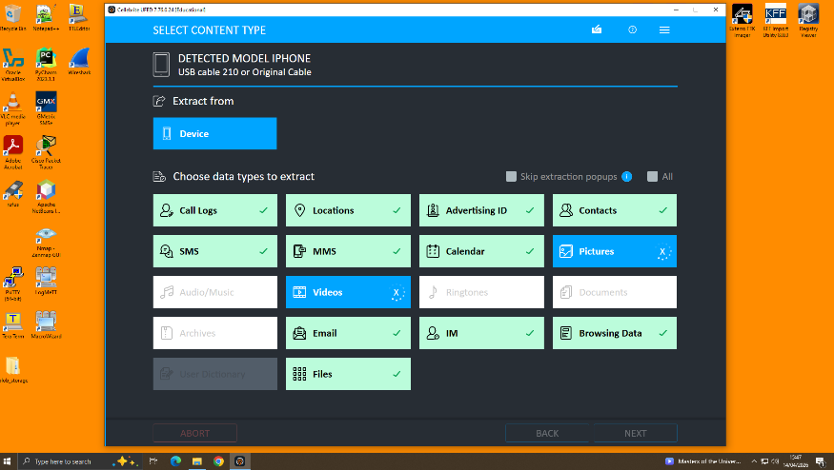
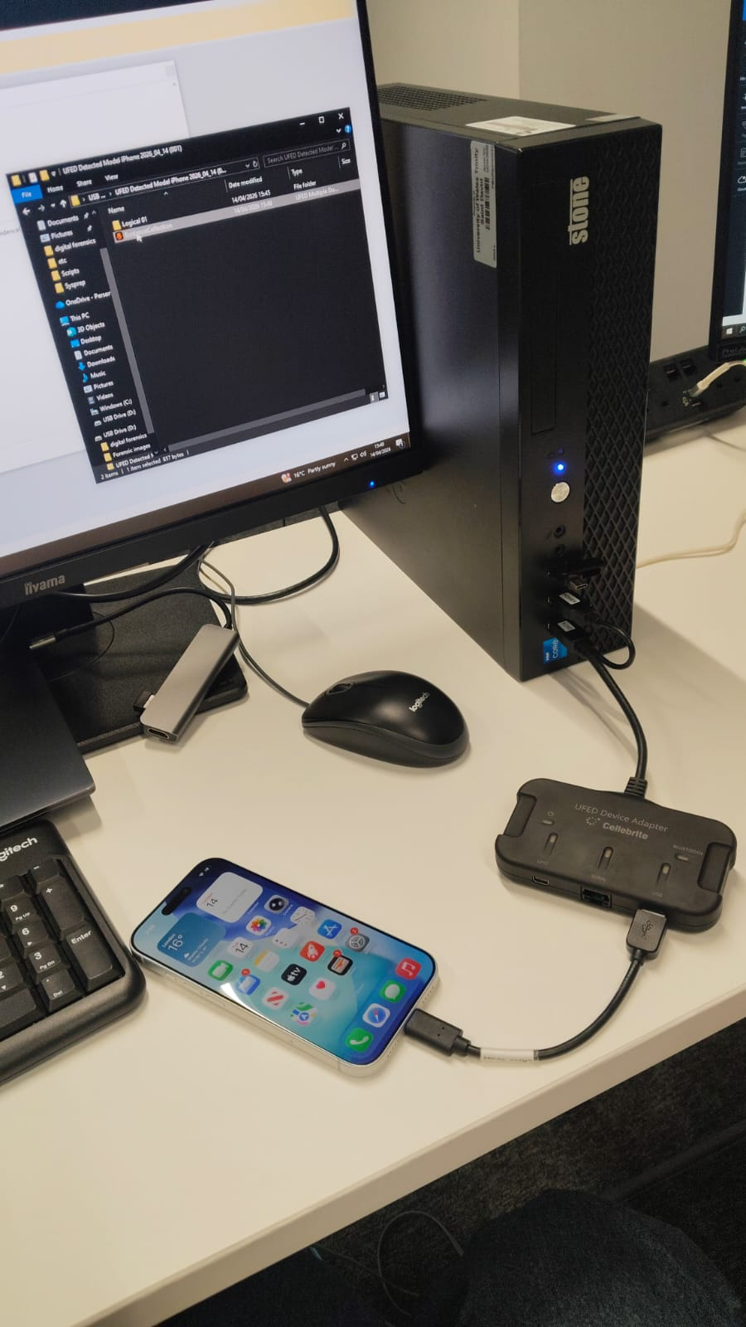
03
Mobile Evidence Acquisition
Cellebrite UFED conducted controlled logical extraction of smartphones that were seized.
Recovered artefacts Messages, contacts, media, calendars and files. This was done by detecting devices and ensuring that they were successfully connected prior to extraction processes. (Vajjhala and Strang, 2025)
Extractions logs, which were documented, entailed procedures that were reliable and accountable to the evidence.
Digital Forensic Investigation | Quantum Tech

Slide 5
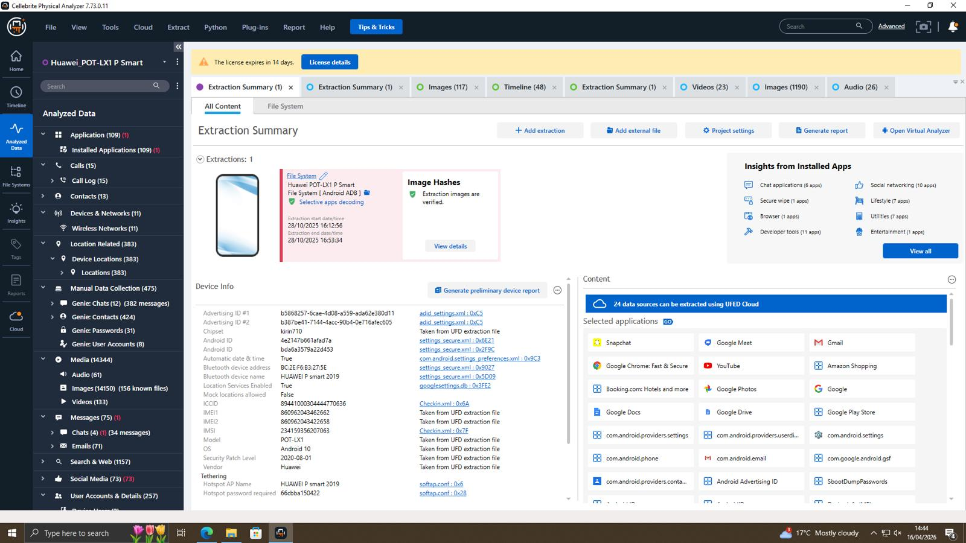
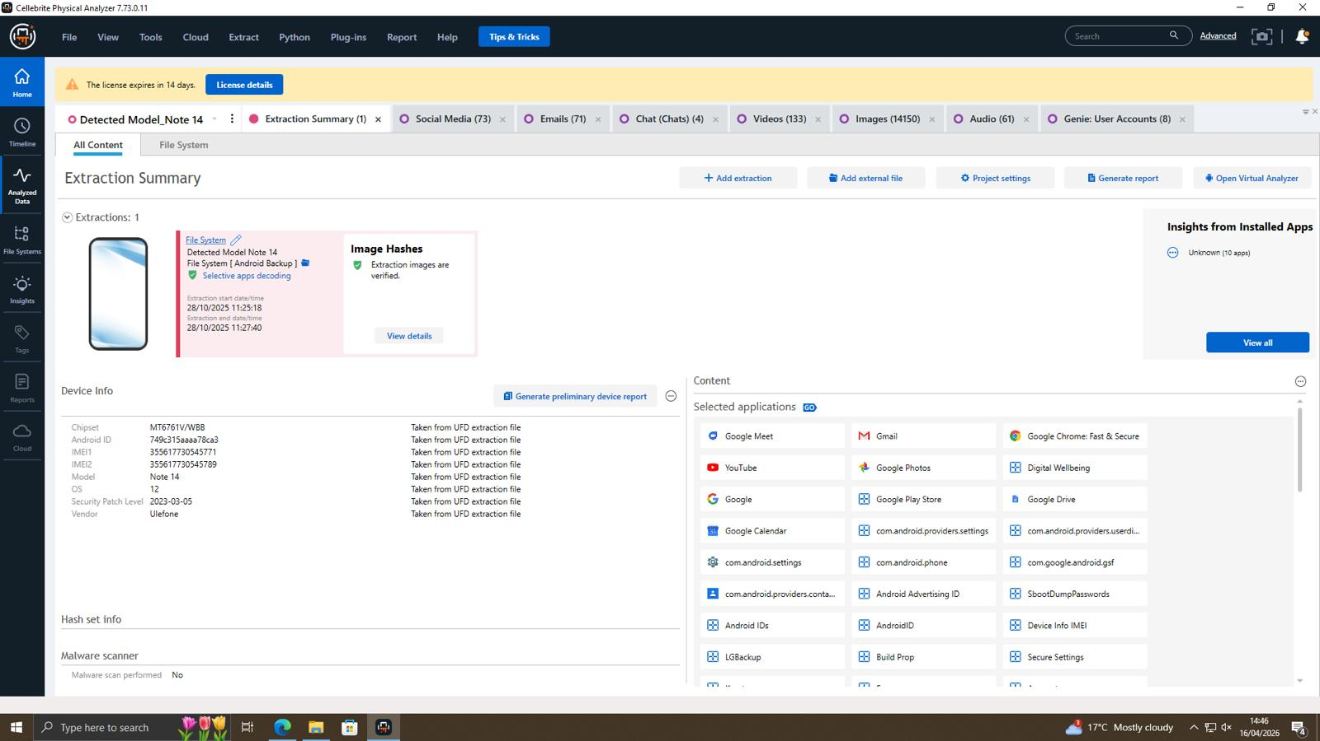
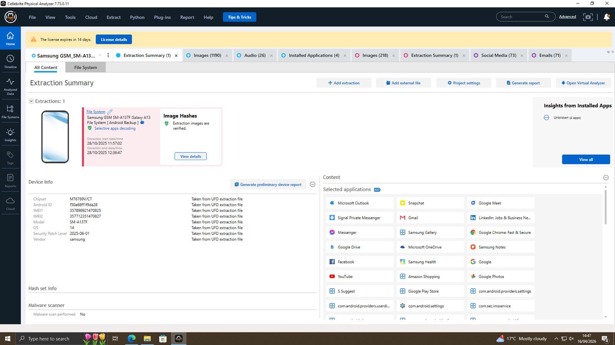
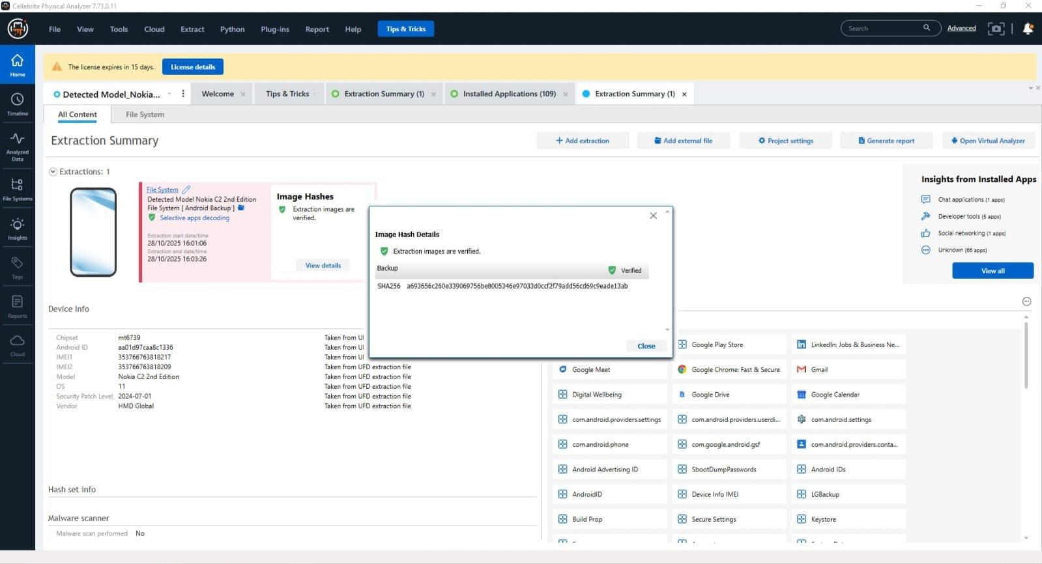
H Hash Verification – All Four Images
04
Digital Forensic Investigation | Quantum Tech

Slide 6
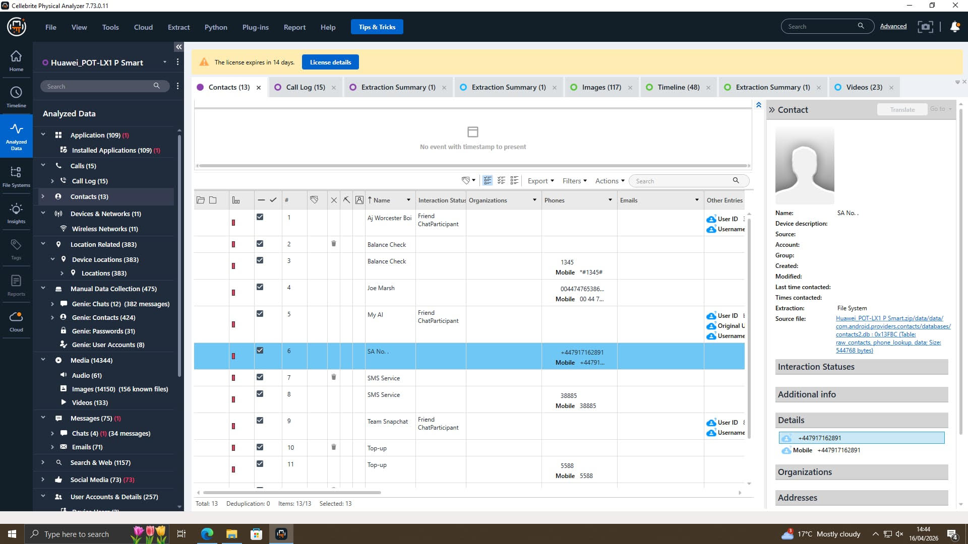
04
Contact Analysis
Forensic examination of Huawei phone was returned with thirteen contacts from examination.
Important contacts included SA No., Top-up, Joe Marsh, Anonymous contacts found.
Labels may represent personal, professional and/or covert relationships (Jain et al., 2026).
Found directory can assist ownership and network analysis of potential illegal communications.
Digital Forensic Investigation | Quantum Tech

Slide 7
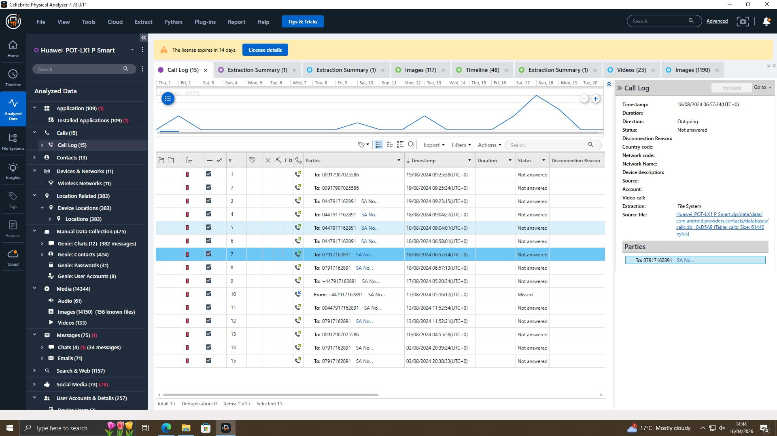
05
Call Data Evidence
  • Fifteen telephone logs were extracted from Huawei mobile phone logs(Choudhury et al., 2025).
  • There were several attempted calls to contact SA No.
  • Some calls were not answered, possibly requiring urgency or attempts at concealment.
  • Call history with August 2024 dates indicate the time frame for relevant communication.
Digital Forensic Investigation | Quantum Tech

Slide 8
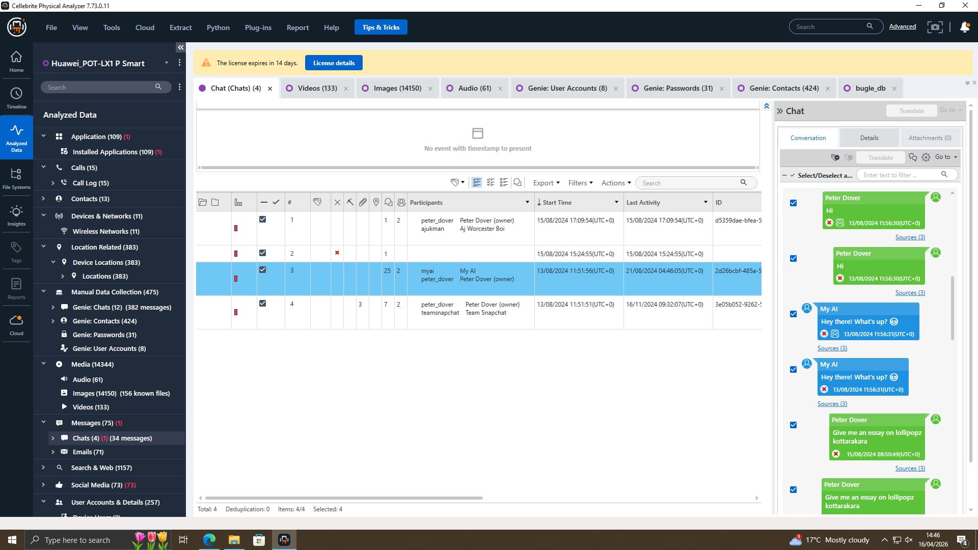
06
Chat Evidence
Chats referred to confidential assistance and useful information.
Chats openly referred to interested clients and offshore payment arrangements.
No returning indicated resolve and secrecy.
Messages mention inboxes and therefore document or evidence expected(Jain et al., 2026).
Digital Forensic Investigation | Quantum Tech

Slide 9
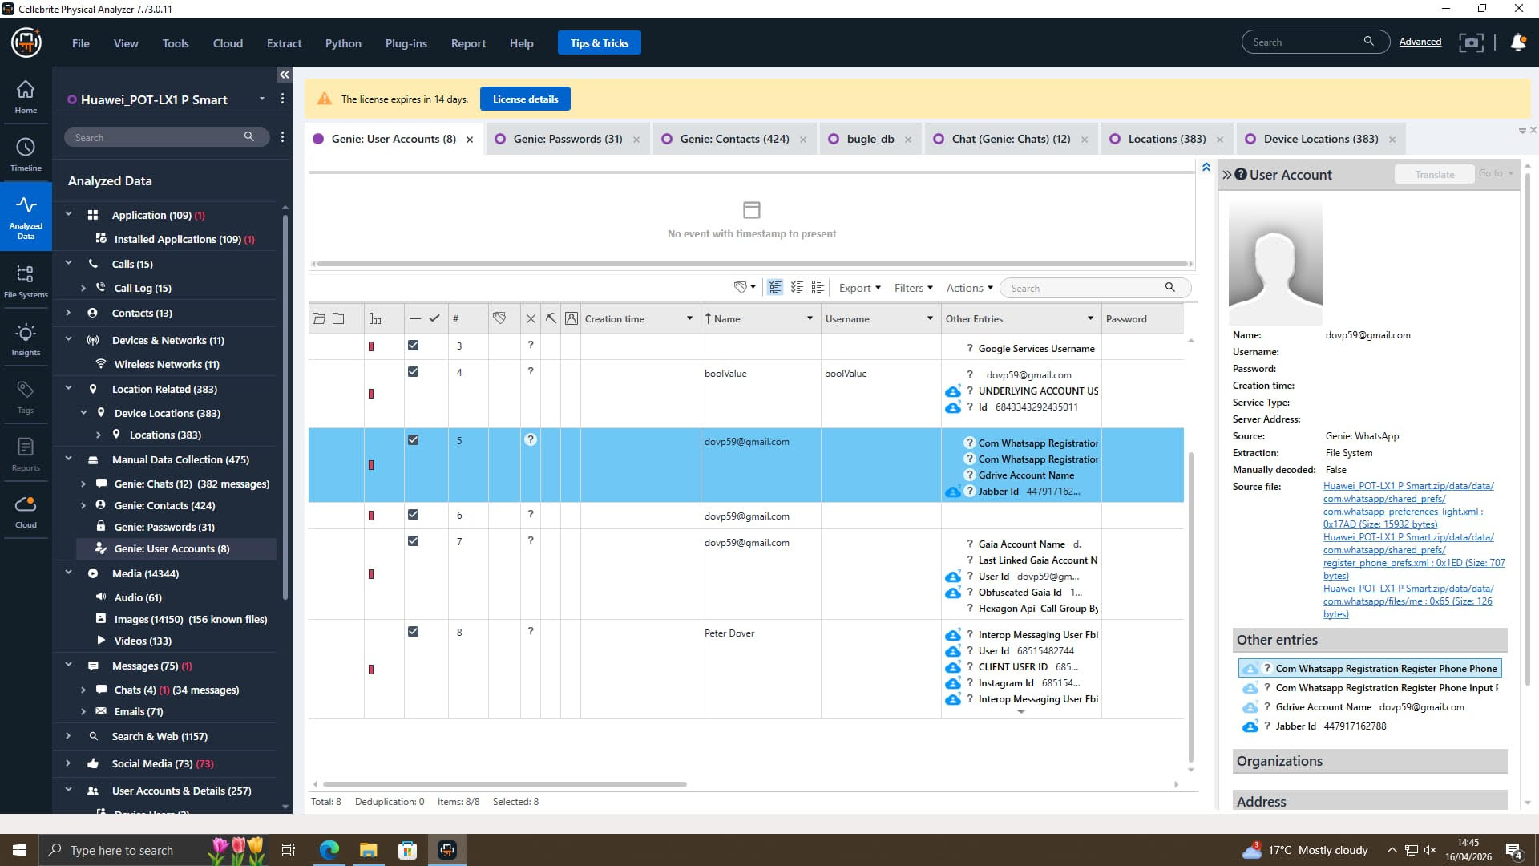
06
Email and Accounts
Seventy-one emails from the associated Gmail were successfully collected.
Multiple accounts were registered for using apps and services.
Accounts were used to associate with the analysed phone (Pernin et al., 2026).
Email dates may link to dates of interest for (possibly suspicious) email activity.
Digital Forensic Investigation | Quantum Tech

Slide 10
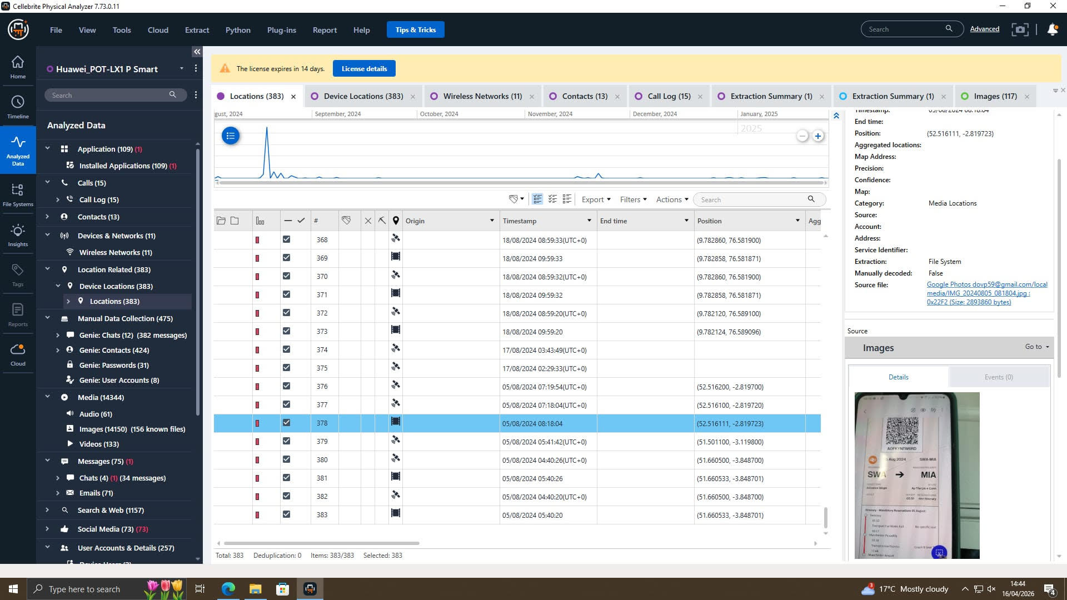
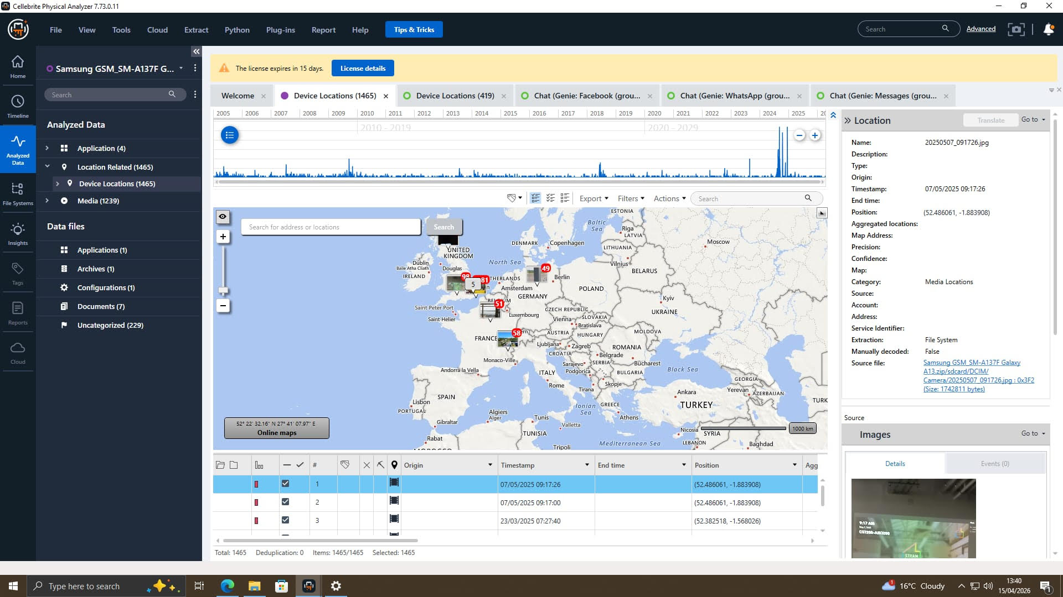
06
Location Evidence
Three hundred eighty-three location artefacts with coordinates were found.
GPS times convert to travel times and routes (Vajjhala and Strang, 2025).
Locations can also be associated with associated meeting points.
Location evidence is helpful to supplement communications in timelines.
Digital Forensic Investigation | Quantum Tech

Slide 11
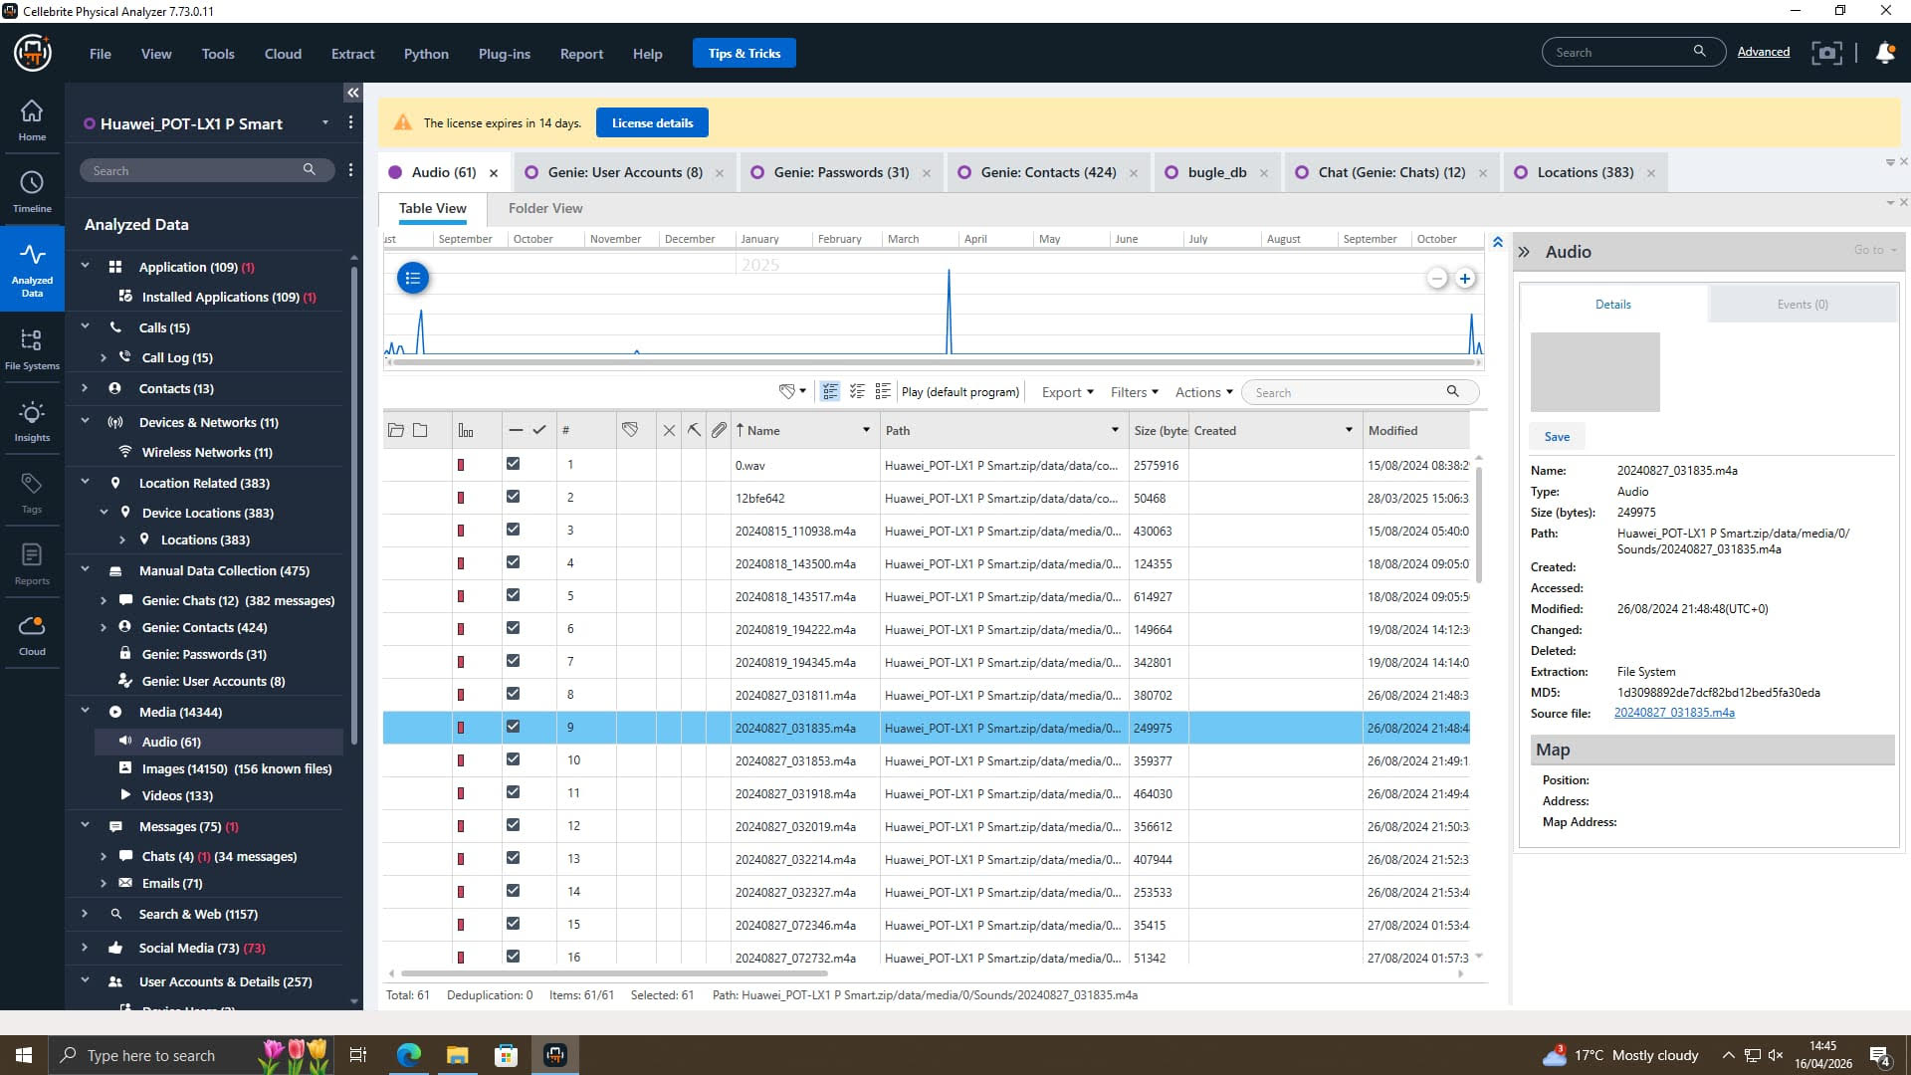
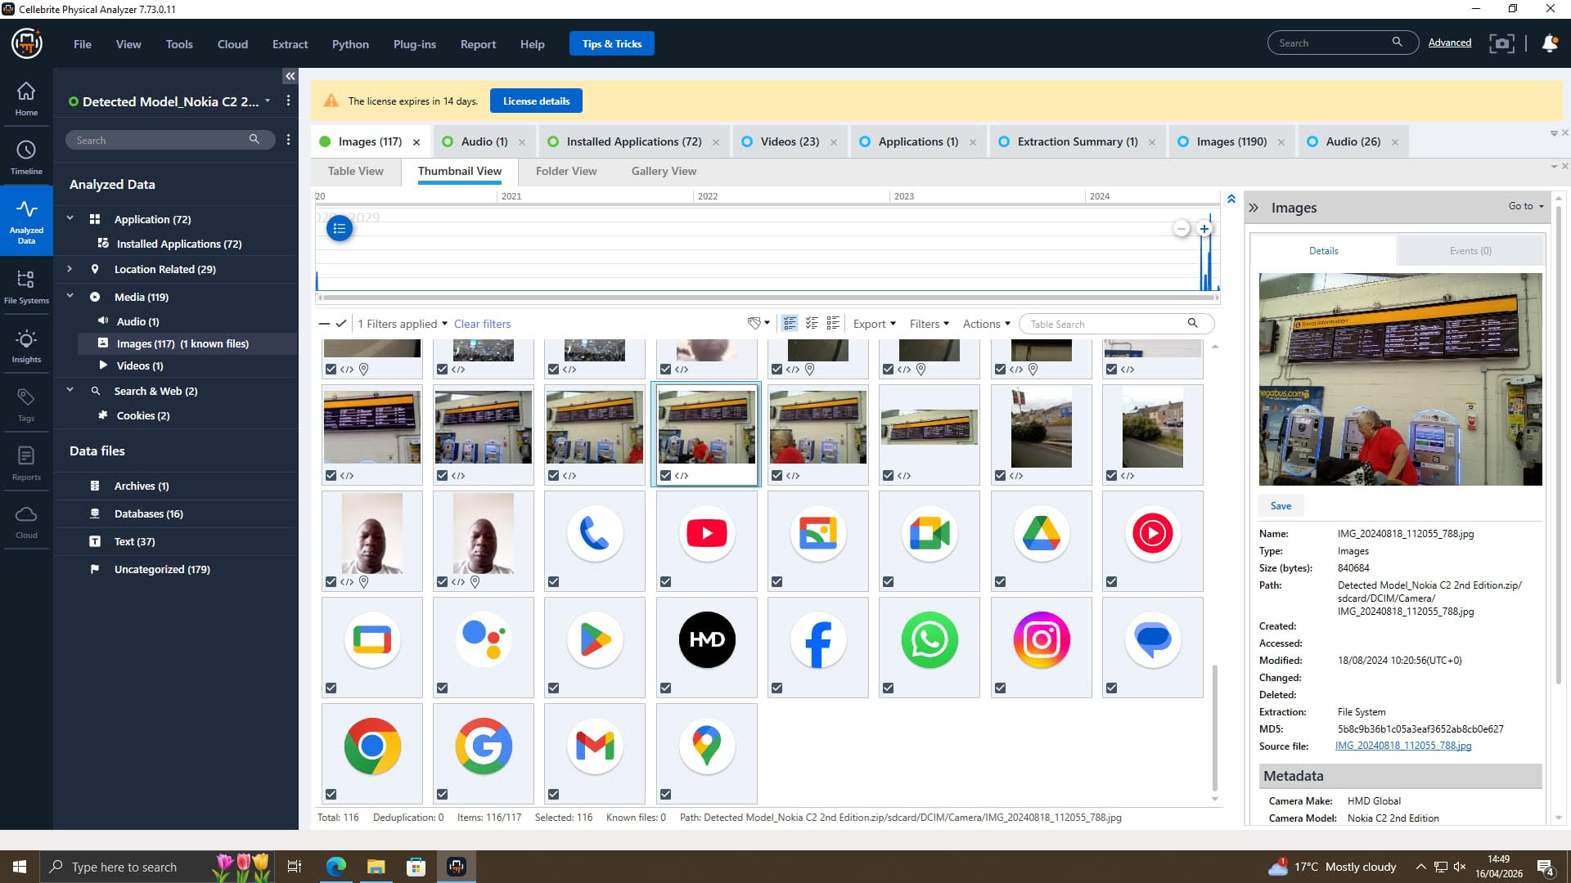
06
Media Evidence
We were successful in retrieving 14,150 images from the device.
They also found: 133 video and 61 audio(Durand and Briggs, 2025).
Files can be critical screenshots or documents, other audio or video recordings or even photos.
Numerous files suggest a high degree of usage.
Digital Forensic Investigation | Quantum Tech

Slide 12
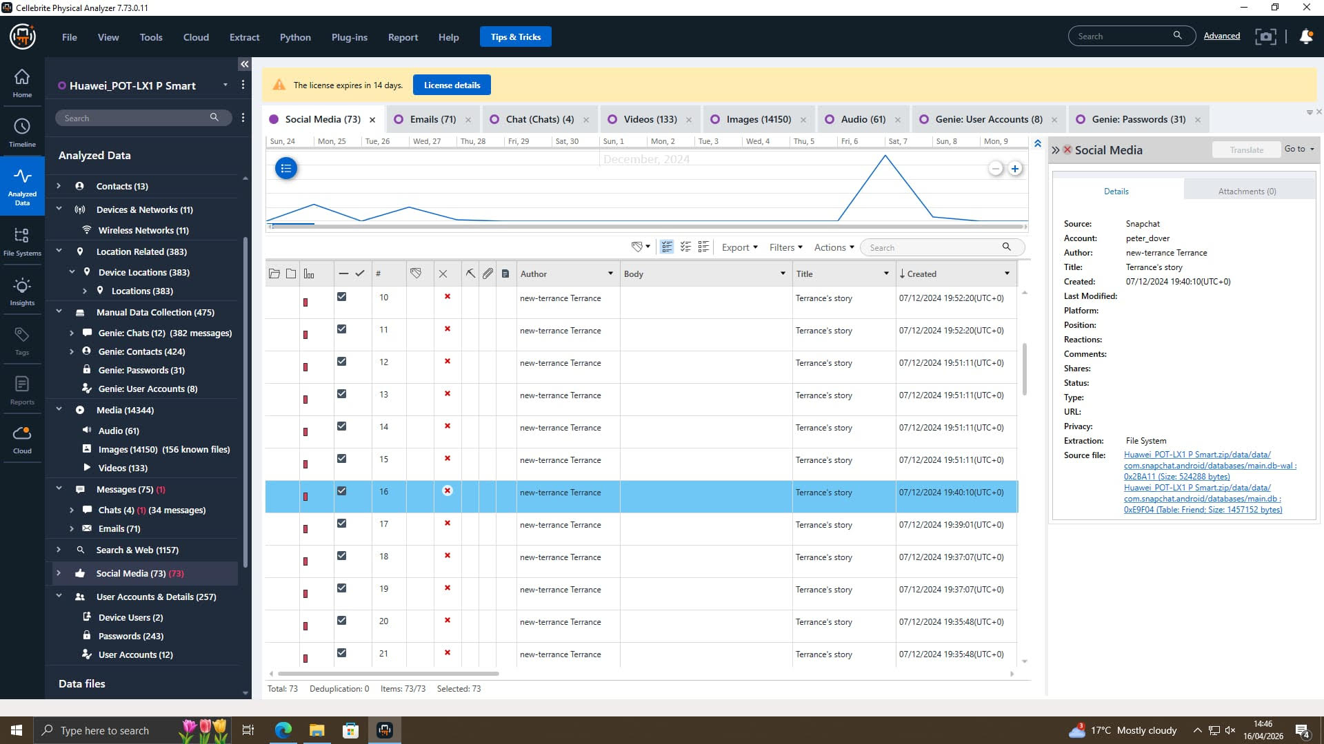
07
Social Media Evidence
Snapchat logs contained 73 social media artefacts.
The user name peter_dover was found within the app's data.
Social media accounts can establish online and device ownership.
Activity can offer additional modes of communication and contacts (Karahan et al., 2025).
Digital Forensic Investigation | Quantum Tech

Slide 13
08
Timeline
Date | Incident
17th Aug 2024 | Emma Create her Faje Accounts as a Peter Dover
21st Aug 2024 | First time Massages Between Emma and Joe
20th Nov 2024 | Emma Massages Joes for The Meetings and Dealing
22nd Nov 2024 | Joe Travelled to Manchester Confimes Ticket and GPS
31st Jan 2025 | 5M Offshore Transfer Confirm on Whatsapp and Facebook Massenger
Digital Forensic Investigation | Quantum Tech

Slide 14
08
Key Findings
• Successful device acquisition, with forensic integrity.
• Ownership evidenced via Gmail and social apps.
• Odd chats and excessive phone calls suggested concert of action.
• Corroborating evidence through GPS, media and apps.
Digital Forensic Investigation | Quantum Tech

Slide 15
09
Conclusions
Huawei phone held numerous digital artefacts.
Calls and accounts indicated secret negotiation, agreements.
Communications logs, accounts and locations enhanced links.
The phone is still extremely important to the ongoing investigation.
Digital Forensic Investigation | Quantum Tech

Slide 16
REF
References
Karahan, Ç., Velioğlu, H. and Arslan, Y., 2025. Unveiling the shadows: Anticipating future cyber risks and their impacts on businesses. In: Risk Management in the Digital Age. Cham: Springer.
Durand, D. and Briggs, K., 2025. Intellectual Property is Economic and National Security. Munich: EconStor. Available at: https://www.econstor.eu
Vajjhala, N.R. and Strang, K.D., 2025. Cybersecurity in Knowledge Management: Cyberthreats and Solutions. Cham: Springer.
Pernin, C.G., Weinbaum, C., Quimbre, F. and Mei, S., 2026. Research Security in Science and Technology. Santa Monica: RAND Corporation.
Jain, U., Sayal, A. and Bijalwan, A., 2026. Handbook of Security, Quantum Computing and Internet of Things (IoT). Singapore: Springer.
Choudhury, S., Costa, F., Manara, G. and Genovesi, S., 2025. Combating the counterfeit: A review on hardware-based anticounterfeiting technologies. Applied Sciences, 15(18), p.10298. Available at: https://doi.org/10.3390/app151810298
Digital Forensic Investigation | Quantum Tech

Slide 17
THANK YOU
Digital Forensic Investigation | Quantum Tech Patent Theft Case

