Slide 1
Certificate of Higher Education in Skills for the Workplace
Professional Career Development (LCLM 4005)
Session 2
Improving Self-awareness

Slide 2

We are Recording!
Notes:
Students should be informed that the class is being recorded
Lecturer should explain how students can access the class recordings on Microsoft Teams.

Slide 3
Previously…
We have;
Overview of the module
Tested existing knowledge

Slide 4
In this session…..
We will
Consider important of self awareness
Discuss
Assignment brief
Investigate some tools available for improving self-awareness
Discuss what is self-awareness
Discuss attributes of self awareness

Slide 5

Assignment Brief Breakdown
Notes:
Lecturer should show students where to find the assignment brief and associated guidance. Read through the briefs with the students and answer any questions. Feedback to the module lead if there are any common issues.

Slide 6
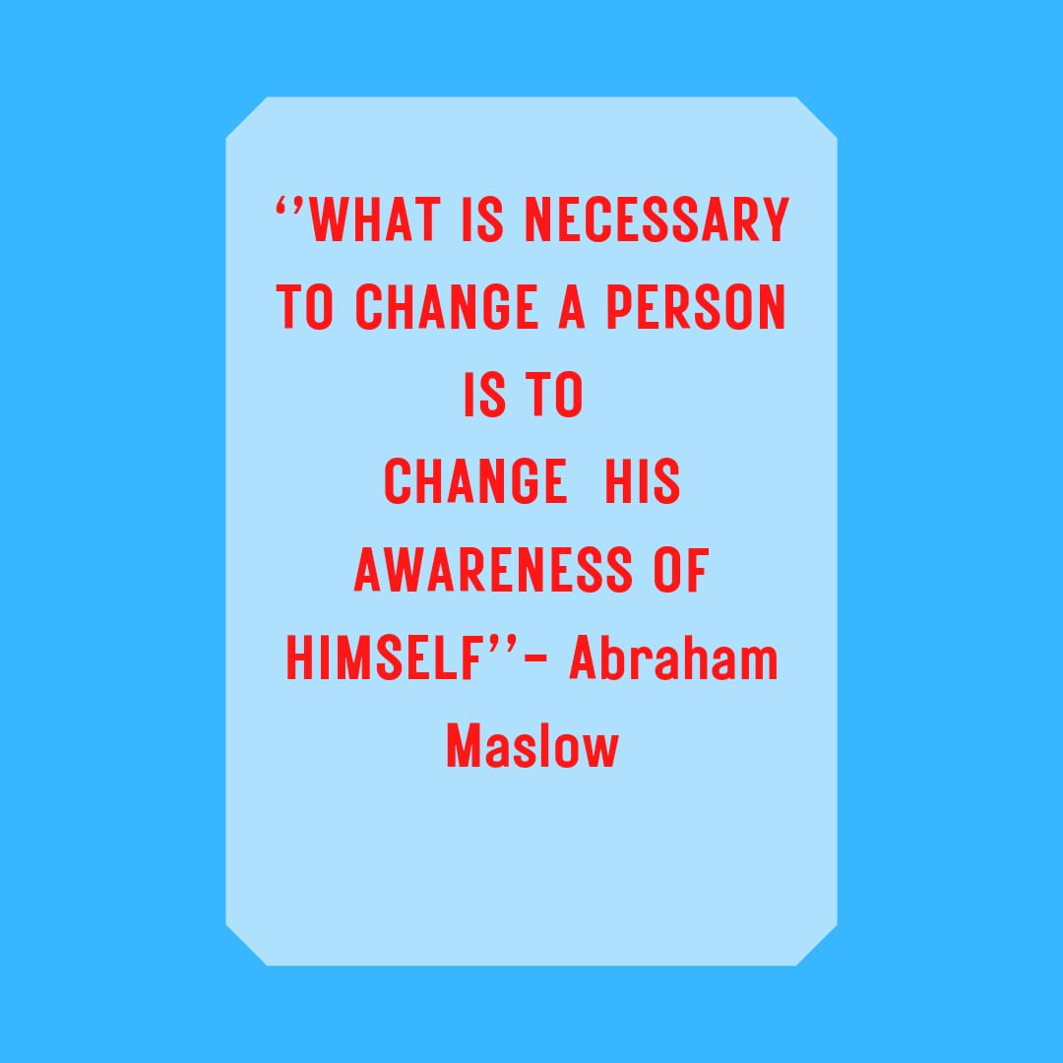
What is Self-Awareness?

Slide 7
What is self-awareness?
Self awareness is having a clear perception of yourself and your personality, including strengths, weakness, thoughts, beliefs, motivation, and emotions.
Self‐awareness represents the capacity of becoming the object of one’s own attention. In this state one actively identifies, processes, and stores information about the self (Alain Morin, 2011)

Slide 8
Why is self awareness Important
Self reflection
Recognise strength and weakness
Helps to manage your emotion
Consider other people
Take criticism

Slide 9
Startling Fact…
‘While 95% of people think they are self-aware, the real figure is closer to 10–15%’
(Eurich, 2017)

Slide 10
What is self-awareness? Cont.…
Four levels of consciousness
Levels | Definition
Unconsciousness | Being non-responsiveness to self and environment
Consciousness | Focusing attention on the environment; processing incoming external stimuli
Self-awareness | Focusing attention on the self; processing private and public self-information
Meta-self awareness | Being aware that one is self-aware

Slide 11
Self-evaluation process
Real self
Ideal self
Discrepancy
Self-criticism
Avoidance of self-awareness
Reducing discrepancy
Modifying Real self
Modifying Ideal self

Slide 12
Activity 2.1
Complete the self-awareness quiz by clicking the link on Moodle.
(15 Minutes)

Slide 13
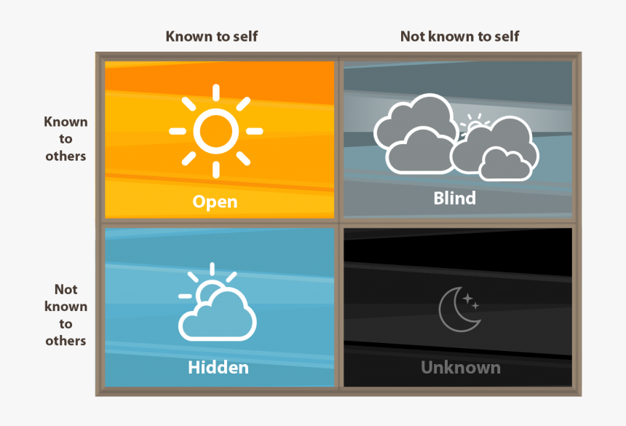
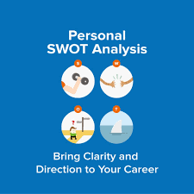

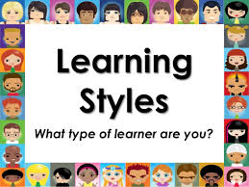
Tools for improving self-awareness
Personality Tests
Johari Window

Slide 14
PERSONAL SWOT ANALYSIS
SWOT analysis or also known as “strengths, weaknesses, opportunities, and threats analysis” is a great tool to assess yourself in order to plan your career.

Slide 15
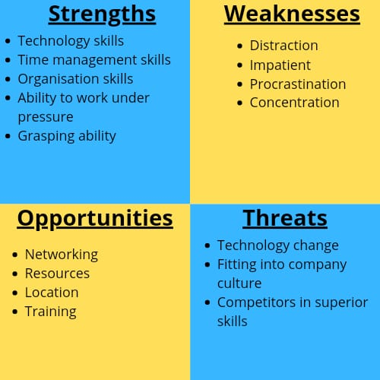
SWOT

Slide 16
Johari Window

Slide 17
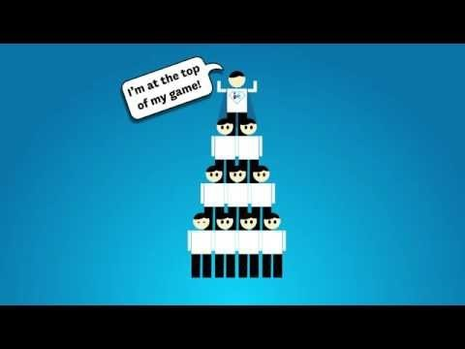
Activity 2.2. - The Johari window

Slide 18
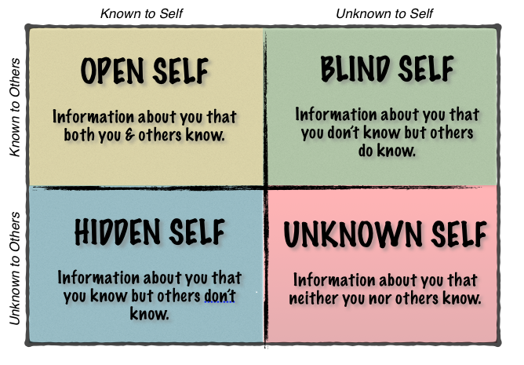
The Johari window

Slide 19
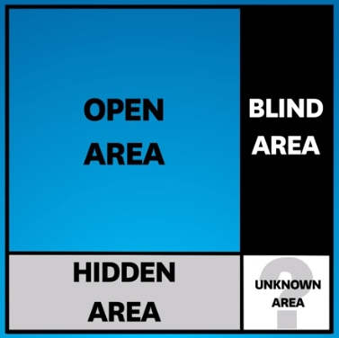
The Johari window
The objective is to enlarge the ‘open self’ and reduce ‘unknown self’

Slide 20


How can we enlarge the ‘open self’?
Notes:
Self disclosure – Example – when you join a new organisation, you reveal to your colleagues about a disability that you have. This will reduce the hidden area.
Feedback - Organisation will use multiples mechanisms to provide feedback such as performance appraisals/360 degree feedback etc. But you can obtain informal feedback from your peers/collegues whould would be able to provide you more insights about how they see yourself.

Slide 21
The Johari window - Activity
From what you have learned from The Johari Window
Ask your friend/family member to complete a Johari Window for you ( and you for them).

Slide 22
Personality Tests

Slide 23
Personality Test
What is Personality?
An individual’s predisposition to behave in a particular manner across a broad range of situations.
Personality Test
A valid and reliable tool which measures an individual’s predisposition to act an behave in particular ways.

Slide 24
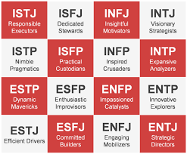
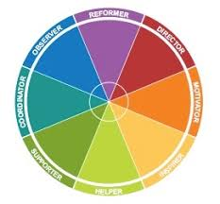
Types of Personality tests
The purpose of the Myers-Briggs Type Indicator (MBTI) personality inventory is to make the theory of psychological types described by C. G. Jung understandable and useful in people's lives.
Insights Discovery helps people understand themselves and their colleagues so that they can have more respectful, productive and positive working relationships, even across virtual boundaries.

Slide 25
Myers-Briggs Types Indicator
The Myers-Briggs system consists of four preference pairs that reflect different aspects of personality
Extraversion (E) – Introversion (I)
Sensing (S) – Intuition (N)
Thinking (T) – Feeling (F)
Judging (J) – Perceiving (P)

Slide 26
Activity 2.3
Complete the online personality test
20 Minutes
https://www.16personalities.com/free-personality-test
Ensure you save your results/take a screen shot. You will need it when you prepare your coursework

Slide 27
Activity reflection
Did you find any elements of your hidden-self?
Share (something that your are comfortable) with the class when you get the opportunity.
10 Minutes.

Slide 28
Activity 2.4 – A job to suite your personality
Use the internet to find suitable jobs for the type of personality you found from your test.
Would you prefer any of the suggested jobs? Why/Why not?
Be ready to share your thought with the class when the lecturer gives you the opportunity

Slide 29
Learning Styles

Slide 30
What are learning styles?
Learning styles refer to a range of competing and contested theories that aim to account for differences in individuals' learning.
The many theories share the proposition that humans can be classified according to their 'style' of learning, but differ in how the proposed styles should be defined, categorized and assessed.
A common concept is that individuals differ in how they learn.
Coffield, Frank; Moseley, David; Hall, Elaine; Ecclestone, Kathryn (2004). Learning styles and pedagogy in post-16 learning: a systematic and critical review (PDF). London: Learning and Skills Research Centre.

Slide 31
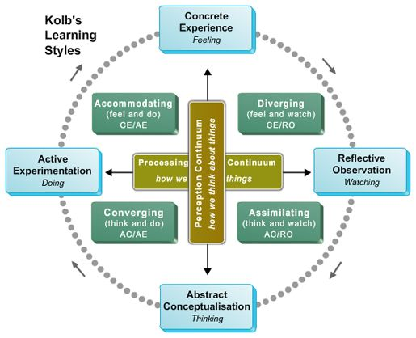
Different learning Styles - Kolb
Source: Ruspat 2010

Slide 32
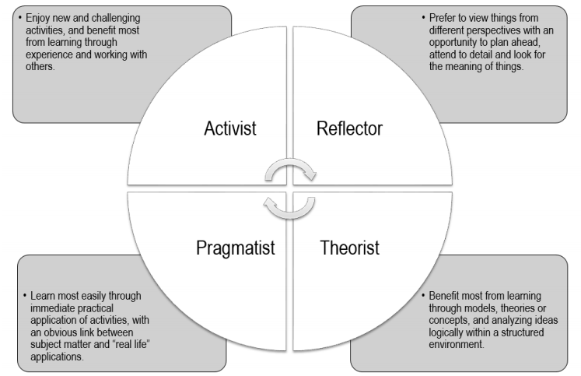
Different learning Styles – Honey & Mumford

Slide 33
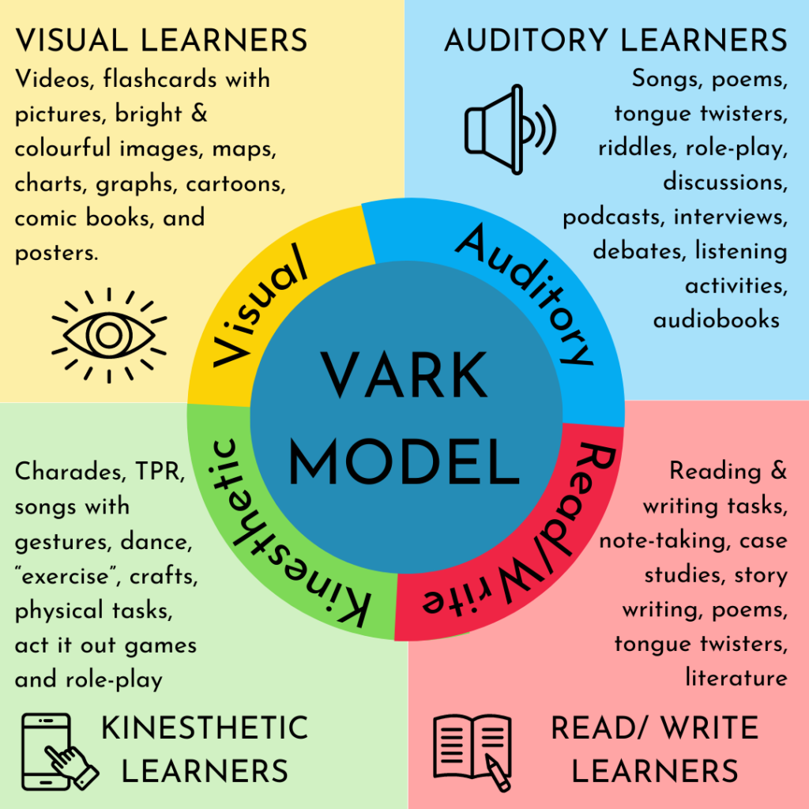
Different learning Styles – Neil Fleming
Source: Weber 2023

Slide 34
Activity 2.5 – What is your learning style?
Complete the quiz below to find out what your strongest learning style is.
http://www.educationplanner.org/students/self-assessments/learning-styles-quiz.shtml
15 Minutes

Slide 35
Activity 2.6 – Log entry
Create a log entry in your reflective journal explaining what your learning style is and if you agree with it or not.
Provide examples from previous experiences to support/defend your thoughts.
(Approximately 250 words – 15 Minutes)

Slide 36
Homework (Reminder)
Don’t Forget your Academic and Library InfoSkills homework
This will be reviewed next week

Slide 37

Summary
Can you explain what is ‘self-awareness?
Can you explain the self-awareness improvement process?
Can you identify some of the tools used for improving self awareness?

Slide 38

Next Session…..
Exploring employment opportunities.

Slide 39
Reference list
Morin, A. (2011). Self‐Awareness Part 1: Definition, Measures, Effects, Functions, and Antecedents. Social and Personality Psychology Compass. 5. 807 - 823. 10.1111/j.1751-9004.2011.00387.x.
Coffield, Frank; Moseley, David; Hall, Elaine; Ecclestone, Kathryn (2004). Learning styles and pedagogy in post-16 learning: a systematic and critical review (PDF). London: Learning and Skills Research Centre.
Cristal
Weber, C. (2023). Learning Styles – Effective Teaching Strategy or Harmful Neuromyth?
Available @: Learning Styles – Effective Teaching Strategy or Harmful Neuromyth? – Crystal Clear ESL (esl-curriculum.com) (Accessed on 28/04/2024)
Eurich, T., (2018). Working with People Who Aren’t Self-Aware, available @: Working with People Who Aren’t Self-Aware (hbr.org) (Accessed on 29/04/2024).
Maslow, A. H., (1943) “A Theory of Human Motivation.” Psychological Review, vol. 50, no. 4, pp. 370-396, http://psychclassics.yorku.ca/Maslow/motivation.htm
Ruspat, (2010). Investigating Learning Styles, available @: https://ruspat.wordpress.com/2010/12/05/investigating-learning-styles/, (Accessed 20/04/2024).

