Slide 1

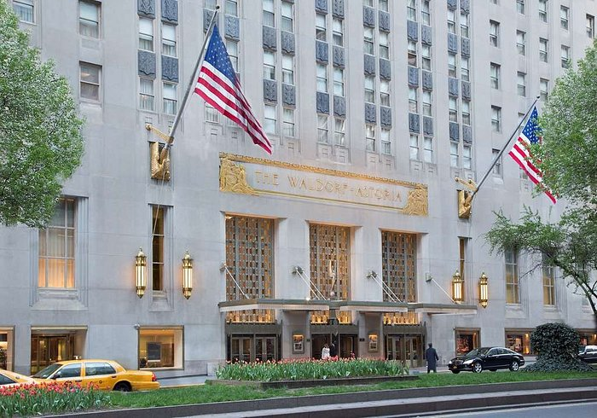

The Role and Importance of Quality Service, Hospitality and Guest Services within
Hotel Industry
(Waldorf Astoria)
STUDENT NAME: MIHAI DANIEL MIHALCEA
STUDENT ID: 2244870
Notes:
Hello, this is Mihai and my student ID 2244870. I am now presenting on The Role and Importance of Quality Service, Hospitality and Guest Services within Waldorf Astoria. Without delay, let’s get started.

Slide 2

Contents
Hotel Overview of Waldorf Astoria
Waldorf Astoria’s Main Consumers
Nature and Scope of Guests Services and Facilities
Role of Guests Services and Facilities
The Need to Consider the Role and Function of Guest Services
The Importance of Hospitality and How Waldorf Astoria exceeds Guest expectation
Conclusion
Notes:
The contents are as follows:
Hotel Overview of Waldorf Astoria
Waldorf Astoria’s Main Consumers
Nature and Scope of Guests Services and Facilities
Role of Guests Services and Facilities
The Need to Consider the Role and Function of Guest Services
The Importance of Hospitality and How Waldorf Astoria exceeds Guest expectation
Conclusion

Slide 3

Hotel Overview of Waldorf Astoria
Originally built by William Waldorf Astor and opening to the public in 1893 at the corner of 33rd Street and Fifth Avenue, the Waldorf Hotel is named after its original owner (Walford, 2023).
The Waldorf Astoria's blend of luxury, convenience, and unsurpassed hospitality
Waldorf Astoria has 50 luxury hotels and resorts in prime locations worldwide (Walford, 2023).
  Waldorf Astoria is a global hospitality leader with an annual turnover of over $3.5 billion (Walford, 2023).
Notes:
Hotel Overview of Waldorf Astoria
Originally built by William Waldorf Astor and opening to the public in 1893 at the corner of 33rd Street and Fifth Avenue, the Waldorf Hotel is named after its original owner (Walford, 2023). John Jacob Astor IV, a cousin and a relative adversary of William's, built a hotel next to the latter's establishment that was taller four years after it was finished. In a bustling metropolis, the Waldorf Astoria is a magnificent retreat. This legendary hotel exudes richness with its timeless beauty and outstanding service. The Waldorf Astoria blends classic charm with modern comforts, drawing from years of history (Walford, 2023). A world of refinement and comfort awaits guests in its spacious lobby with crystal chandeliers and marble floors. The hotel's luxurious rooms and suites are designed to satisfy the most discerning tourist. Guests can relax in the spa, dine at the hotel's restaurants, or enjoy city views from the rooftop terrace. The Waldorf Astoria's blend of luxury, convenience, and unsurpassed hospitality makes your stay unforgettable, whether you're here for business or pleasure. Waldorf Astoria has 50 luxury hotels and resorts in prime locations worldwide (Walford, 2023). These businesses are in North America, Europe, Asia, and beyond. Waldorf Astoria is a global hospitality leader known for its great service and luxurious experiences, with an annual turnover of over $3.5 billion (Walford, 2023).

Slide 4




Waldorf Astoria’s Main Consumers
Wealthy Tourists
Business executives
Celebrities and Entertainers
Notes:
Now, let’s find out Waldorf Astoria’s Main Consumers
Wealthy Tourists: The iconic Waldorf Astoria in New York City caters to a distinguished clientele. Its main customers are wealthy travelers from throughout the world seeking luxury. These travelers choose the Waldorf Astoria for its prime Manhattan location and luxurious reputation. The luxurious rooms and excellent service make their stay a true New York experience (Bodet, Anaba and Bouchet, 2017).
Business executives: Top CEOs and corporate leaders prefer the Waldorf Astoria. Its luxurious meeting spaces, cutting-edge conference facilities, and concierge services cater to high-stakes meetings, negotiations, and conferences in the city (Peng and Chen, 2019). Business travelers love the hotel's seamless blend of luxury and functionality, which ensures competent service.
Celebrities and Entertainers: The Waldorf Astoria has long hosted celebrities and entertainers seeking a discreet but luxurious getaway. Its privacy and exclusivity attract actors, musicians, and other celebrities. The hotel's apartments offer privacy from the public, and its proximity to New York's entertainment scene attracts industry professionals (Denysenko and Breus, 2020).

Slide 5

Waldorf Astoria’s Main Consumers
Government officials and diplomats
High Society and Socialites
Wedding parties
Notes:
Government officials and diplomats: Diplomats, ambassadors, and government officials visiting New York City for international meetings and talks choose the Waldorf Astoria because of its proximity to the UN headquarters (Merlo and de Souza João, 2022). Diplomatic guests can do business in privacy and comfort due to its elegant atmosphere and strict security.
High Society and Socialites: The Waldorf Astoria attracts New York's elite. The city's elite attend its galas and parties. It is part of the city's social calendar since its enormous ballrooms and lavish settings provide for dazzling events (Murasiranwa, Nield and Ball, 2020).
Wedding parties: A fairytale wedding often takes place at the Waldorf Astoria due to its gorgeous wedding settings and exceptional service. Brides and grooms choose the hotel for its grandeur and attention to detail, which makes weddings spectacular.

Slide 6

Nature and Scope of Guests Services and Facilities
Luxury Accommodations
Dining Excellence
Guest rooms and suites at the Waldorf Astoria are luxuriously designed and furnished with the best materials and attention to detail. Many rooms have luxury mattresses, marble baths, and city views (Bodet, Anaba and Bouchet, 2017).
The hotel has many fine dining alternatives. The elegant Peacock Alley delivers gourmet food, while other restaurants serve steaks and international cuisine. Guests who prefer dining in their suites can order room service 24/7.
Spa and Wellness
Concierge Services
Meeting and event spaces
A magnificent spa and wellness center of the Waldorf Astoria offers massages, facials, and other revitalizing treatments. The fitness center has modern equipment and personal trainers to help customers stay healthy (Jones, 2022).
The hotel's concierge team helps visitors book great meals, Broadway tickets, and transportation. They help guests plan and enjoy their New York City stay.
The Waldorf Astoria has huge ballrooms, boardrooms, and exquisite salons for events. Professional event planners help organise weddings, corporate meetings, seminars, and social gatherings at these sites (Peng and Chen, 2019).
Figure: Nature and Scope of guest services (Self Made)
Notes:
Nature and Scope of Guests Services and Facilities
The Waldorf Astoria is known for its top-notch guest services and facilities for discerning guests. A summary of Waldorf Astoria guest services and facilities:
Luxury Accommodations: Guest rooms and suites at the Waldorf Astoria are luxuriously designed and furnished with the best materials and attention to detail. Many rooms have luxury mattresses, marble baths, and city views (Bodet, Anaba and Bouchet, 2017).
Dining Excellence: The hotel has many fine dining alternatives. The elegant Peacock Alley delivers gourmet food, while other restaurants serve steaks and international cuisine. Guests who prefer dining in their suites can order room service 24/7.
Spa and Wellness: A magnificent spa and wellness center of the Waldorf Astoria offers massages, facials, and other revitalizing treatments. The fitness center has modern equipment and personal trainers to help customers stay healthy (Jones, 2022).
Concierge Services: The hotel's concierge team helps visitors book great meals, Broadway tickets, and transportation. They help guests plan and enjoy their New York City stay.
Meeting and event spaces: The Waldorf Astoria has huge ballrooms, boardrooms, and exquisite salons for events. Professional event planners help organise weddings, corporate meetings, seminars, and social gatherings at these sites (Peng and Chen, 2019).

Slide 7
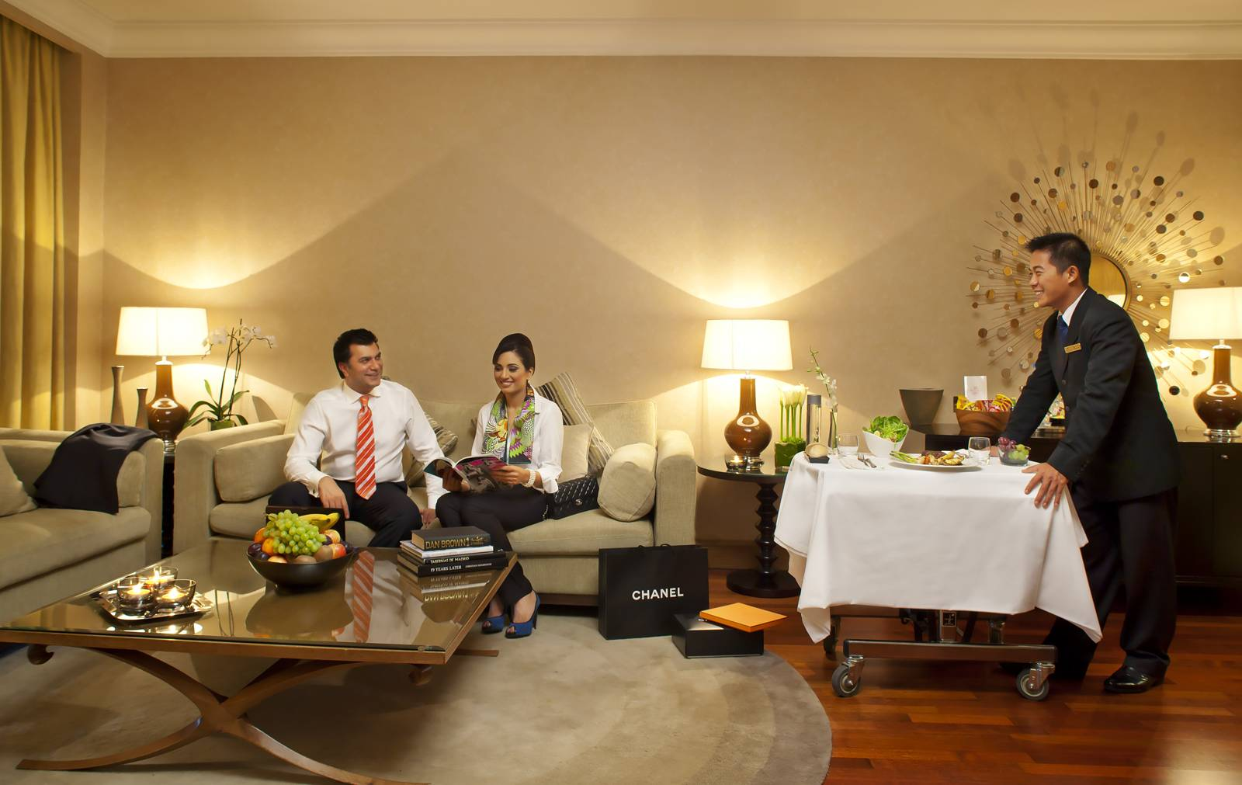
Nature and Scope of Guests Services and Facilities
Business Services: Business travelers can use the hotel's high-speed internet, audiovisual equipment rental, and well-equipped business center.
Transportation: The Waldorf Astoria provides limousine services, airport transfers, and valet parking to help guests traverse the city (Merlo and Souza João, 2022).
Privacy and security: The hotel prioritizes security and privacy, guaranteeing that officials and celebrities may relax.
Culture and entertainment partnerships: The Waldorf Astoria partners with New York City museums and theaters to provide guests special tours and early access to famous plays.
Notes:
Business Services: Business travelers can use the hotel's high-speed internet, audiovisual equipment rental, and well-equipped business center. It helps corporate guests work smoothly.
Transportation: The Waldorf Astoria provides limousine services, airport transfers, and valet parking to help guests traverse the city (Merlo and Souza João, 2022). The hotel's Manhattan location puts public transportation and major attractions within reach.
Privacy and security: The hotel prioritizes security and privacy, guaranteeing that officials and celebrities may relax. Secure safeguards are discreet yet effective (Ramanathan, 2021).
Culture and entertainment partnerships: The Waldorf Astoria partners with New York City museums and theaters to provide guests special tours and early access to famous plays.

Slide 8

Role of Guests Services and Facilities
Enhancing Guest Experience: Guest services and facilities offered by Waldorf Astoria aim to improve the guest experience.
Meeting Diverse Needs: Waldorf Astoria hotels serve diverse clients with different needs and tastes (Murasiranwa, Nield and Ball, 2020).
Ensuring Comfort and Convenience: Guest comfort and convenience in Waldorf Astoria are enhanced by well-appointed rooms, comfortable bedding, superb dining, and fast transit.
Providing Personalization: Guest services are crucial to understanding guest preferences and customising the experience.
Creating a Memorable Stay: Excellent guest services and facilities offered by Waldorf Astoria seek to make guests' stays unforgettable (Bodet, Anaba and Bouchet, 2017).
Notes:
In this slide, I am going to describe Role of Guests Services and Facilities
Role of Guest Services and Facilities
Guest services and facilities at hotels like the Waldorf Astoria are crucial to a pleasant and comfortable stay. Services and facilities play these crucial roles:
Enhancing Guest Experience: Guest services and facilities offered by Waldorf Astoria aim to improve the guest experience. They want guests to feel welcome, pampered, and catered to during their stay, making their stay unforgettable.
Meeting Diverse Needs: Waldorf Astoria hotels serve diverse clients with different needs and tastes. Guest services and facilities are tailored to leisure travellers, business leaders, and couples commemorating special occasions (Murasiranwa, Nield and Ball, 2020). The hotel meets visitors' different needs by offering a variety of services and amenities.
Ensuring Comfort and Convenience: Comfort and convenience are key in hospitality. Guest comfort and convenience in Waldorf Astoria are enhanced by well-appointed rooms, comfortable bedding, superb dining, and fast transit.
Providing Personalization: The Waldorf Astoria, like other premium hotels, emphasizes customized service. Guest services are crucial to understanding guest preferences and customising the experience. This includes providing accommodation amenities, personalized meal recommendations, or unique requests.
Creating a Memorable Stay: Excellent guest services and facilities offered by Waldorf Astoria seek to make guests' stays unforgettable. From warm greetings to thoughtful gestures and surprises, hotels aim to make guests feel unique and build memories (Bodet, Anaba and Bouchet, 2017).

Slide 9

Role of Guests Services and Facilities
Supporting Special Events: Guest services and facilities offered by Waldorf Astoria help guests holding weddings, conferences, and celebrations at the hotel succeed by providing support and amenities.
Ensuring Safety and Security: To give guests peace of mind, guest services include security and safety (Ramanathan, 2021).
Enhancing Business Travel: Guest services offered by Waldorf Astoria boost business travelers' productivity and efficiency.
Promoting Loyalty and Repeat Business: Guest pleasure and loyalty often result from excellent service and facilities offered by Waldorf Astoria (Watson, 2018).
Differentiating the Brand: Quality and distinctive guest services and facilities offered by Waldorf Astoria set the hotel apart.
(Ramanathan, 2021).
Notes:
Supporting Special Events: Guest services and facilities offered by Waldorf Astoria help guests holding weddings, conferences, and celebrations at the hotel succeed by providing support and amenities. Event planning, food, and conference technical assistance are included.
Ensuring Safety and Security: To give guests peace of mind, guest services include security and safety. Secure access, surveillance, and emergency-trained staff are included (Ramanathan, 2021).
Enhancing Business Travel: Guest services offered by Waldorf Astoria boost business travelers' productivity and efficiency. Business amenities include well-equipped business centers, high-speed internet, and concierge services (Peng and Chen, 2019).
Promoting Loyalty and Repeat Business: Guest pleasure and loyalty often result from excellent service and facilities offered by Waldorf Astoria. Happy customers return and recommend the hotel, boosting its long-term prosperity (Watson, 2018).
Differentiating the Brand: Quality and distinctive guest services and facilities offered by Waldorf Astoria set a hotel apart in the competitive hospitality business. Luxury hotels like the Waldorf Astoria are noted for their magnificence and individual service.

Slide 10

The Need to Consider the Role and Function of Guest Services
Due to the Waldorf Astoria's dedication to elegance and hospitality, guest services must be understood.
These renowned brand guests want the best service, and the guest services team is key to meeting and surpassing those expectations.
This prestigious brand is known for exclusivity and excellent service, so any deviation could damage its image (Jones, 2022).
Service is crucial in a competitive business with many high-end options for discerning travelers.
The Waldorf Astoria's long-term success is due to guests who return and promote it due to its excellent service.
Notes:
The Need to Consider the Role and Function of Guest Services
Due to the Waldorf Astoria's dedication to elegance and hospitality, guest services must be understood. Waldorf Astoria is known for its elegance and sophistication, and guest services are its foundation. Guest services are Waldorf Astoria's top priority for a memorable stay (Merlo and Souza João, 2022). These renowned brand guests want the best service, and the guest services team is key to meeting and surpassing those expectations. Guests are met personally and treated like royalty from the start. Additionally, Waldorf Astoria guest services help create and sustain the hotel's prestige. This prestigious brand is known for exclusivity and excellent service, so any deviation could damage its image (Jones, 2022). Thus, maintaining the Waldorf Astoria's brand identity requires knowing guest services' rigorous attention to detail and commitment to quality. In the competitive luxury hotel industry, Waldorf Astoria guest services stand out. Service is crucial in a competitive business with many high-end options for discerning travelers. Guests choose the Waldorf Astoria for its luxury amenities and exceptional guest services that make their stay memorable. Customer loyalty and repeat business depend on Waldorf Astoria guest services. The Waldorf Astoria's long-term success is due to guests who return and promote it due to its excellent service. The Waldorf Astoria must understand guest services to preserve its elegance and excellence, stand out in a competitive market, and keep its valued guests happy (Bader, 2021). These services define the Waldorf Astoria experience and make a stay unforgettable.

Slide 11
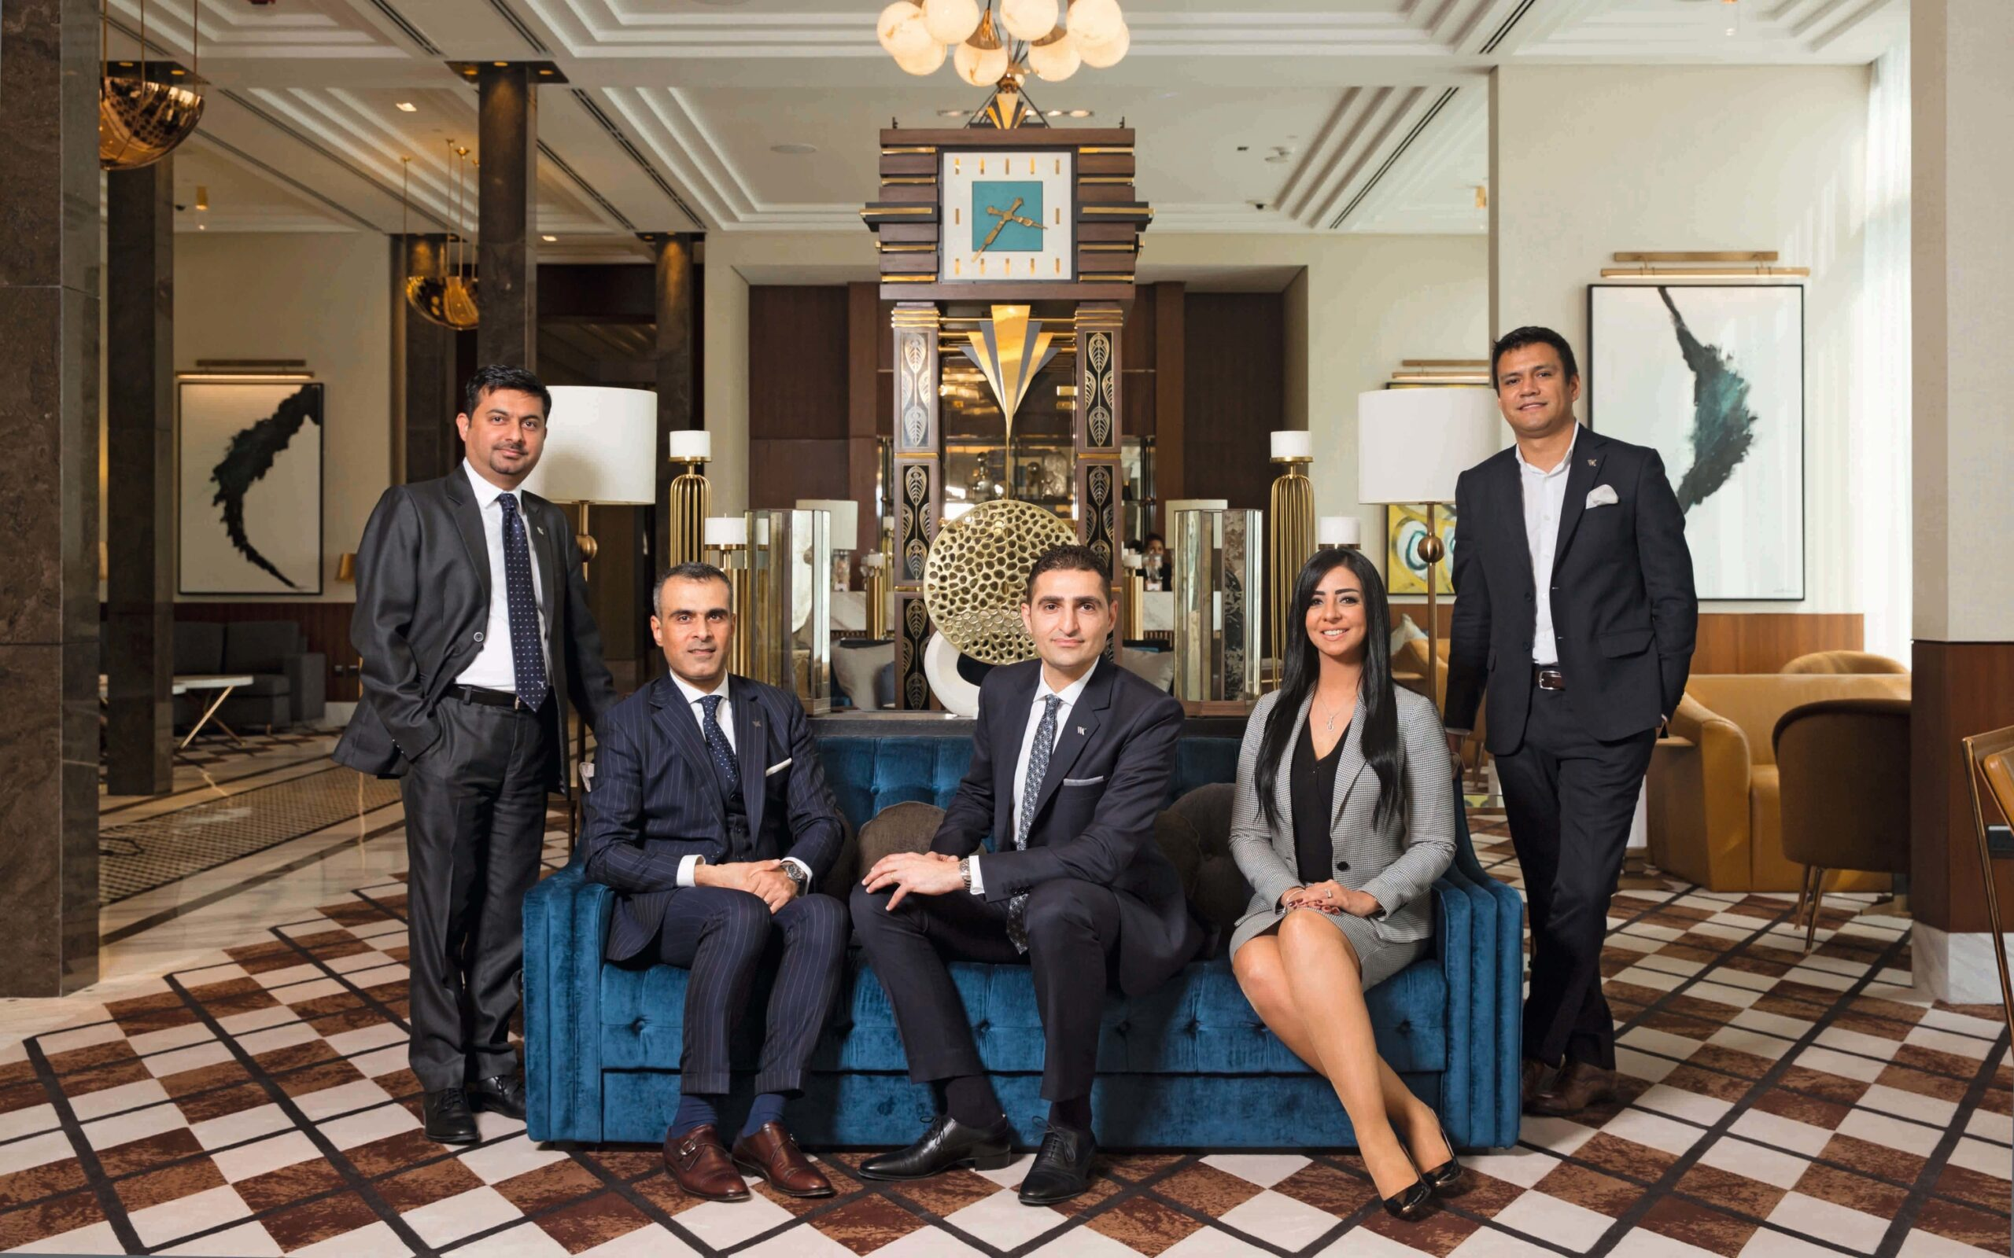
The Importance of Hospitality and How Waldorf Astoria exceeds Guest expectation
Hospitality is about making others feel welcome, comfortable, and included.
Providing outstanding hospitality means creating memorable visitor experiences
Hospitality promotes cultural understanding and tranquility.
Hospitality drives customer pleasure, social harmony, and personal well-being
Notes:
The Importance of Hospitality and How Waldorf Astoria exceeds Guest expectation
Hospitality is crucial to society, business, and personal relationships. Hospitality is about making others feel welcome, comfortable, and included. It's key to success in hotels, restaurants, and tourism (Bodet, Anaba and Bouchet, 2017). Providing outstanding hospitality means creating memorable visitor experiences, not merely providing a bed or a food. Hospitality is crucial in business. It boosts brand reputation, trust, and loyalty. Customers are more inclined to return, promote a firm, and give great reviews, which can boost profits. In a globalized society where diverse people interact, hospitality promotes cultural understanding and tranquility. Personal hospitality shows kindness and sensitivity. It enhances our lives, promotes social relationships, and fosters belonging. Hospitality underpins business and society (Davies, 2021). It drives customer pleasure, social harmony, and personal well-being via generosity, respect, and empathy. Recognizing its value can make the world more inclusive, prosperous, and compassionate.

Slide 12
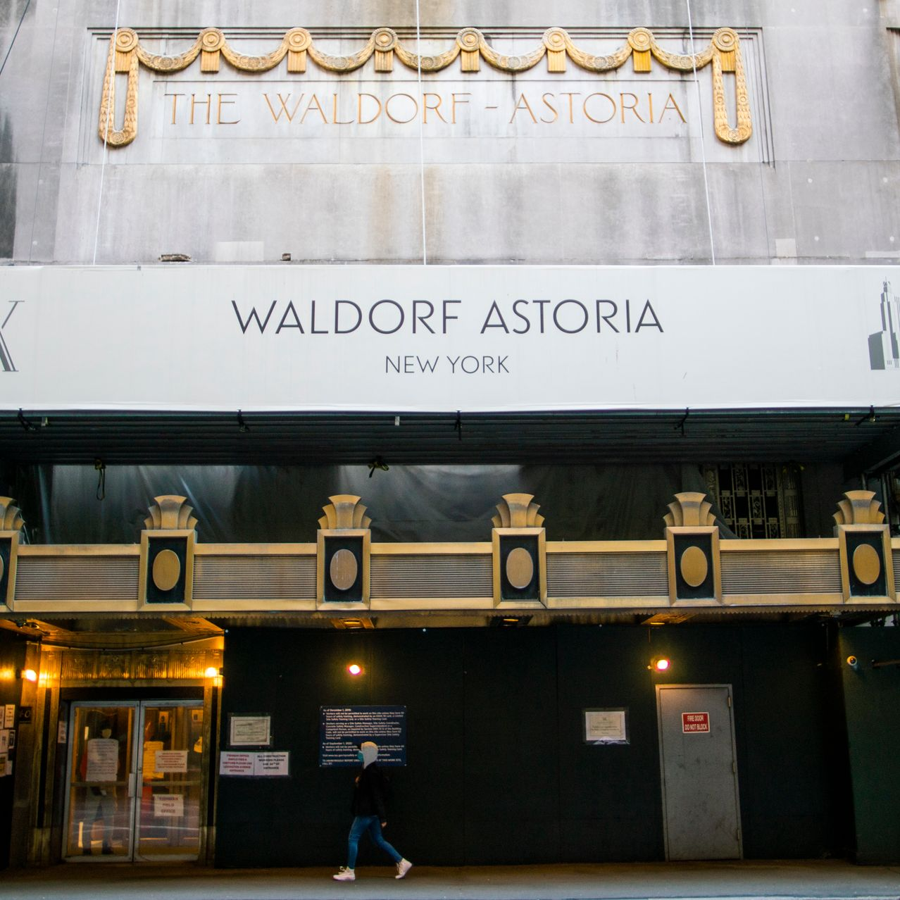
The Importance of Hospitality and How Waldorf Astoria exceeds Guest expectation
Waldorf Astoria thoughtfully curates a classic and modern luxury experience that exceeds guest expectations.
The lavish lobby greets guests with customized service and a warm welcome that sets the tone for their stay.
Waldorf Astoria's guest services team anticipates and meets guests' needs, making them feel cherished and cared for (Merlo and Souza João, 2022).
From the original Waldorf Astoria in New York, the brand has maintained its famous service, instilling trust and tradition in visitors.
(Jones, 2022)
Notes:
The Importance of Hospitality and How Waldorf Astoria exceeds Guest expectation
Waldorf Astoria thoughtfully curates a classic and modern luxury experience that exceeds guest expectations. The lavish lobby greets guests with customized service and a warm welcome that sets the tone for their stay (Jones, 2022). From the luxurious rooms with sophisticated décor to the world-class dining selections that cater to varied culinary preferences, the hotel's commitment to great service is obvious in every aspect. Waldorf Astoria's guest services team anticipates and meets guests' needs, making them feel cherished and cared for (Merlo and Souza João, 2022). From the original Waldorf Astoria in New York, the brand has maintained its famous service, instilling trust and tradition in visitors. Waldorf Astoria also blends current technology with timeless luxury. The brand's traditional beauty and sophistication are combined with modern amenities and digital conveniences (Bader, 2021). Whether they're relaxing by the pool, getting a spa treatment, or discovering the hotel's culture, Waldorf Astoria visitors have everything they want. Waldorf Astoria exceeds guest expectations by combining heritage, luxury, innovation, and personalized service. Waldorf Astoria fulfills guests' dreams by continually giving an amazing experience.

Slide 13
CONCLUSION
In conclusion, Waldorf Astoria epitomizes hospitality luxury and quality.
Since its founding in 1893, this legendary brand has exceeded visitor expectations with its distinctive blend of classic charm and modern amenities.
Waldorf Astoria stands apart in a competitive industry with its superior guest services, customized care, and attention to detail.
The brand's versatility and adaptability allow it to serve wealthy tourists, business leaders, celebrities, and diplomats.
The hotel's world-class accommodations, dining, spa, and wellness amenities give visitors everything they need for a wonderful stay.
The success of Waldorf Astoria's exceptional hospitality is due to its guest services, which keep guests coming back for an unforgettable experience.
Notes:
Conclusion
In conclusion, Waldorf Astoria epitomizes hospitality luxury and quality. Since its founding in 1893, this legendary brand has exceeded visitor expectations with its distinctive blend of classic charm and modern amenities. Waldorf Astoria stands apart in a competitive industry with its superior guest services, customized care, and attention to detail. The brand's versatility and adaptability allow it to serve wealthy tourists, business leaders, celebrities, and diplomats. The hotel's world-class accommodations, dining, spa, and wellness amenities give visitors everything they need for a wonderful stay. The success of Waldorf Astoria's exceptional hospitality is due to its guest services, which keep guests coming back for an unforgettable experience.

Slide 14
REFERENCES
Bader, E.E., 2021. Sustainable hotel business practices. Journal of Retail & Leisure Property, 5, pp.70-77.
Bodet, G., Anaba, V. and Bouchet, P., 2017. Hotel attributes and consumer satisfaction: A cross-country and cross-hotel study. Journal of Travel & Tourism Marketing, 34(1), pp.52-69.
Davies, B., 2021. Industrial organization the UK hotel sector. Annals of tourism research, 26(2), pp.294-311.
Denysenko, M. and Breus, S., 2020. The impact of tourism development in the hotel business in the context of management. Economic strategies for the development of society.
Jones, C., 2022. Facilities management in medium‐sized UK hotels. International Journal of Contemporary Hospitality Management, 14(2), pp.72-80.
Merlo, E.M. and de Souza João, I., 2022. Consumers attribute analysis of economic hotels: An exploratory study. African Journal of Business Management, 5(21), p.8410.
Murasiranwa, E., Nield, K. and Ball, S., 2020. Hotel Service Quality and Business Performance in five hotels belonging to a UK Hotel Chain.
P. Crick, A. and Spencer, A., 2021. Hospitality quality: new directions and new challenges. International Journal of Contemporary Hospitality Management, 23(4), pp.463-478.
Peng, N. and Chen, A., 2019. Examining consumers’ luxury hotel stay repurchase intentions-incorporating a luxury hotel brand attachment variable into a luxury consumption value model. International Journal of Contemporary Hospitality Management, 31(3), pp.1348-1366.
Ramanathan, U. and Ramanathan, R., 2021. Guests' perceptions on factors influencing customer loyalty: An analysis for UK hotels. International Journal of Contemporary Hospitality Management, 23(1), pp.7-25.
Slattery, P., 2002. Finding the hospitality industry. Journal of hospitality, leisure, sport and tourism education, 1(1), pp.19-28.
Walford (2023). Waldorf Astoria Hotels and Resorts - Luxury Hotels. [online] Hilton. Available at: https://www.hilton.com/en/brands/waldorf-astoria/.
Watson, S., 2018. Conceptual model for analysing management development in the hospitality industry: A UK perspective. International Journal of Hospitality Management, 27(3), pp.414-425.
Notes:
References
Bader, E.E., 2021. Sustainable hotel business practices. Journal of Retail & Leisure Property, 5, pp.70-77.
Bodet, G., Anaba, V. and Bouchet, P., 2017. Hotel attributes and consumer satisfaction: A cross-country and cross-hotel study. Journal of Travel & Tourism Marketing, 34(1), pp.52-69.
Davies, B., 2021. Industrial organization the UK hotel sector. Annals of tourism research, 26(2), pp.294-311.
Denysenko, M. and Breus, S., 2020. The impact of tourism development in the hotel business in the context of management. Economic strategies for the development of society.
Jones, C., 2022. Facilities management in medium‐sized UK hotels. International Journal of Contemporary Hospitality Management, 14(2), pp.72-80.
Merlo, E.M. and de Souza João, I., 2022. Consumers attribute analysis of economic hotels: An exploratory study. African Journal of Business Management, 5(21), p.8410.
Murasiranwa, E., Nield, K. and Ball, S., 2020. Hotel Service Quality and Business Performance in five hotels belonging to a UK Hotel Chain.
P. Crick, A. and Spencer, A., 2021. Hospitality quality: new directions and new challenges. International Journal of Contemporary Hospitality Management, 23(4), pp.463-478.
Peng, N. and Chen, A., 2019. Examining consumers’ luxury hotel stay repurchase intentions-incorporating a luxury hotel brand attachment variable into a luxury consumption value model. International Journal of Contemporary Hospitality Management, 31(3), pp.1348-1366.
Ramanathan, U. and Ramanathan, R., 2021. Guests' perceptions on factors influencing customer loyalty: An analysis for UK hotels. International Journal of Contemporary Hospitality Management, 23(1), pp.7-25.
Slattery, P., 2002. Finding the hospitality industry. Journal of hospitality, leisure, sport and tourism education, 1(1), pp.19-28.
Walford (2023). Waldorf Astoria Hotels and Resorts - Luxury Hotels. [online] Hilton. Available at: https://www.hilton.com/en/brands/waldorf-astoria/.
Watson, S., 2018. Conceptual model for analysing management development in the hospitality industry: A UK perspective. International Journal of Hospitality Management, 27(3), pp.414-425.

Slide 15

THANK YOU
Notes:
That’s all from me. I would like to hear feedbacks. Thank you.

