Slide 1


CB600F Upgrade Plan
1/10

Slide 2
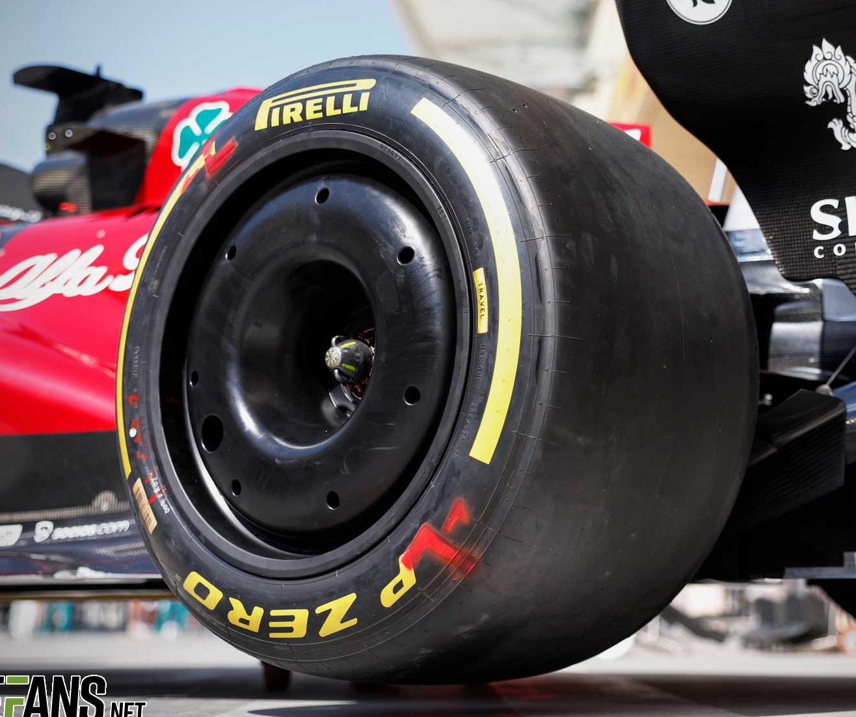
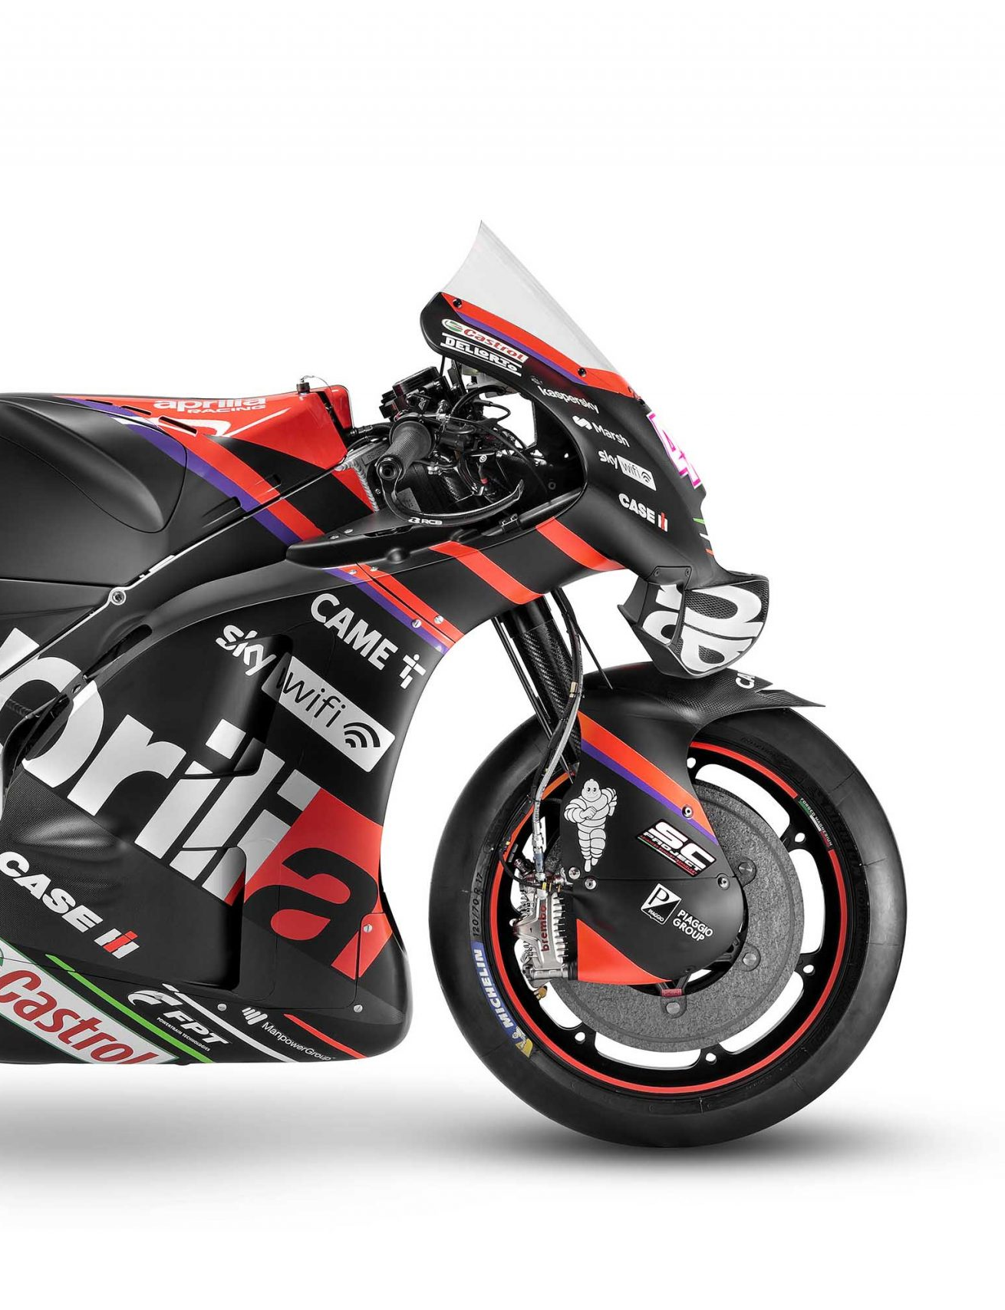
Project Introduction
2/10
Project aims and criteria
Reduced drag, weight & variables.
Increased effective power
Improved control

Slide 3

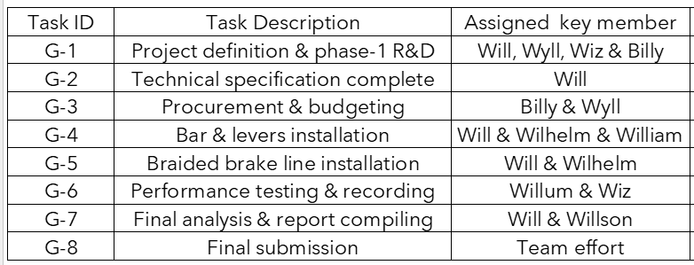
Timing Plan &
Team Organisation
3/10

Slide 4
Literature Survey
4/10
Research, References, Bibliography.

Slide 5
Experimental Work
5/10

Slide 6
Analytical Work
6/10

Slide 7
Modelling Work
7/10

Slide 8
Results
8/10

Slide 9
Conclusions
9/10

Slide 10
Ongoing Work
10/10
Timing plan to project completion in May.

