Slide 1
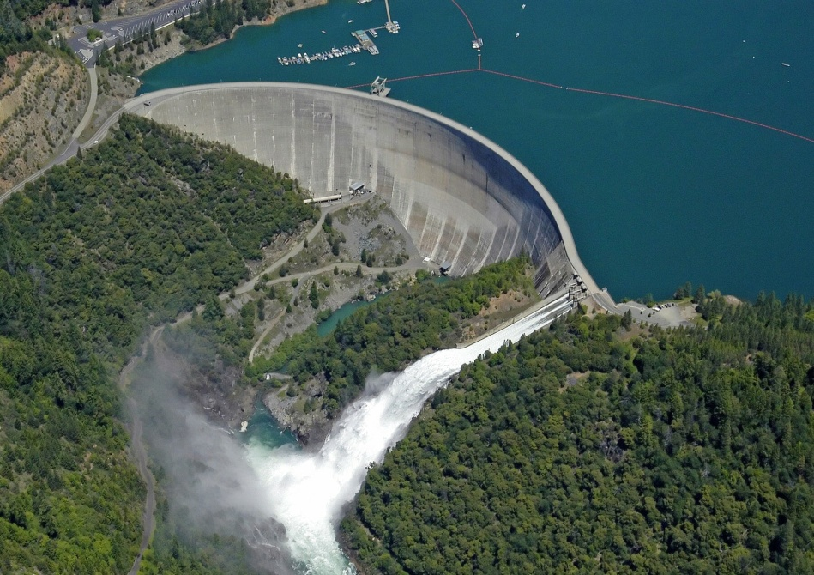
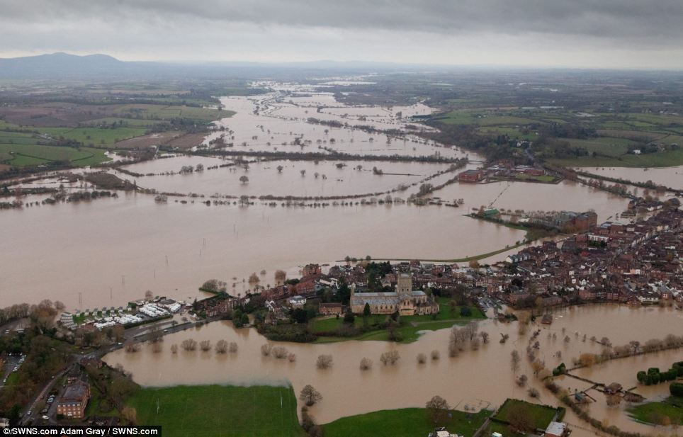
River Management
why do we need to manage rivers?
What are THE CAUSES AND EFFECTS OF FLOODING?
HOW DO WE MANAGE RIVERS?
Notes:
Chris has asked me to give a 30 Minute presentation and video lesson for this module.
I will be talking about River Management strategies (some of the processes involves may be similar to coastal).
Firstly looking at the reasons why we manage rivers, then looking in depth about the causes and effects of flooding.
Then, I will present various river management strategies, what they are and how effective they are.

Slide 2
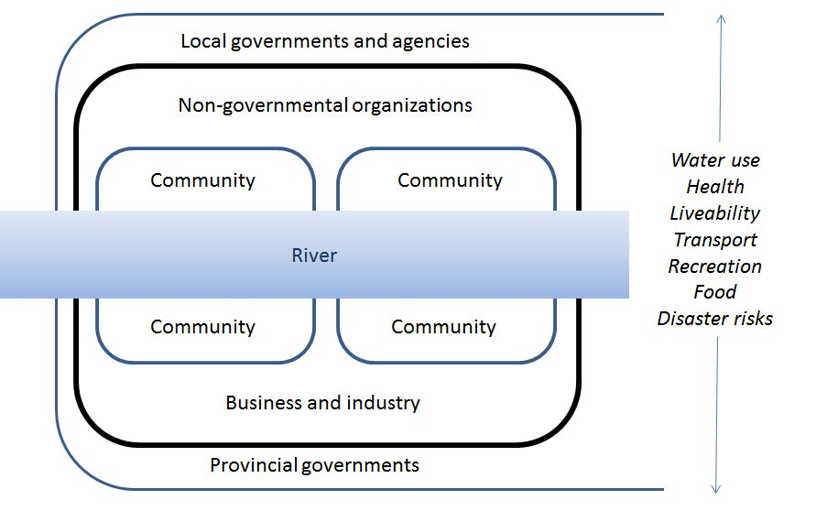
The Need to Manage Rivers
Source of Water
Population and Settlements
Environmental Protection
Human Health
Habitats and Ecosystems
Agriculture and Industry
Transportation
Recreation and Tourism
Impacts & Causes (Srinivas, 2016)
Notes:
Create a class brainstorm of ideas and go over any ones that the class miss out.
Water sources are very important, many people live near rivers as they tend to flow through cities, river pollution is an environmental problem, pollution could impact health, many species rely on rivers, agriculture and industry rely on them, public transport and historical moving of goods, river cruises.
Figure shows how rivers can impact communities, livelihoods etc.

Slide 3
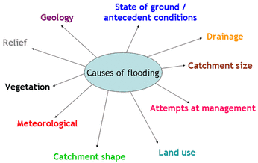
Causes of Flooding
Floods occur due to Physical and Human Causes.
Physical Causes are summarised in the figure below;
Human causes include population growth pressures, deforestation, soil erosion, urbanisation and poor river management.
Causes of Floods (FSC)
Notes:
Physical involves the work of the enivronment, but human is due to human intervention.
Only cover a few from the figure. Ground may not be able to absorb water, small catchment means less water absorbed (and vice versa), if management is poor then there will be floods, more vegetation intercepts rainwater.

Slide 4
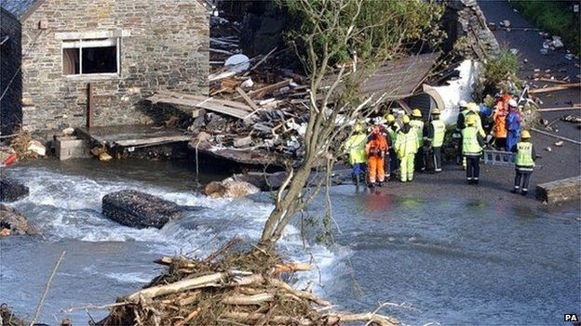
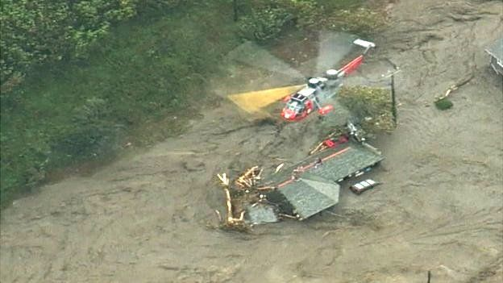
Effects of Flooding
Case Study: Boscastle Flood, Cornwall
Date: 16th August 2004
200mm of rain fell in 24 hours, causing the River Valency to burst its banks
58 properties were flooded and 4 were destroyed completely
100 people airlifted to safety by 7 helicopters
Following the incident, £10 million was spent on flood defences
Source: BBC (2014)
Notes:
Floods had been recorded in Boscastle prior to this incident.
A large amount of rain fell on the peaks of the steep sided valley, causing a large amount of water to flow downstream.
Flood defences include widening the river, raising the car park, installing river channels and more.
Video – 3 Rivers flowing onto Boscastle, Cars flowing out to sea (Some sunk, others didn’t and were recovered)

Slide 5
Strategies to Manage Rivers
There are two main strategies involved in river management. These are;
Hard Engineering: Involves artificial structures, is generally more expensive and could impact the surrounding environment.
Soft Engineering: A more natural approach, which is usually cheaper and takes the local environment into consideration.
Notes:
Again, this is very similar to coastal management strategies.

Slide 6
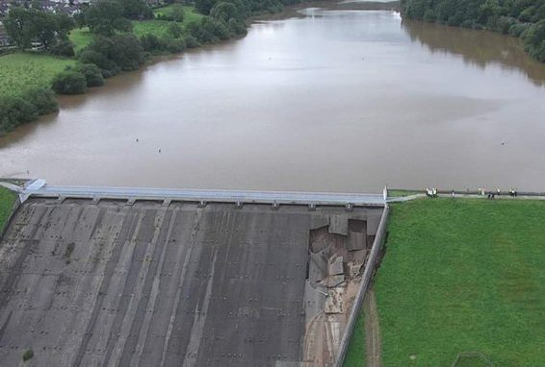
Hard Engineering
1) Dams
Description: Built along a river to hold water and control flooding, which creates a reservoir behind. Water may be controlled and released from it.
Toddbrook Resevoir & Dam, Derbyshire
Advantages | Disadvantages
Can generate hydroelectric power | Very expensive to build
Reservoirs can be used for recreation (e.g. Tourist attractions) | Sediment becomes trapped, causing downstream erosion
 | During construction, settlements may be lost and habitats could be flooded
Notes:
Dam in the image is near the village of Whaley Bridge, which was at risk of flooding earlier this year due to the dam failing.

Slide 7
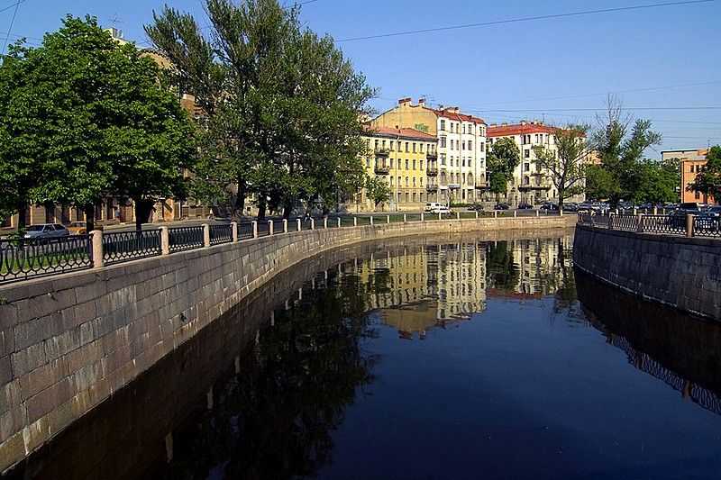
Hard Engineering
2) Embankments
Description: Increases the height of the river bank to allow more water to flow. Made of concrete that is resistant to erosion.
Karpovka River Embankment, St. Petersburg
Advantages | Disadvantages
Enables the containment of flood water within the river | Poor appearance
Can be cheap (especially if they are manmade levees) | Flood risk increases
Encourages construction and development on nearby floodplains | There could be significant damage if an overflow occurs
Notes:
Some embankments appear better than others. The one in the picture is a good example.

Slide 8
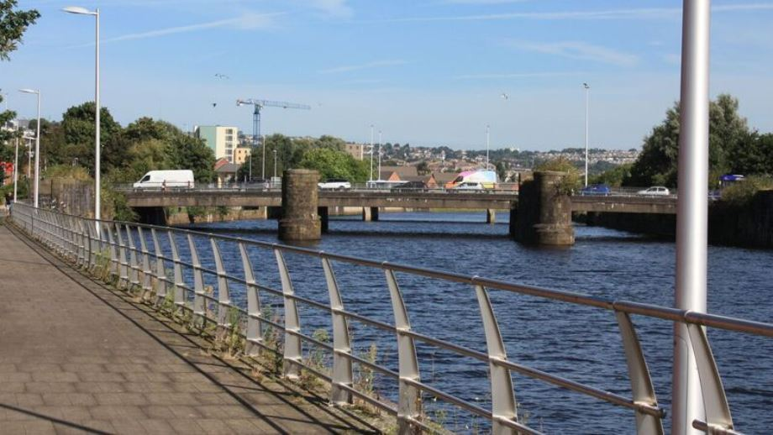
Hard Engineering
3) Channelisation
Description: Straightens, widens and/or changes the direction of the river channel, which allows it to carry more water and can divert water away from areas at risk of flooding.
River Tawe Channelisation, Swansea
Advantages | Disadvantages
More water may be held within the river | The speed of the river may increase, which could create a flood risk
Flood risk in build-up areas may decrease | Maintenance is necessary to prevent it from reverting to its previous channel
River navigation is made easier and quicker
Notes:
Tawe’s original course exited near Swansea castle, but was modified and now exits at its present location.

Slide 9
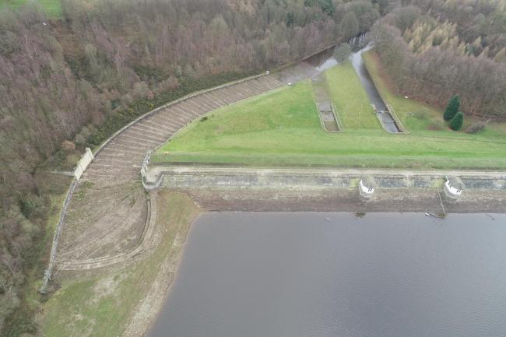
Hard Engineering
4) Spillways
Description: Water flows into a relief channel, where it is absorbed or may re-enter the river at a later stage.
River Washburn Spillway, Yorkshire
Advantages | Disadvantages
May prevent flooding by removing water from the river channel | Can be expensive
Are equipped with floodgates to control the amount of water entering | The spillway could also flood due to high water levels
 | If the water re-enters the channel, the downstream areas could be at risk
Notes:
Describe what happens in the image if the river floods and how water moves down the spillway.

Slide 10
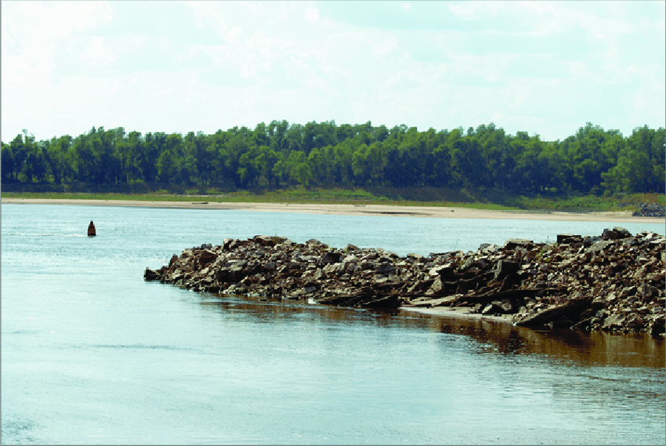
Hard Engineering
5) Wing Dykes
Description: Gaps are placed in the river channel in groups, which builds up sediment behind them. Also, the water is forced to flow faster.
Mississippi River Wing Dyke, USA
Advantages | Disadvantages
Water moves away quickly from flood risk areas | Greater risk of flooding downstream
Improved navigation | Only useful in sparsely populated areas
Prevents water from building up
Notes:
Less common example, but are very common along the Mississippi.

Slide 11
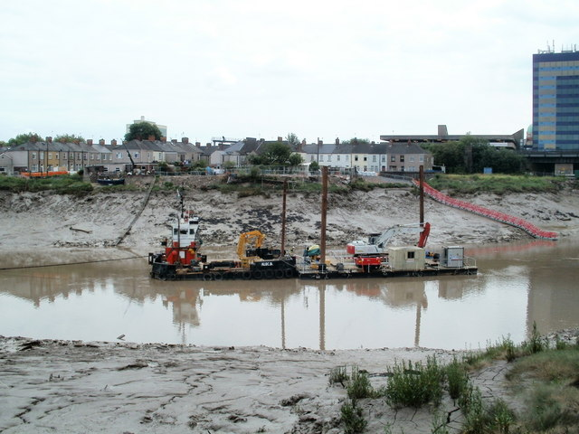
Soft Engineering
1) Dredging
Description: This involves collecting sediment at the bottom of the river and moving it elsewhere, which deepens the river.
River Usk Dredging, Newport
Advantages | Disadvantages
The river capacity increases as it can hold more water, lessening the flood risk | Due to deposition, dredging has to be carried out on a regular basis
 | It could affect ecosystems and wildlife within the river
 | The river may speed up and this could create a flood risk downstream
Notes:
Dredging also occurs out at sea.

Slide 12
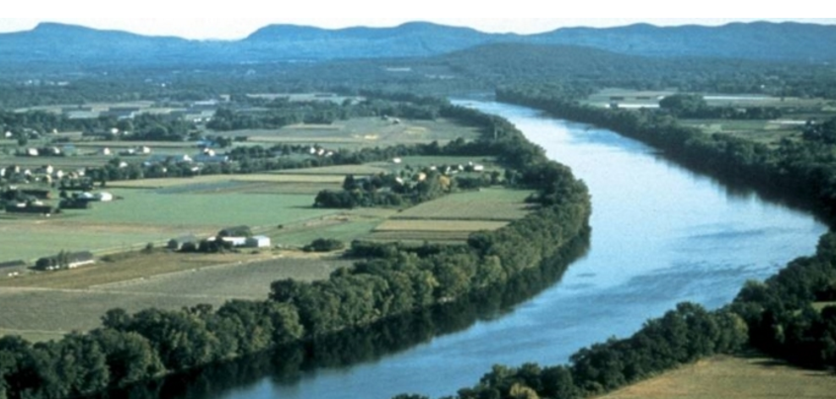
Soft Engineering
2) Afforestation
Description: Planting trees and vegetation close to the river, which can intercept rainwater.
Connecticut River Afforestation, USA
Advantages | Disadvantages
Lowers river discharge, which lowers the risk of flooding | Planting may ease the risk of flooding, but will not solve the problem
Improves the environmental and ecological quality of the area
Cheap
Notes:
Notice how the trees line the river like an embankment all the way up.

Slide 13
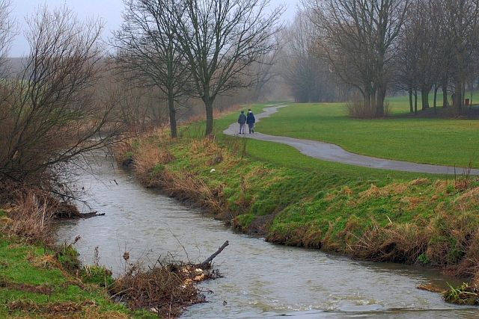
Soft Engineering
3) River Restoration
Description: The process of reverting a river to its original course. This occurs if land protection near the river is no longer needed.
River Skerne Restoration, Darlington
Advantages | Disadvantages
Reduces the risk of flooding downstream | Controversial, as flooding could possibly occur in the area
Low maintenance costs | Could affect people, communities and settlements in the area
Reverting to the natural course prevents environmental damage by hard methods
Notes:
Skerne is a tributary to the River Tees.

Slide 14
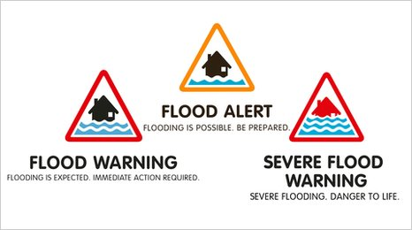
Soft Engineering
4) Warning Systems
Description: Rivers are monitored and warnings are issued to the public by TV, radio, internet, etc. to allow preparation.
Flood Warning Categories, UK
Advantages | Disadvantages
This gives people enough time to protect their property | Some warnings are not accessible for many people
Allows people to save their most important possesions | Flash floods prevent effective warning due to their speed of occurrence
 | They are limited to warning only and cannot mitigate against floods
Notes:
Warnings are put into categories to allow people to prepare accordingly.

Slide 15
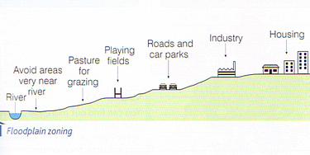
Soft Engineering
5) Floodplain Zoning
Description: Introducing policies to control land use on floodplains, which reduces the risk of flooding to buildings.
Floodplain Zoning Diagram
Advantages | Disadvantages
Reduced flood risk applies to the valuable areas as they are further away | Sometimes, it is not possible to change the existing land uses
Less damage caused to buildings, so there are less insurance claims | Planners need to decide on a flood type before planning the area
 | There may be backlash against planning restrictions in areas lacking housing
Notes:
Describe the diagram, noting how the more important land uses are found further up and away from the river itself.

