Slide 1
Willow farm
(Working title)
1500128_CAMF6001

Slide 2
D.I Megan Williams move to Llanberem to start a new job, during her first week a body is found murdered.
Newly promoted D.I Megan Williams moves from Cardiff to the village of Llanberem. During her first week in Llanberem, local nurse Mali Jenkins is found murdered in her home, Willow Farm. D.I Williams heads up the investigation, her first solo murder case, with help from P.C Gareth Morgan. Megan is convinced that Owain Jenkins, the victims husband is to blame.

Slide 3
Aims
To create a murder mystery script, between 40 – 60 minutes long
To create detailed characters
To have interesting plot points which build suspense throughout the story

Slide 4

Research
Films and Television programs
Characters
Location

Slide 5
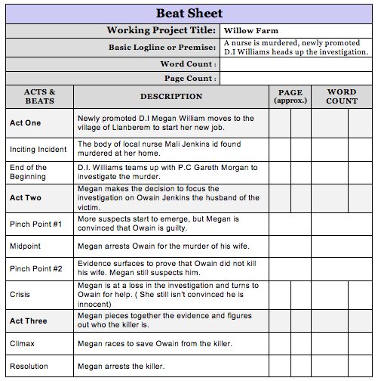
Planning
Beat Sheet
Treatment
Step Outline

Slide 6

Character profiles
D.I. Megan Williams
D.O.B – 16/04/82
Recently moved from Cardiff to Llanberem
Newly promoted to Deceive Inspector

Slide 7


Suspect - Owain Jenkins
D.O.B – 28/05/1983
Married to the victim
Farmer
Suspect - Rhodri Lewis
D.O.B – 12/02/1988
Owain’s younger half brother
Primary school teacher

Slide 8


Suspect - Lowri Edwards
D.O.B – 18/06/1985
Best friend to victim
Engaged to Rhodri Lewis
Suspect - Dr. Catrin Evans
D.O.B – 03/10/80
Works with the victim in the hospital

Slide 9


Gareth Morgan
D.O.B – 26/01/1988
Police officer
Rugby player
Victim – Mali Jenkins
D.O.B – 02/10/1985
Nurse
Married to Owain Jenkins

Slide 10
Location /Setting
Set in Wales
Fictional village
Set in the Autumn

Slide 11
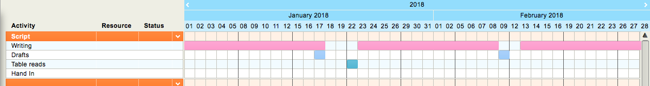
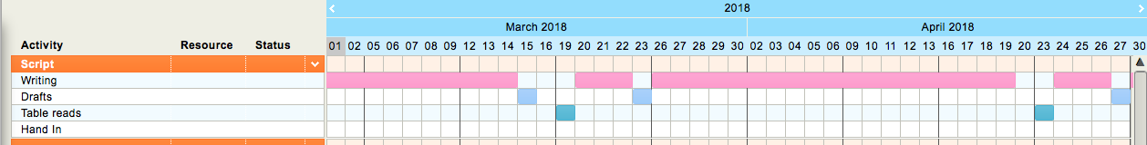
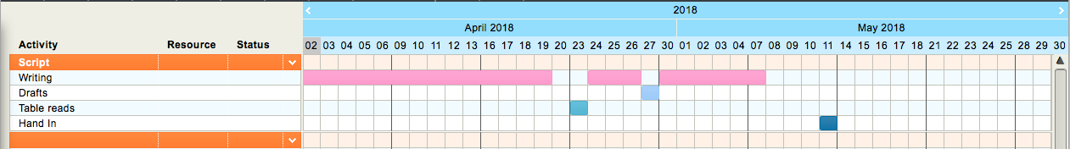
Schedule

Slide 12
Issues
Time management
Narrative construct
Dialogue

Slide 13
Thank you for Listening.
Any Questions?

