Slide 2
IP ADDRESSING
Network and Cybersecurity
Essentials (ACCA4024)
Applied Computing - WISA

Slide 3
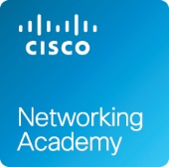
Previous Class
Network Types
Data Transmission
Bandwidth and Throughput
Clients and Servers
Network Components
Wireless Networks
Local Network Connections
Network Documentation
During our previous lectures, we discussed the concept of network, its entities (data, devices), metrics (bandwidth, throughput), roles (server, client/host) and components.
Finally, the importance of documenting the network was elaborated.

Slide 4
Continuing the network concepts, we discussed different types of network cables used in a home network. Network cables are very vital component which helps in establishing a successful network.
Further to that, the need of standard protocols in a network and discuss in detail about the communication principles used with in the network.
After having a better understanding on the connecting components and the rules in establishing the communication, I hope you will deep dive and look into the Ethernet frame and the purpose of routing.
Previous Class
Cables
Communication Principles
Ethernet
Routing

Slide 5
Labs Checkpoint
Install Packet Tracer 8.0
Complete the Introduction to Packet Tracer Course via Cisco Networking Academy
Design and Connect a Simple Network and determine IP Address
Analyze MAC Address
Analyze Wired and Wireless Network Connection and Analyze Network Connectivity. (Address resolution protocol (ARP), PING (ICMP), TRACERT).
So far Tutorial session: Sign up to Introduction to Packet Tracer Course, Download the latest packet tracer file, Install and complete a simple activity. Simultaneously, complete the 10 hours independent learning and get your certificate/ digital badge.
https://www.netacad.com/courses/packet-tracer/introduction-packet-tracer

Slide 6
In this lecture, you will understand the purpose of logical addressing (IP Address). How IP address are classified/ derived, how they are organized, how they are used etc. In addition to that, you will also learn about the different methods of assigning IP addresses (static and dynamic). When talking about IP addressing, it is also very important to look at the concept of NAT. Finally, the features of IPv6 will be discussed.
This session will prepare you to deep dive into advanced network configurations in your future modules.
In this session, we shall also discuss TCP, UDP functions, Domain Name System and other services.
Today’s Class
IP ADDRESSING
  IPv4: Purpose, Conversion, Operation, Subnet Mask, Classes, Range
  Static and Dynamic Addressing
  DHCPv4
  Network Address Translation
  IPv6
TCP, UDP Functions
Domain Name System
Other Services
Tutorial session:
Understand, calculate and apply IPv4 address in a hybrid network (Wired and Wireless)
Observe URL to IP Address conversion

Slide 7
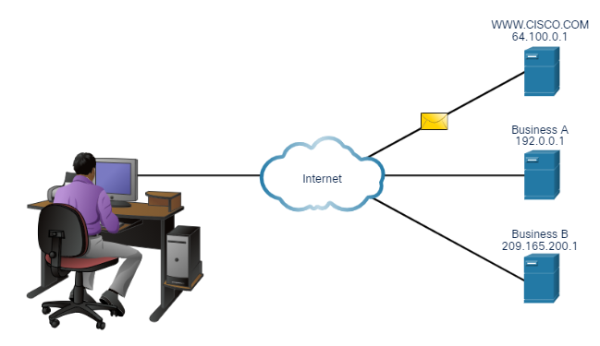
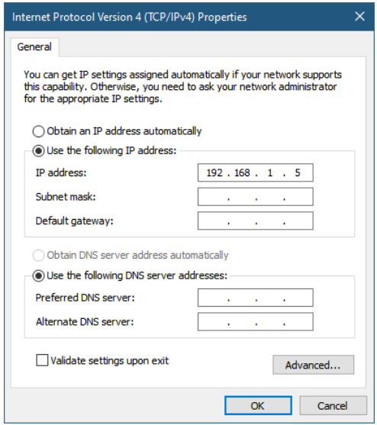
IP Addressing - Purpose
The IPv4 address is a logical network address that identifies a particular host. Must be properly configured and unique within the LAN and world
An IPv4 address is assigned to the network interface connection for a host such as workstations, servers, network printers, and IP phones.
Router interfaces that provide connections to an IP network will also have an IPv4 address.
Every packet sent across the internet has a source and destination IPv4 address.
Required by networking devices to ensure the information gets to the destination and any replies are returned to the source

Slide 8
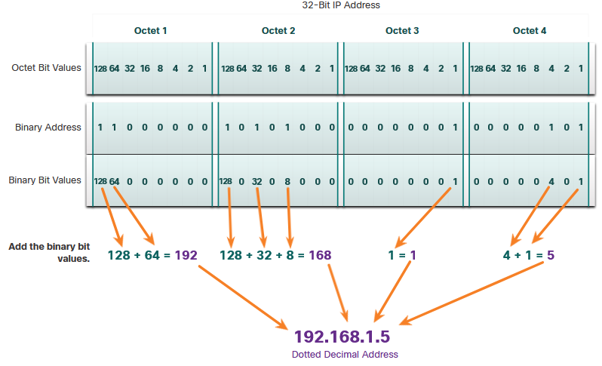
IP Addressing - Conversion
An IPv4 address is a series of 32 binary bits (ones and zeros).
The 32 bits are grouped into four 8-bit bytes called octets.
To make the IPv4 address easier to understand, each octet is presented as its decimal value, separated by a decimal point or period. This is referred to as dotted-decimal notation.
When a host is configured with an IPv4 address, it is entered as a dotted decimal number such as 192.168.1.5.
The 32-bit binary equivalent is: 11000000101010000000000100000101.

Slide 9
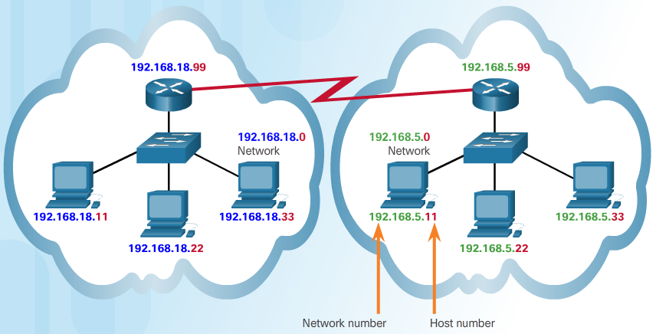
IP Addressing - Operation
The logical 32-bit IPv4 address is hierarchical and is made up of two parts, the network and the host. Both parts are required in an IPv4 address.
As an example, there is a host with an IPv4 address 192.168.18.99 with a subnet mask of 255.255.255.0.
The first three octets, (192.168.18), identify the network portion of the address, and the last octet, (99) identifies the host.
This is known as hierarchical addressing because the network portion indicates the network on which each unique host address is located.
Routers only need to know how to reach each network, rather than needing to know the location of each individual host.

Slide 10
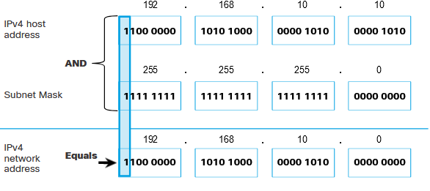
IP Addressing – Operation (Logical AND)
A logical AND is one of three basic binary operations used in digital logic and is used in determining the network address.
Logical AND is the comparison of two bits that produce the results shown in the following. Note how only a 1 AND 1 produce a 1.
  1 AND 1 = 1
  0 AND 1 = 0
  1 AND 0 = 0
  0 AND 0 = 0
To identify the network address of an IPv4 host, the IPv4 address is logically ANDed, bit by bit, with the subnet mask. ANDing between the address and the subnet mask yields the network address.

Slide 11
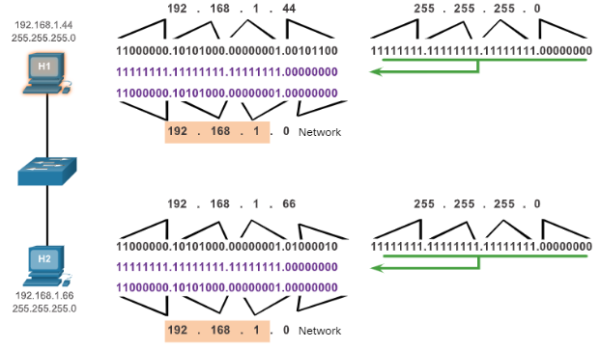
IP Addressing - Subnet Mask
  255.0.0.0 (8-bits)
  255.255.0.0 (16 bits)
  255.255.255.0 (24 bits)
  A subnet mask of 255.255.255.0 (decimal) or
  11111111.11111111.1111111.00000000 (binary) uses 24 network bits and 8 host bits.
How do hosts know which portion of an IPv4 address is the network and which is the host?
Answer – The subnet mask
The subnet mask signifies which part of the IPv4 address is network and which part is host. The subnet mask is compared to the IPv4 address from left to right, bit for bit.
  The 1s in the subnet mask represent the network portion; the 0s represent the host portion.
  When a host sends a packet, it compares its subnet mask to its own IPv4 address and the destination IPv4 address.
    If the network bits match, both the source and destination host are on the same network and the packet can be delivered locally.
    If the network bits do not match, the sending host forwards the packet to the local router interface to be sent on to the other network.
  To determine how many hosts can be on that network, take the number 2 to the power of the number of host bits (2 ⁸ = 256).
  Subtract 2 (256-2) for numbers that cannot be used

Slide 12
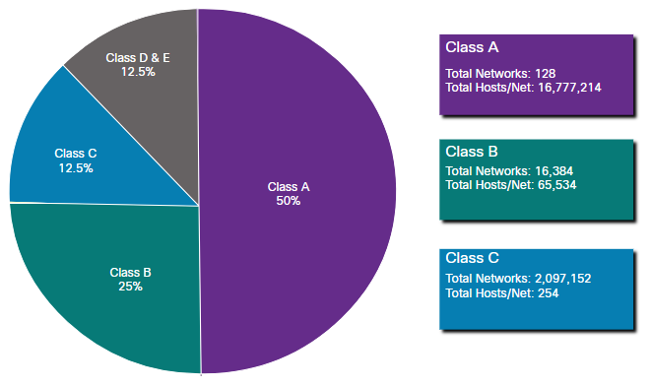
IP Addressing –Classes (Classful and Classless)
IPv4 addresses are divided into the following ranges or classes:
  Class A (0.0.0.0/8 to 127.0.0.0/8) - Designed to support extremely large networks with more than 16 million host addresses. It used a fixed /8 prefix (255.0.0.0).
  Class B (128.0.0.0 /16 - 191.255.0.0 /16) - Designed to support the needs of moderate to large size networks with up to approximately 65,000 host addresses. It used a fixed /16 prefix (255.255.0.0).
  Class C (192.0.0.0 /24 - 223.255.255.0 /24) - Designed to support small networks with a maximum of 254 hosts. It used a fixed /24 prefix (255.255.255.0).
  Note: There is also a Class D multicast block consisting of 224.0.0.0 to 239.0.0.0 and a Class E experimental address block consisting of 240.0.0.0 - 255.0.0.0.

Slide 13
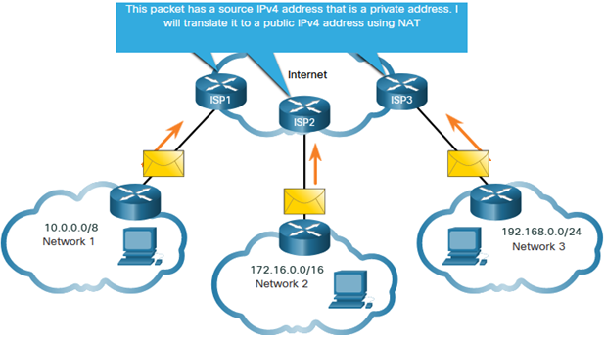
IP Addressing - Public and Private
Public IPv4 addresses are addresses which are globally routed between ISP (internet service provider) routers.
Private IPv4 addresses were introduced because of the depletion of IPv4 address space. Private IPv4 addresses are not unique and can be used by an internal network.
Specifically, the private address blocks are:
  10.0.0.0 /8 or 10.0.0.0 to 10.255.255.255
  172.16.0.0 /12 or 172.16.0.0 to 172.31.255.255
  192.168.0.0 /16 or 192.168.0.0 to 192.168.255.255
Note: Private addresses are defined in RFC 1918.
Most organizations use private IPv4 addresses for their internal hosts. However, these RFC 1918 addresses are not routable in the internet and must be translated to a public IPv4 address.

Slide 14
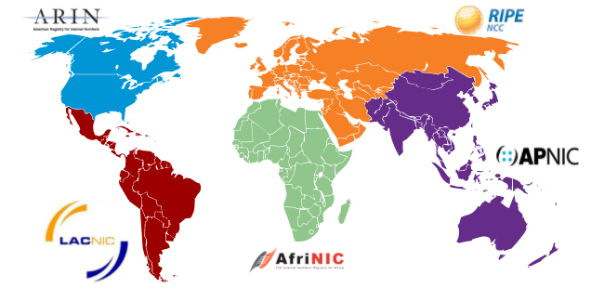
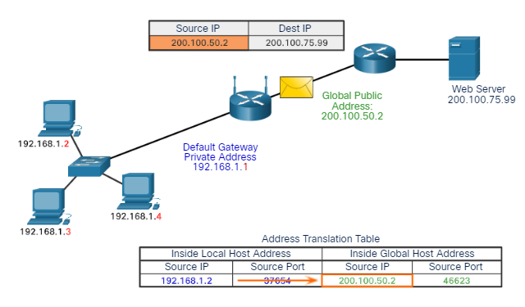
IP Addressing - Public
Both IPv4 and IPv6 addresses are managed by the Internet Assigned Numbers Authority (IANA).
The IANA manages and allocates blocks of IP addresses to the Regional Internet Registries (RIRs).
  RIRs are responsible for allocating IP addresses to ISPs, who in turn provide IPv4 address blocks to organizations and smaller ISPs.
    Organizations can get their addresses directly from an RIR subject to the policies of that RIR.
Network Address Translation (NAT) is used to translate between private IPv4 and public IPv4 addresses. This is usually done on the router that connects the internal network to the ISP's network. One public address can be shared among many private IP addresses through the use of port numbers.
  Home routers provide the same capability.
Notes:
10.2.3: Packet Tracer - Examine NAT on a Wireless Router

Slide 15
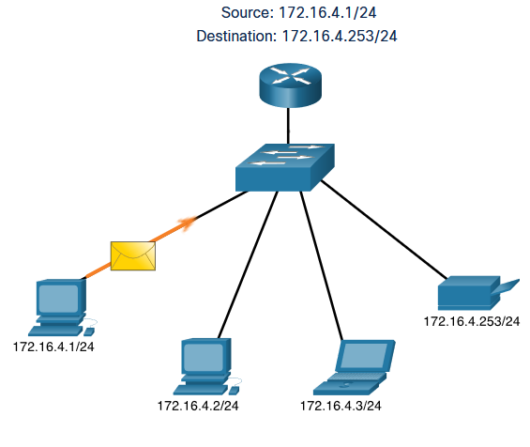
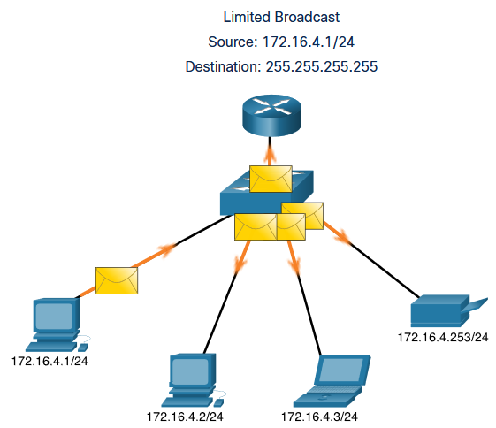
IP Addressing – Transmission
    By default, routers do not forward broadcasts.
    Routers can eliminate excessive broadcast traffic by subdividing networks into separate broadcast domains.
    Unicast: host-to-host communication in both a client/server and a peer-to-peer network. Unicast packets use the address of the destination device as the destination address and can be routed through an internetwork.
    Broadcast packets are sent to all hosts in the network using a broadcast address. A broadcast packet contains a destination IPv4 address with all ones (1s) in the host portion. When a host receives a broadcast packet, the host processes the packet as it would a packet addressed to its unicast address.
    Broadcast may be directed or limited: A directed broadcast is sent to all hosts on a specific network and a limited broadcast is sent to 255.255.255.255.
Notes:
8.6.7: Activity - Unicast, Broadcast, or Multicast

Slide 16
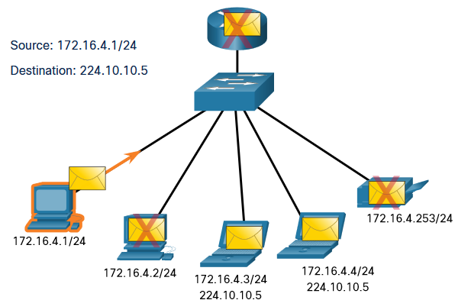
IP Addressing – Transmission
    Multicast transmission reduces traffic by allowing a host to send a single packet to a selected set of hosts that subscribe to a multicast group. IPv4 has reserved the 224.0.0.0 to 239.255.255.255 addresses as a multicast range. The IPv4 multicast addresses 224.0.0.0 to 224.0.0.255 are reserved for multicasting on the local network only.
    A router connected to the local network will not forward them further. Hosts that receive multicast data are called multicast clients.
    The multicast clients use services requested by a client program to subscribe to the multicast group. Each multicast group is represented by a single IPv4 multicast destination address.
Notes:
8.6.7: Activity - Unicast, Broadcast, or Multicast

Slide 17
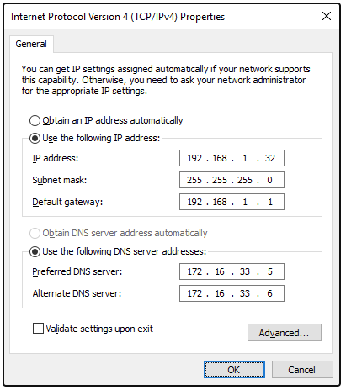
IP Address – Assignment
IPv4 addresses can be assigned either statically or dynamically. With a static assignment, the host IPv4 address must be configured manually, together with subnet mask, default gateway, and DNS server address.
Static addresses are typically assigned for printers, servers, and other networking devices that need to retain a fixed IP address to provide services. Static assignment can be time consuming to implement. It is prone to errors because manual configuration is required.
IPv4 addresses can be dynamically assigned to end devices through an application protocol known as Dynamic Host Configuration Protocol (DHCP).
DHCP automatically assigns addressing information such as IPv4 address, subnet mask, default gateway, and other configuration information.
  Using DHCP, reduces the burden on network support staff and virtually eliminates entry errors.
  A dynamic IP address is not permanently assigned to a host but is only leased for a period of time.

Slide 18
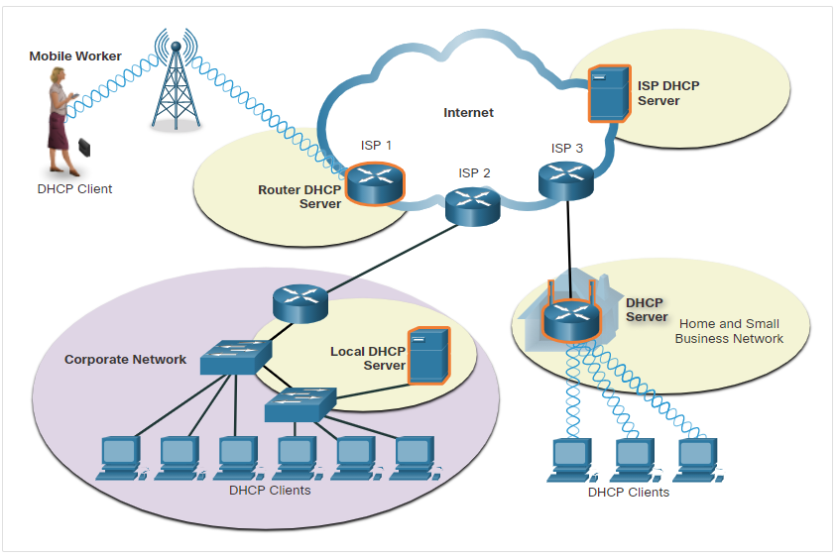
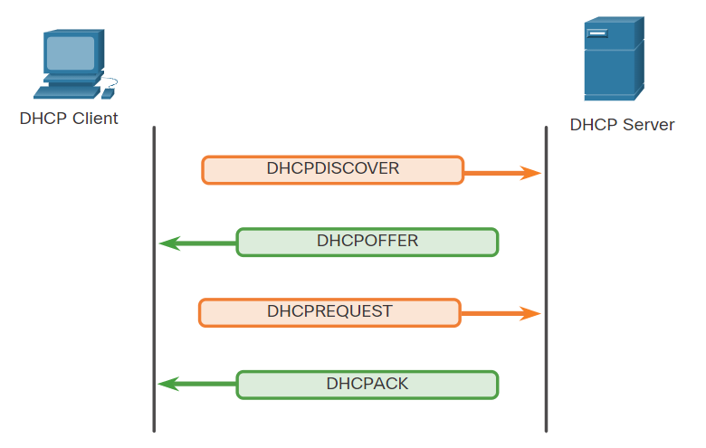
IP Address – DHCP Servers
A device can be a DHCP server if it is running the DHCP service software.
DHCPv4 servers are typically connected to a LAN because it uses broadcast. DHCPv4 servers deployed outside of a LAN will require relay service.
In a home network or SOHO, a wireless router provides DHCP service to end devices. It is also a DHCP client to get IPv4 address from ISP.
When a host is configured using DHCP, it will try to obtain an IPv4 address, subnet mask, default gateway, and DNS server from a DHCP. The process is as follows:
  The client sends a DHCPDISCOVER message using broadcast.
  A DHCP server responds with a DHCPOFFER message with a set of IPv4 addressing information.
  The client then sends a DHCPREQUEST message to request the use of IPv4 addressing information offered by the SHCP server.
  The DHCP server responds with a DHCPACK message to grant the request from the client.

Slide 19
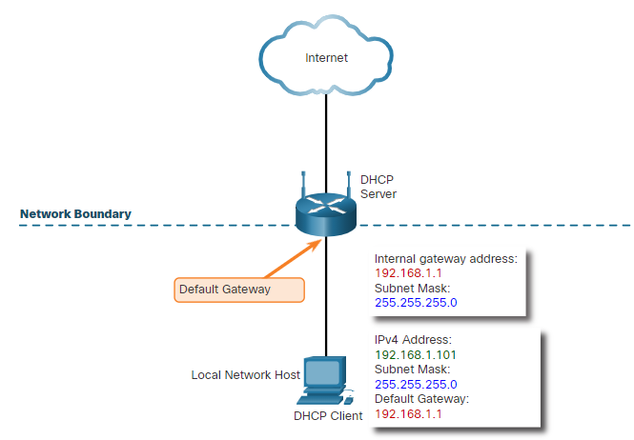
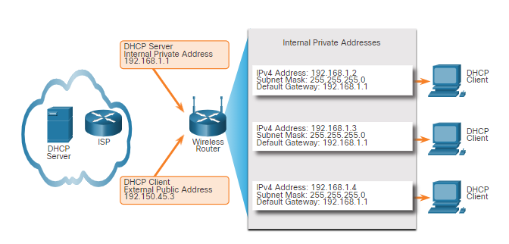
IP Address – DHCP Servers
Routers are used to connect networks. Each router interface connects to a separate network.
The IPv4 address assigned to the interface is the default gateway address for all hosts connected to that same network.
A wireless router commonly provides IP addressing information for local internal hosts.
A router that connects to the internet commonly gets addressing information using DHCP from the internet provider.

Slide 20

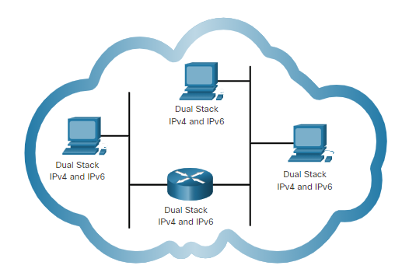
IP Address – Depletion and Existence
What is the purpose of NAT? NAT has been used to slow the depletion of IPv4 addresses. But still, NAT creates latency and has limitations. In today’s scenario, IoT devices are furthering the need for IPv6 addressing.
IPv6 Addressing? Why? Its Size!!!
  An IPv4 address is 32 bits (4 bytes) long and An IPv6 address is 128 bits (16 bytes) in length.
IPv6 benefits
  More IP addresses
  Auto configuration capabilities
  IPv4 and IPv6 shall co-exist
  Dual stack allows IPv4 and IPv6 to coexist on the same network segment. Dual stack devices run both IPv4 and IPv6 protocol stacks simultaneously. Known as native IPv6, this means the customer network has an IPv6 connection to its ISP and is able to access content found on the internet over IPv6.

Slide 21
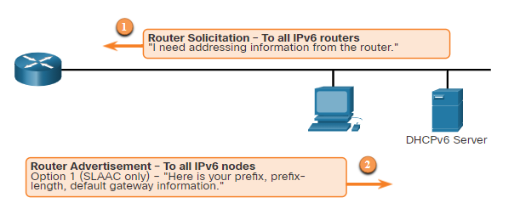
IP Address – IPv6 Features
Stateless Address Autoconfiguration (SLAAC) allows a host to create its own internet-routable IPv6 address without the need for a DHCP server.
Link-local address is used to communicate with devices on the same IPv6 local network.

Slide 22
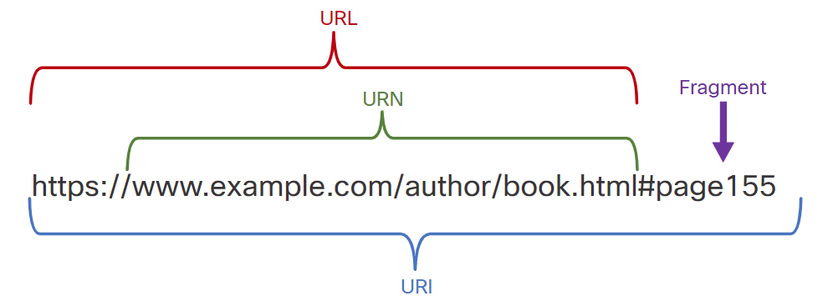
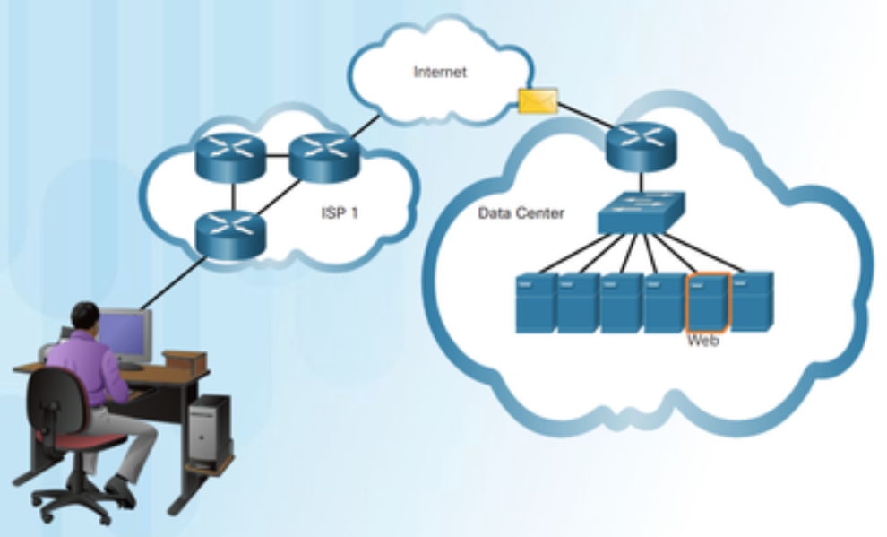
Client/ Server
A client/server system is illustrated by the interaction between a web client and a web server: A person uses a web browser to access a web server by sending a request, for example, requesting a web page.
The server receives the request and responds by sending the requested web page back to the client.
A web server is usually in a part of the network with other servers called a server farm, or within a data center.
Uniform Resource Name (URN) - identifies only the namespace of the resource without reference to the protocol
Uniform Resource Locator (URL) - defines the network location of a specific resource on the network.
Protocol/scheme - HTTPS or other protocols such as FTP, SFTP, mailto, and NNTP
Hostname - w​ww.example.com
Path and file name - /author/book.html
Fragment - #page155

Slide 23
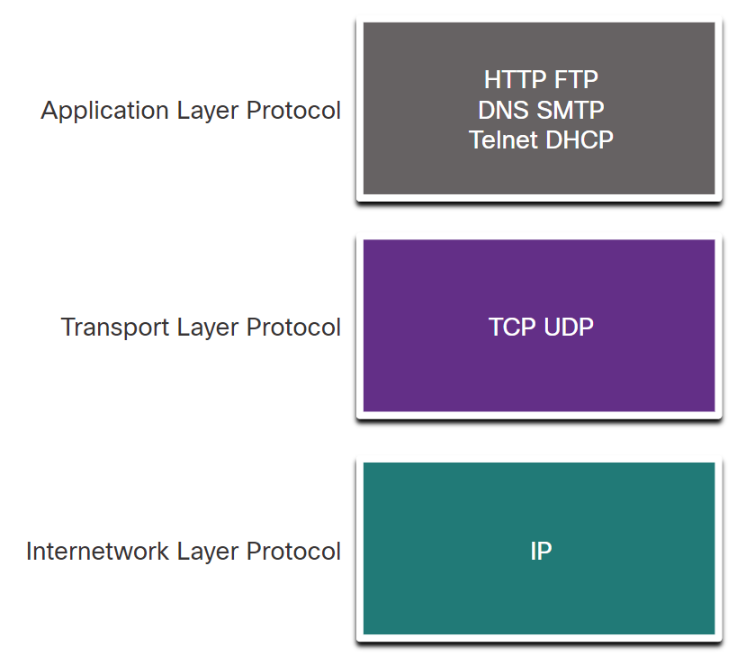
Client/ Server
A web server and a web client use specific protocols and standards in the process of exchanging information to ensure that the messages are received and understood.
The various protocols necessary to deliver a web page function at the four different layers of the TCP/IP model are as follows:
Application Layer Protocol - Hypertext Transfer Protocol (HTTP) governs the way that a web server and a web client interact.
Transport Layer Protocol - Transmission Control Protocol (TCP) ensures that IP packets are sent reliably, and any missing packets are resent.
Internetwork Layer Protocol - The most common internetwork protocol is Internet Protocol (IP) which is used to identify end hosts and to route packets to destination host.
Network Access Layer - The specific protocol at the network access layer, such as Ethernet, depends on the type of media and transmission methods used in the physical network.

Slide 24
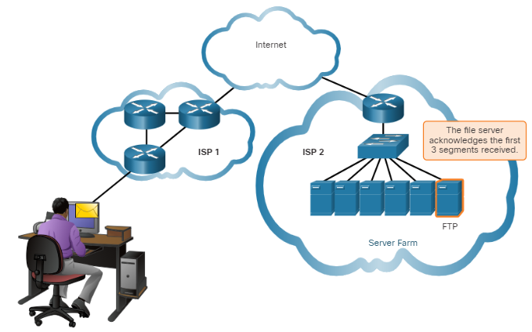
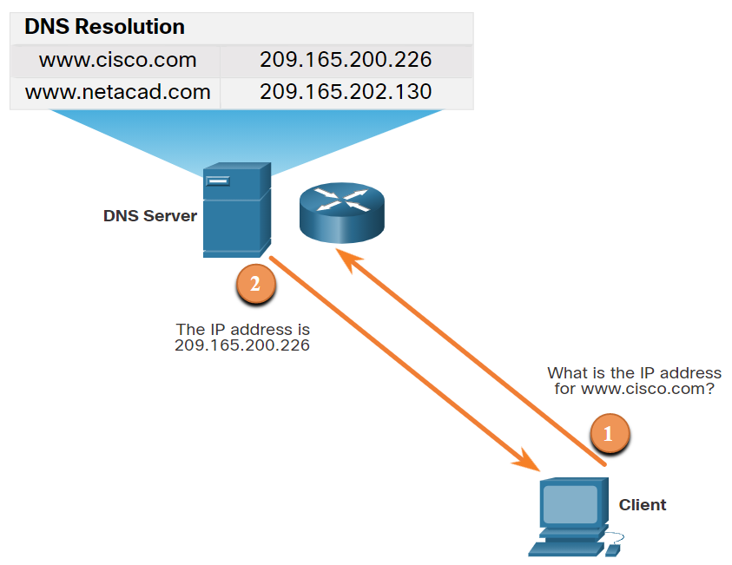
TCP/UDP
Transmission Control Protocol (TCP) helps ensure reliable delivery of data packets:
TCP breaks up a message into small pieces (segments)
Segments are numbered in sequence and passed to the IP process for assembly into packets.
TCP tracks the number of segments that have been sent.
If the sender does not receive an acknowledgment within a certain period, it assumes that the segments were lost and retransmits only the missing portion of the message.
On the receiving host, TCP is responsible for reassembling the message segments in orders and passing them to the application.
In some applications, reliable delivery is not required, UDP may be an appropriate transport protocol. UDP is a 'best effort' delivery system that does not require acknowledgment of receipt.
UDP is preferable with applications that use time sensitive technology such as streaming audio and voice over IP (VoIP). Acknowledgments would slow down delivery and retransmissions are undesirable.

Slide 25
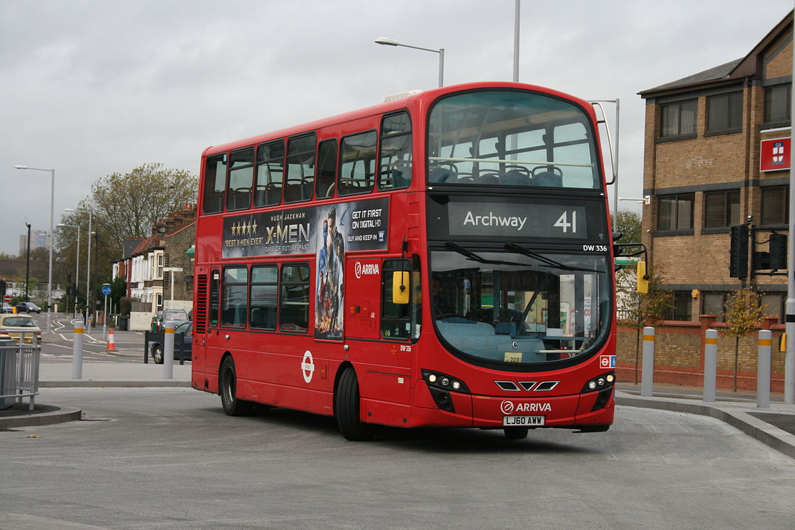
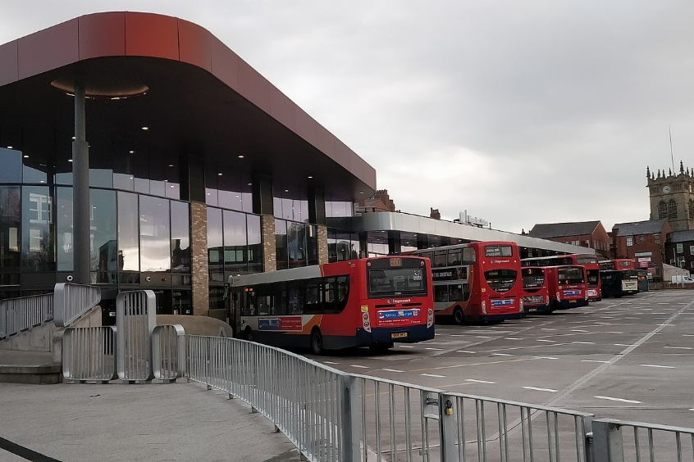
Port Numbers
Other than Physical Addressing and Logical Addressing, Port Numbers. When a message is delivered using either TCP or UDP, the protocols and services requested are identified by a port number.
A port is a numeric identifier within each segment that is used to keep track of specific conversations between a client and server. Every message that a host sends contains both a source and destination port.
Ports are assigned and managed by an organization known as the Internet Corporation for Assigned Names and Numbers (ICANN). Ports are broken into three categories and range in number from 1 to 65,535:
  Well-Known Ports - Destination ports that are associated with common network applications. These ports are in the range of 1 to 1023.
  Registered Ports - Ports 1024 through 49151 can be used as either source or destination ports.
  Private Ports - Ports 49152 through 65535 are often used as source ports. These ports can be used by any application.
Notes:
netstat

Slide 26
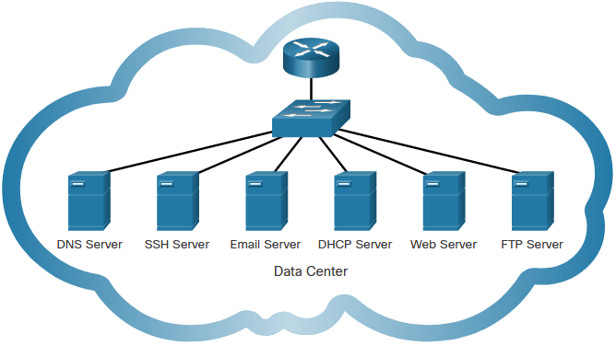
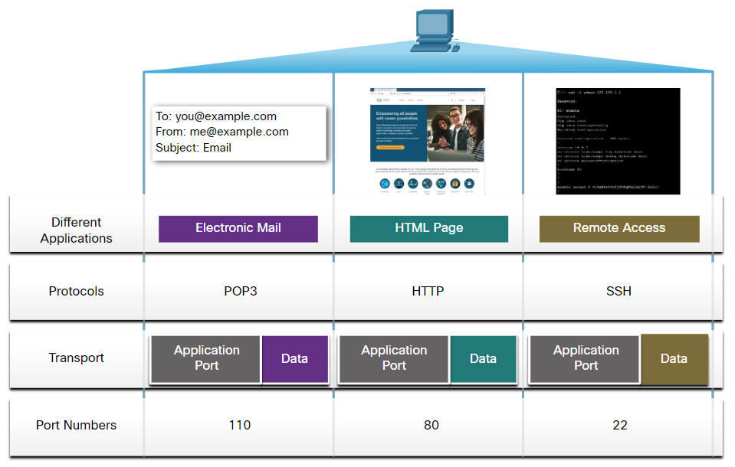
Application Services
In a Quiz posted on 11/10/2021 via Teams Channel, (if you have not answered ☹) internet searches, shopping karts, emails, social media etc.
Each of these services relies on protocols from the TCP/IP protocol suite to reliably communicate the information between the clients and the servers. Some of the most common servers that provide these services are shown.
Protocol | Description
Domain Name System (DNS) | Resolves internet names to IP addresses.
Secure Shell (SSH) | Used to provide remote access to servers and networking devices.
Simple Mail Transfer Protocol (SMTP) | Sends email messages and attachments from clients to servers and from servers to other email servers.
Post Office Protocol (POP) | Used by email clients to retrieve email and attachments from a remote server.
Internet Message Access Protocol (IMAP) | Used by email clients to retrieve email and attachments from a remote server.
Dynamic Host Configuration Protocol (DHCP) | Used to automatically configure devices with IP addressing and other necessary information to enable them to communicate over the internet.
Hypertext Transfer Protocol (HTTP) | Used by web browsers to request web pages and web servers to transfers the files that make up web pages of the World Wide Web.
File Transfer Protocol (FTP) | Used for interactive file transfer between systems.
Notes:
Observe DNS lookup using the nslookup command

Slide 27
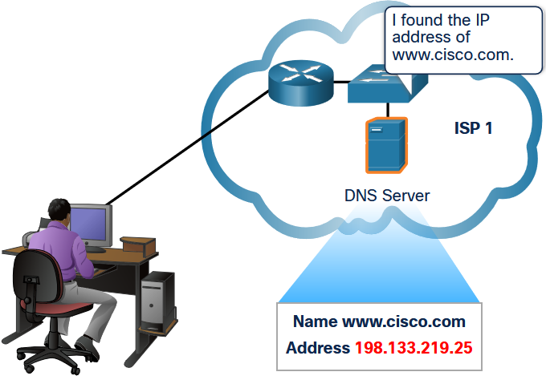
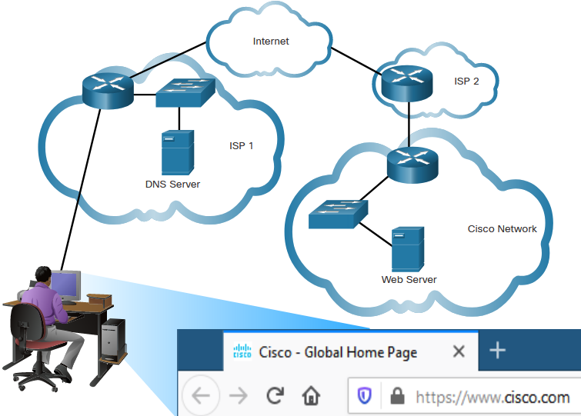
DNS
Names are easier than numbers. The Domain Name System (DNS) provides a way for hosts to use this name to request the IP address of a specific server.
DNS names are registered and organized on the internet within specific high-level groups, or domains. Some of the most common high-level domains on the internet are .com, .edu, and .net.
When a client has the name of server, such as a web server, but needs to find the IP address, it sends a request to the DNS server on port 53. DNS server checks its table to determine the IP address associated with that web server. If the local DNS server does not have an entry for the requested name, it queries another DNS server within the domain.
Notes:
netstat

Slide 28
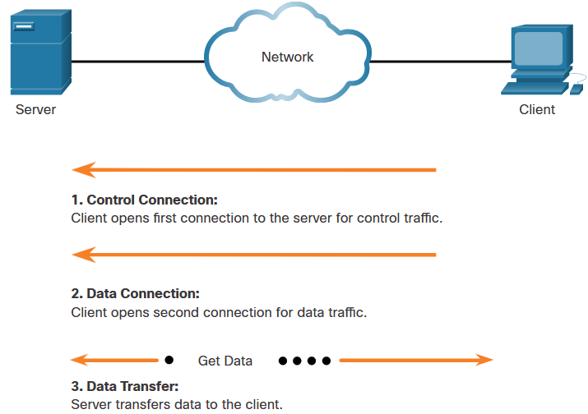
Other Services: HTTP, FTP
When a web client receives the IP address of a web server, the client browser uses that IP address and port 80 to request web services. This request is sent to the server using the Hypertext Transfer Protocol (HTTP). Requests for secure HTTP are sent to port 443.
The File Transfer Protocol (FTP) provides an easy method to transfer files from one computer to another. A host running FTP client software can access an FTP server to perform various file management functions, including file uploads and downloads. The FTP server enables a client to exchange files between devices. It also enables clients to manage files remotely by sending file management commands such as delete or rename.
The FTP service uses two different ports to communicate between client and server.
  To begin an FTP session, control connection requests are sent to the server using destination TCP port 21.
  When the session is opened, the server uses TCP port 20 to transfer the data files.
Notes:
netstat

Slide 29
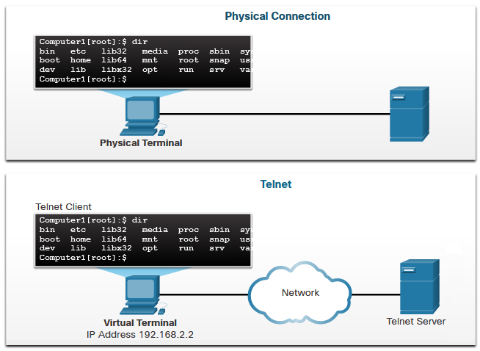
Other Services: Virtual Terminals – Telnet, SSH
Telnet provides a standard method of emulating text-based terminal devices over the data network. Telnet servers listen for client requests on TCP port 23. A connection using Telnet is called a virtual terminal (vty) session, or connection.
Rather than using a physical device to connect to the server, Telnet uses software to create a virtual device that provides the same features of a terminal session with access to the server’s command line interface (CLI).
The client is able to execute commands as if it were locally (physically) connected to the server. After a Telnet connection is established, users can perform any authorized function on the server, just as if they were using a command line session on the server itself.
Although the Telnet protocol can require a user to login, it does not support transporting encrypted data. All data exchanged during Telnet sessions is transported as plaintext across the network.
Notes:
netstat

Slide 30
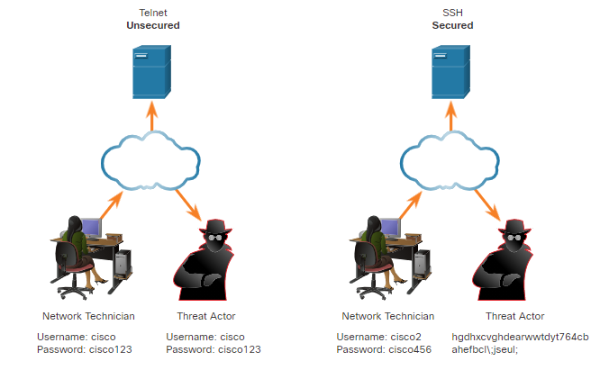
Other Services: Virtual Terminals – Telnet, SSH
The Secure Shell (SSH) protocol offers an alternate and secure method for server access.
SSH provides the structure for secure remote login and other secure network services.
SSH provides stronger authentication than Telnet and supports transporting session data using encryption.
Notes:
netstat

Slide 31
The logical 32-bit IPv4 address is hierarchical and is made up of two parts, the network and the host. Both parts are required in an IPv4 address.
The hosts with the same network number in their IPv4 addresses will be able to communicate with each other, but will not be able to communicate with the other hosts without the use of routing.
A logical AND is one of three basic binary operations used in digital logic and is used in determining the network address.
The subnet mask signifies which part of the IPv4 address is network and which part is host.
Internet IPv4 addresses were assigned using classful addressing
Public IPv4 addresses are addresses which are globally routed between ISP (internet service provider) routers.
Private IPv4 addresses are not unique and can be used by an internal network. Private addresses are defined in RFC 1918.
Unicast communication is used for normal host-to-host communication. Broadcast packets are sent to all hosts in the network using a broadcast address. Multicast transmission allows a host to send a single packet to a selected set of hosts
Summary
A host needs an IPv4 address to participate on the internet and almost all LANs today.
  Every packet sent across the internet has a source and destination IPv4 address.
  This information is required by networking devices to ensure the information gets to the destination and any replies are returned to the source.
An IPv4 address is simply a series of 32 binary bits (ones and zeros). There are over 4 billion possible IPv4 addresses using a 32-bit addressing scheme.
  The 32 bits are grouped into four 8-bit bytes called octets.
  To make IPv4 addresses easier to understand, each octet is presented as its decimal value, separated by a decimal point or period. This is referred to as dotted-decimal notation.

Slide 32
Routers create network boundaries.
The IP address on a router interface that connects to an internal (inside) network is the default gateway address for all hosts on that same network.
The IP address assigned to the internet side of a router such as a wireless router is the external, or outside, network.
Network Address Translation (NAT) is used co convert private IP addresses used on an internal network to a public (global) address that can be routed through the internet.
With NAT one single public address can be used for many internal hosts.
An IPv6 address is 128 bits and does not require NAT.
IPv6 addresses support address autoconfiguration using SLAAC and link-local addresses.
Two ways of shortening an IPv6 address is to omit the leading zeros and to use a double colon for any group of consecutive segments that contain all zeros.
Dual stack allows IPv4 and IPv6 networks to coexist.
Tunneling is a method used to transport an IPv6 packet over an IPv4 network.
Summary
IPv4 addresses static assignment must be manually configured on a host. When using static IPv4 addressing, maintain an accurate list of which IPv4 addresses are assigned to which devices is difficult.
Dynamic addressing uses DHCP to provides automatic assignment of addressing information such as IPv4 address, subnet mask, default gateway, and other IPv4 networking parameters. DHCP can allocate IP addresses for a configurable period of time, called a lease period.
Many networks use both DHCP and static addressing. DHCP is used for general purpose hosts, such as end user devices. Static addressing is used for network devices, such as gateway routers, switches, servers, and printers.
A DHCPv4 client and servers use DHCP messages to initiate and complete a dynamic IPv4 addressing.

Slide 33
Domain Name System (DNS) provides a way for hosts to use this name to request the IP address of a specific server.
  DNS names are registered and organized on the internet within specific high level groups, or domains. Some of the most common high level domains on the internet are .com, .edu, and .net.
  When a client has the name of server, such as a web server, but needs to find the IP address, it sends a request to the DNS server on port 53.
When a web client receives the IP address of a web server, the client browser uses that IP address and port 80 to request web services.
  This request is sent to the server using the Hypertext Transfer Protocol (HTTP).
File Transfer Protocol (FTP) provides an easy method to transfer files from one computer to another.
Control connection requests are sent to the server using destination TCP port 21.
The server uses TCP port 20 to transfer the data files.
Telnet provides a standard method of emulating text-based terminal devices over the data network.
Telnet servers listen for client requests on TCP port 23.
Secure Shell (SSH) protocol offers an alternate and secure method for server access
Summary
In the client/server model, the term server refers to a host running a software application that provides information or services to other hosts connected to the network. The client refers to a host running a software application makes a service request to a server.
TCP and UDP are two network protocols operating at the Transport Layer. TCP provides mechanisms to ensure reliable data packets delivery with sequencing and acknowledgement. However, the acknowledgement slows down the packet delivery process. UDP is a 'best effort' delivery system that does not require acknowledgment of receipt.
A port is a numeric identifier within each segment that is used to keep track of specific conversations between a client and server.
Port numbers are in three categories: well-known ports, registered ports, and private ports.

