Slide 1

Fibre Presentation
Presented and created by: Lindsay, Amelie, Lottie, Kate, Megan, Emilia

Slide 2
Fibre is a current and hot topic within society, and there are many misconceptions about fibre.
Our aim is to educate the people within our university. We want to ensure they walk away with a deeper understanding of fibre and feel more confident in it.
We chose to explore fibre because it plays a crucial role in maintaining digestive health and preventing long-term illnesses such as type 2 diabetes, stroke, and colorectal cancer. Despite its importance, many people do not meet the recommended daily intake. This presentation aims to raise awareness of how fibre supports overall well-being and how simple dietary changes can improve health.
The Rationale – Health promotion day

Slide 3
Explain what dietary fibre is
Educate individuals on fibre intake/talk about the dietary reference values for fibre
Show individuals how they can consume the recommended fibre intake per day
Educate individuals on the health benefits of fibre
Test individuals on their knowledge of fibre and what foods contain fibre and how much.
Encourage individuals to consume more fibre in the diet
Aims
Objectives
Put up posters and provide leaflets explaining what fibre is
Have a poster presenting how you can include fibre in your diet and how to reach the DRVs
Have physical examples of high fibre foods and ask individuals to guess how much fibre is in each food item.
Health benefit : posters and pictures will show different things, such as stool charts. Discuss health benefits e.g. digestion
Ask individuals to complete a questionnaire at the end to understand if they have learnt anything new
Suggest meals including fibre and easy food swaps that could be made. Examples of this are white bread -> whole meal &white pasta -> wholemeal pasta

Slide 4
COM-B Model
Capability
Opportunity
Motivation
Behaviour
Notes:
We propose a fiber-focused health promotion stall underpinned by the COMB model to ensure that all components of the intervention directly support behaviour change. To enhance capability, the stall will provide clear, evidence-based information on the health benefits of dietary fibre, the recommended daily intake, and practical strategies to increase fiber consumption. Visual displays and concise, student-led explanations will support understanding and make the information accessible to a wide audience.
To create opportunity, the stall will offer free water bottles, interactive educational materials, and a supportive environment that encourages engagement. This approach reduces environmental and social barriers that commonly limit participation in nutrition-related activities and enables students to interact with the content in a low-pressure setting.
To strengthen motivation, the stall will incorporate positive, autonomy-supportive messaging and invite participants to identify one small, achievable change they could implement to increase their fiber intake. This focus on realistic, self-directed action aligns with evidence that incremental goals enhance adherence and support sustained behaviour change.
By addressing capability, opportunity, and motivation in an integrated manner, the proposed stall is designed to facilitate meaningful and sustainable improvements in dietary behaviour.

Slide 5
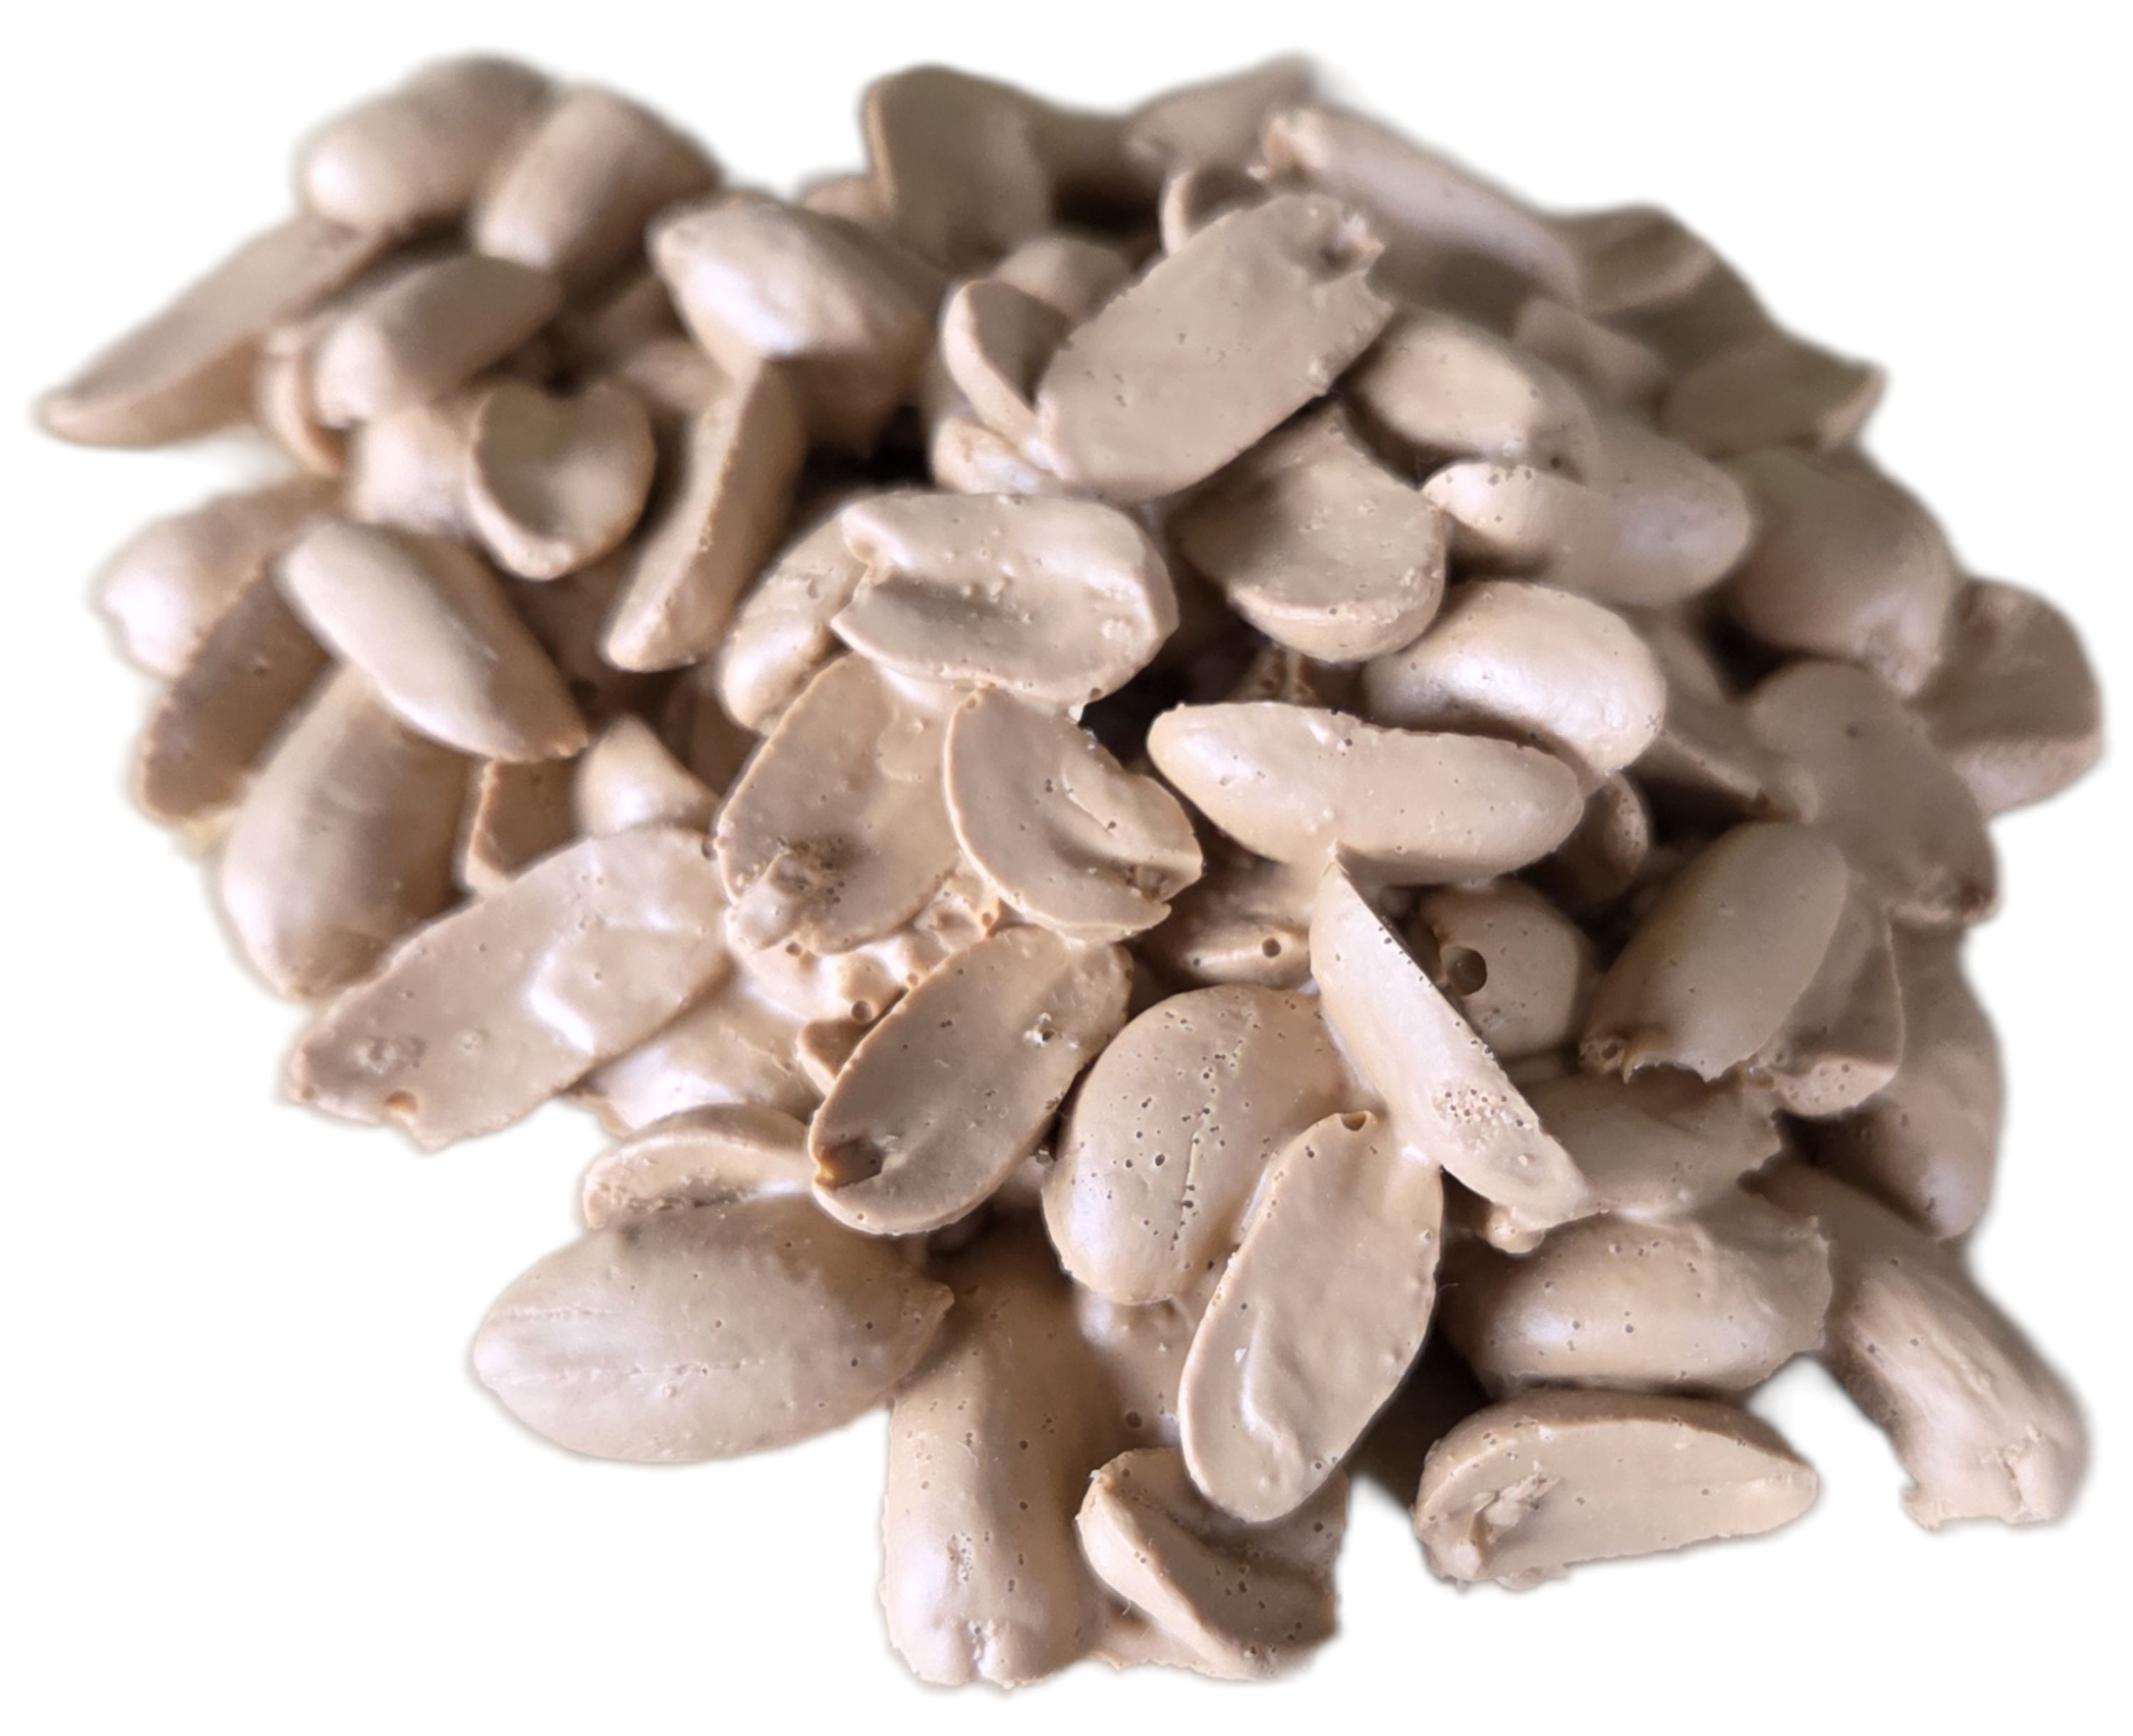
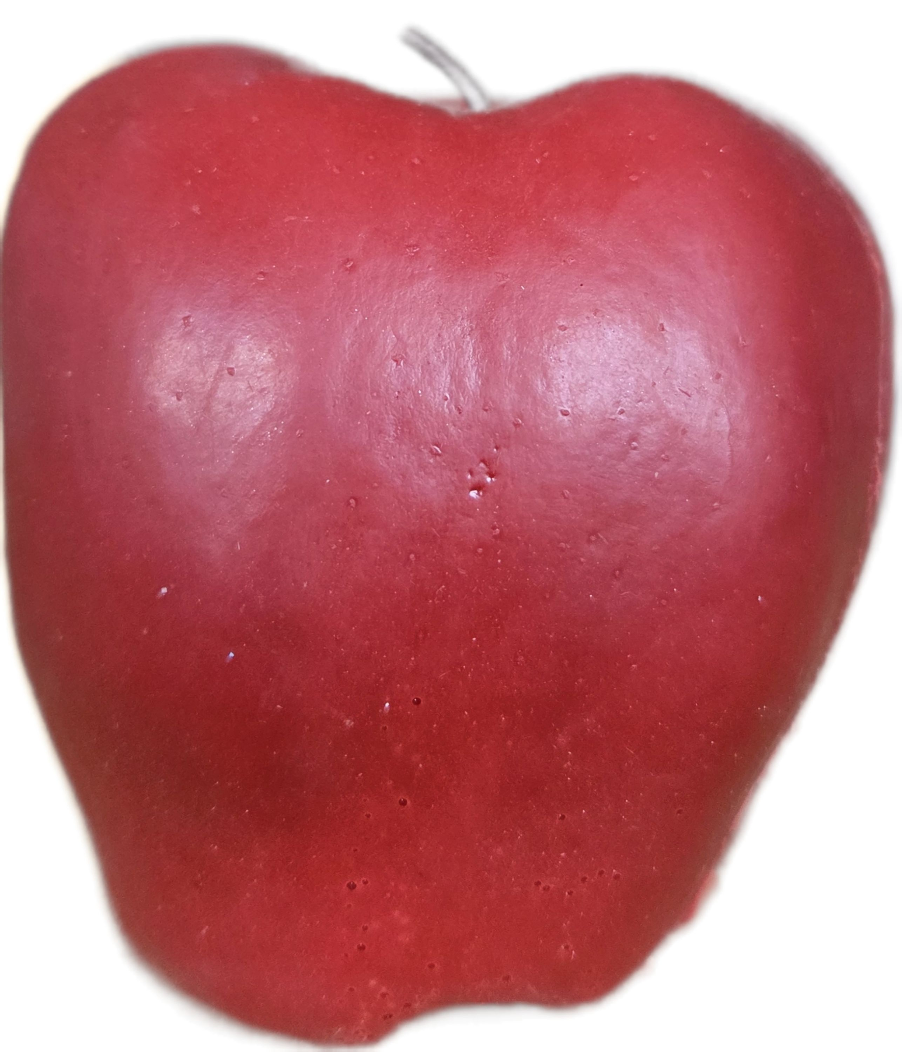
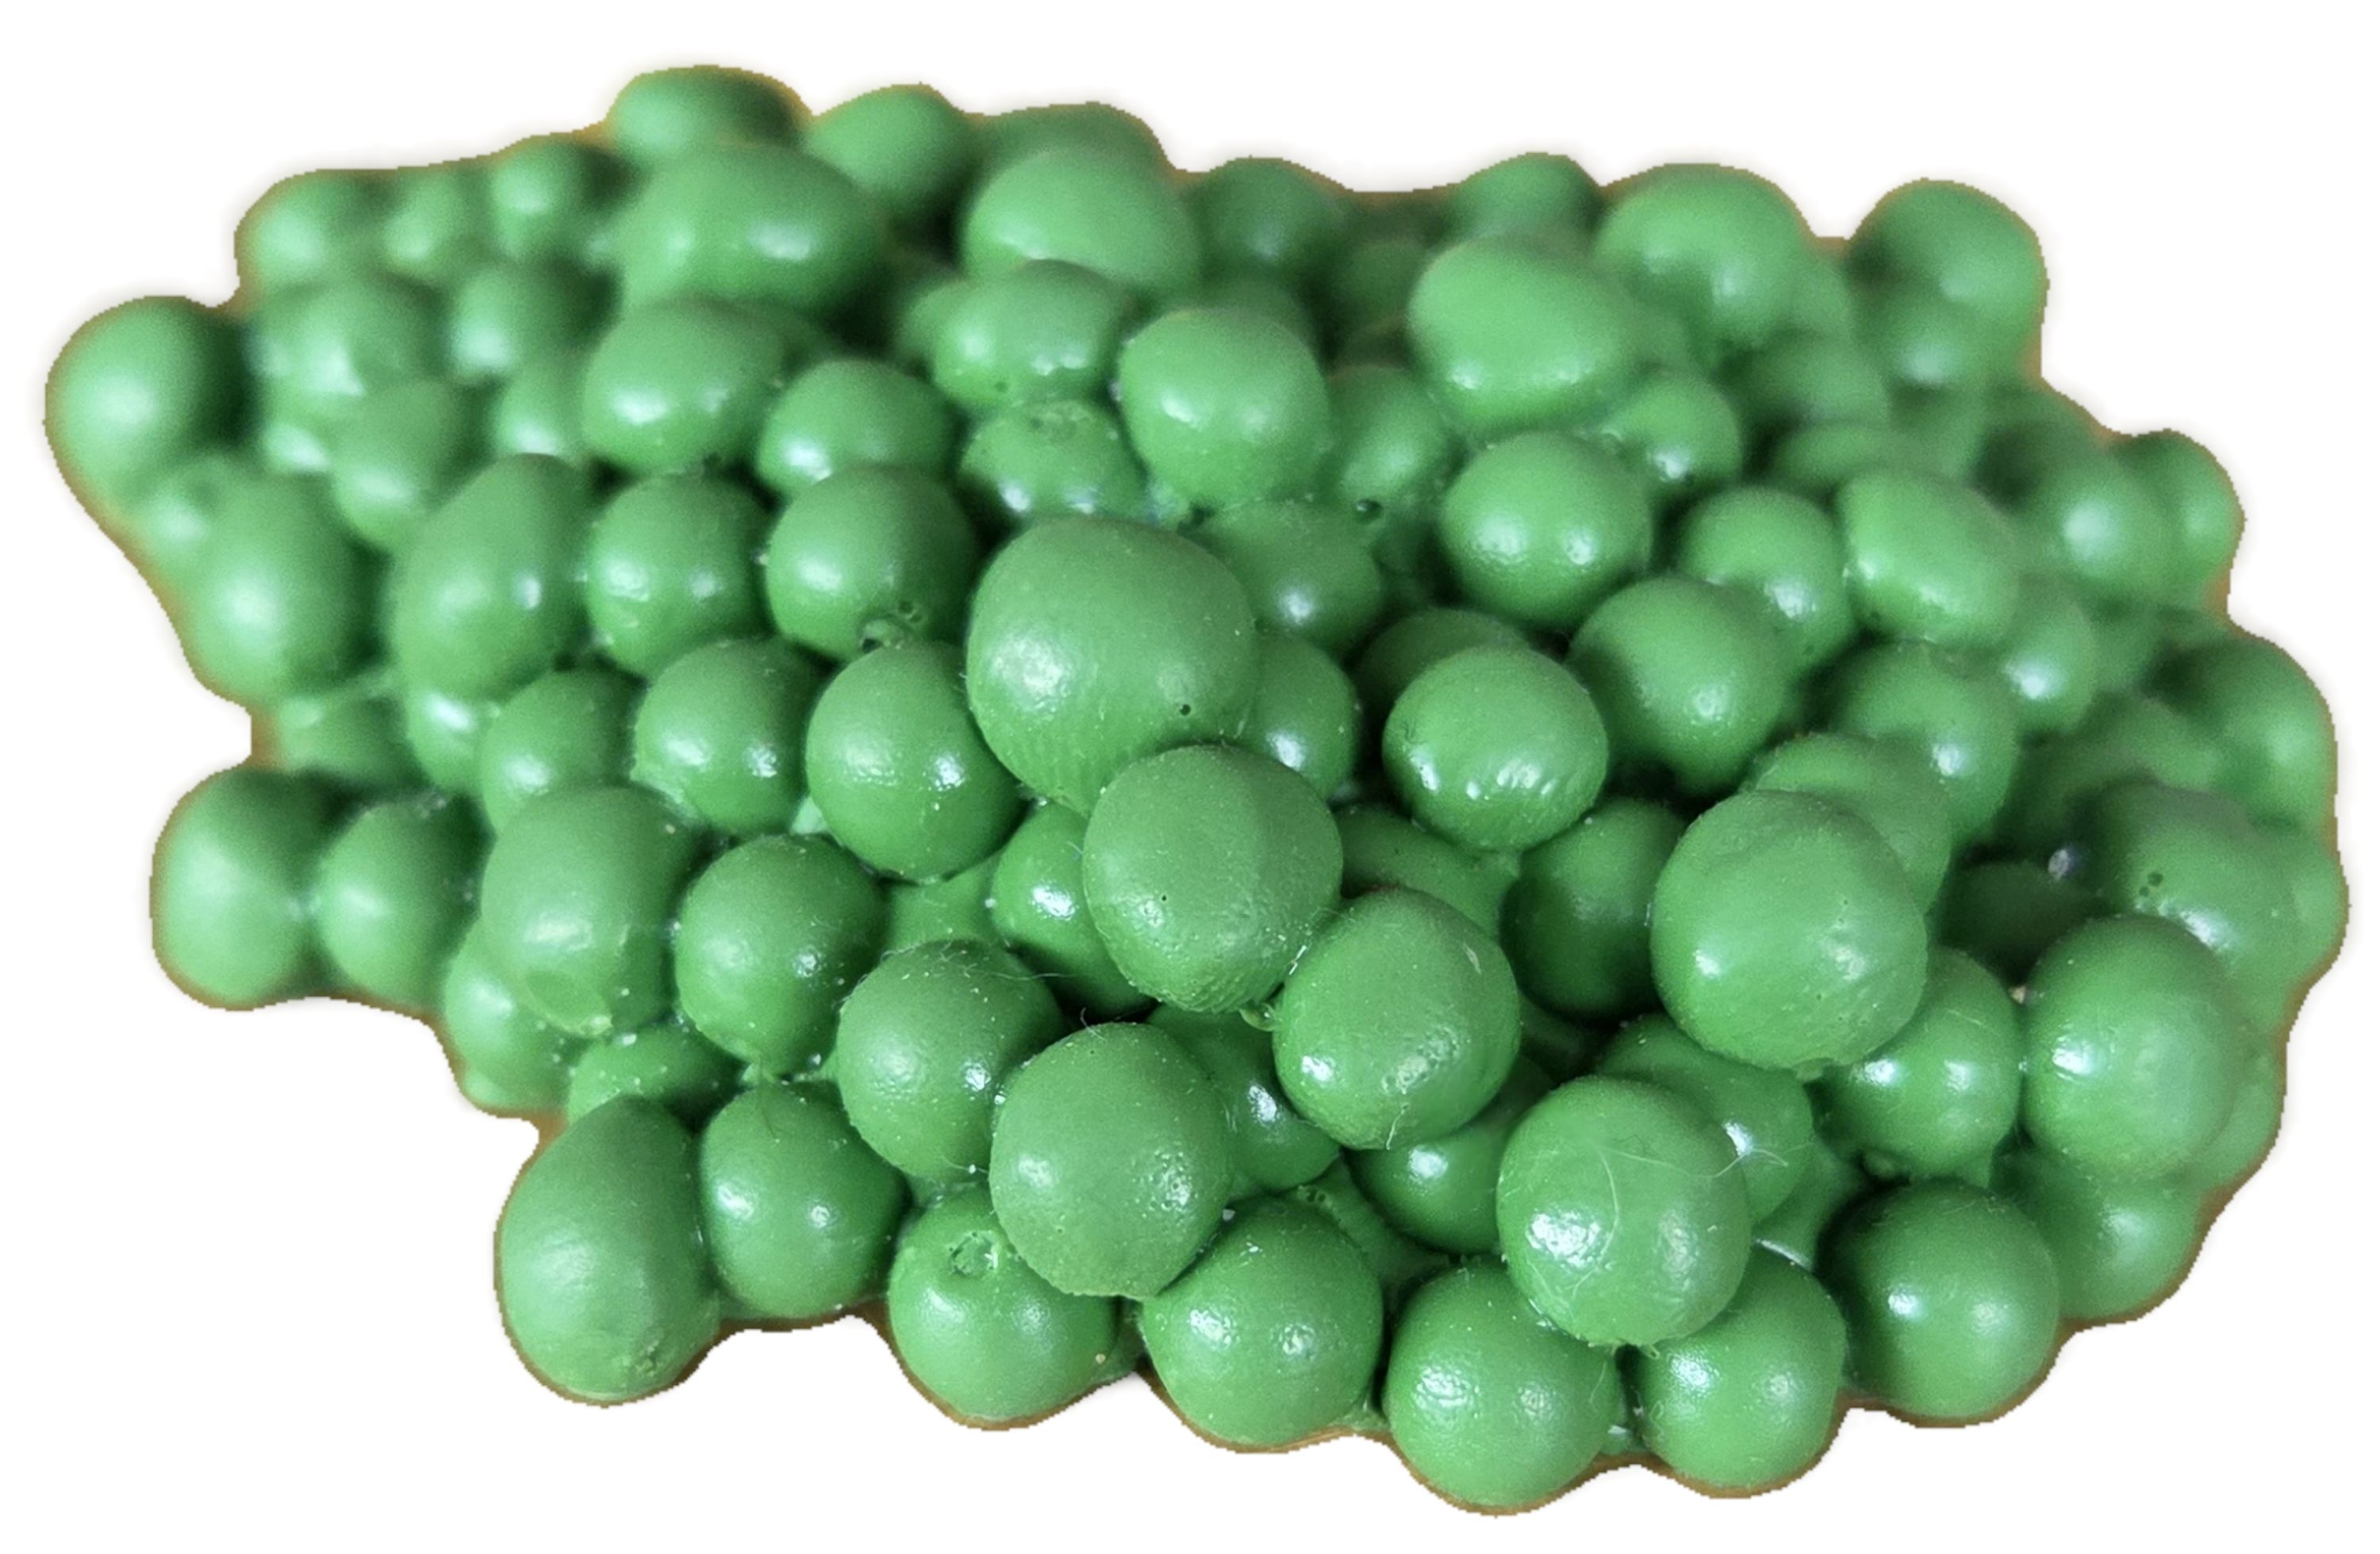

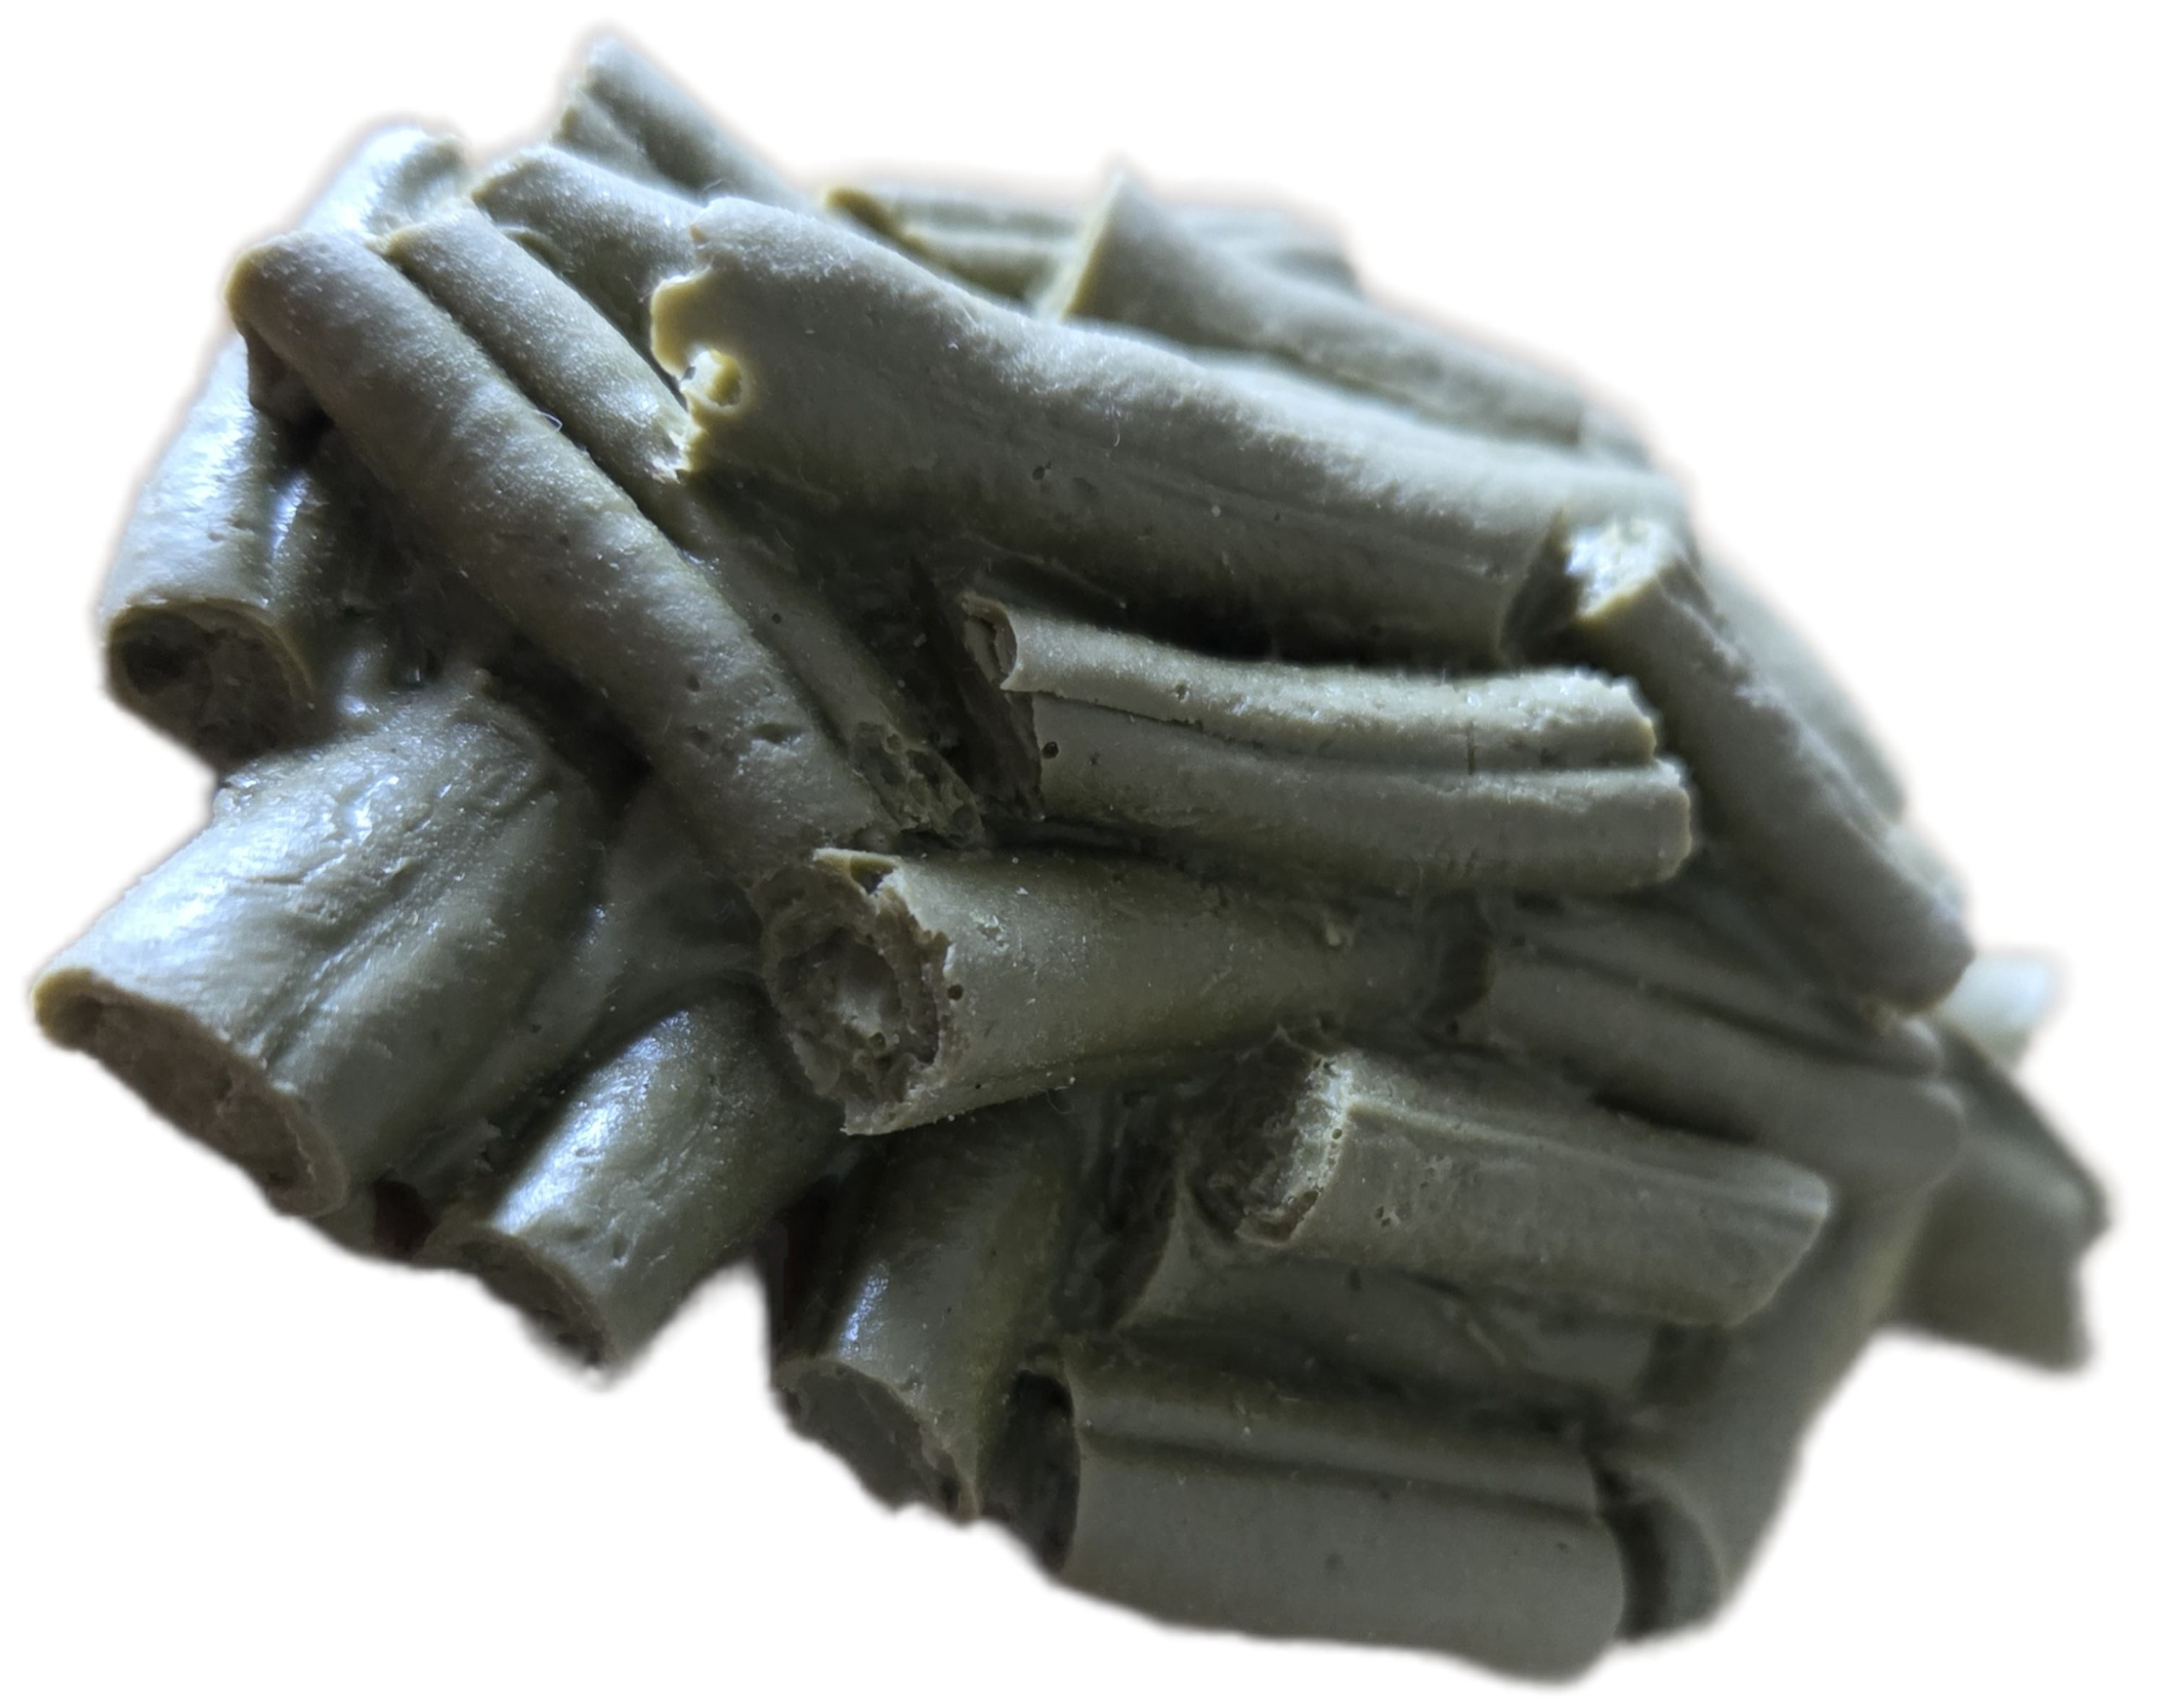
Resources
Presentation boards (including posters)
Leaflets
Questionnaires [ physical + online ]
- pens to use for physical copies
Prop food with written fibre count underneath
Freebies
water bottles
pens

Slide 6
Evaluating the Initiative Using Questionnaires
Pre-initiative questionnaire to measure participants’ baseline knowledge, attitudes, and behaviours.
Post-initiative questionnaire to assess changes in knowledge, awareness, and participant experiences.
Questions will include Likert scales, multiple choice, and short open-ended responses.
Responses will be analysed using percentages and common themes.
•Participation will be voluntary and responses will remain anonymous and confidential

Slide 7
Barriers and Mitigation Strategies
Limited time for planning and preparing resources
Difficulty engaging students who are rushed or uninterested
Technical difficulties in accessing the survey
Notes:
We have identified several potential barriers that may influence the planning and delivery of our fiber‑education stall.
The first relates to limited time for planning and preparing resources, as the initiative must be organised alongside other academic commitments. To address this, we will allocate tasks early, streamline our materials, and ensure all resources are prepared in advance.
A second barrier is the challenge of engaging students who may be rushed or uninterested. As the stall will be situated in a busy environment, not all students will have time to stop. To mitigate this, we will use clear, visually appealing materials and brief, accessible messaging to encourage quick interaction.
The third barrier concerns potential technical difficulties when accessing the survey, such as slow Wi‑Fi or issues scanning QR codes. To reduce this risk, we will provide both a QR code and a short URL, and we will have a paper‑based alternative available if required.
By anticipating these barriers and planning appropriate mitigation strategies, we aim to ensure the stall runs smoothly and supports effective engagement with our target audience.

