Slide 1
Module Name : Electronics I
Module Code : ACDB5002
Lecture : 9
Topic : Buck Boost Converter
Lecture By,
Mrs. Jenifer Prince Devaraj,
Lecturer - Embedded Electronics,
Faculty of Applied Computing,
UWTSD
Email:j.prince-devaraj@uwtsd.ac.uk

Slide 2
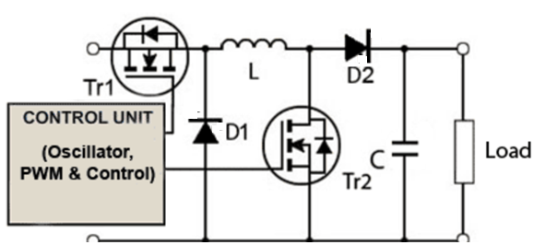
SWITCH MODE POWER SUPPLY
Buck – Boost Converter
A Buck-Boost converter is a type of switched mode power supply that combines the principles of the Buck Converter and the Boost converter in a single circuit.
The buck–boost converter is a type of DC-to-DC converter that has an output voltage magnitude that is either greater than or less than the input voltage magnitude.
UWTSD Lectures / ACDB5002 – Electronics 1

Slide 3
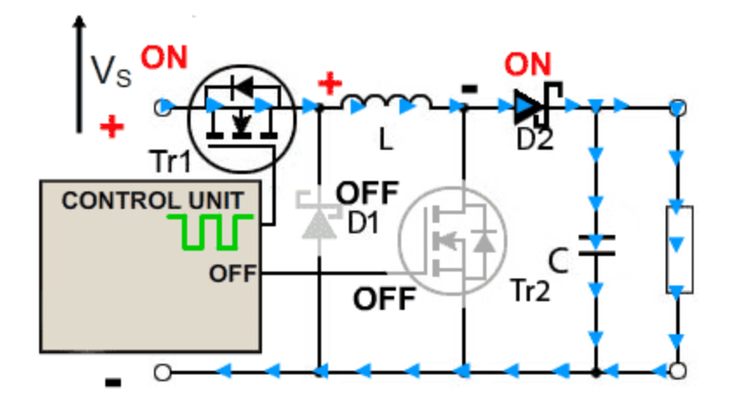
SWITCH MODE POWER SUPPLY
Operation as a Buck Converter
(Tr1-ON and Tr 2- OFF)
Tr2 is turned off.
Tr1 is switched on and off by a high-frequency square wave from the control unit.
When the gate of Tr1 is high, current flows through the inductor (𝐿), charging its magnetic field.
The capacitor (𝐶) is charged. The load is supplied with current.
The Schottky diode 𝐷1 is turned off due to the positive voltage on its cathode.
UWTSD Lectures / ACDB5002 – Electronics 1

Slide 4
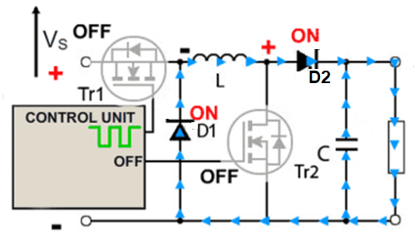
SWITCH MODE POWER SUPPLY
Operation as a Buck Converter
(Tr1-OFF and Tr 2- OFF)
When the control unit switches Tr1 off, the inductor 𝐿 becomes the initial source of current.
The magnetic field in the inductor begins to collapse. The collapsing field generates a back e.m.f., which reverses the polarity of the voltage across 𝐿.
The reversed polarity turns on the Schottky diode 𝐷1.Current flows through, D2, the load, maintaining power to the circuit.
UWTSD Lectures / ACDB5002 – El
ectronics 1

Slide 5
SWITCH MODE POWER SUPPLY
Operation as a Buck Converter
When current in L decreases, the charge accumulated in C during the ON period of Tr1 adds to the current flowing through the load.
Vout is reasonably constant during the OFF period.
UWTSD Lectures / ACDB5002 – Electronics 1

Slide 6
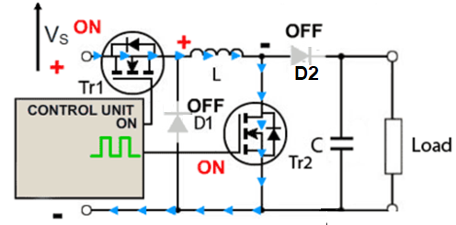
SWITCH MODE POWER SUPPLY
Operation as a Boost Converter
In Boost Converter mode, Tr1 is turned ON continually and the high frequency square wave applied to Tr2 gate.
During the ON periods when Tr2 is conducting, the input current flows through the inductor L and via Tr2, directly back to the supply negative terminal charging up the magnetic field around L.
UWTSD Lectures / ACDB5002 – Electronics 1

Slide 7
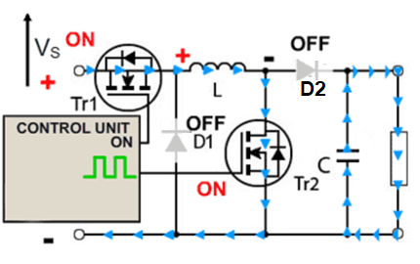
SWITCH MODE POWER SUPPLY
Operation as a Boost Converter
When this happens, D2 cannot conduct as its anode is being held at ground potential by the heavily conducting Tr2.
For the duration of the ON period, the load is being supplied entirely by the charge on the capacitor C, built up on previous oscillator cycles.
UWTSD Lectures / ACDB5002 – Electronics 1

Slide 8
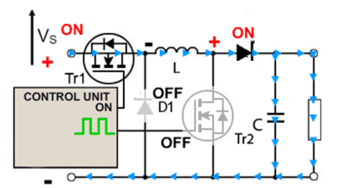
SWITCH MODE POWER SUPPLY
Operation as a Boost Converter –Off Period
At the start of the off period of Tr2, L is charged, and C is partially discharged.
The inductor L now generates a back e.m.f. and its value that depends on the rate of change of current as Tr2 switches OFF and ON the amount of inductance the coil possesses;
UWTSD Lectures / ACDB5002 – Electronics 1

Slide 9
SWITCH MODE POWER SUPPLY
Operation as a Boost Converter –Off Period
Therefore, the back e.m.f can be any voltage over a wide range, depending on the design of the circuit.
The polarity of the voltage across L has now reversed, and so adds to the input voltage VS giving an output voltage that is at least equal to or greater than the input voltage.
D2 is now forward biased and so the circuit current supplies the load current, and at the same time re-charges the capacitor to VS + VL ready for the next on period of Tr2.
UWTSD Lectures / ACDB5002 – Electronics 1

Slide 10
SWITCH MODE POWER SUPPLY
Exercise
Design and Simulate a Buck-Boost Converter circuit in Proteus with a 24V DC input. The circuit utilises IRF740 MOSFETs for switching and includes components like an inductor, diodes, a capacitor, and a load resistor.
Observe the output voltage
  If the second transistor is kept OFF, giving pulse to the first transistor.
  If the first transistor is kept ON continually and second transistor is given pulse.
UWTSD Lectures / ACDB5002 – Electronics 1

Slide 11
SWITCH MODE POWER SUPPLY
References
[1] Learnabout-Electronics, "Power Supply Units," [Online]. Available: https://learnabout-electronics.org/PSU.
[2] P. Horowitz and W. Hill, The Art of Electronics, 3rd ed. Cambridge, UK: Cambridge University Press, 2015.
UWTSD Lectures / ACDB5002 – Electronics 1

Slide 12
Thank You

